Slide 1


Slide 2


Slide 3


Slide 4
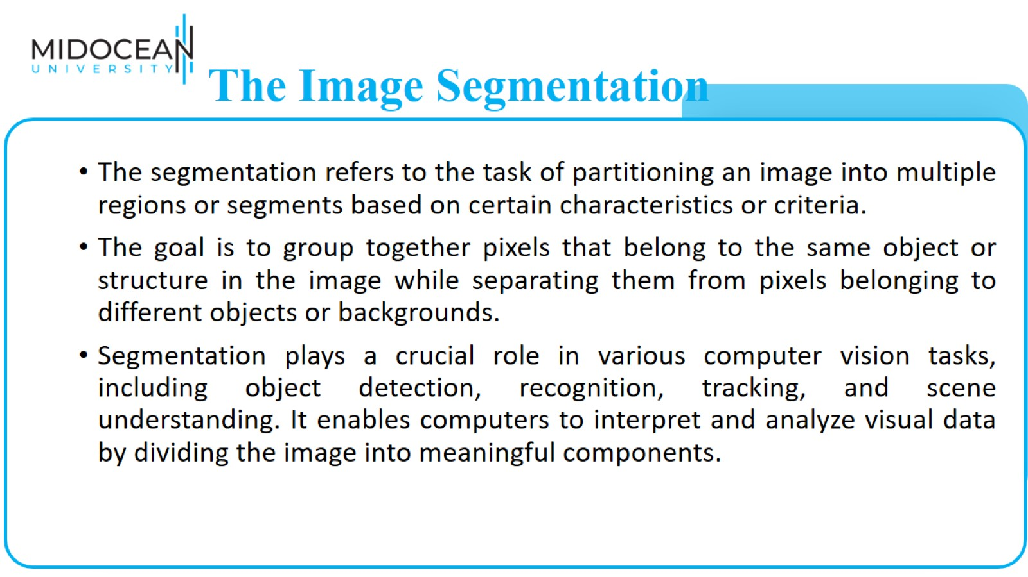
The Image Segmentation

Slide 5
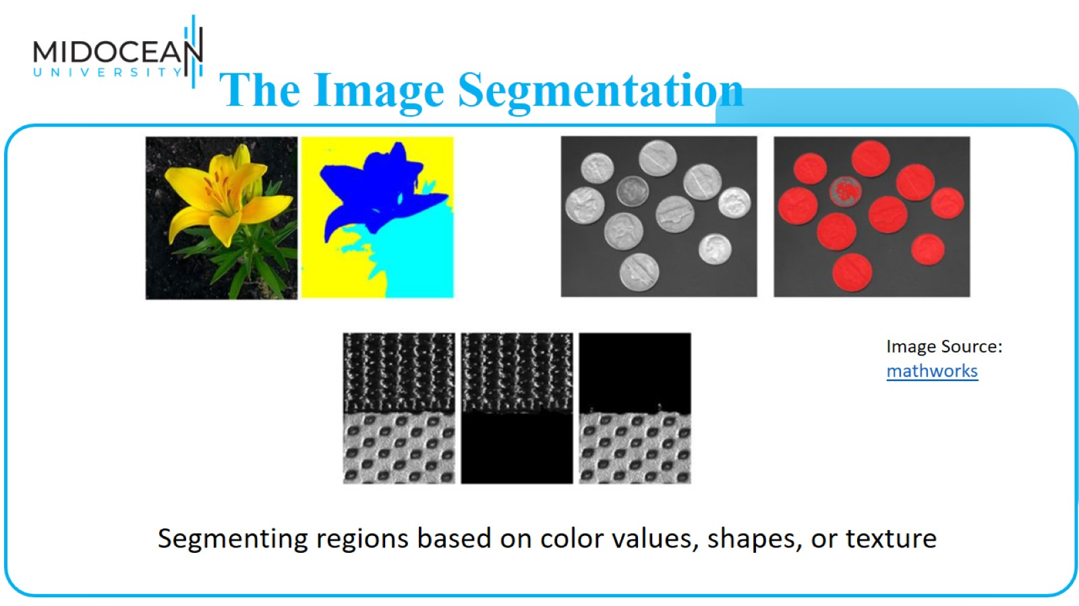
The Image Segmentation

Slide 6
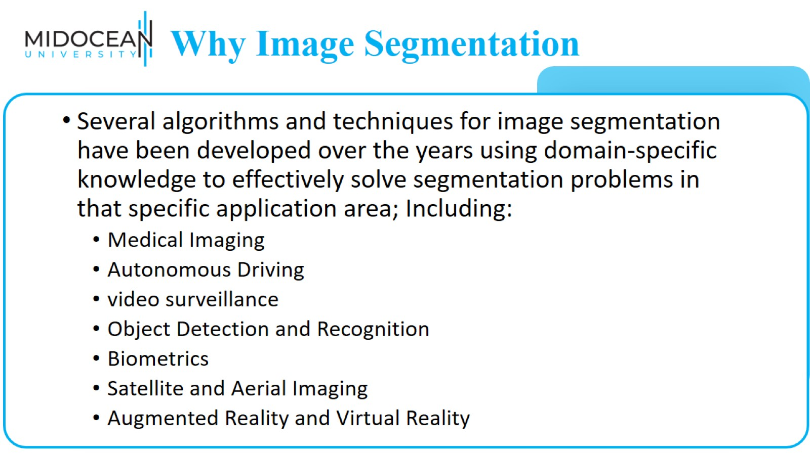
Why Image Segmentation Matters

Slide 7
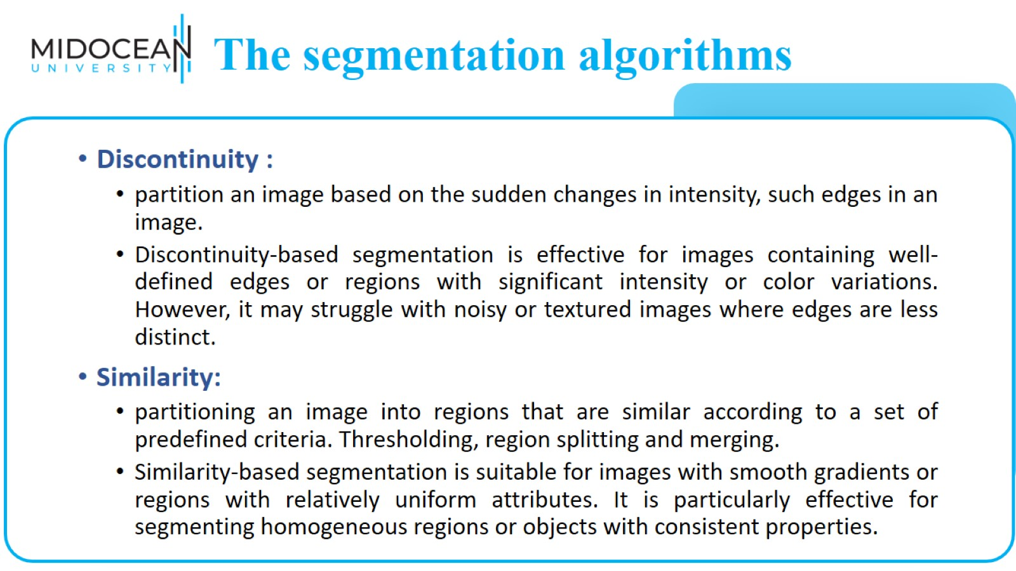
The segmentation algorithms

Slide 8
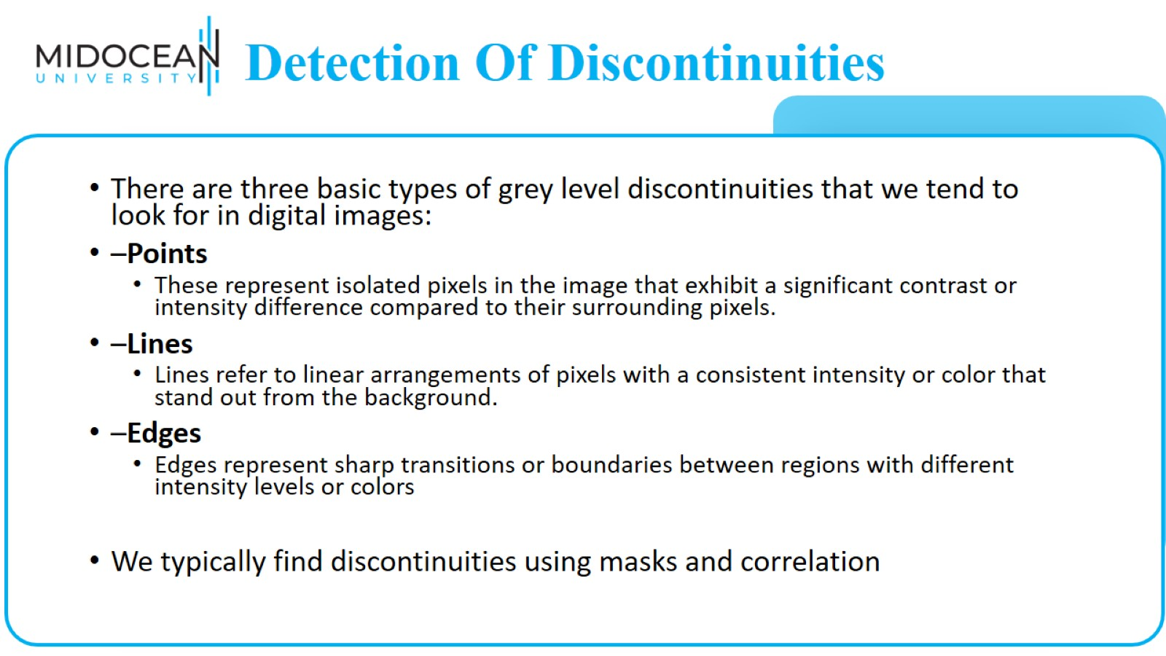
Detection Of Discontinuities

Slide 9
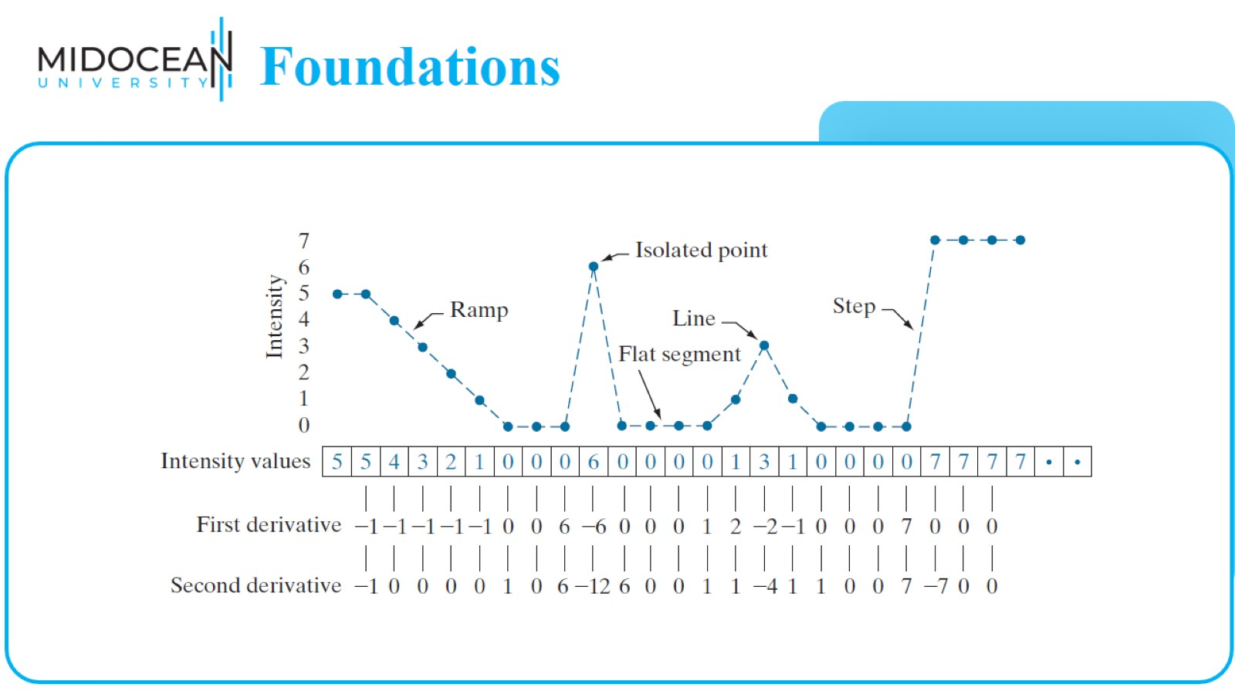
Foundations

Slide 10
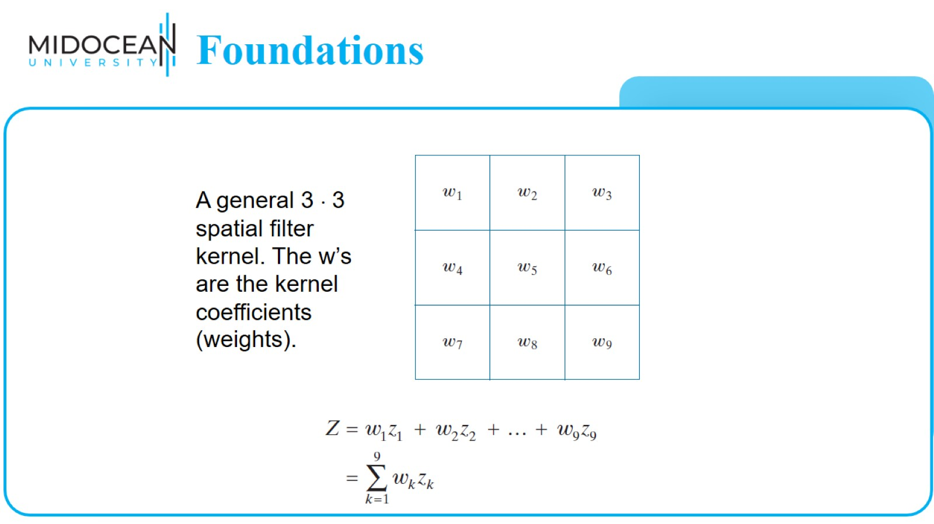
Foundations

Slide 11
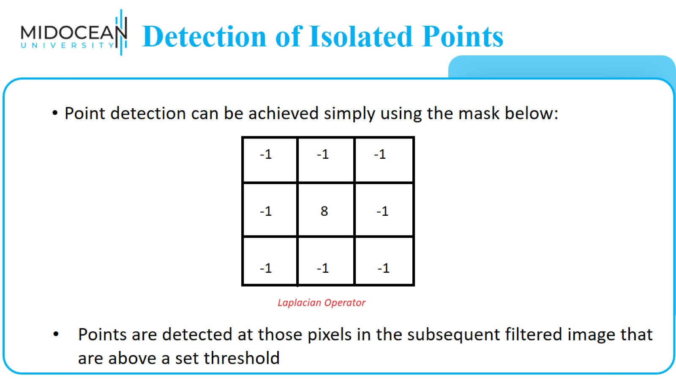
Detection of Isolated Points

Slide 12
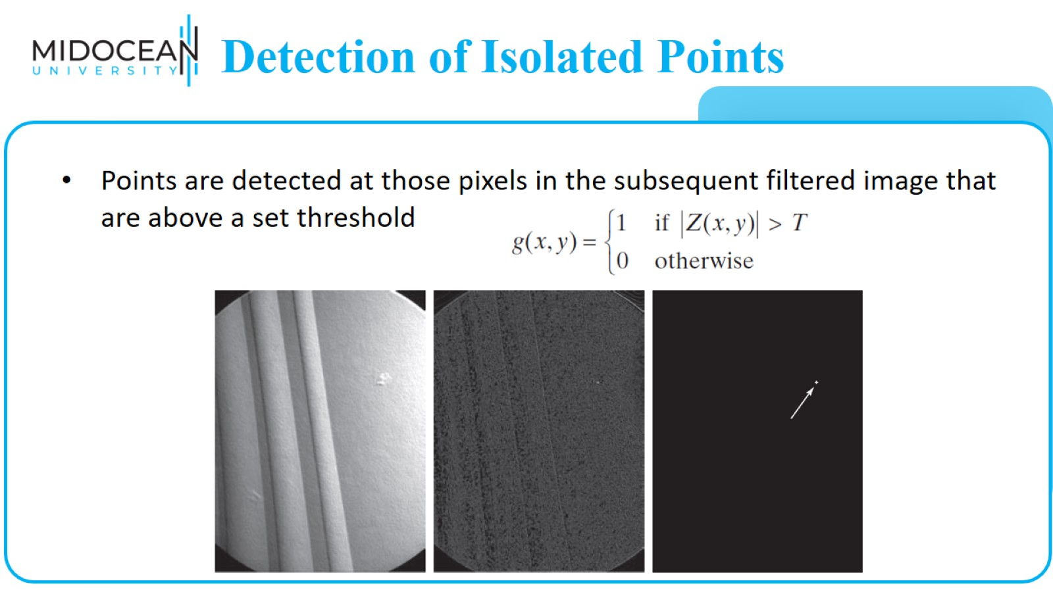
Detection of Isolated Points

Slide 13
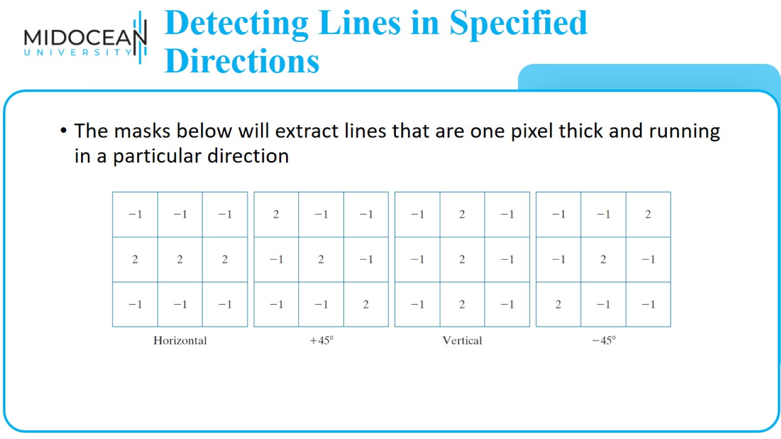
Detecting Lines in Specified Directions

Slide 14
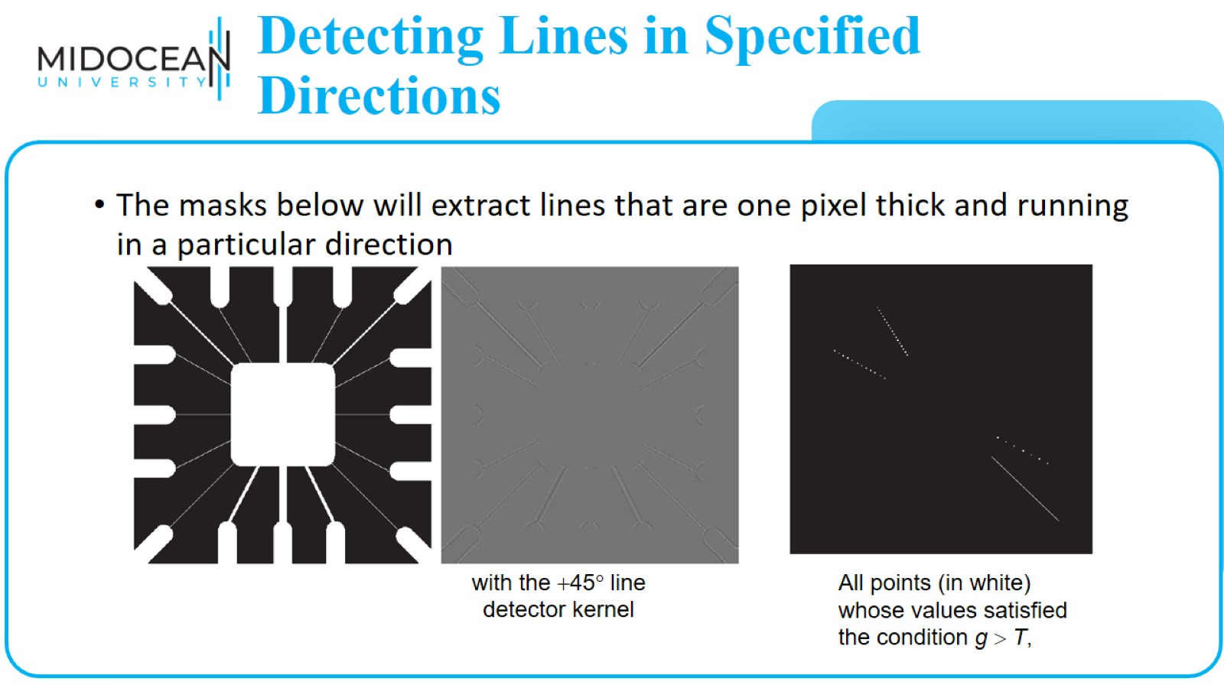
Detecting Lines in Specified Directions

Slide 15
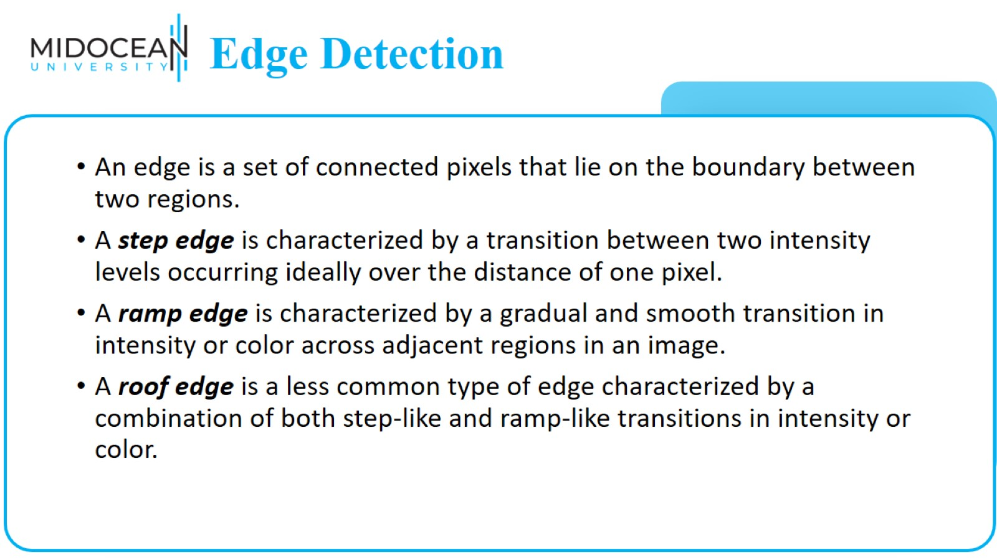
Edge Detection

Slide 16
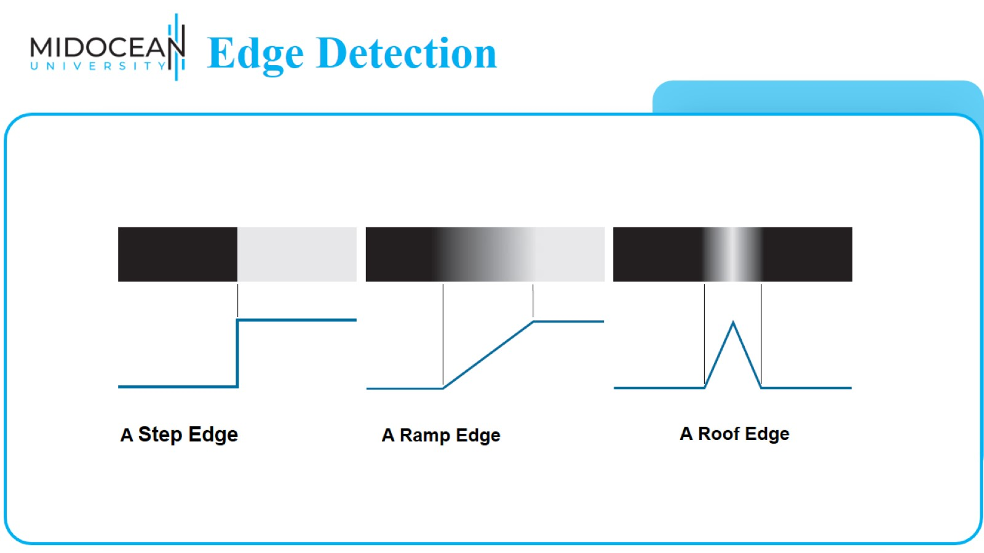
Edge Detection

Slide 17
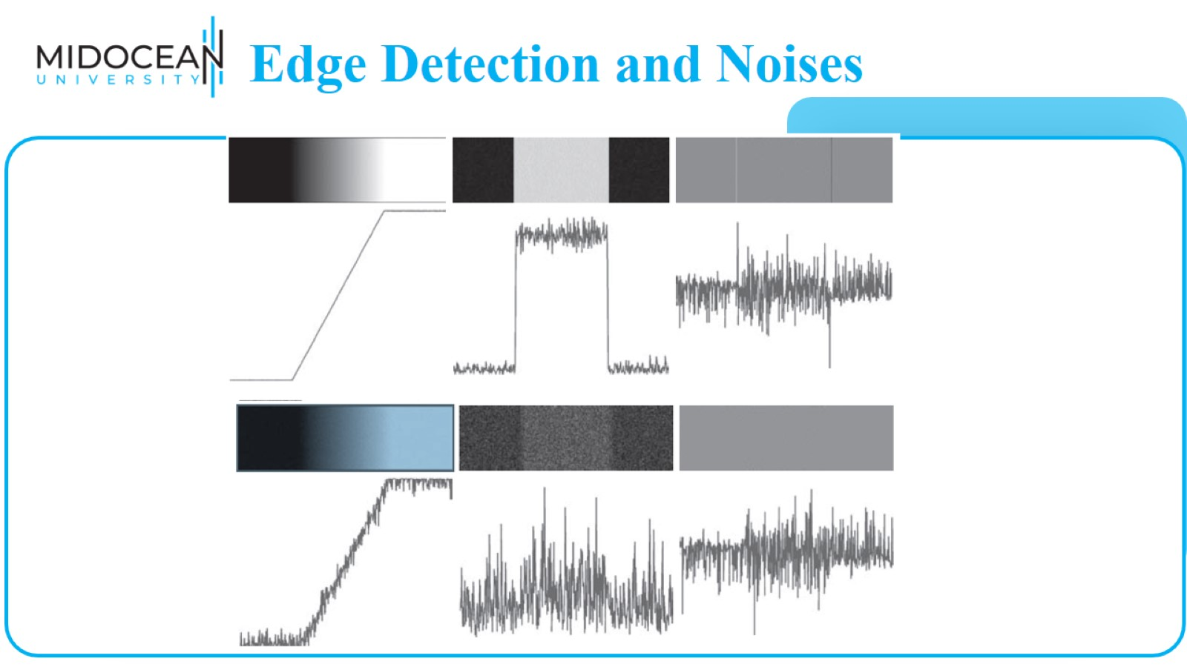
Edge Detection and Noises

Slide 18
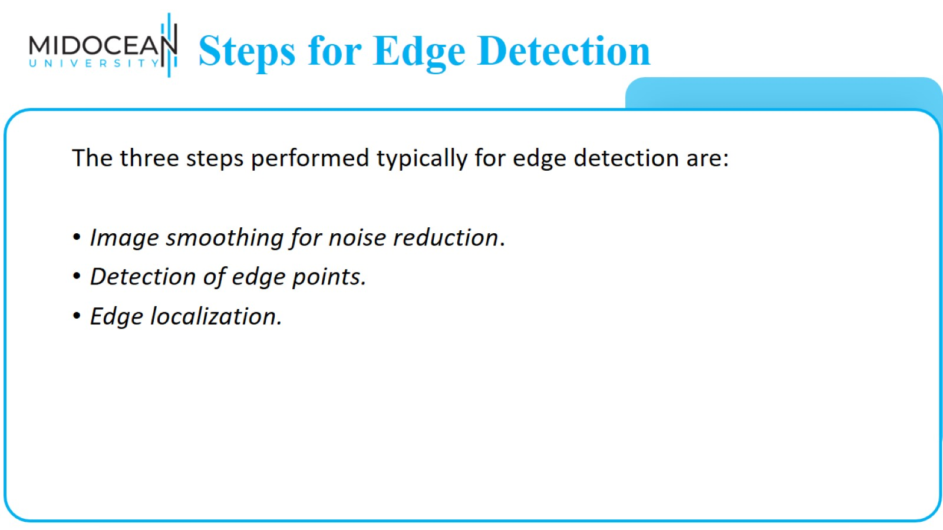
Steps for Edge Detection

Slide 19
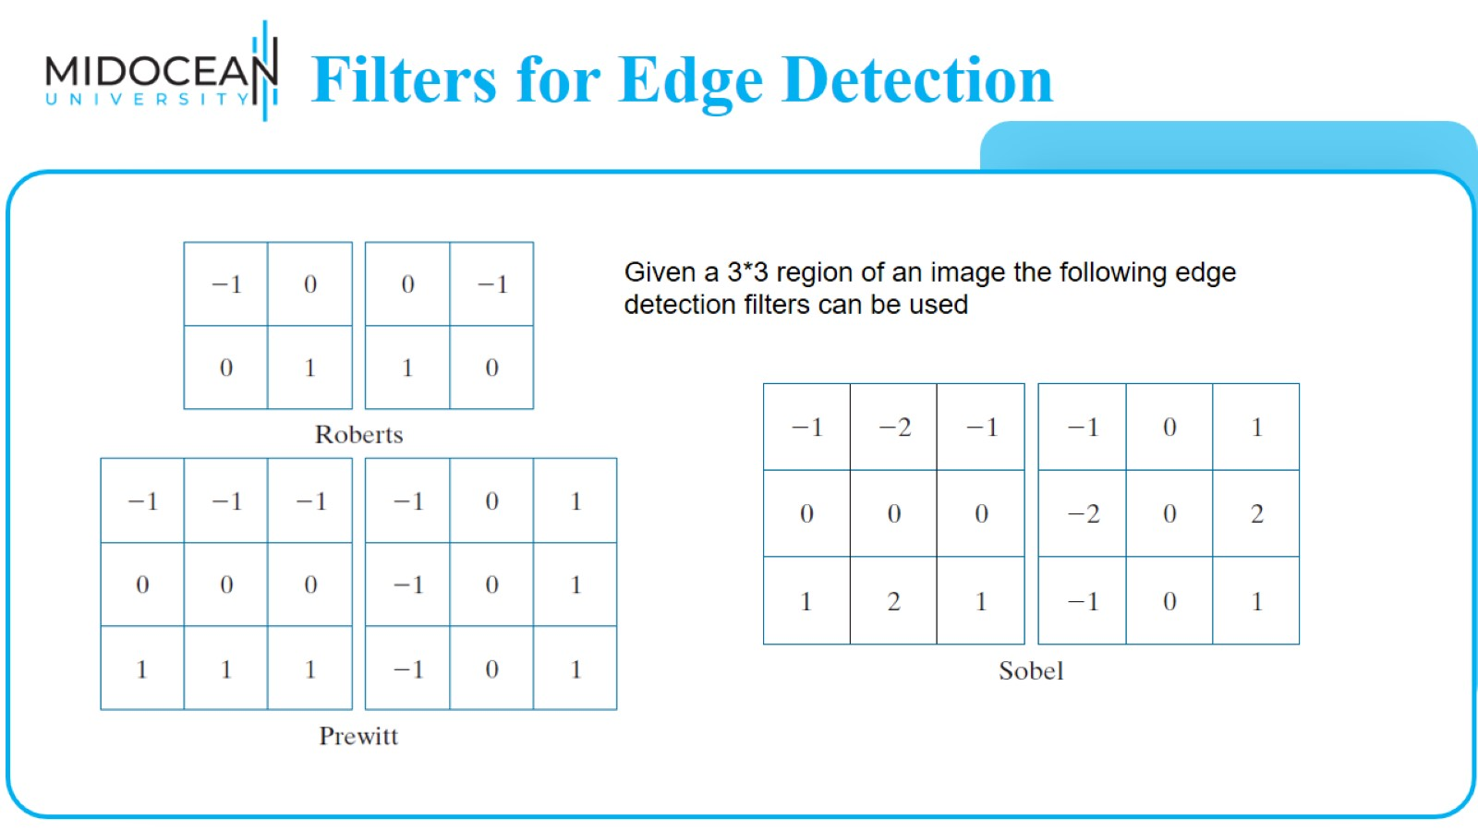
Filters for Edge Detection

Slide 20
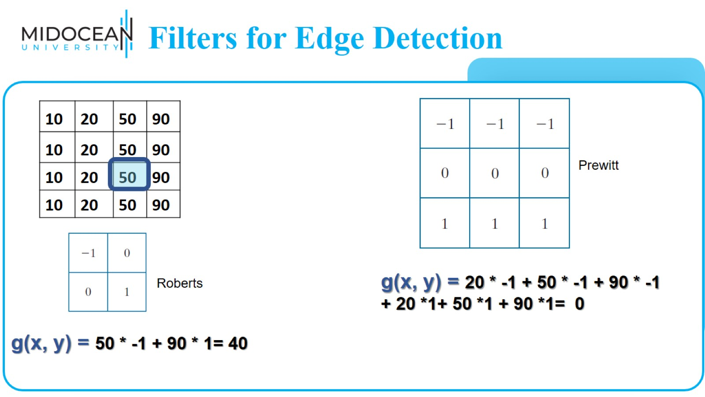
Filters for Edge Detection

Slide 21
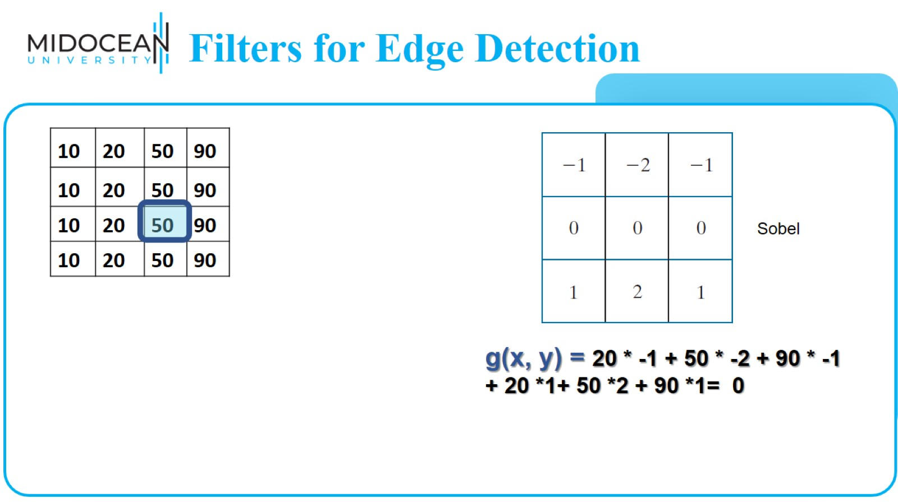
Filters for Edge Detection

Slide 22
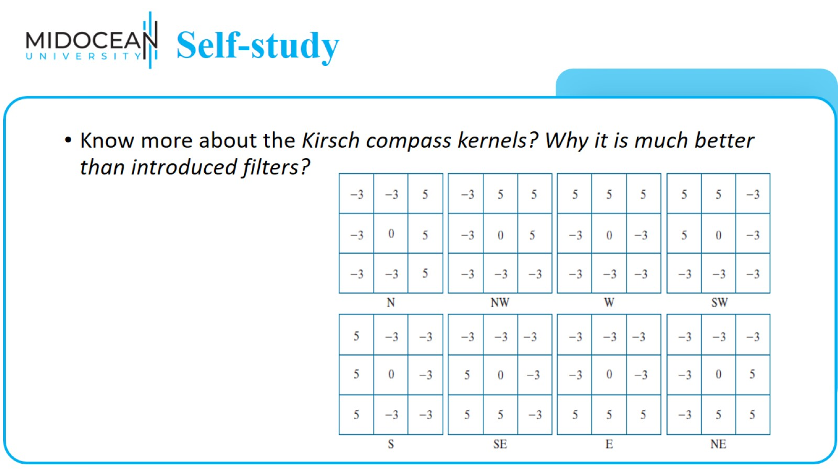
Self-study

Slide 23
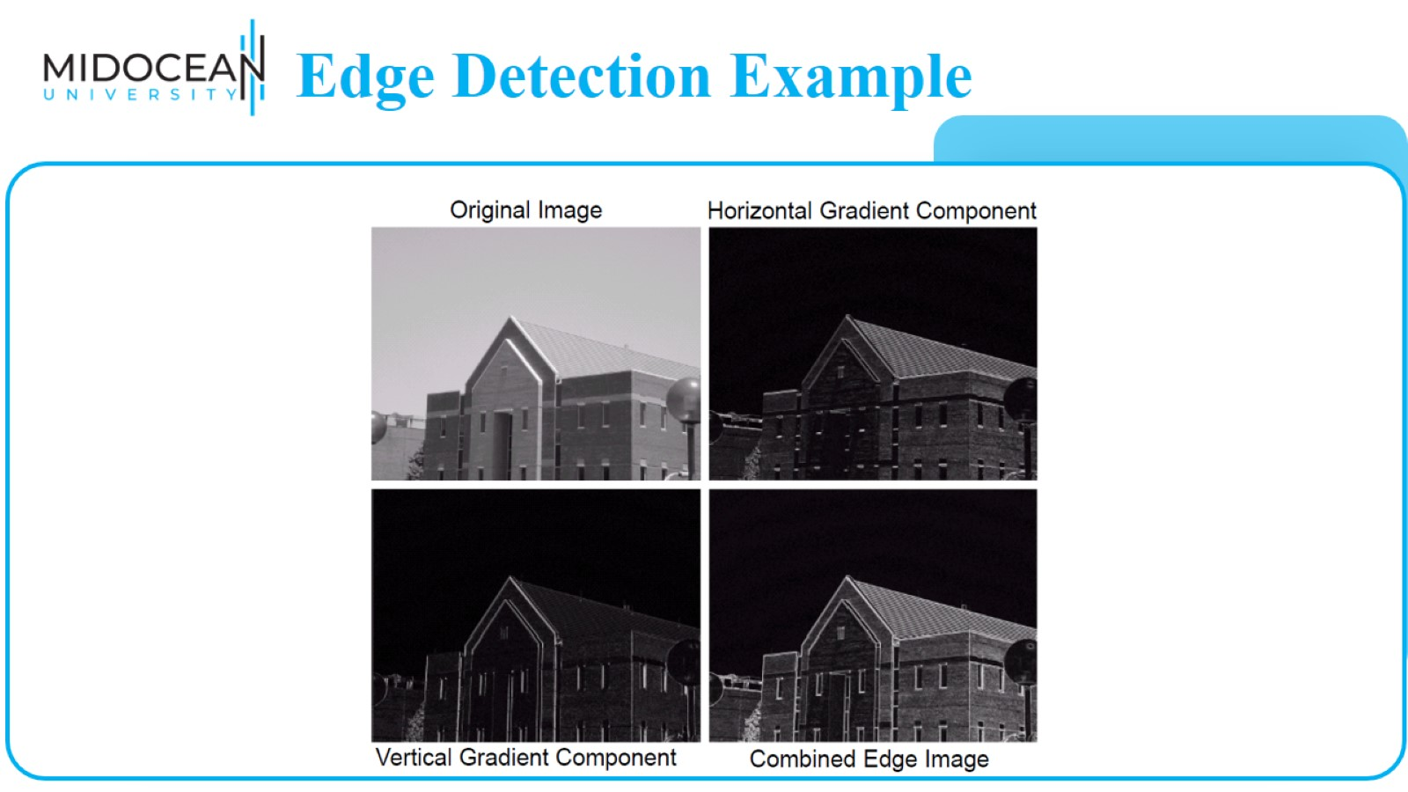
Edge Detection Example

Slide 24
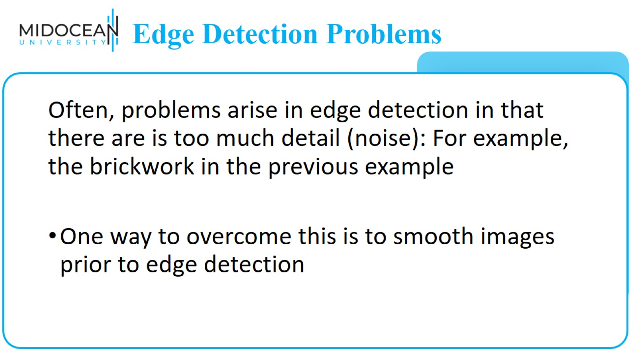
Edge Detection Problems

Slide 25
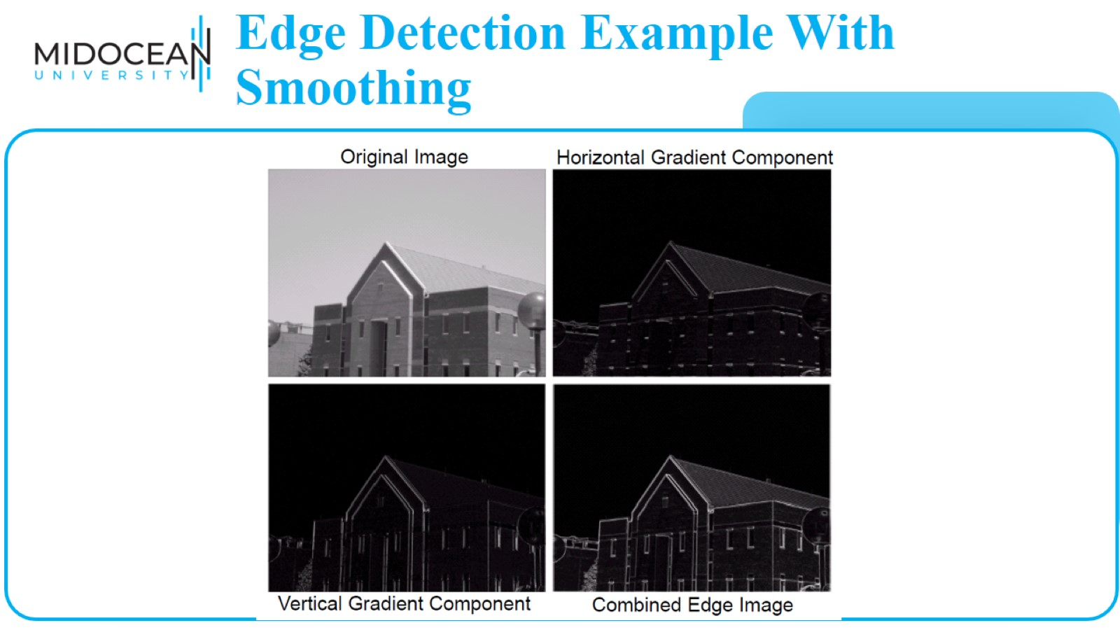
Edge Detection Example With Smoothing

Slide 26
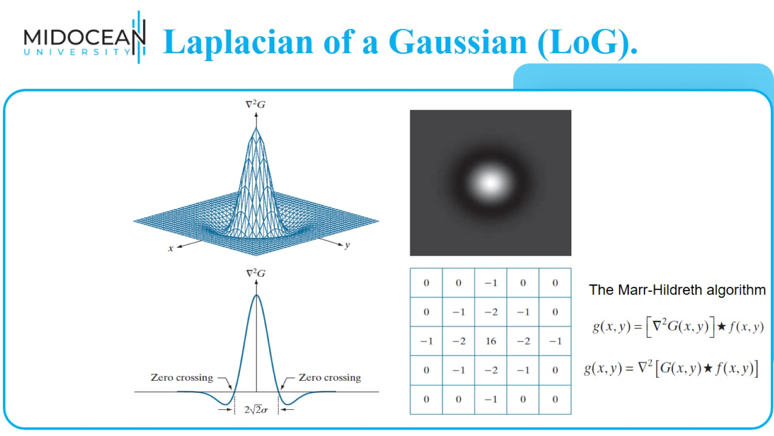
Laplacian of a Gaussian (LoG).

Slide 27
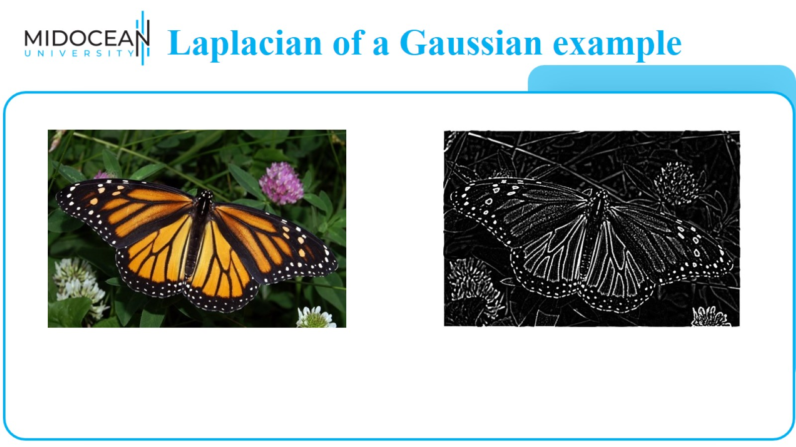
Laplacian of a Gaussian example

Slide 28
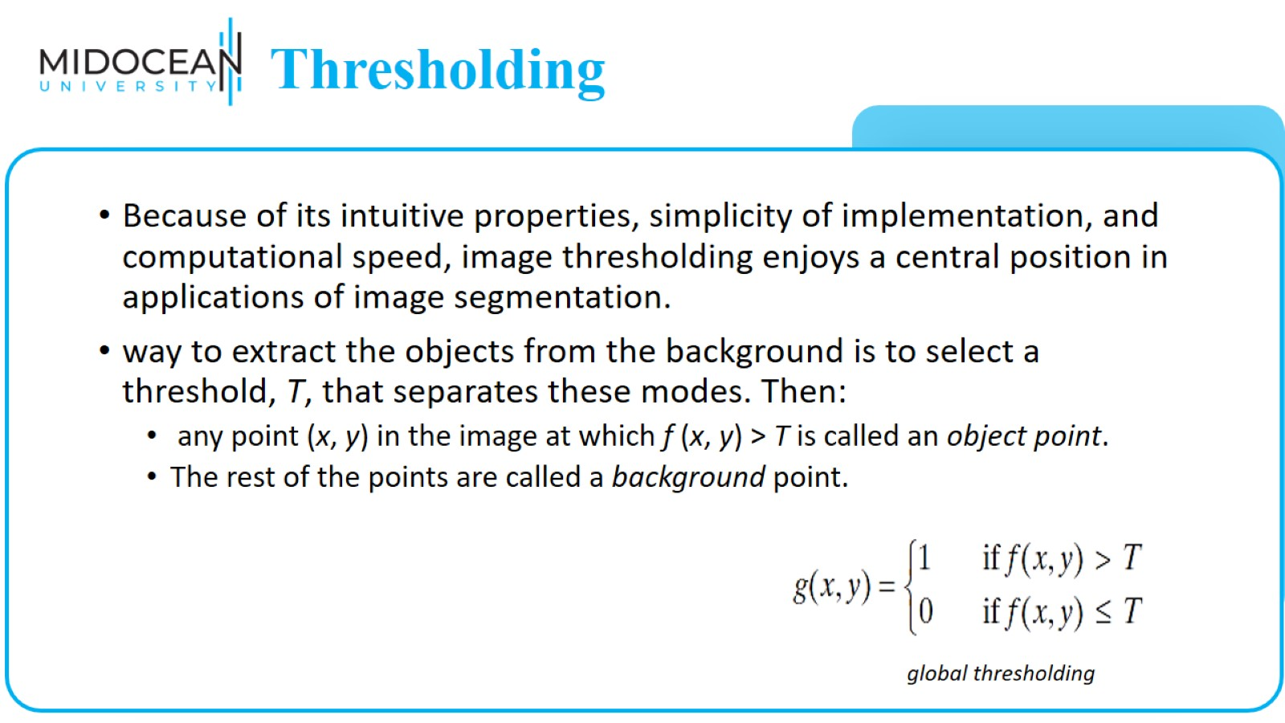
Thresholding

Slide 29
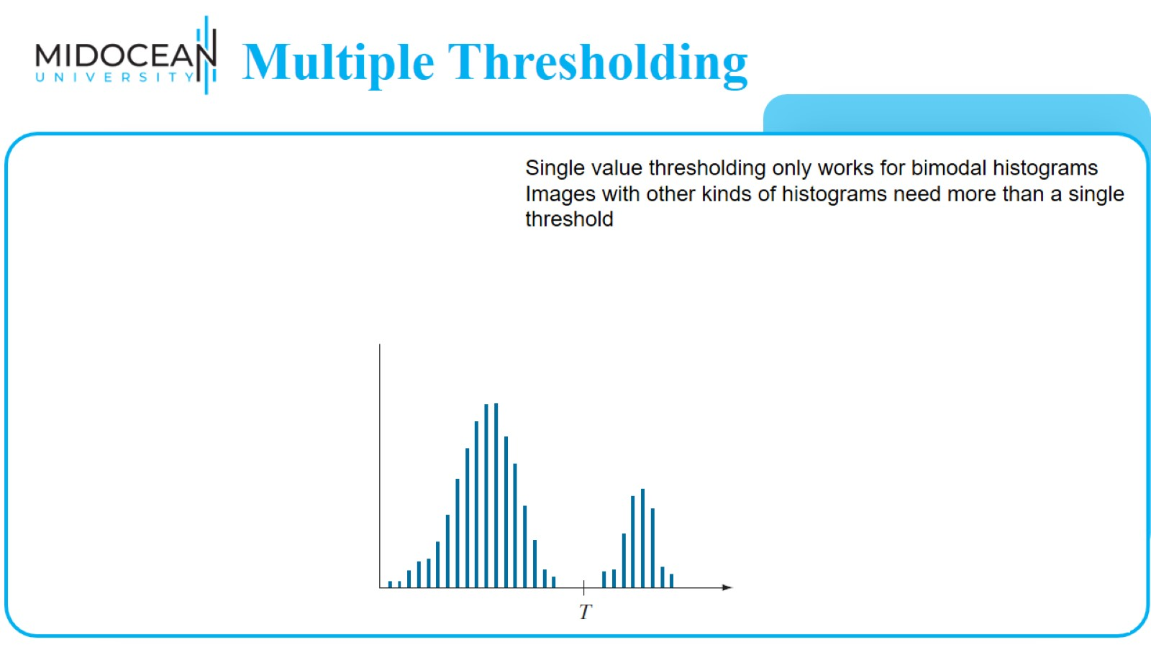
Multiple Thresholding

Slide 30
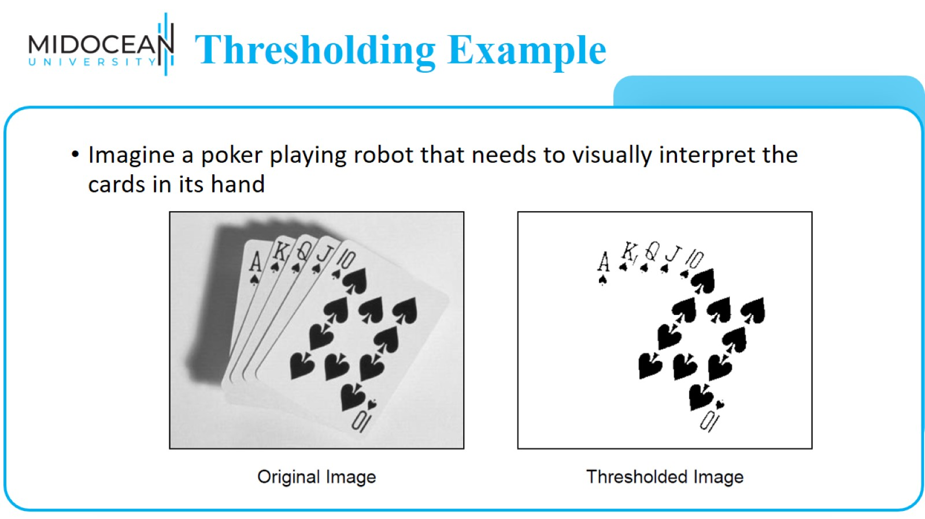
Thresholding Example

Slide 31
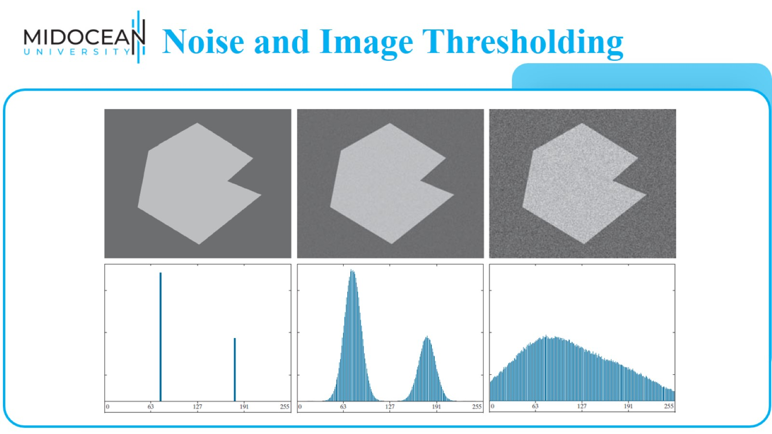
Noise and Image Thresholding

Slide 32
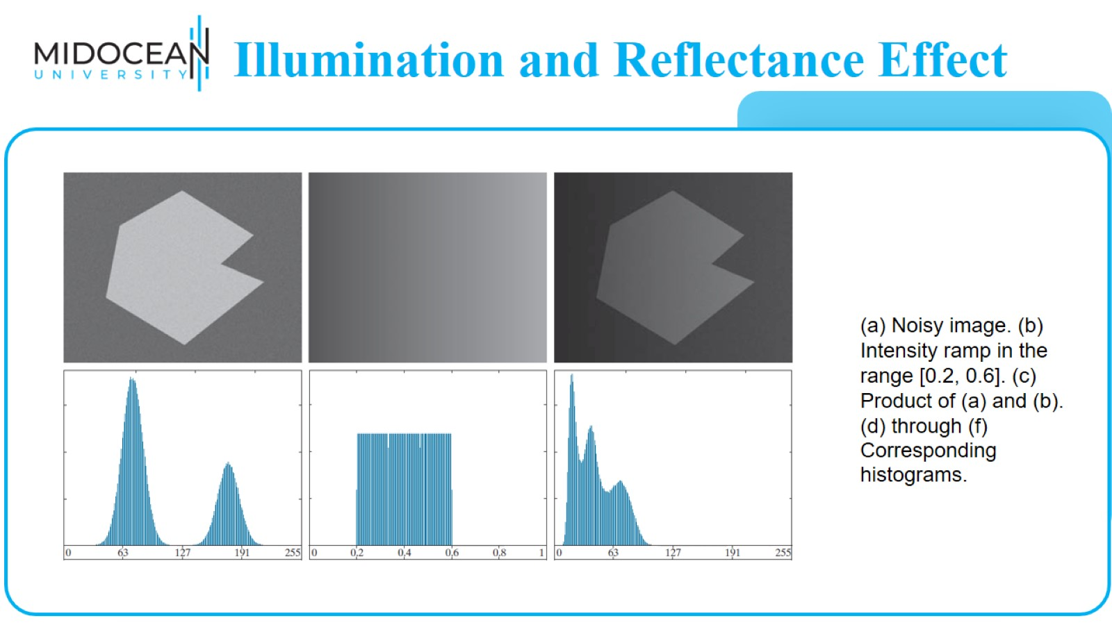
Illumination and Reflectance Effect

Slide 33
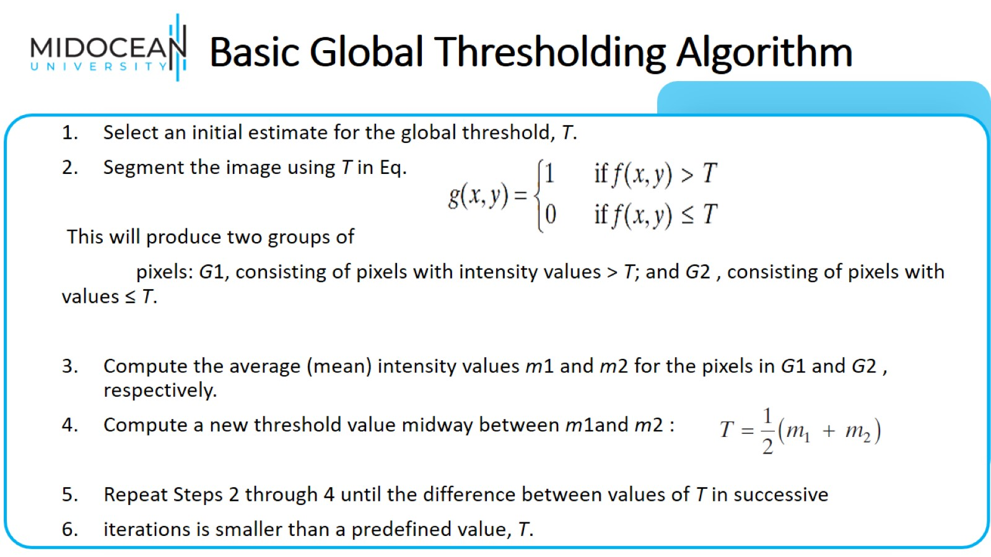
Basic Global Thresholding Algorithm

Slide 34
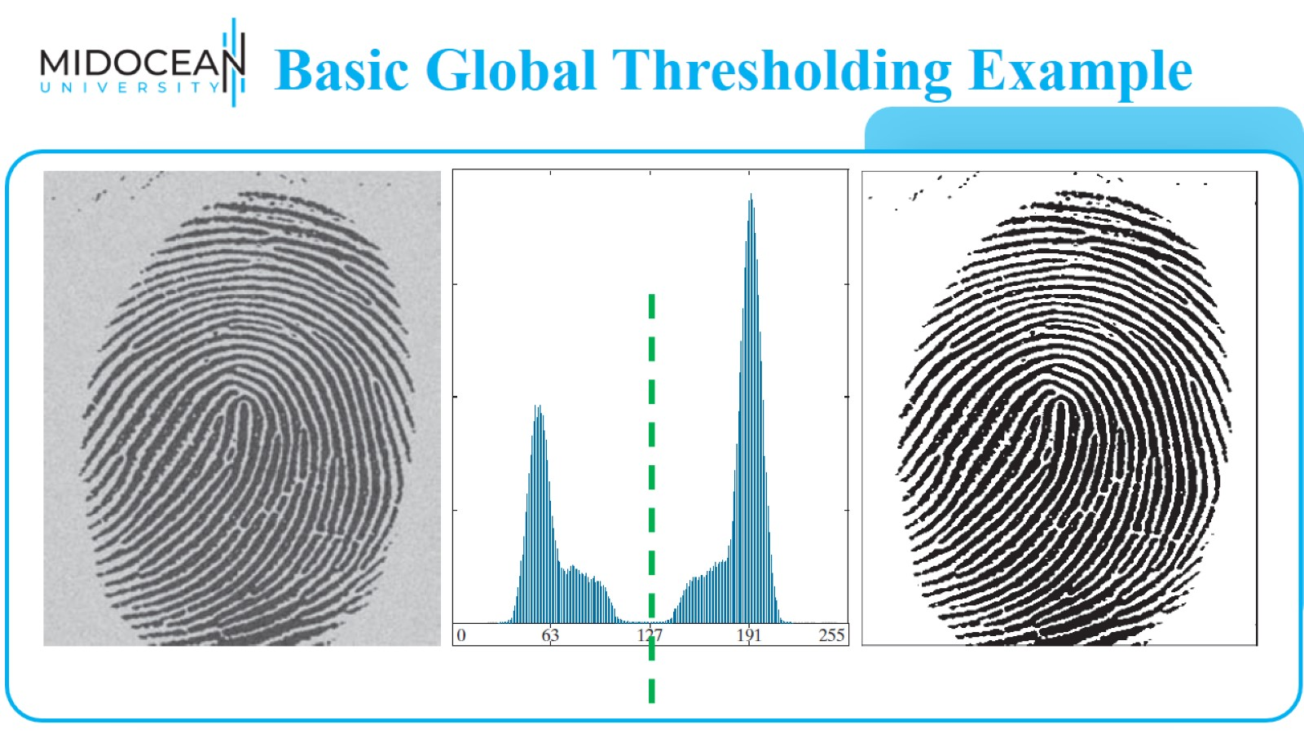
Basic Global Thresholding Example

Slide 35

Feature Extraction

Slide 36
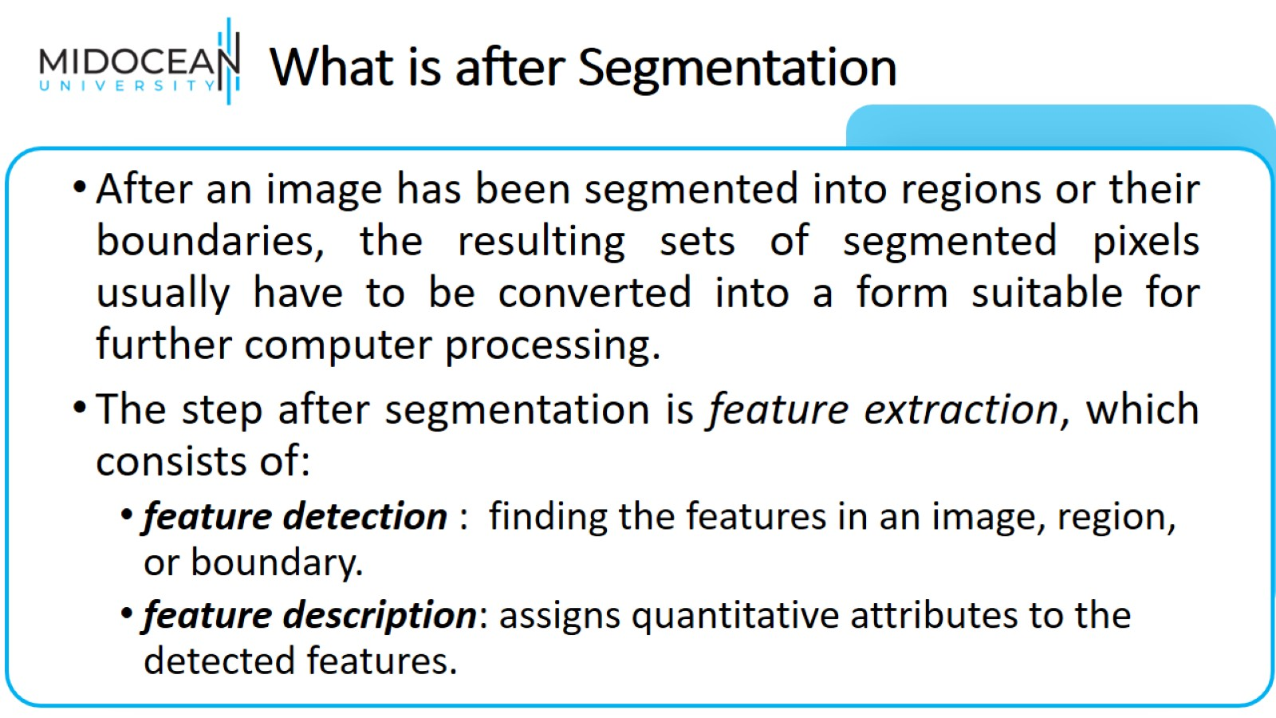
What is after Segmentation

Slide 37
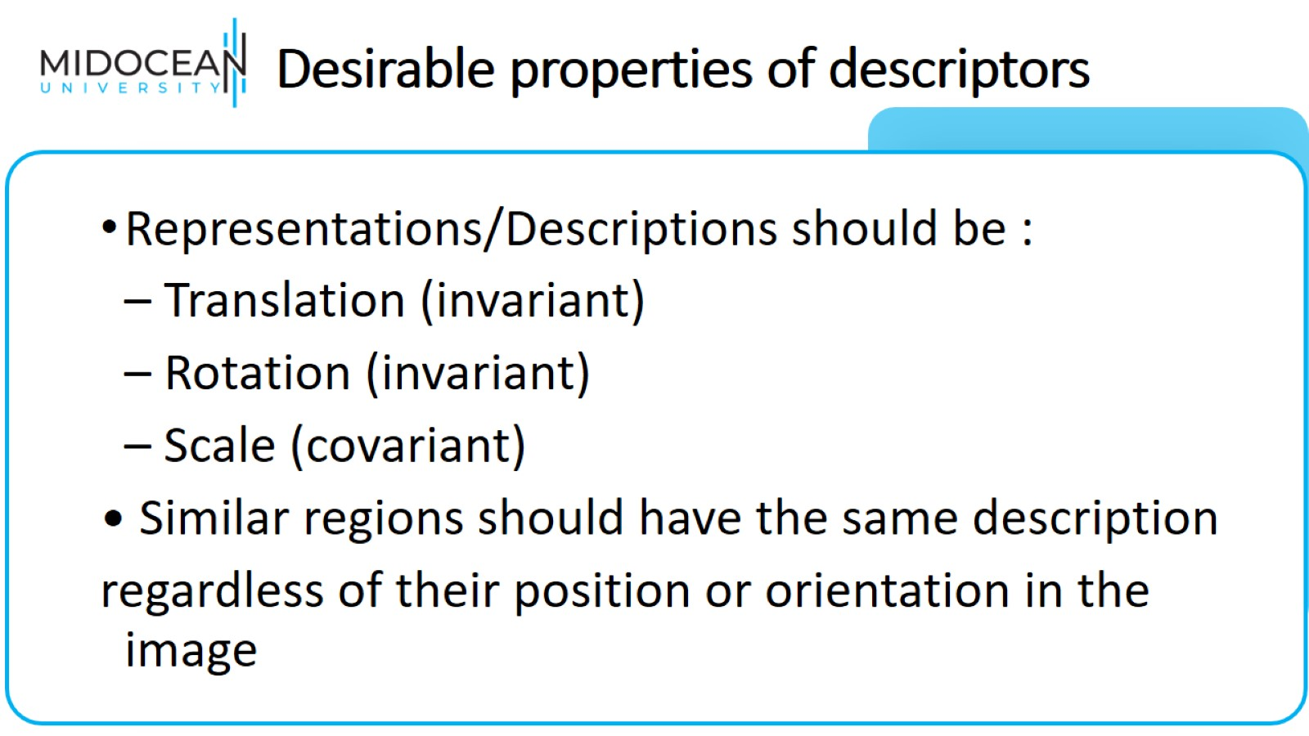
Desirable properties of descriptors

Slide 38
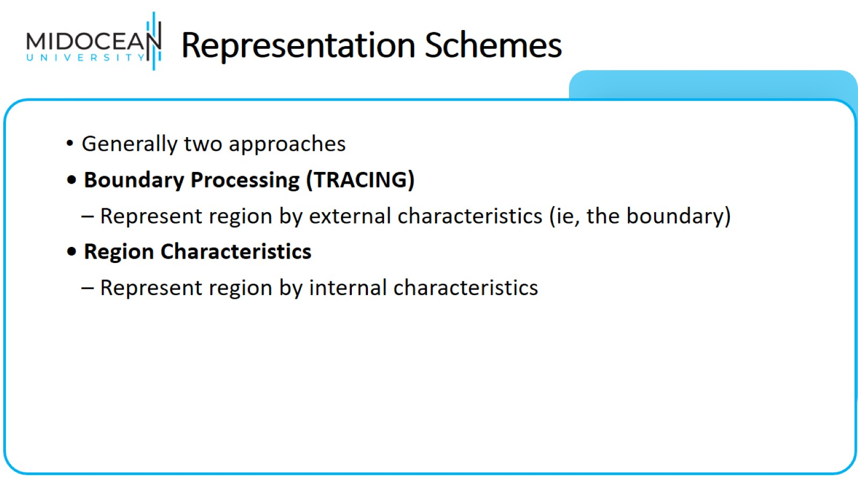
Representation Schemes

Slide 39
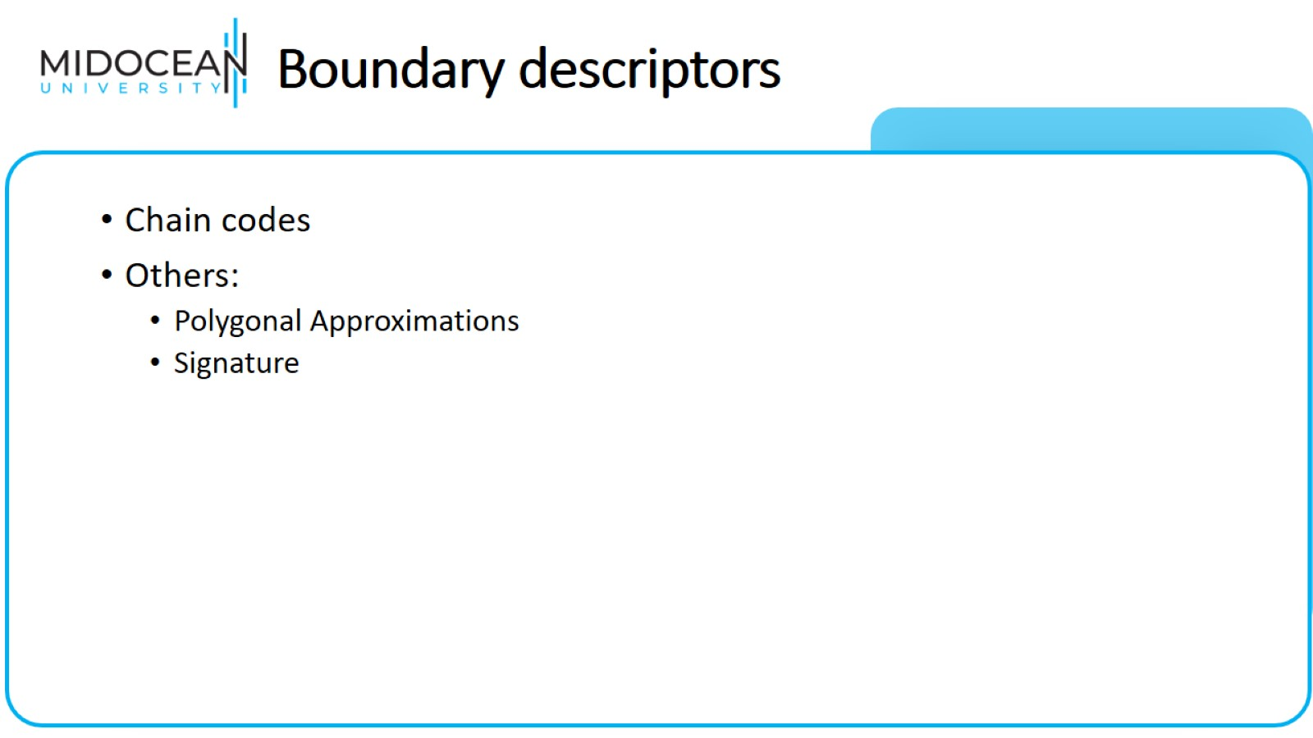
Boundary descriptors

Slide 40
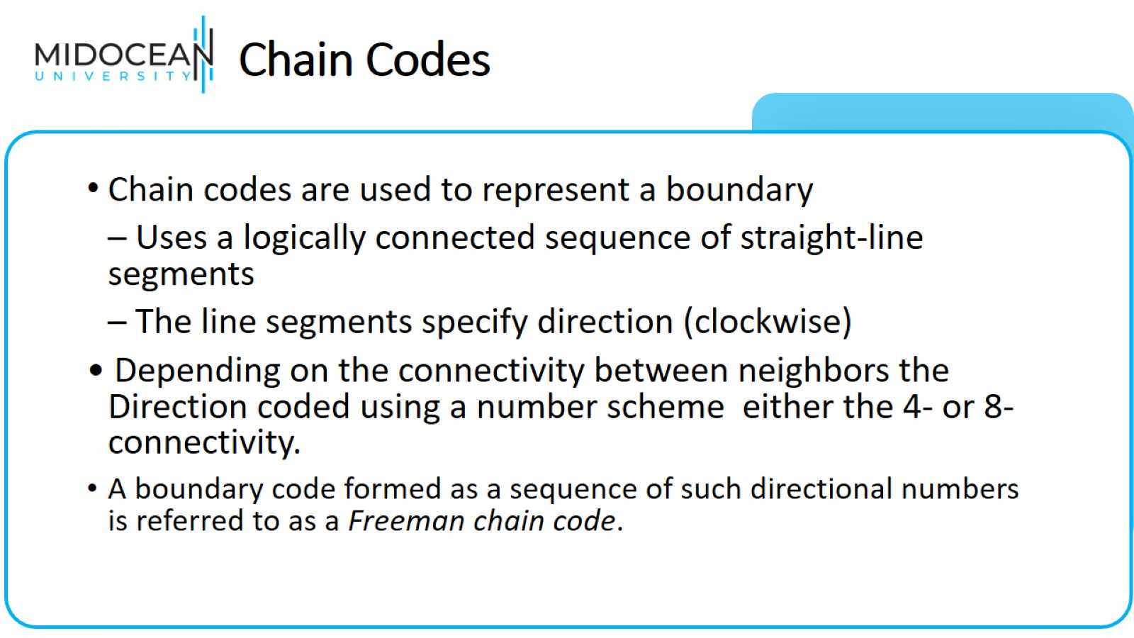
Chain Codes

Slide 41
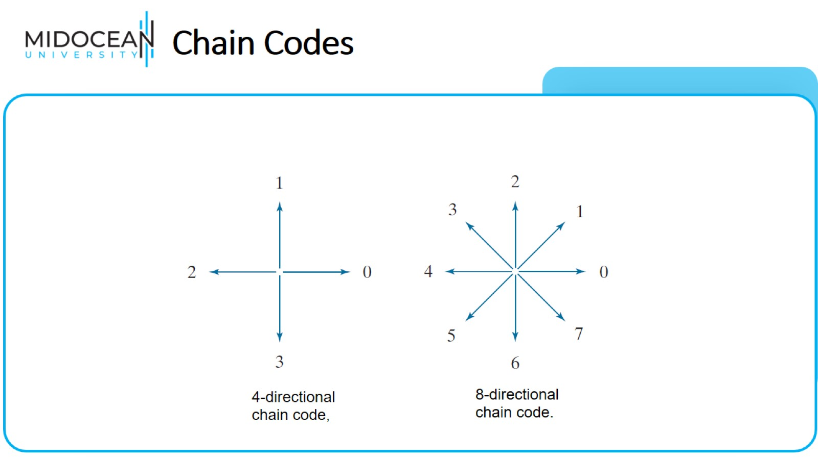
Chain Codes

Slide 42
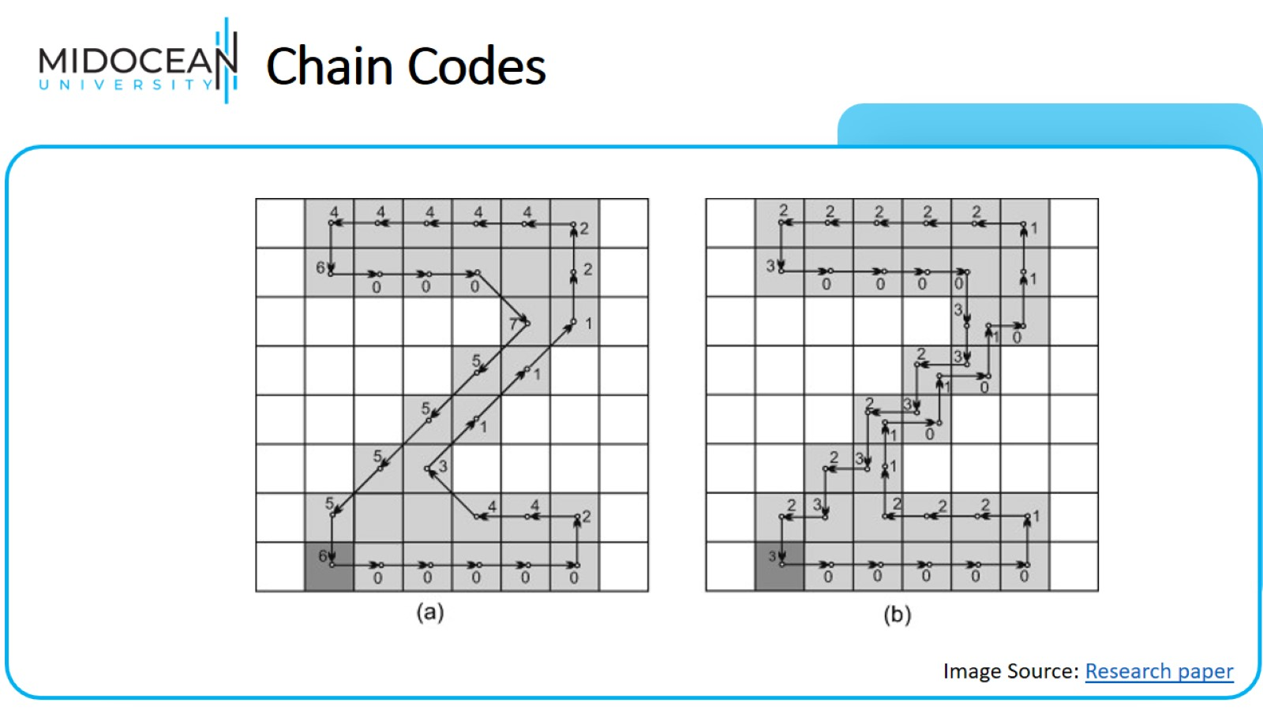
Chain Codes

Slide 43
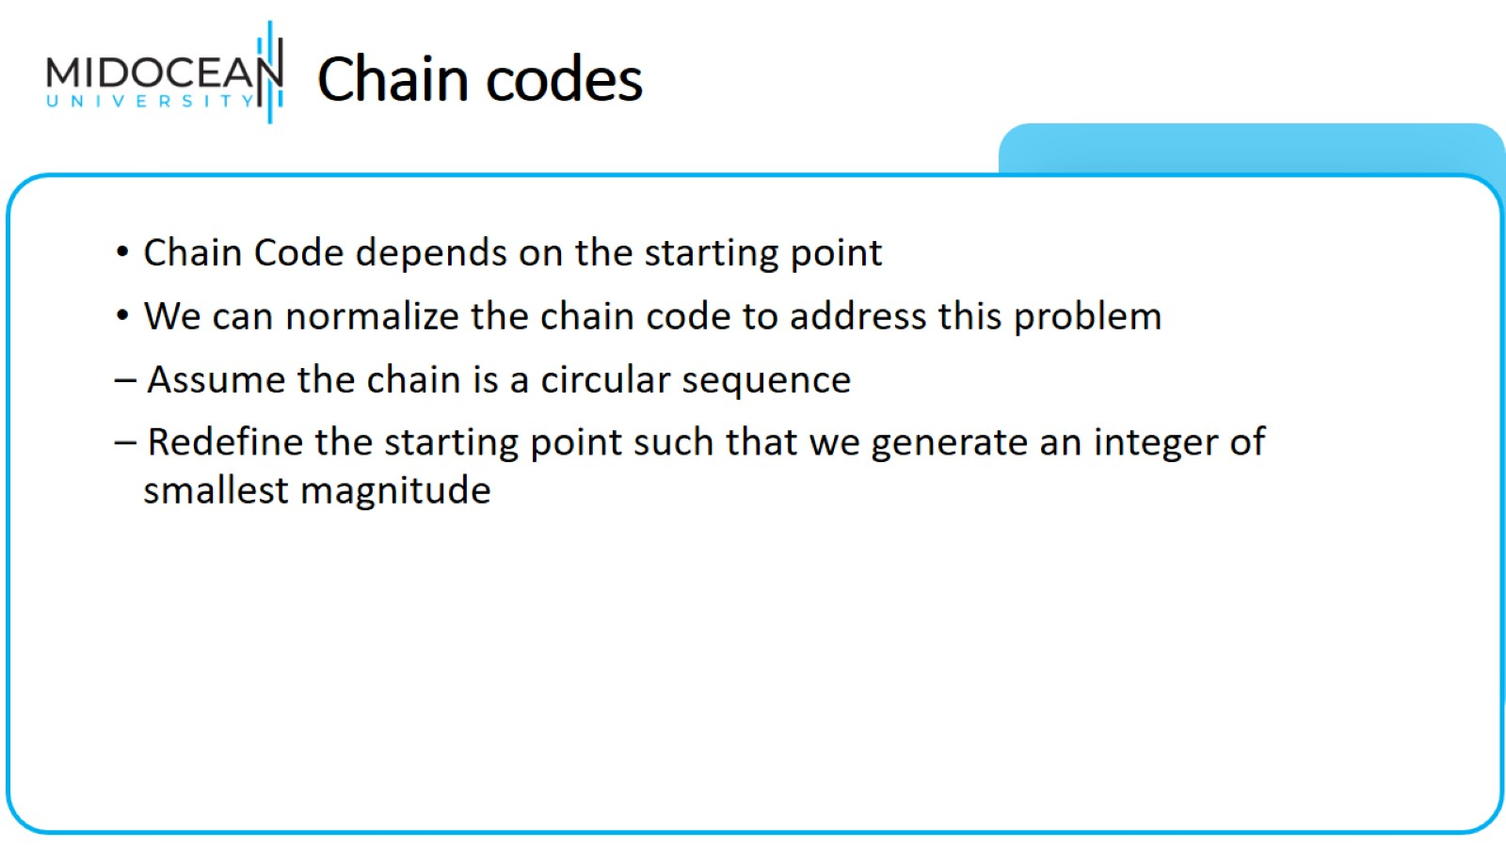
Chain codes

Slide 44
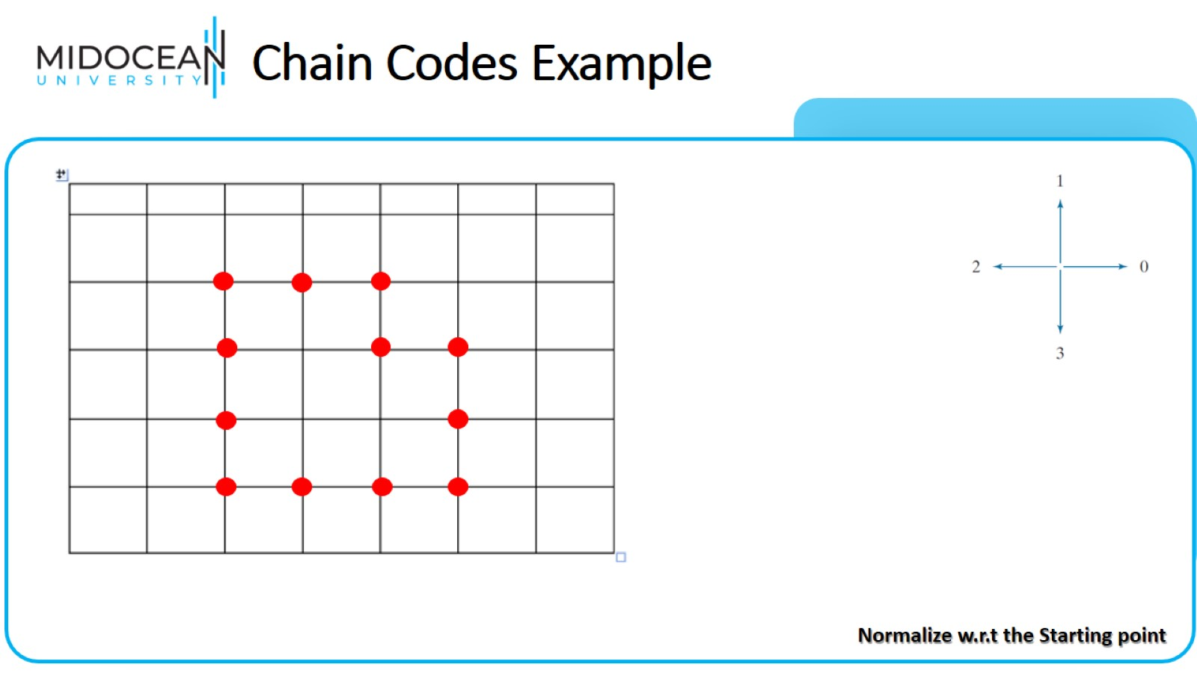
Chain Codes Example

Slide 45
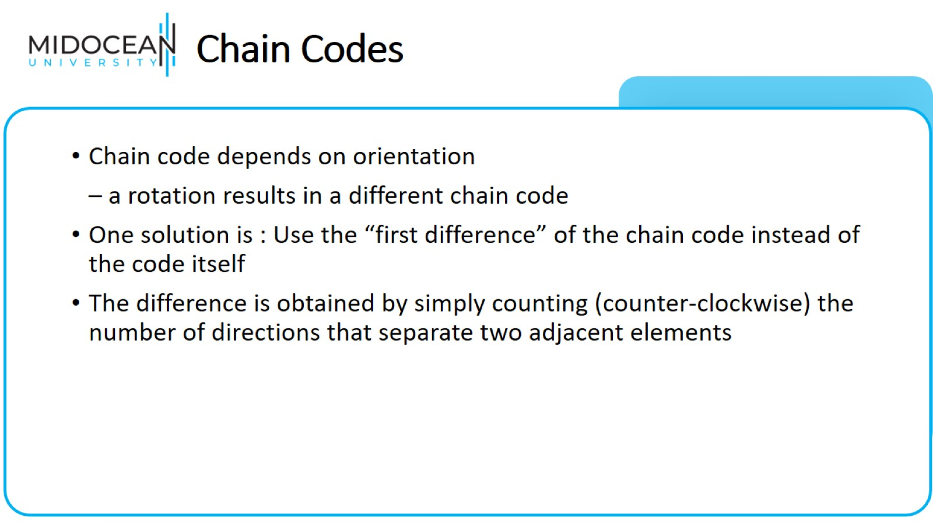
Chain Codes

Slide 46
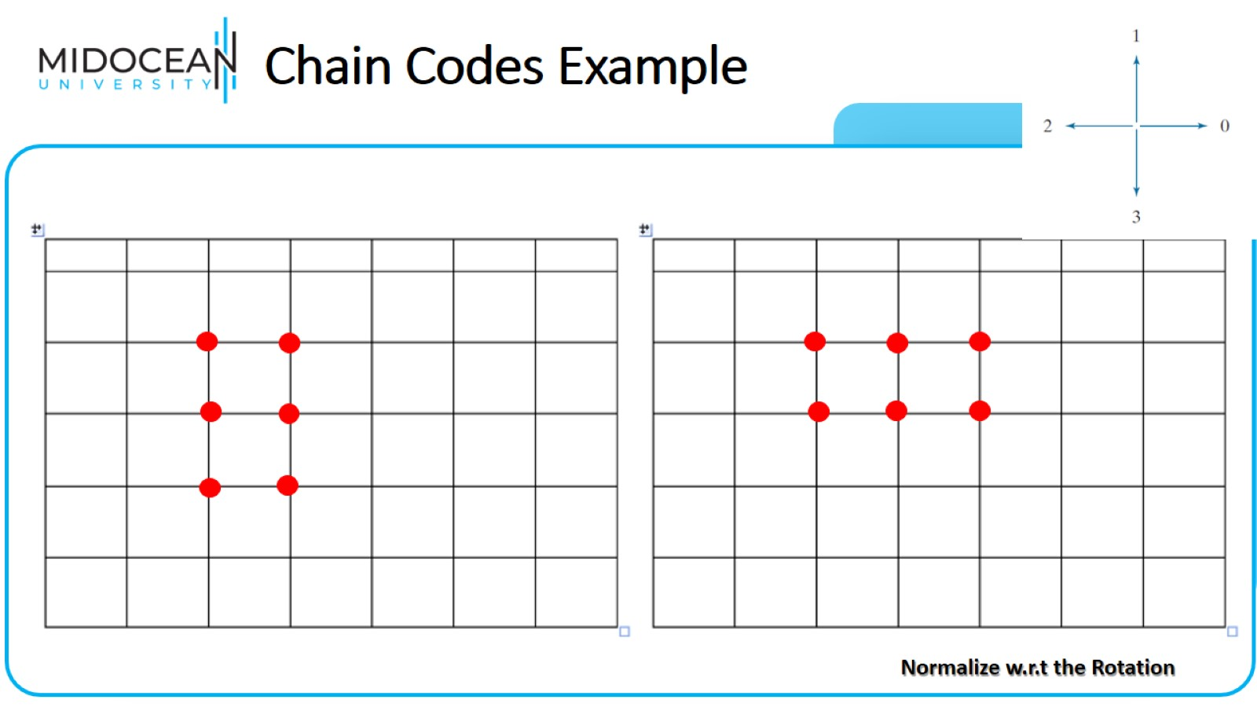
Chain Codes Example

Slide 47


