Slide 1




AWS Cloud Security Foundations– AWS-CSF
Dr. Ibrahim Gomaa
Lecture 7 – Securing Access to Cloud Resources

Slide 2


Lecture
Course Outline
7
Lecture 7: Securing Access to Cloud Resources
Topics
IAM fundamentals
Authenticating with IAM
Authorizing with IAM
Examples of authorizing with IAM
Additional authentication and access management services
Using AWS Organizations
Demo
Amazon S3 Cross-Account Resource-Based Policy
Lab
Using Resource-Based Policies to Secure an S3 Bucket
AWS Cloud Security Foundations– AWS-CSF
Lecture 7: Securing Access to Cloud Resources
Dr. Ibrahim Gomaa

Slide 3
Lecture
Securing Access to Cloud Resources
7
IAM Fundamentals
AWS Cloud Security Foundations– AWS-CSF
Lecture 7: Securing Access to Cloud Resources
Dr. Ibrahim Gomaa

Slide 4

Lecture
IAM Fundamentals
7
AWS Identity and Access Management (IAM)
Securely shares and controls individual and group access to your AWS resources
Integrates with many other AWS services
Supports federated identity management
Supports granular permissions
Supports multi-factor authentication (MFA)
Provides identity information for assurance
AWS Identity and Access Management (IAM)
AWS Cloud Security Foundations– AWS-CSF
Lecture 7: Securing Access to Cloud Resources
Dr. Ibrahim Gomaa

Slide 5

Lecture
IAM Fundamentals
7
What IAM provides
Authentication
  Who is requesting access to the AWS account and the resources in it?
  It’s important to establish the identity of the requester through credentials.
  The requester could be a person or an application; IAM calls them principals.
Authorization
  After the requester has been authenticated, what should they be allowed to do?
  IAM checks for policies that are relevant to the request to determine whether to allow or deny the request.
AWS Cloud Security Foundations– AWS-CSF
Lecture 7: Securing Access to Cloud Resources
Dr. Ibrahim Gomaa

Slide 6




Lecture
IAM Fundamentals
7
IAM overview
User
Group
Role
IAM policy
A person or application that can authenticate with an AWS account
A collection of IAM users who are granted identical authorization
An identity used to grant a temporary set of permissions to make AWS service requests
The document that defines which resources can be accessed and the level of access to each resource
AWS Cloud Security Foundations– AWS-CSF
Lecture 7: Securing Access to Cloud Resources
Dr. Ibrahim Gomaa

Slide 7

Lecture
IAM Fundamentals
7
IAM terminology
IAM entity: Used by AWS for authentication (users and roles)
IAM identity: Used to identify and group
  You can attach a policy to an IAM identity (user, group, or role).
IAM resource: The user, group, role, policy, and identity provider objects that are stored in IAM
  You can add, edit, and remove resources from IAM.
Principal: A person or application that uses the AWS account root user, IAM user, or IAM role to sign in and make requests to AWS
AWS Cloud Security Foundations– AWS-CSF
Lecture 7: Securing Access to Cloud Resources
Dr. Ibrahim Gomaa

Slide 8
Lecture
IAM Fundamentals
7
Requests in IAM
A request is made any time a principal attempts to use the AWS Management Console, application programming interface (API), or AWS Command Line Interface (AWS CLI).
The request contains the following information:
  Actions or operations: What the principal wants to perform
  Resources: The object upon which the actions or operations are performed
  Principal: The person or application that sends a request by using a user or role
  Environment data: The IP address, user agent, Secure Sockets Layer (SSL) enabled status, or time of day
  Resource data: Data related to the resource being requested
AWS Cloud Security Foundations– AWS-CSF
Lecture 7: Securing Access to Cloud Resources
Dr. Ibrahim Gomaa

Slide 9

Lecture
IAM Fundamentals
7
Service endpoints
To connect to an AWS service, you must use the URL of the entry point for that service, known as an endpoint.
The AWS software development kits (SDKs) and AWS CLI use the default endpoint for each service in an AWS Region.
You can specify alternate endpoints for API requests based on configuration requirements.
An example of an Amazon Elastic Compute Cloud (Amazon EC2) endpoint is ec2.us-east-1.amazonaws.com, which is the US East (N. Virginia) service endpoint for Amazon EC2
AWS Cloud Security Foundations– AWS-CSF
Lecture 7: Securing Access to Cloud Resources
Dr. Ibrahim Gomaa

Slide 10
Lecture
Securing Access to Cloud Resources
7
Authenticating with IAM
AWS Cloud Security Foundations– AWS-CSF
Lecture 7: Securing Access to Cloud Resources
Dr. Ibrahim Gomaa

Slide 11
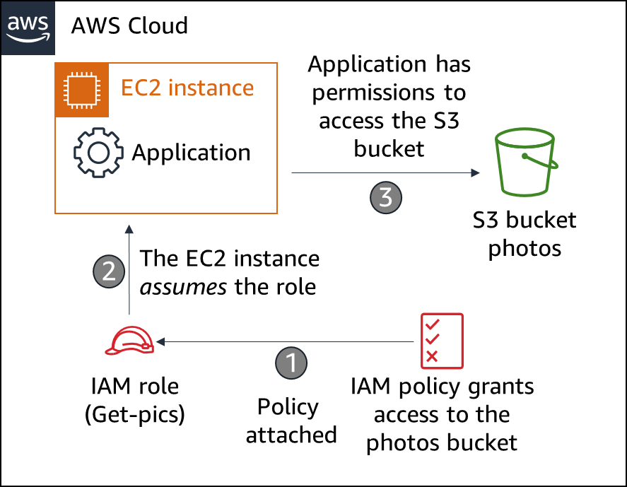
Lecture
Authenticating with IAM
7
AWS Identity and Access Management (IAM)
IAM role characteristics
  It provides temporary security credentials.
  A role is not uniquely associated with one person.
  A person, application, or AWS service can assume a role.
  A role is often used to delegate access.
  The AWS Security Token Service (AWS STS) issues temporary security credentials.
Common use cases
  Applications that run on Amazon Elastic Compute Cloud (Amazon EC2)
  Cross-account access for an IAM user
  Mobile applications
AWS Cloud Security Foundations– AWS-CSF
Lecture 7: Securing Access to Cloud Resources
Dr. Ibrahim Gomaa

Slide 12



Lecture
Authenticating with IAM
7
Authenticate as an IAM user to gain access
  When you define an IAM user, you select what types of access the user is permitted to use.
  Programmatic access
      Authenticate using:
        Access key ID
        Secret access key
      Provides AWS CLI and AWS SDK access
  AWS Management Console access
      Authenticate using:
        12-digit Account ID or alias
        IAM username
        IAM password
      If enabled, multi-factor authentication (MFA) prompts for an authentication code.
AWS CLI
AWS Tools and SDKs
AWS Management Console
AWS Cloud Security Foundations– AWS-CSF
Lecture 7: Securing Access to Cloud Resources
Dr. Ibrahim Gomaa

Slide 13
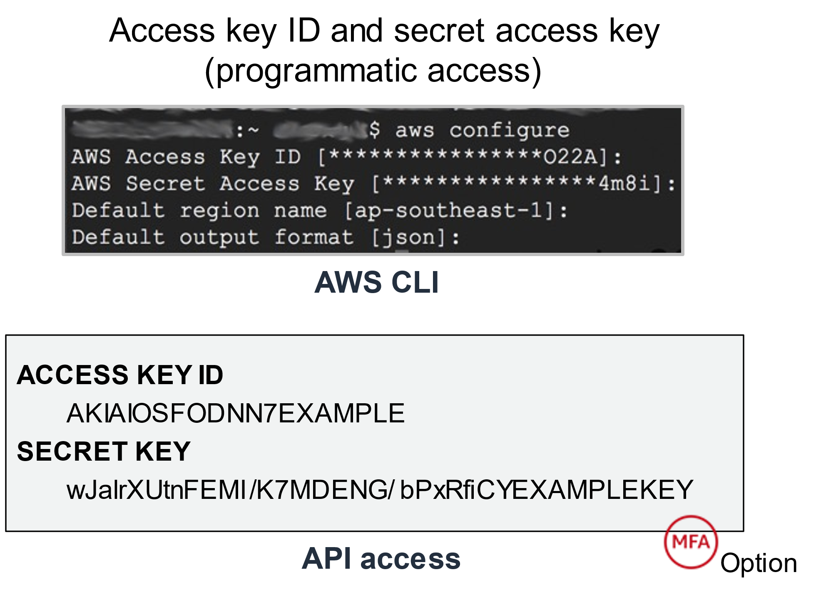
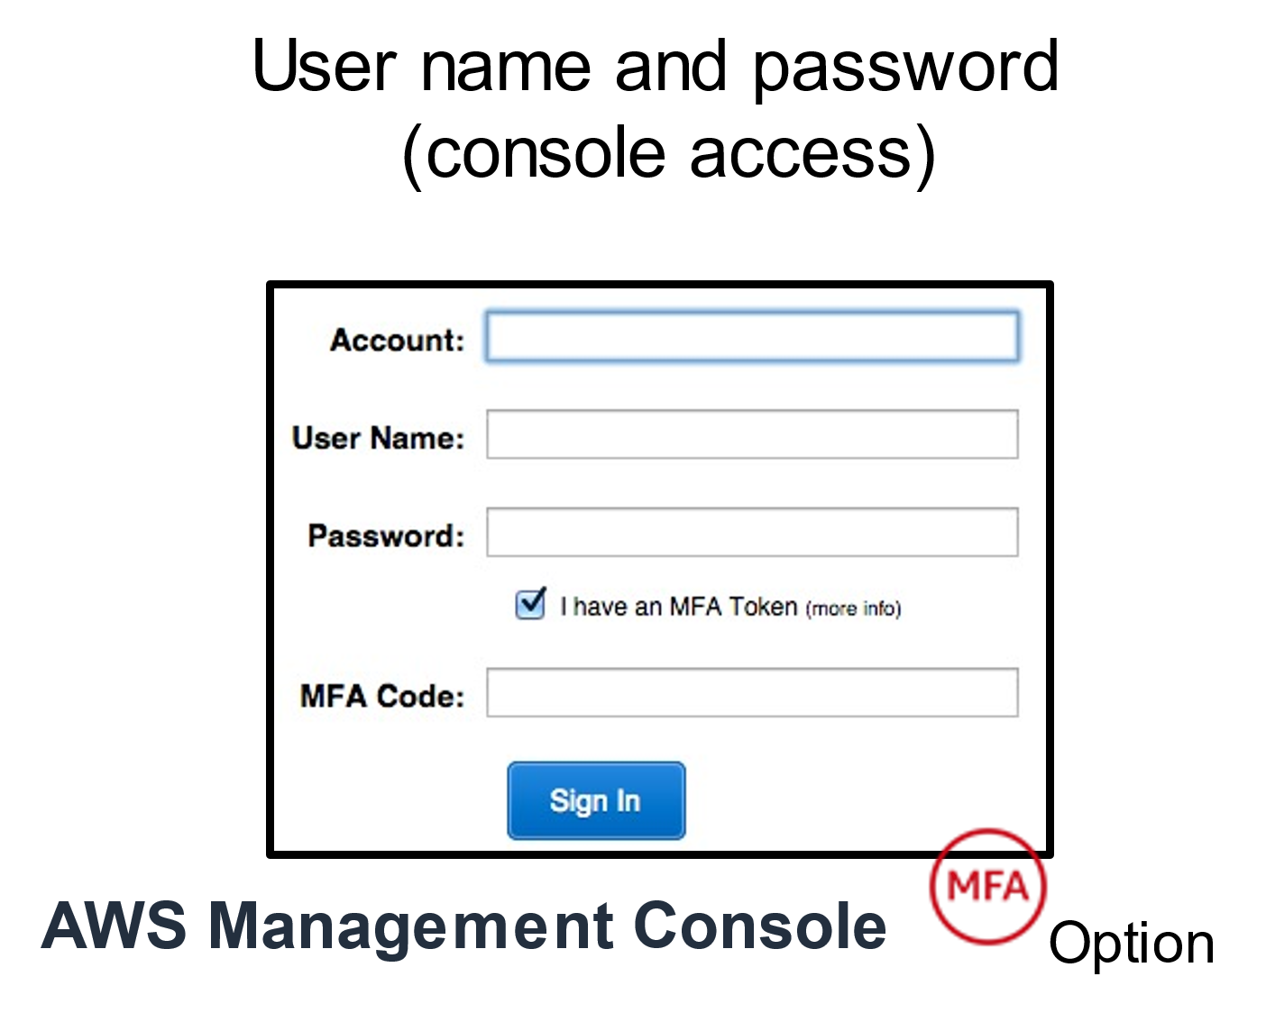
Lecture
Authenticating with IAM
7
IAM credentials for authentication
AWS Cloud Security Foundations– AWS-CSF
Lecture 7: Securing Access to Cloud Resources
Dr. Ibrahim Gomaa

Slide 14

Lecture
Authenticating with IAM
7
Multi-factor authentication (MFA)
Adds an extra layer of protection on top of your username and password
  Users prompted for an authentication code
  Can be hardware based or a virtual device
Activate MFA for:
  AWS Management Console users
  AWS API users (requires temporary security credentials)
Examples of MFA devices:
  Security keys devices (YubiKey, Gemalto)
  Applications (Google Authenticator, Authy)
  Hardware devices
AWS Cloud Security Foundations– AWS-CSF
Lecture 7: Securing Access to Cloud Resources
Dr. Ibrahim Gomaa

Slide 15
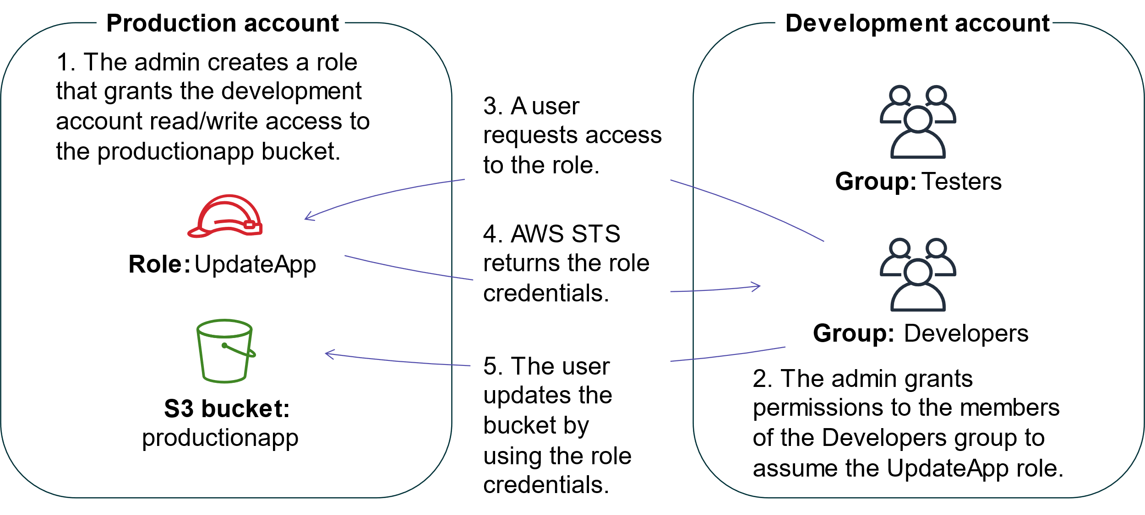
Lecture
Authenticating with IAM
7
Authentication scenario
AWS Cloud Security Foundations– AWS-CSF
Lecture 7: Securing Access to Cloud Resources
Dr. Ibrahim Gomaa

Slide 16
Lecture
Securing Access to Cloud Resources
7
Authorizing with IAM
AWS Cloud Security Foundations– AWS-CSF
Lecture 7: Securing Access to Cloud Resources
Dr. Ibrahim Gomaa

Slide 17
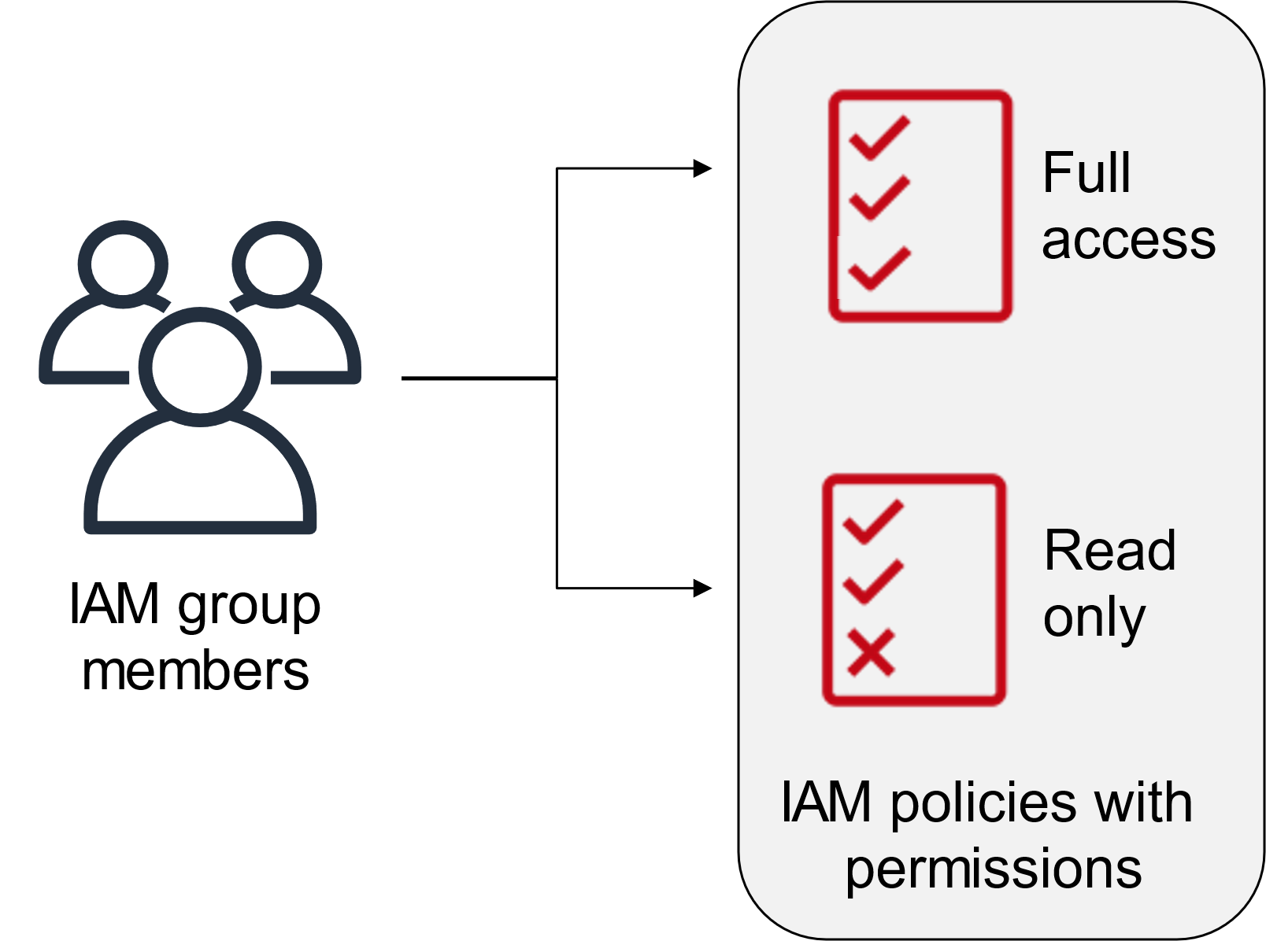
Lecture
Authorizing with IAM
7
Principle of least privilege
Best practices:
Start by granting the minimum AWS account permissions that are needed for the job role.
Grant additional access as needed.
AWS Cloud Security Foundations– AWS-CSF
Lecture 7: Securing Access to Cloud Resources
Dr. Ibrahim Gomaa

Slide 18
Lecture
Authorizing with IAM
7
Policies and permissions
AWS currently supports six types of policies:
Identity-based policies: These policies are attached to IAM identities and grant permissions to the identity.
Resource-based policies: These are attached to resources and grant permissions to the principal specified in the policy.
Permissions boundaries: These define the maximum permissions that the identity-based policies can grant to an entity. Permissions boundaries do not grant permissions.
AWS Organizations service control policy (SCP): This defines the maximum permissions for account members of an organization or organizational unit (OU). You can use SCPs to limit the permissions of identity-based or resource-based policies, but they cannot be used to grant permissions.
Access control lists (ACLs): You can use an ACL to control which principals in other accounts can access the resource to which the ACL is attached. You cannot use an ACL to grant permissions to entities that reside within the same account. ACLs are the only policy type that doesn't use the JSON document format.
Session policies: These are used with the AWS CLI or AWS API to create a temporary session for a role or federated user. You can use session policies to limit the permissions that a role or a user's identity-based policies grant to a session. Session policies limit permissions but cannot grant them.
AWS Cloud Security Foundations– AWS-CSF
Lecture 7: Securing Access to Cloud Resources
Dr. Ibrahim Gomaa

Slide 19


Lecture
Authorizing with IAM
7
Identity-based versus resource-based policies
Identity-based policies
Attached to a user, group, or role
Types of policies
  AWS managed
    policies are created and managed by AWS.
  Customer managed
    policies that you create and manage in your AWS account
  Inline
    policies that you create and manage, and that are embedded directly into a single user, group, or role
Resource-based policies
Attached to AWS resources
  Example: Attach to an Amazon S3 bucket
Always an inline policy
AWS Cloud Security Foundations– AWS-CSF
Lecture 7: Securing Access to Cloud Resources
Dr. Ibrahim Gomaa

Slide 20
Lecture
Authorizing with IAM
7
Identity-based and resource-based policies
Identity-based policies
Resource-based policies
What does a particular identity have access to?
Who has access to a particular resource?
Carlos
Resource | Read | Write | List
Resource X | Allow | Allow | Allow
Resource X
User | Read | Write | List
Ana | Allow | Allow | Allow
Akua | Allow | Allow | Allow
Mary | Allow | N/A | Allow
Mateo | N/A | N/A | Allow
Richard
Resource | Read | Write | List
Resource Y | Allow | N/A | N/A
Resource Z | Allow | N/A | N/A
Resource Y
User | Read | Write | List
Paulo | Allow | Allow | Allow
Nikki | Allow | N/A | N/A
Mateo | N/A | Allow | Allow
Managers
Resource | Read | Write | List
Resource X | N/A | N/A | Allow
Resource Y | N/A | N/A | Allow
Resource Z | N/A | N/A | Allow
AWS Cloud Security Foundations– AWS-CSF
Lecture 7: Securing Access to Cloud Resources
Dr. Ibrahim Gomaa

Slide 21
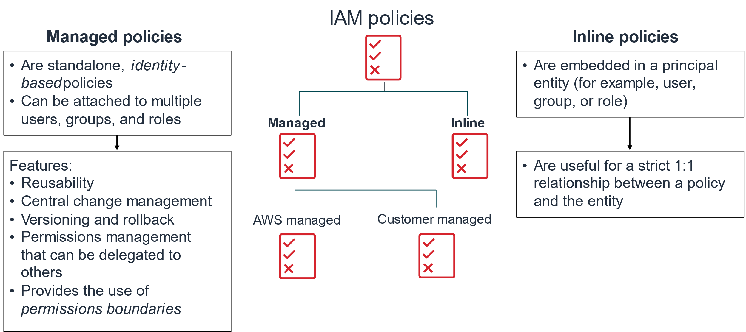
Lecture
Authorizing with IAM
7
Managed and inline IAM policies
AWS Cloud Security Foundations– AWS-CSF
Lecture 7: Securing Access to Cloud Resources
Dr. Ibrahim Gomaa

Slide 22
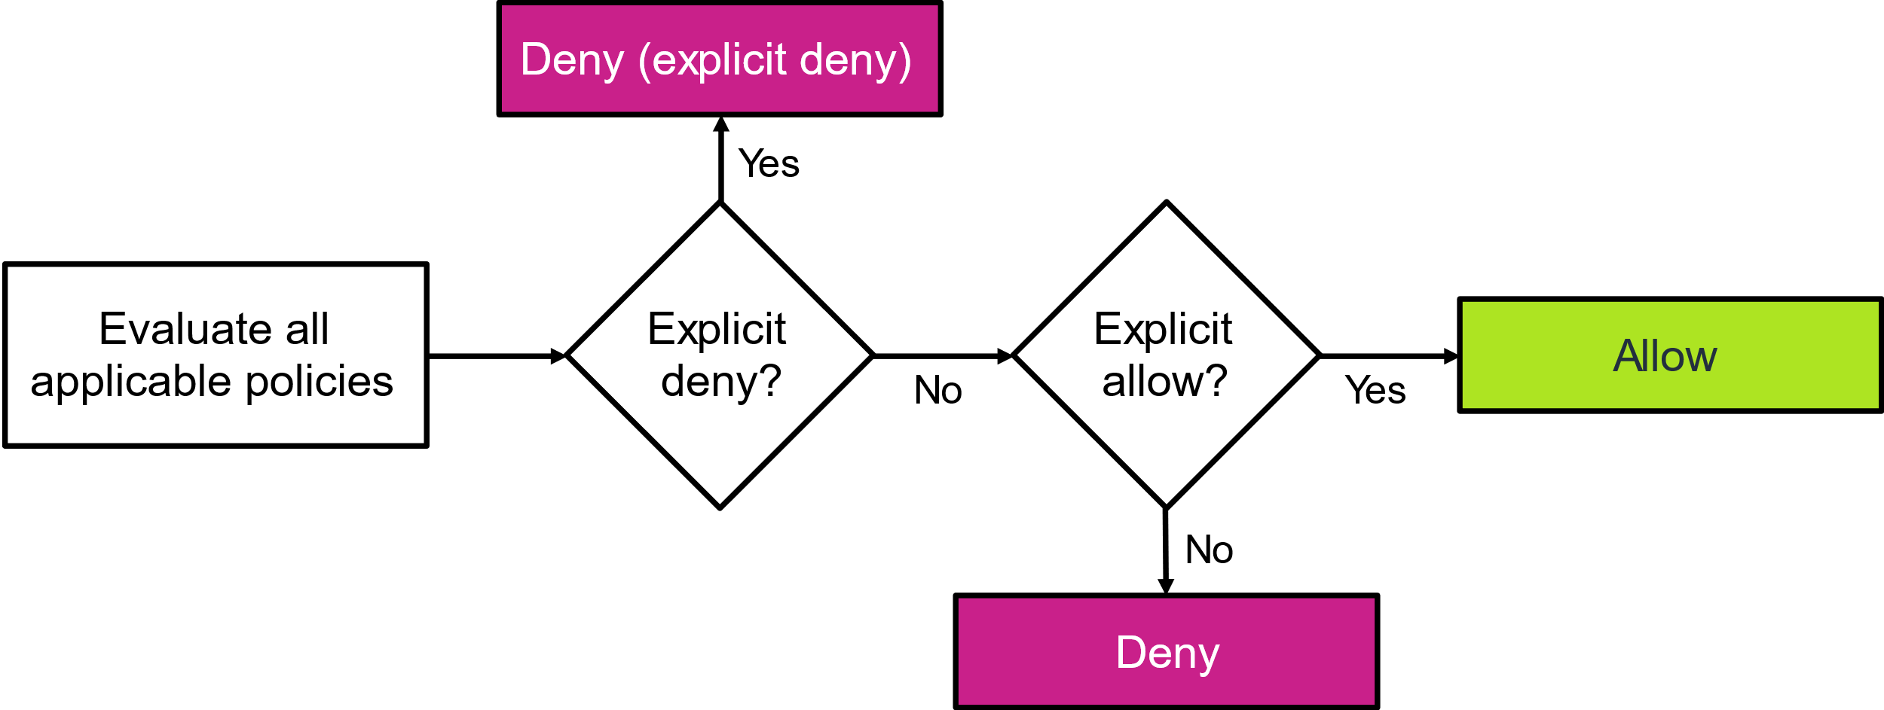
Lecture
Authorizing with IAM
7
Evaluation logic for IAM policies
AWS Cloud Security Foundations– AWS-CSF
Lecture 7: Securing Access to Cloud Resources
Dr. Ibrahim Gomaa

Slide 23
Lecture
Securing Access to Cloud Resources
7
Examples of authorizing with IAM
AWS Cloud Security Foundations– AWS-CSF
Lecture 7: Securing Access to Cloud Resources
Dr. Ibrahim Gomaa

Slide 24
Lecture
Examples of authorizing with IAM
7
IAM policy document structure
{
"Version": "2012-10-17",
"Statement":[{
"Effect": "effect",
"Action": "action",
"Resource": "arn",
"Condition":{
"condition":{
"key": "value"
}
}
}]
}
Effect: Effect can be either Allow or Deny
Action: Type of access that is allowed or denied
  "Action": "s3:GetObject"
Resource: Resources that the action will act on
  "Resource": "arn:aws:sqs:us-west-2:123456789012:queue1"
Condition: Conditions that must be met for the rule to apply
  "Condition" : {
  "StringEquals" : {
  "aws:username" : "johndoe"
  }
  }
AWS Cloud Security Foundations– AWS-CSF
Lecture 7: Securing Access to Cloud Resources
Dr. Ibrahim Gomaa

Slide 25
Lecture
Examples of authorizing with IAM
7
ARNs and wildcards
Resources are identified by using Amazon Resource Name (ARN) format
  Syntax – arn:partition:service:region:account:resource
  Example – "Resource": "arn:aws:iam::123456789012:user/mmajor"
You can use a wildcard (*) to give access to all actions for a specific AWS service
  Examples –
    "Action": "s3:*"
    "Action": "iam:*AccessKey*"
AWS Cloud Security Foundations– AWS-CSF
Lecture 7: Securing Access to Cloud Resources
Dr. Ibrahim Gomaa

Slide 26

Lecture
Examples of authorizing with IAM
7
IAM policy example
{
"Version": "2012-10-17",
"Statement":[{
"Effect":"Allow",
"Action":["DynamoDB:*","s3:*"],
"Resource":[
"arn:aws:dynamodb:region:account-number-without-hyphens:table/table-name",
"arn:aws:s3:::bucket-name",
"arn:aws:s3:::bucket-name/*"]
},
{
"Effect":"Deny",
"Action":["dynamodb:*","s3:*"],
"NotResource":["arn:aws:dynamodb:region:account-number-without-hyphens:table/table-name”,
"arn:aws:s3:::bucket-name",
"arn:aws:s3:::bucket-name/*"]
}
]
}
Explicit allow gives users access to a specific DynamoDB table and…
…Amazon S3 buckets.
Explicit deny ensures that the users cannot use any other AWS actions or resources other than that table and those buckets.
An explicit deny statement takes precedence over an allow statement.
AWS Cloud Security Foundations– AWS-CSF
Lecture 7: Securing Access to Cloud Resources
Dr. Ibrahim Gomaa

Slide 27
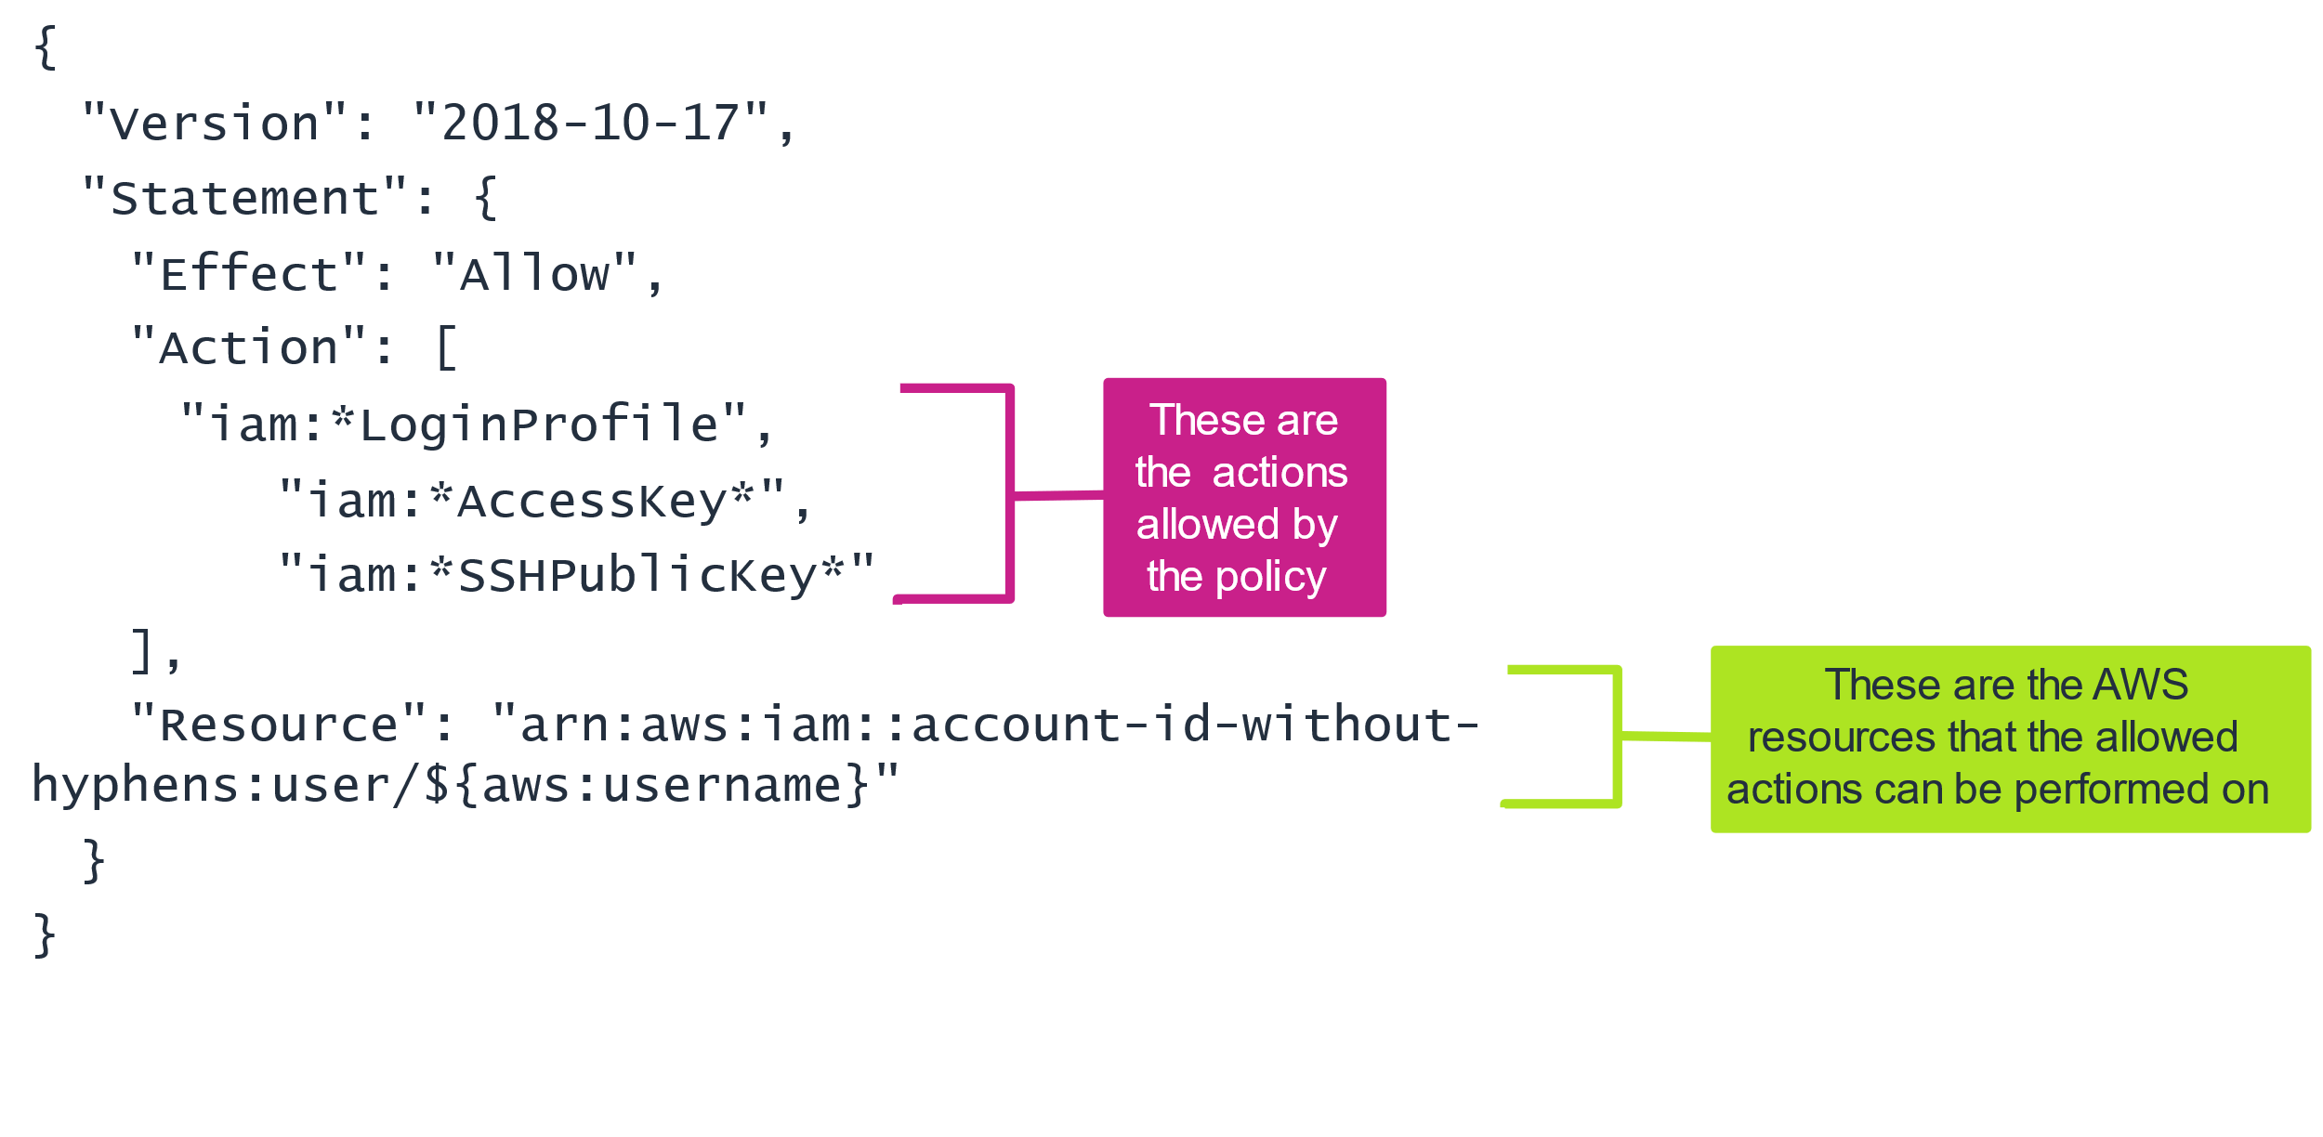
Lecture
Examples of authorizing with IAM
7
Example: Identity-based policy
AWS Cloud Security Foundations– AWS-CSF
Lecture 7: Securing Access to Cloud Resources
Dr. Ibrahim Gomaa

Slide 28
Lecture
Examples of authorizing with IAM
7
Example: Identity-based policy
AWS Cloud Security Foundations– AWS-CSF
Lecture 7: Securing Access to Cloud Resources
Dr. Ibrahim Gomaa

Slide 29
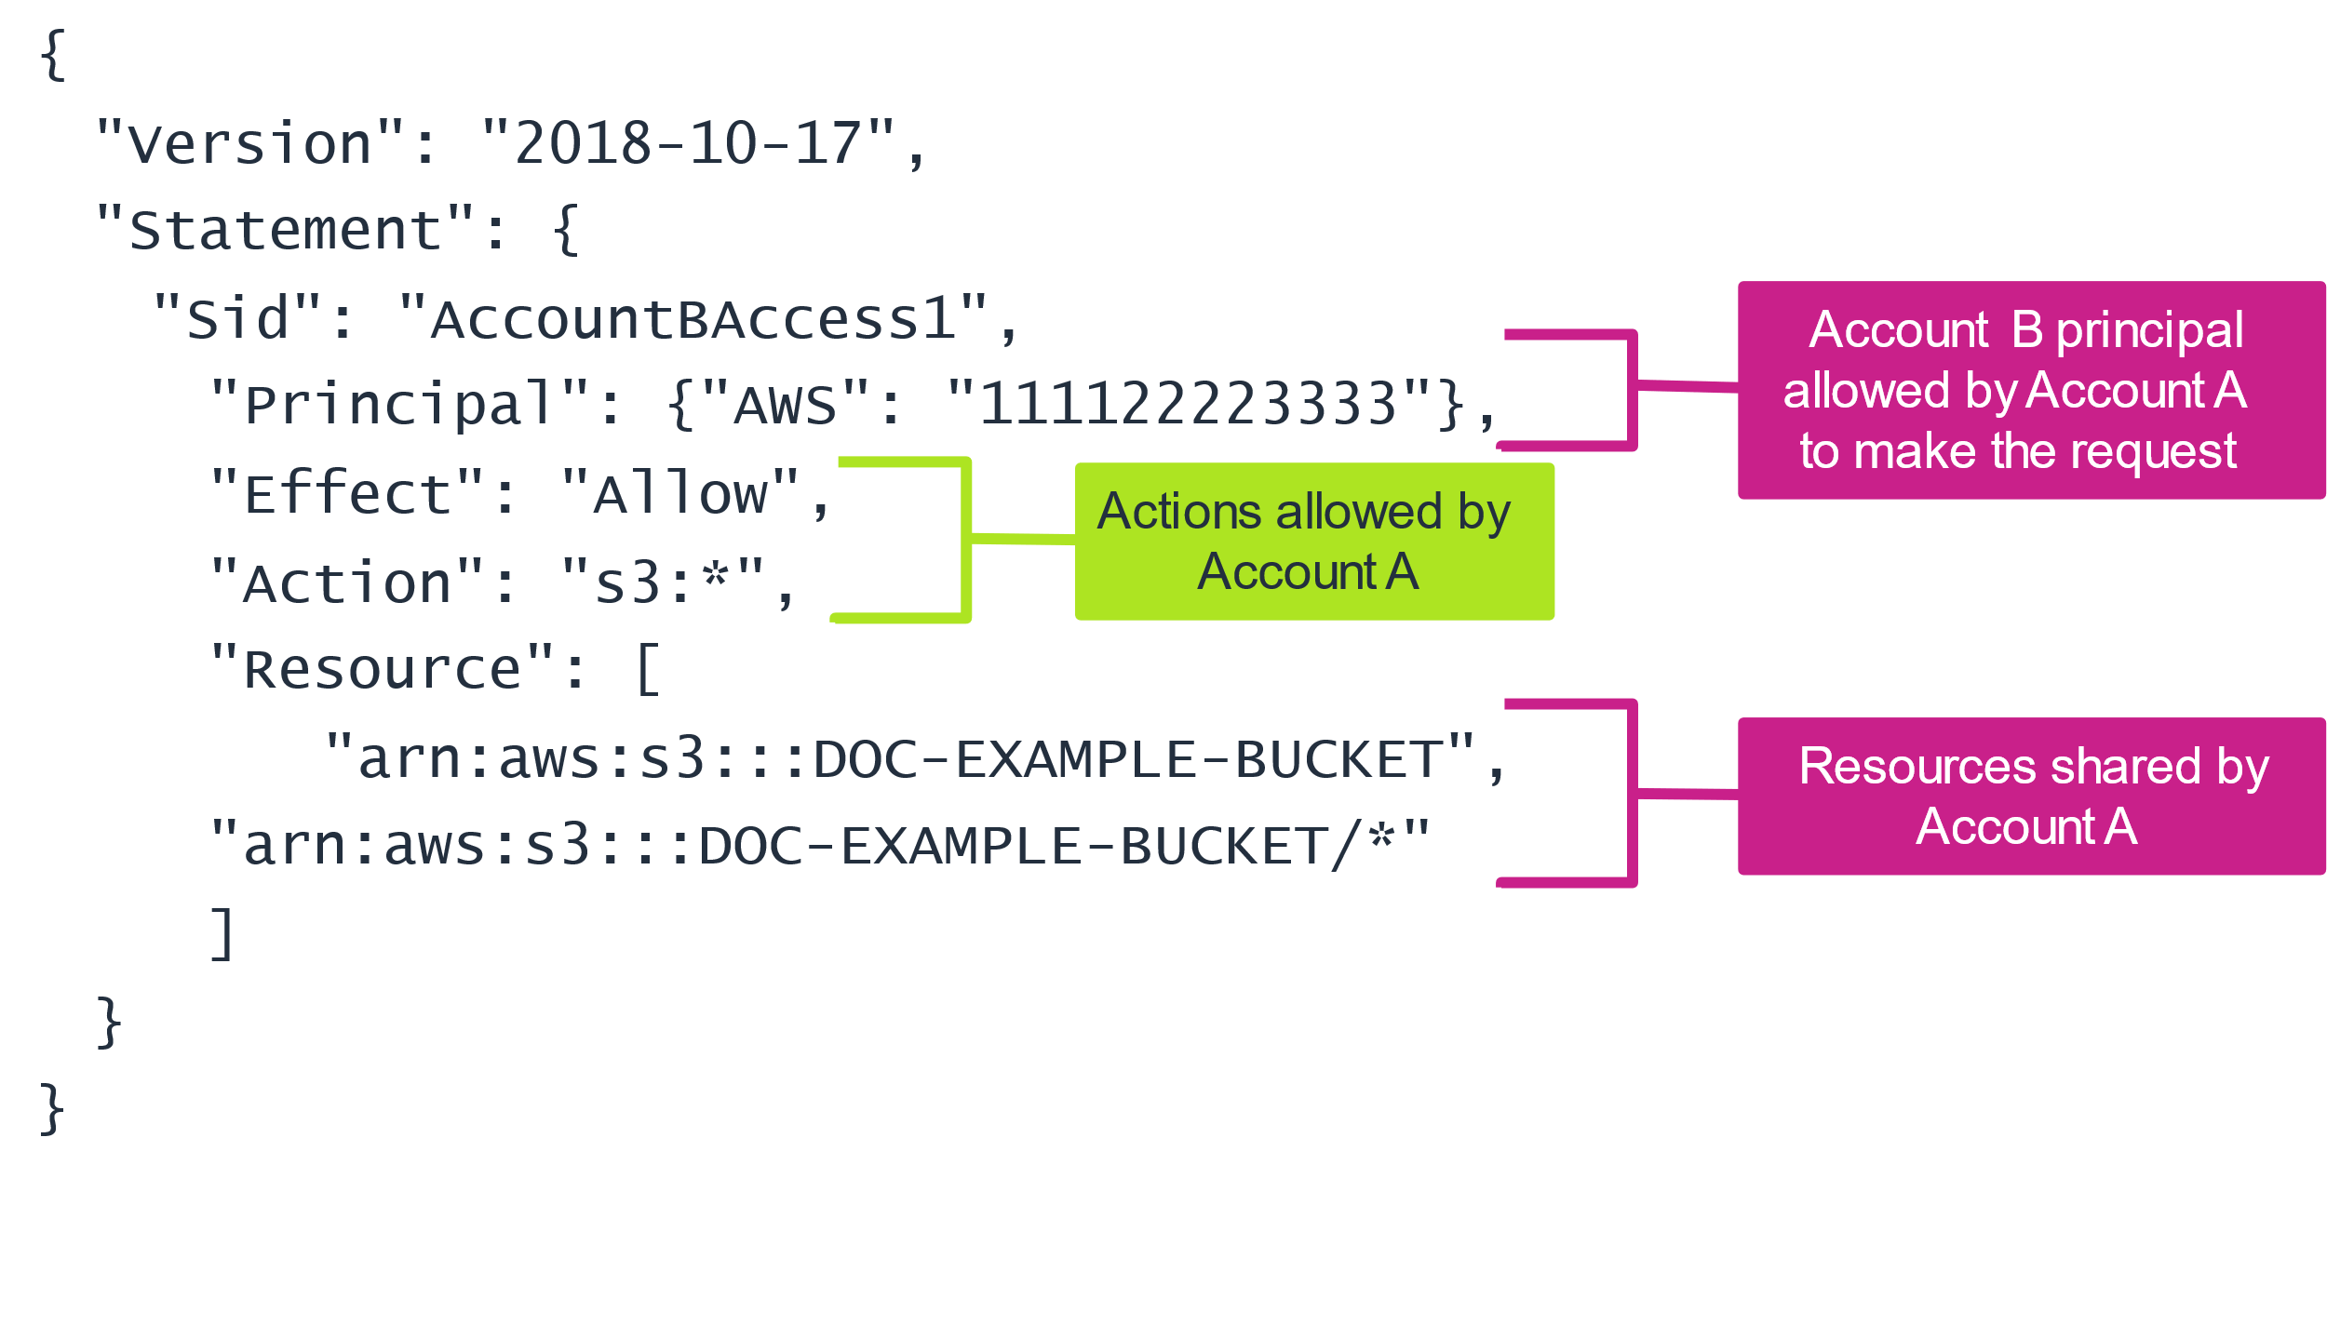
Lecture
Examples of authorizing with IAM
7
Example: Cross-account, resource-based policy
AWS Cloud Security Foundations– AWS-CSF
Lecture 7: Securing Access to Cloud Resources
Dr. Ibrahim Gomaa

Slide 30
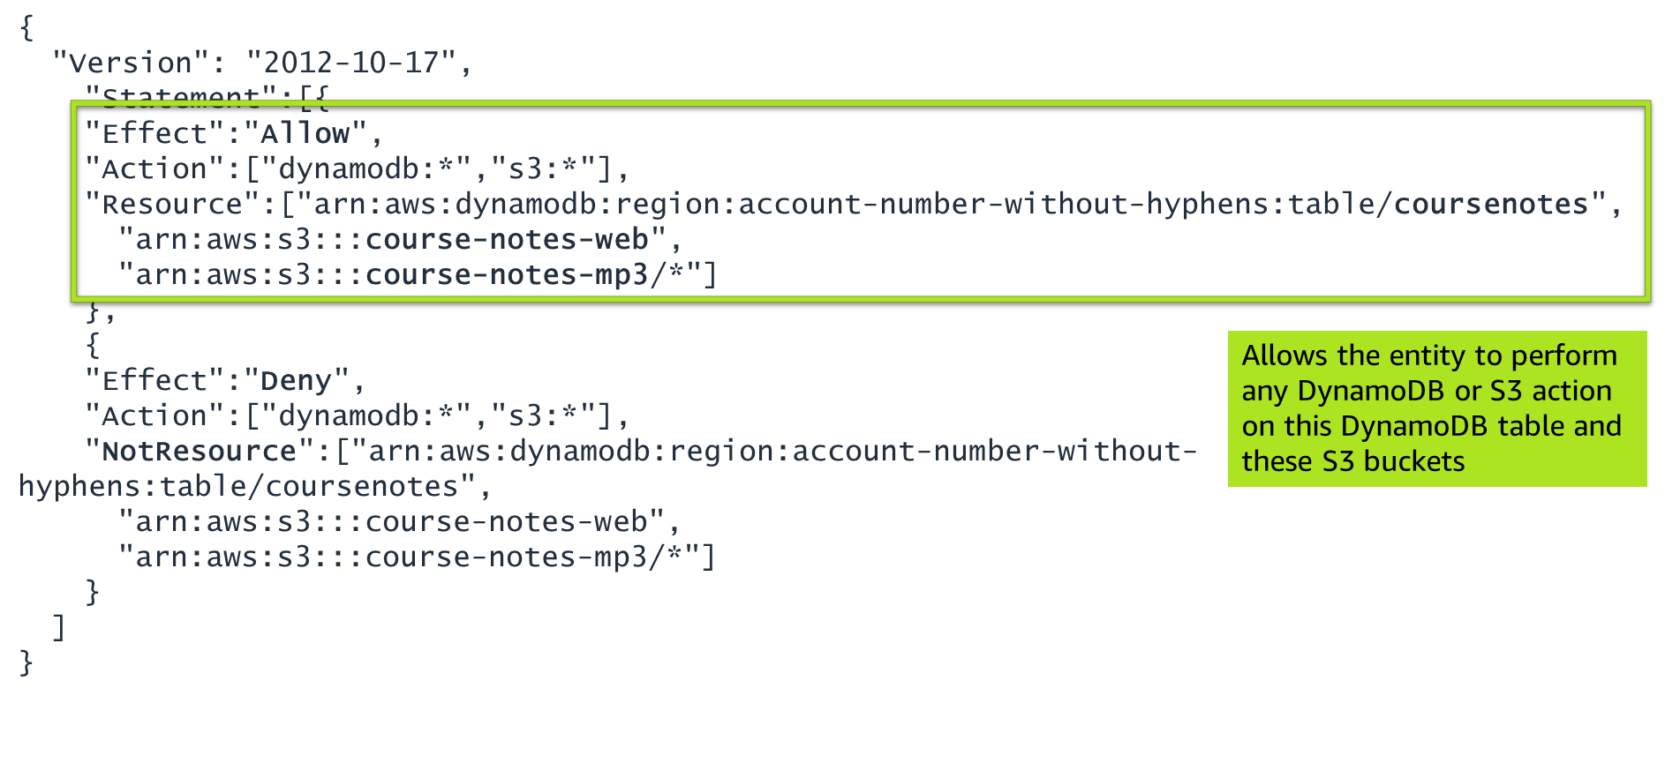
Lecture
Examples of authorizing with IAM
7
Example IAM policy: Allow statement
AWS Cloud Security Foundations– AWS-CSF
Lecture 7: Securing Access to Cloud Resources
Dr. Ibrahim Gomaa

Slide 31
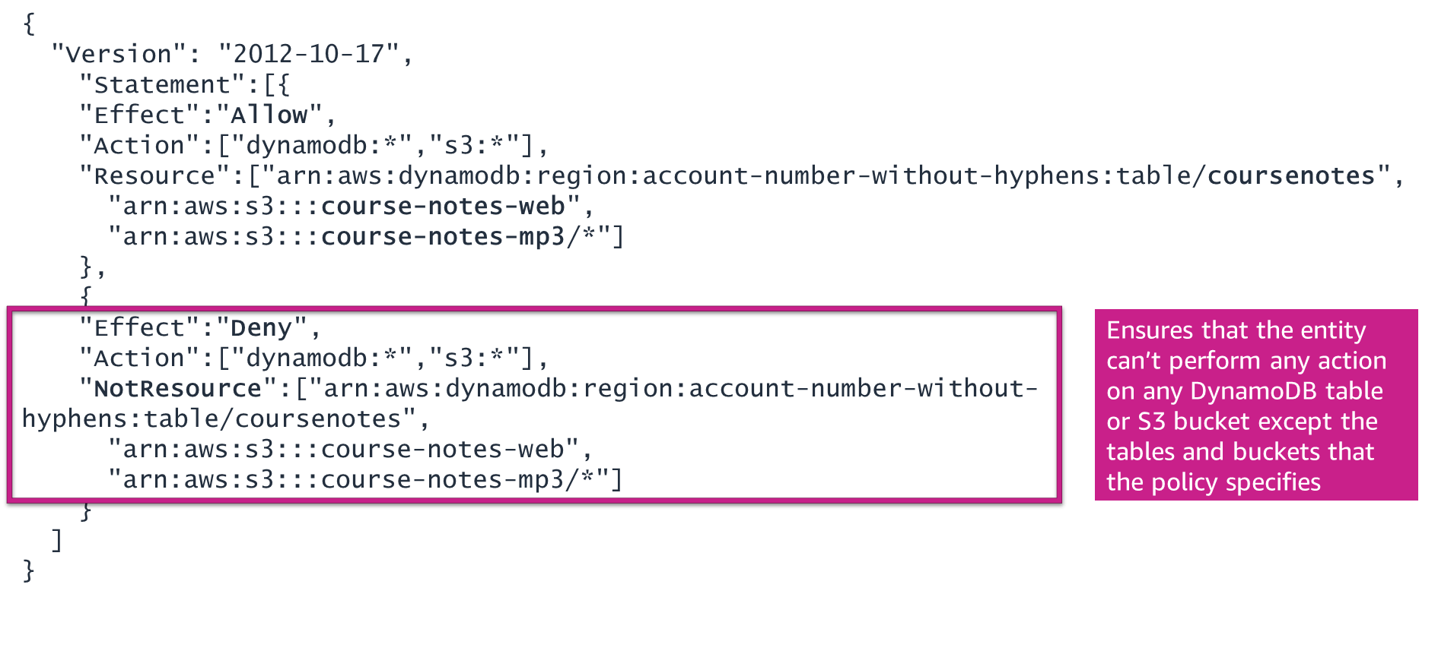
Lecture
Examples of authorizing with IAM
7
Example IAM policy: Deny statement
AWS Cloud Security Foundations– AWS-CSF
Lecture 7: Securing Access to Cloud Resources
Dr. Ibrahim Gomaa

Slide 32
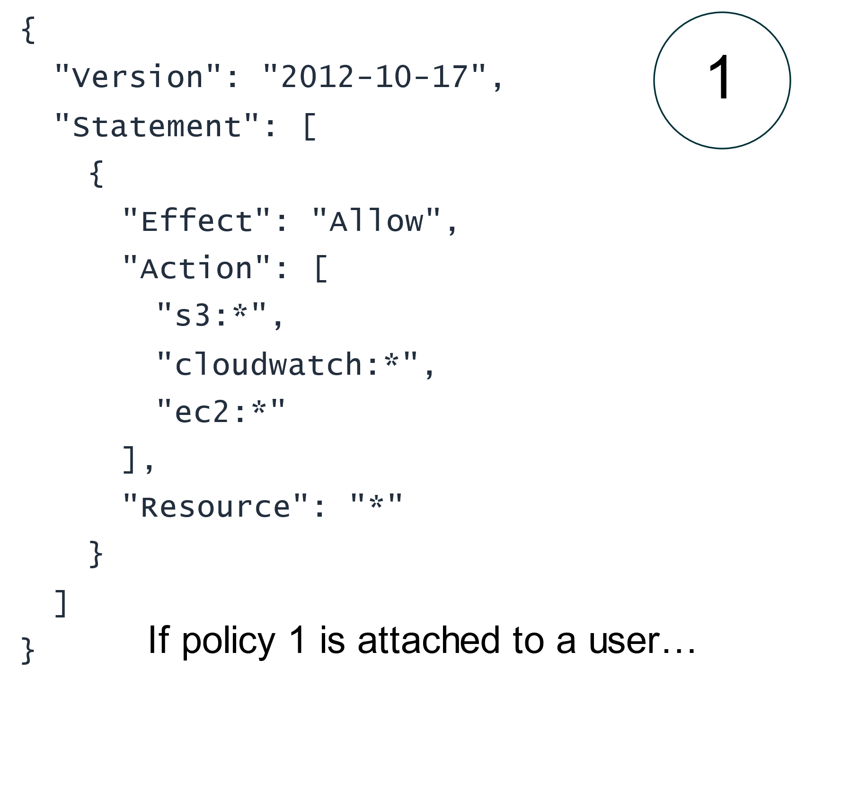
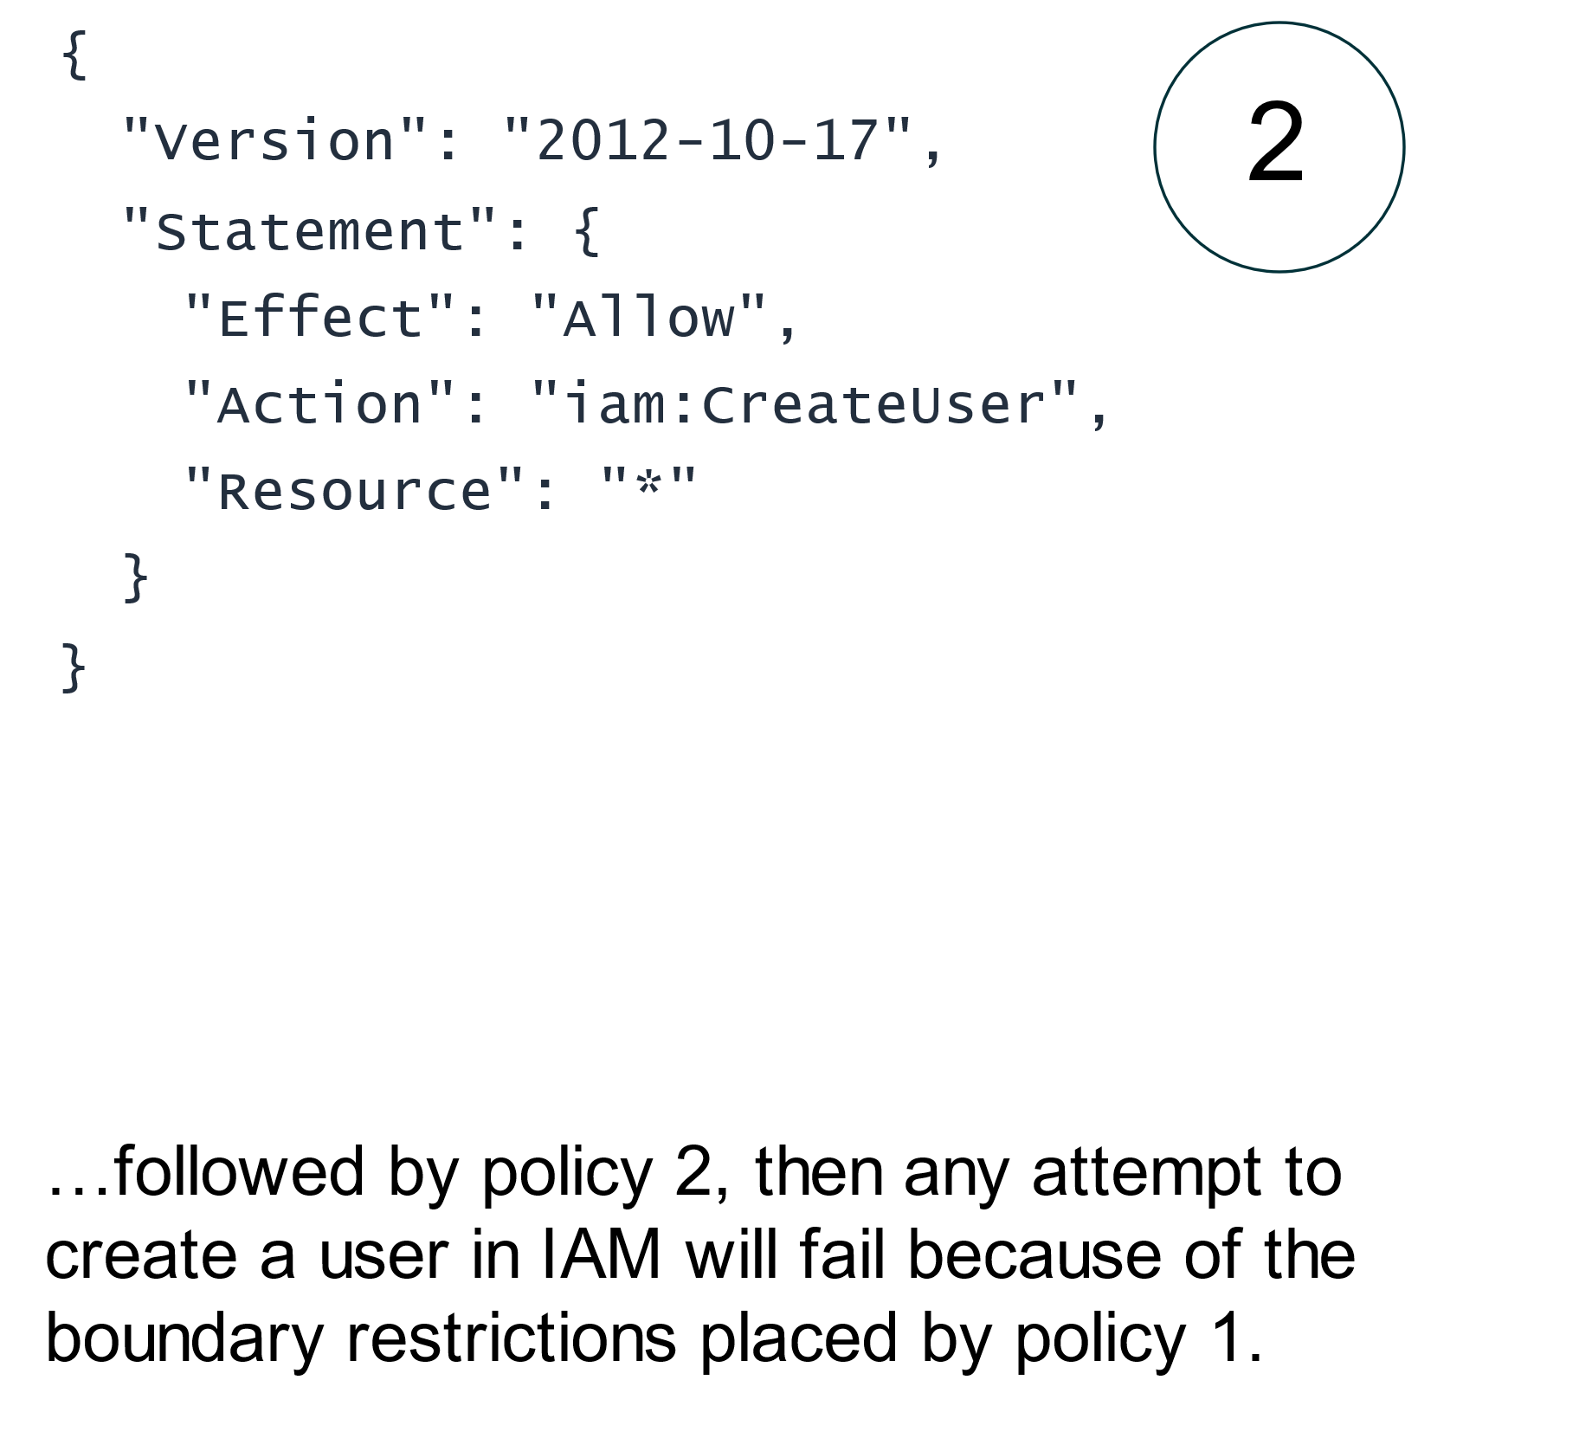
Lecture
Examples of authorizing with IAM
7
Example IAM policy: Permissions boundary
AWS Cloud Security Foundations– AWS-CSF
Lecture 7: Securing Access to Cloud Resources
Dr. Ibrahim Gomaa

Slide 33
Lecture
Examples of authorizing with IAM
7
Activity: IAM policy analysis
Consider this IAM policy, then answer the questions as they are presented.
Which AWS service does this policy grant you access to?
  ANSWER: The IAM service.
Does it allow you to create an IAM user, group, policy, or role?
  ANSWER: No. The access is limited to get and list requests. It effectively grants read-only permissions.
Go to https://docs.aws.amazon.com/IAM/latest/UserGuide/ and in the left navigation expand Reference > Policy Reference > Actions, Resources, and Condition Keys. Choose Identity And Access Management. Scroll to the Actions Defined by Identity And Access Management list.
Name at least three specific actions that the iam:Get* action allows.
  ANSWER: iam:Get* allows many specific actions, including GetGroup, GetPolicy, GetRole, and others.
{
"Version": "2012-10-17",
"Statement": {
"Effect": "Allow",
"Action": [
"iam:Get*",
"iam:List*"
],
"Resource": "*"
}
}
AWS Cloud Security Foundations– AWS-CSF
Lecture 7: Securing Access to Cloud Resources
Dr. Ibrahim Gomaa

Slide 34
Lecture
Securing Access to Cloud Resources
7
Additional authentication and access management services
AWS Cloud Security Foundations– AWS-CSF
Lecture 7: Securing Access to Cloud Resources
Dr. Ibrahim Gomaa

Slide 35
Lecture
Additional authentication and
access management services
7
Identity federation
Identity federation is a system of trust between two parties to authenticate users and convey information that is needed to authorize resource access.
  Identity providers are responsible for user authentication.
  Service providers are responsible for resource access.
Two AWS services are available to provide federation to AWS accounts and applications:
  AWS Single Sign-On (AWS SSO)
  AWS Identity and Access Management (IAM)
AWS Cloud Security Foundations– AWS-CSF
Lecture 7: Securing Access to Cloud Resources
Dr. Ibrahim Gomaa

Slide 36

Lecture
Additional authentication and
access management services
7
AWS Single Sign-On (AWS SSO)
Create or connect identities once and manage access centrally across your AWS accounts.
AWS SSO provides a unified administration experience to define, customize, and assign fine-grained access.
Users are provided a user portal to access all their assigned AWS accounts or cloud applications.
You can flexibly configure access to run parallel to or replace AWS account access management by using IAM.
AWS Single Sign-On (AWS SSO)
AWS Cloud Security Foundations– AWS-CSF
Lecture 7: Securing Access to Cloud Resources
Dr. Ibrahim Gomaa

Slide 37

Lecture
Additional authentication and
access management services
7
AWS Directory Service
you can use your existing on-premises user credentials to access cloud resources, which simplifies the process to extend your existing Active Directory to AWS.
AWS Directory Service for Microsoft Active Directory, also called AWS Managed Microsoft AD
Facilitates directory-aware workloads and AWS resources to use managed Active Directory in the AWS Cloud
Provides the ability to extend your existing Active Directory to AWS by using your existing on-premises user credentials to access cloud resources
Supports Active Directory SSO to AWS applications by using a single set of credentials
AWS Directory Service
AWS Cloud Security Foundations– AWS-CSF
Lecture 7: Securing Access to Cloud Resources
Dr. Ibrahim Gomaa

Slide 38

Lecture
Additional authentication and
access management services
7
Amazon Cognito
Integrates user sign-up, sign-in, and access control with web and mobile applications
Provides a secure identity store that can scale to millions of users with Amazon Cognito user pools
Offers user sign-in through enterprise identity providers and social identity providers such as Apple, Google, Facebook, and Amazon
Provides the ability to create unique identities for your users and federate them with identity providers through Amazon Cognito identity pools
Amazon Cognito
User pools are directories that provide sign-up and sign-in options for your application users
identity pools, you can grant your users access to AWS services through temporary, limited-privilege AWS credentials.
AWS Cloud Security Foundations– AWS-CSF
Lecture 7: Securing Access to Cloud Resources
Dr. Ibrahim Gomaa

Slide 39
Lecture
Securing Access to Cloud Resources
7
Using AWS Organizations
AWS Cloud Security Foundations– AWS-CSF
Lecture 7: Securing Access to Cloud Resources
Dr. Ibrahim Gomaa

Slide 40

Lecture
Using AWS Organizations
7
AWS Organizations
Account management service that you can use to consolidate multiple AWS accounts into a centrally managed organization
Includes account creation and management as well as consolidated billing capabilities
Provides for hierarchical grouping of accounts
Supports centralized policy control over AWS services and API actions using service control policies (SCPs)
Integrates with IAM and other services
AWS Organizations
AWS Cloud Security Foundations– AWS-CSF
Lecture 7: Securing Access to Cloud Resources
Dr. Ibrahim Gomaa

Slide 41
Lecture
Using AWS Organizations
7
Example: SCP
Prevent member accounts from leaving the organization:
{
"Version": "2012-10-17",
"Statement": [
{
"Effect": "Deny",
"Action": [ "organizations:LeaveOrganization"
],
"Resource": "*"
}
]
}
AWS Cloud Security Foundations– AWS-CSF
Lecture 7: Securing Access to Cloud Resources
Dr. Ibrahim Gomaa

Slide 42
Lecture
Securing Access to Cloud Resources
7
Thanks
AWS Cloud Security Foundations– AWS-CSF
Lecture 7: Securing Access to Cloud Resources
Dr. Ibrahim Gomaa

