Slide 1


Slide 2
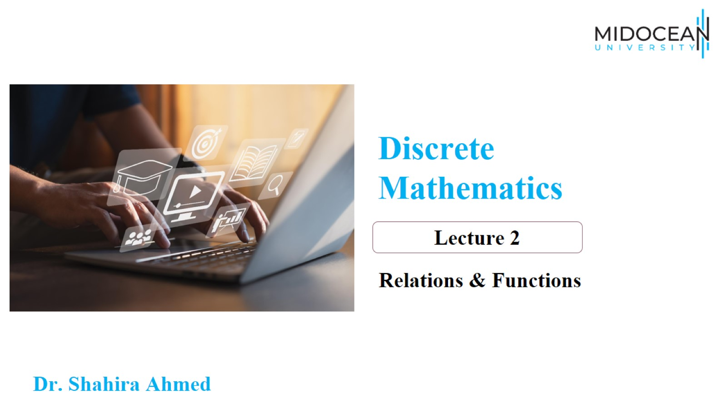

Slide 3
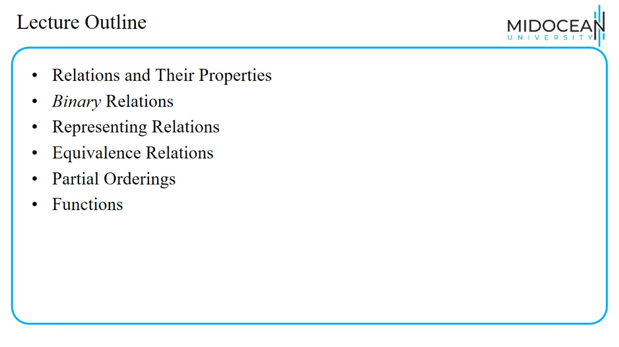
Lecture Outline

Slide 4
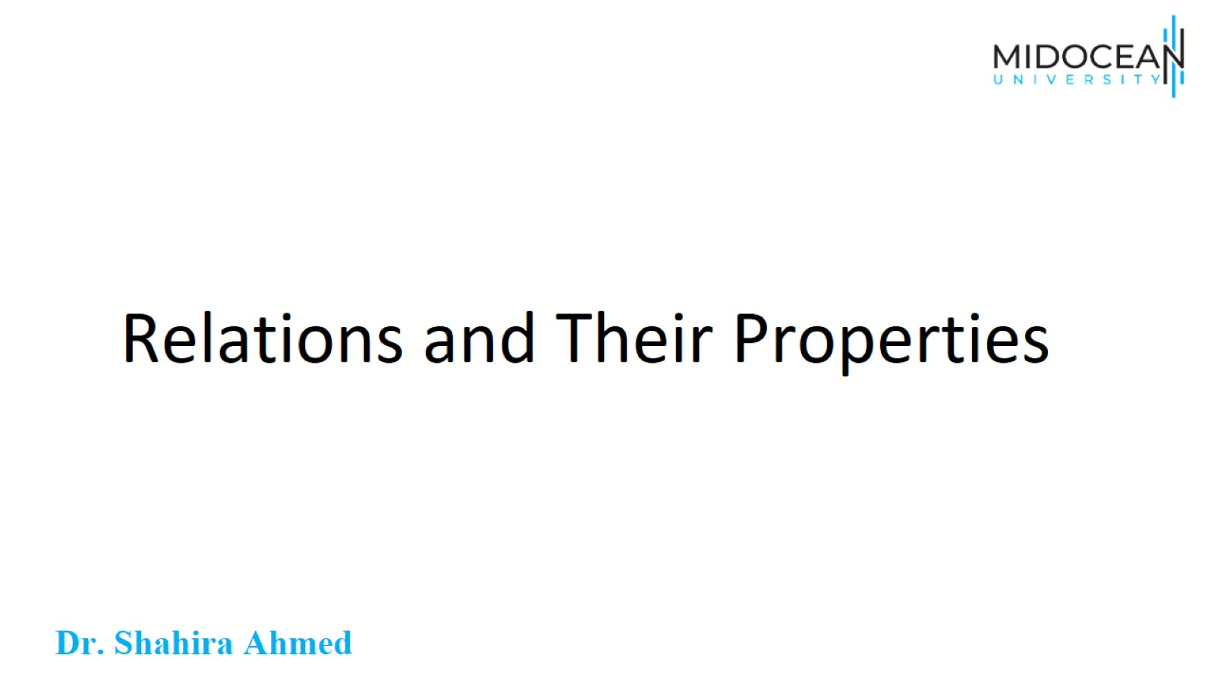
Relations and Their Properties

Slide 5
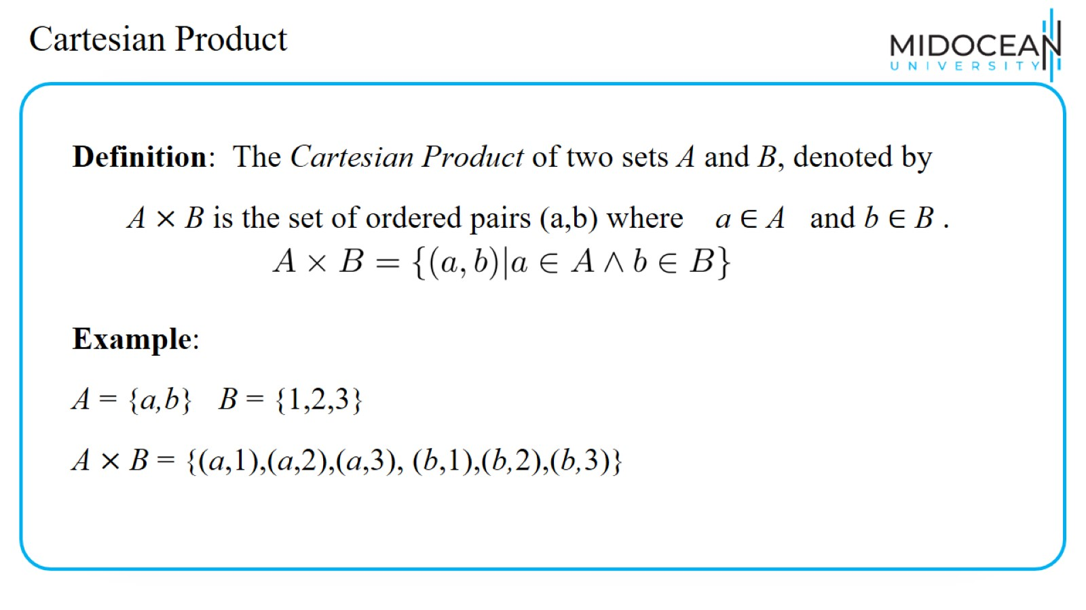
Cartesian Product

Slide 6
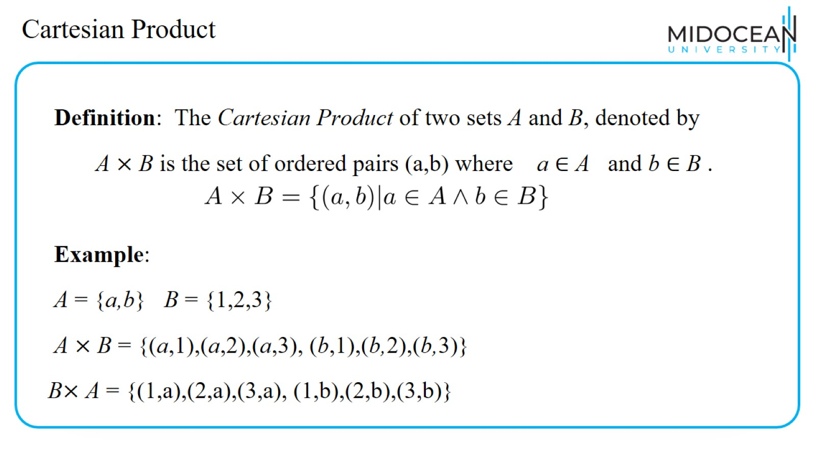
Cartesian Product

Slide 7
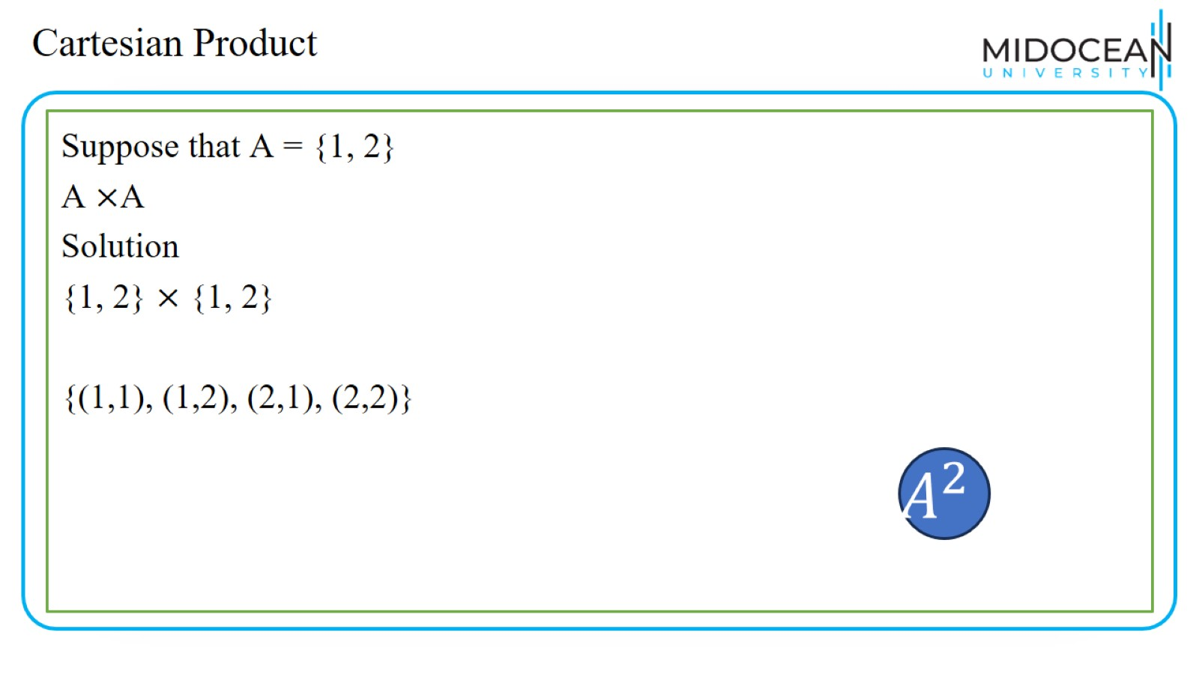
Cartesian Product

Slide 8
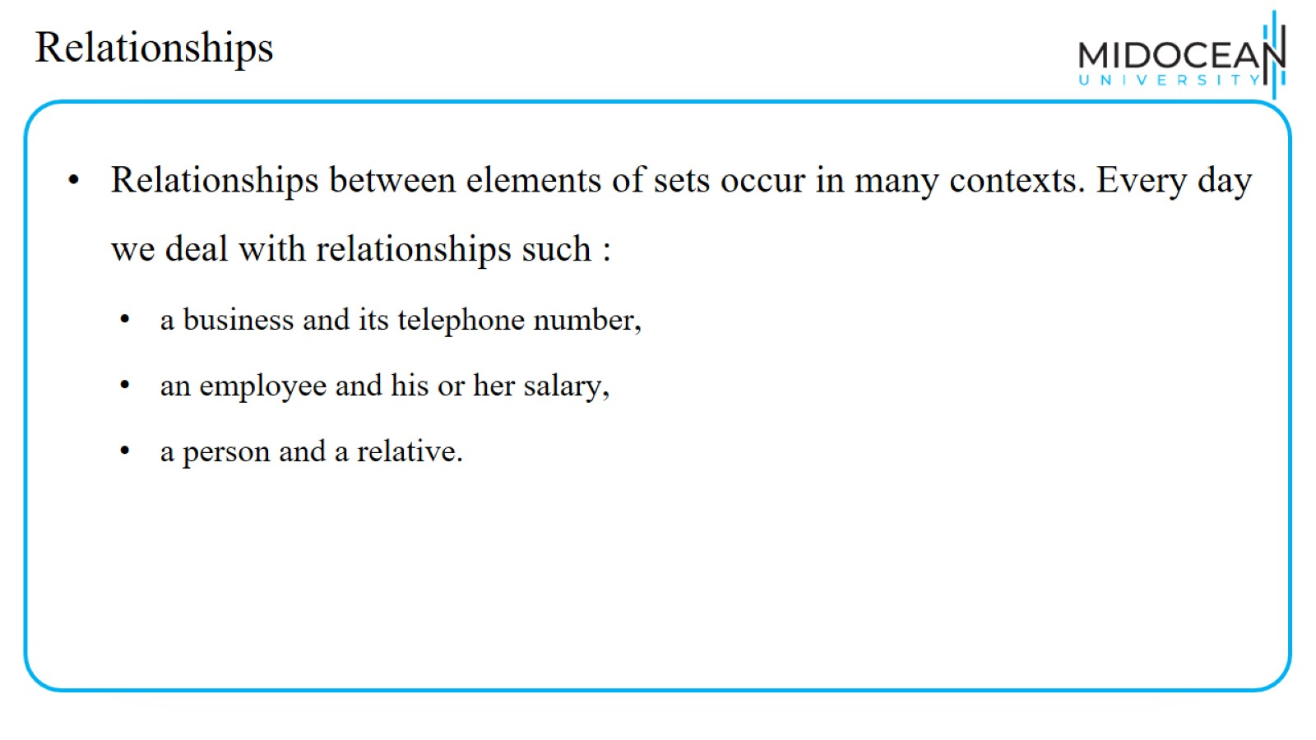
Relationships

Slide 9
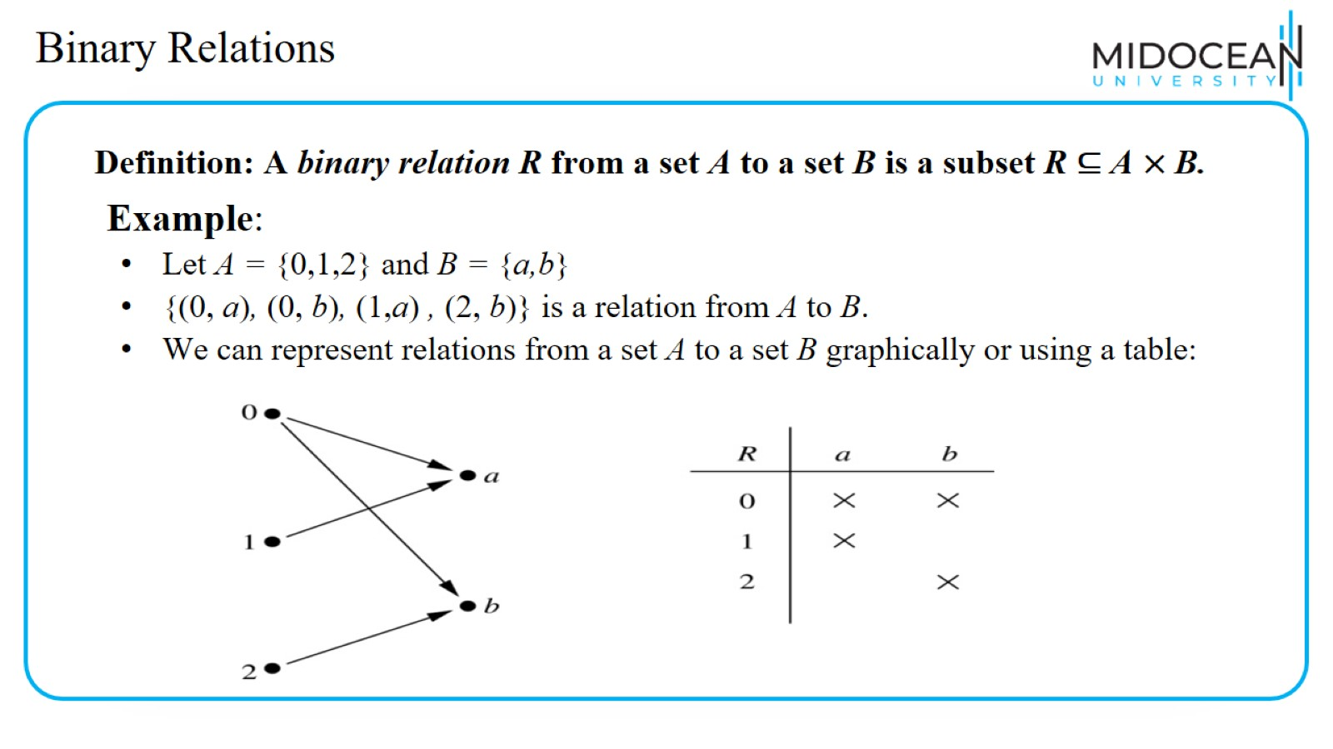
Binary Relations

Slide 10
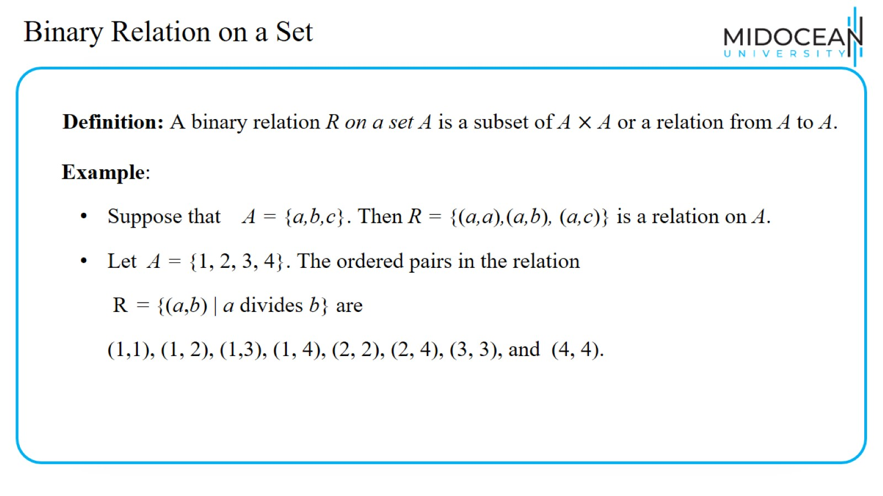
Binary Relation on a Set

Slide 11
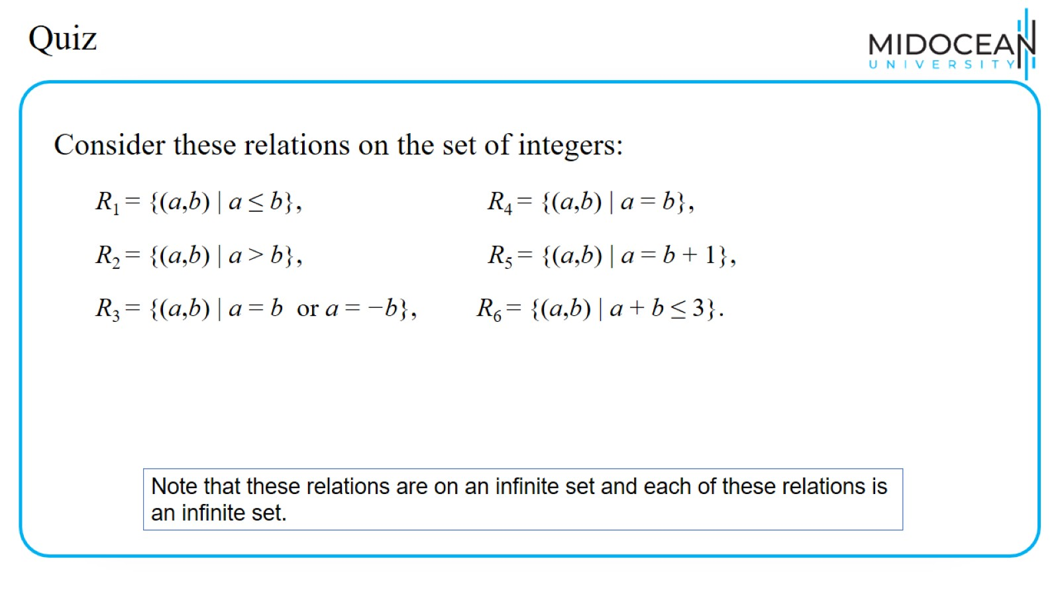
Quiz

Slide 12
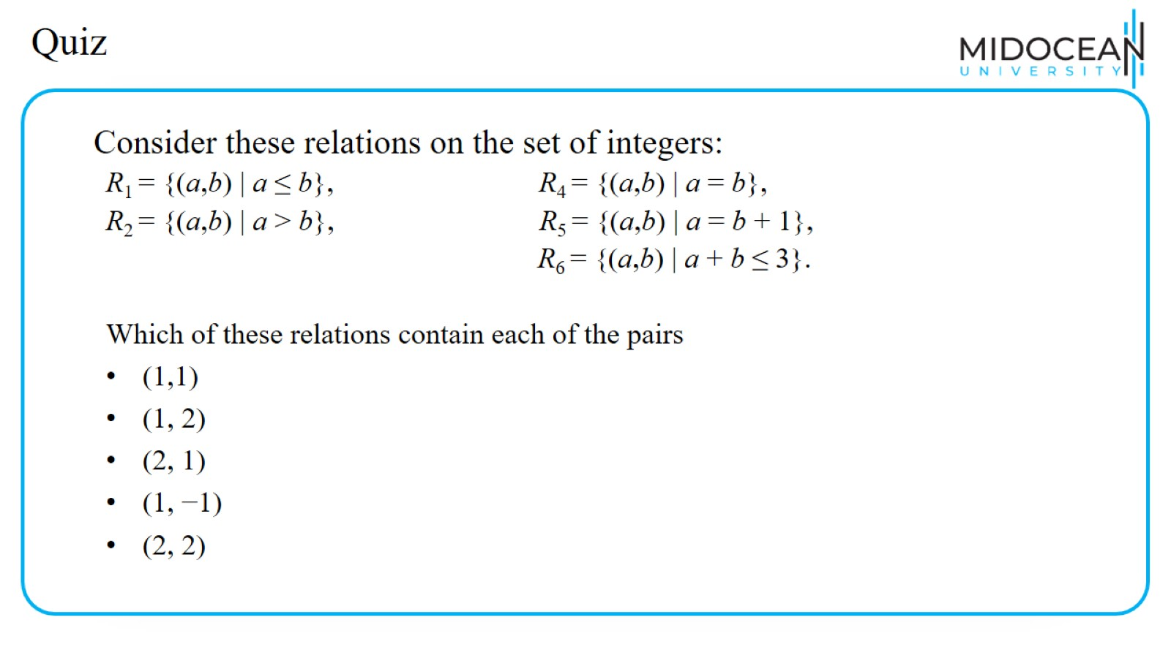
Quiz

Slide 13
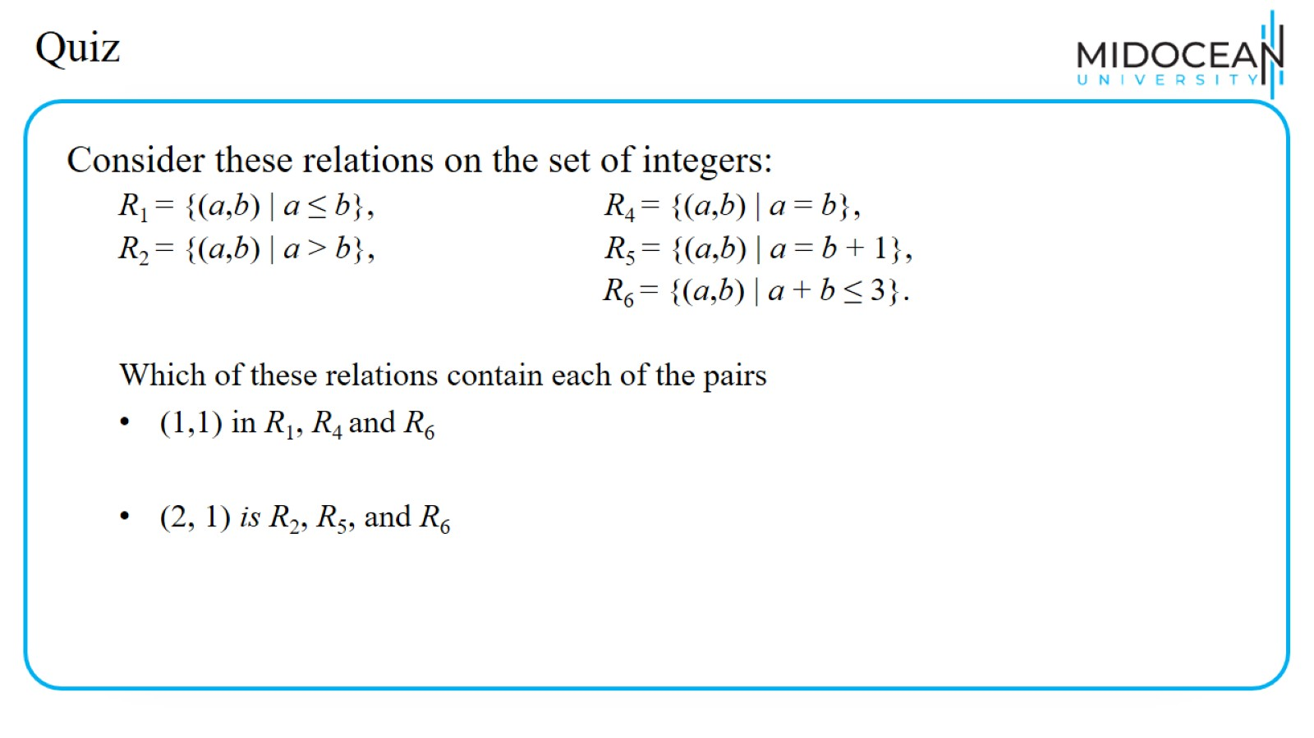
Quiz

Slide 14
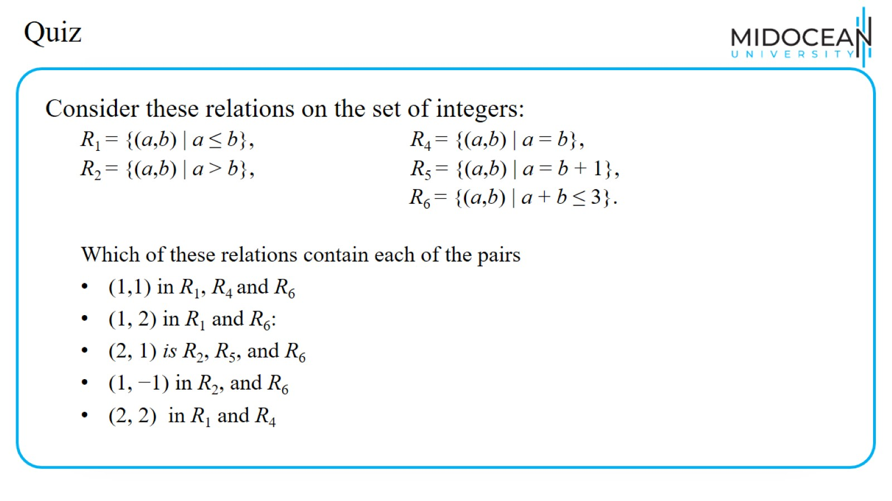
Quiz

Slide 15
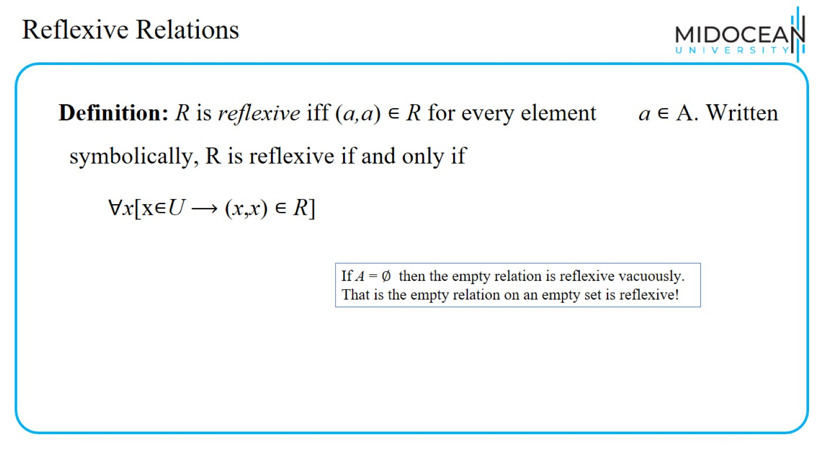
Reflexive Relations

Slide 16
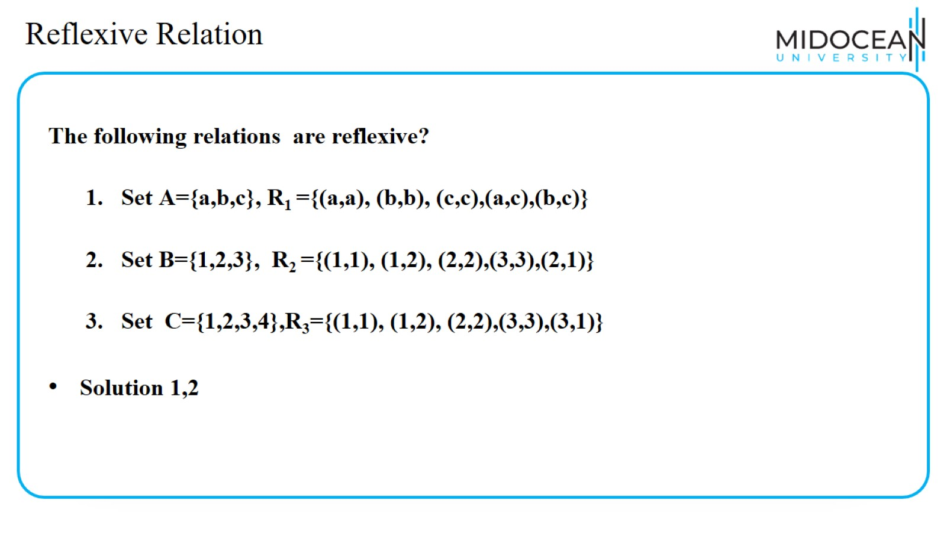
Reflexive Relation

Slide 17
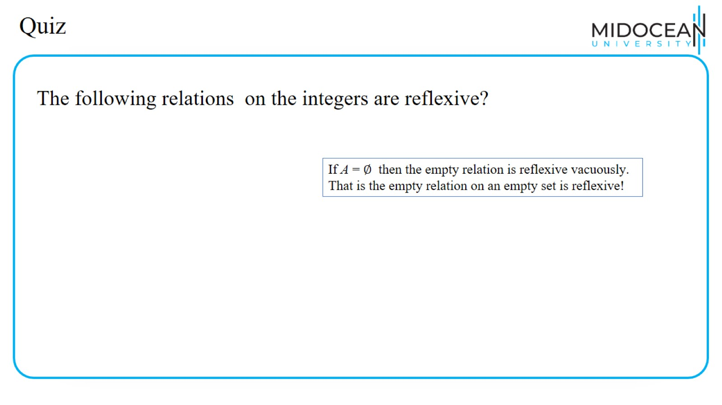
Quiz

Slide 18
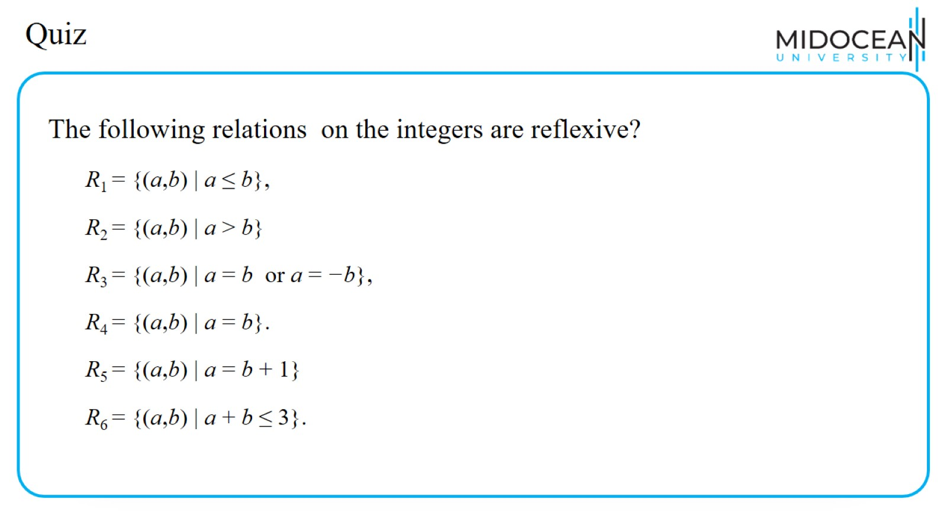
Quiz

Slide 19
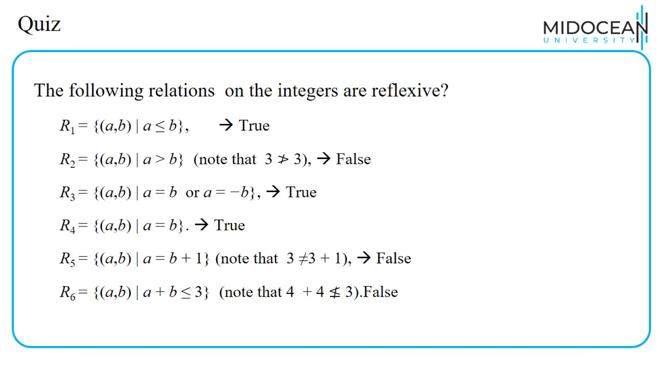
Quiz

Slide 20
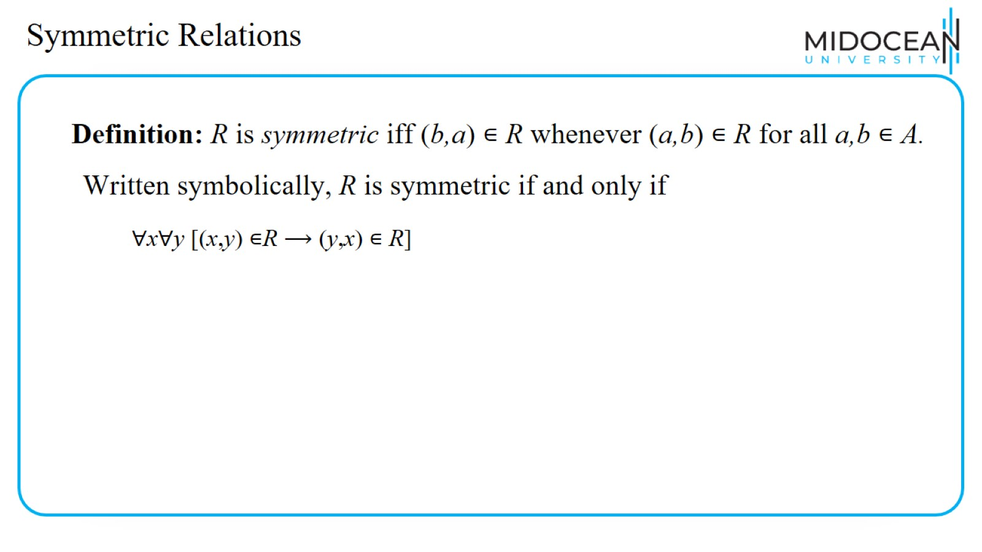
Symmetric Relations

Slide 21

Symmetric Relation

Slide 22
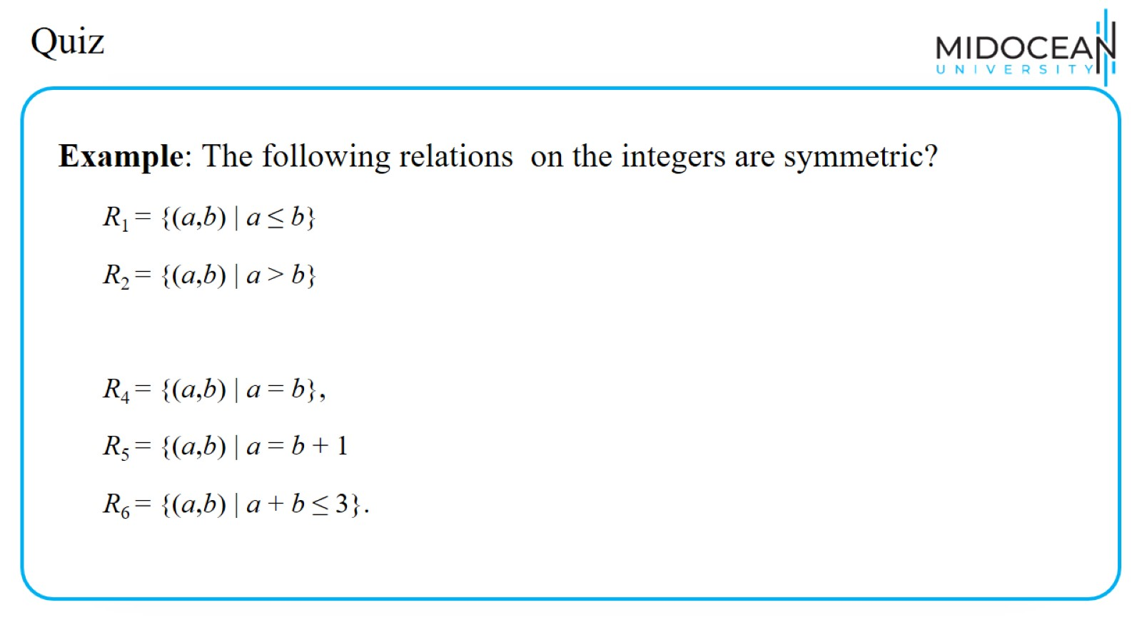
Quiz

Slide 23
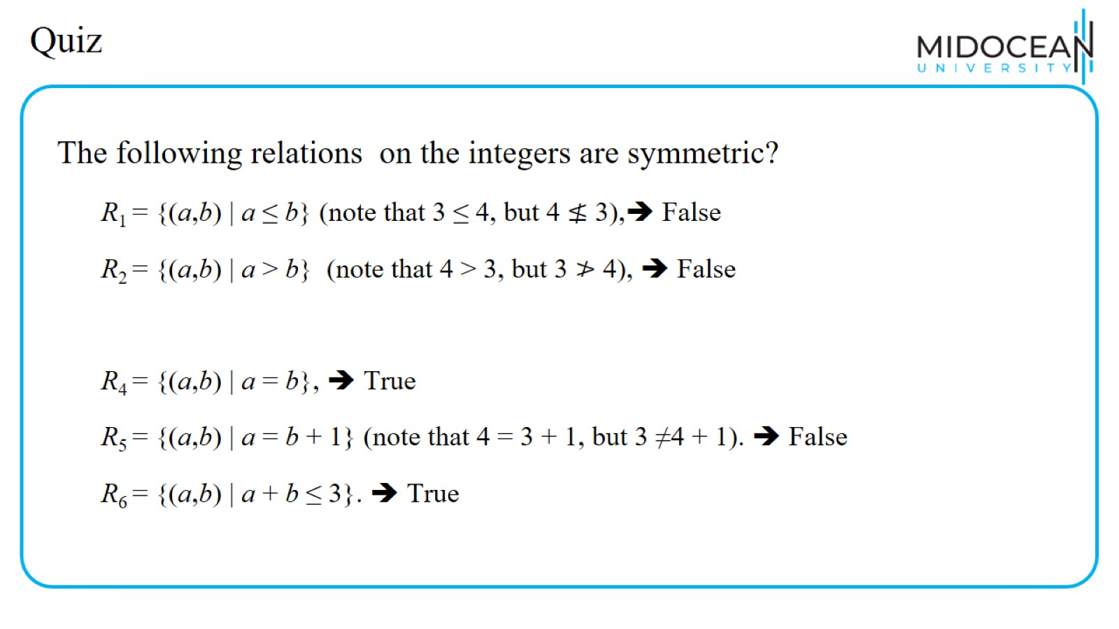
Quiz

Slide 24
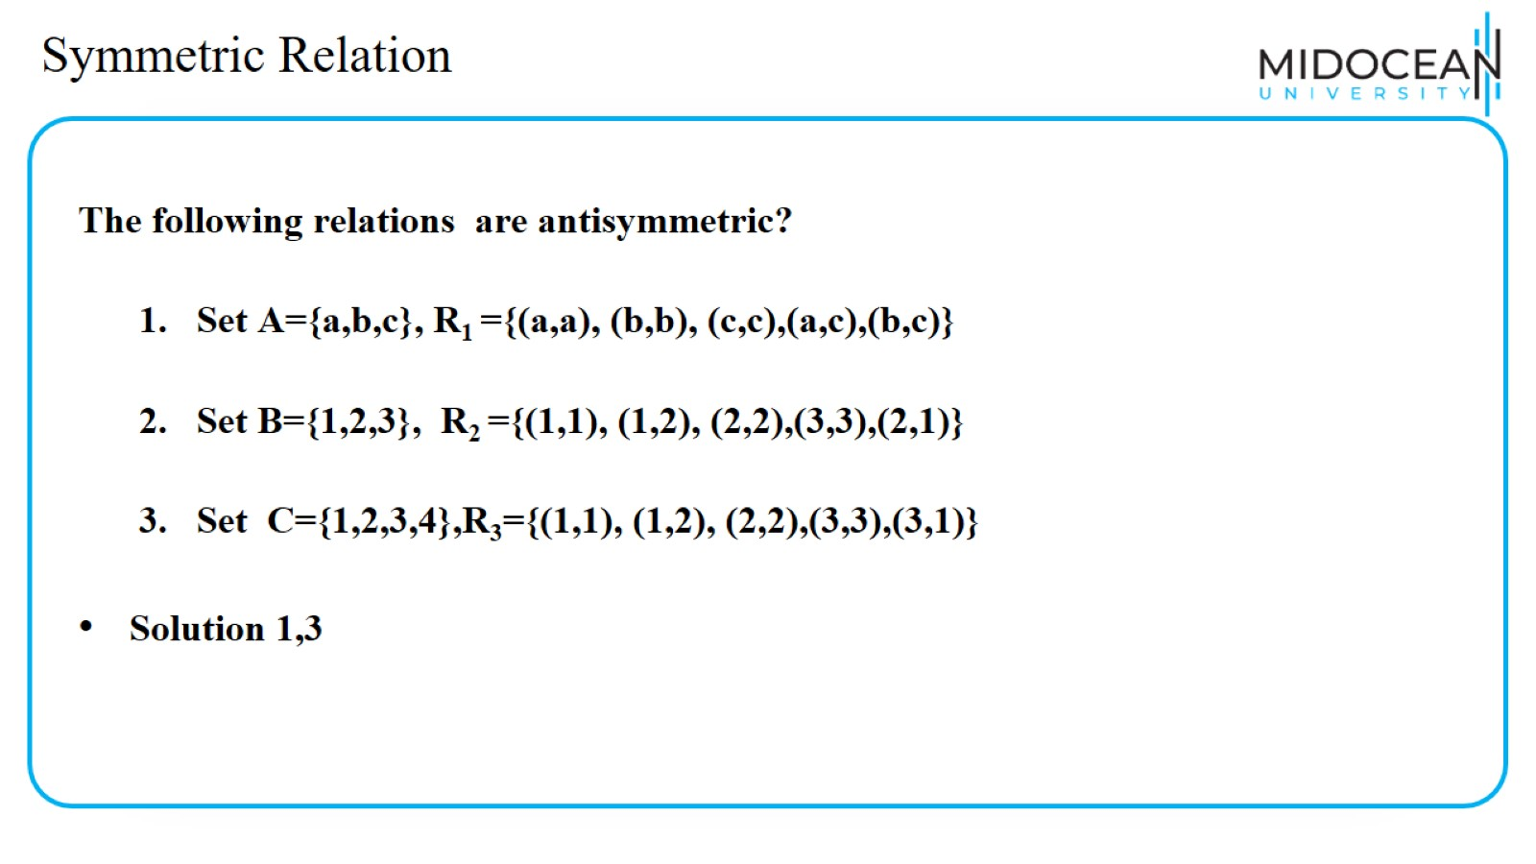
Symmetric Relation

Slide 25
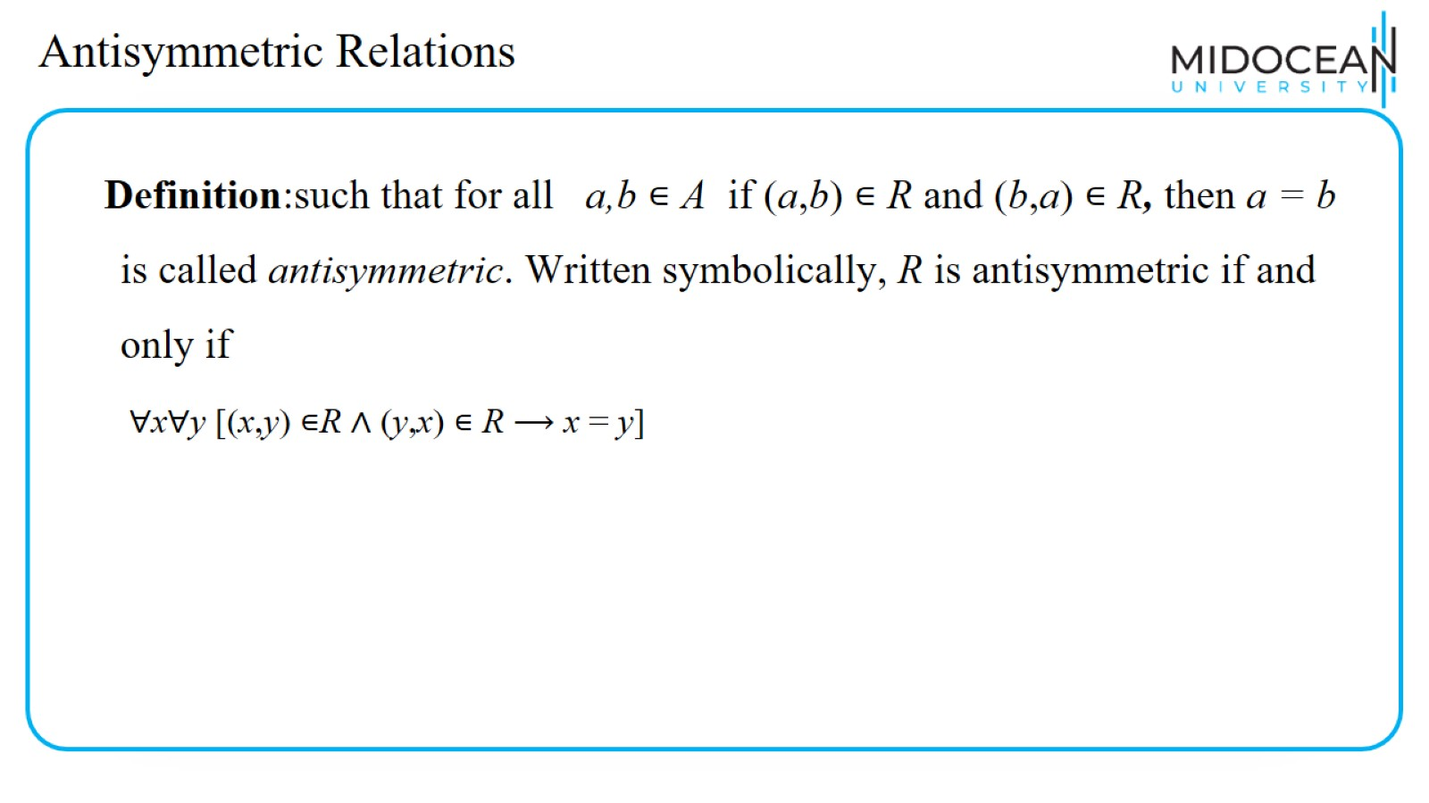
Antisymmetric Relations

Slide 26
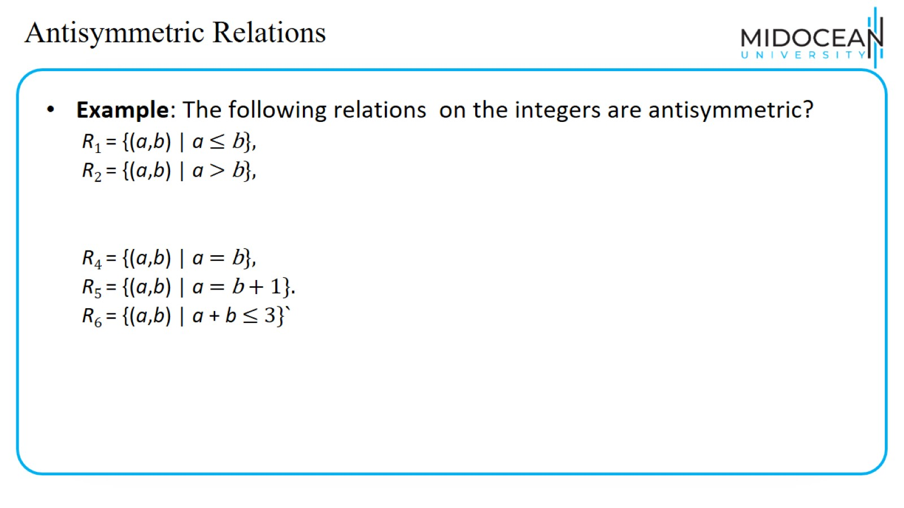
Antisymmetric Relations

Slide 27
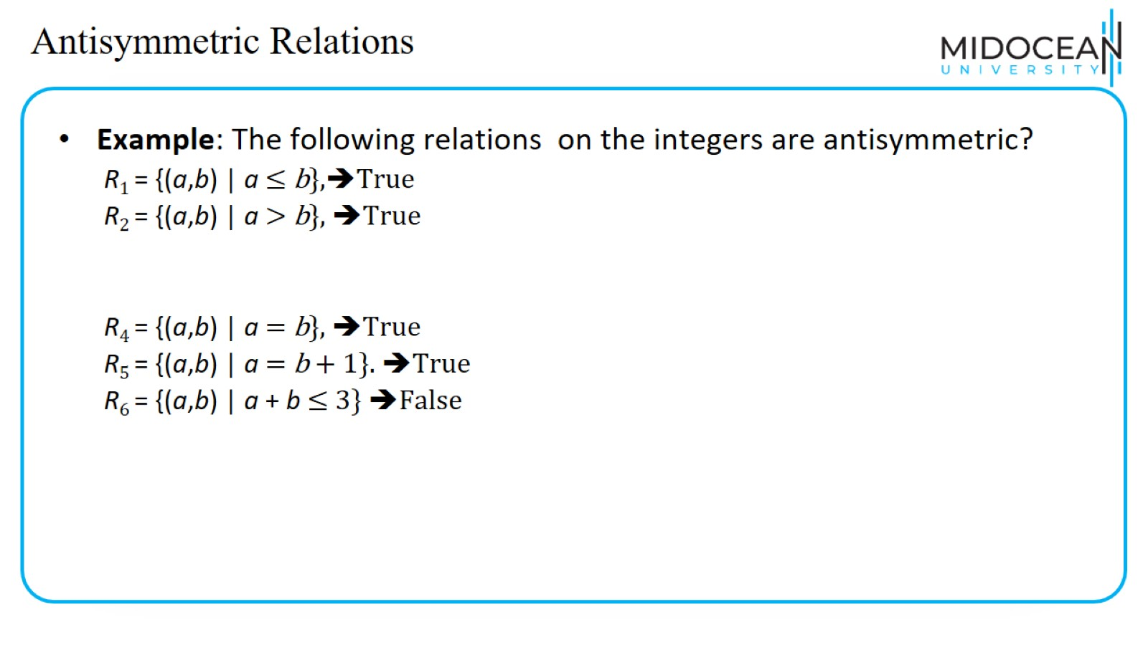
Antisymmetric Relations

Slide 28
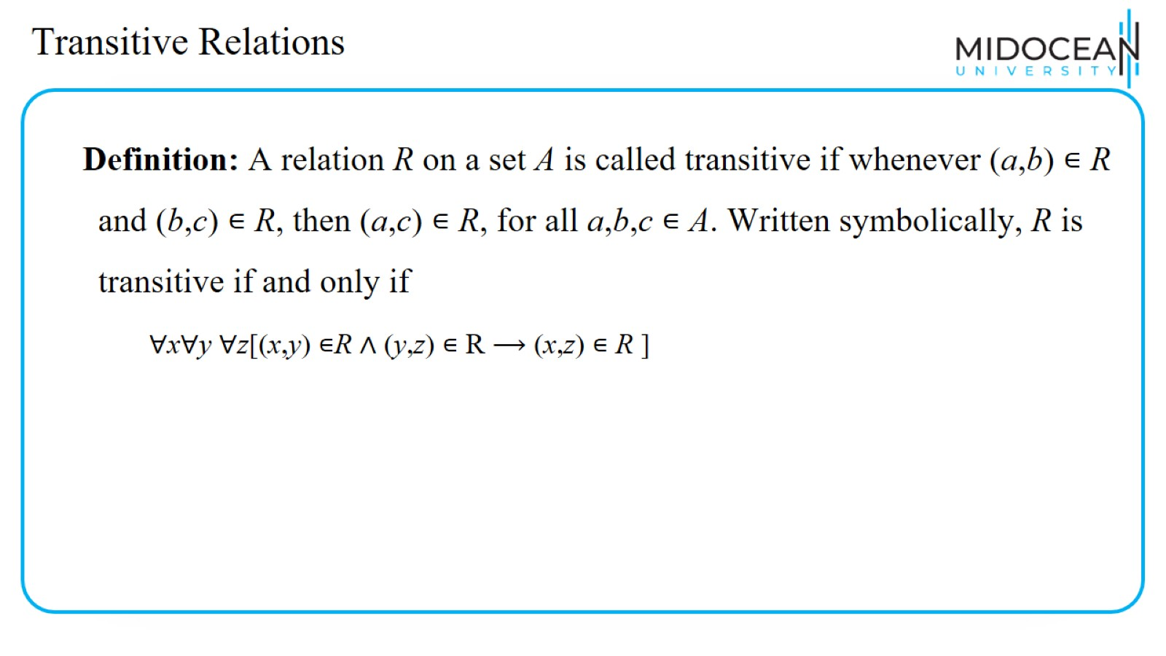
Transitive Relations

Slide 29
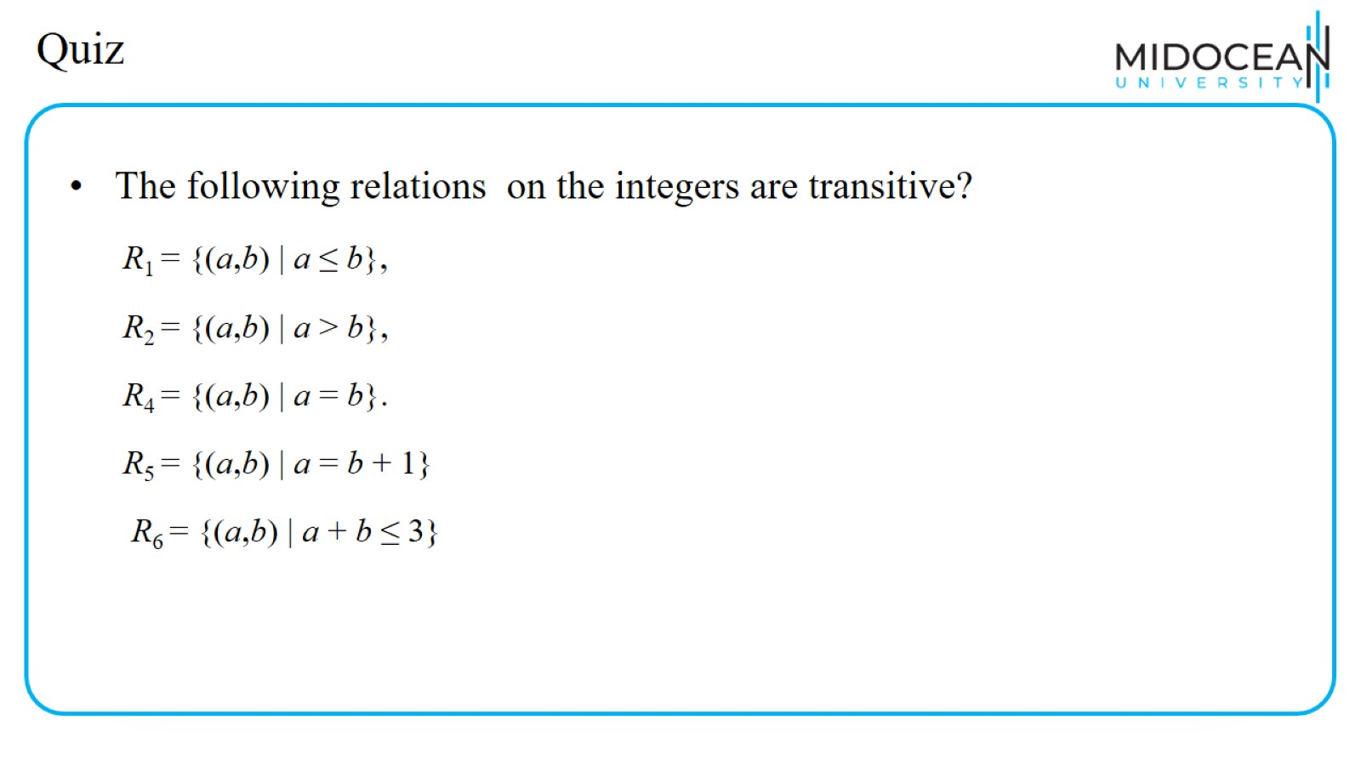
Quiz

Slide 30
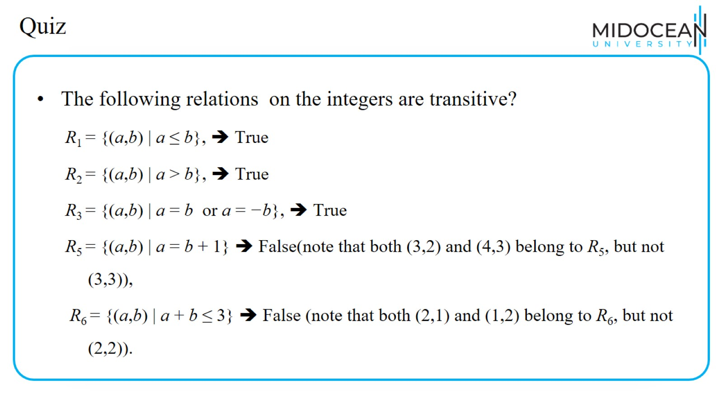
Quiz

Slide 31
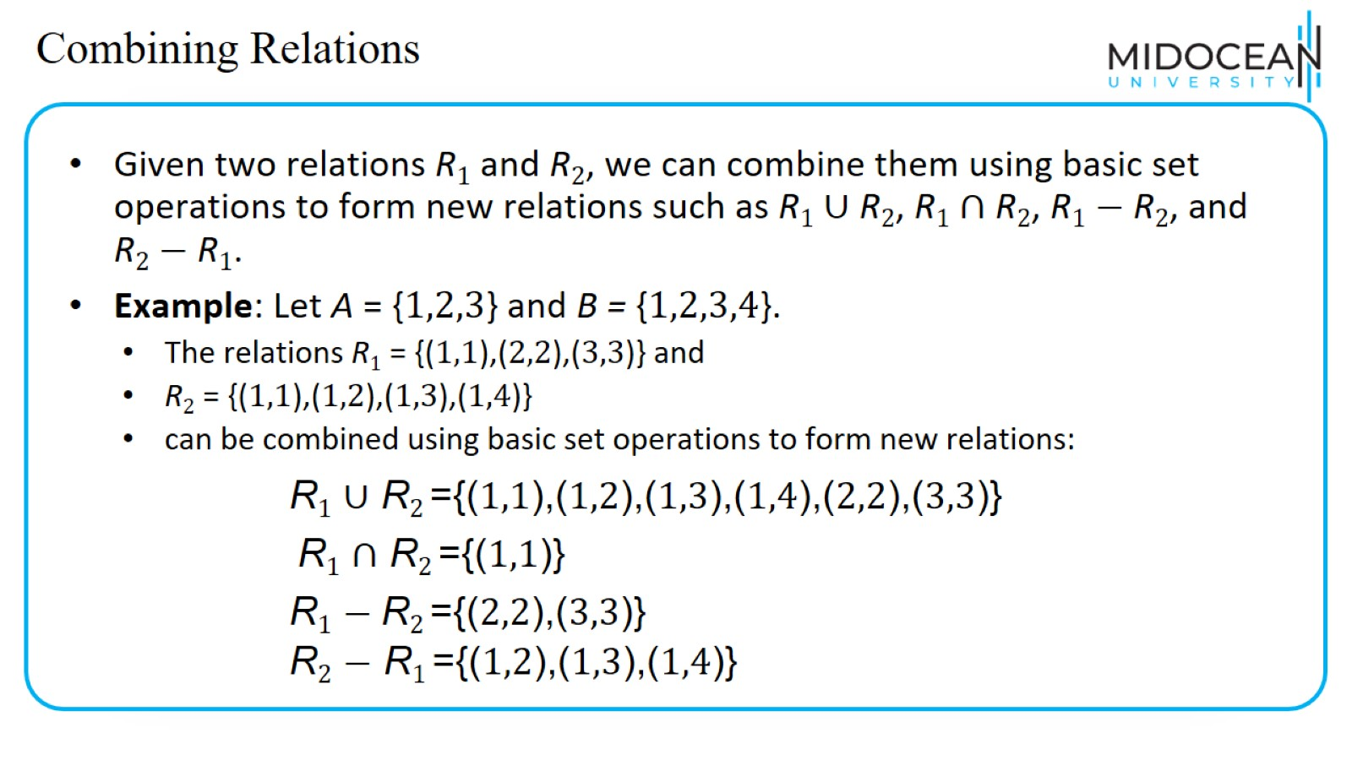
Combining Relations

Slide 32
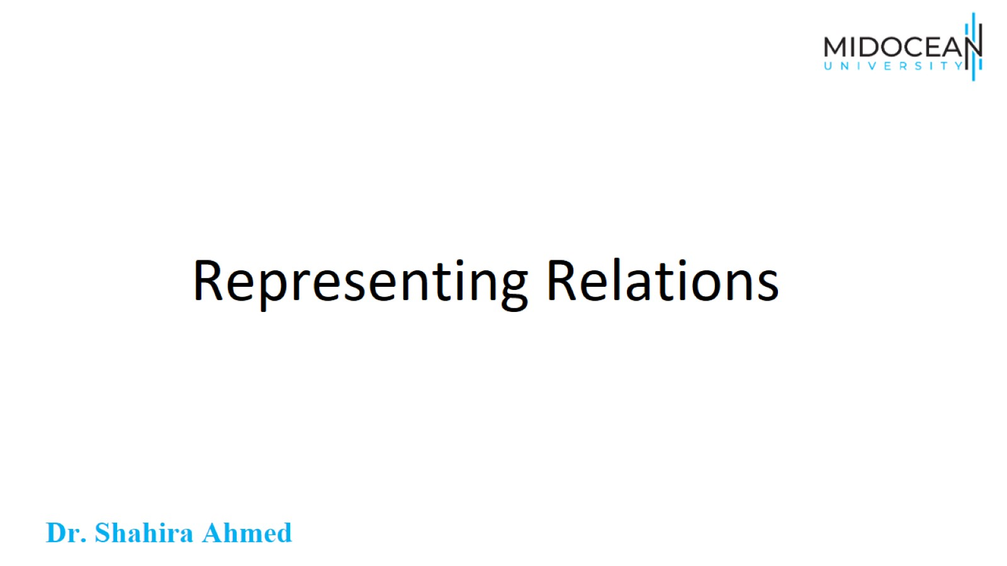
Representing Relations

Slide 33
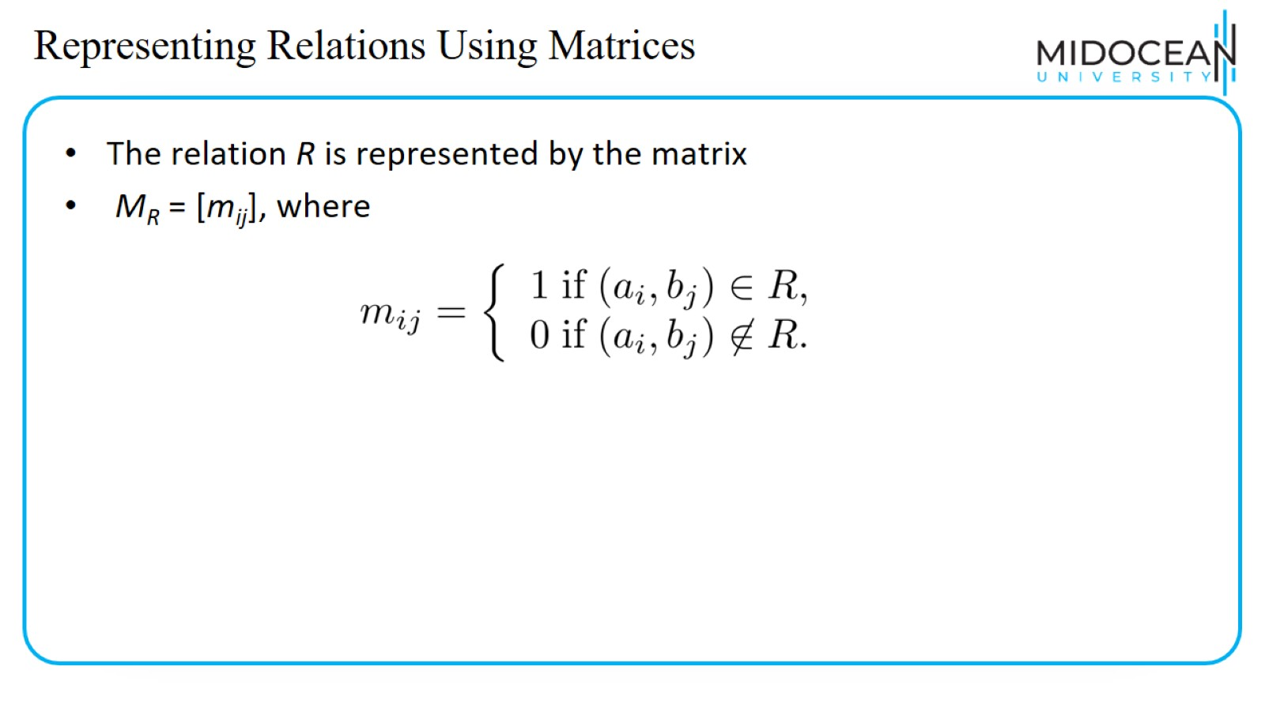
Representing Relations Using Matrices

Slide 34
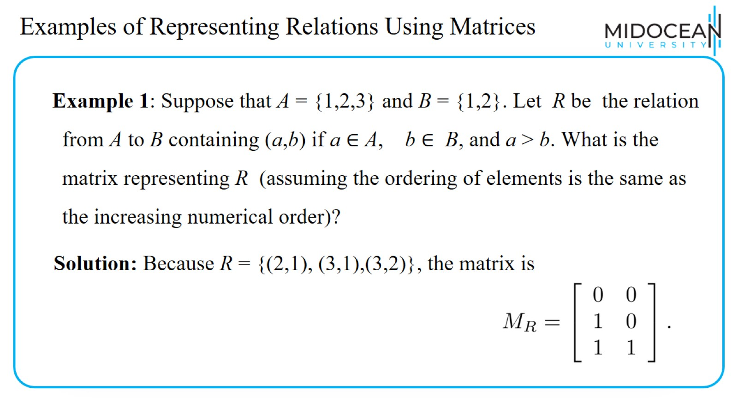
Examples of Representing Relations Using Matrices

Slide 35
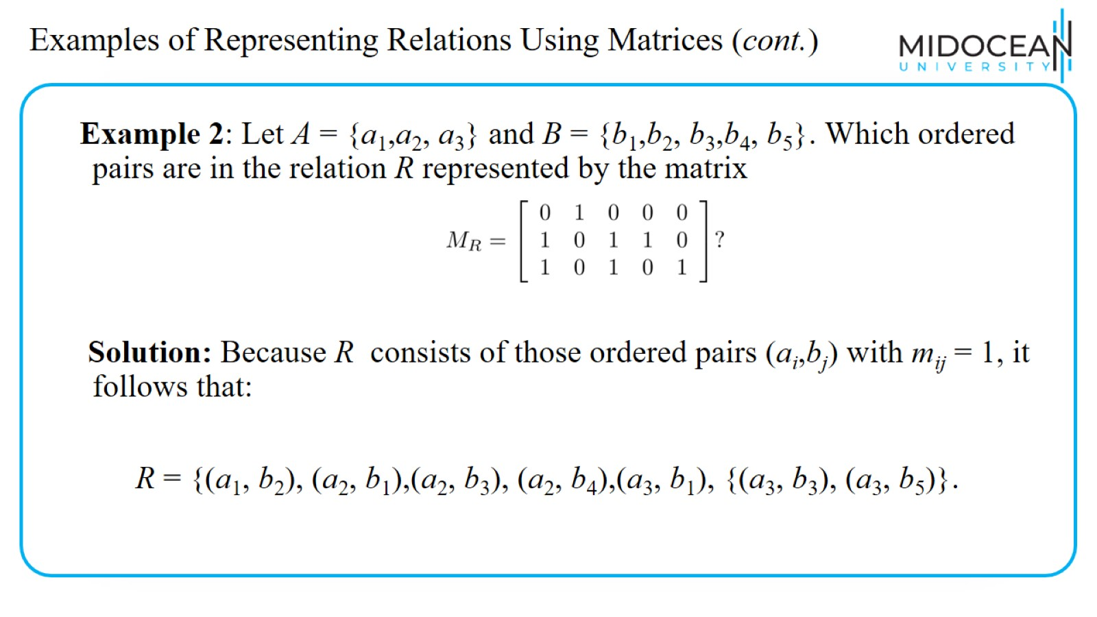
Examples of Representing Relations Using Matrices (cont.)

Slide 36
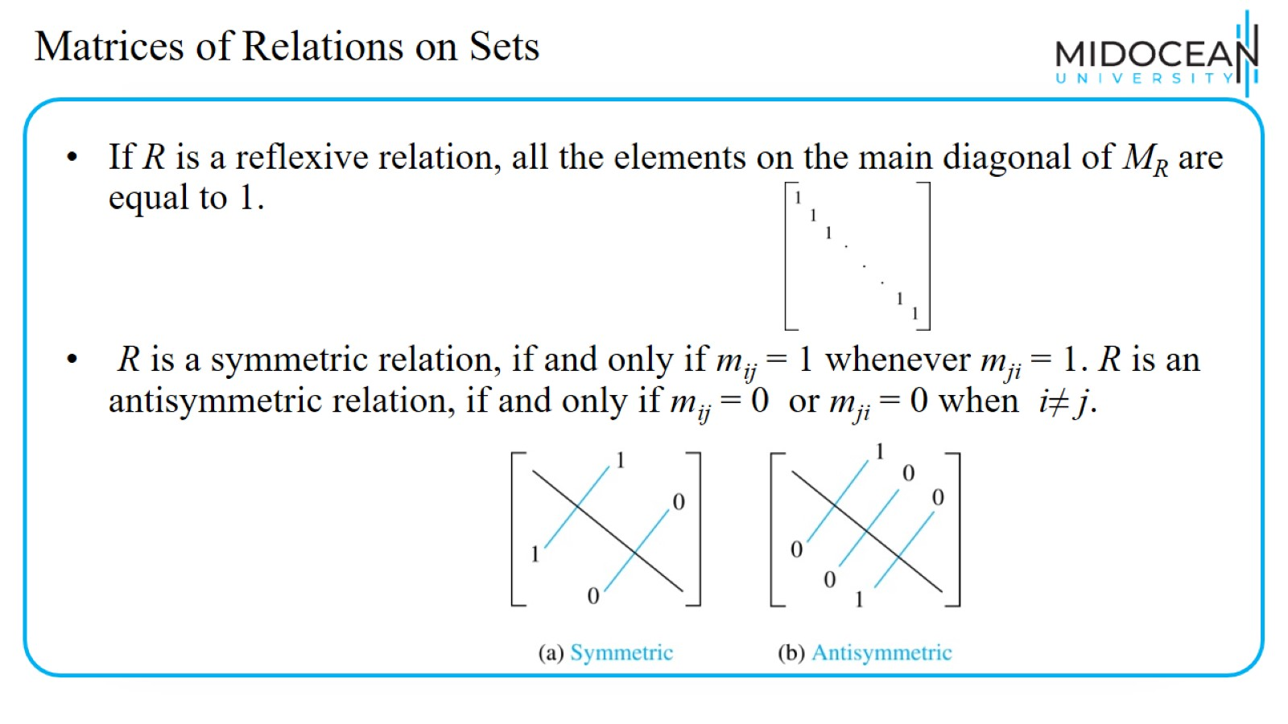
Matrices of Relations on Sets

Slide 37
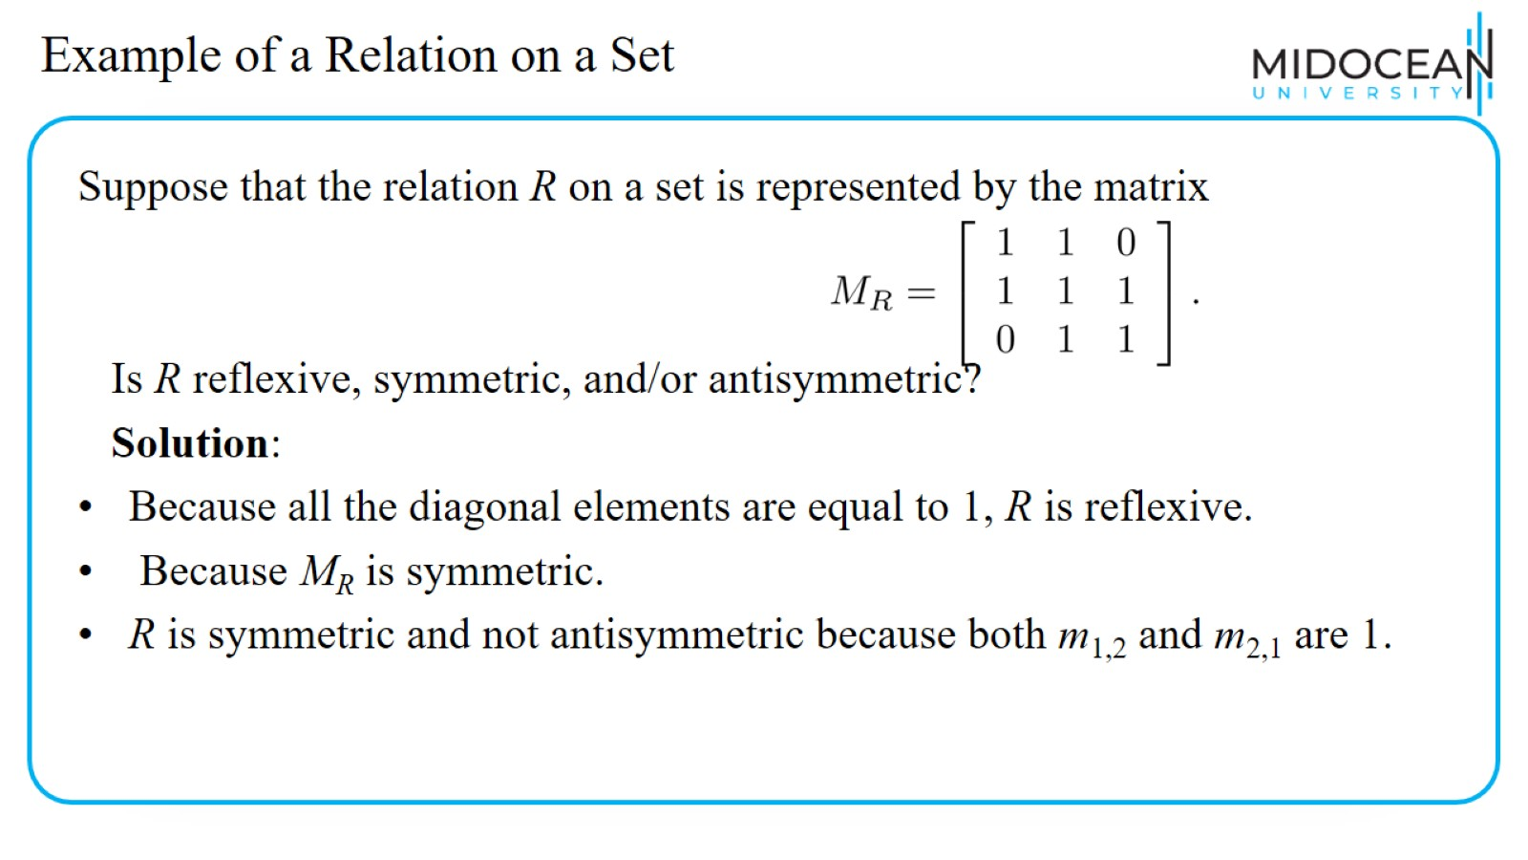
Example of a Relation on a Set

Slide 38
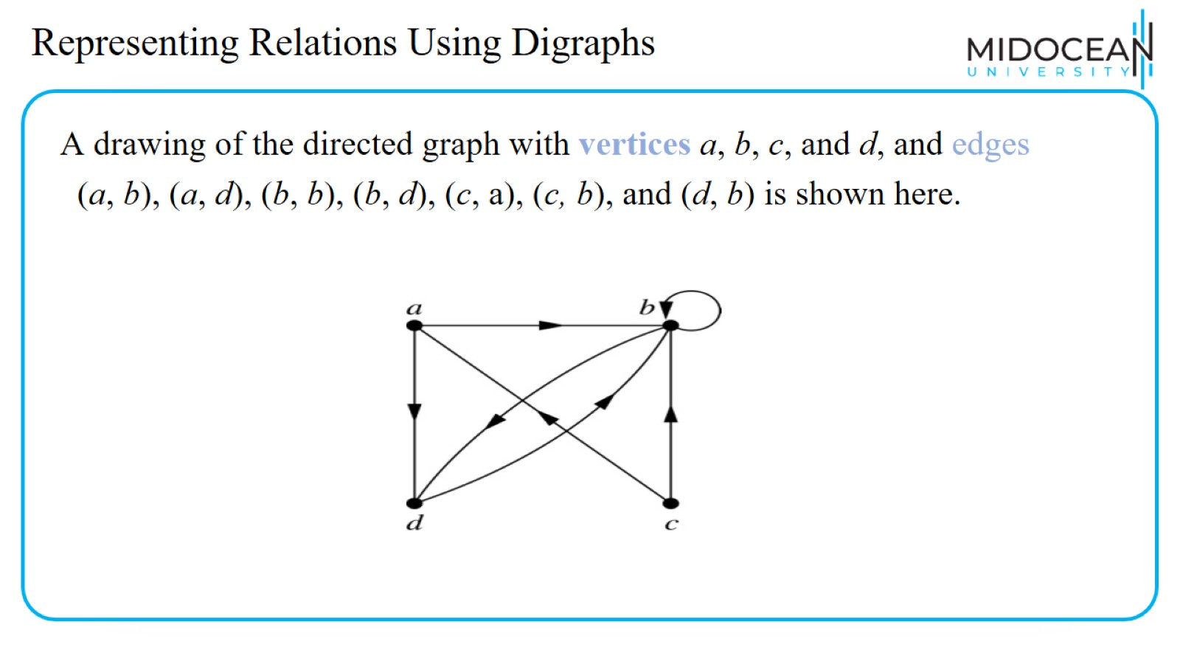
Representing Relations Using Digraphs

Slide 39
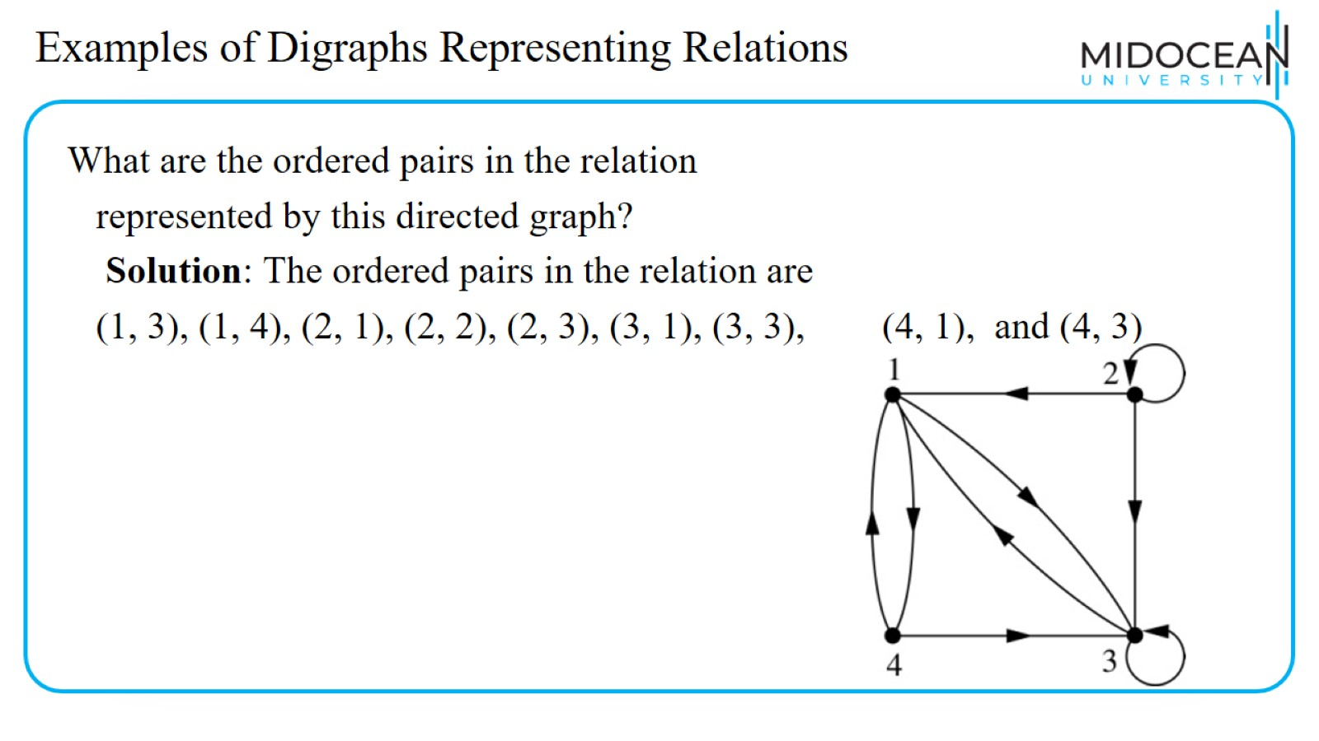
Examples of Digraphs Representing Relations

Slide 40
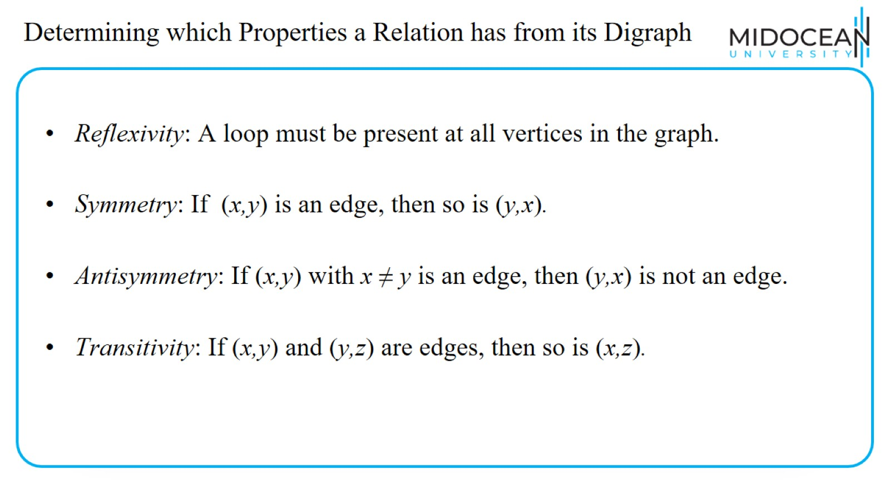
Determining which Properties a Relation has from its Digraph

Slide 41
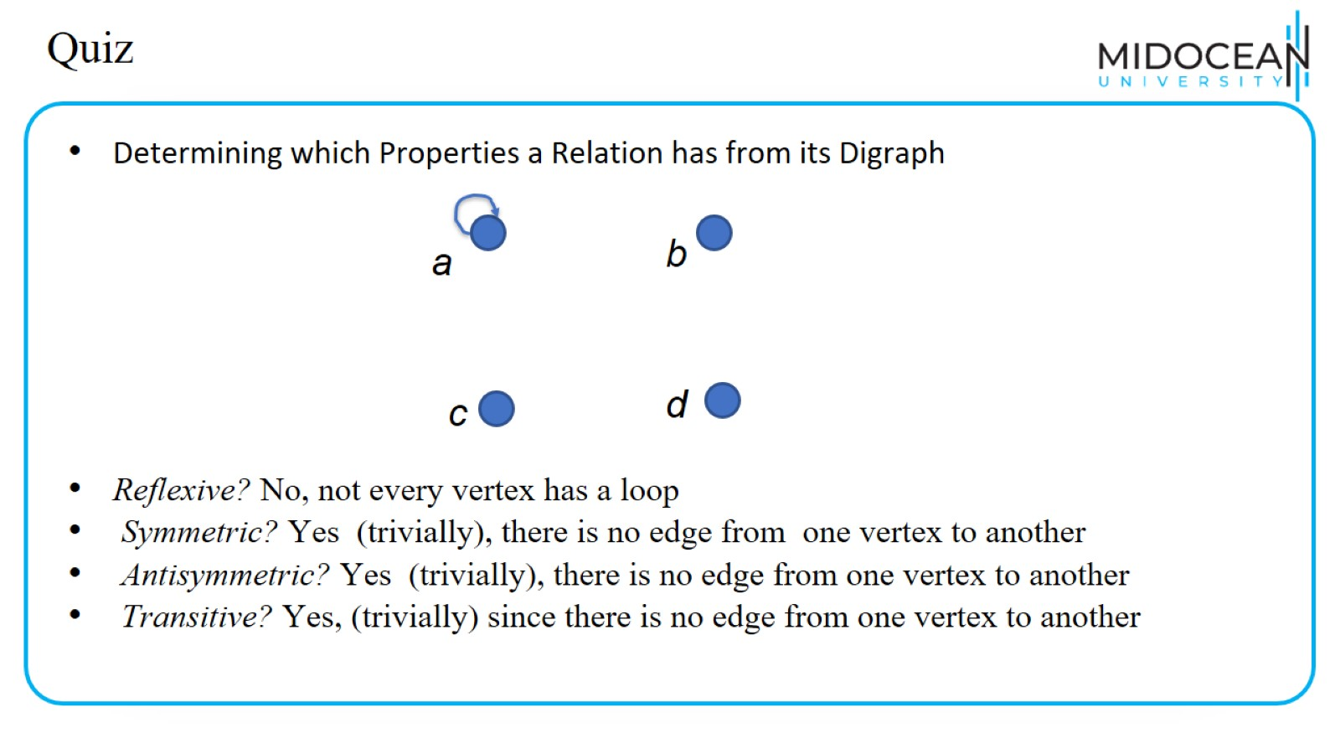
Quiz

Slide 42
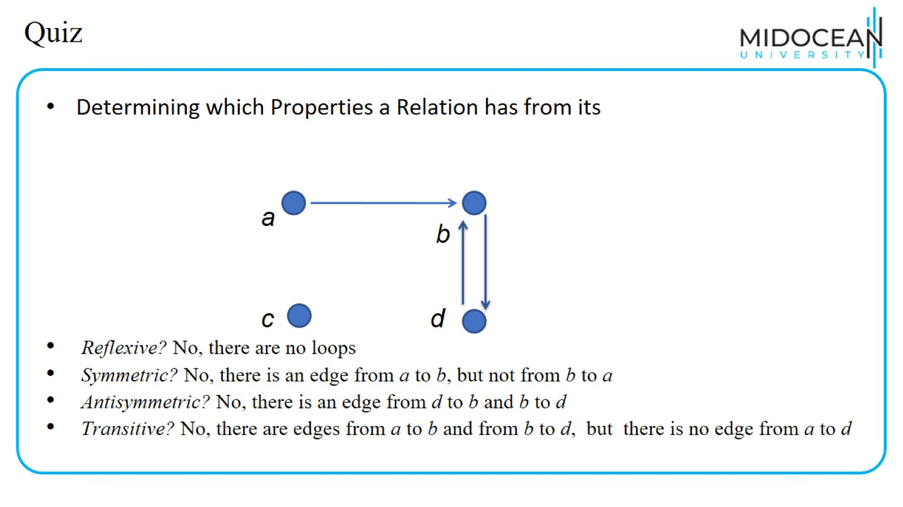
Quiz

Slide 43
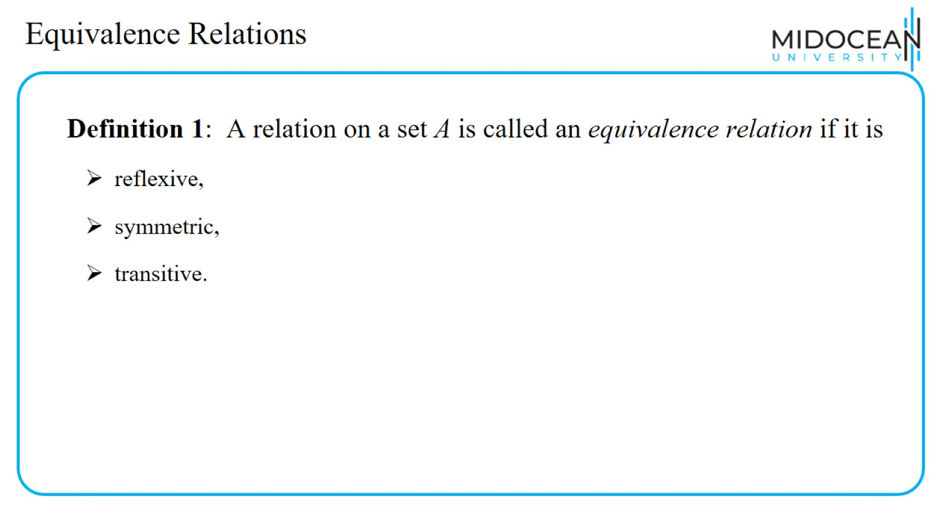
Equivalence Relations

Slide 44
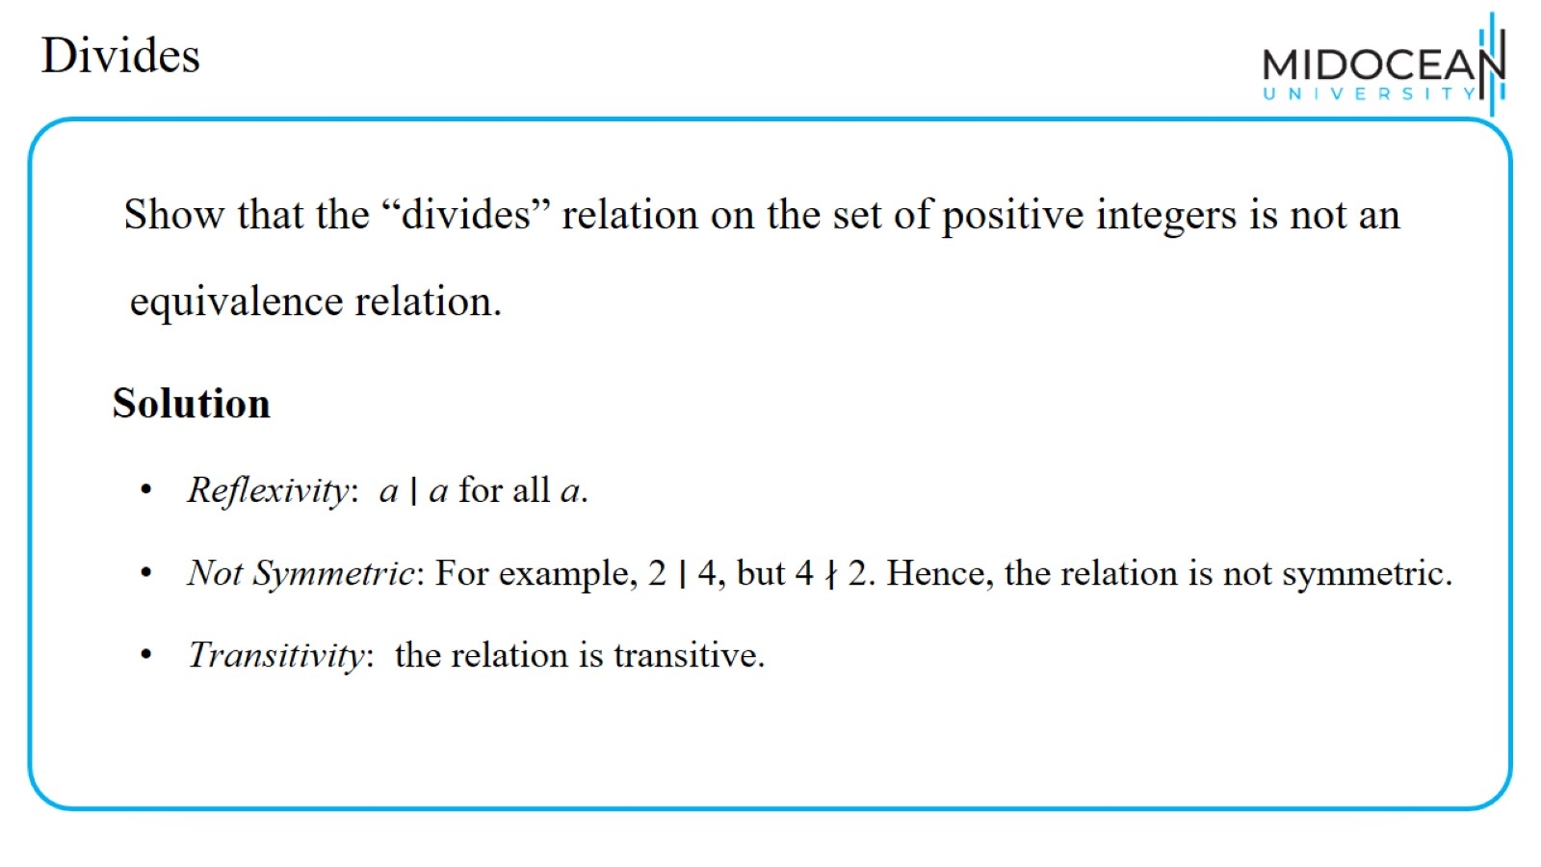
Divides

Slide 45
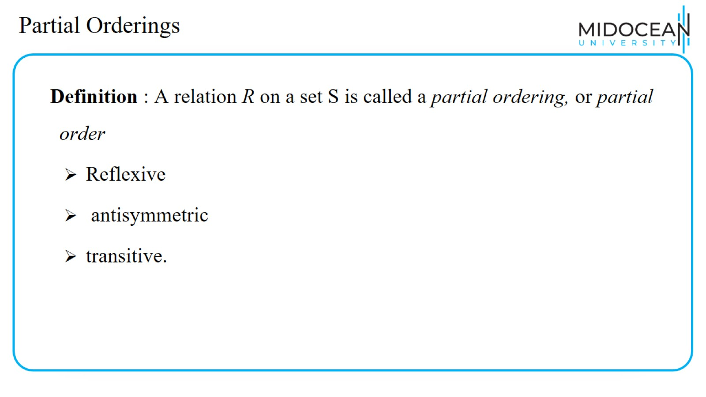
Partial Orderings

Slide 46
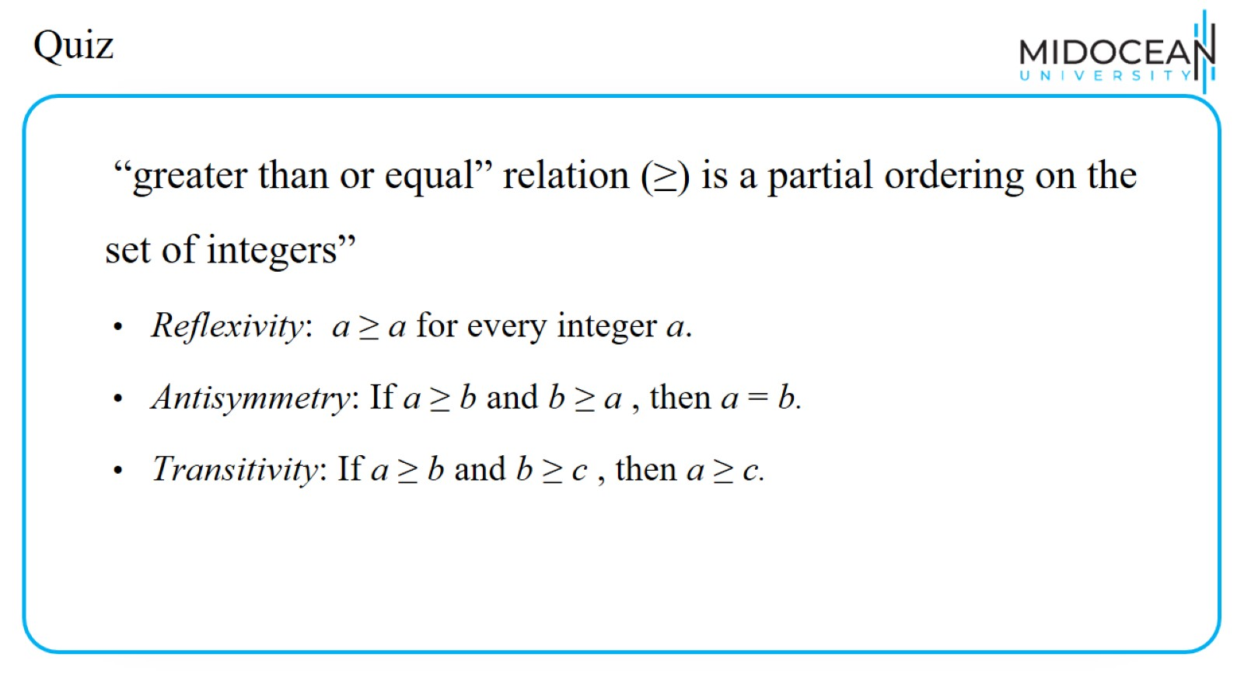
Quiz

Slide 47
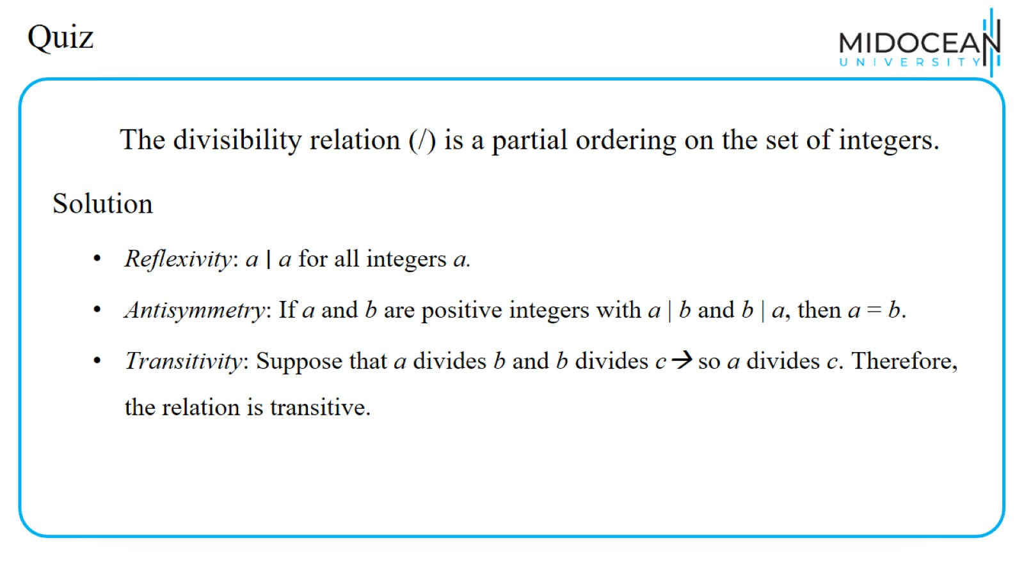
Quiz

Slide 48
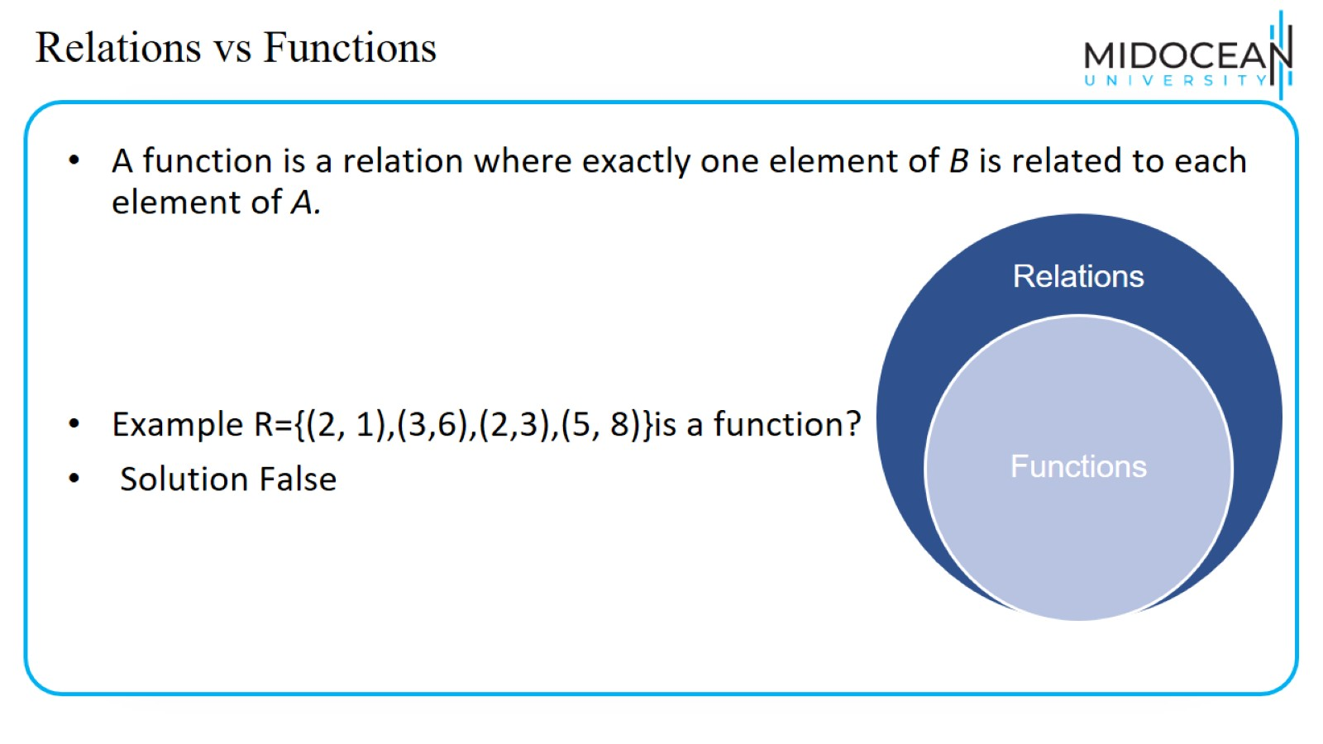
Relations vs Functions

Slide 49
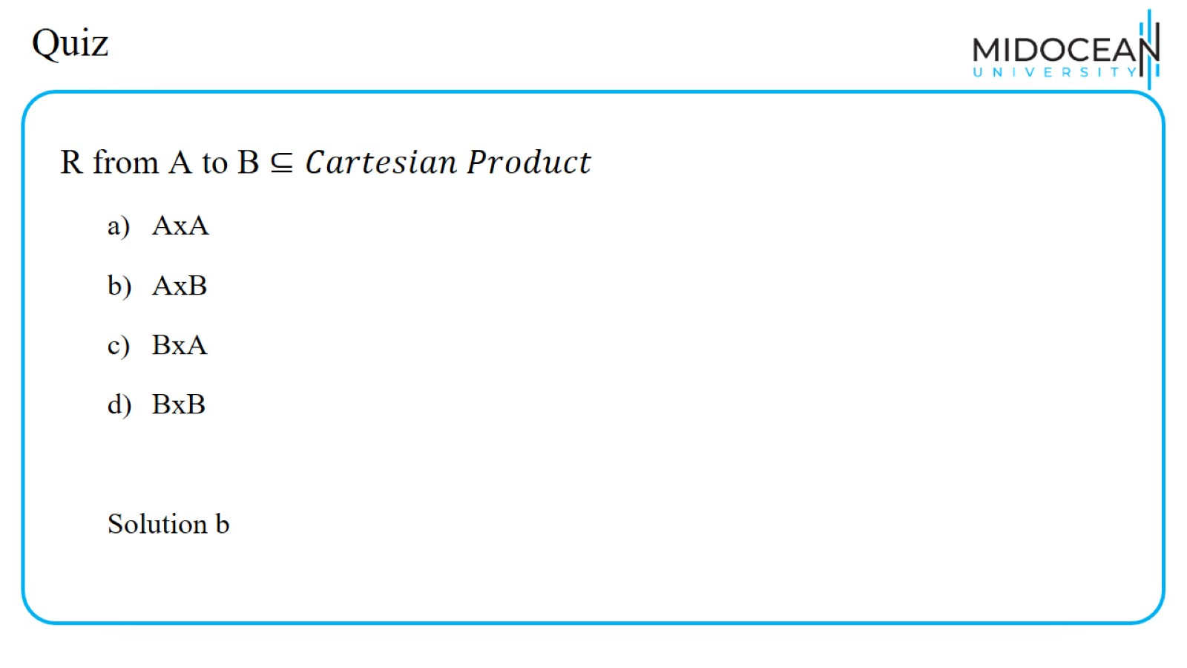
Quiz

Slide 50
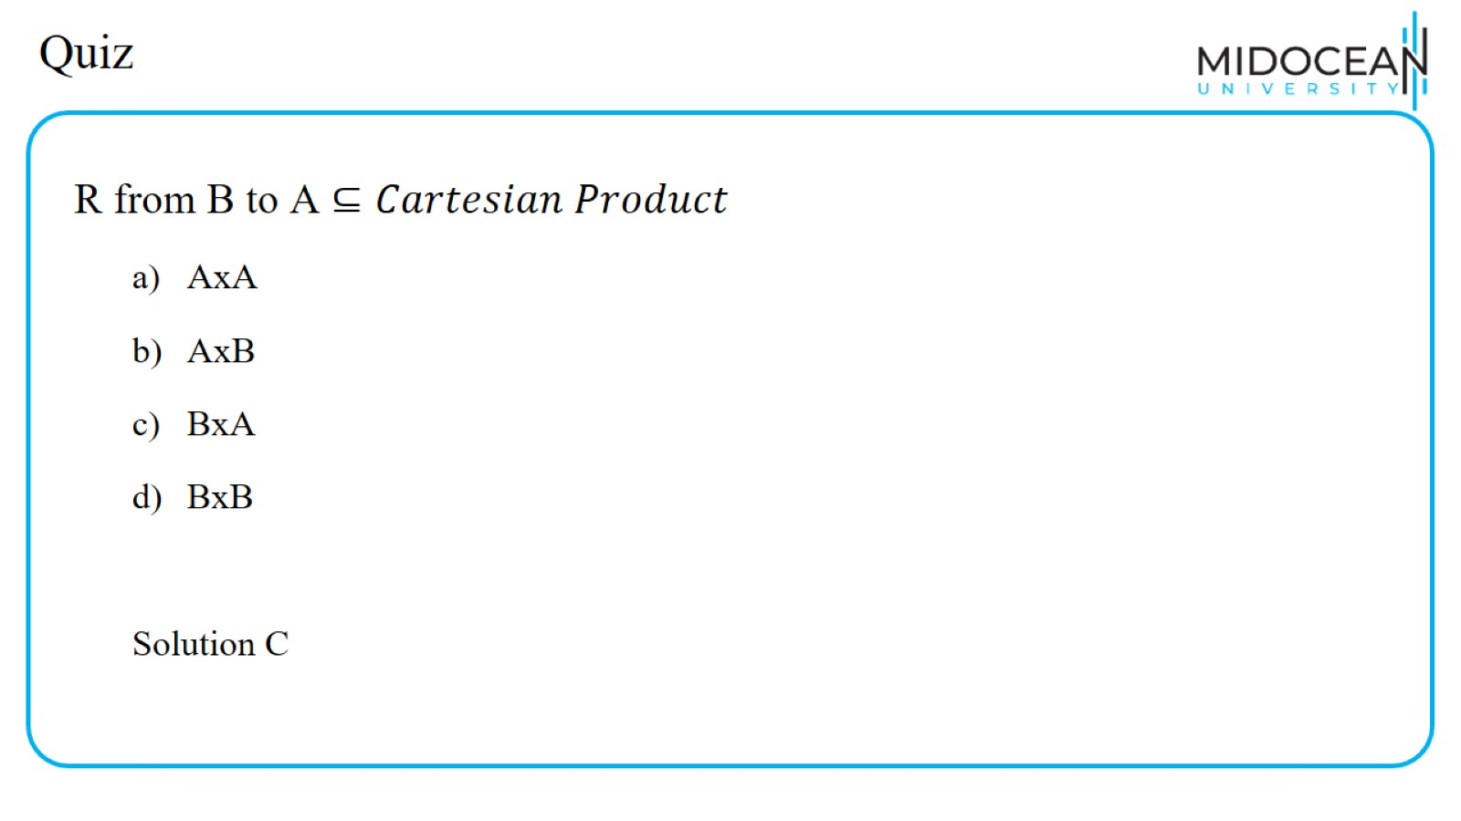
Quiz

Slide 51
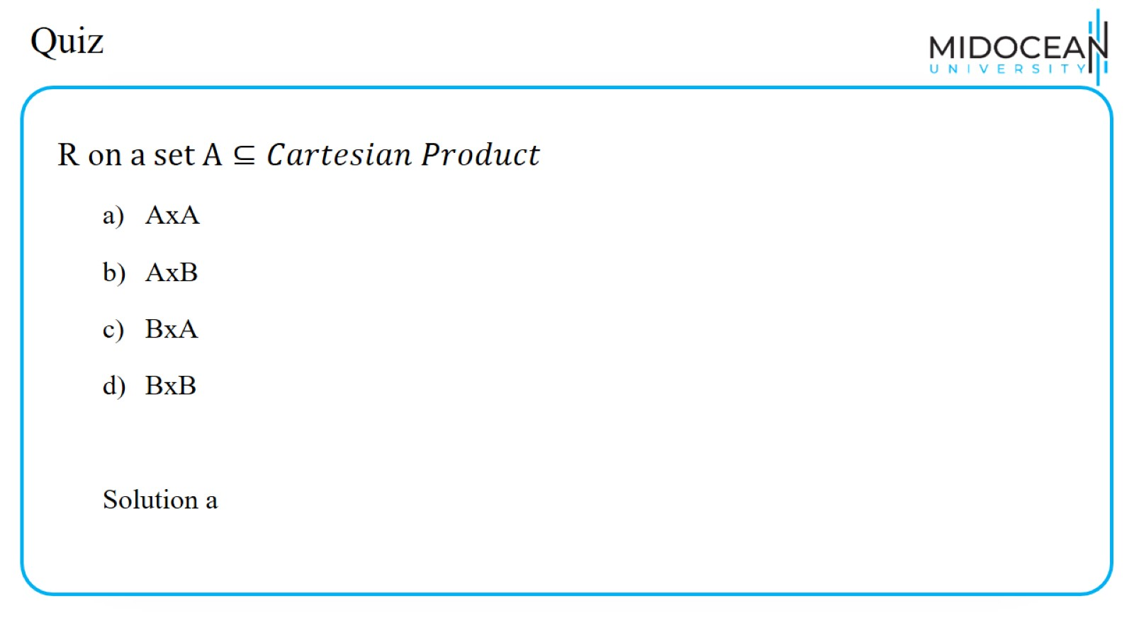
Quiz

Slide 52
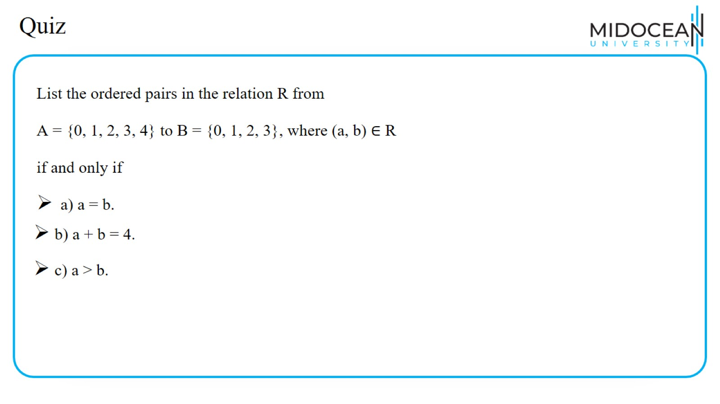
Quiz

Slide 53

Quiz

Slide 54

Quiz

Slide 55

Quiz

Slide 56

Quiz

Slide 57
Quiz

Slide 58
Quiz

Slide 59
Quiz

Slide 60

Quiz

Slide 61

Quiz

Slide 62

Quiz

Slide 63

Quiz

Slide 64

Quiz

Slide 65

Quiz

Slide 66

Quiz

Slide 67

Quiz

Slide 68

Quiz

Slide 69

Quiz

Slide 70

Quiz

Slide 71

Quiz

Slide 72

Quiz

Slide 73

Summary

Slide 74


