Slide 1


Project Time Management
Prepared by Dr. Amira Elfekky
PMG 212
Lecture 6

Slide 2

Agenda
Purpose of a Performance Measurement Baseline
Components of the Performance Baseline
Components and Assembly of the Performance Baseline
Scope
Contract Terms and Conditions (CTC)
Project Execution Plan (PEP)
Schedule
Work Breakdown Structure
Work Breakdown Structure Benefits
Organizational Breakdown Structure
WBS/OBS Diagram
Ownership
The Concept of Rolling Wave Planning
www.midocean.ae

Slide 3
Agenda
Purpose of a Performance Measurement Baseline
Components of the Performance Baseline
Components and Assembly of the Performance Baseline
Scope
Contract Terms and Conditions (CTC)
Project Execution Plan (PEP)
Schedule
Work Breakdown Structure
Work Breakdown Structure Benefits
Organizational Breakdown Structure
WBS/OBS Diagram
Ownership
The Concept of Rolling Wave Planning
www.midocean.ae

Slide 4
Chapter
Purpose of a Performance Measurement Baseline
06
Roadmap for project execution
Integration of project components
Basis for change management
Project communication
Basis for project status and metrics
www.midocean.ae

Slide 5
Agenda
Purpose of a Performance Measurement Baseline
Components of the Performance Baseline
Components and Assembly of the Performance Baseline
Scope
Contract Terms and Conditions (CTC)
Project Execution Plan (PEP)
Schedule
Work Breakdown Structure
Work Breakdown Structure Benefits
Organizational Breakdown Structure
WBS/OBS Diagram
Ownership
The Concept of Rolling Wave Planning
www.midocean.ae

Slide 6
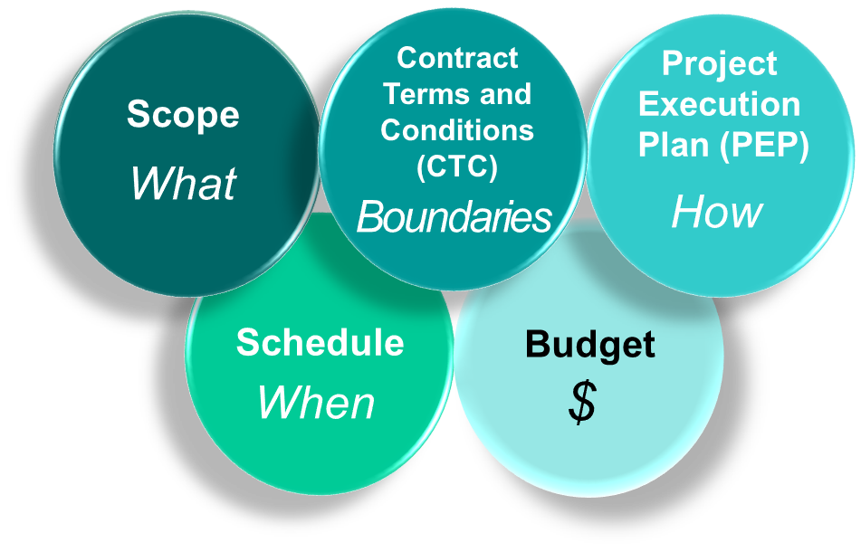
Components of the Performance
Baseline
Chapter
06
All five components interact and must be combined in baselining.
Project team members must be made aware of the components within their area of responsibility.
www.midocean.ae

Slide 7
Agenda
Purpose of a Performance Measurement Baseline
Components of the Performance Baseline
Components and Assembly of the Performance Baseline
Scope
Contract Terms and Conditions (CTC)
Project Execution Plan (PEP)
Schedule
Work Breakdown Structure
Work Breakdown Structure Benefits
Organizational Breakdown Structure
WBS/OBS Diagram
Ownership
The Concept of Rolling Wave Planning
www.midocean.ae

Slide 8
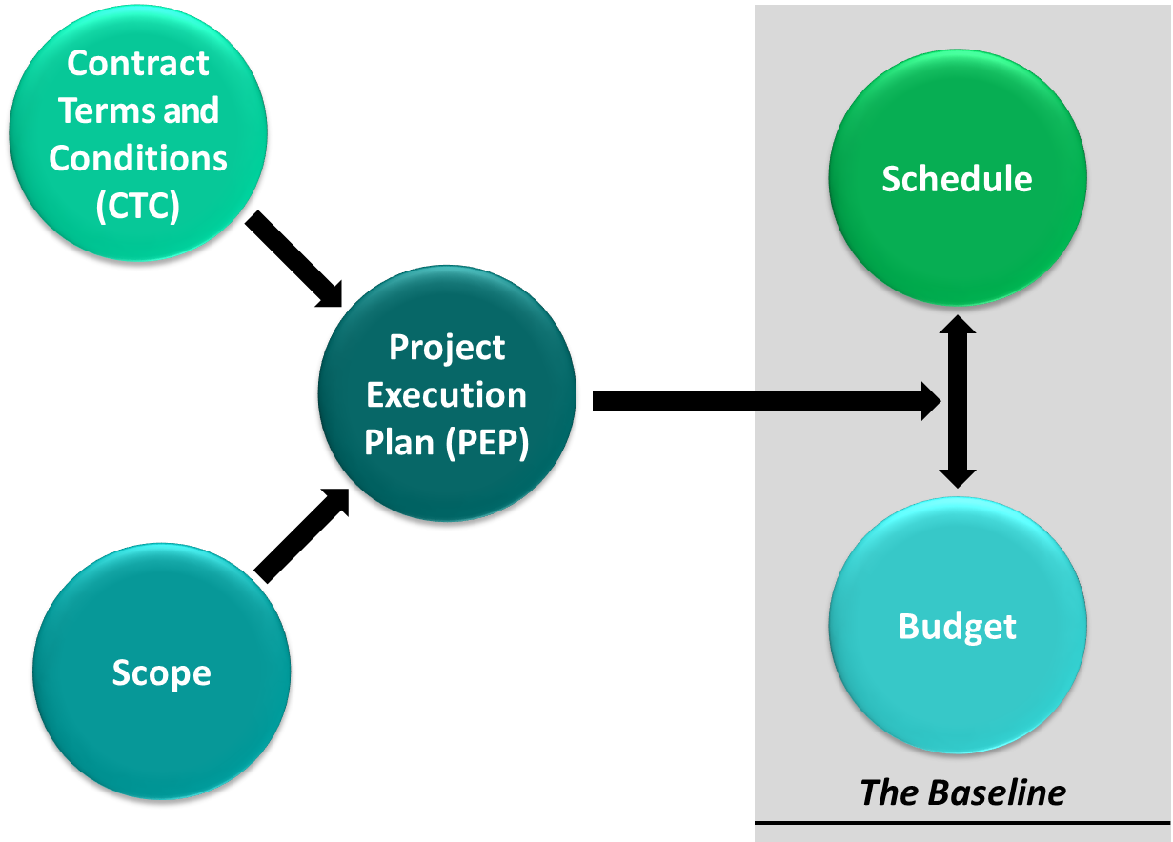
Components and Assembly of the Performance Baseline
Chapter
06
www.midocean.ae

Slide 9
Agenda
Purpose of a Performance Measurement Baseline
Components of the Performance Baseline
Components and Assembly of the Performance Baseline
Scope
Contract Terms and Conditions (CTC)
Project Execution Plan (PEP)
Schedule
Work Breakdown Structure
Work Breakdown Structure Benefits
Organizational Breakdown Structure
WBS/OBS Diagram
Ownership
The Concept of Rolling Wave Planning
www.midocean.ae

Slide 10

Chapter
06
Scope
Defines the work the contractor or supplier is required to complete
  Statement of Work
  Scope determines the cost and schedule
  Creation of Work breakdown structure
www.midocean.ae

Slide 11
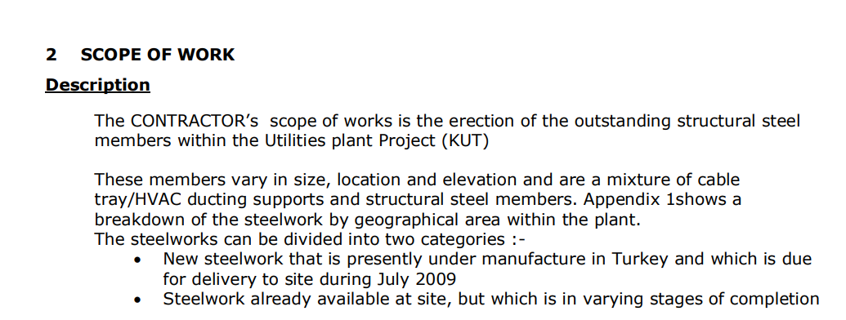
Chapter
Scope – Case study -1
06
www.midocean.ae

Slide 12
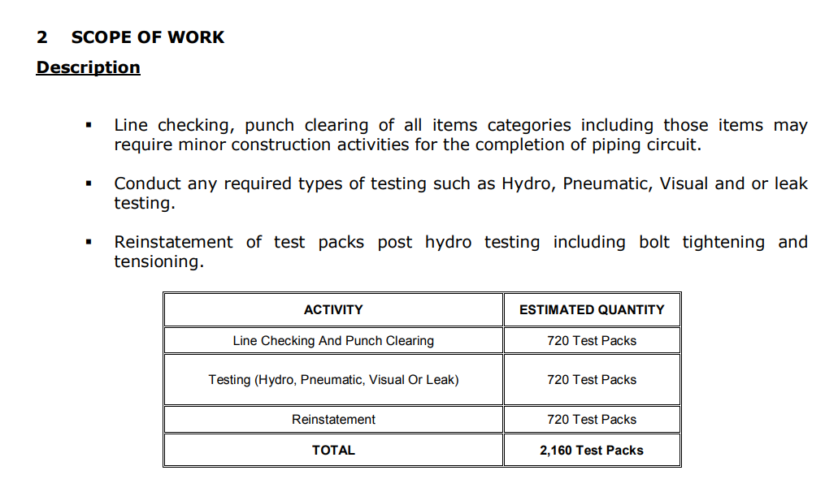
Chapter
06
Scope – Case study - 2
www.midocean.ae

Slide 13
Agenda
Purpose of a Performance Measurement Baseline
Components of the Performance Baseline
Components and Assembly of the Performance Baseline
Scope
Contract Terms and Conditions (CTC)
Project Execution Plan (PEP)
Schedule
Work Breakdown Structure
Work Breakdown Structure Benefits
Organizational Breakdown Structure
WBS/OBS Diagram
Ownership
The Concept of Rolling Wave Planning
www.midocean.ae

Slide 14
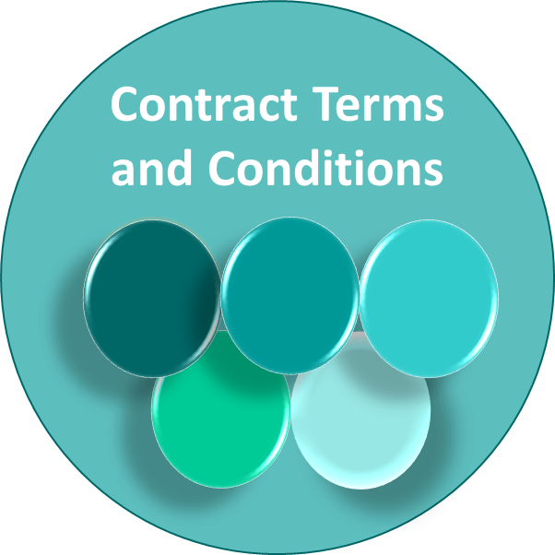
Chapter
Contract Terms and Conditions (CTC)
06
Contract terms and conditions address:
  Rights and obligations
  Contract form and function
  Risk allocation
  Contract management process, including dispute resolution
www.midocean.ae

Slide 15
Contract Terms and Conditions (CTC)
Chapter
06
Contract terms and conditions address:
  Payment terms
  Quality requirements
  Acceptance and testing requirements
  Reporting requirements
www.midocean.ae

Slide 16
Agenda
Purpose of a Performance Measurement Baseline
Components of the Performance Baseline
Components and Assembly of the Performance Baseline
Scope
Contract Terms and Conditions (CTC)
Project Execution Plan (PEP)
Schedule
Work Breakdown Structure
Work Breakdown Structure Benefits
Organizational Breakdown Structure
WBS/OBS Diagram
Ownership
The Concept of Rolling Wave Planning
www.midocean.ae

Slide 17
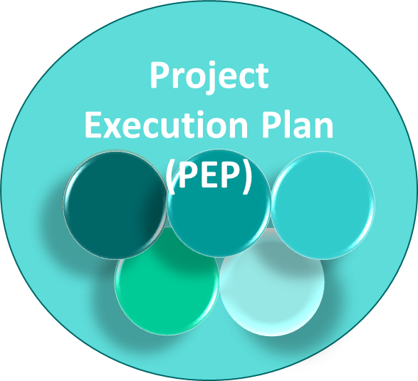
Project Execution Plan (PEP)
Chapter
06
Defines the execution approach
  Identifies how engineering will be carried out
  Identifies how equipment and materials will be acquired
  Identifies how construction will be completed
www.midocean.ae

Slide 18
Chapter
Project Execution Plan (PEP)
06
Defines the execution approach
  Identifies what all functions (E, P, C, PC, Contracts, Startup, and others) will do in delivering the project and how they will do it
  Describes how handoffs, interfaces, and integration between functions will work
www.midocean.ae

Slide 19
Agenda
Purpose of a Performance Measurement Baseline
Components of the Performance Baseline
Components and Assembly of the Performance Baseline
Scope
Contract Terms and Conditions (CTC)
Project Execution Plan (PEP)
Schedule
Work Breakdown Structure
Work Breakdown Structure Benefits
Organizational Breakdown Structure
WBS/OBS Diagram
Ownership
The Concept of Rolling Wave Planning
www.midocean.ae

Slide 20

Schedule
Chapter
06
Management Schedule (Level I) includes:
  Major milestones
  Long lead items
Control Schedule (Level III)
  Part of the contract
  The CS is a package containing:
    Major milestones
    Engineering Work Packages (EWP)
    Procurement and Long lead items
www.midocean.ae

Slide 21
Chapter
Schedule
06
Control Schedule (Level III)
  The CS is a package containing:
    Construction Work Packages
    Critical path activities
    Resources loaded schedule
    Progress curves
    Bulk commodity curves (concrete, structural steel, piping, wire & cable, etc.)
www.midocean.ae

Slide 22
Chapter
Schedule
06
Always provide the Basis of Schedule (assumptions, exclusions, allowances, etc.).
Level II Summary Schedules and Level IV Medium Term Schedules are used when needed.
www.midocean.ae

Slide 23
Agenda
Purpose of a Performance Measurement Baseline
Components of the Performance Baseline
Components and Assembly of the Performance Baseline
Scope
Contract Terms and Conditions (CTC)
Project Execution Plan (PEP)
Schedule
Work Breakdown Structure
Work Breakdown Structure Benefits
Organizational Breakdown Structure
WBS/OBS Diagram
Ownership
The Concept of Rolling Wave Planning
www.midocean.ae

Slide 24

Chapter
Work Breakdown Structure
06
The Work Breakdown Structure (WBS) is a hierarchical code structure representing the entire work scope of a project. The WBS:
  Integrates project data from Engineering, Procurement, Construction, and Startup.
www.midocean.ae

Slide 25
Chapter
Work Breakdown Structure
06
  Is used to separate project scope into manageable subsections, facilitate communication, and identify integration points for project plans.
  Provides a systematic approach to ensure key scope and activities are not omitted.
www.midocean.ae

Slide 26
Agenda
Purpose of a Performance Measurement Baseline
Components of the Performance Baseline
Components and Assembly of the Performance Baseline
Scope
Contract Terms and Conditions (CTC)
Project Execution Plan (PEP)
Schedule
Work Breakdown Structure
Work Breakdown Structure Benefits
Organizational Breakdown Structure
WBS/OBS Diagram
Ownership
The Concept of Rolling Wave Planning
www.midocean.ae

Slide 27
Chapter
Work Breakdown Structure Benefits
06
Facilitates systematic planning
Removes project complexity by allocating scope
Provides a framework for:
    Defining specific tasks
    Linking activities and resources
    Facilitating communication
    Allowing integration of project plans
www.midocean.ae

Slide 28
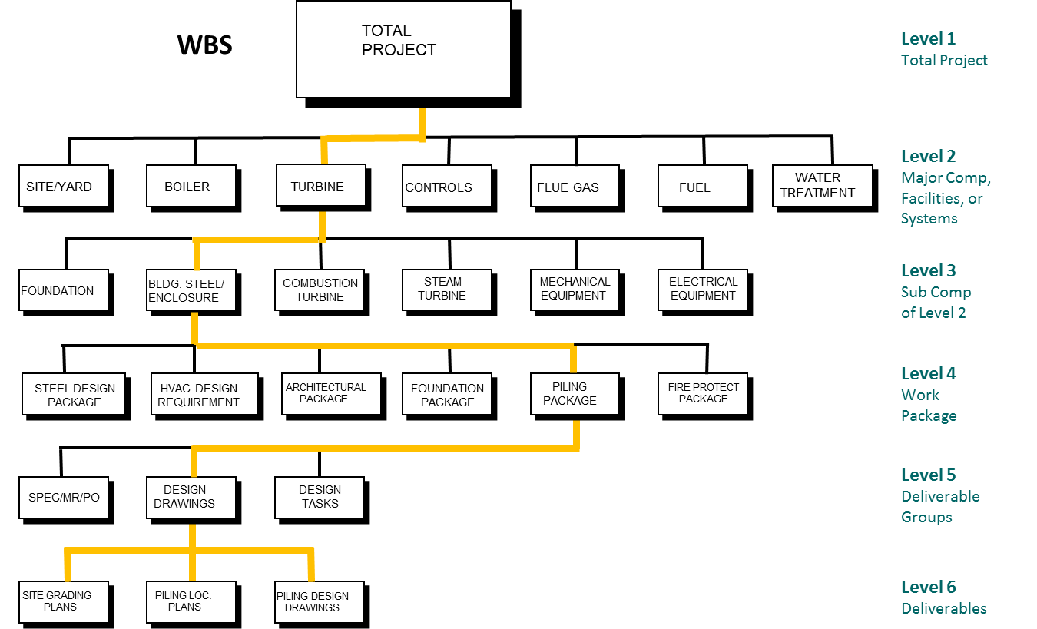
Chapter
Work Breakdown Structure Example
06
www.midocean.ae

Slide 29
Agenda
Purpose of a Performance Measurement Baseline
Components of the Performance Baseline
Components and Assembly of the Performance Baseline
Scope
Contract Terms and Conditions (CTC)
Project Execution Plan (PEP)
Schedule
Work Breakdown Structure
Work Breakdown Structure Benefits
Organizational Breakdown Structure
WBS/OBS Diagram
Ownership
The Concept of Rolling Wave Planning
www.midocean.ae

Slide 30

Chapter
Organizational Breakdown Structure
06
Takes the WBS and merges with the organization and individuals assigned to the project
Benefits:
      Enables clear assignment of scope to
      team members
      Facilitates ownership and accountability
      Assures all project elements are accounted for
www.midocean.ae

Slide 31
Agenda
Purpose of a Performance Measurement Baseline
Components of the Performance Baseline
Components and Assembly of the Performance Baseline
Scope
Contract Terms and Conditions (CTC)
Project Execution Plan (PEP)
Schedule
Work Breakdown Structure
Work Breakdown Structure Benefits
Organizational Breakdown Structure
WBS/OBS Diagram
Ownership
The Concept of Rolling Wave Planning
www.midocean.ae

Slide 32
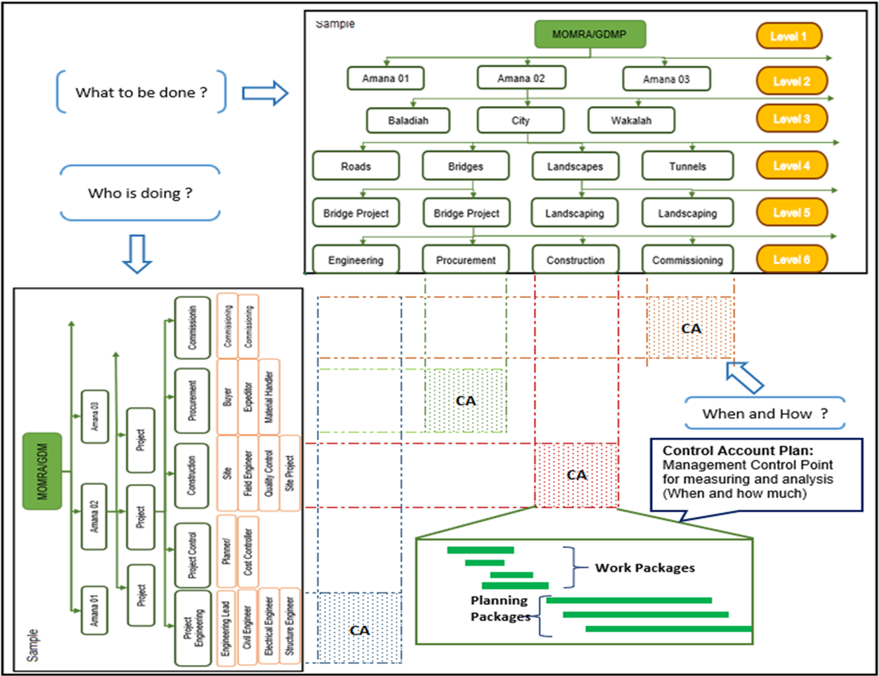
Chapter
WBS/OBS Diagram
06
www.midocean.ae

Slide 33
Agenda
Purpose of a Performance Measurement Baseline
Components of the Performance Baseline
Components and Assembly of the Performance Baseline
Scope
Contract Terms and Conditions (CTC)
Project Execution Plan (PEP)
Schedule
Work Breakdown Structure
Work Breakdown Structure Benefits
Organizational Breakdown Structure
WBS/OBS Diagram
Ownership
The Concept of Rolling Wave Planning
www.midocean.ae

Slide 34
Chapter
Ownership
06
Project organized by teams
100% of scope, budget,
schedule allocated
PEP
PEP
Contractor perform
Partners/ subs/ suppliers
Team A
Hold teams accountable (performance)
Manage change
Risk and contingency management
Project Execution Plan adjustments
Schedule
Team B
Scope
The Baseline
Team C
Budget
Team D
www.midocean.ae

Slide 35
Alignment and Ownership of the Baseline Benefits
Chapter
06
Ensure teams know and accept their scope, schedule, and budgets.
Drive ownership.
Ensure that stretch goals and targets are defined and accepted by the teams.
Establish an environment of accountability.
www.midocean.ae

Slide 36
Agenda
Purpose of a Performance Measurement Baseline
Components of the Performance Baseline
Components and Assembly of the Performance Baseline
Scope
Contract Terms and Conditions (CTC)
Project Execution Plan (PEP)
Schedule
Work Breakdown Structure
Work Breakdown Structure Benefits
Organizational Breakdown Structure
WBS/OBS Diagram
Ownership
The Concept of Rolling Wave Planning
www.midocean.ae

Slide 37
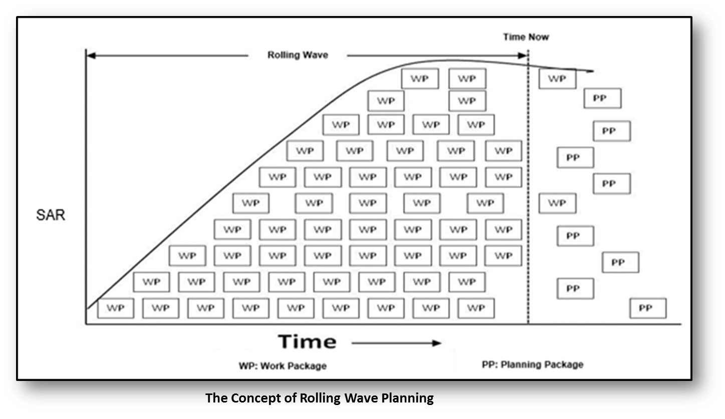
The Concept of Rolling Wave Planning
www.midocean.ae

Slide 38
Chapter
The Concept of Rolling Wave Planning
06
Rolling wave planning is a project management technique that involves progressive elaboration to add detail to the Work Breakdown Structure (WBS) on an ongoing basis.
At the beginning of the project, near term deliverables are decomposed into individual components (work packages) and defined at the greatest level of detail.
www.midocean.ae

Slide 39
Chapter
The Concept of Rolling Wave Planning
06
Deliverables and schedule activities that will take place several reporting periods in the future are more broadly defined. For example, Phases 1-2 might be broken down fully in the WBS.
Phases 3-6 might be outlined only to the level of subprojects.
www.midocean.ae

Slide 40

www.midocean.ae

Slide 41



Thank You

