Slide 1

Advanced Project Management APM
Prepared by Dr. Ahmad Al Ghamdi
PMG 506
Advanced Project Management (APM)

Slide 2
Advanced Project Management
Prepared by Dr. Ahmad Al Ghamdi
Lecture 8
PMG 506
Scheduling

Slide 3


Lecture 8
Scheduling

Slide 4
Lecture 8
Scheduling
In this chapter, we examine some scheduling techniques that have been found to be useful in project management. We cover the Program Evaluation and Review Technique (PERT), the Critical Path Method (CPM), Gantt charts, and briefly discuss Precedence Diagramming, Critical Resource Diagramming, and report-based methods. Risk analysis and management will be considered as an inherent feature of all scheduling methods, and a simulation of a project schedule will be demonstrated.

Slide 5
Lecture 8
Scheduling
8.1 BACKGROUND
A schedule is the conversion of a project action plan into an operating timetable. As such, it serves as the basis for monitoring and controlling project activity and, taken together with the plan and budget, is probably the major tool for the management of projects. In a project environment, the scheduling function is more important than it would be in an ongoing operation because projects lack the continuity of day-to-day operations and often present much more complex problems of coordination. Indeed, project scheduling is so important that a detailed schedule is sometimes a customer-specified requirement. In later chapters, we discuss the fact that a properly designed, detailed schedule can also serve as a key input in establishing the monitoring and control systems for the project.
Not all project activities need to be scheduled at the same level of detail. In fact, there may be several schedules (e.g., the master schedule, the development and testing schedule, the assembly schedule). These schedules are typically based on the previously determined action plan and/or work breakdown structure (WBS), and it is good practice to create a schedule for each major task level in the WBS that will cover the work packages.

Slide 6
Lecture 8
Scheduling
8.1 BACKGROUND
It is rarely necessary, to list all work packages. One can focus mainly on those that need to be monitored for maintaining adequate control over the project. Such packages are usually difficult, expensive, or have a relatively short time frame for their accomplishment.
The basic approach of all scheduling techniques is to form a network of activity and event relationships that graphically portrays the sequential relations between the tasks in a project. Tasks that must precede or follow other tasks are then clearly identified, in time as well as function. Such a network is a powerful tool for planning and controlling a project, and has the following benefits:
• It is a consistent framework for planning, scheduling, monitoring, and controlling the project.
• It illustrates the interdependence of all tasks, work packages, and work elements.
• It denotes the times when specific individuals and resources must be available for work on a given task.

Slide 7
Lecture 8
Scheduling
8.1 BACKGROUND
• It aids in ensuring that the proper communications take place between departments and functions.
• It determines an expected project completion date.
• It identifies so-called critical activities that, if delayed, will delay the project completion time.
• It also identifies activities with slack that can be delayed for specified periods without penalty, or from which resources may be temporarily borrowed without harm.
• It determines the dates on which tasks may be started—or must be started if the project is to stay on schedule.
• It illustrates which tasks must be coordinated to avoid resource or timing conflicts.
• It also illustrates which tasks may be run, or must be run, in parallel to achieve the predetermined project completion date.

Slide 8
Lecture 8
Scheduling
8.1 BACKGROUND
• It relieves some interpersonal conflict by clearly showing task dependencies.
• It may, depending on the information used, allow an estimate of the probability of project completion by various dates, or the date corresponding to a particular a priori probability.

Slide 9
Lecture 8
Scheduling
8.2 NETWORK TECHNIQUES: PERT (ADM) AND CPM (PDM)
The most common approach to project scheduling is the use of network techniques such as The Program Evaluation and Review Technique (PERT) and Critical Path Method (CPM).
In application, PERT has primarily been used for R&D projects, though its use is more common on the “development” side of R&D than it is on the “research” side. CPM was designed for construction projects and has been generally embraced by the construction industry. (There are many exceptions to these generalities.) The use of PERT has decreased sharply in recent years because a large majority of project management software generates CPM networks. The two methods are quite similar and are often combined for educational presentation.
In CPM, activities can be “crashed” (expedited) at extra cost to speed up the completion time. Both techniques identified a project critical path with activities that could not be delayed, and also indicated activities with slack (or float) that could be somewhat delayed without lengthening the project completion time.

Slide 10
Lecture 8
Scheduling
8.2 NETWORK TECHNIQUES: PERT (ADM) AND CPM (PDM)
In 2005, renamed PERT as ADM (Arrow Diagram Method) and CPM as PDM (Precedence Diagram Method). In general, we will simply refer to either as a “network,” but if we wish to refer specifically to a PERT (ADM) network where the activities are shown as arrows on the network, we will call it an AOA (activity-on-arrow) network, and if we refer to a CPM (PDM) network where the activities are shown as nodes, we will call it an AON (activity-on-node) network.
Terminology
Activity A specific task or set of tasks that are required by the project, use up resources, and take time to complete.
Event The result of completing one or more activities. An identifiable end state that occurs at a particular time. Events use no resources.

Slide 11
Lecture 8
Scheduling
8.2 NETWORK TECHNIQUES: PERT (ADM) AND CPM (PDM)
Network The arrangement of all activities (and, in some cases, events) in a project arrayed in their logical sequence and represented by arcs and nodes. This arrangement (network) defines the project and the activity precedence relationships. Networks are usually drawn starting on the left and proceeding to the right. Arrowheads placed on the arcs are used to indicate the direction of flow—that is, to show the proper precedences. Before an event can be realized—that is, achieved—all activities that immediately precede it must be completed. These are called its predecessors. Thus, an event represents an instant in time when each and every predecessor activity has been finished.
Path The series of connected activities (or intermediate events) between any two events in a network.
Critical Activities, events, or paths which, if delayed, will delay the completion of the project. A project’s critical path is understood to mean that sequence of critical activities (and critical events) that connects the project’s start event to its finish event and which cannot be delayed without delaying the project.

Slide 12
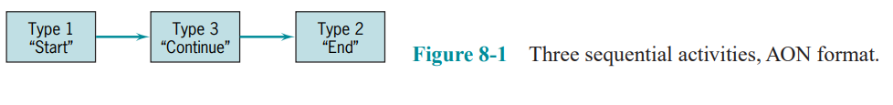
Lecture 8
Scheduling
8.2 NETWORK TECHNIQUES: PERT (ADM) AND CPM (PDM)
To transform a project plan into a network, one must know what activities comprise the project and, for each activity, what its predecessors (or successors) are. An activity can be in any of these conditions: (1) it may have a successor(s) but no predecessor(s); (2) it may have a predecessor(s) but no successor(s); and (3) it may have both predecessor(s) and successor(s). The first of these is an activity that starts a network. The second ends a network. The third is in the middle.
Figure 8-1 shows each of the three types of activities. Activities are represented here by rectangles (one form of what in a network are called “nodes”) with arrows to show the precedence relationships. As noted earlier, this activity-on-node (AON) notation is used for PDM/CPM networks. When there are multiple activities with no predecessors, it is usual to show them all emanating from a single node called “START,”

Slide 13
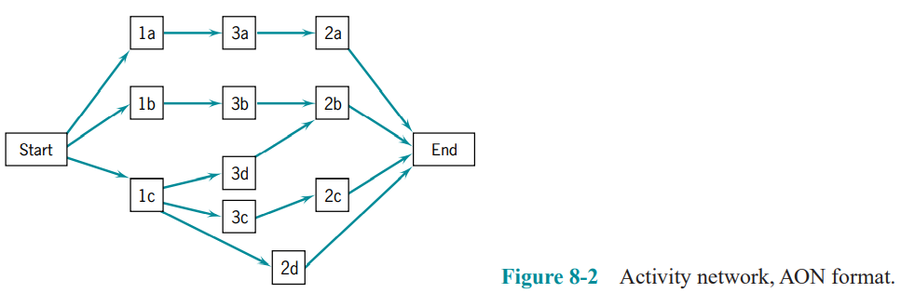
Lecture 8
Scheduling
8.2 NETWORK TECHNIQUES: PERT (ADM) AND CPM (PDM)
as in Figure 8-2. Similarly, when multiple activities have no successors, it is usual to show them connected to a node called “END.”

Slide 14
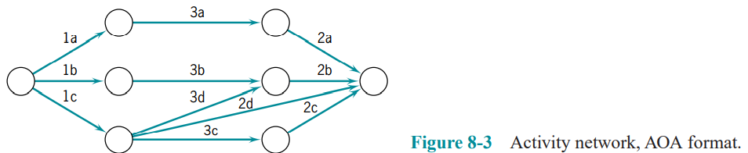
Lecture 8
Scheduling
8.2 NETWORK TECHNIQUES: PERT (ADM) AND CPM (PDM)
In the preceding examples, rectangles (nodes) represented the activities; hence it was called an activity-on-node (AON) network. Another format for drawing networks is AOA (activity-on-arrow), as shown in Figure 8-3. Here, the activities are shown on the arrows and the (circular) nodes represent events. And as noted earlier, this is the standard notation for ADM/PERT networks. If the project begins with multiple activities, they can all be drawn emanating from the initial node and multiple activities can terminate in a single node at the end of the project.

Slide 15
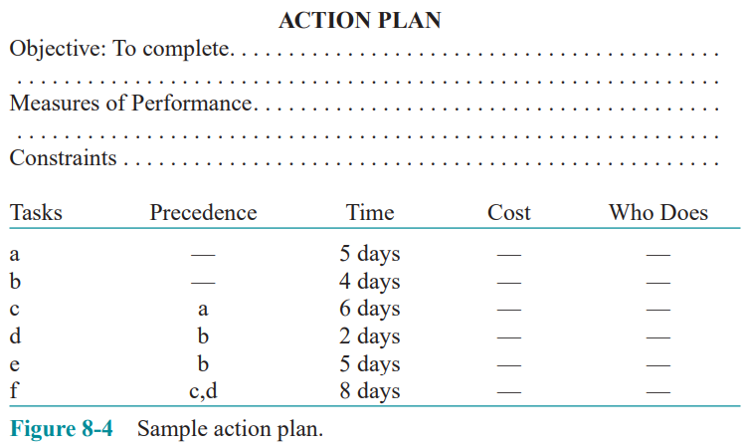
Lecture 8
Scheduling
8.2 NETWORK TECHNIQUES: PERT (ADM) AND CPM (PDM)
Constructing the Network, AON Version
We begin with the node called “START.” Activities a and b have no predecessors, so we draw arrows out of START to each of them (Figure 8-5a). As explained above, the arrowheads show the direction of precedence. Activity c follows a, activity d follows b, and activity e also follows b. Let’s add these to our network in Figure 8-6a. Now, activity f follows both c and d. The action plan does not indicate any further activity is required to complete the task, so we have reached the end of this particular plan. We thus draw arrows from activities e and f to the node END, as shown in Figure 8-7a. Many of the project management software packages will generate these networks on request.

Slide 16
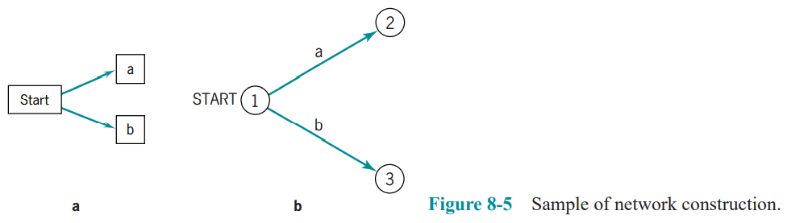
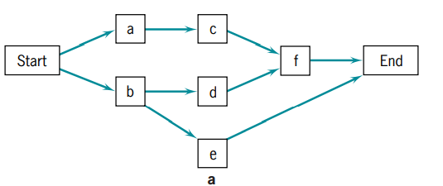
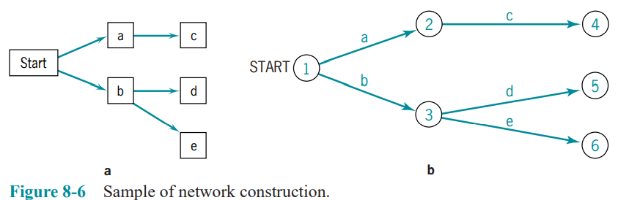
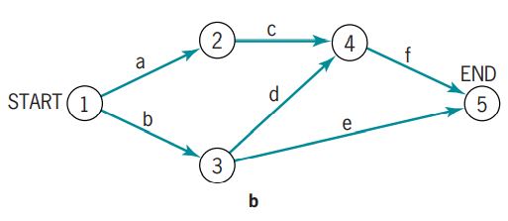
Lecture 8
Scheduling
8.2 NETWORK TECHNIQUES: PERT (ADM) AND CPM (PDM)

Slide 17
Lecture 8
Scheduling
8.2 NETWORK TECHNIQUES: PERT (ADM) AND CPM (PDM)
Constructing the Network, AOA Version
Again, we begin with a node (event) called “START.” Activities a and b have no predecessors, so we draw arrows labeled “a” and “b” from START and terminating in circle-shaped nodes numbered “1” and “2” for easy identification (Figure 8-5b). Activity c follows a, activity d follows b, and activity e also follows b. Let’s add these arrows to our AOA network, labeling the arrows and nodes sequentially as we go (Figure 8-6b). Note that activity f must follow both c and d, but any given activity must have its source in one and only one node. Therefore, c and d must terminate at the same node. Erase activity d and its node—it is now clear that hand-drawn networks should be drawn in pencil—and redraw d to end at the same node that terminates c. We now add activity e following b, and f following c and d. Because e and f have no successors, they will terminate at the END node (Figure 8-7b).

Slide 18
Lecture 8
Scheduling
8.2 NETWORK TECHNIQUES: PERT (ADM) AND CPM (PDM)
The choice between AOA and AON representation is largely a matter of personal preference. As we noted above, AON is typically used in the most popular PC-based commercially available computer software, and AON networks are easier to draw. AOA networks are slightly harder to draw because they sometimes require the use of dummy activities to aid in indicating a particular precedence, via a dashed arc. A dummy activity has no duration and uses no resources. Its sole purpose is to indicate a technological relationship. (AON networks do not require the use of dummy activities.) AOA networks clearly identify events in the network. These must be added as “zero-duration” activities (or milestones) in AON networks.

Slide 19
Lecture 8
Scheduling
8.2 NETWORK TECHNIQUES: PERT (ADM) AND CPM (PDM)
Gantt (Bar) Charts and Microsoft Project® (MSP)
One of the oldest but still one of the most useful methods of presenting project schedule information is the Gantt chart. It shows planned and actual progress for a number of tasks displayed as bars against a horizontal time scale. It is a particularly effective and easy-to-read method of indicating the actual current status for each of a set of tasks compared to the planned progress for each item of the set. As a result, the Gantt chart can be helpful in expediting, sequencing, and reallocating resources among tasks, as well as in the valuable but mundane job of keeping track of how things are going. In addition, the charts usually contain a number of special symbols to designate or highlight items of special concern to the situation being charted.

Slide 20
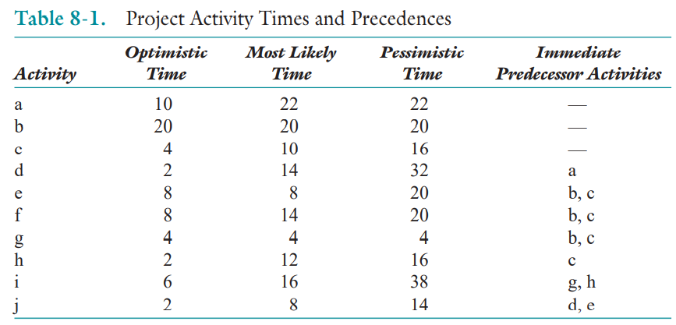
Lecture 8
Scheduling
8.2 NETWORK TECHNIQUES: PERT (ADM) AND CPM (PDM)
Solving the Network

Slide 21
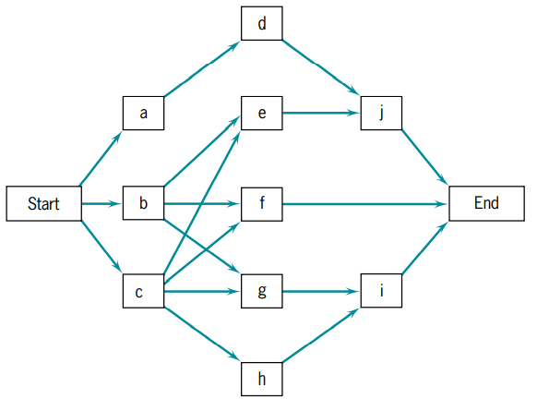

Lecture 8
Scheduling
8.2 NETWORK TECHNIQUES: PERT (ADM) AND CPM (PDM)
Solving the Network
Beginning with a node named START, connect the three activities with no predecessors (a, b, and c) to the Start node as in Figure 8-13. Activity d has a predecessor of a, and thus it follows a. Activities e, f, and g all must follow both b and c as predecessors. Activity h follows c. Activity j follows both d and e. Activity i follows g and h. Because there are no more activities, we must be at the end of the network. Add a node labeled “END” and connect any nodes without successor activities, in this case, j, f, and i, reading from top to bottom. As stated earlier, always show the direction of a connection with an arrowhead.

Slide 22
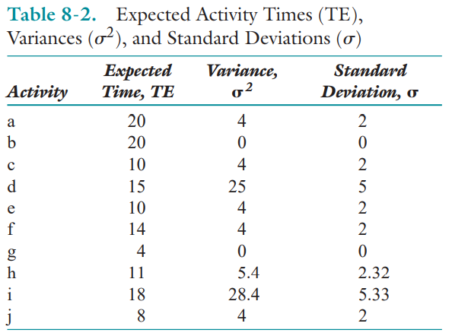




Lecture 8
Scheduling
8.2 NETWORK TECHNIQUES: PERT (ADM) AND CPM (PDM)
Calculating Activity Times
The expected time, TE, is found by
TE = (a+4m+b)/6
Where:
a optimistic time estimate
b pessimistic time estimate
m most likely time estimate, the mode

Slide 23
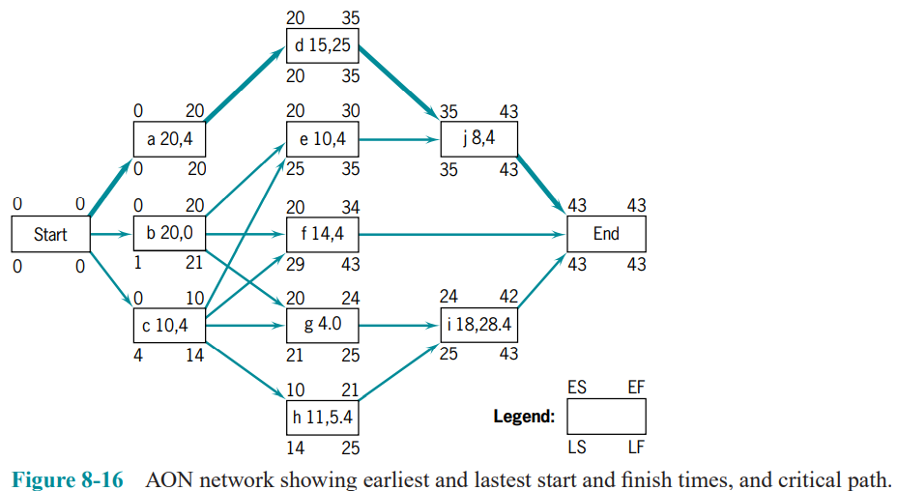
Lecture 8
Scheduling
8.2 NETWORK TECHNIQUES: PERT (ADM) AND CPM (PDM)
Critical Path and Time
If we start the project on day 0, shown as ES (earliest start) at the upper left of each node in Figure 8-16, we can begin simultaneously working on activities a, b, and c, each of which has no predecessor activities. We will complete activity a in 20 days, activity b in 20 days, and activity c in 10 days, shown as EF (earliest finish) at the upper right of each of their respective nodes. These early finish times represent the earliest times that the following activities can begin.

Slide 24
Lecture 8
Scheduling
8.2 NETWORK TECHNIQUES: PERT (ADM) AND CPM (PDM)
Critical Path and Time
Note that activity e not only requires the completion of activity b, but also requires the completion of activity c, as shown by the two incoming arrows. Activity e cannot begin until all paths leading to it have been completed. Therefore, the ES for activity e is equal to the EF of the latest activity leading to it, 20 for activity b.
Proceeding similarly for the remaining activities.
As can be seen, the longest of the paths through the network is a-d-j using 43 days, which means that 43 days is the shortest time in which the entire network can be completed. This is called the critical time of the network, and a-d-j is the critical path, usually shown as a heavy line as in Figure 8-16.

Slide 25
Lecture 8
Scheduling
8.2 NETWORK TECHNIQUES: PERT (ADM) AND CPM (PDM)
Slack (Float)
Refer again to Figure 8-16. The project has a critical time of 43 days. Activity i must therefore be finished by day 43, indicated by LF (latest fi nish time), placed at the bottom right of its node. Also, activity i requires 18 days to be accomplished. Therefore, i must be started no later than day 25 (43 – 18 = 25) if the project is to be complete on day 43. The LS for activity i is thus 25, placed at the lower left corner of the node. Because i cannot begin until activities g and h have finished, the latest time (LF) for each of these is also day 25. The difference between the LS and the ES for an activity is called its float or slack. In the case of activity i, it must be started no later than day 25, but could be started as early as day 24, so it has one day of slack. It should be immediately obvious that all activities on the critical path have zero slack. Zero slack activities cannot be delayed without making the project late

Slide 26
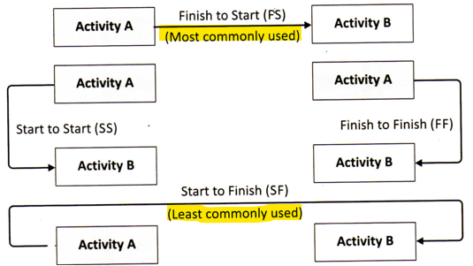
Lecture 8
Scheduling
8.2 NETWORK TECHNIQUES: PERT (ADM) AND CPM (PDM)
Slack (Float)
Some writers and MSP differentiate between “total” slack or float and “free” slack or float. Total slack is LF-EF or LS-ES as described above. Free slack is defined as the time an activity can be delayed without affecting the start time of any successor activity. Activity h could be delayed three days without affecting the start time of activity i. Activity h has three days of free slack and four days of total slack
Precedence Diagramming
Finish to Start Activity B must not start before Activity A has been completed.
Start to Start Activity B cannot begin until Activity A has been underway.
Finish to Finish Activity A must be complete before Activity B is completed.
Start to Finish Activity B cannot be completed before the start of Activity A.

Slide 27

Lecture 8
Scheduling
8.2 NETWORK TECHNIQUES: PERT (ADM) AND CPM (PDM)
Uncertainty of Project Completion Time
When discussing project completion dates with senior management, the PM should try to determine the probability that a project will be completed by the suggested deadline—or find the completion time associated with a predetermined level of risk.
If we assume that the activities are statistically independent of each other, then the variance of a set of activities is equal to the sum of the variances of the individual activities comprising the set.
The critical path of our example includes activities a, d, and j. From Table 8-2 we find that the variances of these activities are 4, 25, and 4, respectively; and the variance for the critical path is the sum of these numbers, 33 days. Assume, as above, that the PM has promised to complete the project in 50 days. What are the chances of meeting that deadline? We find the answer by calculating Z, where

Slide 28
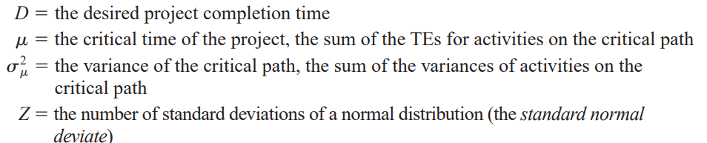
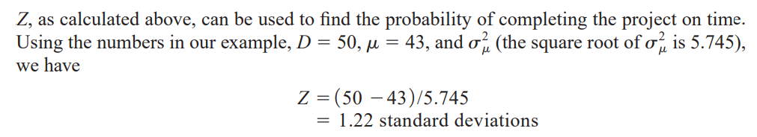
Lecture 8
Scheduling
8.2 NETWORK TECHNIQUES: PERT (ADM) AND CPM (PDM)

Slide 29
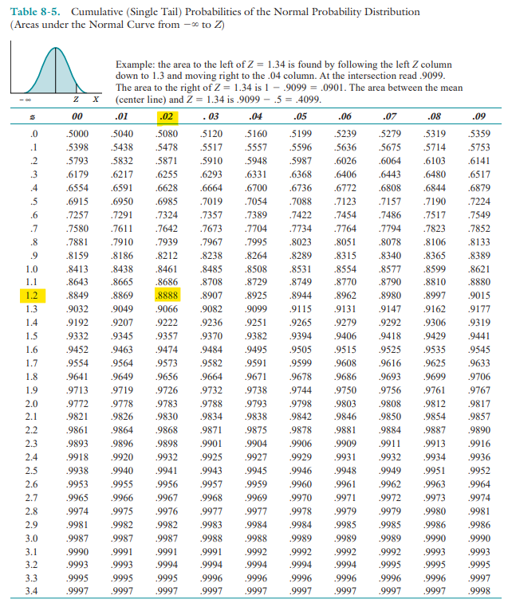
Lecture 8
Scheduling
8.2 NETWORK TECHNIQUES: PERT (ADM) AND CPM (PDM)
We turn now to Table 8-5, which shows the probabilities associated with various levels of Z. We go down the left column until we find Z 1.2, and then across to column .02 to find Z 1.22. The probability value of Z 1.22 shown in the table is .8888, or almost 89 percent, which is the likelihood that we will complete the critical path of our sample project within 50 days of the time it is started.

Slide 30
Lecture 8
Scheduling
Summary
In this chapter the scheduling aspect of project implementation was addressed. Following a description of the benefits of using a network for planning and controlling a project, the AOA and AON approaches were described, as were Gantt charts. Specific points covered in the chapter were these:
• Scheduling is particularly important to projects because of complex coordination problems.
• The network approach to scheduling offers a number of specific advantages of special value for projects.
• Critical project tasks typically constitute fewer than 10 percent of all the project tasks.
• Network techniques can adopt either an activity-on-node or activity-on-arc framework without significantly altering the analysis.

Slide 31
Lecture 8
Scheduling
Summary
• Networks are usually constructed from left to right, indicating activity precedence and event times as the network is constructed. Through use of the network, critical activities and events are identified, early and late activity start times are found, available slacks for each activity are determined, and probabilities of project completion by various times are calculated.
• Gantt charts, a monitoring technique, are closely related to network diagrams, but are more easily understood and provide a clearer picture of the current state of the project. However, while offering some advantages, they also have some drawbacks, such as not clearly indicating task precedence and dependencies.

Slide 32
Lecture 8
Scheduling
GLOSSARY
Activity A specific project task that requires resources and time to complete.
Activity-On-Arrow (Activity-on-Node) The two ways of illustrating a network: placing the activities on the arcs or on the nodes.
Arc The line connecting two nodes.
Crash In CPM, an activity can be conducted at a normal pace or at an expedited pace, known as crashing, at a greater cost.
Critical An activity or event that, if delayed, will delay project completion.
Event An end state for one or more activities that occurs at a specific point in time.
Gantt Chart A manner of illustrating multiple, timebased activities on a horizontal time scale.
Milestone A clearly identifiable point in a project or set of activities that commonly denotes a reporting requirement or completion of a large or important set of activities.
Network A combination of interrelated activities and events depicted with arcs and nodes.
Node An intersection of two or more lines or arrows, commonly used for depicting an event or activity.

Slide 33
Lecture 8
Scheduling
GLOSSARY
Path A sequence of lines and nodes in a network.
Project Management Information System (PMIS) The systems, activities, and data that allow information flow in a project, frequently computerized but not always.
Trade-off The amount of one factor that must be sacrificed in order to achieve more or less of another factor.

Slide 34
Lecture 8
Scheduling
Thank you

