Slide 1

Lecture 11:
Managing Project Teams
PMG 605
Project Resources and Time Management
Dr. Eng.
Abdullah Jameel Halawany

Slide 2
Session Outline
Managing Project Teams
The Five-Stage Team Development Model
Introduction
Situational Factors Affecting Team Development
Building High-Performance Project Teams
Managing Virtual Project Teams
Project Team Pitfalls

Slide 3
Introduction

Slide 4
Project Teams
“Coming together is a beginning.
Keeping together is progress.
Working together is success.”
—Henry Ford
11–4

Slide 5
Synergy
The magic and power of teams is captured in the term “synergy,” which is derived from the Greek word sunergos: “working together.”
There is positive and negative synergy.
The essence of positive synergy can be found in the phrase “The whole is greater than the sum of the parts.”
Conversely, negative synergy occurs when the whole is less than the sum of the parts.
11–5

Slide 6
Synergy
Mathematically, these two states can be symbolized by the following equations:
  1 + 1 + 1 = 10 (positive synergy)
  1 + 1 + 1 = 2 (negative synergy)
Synergy perhaps can best be seen on a basketball court, a soccer pitch, or a football field where teammates play as one to defeat a superior opponent.
Positive and negative synergy can also be observed and felt in the daily operations of project teams.
11–6

Slide 7

Synergy
11–7

Slide 8
Characteristics of High-performing Teams
1. The team shares a sense of common purpose, and each member is willing to work toward achieving project objectives.
2. The team identifies individual talents and expertise and uses them, depending on the project’s needs at any given time. At these times, the team willingly accepts the influence and leadership of the members whose skills are relevant to the immediate task.
3. Roles are balanced and shared to facilitate both the accomplishment of tasks and feelings of group cohesion and morale.
4. The team uses energy toward problem solving rather than allowing itself to be drained by interpersonal issues or competitive struggles.
11–8

Slide 9
Characteristics of High-performing Teams
5. Differences of opinion are encouraged and freely expressed.
6. To encourage risk taking and creativity, mistakes are treated as opportunities for learning rather than reasons for punishment.
7. Members set high personal standards of performance and encourage each other to realize the objectives of the project.
8. Members identify with the team and consider it an important source of both professional and personal growth.
11–9

Slide 10
Characteristics of High-performing Teams
High-performing teams become champions, create breakthrough products, exceed customer expectations, and get projects done ahead of schedule and under budget.
They are bonded together by mutual interdependency and a common goal or vision.
They trust each other and exhibit a high level of collaboration.
11–10

Slide 11
The Five-Stage Team Development Model

Slide 12
The Five-Stage Team Development Model
Stage 1: Forming
Stage 2: Storming
Stage 3: Norming
Stage 4: Performing
Stage 5: Adjourning
11–12

Slide 13
Stage 1: Forming
During this initial stage, the members get acquainted with each other and understand the scope of the project.
They begin to establish ground rules by trying to find out what behaviors are acceptable with respect to both the project (what role they will play, what performance expectations are) and interpersonal relations (who’s really in charge).
This stage is completed once members begin to think of themselves as part of a group.
11–13

Slide 14
Stage 2: Storming
As the name suggests, this stage is marked by a high degree of internal conflict.
Members accept that they are part of a project group but resist the constraints that the project and group put on their individuality.
There is conflict over who will control the group and how decisions will be made.
As these conflicts are resolved, the project manager’s leadership becomes accepted, and the group moves to the next stage.
11–14

Slide 15
Stage 3: Norming
The third stage is one in which close relationships develop and the group demonstrates cohesiveness.
Feelings of friendship and shared responsibility for the project are heightened.
The norming phase is complete when the group structure solidifies, and the group establishes a common set of expectations about how members should work together.
11–15

Slide 16
Stage 4: Performing
The team operating structure at this point is fully functional and accepted.
Group energy has moved from getting to know each other and how the group will work together to accomplishing the project goals.
11–16

Slide 17
Stage 5: Adjourning
For conventional work groups, performing is the last stage of their development.
During this stage, the team prepares for its own disbandment.
High performance is no longer a top priority. Attention is devoted to wrapping up the project.
Responses of members vary in this stage.
Some members are upbeat, basking in the project team’s accomplishments.
Others may be depressed over loss of friendships gained during the project’s life.
11–17

Slide 18
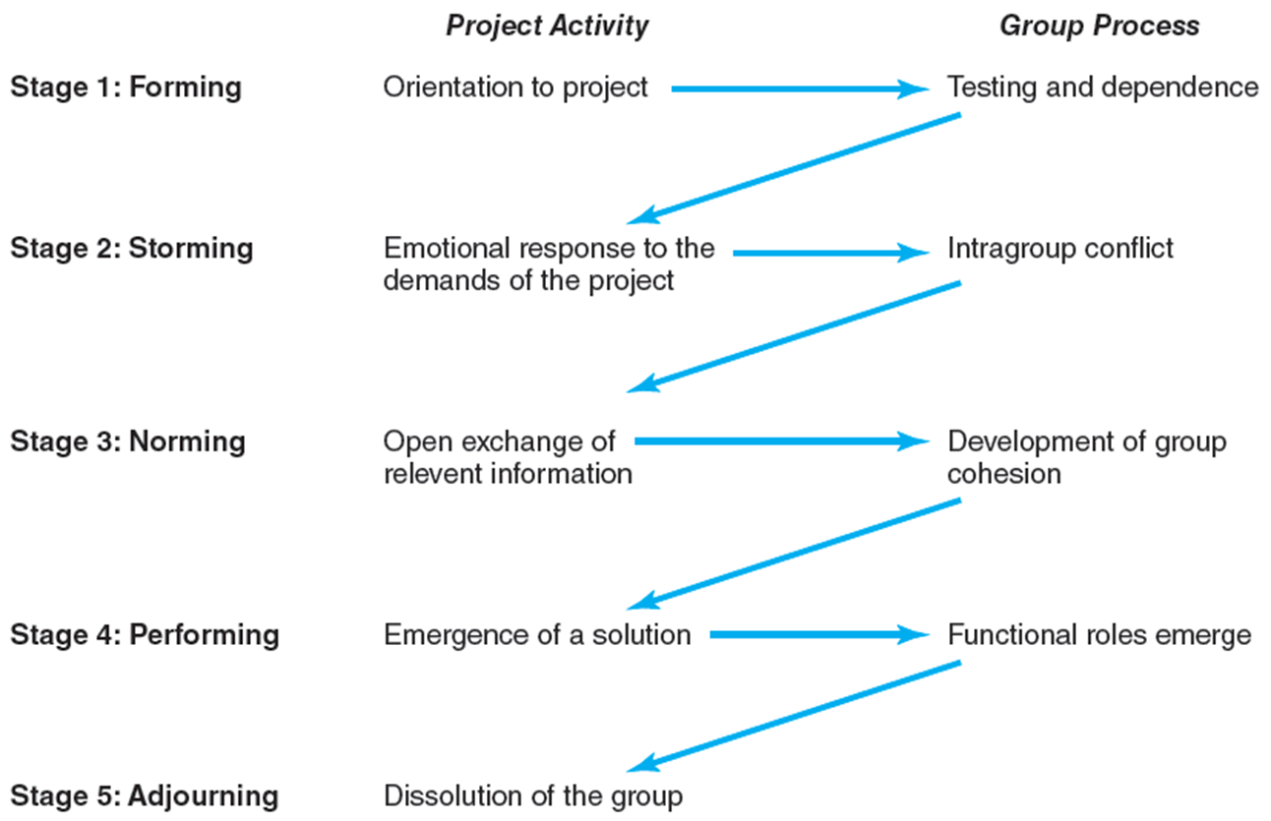
The Five-Stage Team Development Model
11–18

Slide 19
Implications of Five-Stage Team Development Model
The first is that the model provides a framework for the group to understand its own development.
Project managers have found it useful to share the model with their teams.
It helps members accept the tensions of the storming phase, and it directs their focus to moving toward the more productive phases.
Another implication is that it stresses the importance of the norming phase, which contributes significantly to the level of productivity experienced during the performing phase.
11–19

Slide 20
Situational Factors Affecting Team Development

Slide 21
Situational Factors Affecting Team Development
Experience and research indicate that high-performance project teams are much more likely to develop under the following conditions
Ten or fewer team members
Voluntary team membership
Serve on the project from beginning to end
Full-time assignment to the team
An organization culture of cooperation and trust
Members report solely to the project manager
All relevant functional areas are represented on the team
The project involves a compelling objective
Members are in close communication with each other
11–21

Slide 22
Situational Factors Affecting Team Development
In reality, it is rare that a project manager is assigned a project that meets all of these conditions.
In many organizations, functional managers or central manpower offices assign project members with little input from the project manager.
To optimize resource utilization, team member involvement may be part time, and/or participants may move in and out of the project team on an as-needed basis.
Team members often report to different managers.
It would be naive to believe that every project team has the same potential to evolve into a high-performance team.
11–22

Slide 23
Building High-Performance Project Teams

Slide 24
Building High-Performance Project Teams
Project managers play a key role in developing high-performance project teams.
They recruit members, conduct meetings, establish a team identity, create a common sense of purpose or a shared vision, manage a reward system that encourages teamwork, orchestrate decision making, resolve conflicts that emerge within the team, and rejuvenate the team when energy wanes.
Project managers manage the interface between the team and the rest of the organization.
11–24

Slide 25
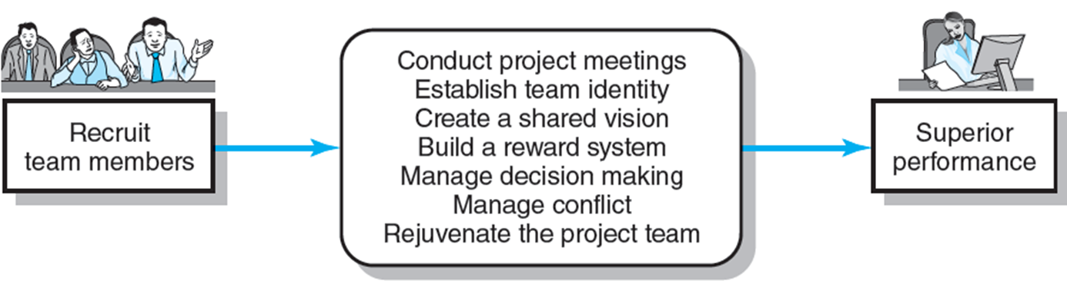
Building High-Performance Project Teams
11–25

Slide 26
Recruiting Project Members
Two important factors affecting recruitment
  The importance of the project. For high priority projects the project manager will be given virtual carte blanche to select whomever he or she deems necessary. For less significant projects, personnel will simply be assigned to the project.
  The management structure being used to complete the project. In many matrix structures, the functional manager controls who is assigned to the project; the project manager will have to work with the functional manager to obtain necessary personnel.
  Who to recruit?
  - Problem-solving ability - Availability
  - Technological expertise - Credibility
  - Political connections - Ambition, initiative, and energy
  - Lesser Familiarity
Experienced project managers stress the importance of asking for volunteers.
11–26

Slide 27
Managing Virtual Project Teams

Slide 28
Managing Virtual Project Teams
Building a high-performance project team among a mixture of part-time and full-time members is a challenging task.
Consider how much more challenging it is to build a team when members cannot engage in face-to-face interactions.
Electronic communication such as the Internet, e-mail, and teleconferencing takes on much more importance in virtual projects because this is the primary means of communication.
Two of the biggest challenges involved in managing a virtual project team are developing trust and effective patterns of communication.
11–28

Slide 29
Managing Virtual Project Teams
Developing Trust
Trust is difficult to establish in virtual project management.
Unlike working as a traditional team, where members can see whether someone has done what they say they have done, virtual team members depend on the word of distant members.
Geographical separation also prohibits the informal social interactions that are often essential to building camaraderie among team members.
11–29

Slide 30
Managing Virtual Project Teams
Developing Trust
How can a project manager facilitate the development of trust within a virtual team?
Orchestrate the exchange of social information—who everyone is and some personal background information during the initial electronic interchange.
Set clear roles for each team member. Specific tasks should be assigned to each member so that they can make an immediate contribution to the project.
Consistently display enthusiasm and an action orientation in all messages; this spirit will hopefully spread to other team members.
11–30

Slide 31
Managing Virtual Project Teams
Effective Patterns of Communication
E-mail and faxes are great for communicating facts—but not the feelings behind the facts; nor do they allow for real-time communication.
Conference calls and project chat rooms can help, but they also have their limitations.
Videoconferencing is a significant improvement over nonvisual electronic forms of communication.
11–31

Slide 32
Managing Virtual Project Teams
Effective Patterns of Communication
When to e-mail. To distribute important information and news.
When to use electronic bulletin boards. To encourage discussion and flush out diversity of opinion on issues.
When to videoconference. When you need to see each other’s face and expressions. Important during the early phases of a project, when you are building relationships and developing a common understanding of what needs to be done. When working on critical decisions/contentious issues.
When to use conference calls. When people in different locations are working with common documents, presentations, sketches, and models. Use for status report meetings and to sustain social camaraderie.
When to fly. Fly to build or repair trust. Use travel budget to get all key players together early on to instill commitment to the goals of the project and engage in team-building activities.
11–32

Slide 33
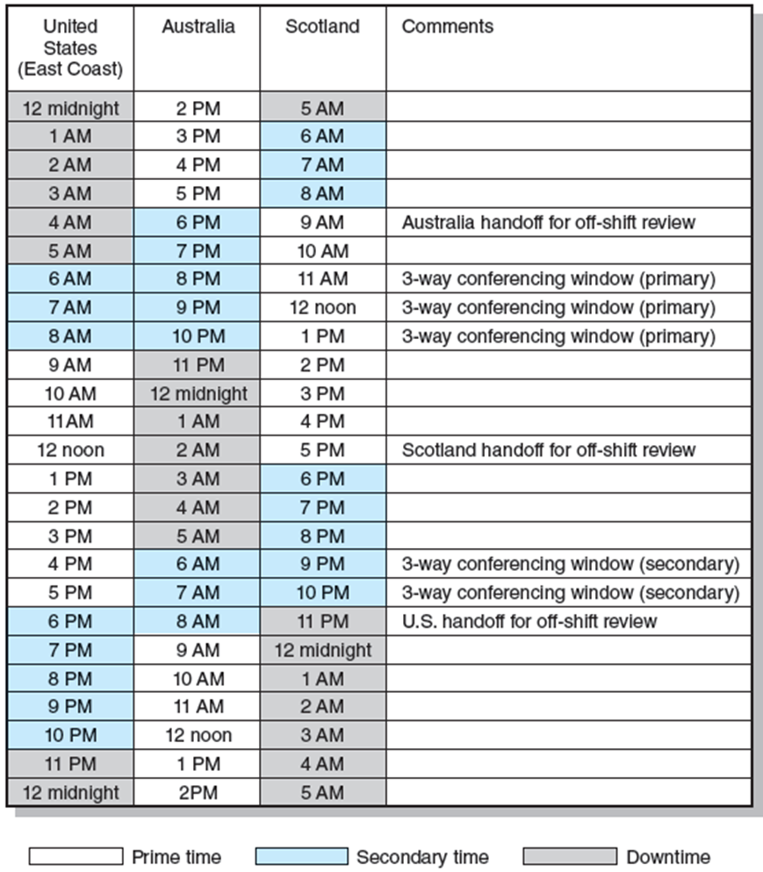
Managing Virtual Project Teams
11–33

Slide 34
Project Team Pitfalls

Slide 35
Project Team Pitfalls
Groupthink
Bureaucratic
Bypass Syndrome
Team Spirit Becomes
Team Infatuation
Going Native
11–35

Slide 36
Project Team Pitfalls –
Groupthink
Refers to the tendency of members in highly cohesive groups to lose their critical evaluative capabilities.
Some of the symptoms of groupthink include the following:
  Illusion of invulnerability. It is marked by an implicit faith in its own wisdom, and an inordinate optimism that allows group members to feel complacent about the quality of their decisions.
  Whitewash of critical thinking. The group members discuss only a few solutions, ignoring alternatives; they fail to examine the adverse consequences that could follow their preferred course of action.
  Negative stereotypes of outsiders. the group considers any outsiders who oppose their decisions as the bad guys.
  Direct pressure. When a team member does speak out or question the direction in which the team is headed, direct pressure is applied to the dissenter. He or she is reminded that speed is important and that the aim is agreement, not argument.
11–36

Slide 37
Project Team Pitfalls –
Bureaucratic Bypass Syndrome
Project teams are often licensed to get things done without having to go through normal protocols of the parent organization.
Bypassing bureaucratic channels is appealing and invigorating.
If bypassing becomes a way of life, it results in the rejection of bureaucratic policies and procedures, which provide the glue for the overall organization.
A team that operates outside the organization may alienate other workers who are constrained by the norms and procedures of the organization.
Eventually, these outside bureaucrats will find ways to put up roadblocks and thwart the project team
11–37

Slide 38
Project Team Pitfalls –
Team Spirit Becomes Team Infatuation
High-performance project teams can be a tremendous source of personal satisfaction.
The excitement, chaos, and joy generated by working on a challenging project can be an invigorating experience.
They become infatuated with the challenge of the project and the talent around them.
This total preoccupation with the project and the project team, while contributing greatly to the remarkable success of the project, can leave in its wake a string of broken professional and personal relationships that contribute to burnout and disorientation upon completion of the project.
11–38

Slide 39
Project Team Pitfalls –
Going Native
The customer’s interests take precedence over the parent organization’s interests.
This change in viewpoint can lead to excessive scope creep and open defiance of corporate policy and interests.
11–39

Slide 40
Overcome Project Team Pitfalls
Awareness is the first step for prevention.
The next step is to take preemptive action to reduce the likelihood of these pitfalls occurring.
  Encourage functional conflict by playing a devil’s advocate role
  Reduce the isolation of the project team by creating work-related connections outside the project team.
  Timely involvement of external specialists.
11–40

Slide 41
Summary of Today Session

Slide 42
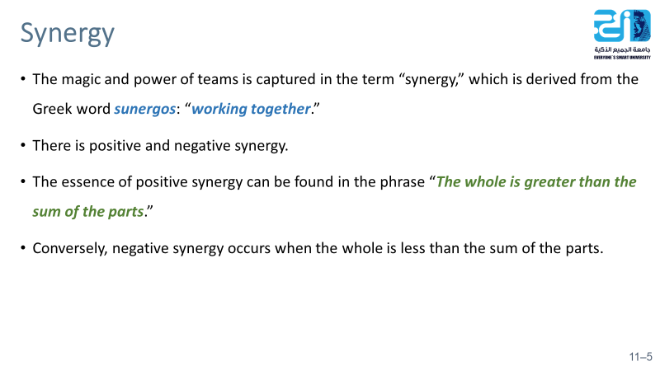
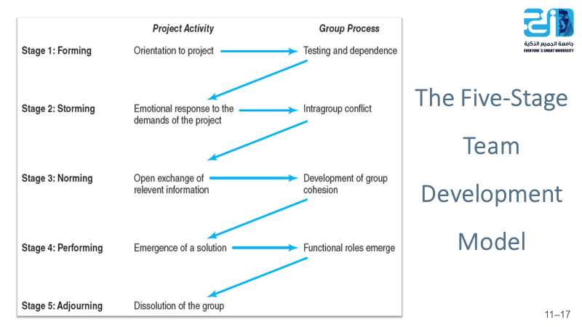
11–42

Slide 43
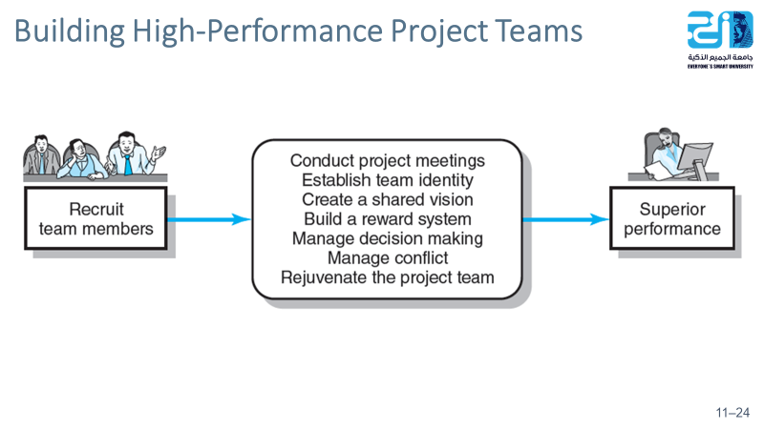
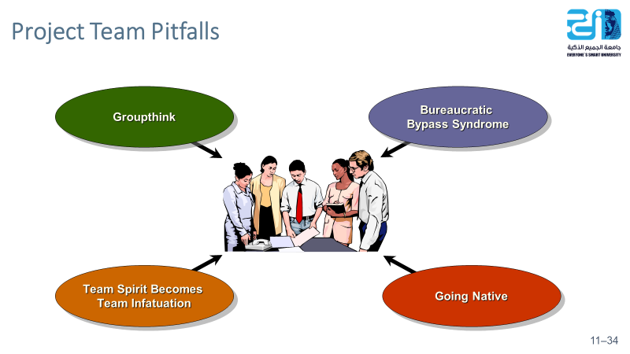
11–43

Slide 44
Resources
Project Management: The Managerial Process Fifth Edition.
By: Erik W. Larson, Oregon State University, Clifford F. Gray, Oregon State University

