Slide 1




Mathematics 3
Lecture 7
MAT 132
Advanced Topics in Calculus
Prepared by
Dr. Israa Lewaa

Slide 2
Lecture
05
Lecture
05
Lecture Objective
Chapter Objectives
To develop and apply the formula for integration by parts.
To show how to integrate a proper rational function.
To illustrate the use of the table of integrals.
To develop the concept of the average value of a function.
To define and evaluate the improper integral.
To discuss functions of several variables and to compute function values.
To compute partial derivatives.
To find partial derivatives of a function defined implicitly.
To compute higher-order derivatives.

Slide 3
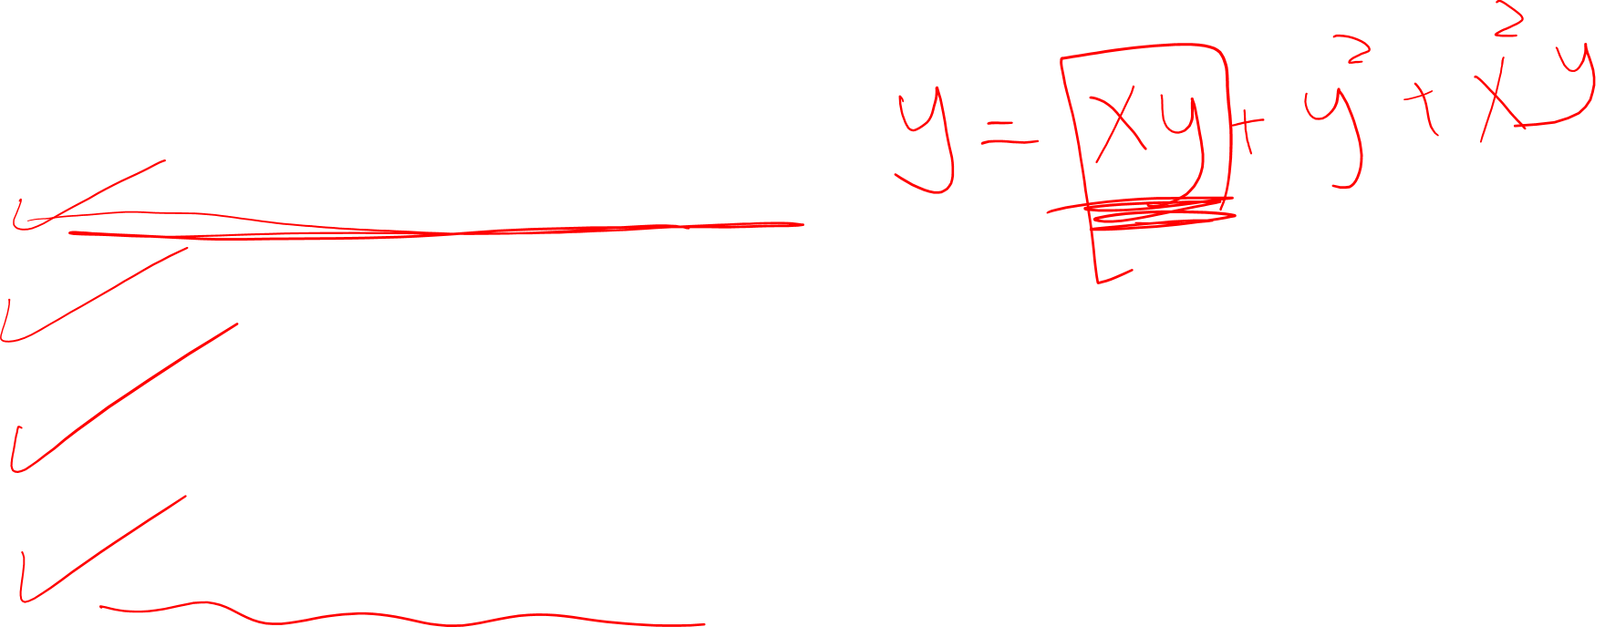
Lecture
09
Lecture
05
Lecture Outline
Lecture Outline
1- Integration by Parts
2- Integration with Initial Conditions
3- Definite Integral

Slide 4
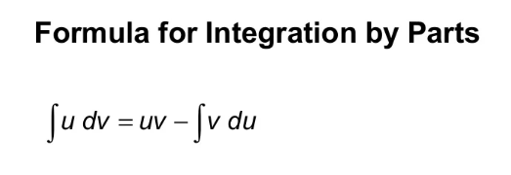
Lecture
08
Lecture
05
1- Integration by Parts
1- Integration by parts

Slide 5
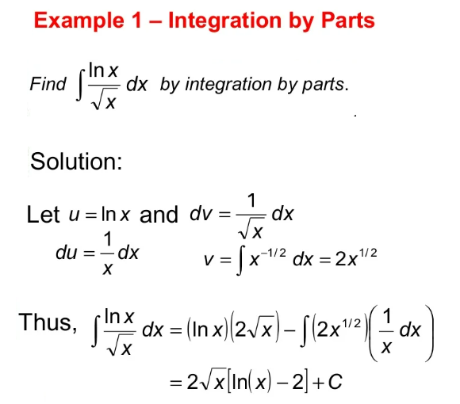
Lecture
08
Lecture
05
Extra Practice – Example 1
Example

Slide 6
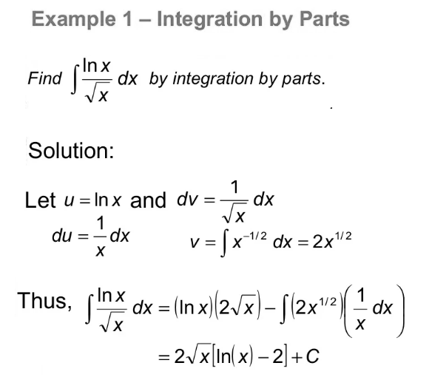
Lecture
08
Lecture
05
Extra Practice – Example 1 Solution
Example

Slide 7
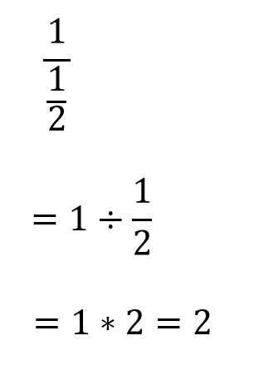
Lecture
08
Lecture
05
Revision – Fundamentals
** Revision – Fundamentals

Slide 8
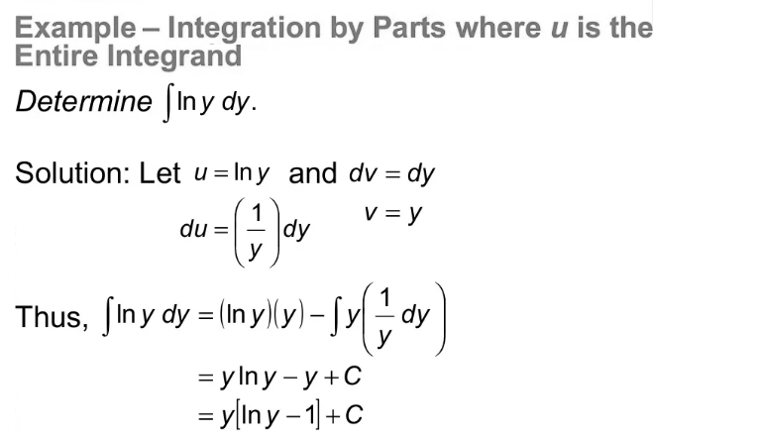
Lecture
08
Lecture
05
Integration by Parts
Example

Slide 9

Lecture
08
Integration with initial Conditions
Integration with initial Conditions
Integration with initial Conditions

Slide 10
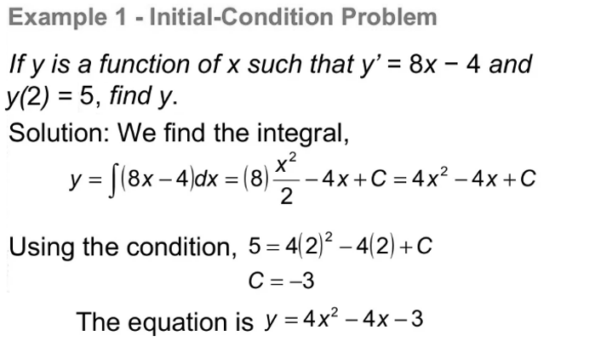
Lecture
08
Extra Practice – Example 2
Example

Slide 11
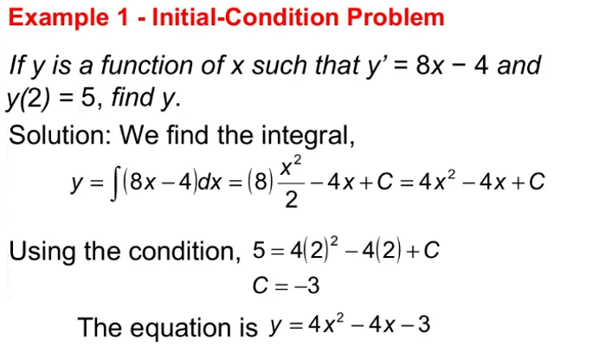
Lecture
08
Extra Practice – Example 3
Example

Slide 12
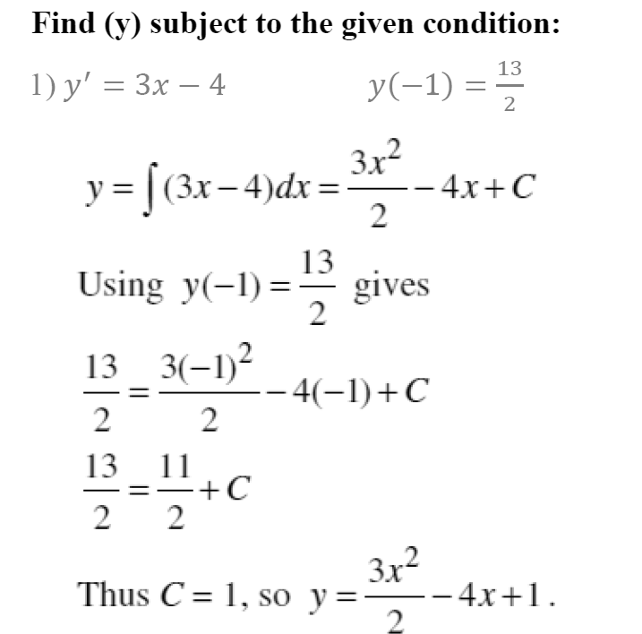
Lecture
07
Extra Practice – Example 4
** EXTRA PRACTISE

Slide 13
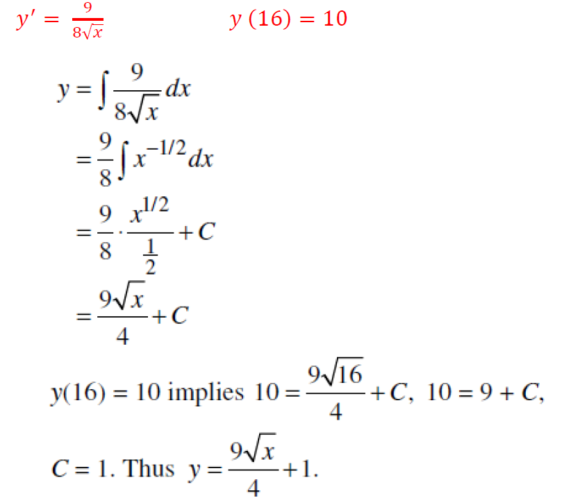
Lecture
07
Extra Practice – Example 5
** EXTRA PRACTISE

Slide 14
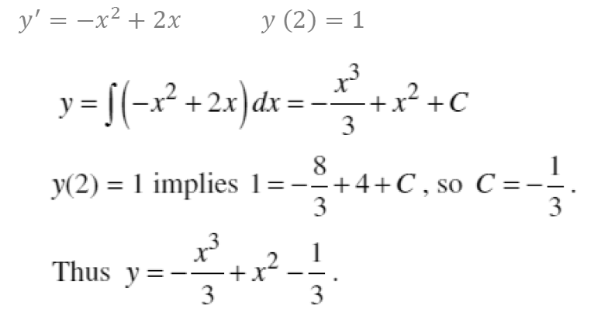
Lecture
07
Extra Practice – Example 6
** EXTRA PRACTISE

Slide 15
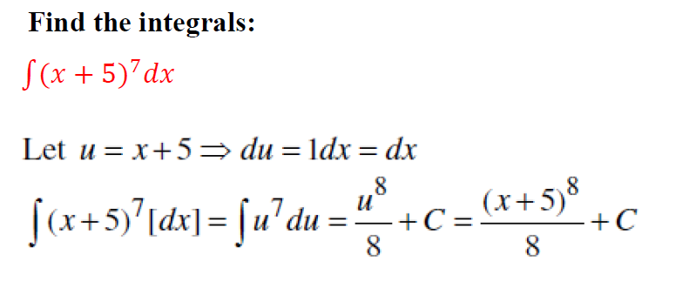
Lecture
08
Extra Practice – Example 7
Examples for different Methods of Integration

Slide 16
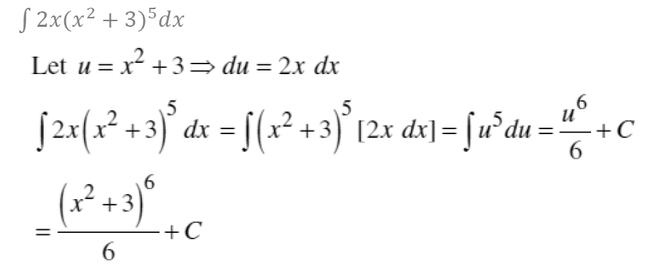
Lecture
08
Extra Practice – Example 8
Example

Slide 17
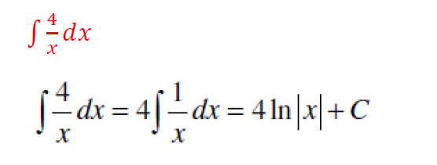
Lecture
08
Extra Practice – Example 9
Example

Slide 18
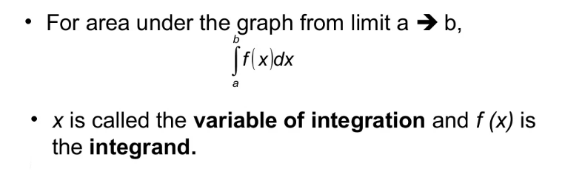
Lecture
08
3- Definite Integral
The Definite Integral

Slide 19

Lecture
08
Extra Practice – Example 10
Example 1 - Definite Integration

Slide 20
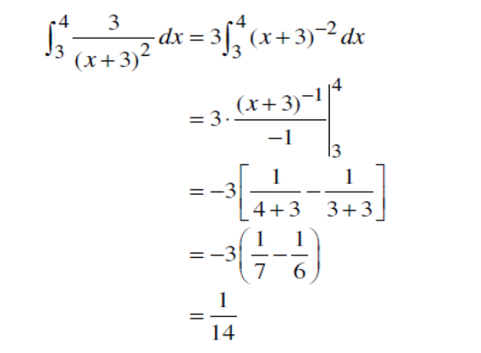
Lecture
08
Extra Practice – Example 11
Example 1 Solution

Slide 21
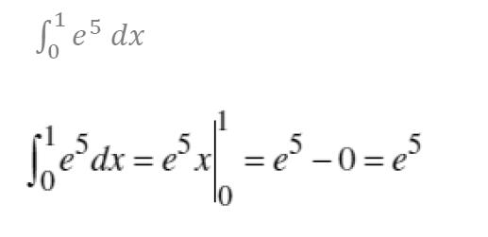
Lecture
08
Extra Practice – Example 12
Example

Slide 22
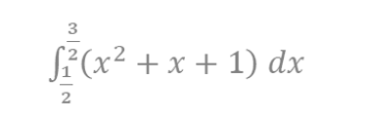
Lecture
08
Extra Practice – Example 13
Example

Slide 23

Lecture
08
Extra Practice – Example 14
** EXTRA PRACTISE

Slide 24
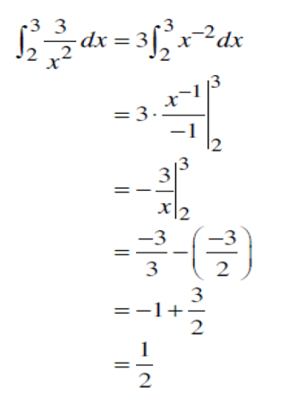
Lecture
08
Extra Practice – Example 15
** EXTRA PRACTISE

Slide 25

Lecture
08
Extra Practice – Example 16
** EXTRA PRACTISE

Slide 26
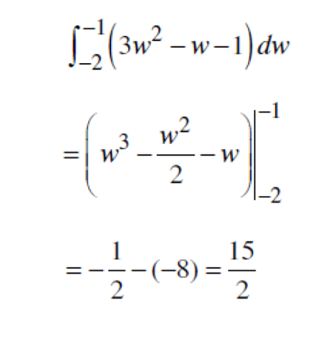
Lecture
08
Extra Practice – Example 16 Solution
** EXTRA PRACTISE

Slide 27
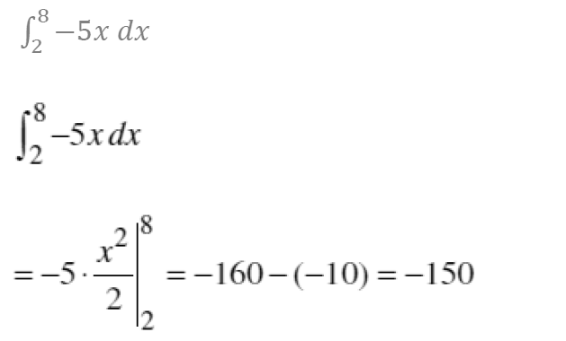
Lecture
08
Extra Practice – Example 17
** EXTRA PRACTISE

Slide 28
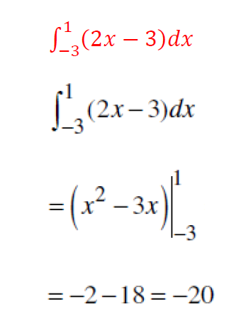
Lecture
08
Extra Practice – Example 18
** EXTRA PRACTISE

Slide 29
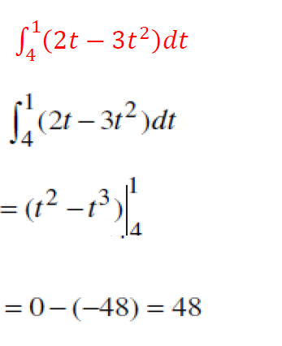
Lecture
08
Extra Practice – Example 19
** EXTRA PRACTISE

Slide 30
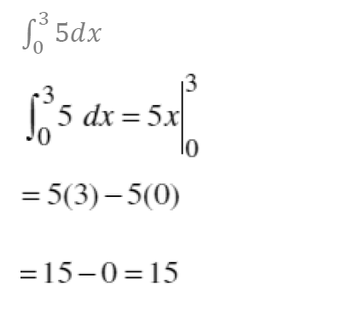
Lecture
08
Extra Practice – Example 20
** EXTRA PRACTISE

Slide 31
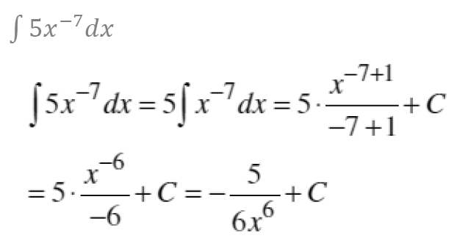
Lecture
07
Extra Practice – Example 21
** EXTRA PRACTISE

Slide 32
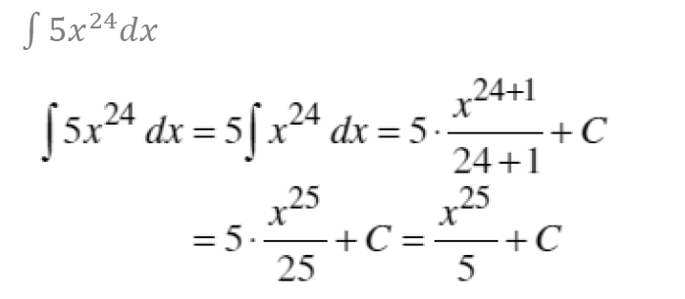
Lecture
07
Extra Practice – Example 22
** EXTRA PRACTISE

Slide 33
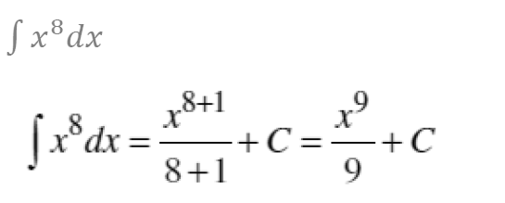
Lecture
07
Extra Practice – Example 23
** EXTRA PRACTISE

Slide 34
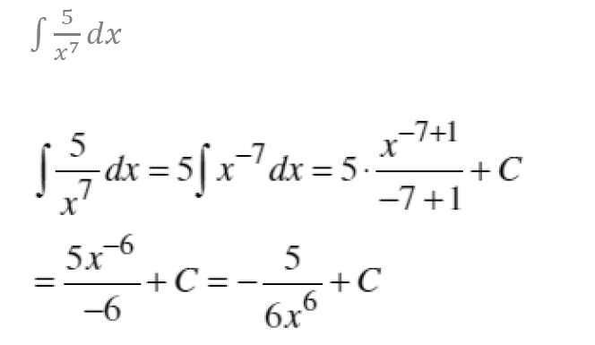
Lecture
07
Extra Practice – Example 24
** EXTRA PRACTISE

Slide 35
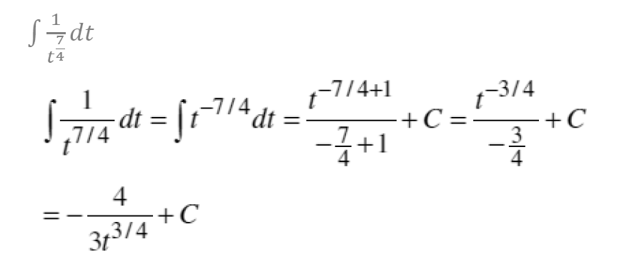
Lecture
07
Extra Practice – Example 25
** EXTRA PRACTISE

Slide 36
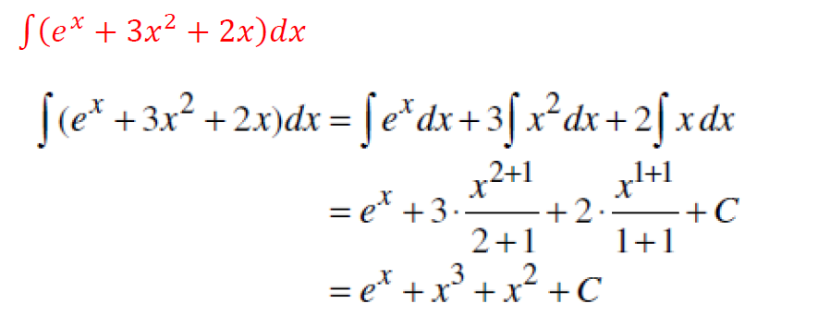
Lecture
07
Extra Practice – Example 26
** EXTRA PRACTISE

Slide 37
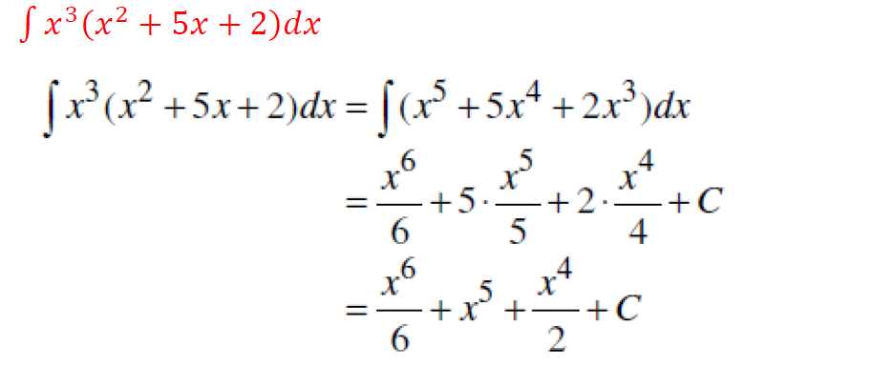
Lecture
07
Extra Practice – Example 27
** EXTRA PRACTISE

Slide 38
Lecture
09
Lecture Summary
Lecture Summary
1- Integration by Parts
2- Integration with Initial Conditions
3- Definite Integral

Slide 39
Lecture
09
Lecture Summary
Lecture Summary
1- Integration by Parts
2- Integration with Initial Conditions
3- Definite Integral

Slide 40



Thank You

