Slide 1


Natural Language
Processing (AI615)
Prepared by Dr. Ashraf Elsayed
Lecture 1

Slide 2


Natural Language
Processing
Lecture 1
Prepared by
Dr. Ashraf Elsayed
www.midocean.ae

Slide 3
Introduction to
Natural Language Processing
www.midocean.ae

Slide 4
What is natural language processing?
Natural language processing (NLP) refers to the branch of computer science—and more specifically, the branch of artificial intelligence or AI—concerned with giving computers the ability to understand text and spoken words in much the same way human beings can.
تشير معالجة اللغة الطبيعية NLP إلى فرع من فروع علوم الحاسب - وبشكل أكثر تحديدًا، فرع من الذكاء الاصطناعي - الذي يهتم بمنح أجهزة الحاسب القدرة على فهم النصوص والكلمات المنطوقة بنفس الطريقة التي يستطيع بها البشر.
www.midocean.ae

Slide 5
NLP combines computational linguistics—rule-based modeling of human language—with statistical, machine learning, and deep learning models. Together, these technologies enable computers to process human language in the form of text or voice data and to ‘understand’ its full meaning, complete with the speaker or writer’s intent and sentiment.
www.midocean.ae

Slide 6
NLP drives computer programs that translate text from one language to another,
Respond to spoken commands,
Summarize large volumes of text rapidly—even in real time.
www.midocean.ae

Slide 7
NLP use cases
Spam detection
Machine translation
Virtual agents and chatbots: Virtual agents such as Apple's Siri and Amazon's Alexa
Social media sentiment analysis
Text summarization
www.midocean.ae

Slide 8
NLP Applications
Classifiers: classify a set of document into categories, (as spam filters)
Information Retrieval: find relevant documents to a given query.
Information Extraction: Extract useful information from resumes; discover names of people and events they participate in, from a document.
Machine Translation: translate text from one human language into another
Question Answering: find answers to natural language questions in a text collection or database…
Summarization: Produce a readable summary, e.g., news about oil today.
Sentiment Analysis: identify people opinion on a subjective.
Speech Processing: book a hotel over the phone, TTS (for the blind)
Spelling checkers, grammar checkers, auto-filling, ….. and more
www.midocean.ae

Slide 9


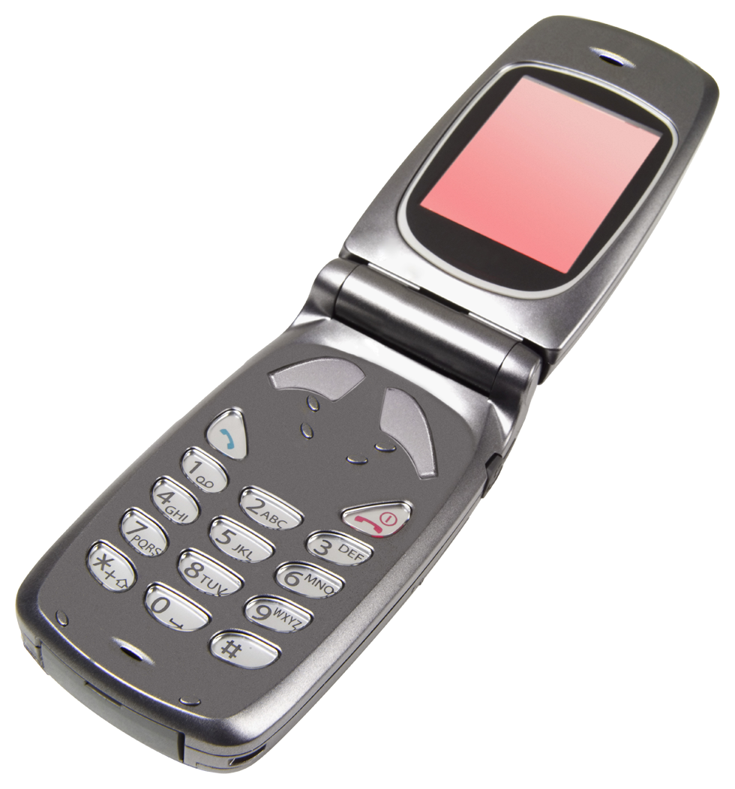

Language Technology
making good progress
Sentiment analysis
still challenging
mostly solved
Best roast chicken in San Francisco!
Question answering (QA)
The waiter ignored us for 20 minutes.
Spam detection
Coreference resolution
Q. How effective is ibuprofen in reducing fever in patients with acute febrile illness?
✓
Let’s go to Agra!
✗
Carter told Mubarak he shouldn’t run again.
Paraphrase
Buy Vvvvvvv
Word sense disambiguation (WSD)
XYZ acquired ABC yesterday
Part-of-speech (POS) tagging
I need new batteries for my mouse.
ABC has been taken over by XYZ
ADJ ADJ NOUN VERB ADV
Summarization
Colorless green ideas sleep furiously.
Parsing
The Dow Jones is up
Economy is good
I can see Alcatraz from the window!
The S&P500 jumped
Named entity recognition (NER)
Machine translation (MT)
Housing prices rose
PERSON ORG LOC
第13届上海国际电影节开幕…
Dialog
Where is Citizen Kane playing in SF?
Einstein met with UN officials in Princeton
The 13th Shanghai International Film Festival…
Information extraction (IE)
Castro Theatre at 7:30. Do you want a ticket?
You’re invited to our dinner party, Friday May 27 at 8:30
Party
May 27
add
www.midocean.ae

Slide 10
Ambiguity makes NLP hard
Ambiguity at multiple levels
Word senses: bank (finance or river ?)
Part of speech: chair (noun or verb ?)
Syntactic structure: I can see a man with a telescope
Multiple: I made her duck
www.midocean.ae

Slide 11
NLP Tasks
NLP applications require several NLP analyses:
  Word tokenization
  Sentence boundary detection
  Part-of-speech (POS) tagging
    to identify the part-of-speech (e.g. noun, verb) of each word
  Named Entity (NE) recognition
    to identify proper nouns (e.g. names of person, location, organization; domain terminologies)
  Parsing
    to identify the syntactic structure of a sentence
  Semantic analysis
    to derive the meaning of a sentence
www.midocean.ae

Slide 12
Part-Of-Speech (POS) Tagging
POS tagging is a process of assigning a POS or lexical class marker to each word in a sentence (and all sentences in a corpus).
Input: the lead paint is unsafe
Output: the/Det lead/N paint/N is/V unsafe/Adj
www.midocean.ae

Slide 13

Named Entity Recognition (NER)
NER is to process a text and identify named entities in a sentence
  e.g. “U.N. official Ekeus heads for Baghdad.”
www.midocean.ae

Slide 14
Parsing
www.midocean.ae

Slide 15
Basic Text Processing
www.midocean.ae

Slide 16
Basic Text Processing
Regular Expressions
www.midocean.ae

Slide 17
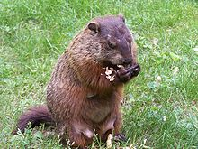
Regular expressions
A formal language for specifying text strings
How can we search for any of these?
  woodchuck
  woodchucks
  Woodchuck
  Woodchucks
www.midocean.ae

Slide 18
Regular Expressions: Disjunctions
Letters inside square brackets []
Ranges [A-Z]
Pattern | Matches
[wW]oodchuck | Woodchuck, woodchuck
[1234567890] | Any digit
Pattern | Matches
[A-Z] | An upper case letter | Drenched Blossoms
[a-z] | A lower case letter | my beans were impatient
[0-9] | A single digit | Chapter 1: Down the Rabbit Hole
www.midocean.ae

Slide 19
Regular Expressions: Negation in Disjunction
Negations [^Ss]
  Carat means negation only when first in []
Pattern | Matches
[^A-Z] | Not an upper case letter | Oyfn pripetchik
[^Ss] | Neither ‘S’ nor ‘s’ | I have no exquisite reason”
[^e^] | Neither e nor ^ | Look here
a^b | The pattern a carat b | Look up a^b now
www.midocean.ae

Slide 20
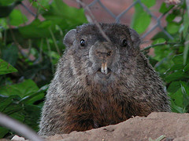
Regular Expressions: More Disjunction
Woodchucks is another name for groundhog!
The pipe | for disjunction
Pattern | Matches
groundhog|woodchuck
yours|mine | yours mine
a|b|c | = [abc]
[gG]roundhog|[Ww]oodchuck
Photo D. Fletcher
www.midocean.ae

Slide 21
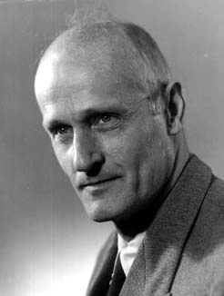
Regular Expressions: ? * + .
Pattern | Matches
colou?r | Optional previous char | color colour
oo*h! | 0 or more of previous char | oh! ooh! oooh! ooooh!
o+h! | 1 or more of previous char | oh! ooh! oooh! ooooh!
baa+ |  | baa baaa baaaa baaaaa
beg.n | Exactly 1 char | begin begun begun beg3n
Stephen C Kleene
Kleene *, Kleene +
www.midocean.ae

Slide 22
Regular Expressions: Anchors ^ $
Pattern | Matches
^[A-Z] | Palo Alto
^[^A-Za-z] | 1 “Hello”
\.$ | The end.
.$ | The end? The end!
www.midocean.ae

Slide 23
Example
Find me all instances of the word “the” in a text.
  the
    Misses capitalized examples
  [tT]he
    Incorrectly returns other or theology
  [^a-zA-Z][tT]he[^a-zA-Z]
www.midocean.ae

Slide 24
Example
  \w = [A-Za-z0-9_]
  \W = [^a-zA-Z0-9_]
  \d = [0-9]
  \D = [^0-9]
  {} use to repeat the previous group
  Example:
  [0-9]{4} matches 2345 1112 4565
  [A-Z]{2,4} matches AD ACC ASDF
  [0-9]{3,} matches any text with at least three digits
  e.g. 34 567 6789 666778
www.midocean.ae

Slide 25
Grouping
  We use () to group characters
  Example
  ([A-Z][0-9]){2} matches A7 A5V6
    does not match A55 B56 RD5
www.midocean.ae

Slide 26
Errors
The process we just went through was based on fixing two kinds of errors
  Matching strings that we should not have matched (there, then, other)
    False positives (Type I)
  Not matching things that we should have matched (The)
    False negatives (Type II)
www.midocean.ae

Slide 27
Errors cont.
In NLP we are always dealing with these kinds of errors.
Reducing the error rate for an application often involves two efforts:
  Increasing accuracy or precision (minimizing false positives)
  Increasing coverage or recall (minimizing false negatives).
www.midocean.ae

Slide 28
Summary
Regular expressions play a surprisingly large role
  Sophisticated sequences of regular expressions are often the first model for any text processing tasks
For many hard tasks, we use machine learning classifiers
  But regular expressions are used as features in the classifiers
  Can be very useful in capturing generalizations
www.midocean.ae

Slide 29
Basic Text Processing
Words and Corpora
www.midocean.ae

Slide 30
How many words?
I do uh main- mainly business data processing
  Fragments, filled pauses
Seuss’s cat in the hat is different from other cats!
  Lemma: same stem and may be different part of speech
    cat and cats = same lemma
  Wordform: the full inflected surface form
    cat and cats = different wordforms
www.midocean.ae

Slide 31
How many words?
they lay back on the San Francisco grass and looked at the stars and their
Type: an element of the vocabulary.
Token: an instance of that type in running text.
How many?
  15 tokens (or 14)
  13 types (or 12) (or 11?)
www.midocean.ae

Slide 32
How many words?
N = number of tokens
V = vocabulary = set of types
  |V| is the size of the vocabulary
Church and Gale (1990): |V| > O(N^{½})
 | Tokens = N | Types = |V|
Switchboard phone conversations | 2.4 million | 20 thousand
Shakespeare | 884,000 | 31 thousand
Google N-grams | 1 trillion | 13 million
www.midocean.ae

Slide 33
Corpora
Words don't appear out of nowhere!
A text is produced by
a specific writer(s),
at a specific time,
in a specific variety,
of a specific language,
for a specific function.
www.midocean.ae
Notes:
Where did these corpora come from? …. These characteristics of a text influence properties of the text.

Slide 34
Corpora vary along dimension like
  Language: 7097 languages in the world
  Variety, like African American Language varieties.
    AAE Twitter posts might include forms like "iont" (I don't)
  Code switching, e.g., Spanish/English, Hindi/English:
    S/E: Por primera vez veo a @username actually being hateful! It was beautiful:)
    [For the first time I get to see @username actually being hateful! it was beautiful:) ]
    H/E: dost tha or ra- hega ... dont wory ... but dherya rakhe
    [“he was and will remain a friend ... don’t worry ... but have faith”]
  Genre: newswire, fiction, scientific articles, Wikipedia
  Author Demographics: writer's age, gender, ethnicity,
www.midocean.ae
Notes:
For example, what language is the text in? As we'll see when we get to talking about word tokenization, what counts as a word can be different in different languages.

Slide 35
Corpus datasheets
Motivation:
Why was the corpus collected?
By whom?
Who funded it?
Situation: In what situation was the text written?
Collection process: If it is a subsample how was it sampled? Was there consent? Pre-processing?
+Annotation process, language variety, demographics, etc.
www.midocean.ae
Notes:
You'll need to make sure you consider all those properties of a text when you are using it for processing purposes. And there are even more properties of corpora that it's important to consider. Who collected this corpus?
Whenever you build a corpus, you should be documenting these decisions in a datasheet for the corpus.

Slide 36
Basic Text Processing
Word tokenization
www.midocean.ae

Slide 37
Text Normalization
Every NLP task needs to do text normalization:
  Segmenting/tokenizing words in running text
  Normalizing word formats
  Segmenting sentences in running text
www.midocean.ae

Slide 38
Space-based tokenization
A very simple way to tokenize
  For languages that use space characters between words
    Arabic, Cyrillic, Greek, Latin, etc., based writing systems
  Segment off a token between instances of spaces
Unix tools for space-based tokenization
  The "tr" command
  Given a text file, output the word tokens and their frequencies
www.midocean.ae
Notes:
Let's now introduce some simple Unix tools for text processing, starting with the UNIX "tr" command for space-based word tokenization. Our goal will be to take a text file and output word tokens and their frequencies.

Slide 39
Simple Tokenization in UNIX
Given a text file, output the word tokens and their frequencies
tr -sc ’A-Za-z’ ’\n’ < shakes.txt
| sort
| uniq –c
1945 A
72 AARON
19 ABBESS
5 ABBOT
... ...
Change all non-alpha to newlines
Sort in alphabetical order
Merge and count each type
25 Aaron
6 Abate
1 Abates
5 Abbess
6 Abbey
3 Abbot
.... …
www.midocean.ae

Slide 40
The first step: tokenizing
tr -sc ’A-Za-z’ ’\n’ < shakes.txt | head
THE
SONNETS
by
William
Shakespeare
From
fairest
creatures
We
...
www.midocean.ae

Slide 41
The second step: sorting
tr -sc ’A-Za-z’ ’\n’ < shakes.txt | sort | head
A
A
A
A
A
A
A
A
A
...
www.midocean.ae

Slide 42
More counting
Merging upper and lower case
tr ‘A-Z’ ‘a-z’ < shakes.txt | tr –sc ‘A-Za-z’ ‘\n’ | sort | uniq –c
Sorting the counts
tr ‘A-Z’ ‘a-z’ < shakes.txt | tr –sc ‘A-Za-z’ ‘\n’ | sort | uniq –c | sort –n –r
23243 the
22225 i
18618 and
16339 to
15687 of
12780 a
12163 you
10839 my
10005 in
8954 d
What happened here?
www.midocean.ae

Slide 43
Issues in Tokenization
Can't just blindly remove punctuation:
  m.p.h., Ph.D., AT&T, cap’n
  prices ($45.55)
  dates (01/02/06)
  URLs (http://www.stanford.edu)
  hashtags (#nlproc)
  email addresses (someone@cs.colorado.edu)
Clitic: a word that doesn't stand on its own
  "are" in we're, French "je" in j'ai, "le" in l'honneur
When should multiword expressions (MWE) be words?
  New York, rock ’n’ roll
www.midocean.ae
Notes:
Of course, tokenization in most real situations isn't as simple as I've suggested with the simple UNIX tools.

Slide 44
Tokenization in NLTK
Bird, Loper and Klein (2009), Natural Language Processing with Python. O’Reilly
www.midocean.ae
Notes:
So most standard tokenization programs for English or languages with similar writing systems need to deal with each of these issues. Here's a simple python tokenizer in the Natural Language Toolkit that has little regular expressions for dealing with hypthens, and currency, and whatnot

Slide 45
Tokenization in languages without spaces
Many languages (like Chinese, Japanese, Thai) don't use spaces to separate words!
How do we decide where the token boundaries should be?
www.midocean.ae
Notes:
But wait, what about all the languages that don't have spaces!

Slide 46
How to do word tokenization in Chinese?
姚明进入总决赛 “Yao Ming reaches the finals”
3 words?
姚明 进入 总决赛
YaoMing reaches finals
5 words?
姚 明 进入 总 决赛
Yao Ming reaches overall finals
7 characters? (don't use words at all):
姚 明 进 入 总 决 赛
Yao Ming enter enter overall decision game

Slide 47
How to do word tokenization in Chinese?
姚明进入总决赛 “Yao Ming reaches the finals”
3 words?
姚明 进入 总决赛
YaoMing reaches finals
5 words?
姚 明 进入 总 决赛
Yao Ming reaches overall finals
7 characters? (don't use words at all):
姚 明 进 入 总 决 赛
Yao Ming enter enter overall decision game

Slide 48
How to do word tokenization in Chinese?
姚明进入总决赛 “Yao Ming reaches the finals”
3 words?
姚明 进入 总决赛
YaoMing reaches finals
5 words?
姚 明 进入 总 决赛
Yao Ming reaches overall finals
7 characters? (don't use words at all):
姚 明 进 入 总 决 赛
Yao Ming enter enter overall decision game
www.midocean.ae

Slide 49
Word tokenization / segmentation
So in Chinese it's common to just treat each character (zi) as a token.
So the segmentation step is very simple
In other languages (like Thai and Japanese), more complex word segmentation is required.
The standard algorithms are neural sequence models trained by supervised machine learning.
www.midocean.ae

Slide 50


Thank You

