Slide 1



Application Layer
Lecture 8
CCNA – Introduction to Networks V7.0 (ITN)
Prepared by
Dr. Abdelrhman Ahmed

Slide 2
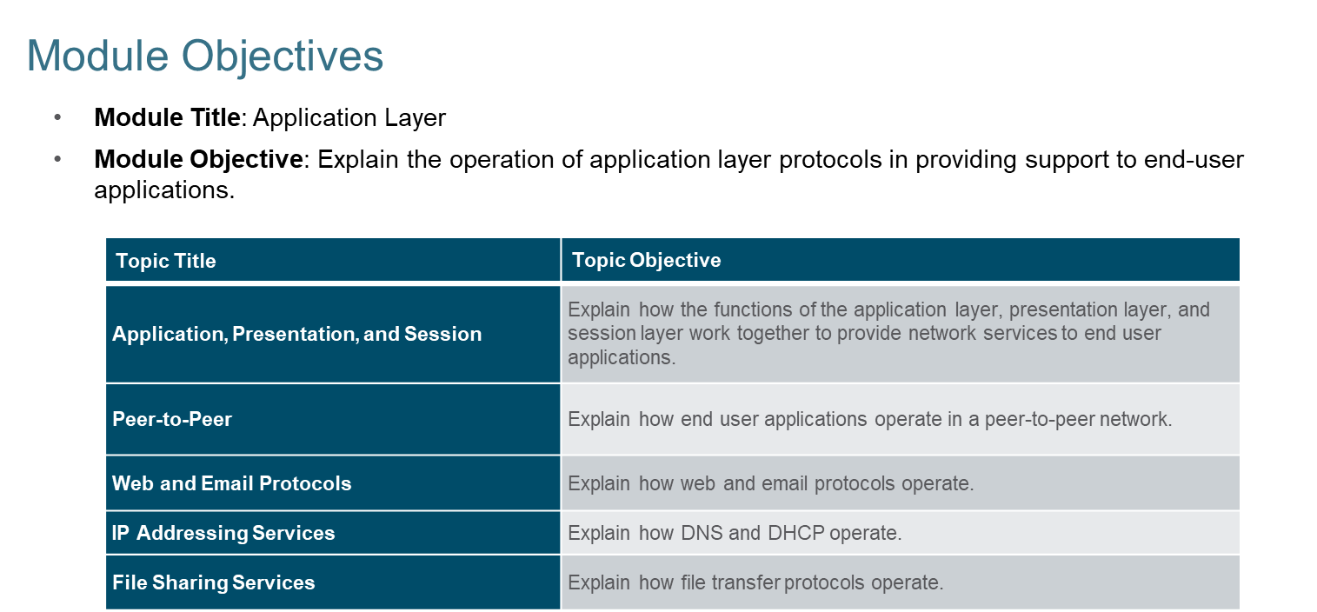
Chapter
Module Objectives
08

Slide 3
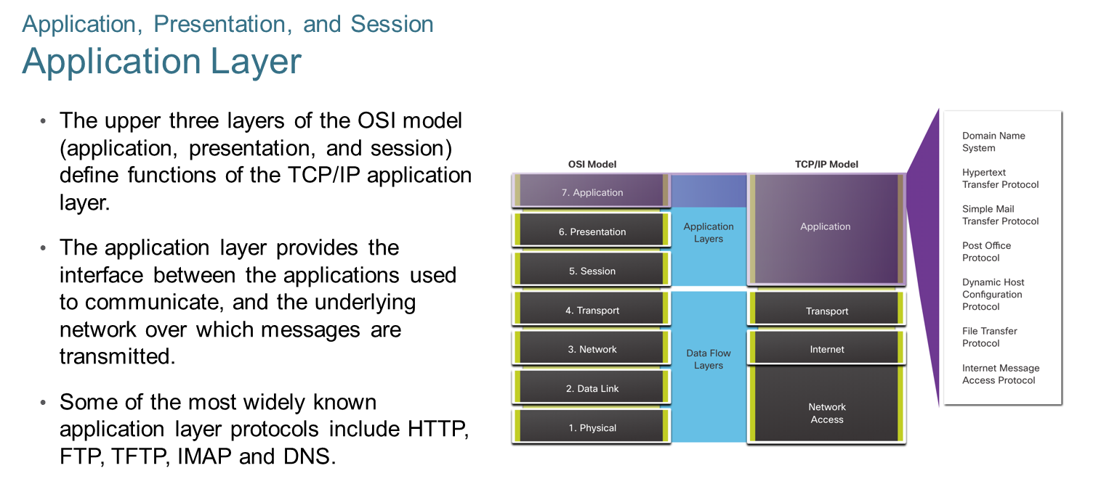
Chapter
Application, Presentation, and Session
08

Slide 4
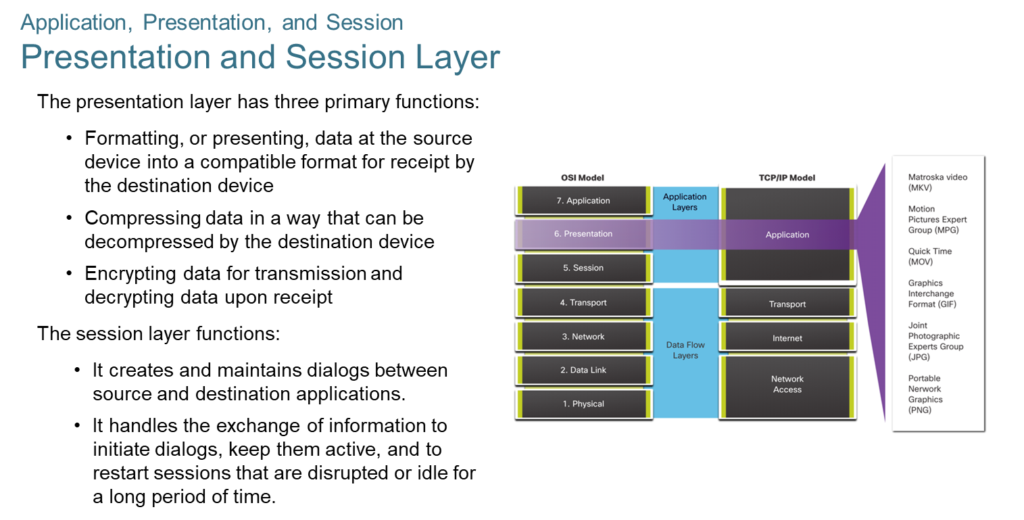
Chapter
Application, Presentation, and Session
08

Slide 5
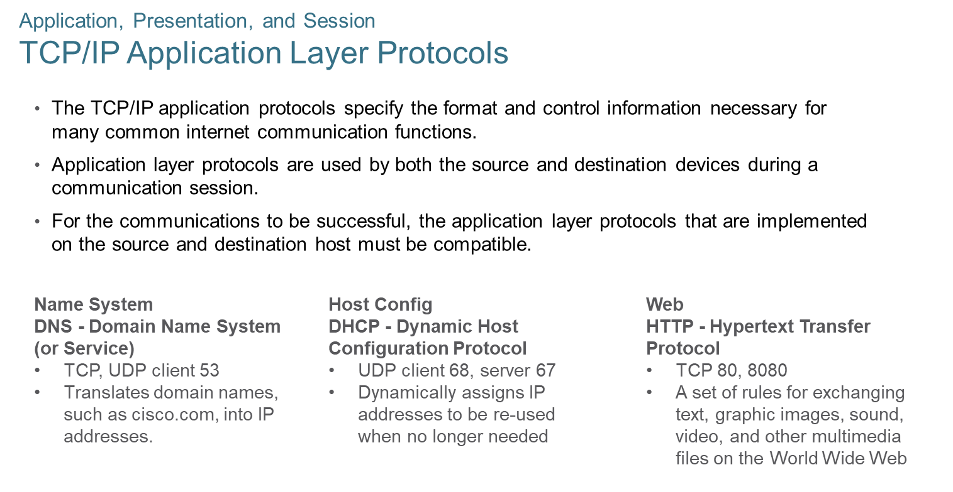
Chapter
Application, Presentation, and Session
08

Slide 6
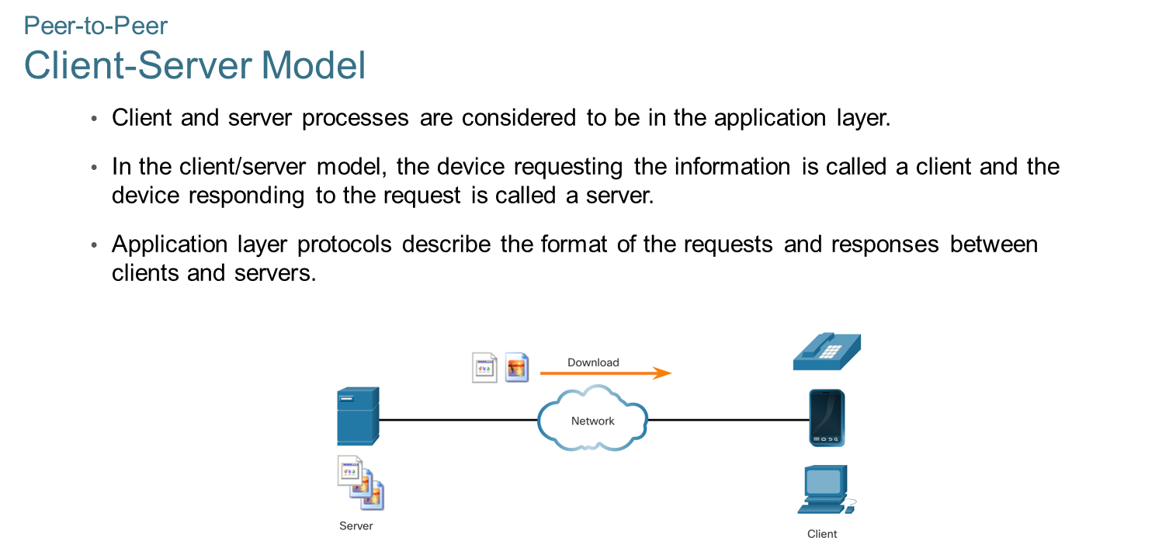
Chapter
Peer-to-Peer
08

Slide 7
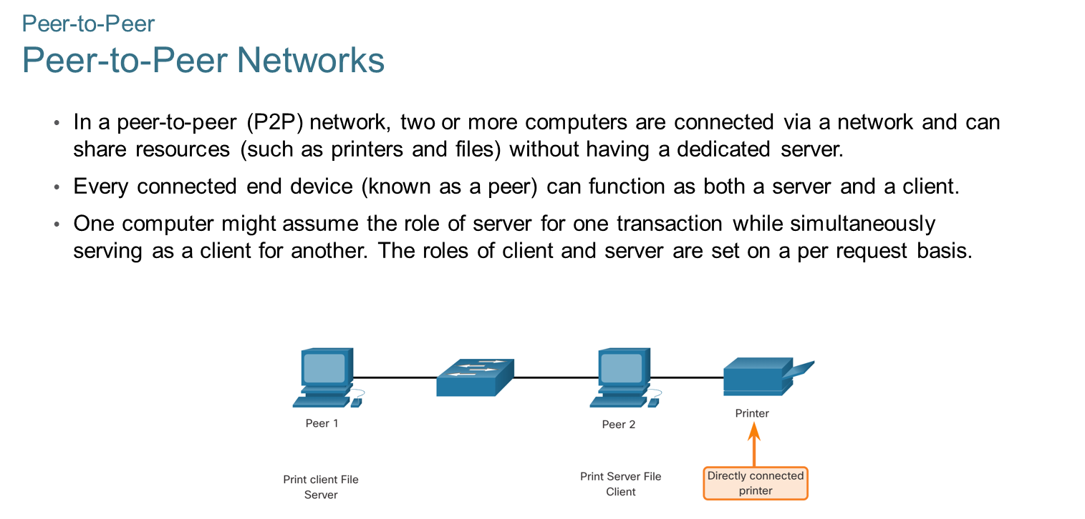
Chapter
Peer-to-Peer
08

Slide 8
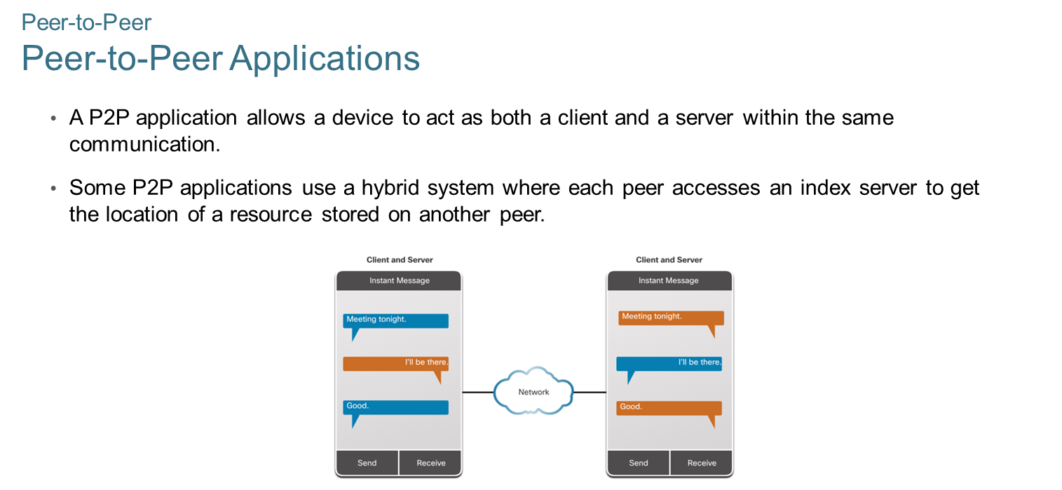
Chapter
Peer-to-Peer
08

Slide 9
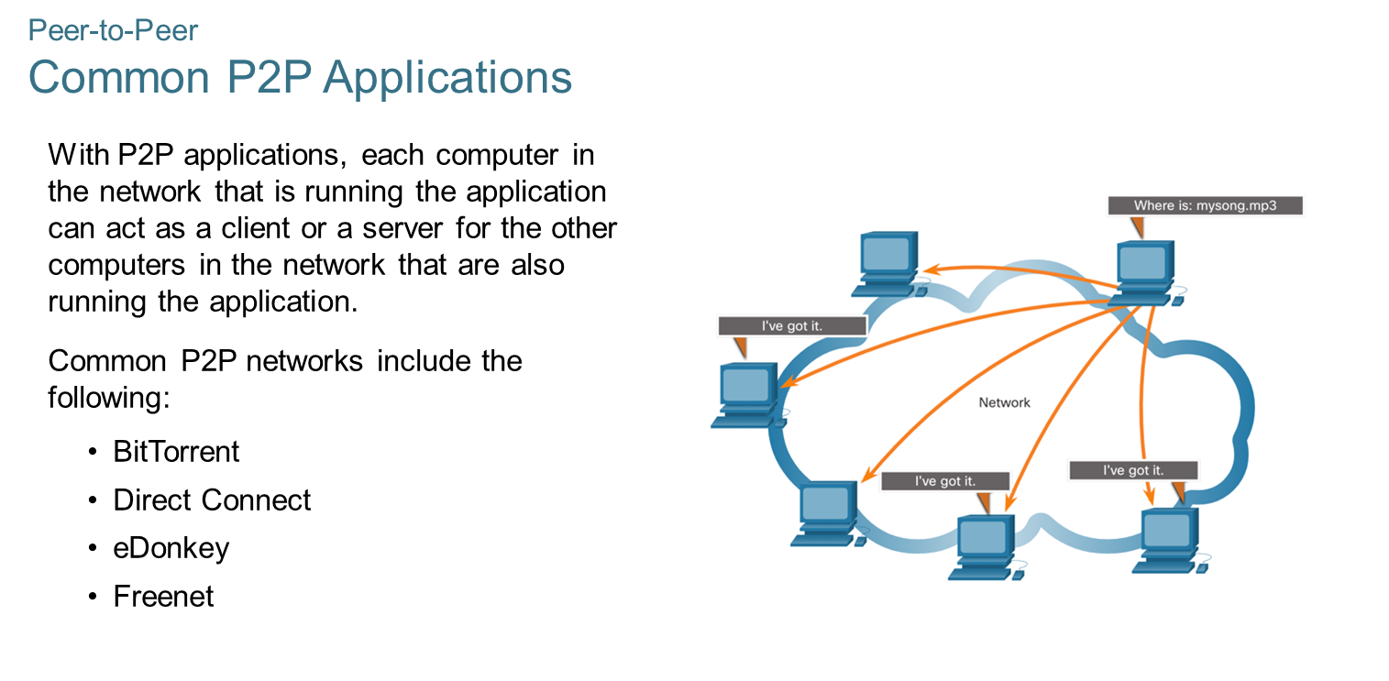
Chapter
Peer-to-Peer
08

Slide 10
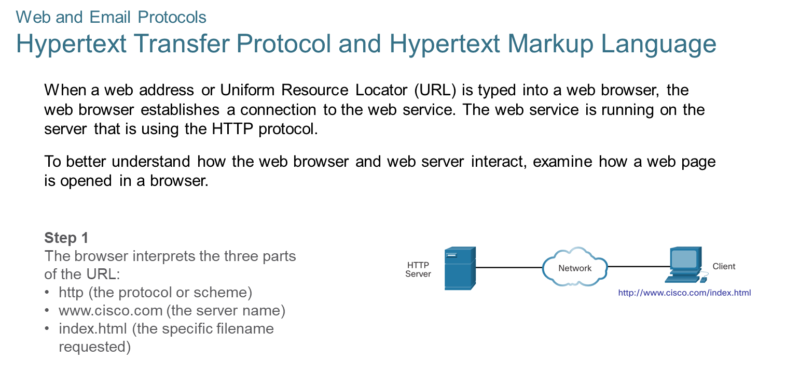
Chapter
Web and Email Protocols
08

Slide 11
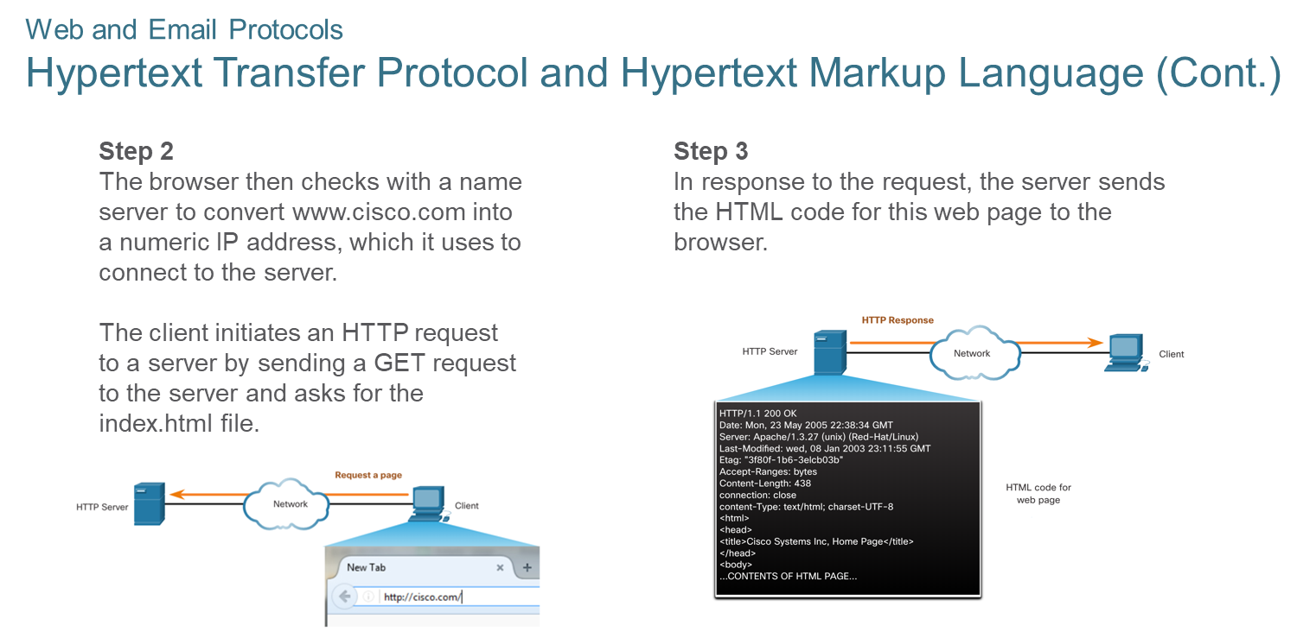
Chapter
Web and Email Protocols
08

Slide 12
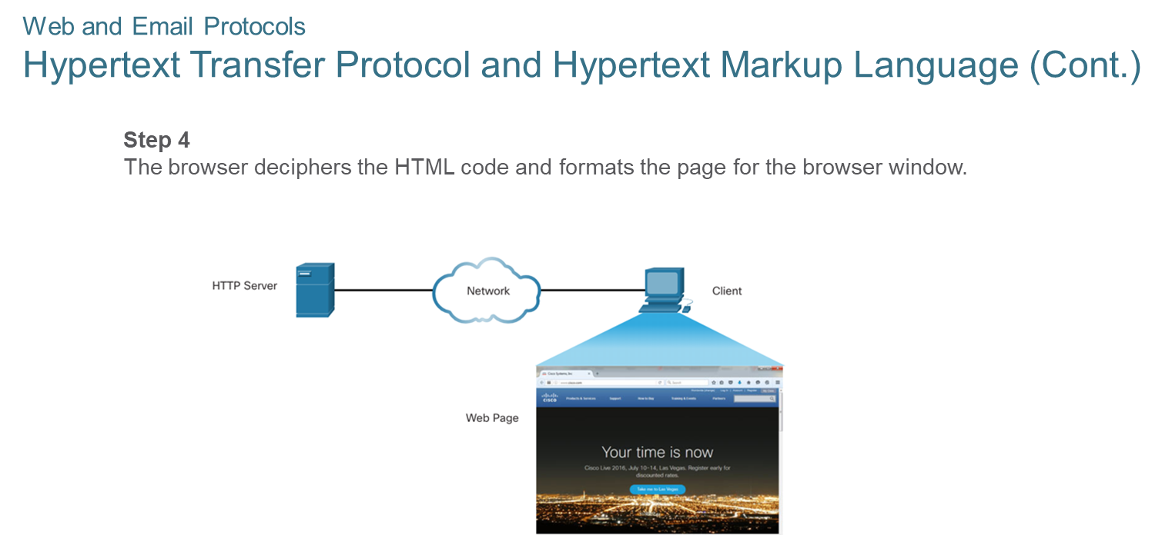
Chapter
Web and Email Protocols
08

Slide 13
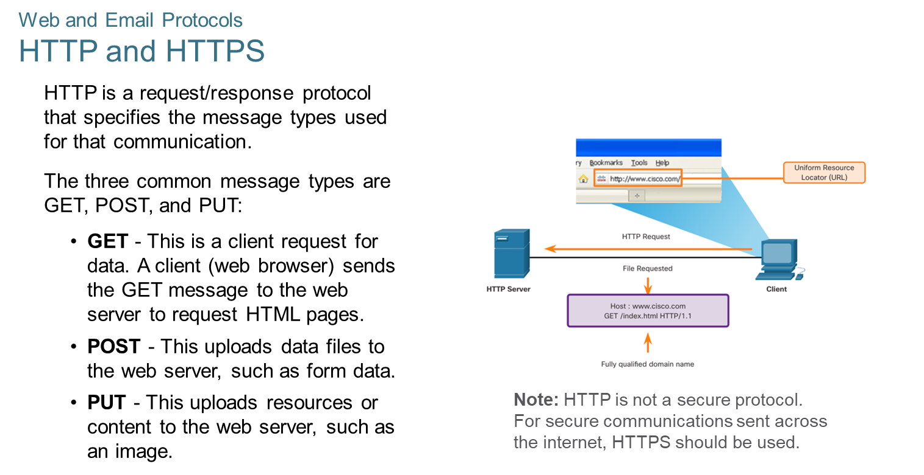
Chapter
08
Web and Email Protocols

Slide 14
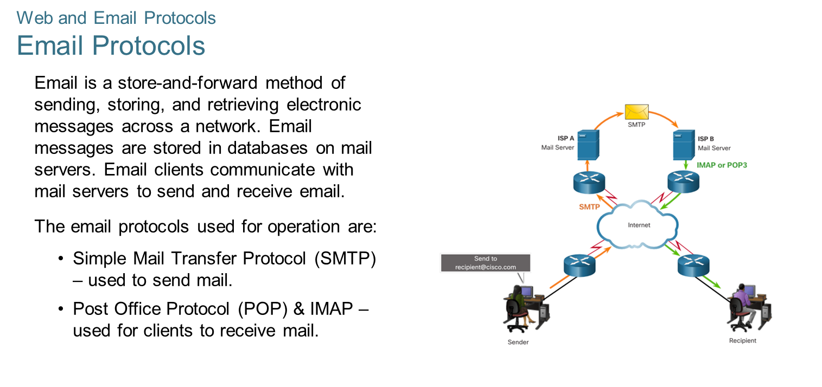
Chapter
08
Web and Email Protocols

Slide 15
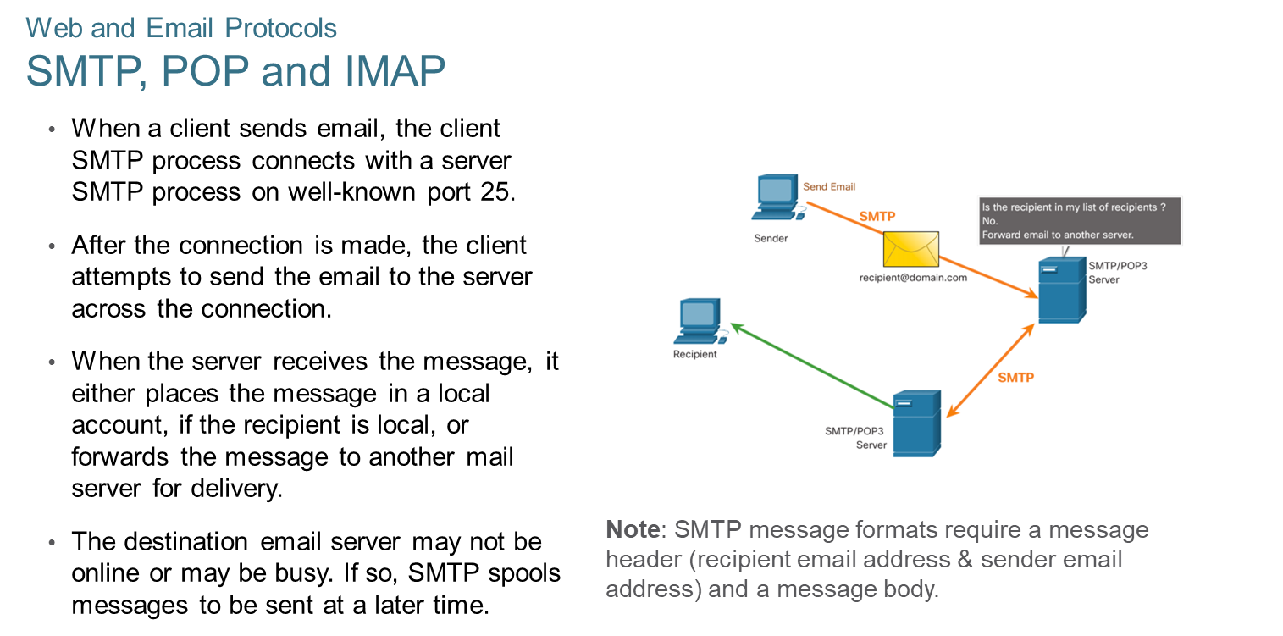
Chapter
08
Web and Email Protocols

Slide 16
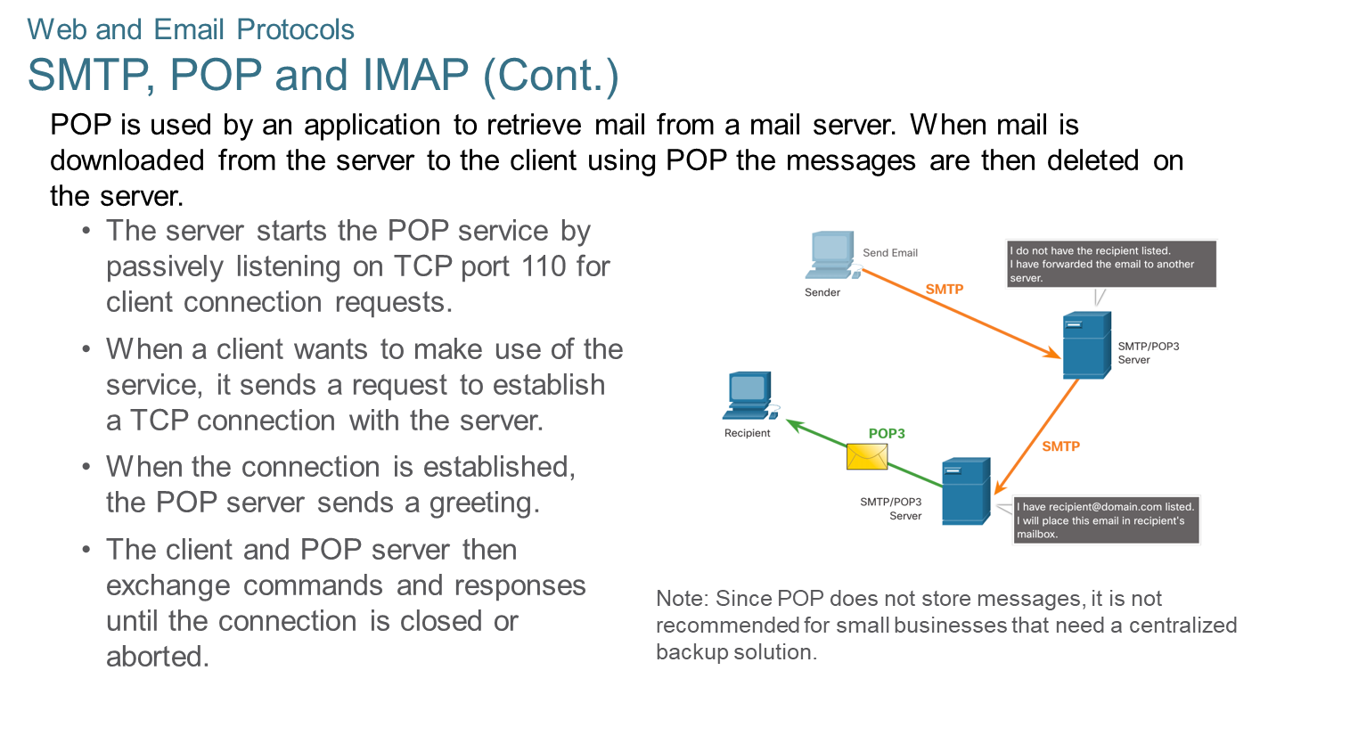
Chapter
08
Web and Email Protocols

Slide 17
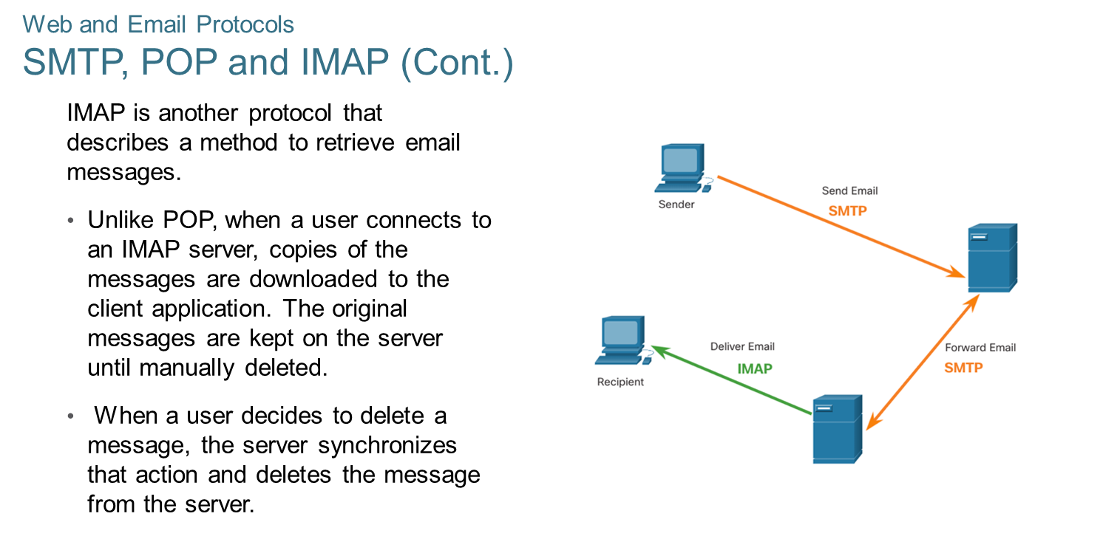
Chapter
08
Web and Email Protocols

Slide 18
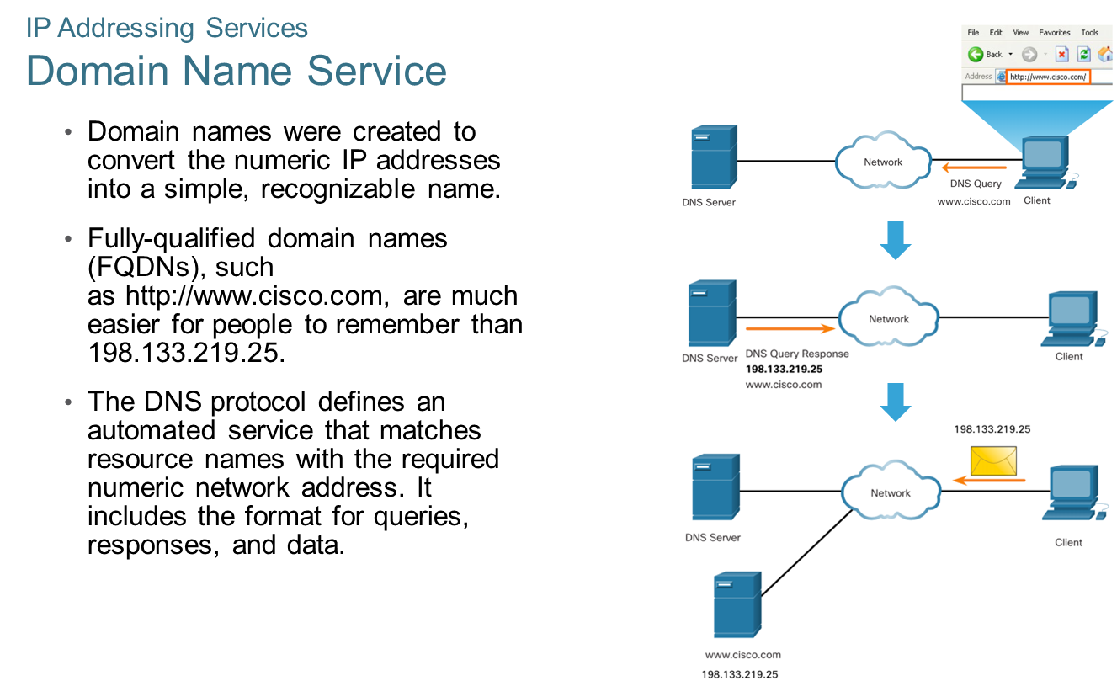
Chapter
08
IP Addressing Services

Slide 19
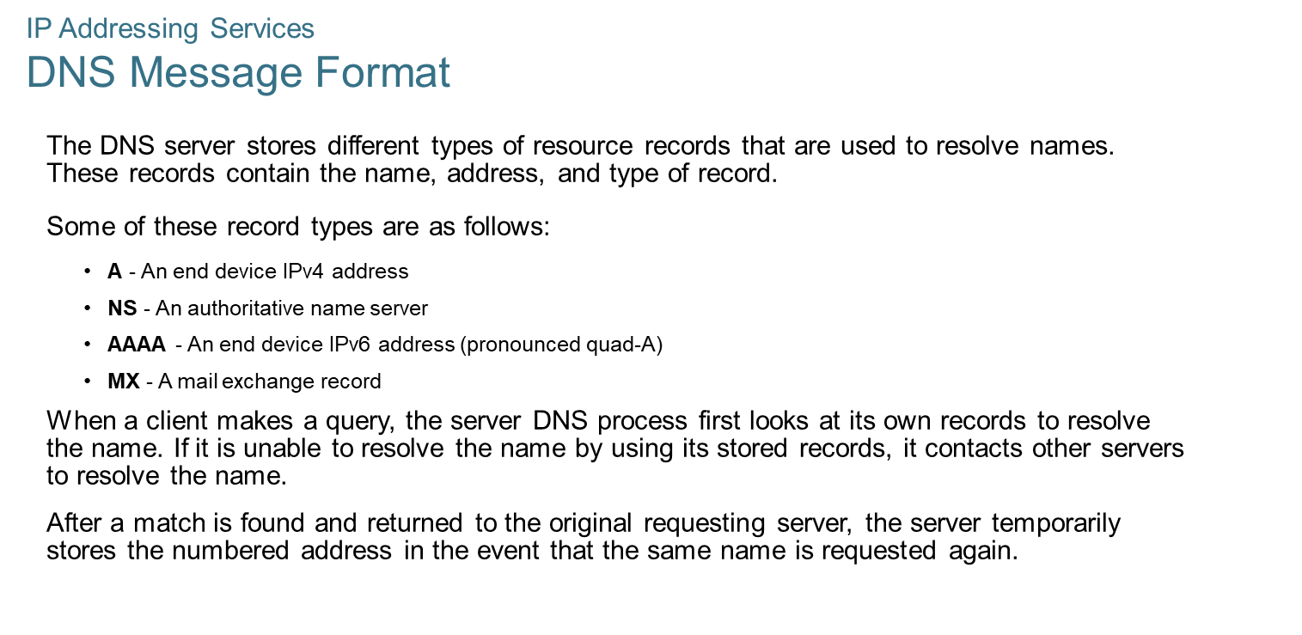
Chapter
08
IP Addressing Services

Slide 20
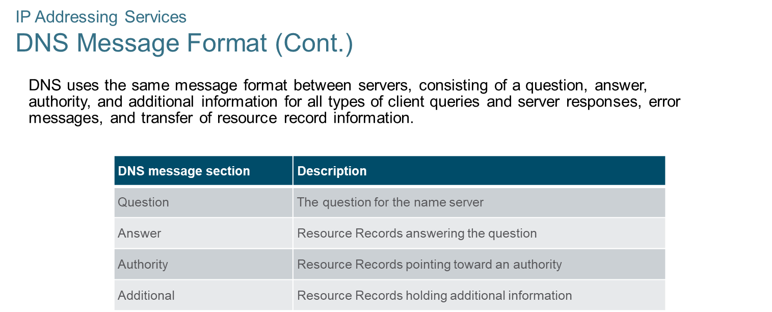
Chapter
08
IP Addressing Services

Slide 21
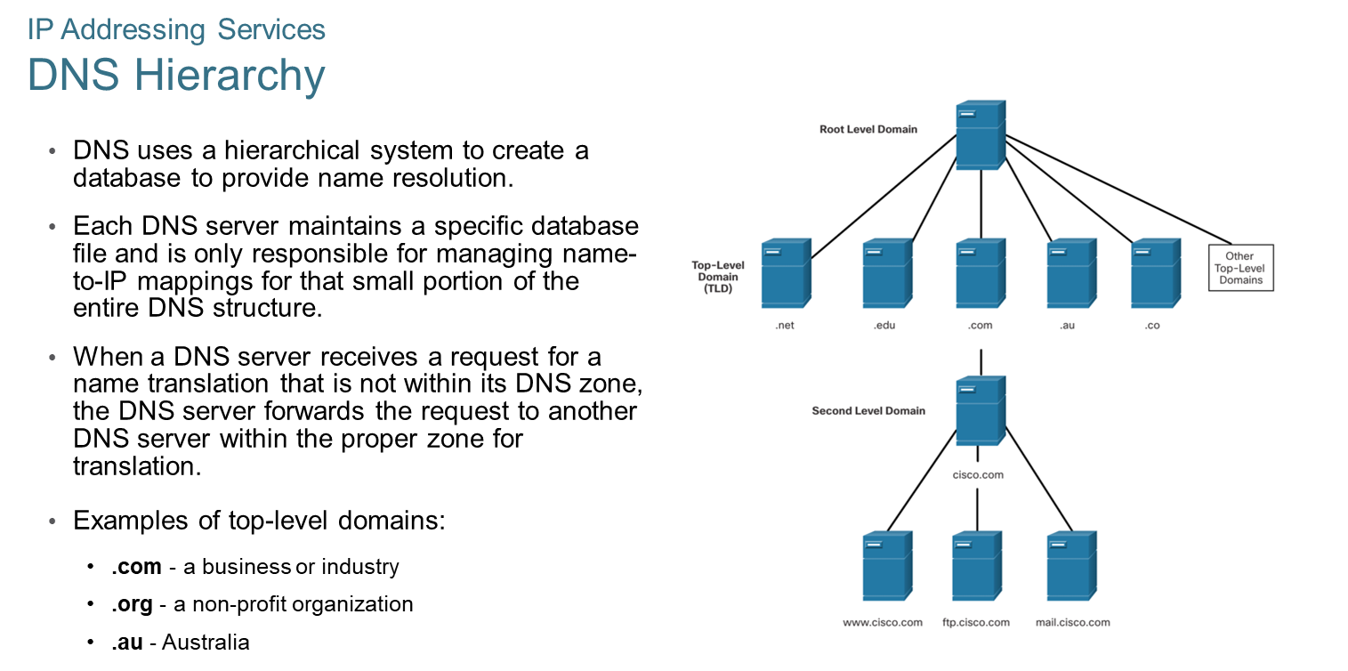
Chapter
08
IP Addressing Services

Slide 22
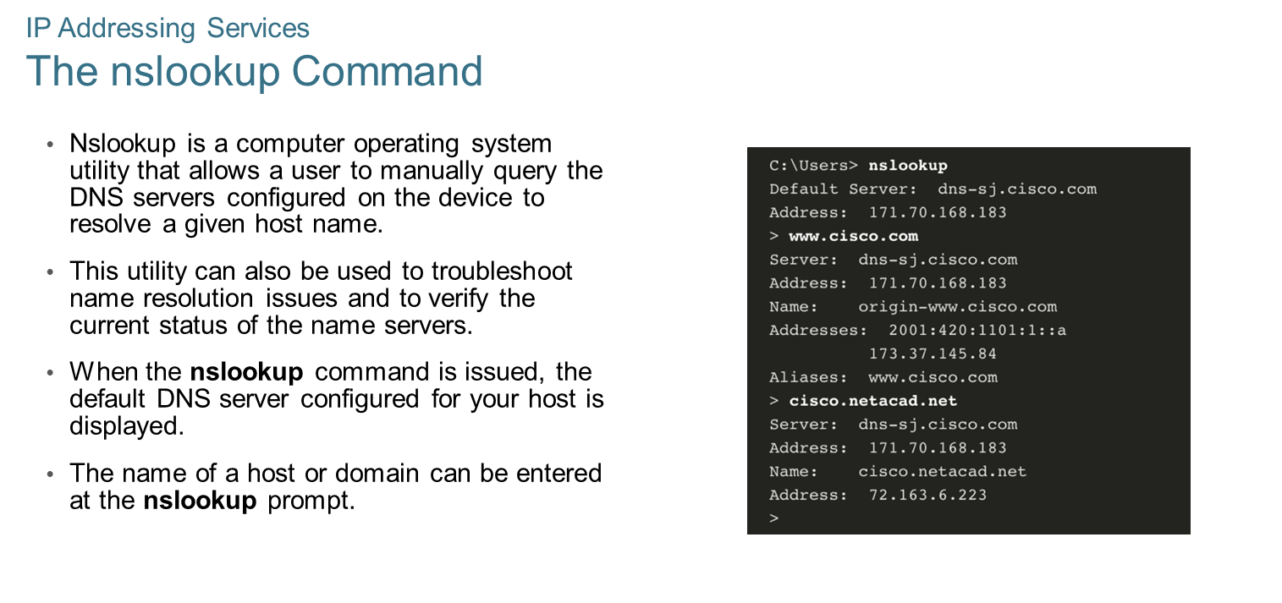
Chapter
08
IP Addressing Services

Slide 23
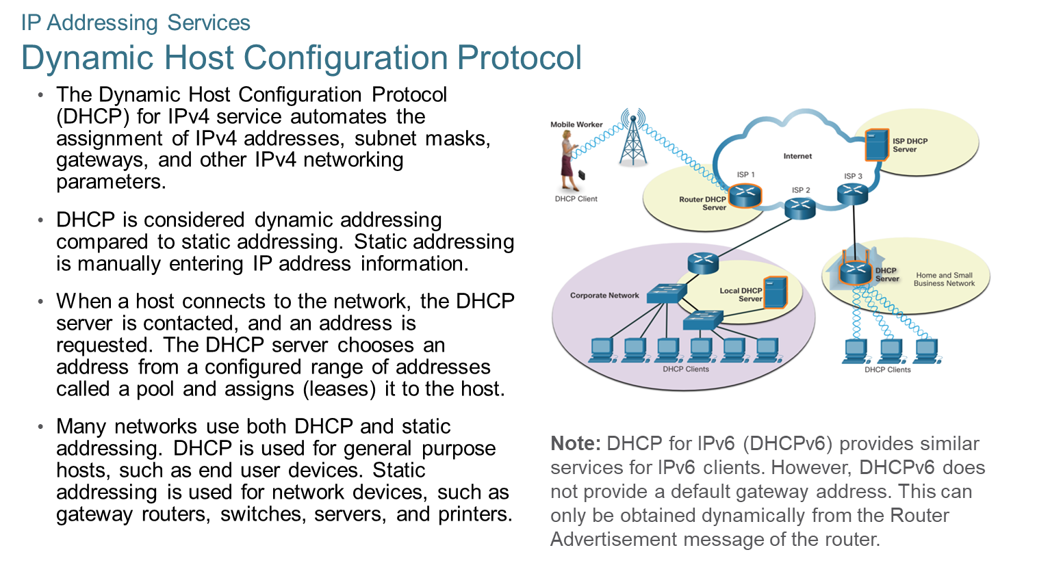
Chapter
08
IP Addressing Services

Slide 24
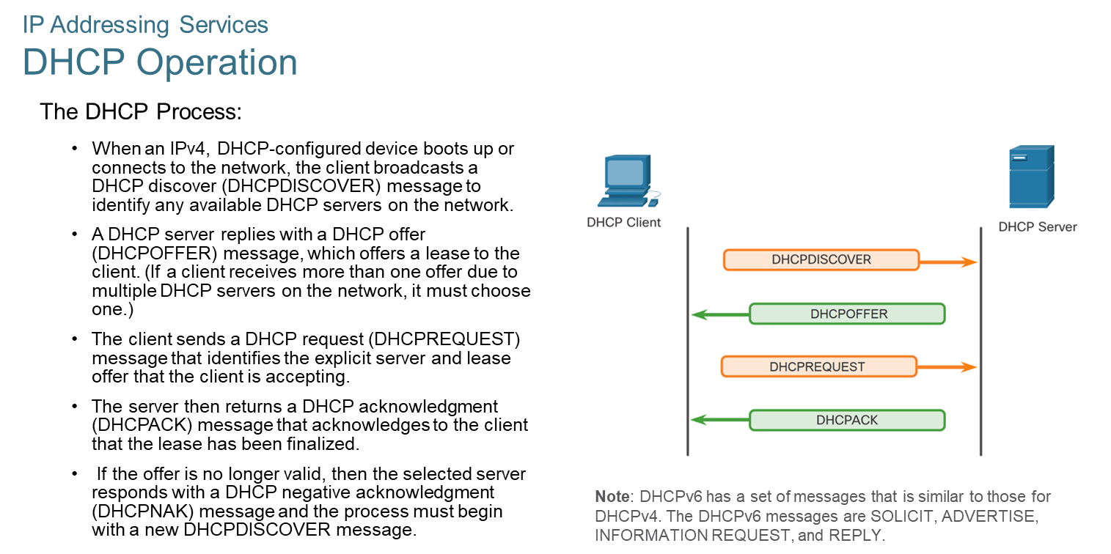
Chapter
08
IP Addressing Services

Slide 25
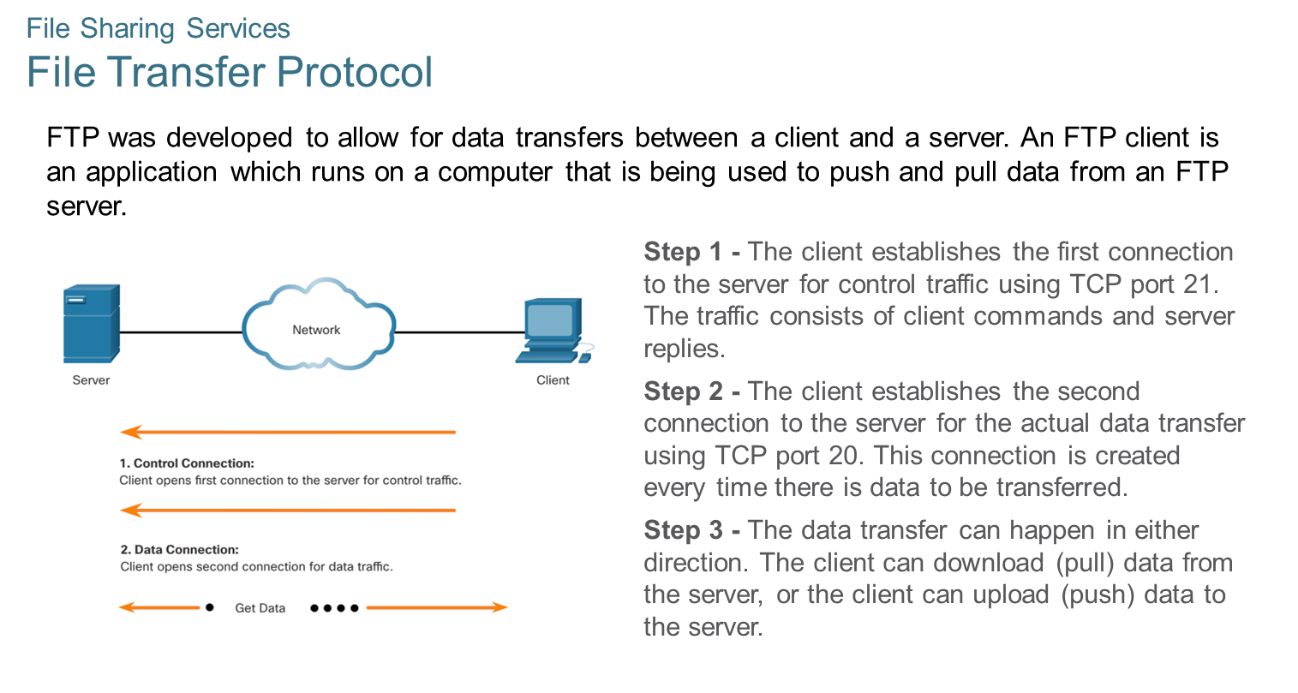
Chapter
08
File Sharing Services

Slide 26
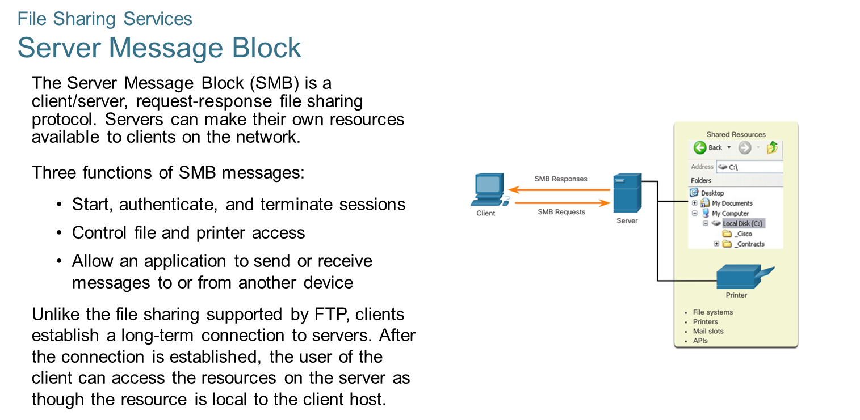
Chapter
08
File Sharing Services

Slide 27



Thank You

