Slide 1


Inventory
Management
Prepared by Dr. Nagwan AlQershi
Lecture 8

Slide 2
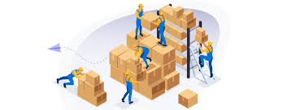
Inventory
Inventory
  A stock or store of goods
Independent-demand items
  Items that are ready to be sold or used
The average inventory level is positively related to order size.
Inventories are a vital part of business:
necessary for operations
contribute to customer satisfaction
  A “typical” firm has roughly 30% of its current assets and as much as 90% of its working capital invested in inventory
12-2

Slide 3
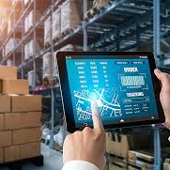
What are the 5 elements of inventory management?
An efficient inventory management process should cover:
Planning & forecasting
purchasing & ordering
receiving & storing
packing, inventory tracking,
order fulfillment.
Inventory is at the core of any successful business, ensuring an appropriate balance between supply and demand.

Slide 4
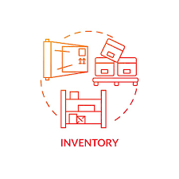
Types of Inventory
Raw materials and purchased parts
Work-in-process (WIP)
Finished goods inventories or merchandise
Tools and supplies
Maintenance and repairs (MRO) inventory
Goods-in-transit to warehouses or customers (pipeline inventory)
12-4

Slide 5
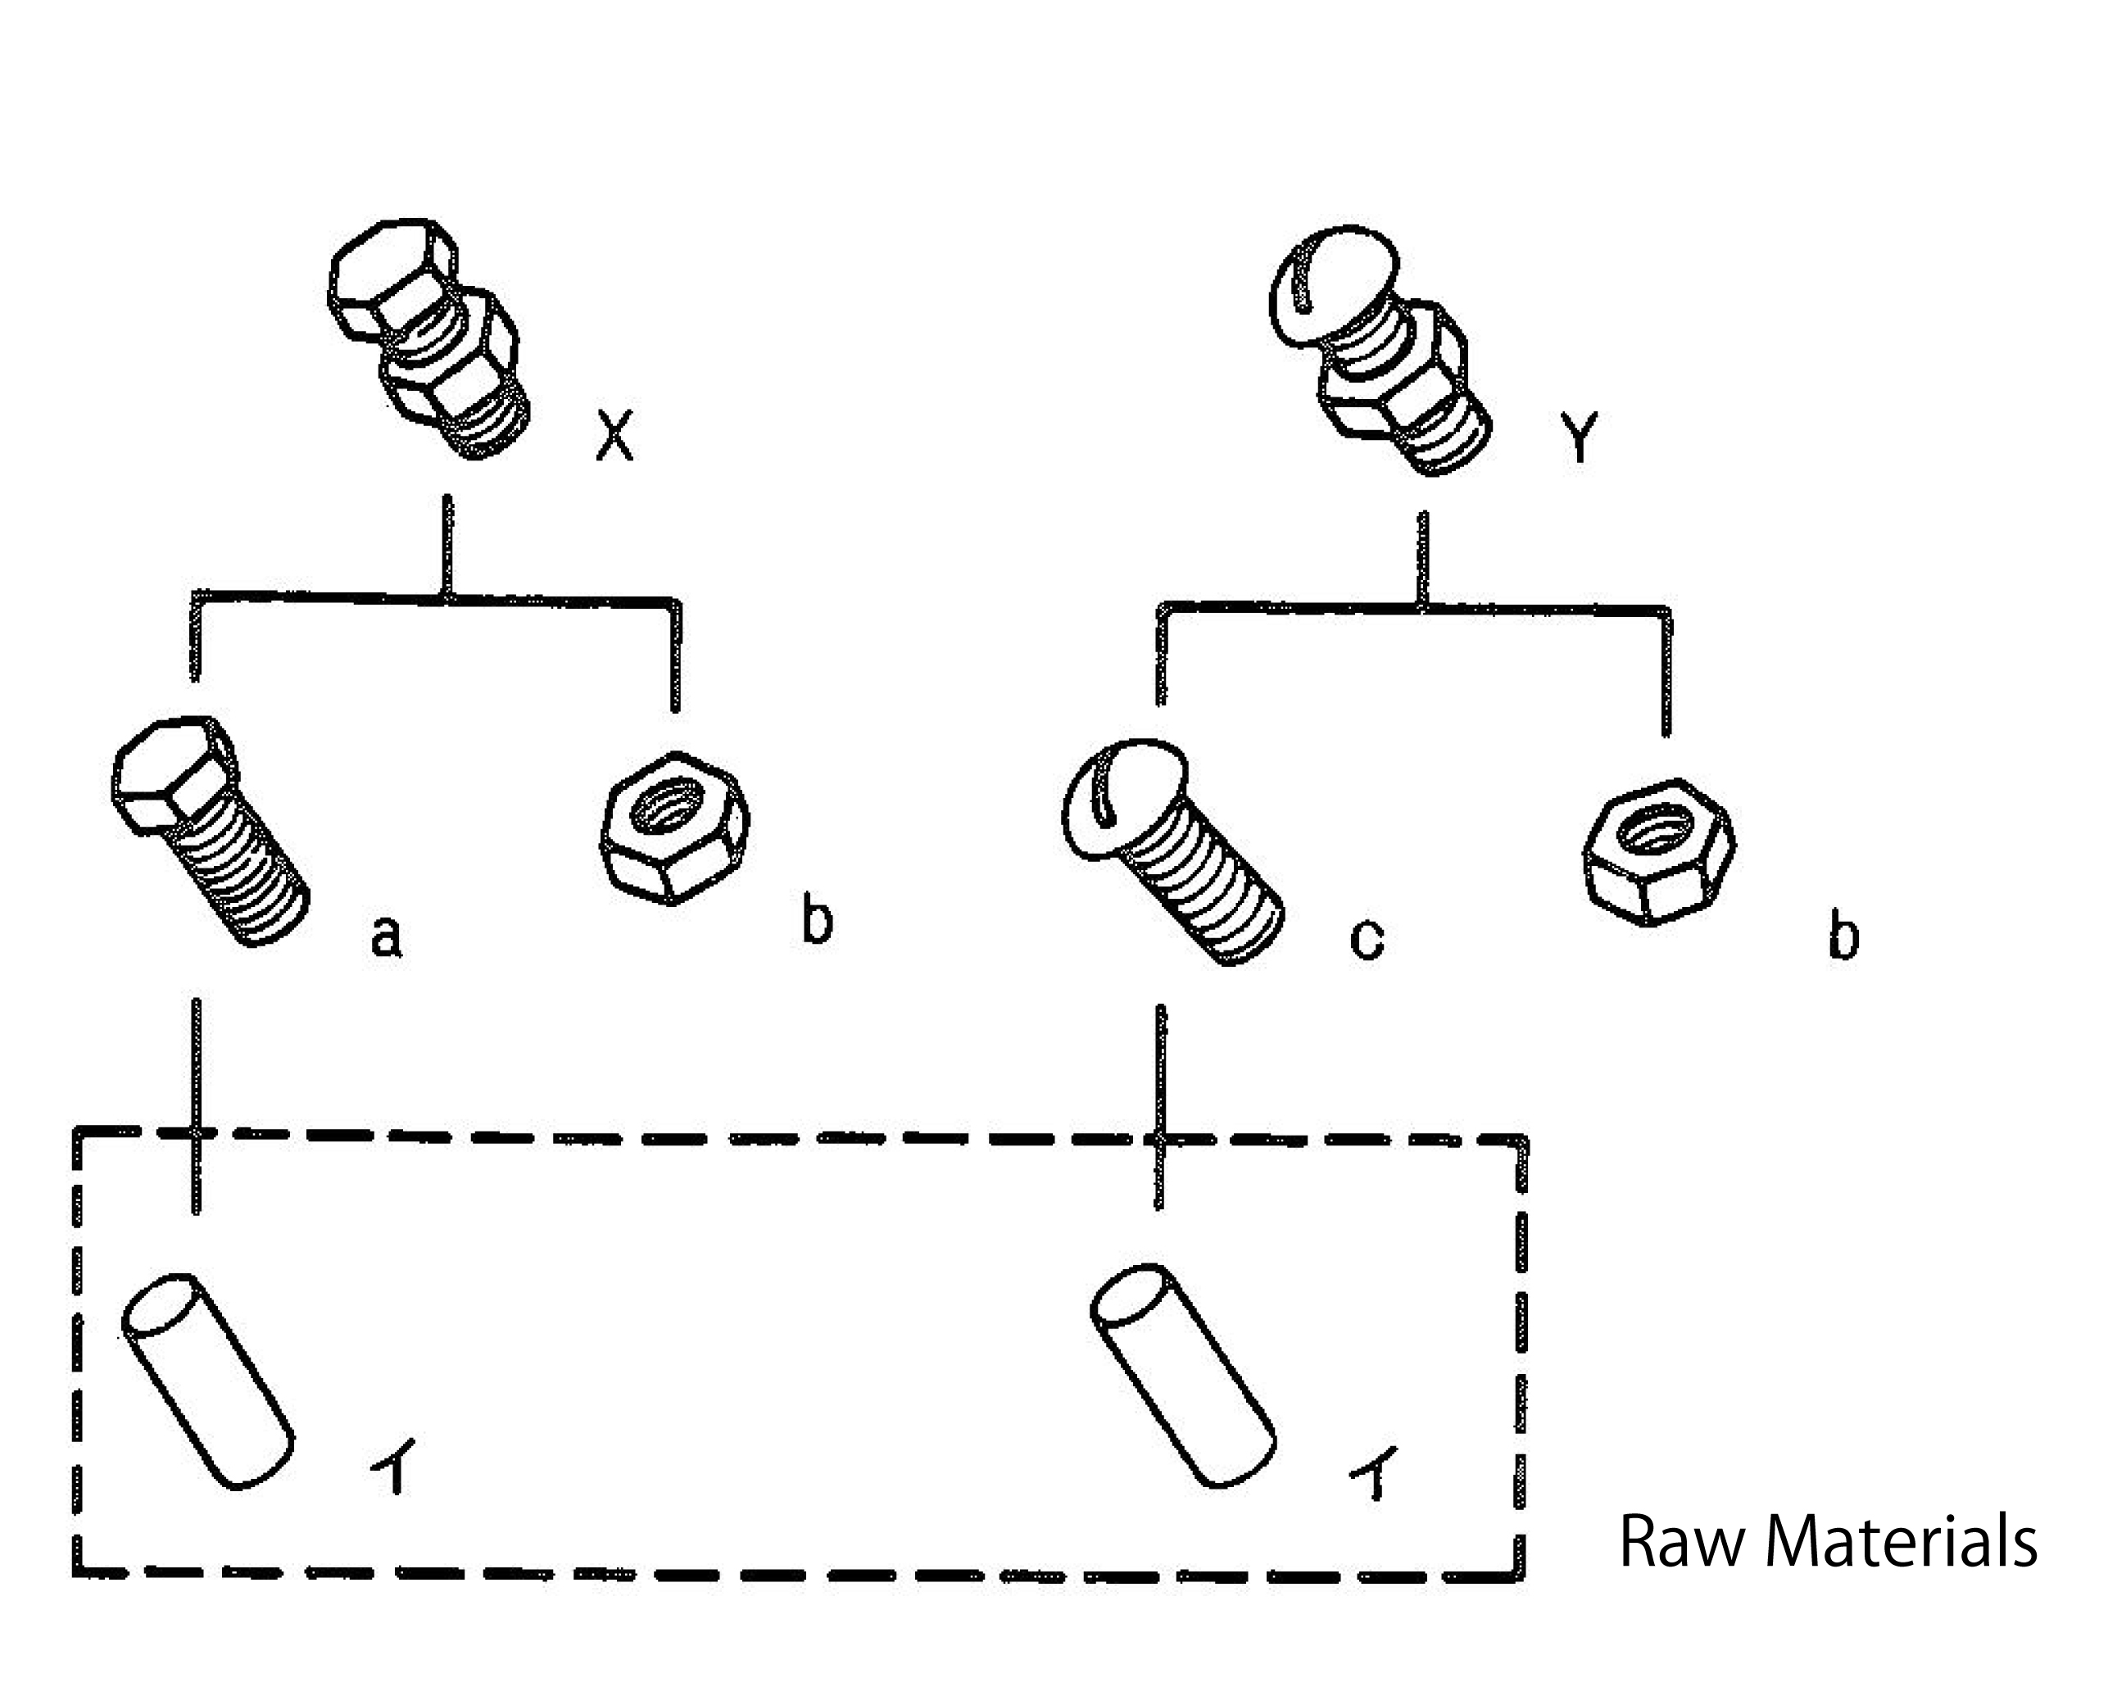
Types of Inventory: # 1
Raw materials and purchased parts
the total cost of a manufacturer's components, subassemblies, and supplies in stock that are not currently in production. There are two types of raw materials that go into making a final product: Direct materials (DM) Indirect materials (IM)

Slide 6

Types of Inventory: # 2
Work-in-process (WIP)
Work in process (WIP) inventory refers to materials that are waiting to be assembled and sold. WIP inventory includes the cost of raw materials, labor, and overhead costs needed to manufacture a finished product

Slide 7
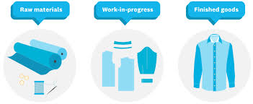
Types of Inventory: # 3
Finished goods inventories or merchandise
Finished goods are products that go through the production process and are completed and ready for sale. Retailers typically refer to this inventory as merchandise. Common examples of merchandise include electronics, clothes, and cars held by retailers.

Slide 8
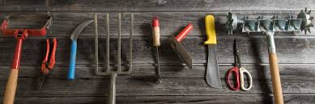
Types of Inventory: # 4
Tools and supplies
Inventory is items subject to sale, rent or leases. Supplies are things consumed in your normal course of business

Slide 9
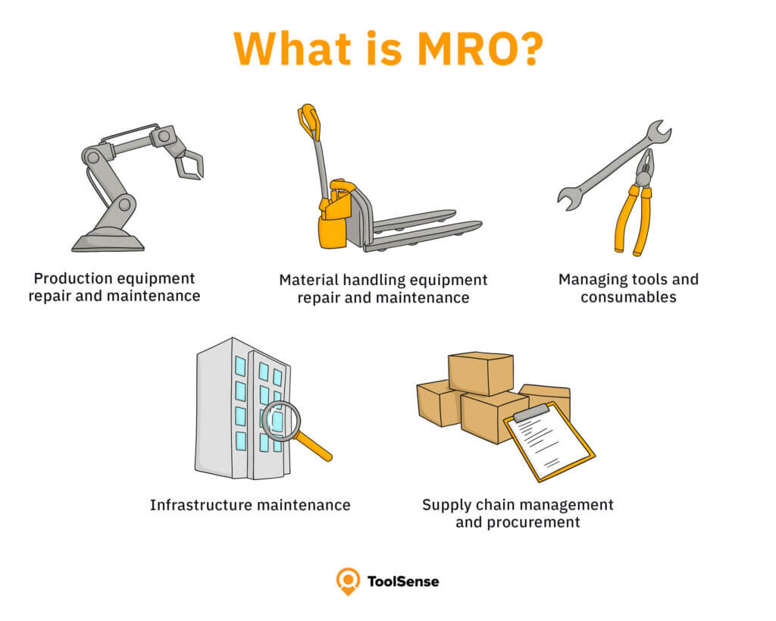
Types of Inventory: # 5
Maintenance and repairs (MRO) inventory
MRO inventory comprises the consumable materials, equipment and supplies needed for maintenance, repair and operations activities. MRO includes items that are used in a production process but — unlike raw materials — are not incorporated into a company's finished products

Slide 10
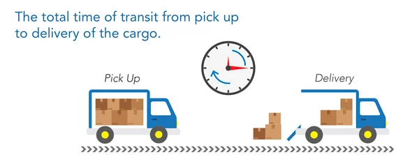
Types of Inventory: # 6
Goods-in-transit to warehouses or customers (pipeline inventory)
In-transit inventory is products that have been shipped by the seller but have yet to reach the customer. These goods are also called goods-in-transit, pipeline inventory, or transportation inventory.

Slide 11
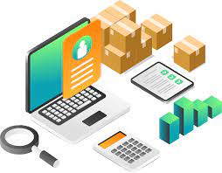
Inventory Functions
Inventories serve several functions such as:
  To meet anticipated customer demand
  To smooth production requirements
  To decouple operations
  To protect against stockouts
  To take advantage of order cycles
  To hedge against price increases
  To permit operations
  To take advantage of quantity discounts
Decoupling refers to buffering operations in manufacturing.
12-11

Slide 12

Objectives of Inventory Control
Inventory management has two main concerns:
  Level of customer service
    Having the right goods available in the right quantity in the right place at the right time
12-12

Slide 13
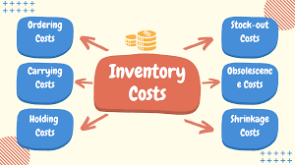
Objectives of Inventory Control
  2. Costs of ordering and carrying inventories
    The overall objective of inventory management is to achieve satisfactory levels of customer service while keeping inventory costs within reasonable bounds
      Measures of performance
      Customer satisfaction
          Number and quantity of backorders
          Customer complaints
        3. Inventory turnover
There is a limit to how high service level can go; if the competitor's service level is 90 percent, the retailer can't double that.

Slide 14
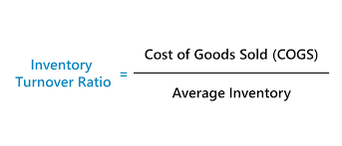
Inventory Turnover Ratio
Ratio of annual cost of goods sold to average inventory investment
  How many times a year the inventory is sold
  Higher the better as it implies more efficient use of the inventory
Larger order quantities lead to higher inventory carrying cost.
12-14

Slide 15
Effective Inventory Management
Requires:
  A system keep track of inventory
  A reliable forecast of demand
  Knowledge of lead time and lead time variability
  Reasonable estimates of
    Holding costs
    Ordering costs
    Shortage costs
  A classification system for inventory items
Many buffers increase costs across supply chains.
12-15

Slide 16
Inventory Counting Systems
Periodic system
  Physical count of items in inventory made at periodic intervals
Perpetual inventory system
  System that keeps track of removals from inventory continuously, thus monitoring current levels of each item
  An order is placed when inventory drops to a predetermined minimum level
  Two-bin system
    Two containers of inventory; reorder when the first is empty (ROP)
    second bin equals the amount needed during lead time in addition to any safety stock
12-16

Slide 17
Inventory Counting Technologies
Universal product code (UPC)
  Bar code printed on a label that has information about the item to which it is attached
Radio frequency identification (RFID) tags
  A technology that uses radio waves to identify objects, such as goods, in supply chains
12-17

Slide 18
Inventory Costs
Purchase cost
  The amount paid to buy the inventory
  It is typically the largest of all inventory costs.
Holding (carrying) costs
  Cost to carry an item in inventory for a length of time, usually a year
  costs are expressed in monetary terms, whether as a set value or as a percentage of the per-unit cost.
12-18

Slide 19
Inventory Costs cont.
Ordering costs
  Costs of ordering and receiving inventory
Setup costs
  The costs involved in preparing equipment for a job
  Analogous to ordering costs
Shortage costs
  Costs resulting when demand exceeds the supply of inventory; often unrealized profit per unit
  These costs can include the opportunity cost of not making a sale, loss of customer goodwill, late charges, backorder costs, and similar costs.
12-19

Slide 20
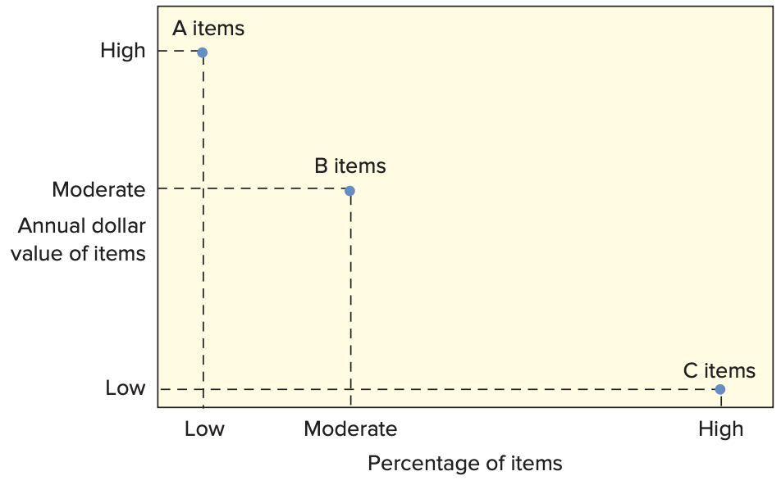
ABC Classification System
  Classifying inventory according to some measure of importance, and allocating control efforts accordingly
  A items (very important)
    10 to 20 percent of the number of items in inventory and about 60 to 70 percent of the annual dollar value
  B items (moderately important)
  C items (least important)
    50 to 60 percent of the number
    of items in inventory but only
    about 10 to 15 percent of the
    annual dollar value
12-20

Slide 21
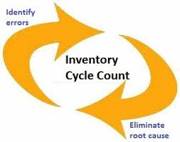
Cycle Counting
Cycle counting
  A physical count of items in inventory
Cycle counting management
    How much accuracy is needed?
        A items: ± 0.2 percent
        B items: ± 1 percent
        C items: ± 5 percent
    When should cycle counting be performed?
    Who should do it?
12-21

Slide 22
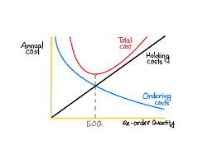
How Much to Order: EOQ Models
Economic order quantity models identify the optimal order quantity by minimizing the sum of annual costs that vary with order size and frequency
  The basic economic order quantity model
  The economic production quantity model
  The quantity discount model
12-22

Slide 23
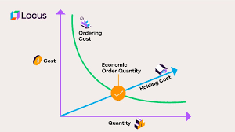
Economic order quantity models
EOQ Models
  1. The basic economic order quantity model (EOQ)
  The overall goal of economic order quantity is to decrease spending; its formula is used to identify the greatest number of units needed (per order) to reduce buying.

Slide 24
Basic EOQ Model
The basic EOQ model is used to find a fixed order quantity that will minimize total annual inventory costs
Assumptions:
  Only one product is involved
  Annual demand requirements are known
  Demand is even throughout the year
  Lead time does not vary
  Each order is received in a single delivery
  There are no quantity discounts
12-24

Slide 25
Total Annual Cost
12-25

Slide 26
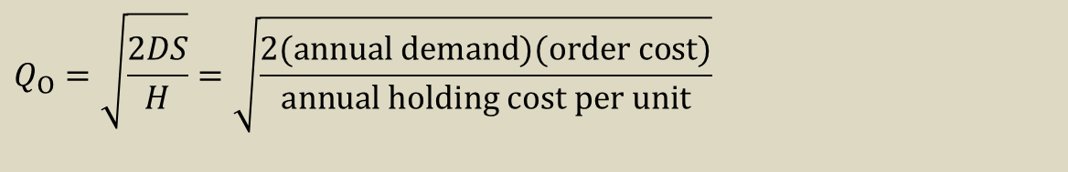
Deriving EOQ
Using calculus, we take the derivative of the total cost function and set the derivative (slope) equal to zero and solve for Q.
The total cost curve reaches its minimum where the carrying and ordering costs are equal.
Length of the optimal order cycle = Q₀ / D
$$Q_{O}=\sqrt{\frac{2DS}{H}}=\sqrt{\frac{2(\text{annual} \text{demand})(\text{order} \text{cost})}{\text{annual} \text{holding} \text{cost} \text{per} \text{unit}}}$$
12-26

Slide 27
Economic order quantity models EOQ Models
  2. The economic production quantity model ( EPQ)
  (EPQ) model is used to determine the optimal order quantity that an organization should place with a supplier to minimize inventory costs, while balancing inventory holding and average fixed order costs

Slide 28
Economic Production Quantity (EPQ)
The batch mode is widely used in production. In certain instances, the capacity to produce a part exceeds its usage (demand rate).
  Assumptions
    Only one item is involved
    Annual demand requirements are known
    Usage rate is constant
    Usage occurs continually, but production occurs periodically
    The production rate is constant
    Lead time is known and constant
    There are no quantity discounts
12-28

Slide 29
EPQ – Total Cost
12-29

Slide 30
Economic order quantity models EOQ Models
  3. The quantity discount model
  a pricing strategy in which companies offer lower prices to customers that purchase large quantities of a product. Quantity discounts are meant to entice customers to buy more products, often leading to increased overall revenue and production cost savings for companies.

Slide 31
Quantity Discount Model
Quantity discount
  Price reduction for larger orders offered to customers to induce them to buy in large quantities
12-31

Slide 32
When to Reorder
Reorder point ( ROP)
  When the quantity on hand of an item drops to this amount, the item is reordered.
  Determinants of the reorder point
    The rate of demand
    The lead time
    The extent of demand and/or lead time variability
    The degree of stockout risk acceptable to management
12-32

Slide 33
Safety Stock?
As the amount of safety stock carried increases, the risk of stockout decreases.
  This improves customer service level
Service level
  The probability that demand will not exceed supply during lead time
  Service level = 100% − stockout risk
12-33

Slide 34
How Much Safety Stock?
The amount of safety stock that is appropriate for a given situation depends upon:
  The average demand rate and average lead time
  Demand and lead time variability
  The desired service level
12-34

Slide 35
Single-Period Model
The goal of the single-period model is to identify the order quantity that will minimize the long-run excess and shortage costs
Two categories of problem:
  Demand can be characterized by a continuous distribution
  Demand can be characterized by a discrete distribution
12-35

Slide 36
Single-Period Model (cont.)
Single-period model
  Model for ordering of perishables and other items with limited useful lives
  Shortage cost
    Generally, the unrealized profit per unit
    C_{shortage} = C_{s} = Revenue per unit – Cost per unit
  Excess cost
    Different between purchase cost and recover value of items left over at the end of the period
    C_{excess} = C_{e} = Cost per unit – Recover value per unit
12-36

Slide 37
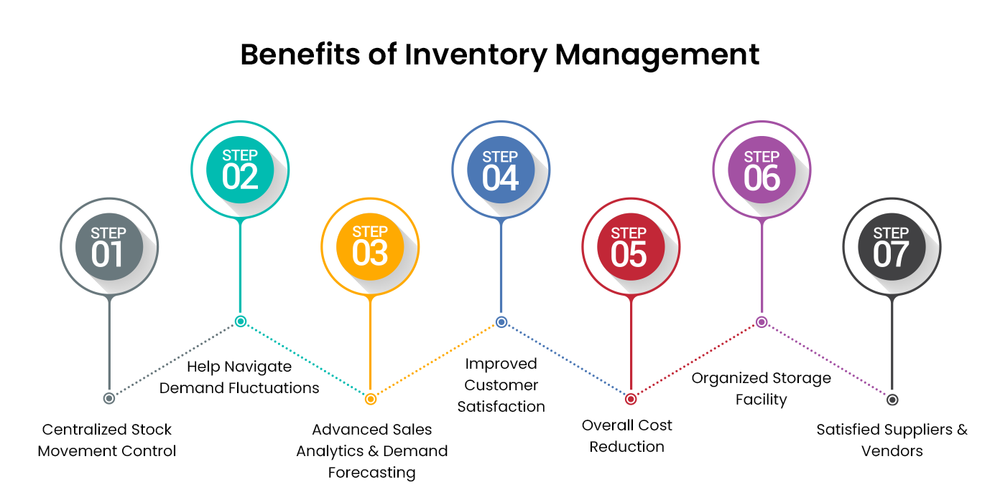

Slide 38
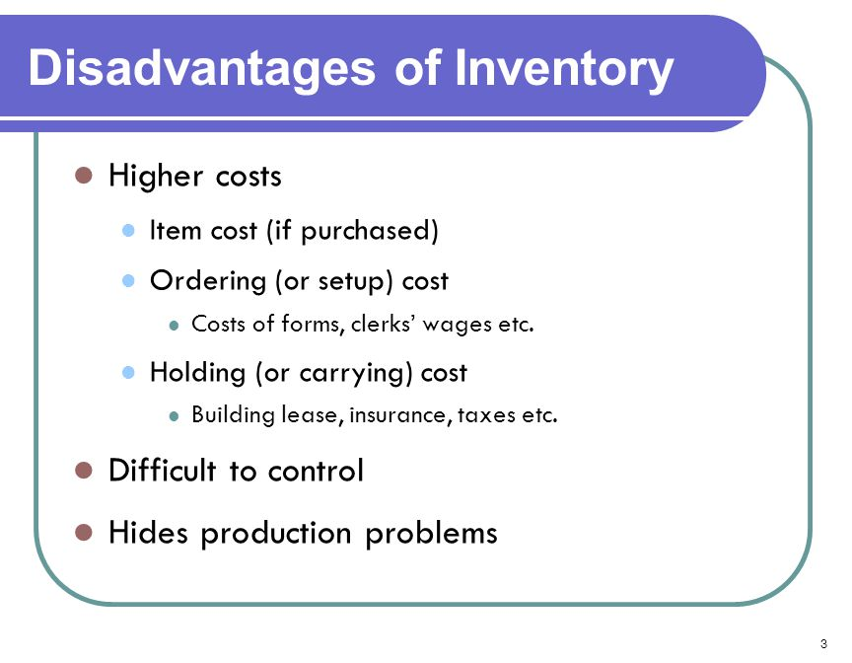

Slide 39



Thank You

