Slide 1


Software Engineering
Prepared by Dr. Yasser Abdelhamid
IT 382
Software Engineering
Lecture 4

Slide 2

Lecture Outline
Coping with change.
Sources of change
Cost of change
How to reduce cost of change
Prototyping
Incremental development and delivery
midocean.edu.km

Slide 3
Coping with change
Change is inevitable in all large software projects.

Slide 4
Sources of change
Business requirements changes
New technologies emerge which open up new possibilities for improving implementations
Changing platforms require application changes

Slide 5
Cost of change
costs of change
  cost of rework (e.g., re-analyzing requirements)
  costs of implementing new functionality

Slide 6
Reducing the costs of rework
Two ways to reduce cost of change
  Change avoidance
  Change tolerance

Slide 7
Change avoidance
Change avoidance, can be accomplished by anticipating possible changes.
  For example, a prototype system may be developed to show some key features of the system to customers.

Slide 8
Change tolerance
Change tolerance can be accomplished by making changes accommodated at relatively low cost.
  Using incremental development approach
  Proposed changes may be implemented in increments that have not yet been developed.

Slide 9
Software prototyping
What is a prototype?
  A prototype is an initial version of a system.
  It is used to:
    Demonstrate concepts.
    Try out design options.

Slide 10
Software prototyping
How a prototype can be used?
  Prototyping can be used for:
  The requirements engineering process to help with requirements elicitation and validation;
  In design processes to explore options and develop a User Interface design;
  In the testing process to run back-to-back tests.

Slide 11
Benefits of prototyping
Improved system usability.
A closer match to users’ real needs.
Improved design quality.
Improved maintainability.
Reduced development effort.

Slide 12
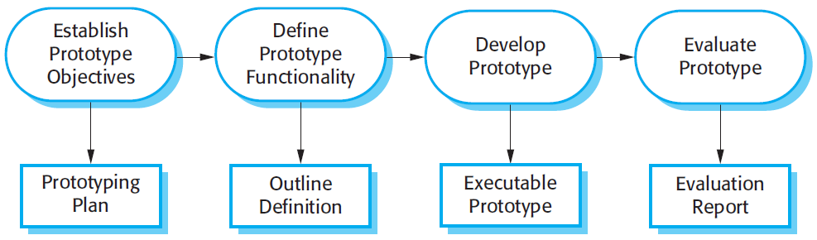
The process of prototype development

Slide 13
Prototype development features
A prototype may involve leaving out functionality

Slide 14
Prototype development features
Prototype should focus on areas of the product that are
not well-understood

Slide 15
Prototype development features
Error checking and recovery may not be included in the prototype

Slide 16
Prototype development features
Focus on functional rather than non-functional requirements such as reliability and security

Slide 17
Question?
Should we use the prototype as a part of the real product, or should we throw it away, and start building the system from the beginning
?

Slide 18
Throw-away prototypes
Prototypes should be discarded after development as they are not a good basis for a production system.

Slide 19
Why Prototypes should be discarded?
(1)
It may be impossible to tune the system to meet non-functional requirements;

Slide 20
Why Prototypes should be discarded?
(2)
Prototypes are normally undocumented;

Slide 21
Why Prototypes should be discarded?
(3)
The prototype structure is usually degraded through rapid change;

Slide 22
Why Prototypes should be discarded?
(4)
The prototype probably will not meet normal organizational quality standards.

Slide 23
Incremental delivery
Rather than deliver the system as a single delivery, the development and delivery is broken down into increments with each increment delivering part of the required functionality.

Slide 24
Incremental delivery
User requirements are prioritised and the highest priority requirements are included in early increments.

Slide 25
Incremental delivery
Once the development of an increment is started, the requirements are frozen though requirements for later increments can continue to evolve.

Slide 26
Incremental development and delivery
Incremental development
  Develop the system in increments and evaluate each increment before proceeding to the development of the next increment;
  Normal approach used in agile methods;
  Evaluation done by user/customer.

Slide 27
Incremental development and delivery
Incremental delivery
  Deploy an increment for use by end-users;
  More realistic evaluation about practical use of software;
  But difficult to implement for replacement systems as increments have less functionality than the system being replaced.

Slide 28
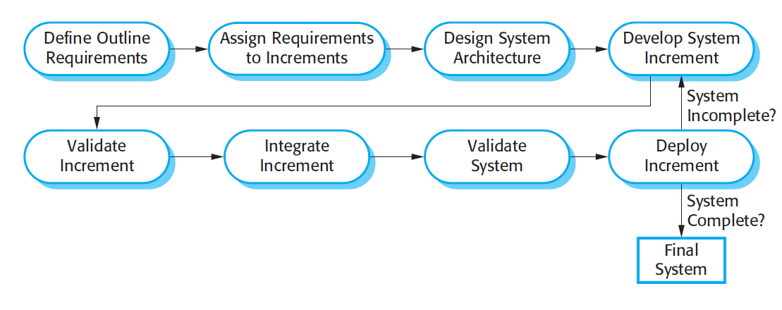
Incremental delivery

Slide 29
Incremental delivery advantages
(1)
Customer value can be delivered with each increment so system functionality is available earlier.

Slide 30
Incremental delivery advantages
(2)
Early increments act as a prototype to help elicit requirements for later increments.

Slide 31
Incremental delivery advantages
(3)
Lower risk of overall project failure.

Slide 32
Incremental delivery advantages
(4)
The highest priority system services tend to receive the most testing.

Slide 33
Incremental delivery problems
(1)
Most systems require a set of basic facilities that are used by different parts of the system.
As requirements are not defined in detail until an increment is to be implemented, it can be hard to identify common facilities that are needed by all increments.

Slide 34
Incremental delivery problems
(2)
The essence of iterative processes is that the specification is developed in conjunction with the software.
This conflicts with the procurement model, where the complete system specification is part of the system development contract.

Slide 35
Boehm’s spiral model
Process is represented as a spiral rather than as a sequence of activities with backtracking..
No fixed phases such as specification or design
  loops in the spiral are chosen depending on what is required.
Risks are explicitly assessed and resolved throughout the process.

Slide 36
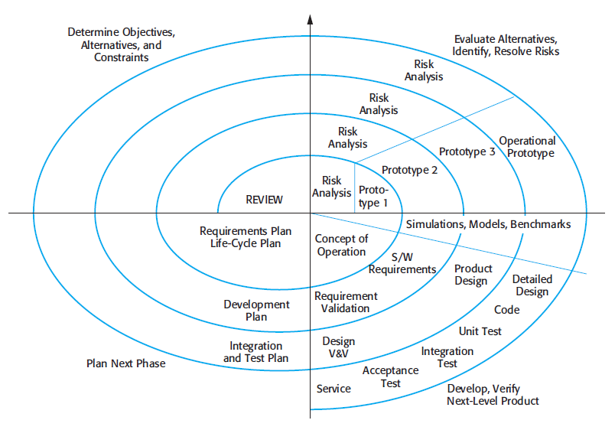
Boehm’s spiral model

Slide 37
Spiral model sectors
Objective setting
  Specific objectives for the phase are identified.

Slide 38
Spiral model sectors
Risk assessment and reduction
  Risks are identified and assessed and
  Activities put in place to reduce the key risks.

Slide 39
Spiral model sectors
Development and Validation
  A development model for the system is chosen which can be any of the generic models.

Slide 40
Spiral model sectors
Planning
  The project is reviewed and the next phase of the spiral is planned.

Slide 41
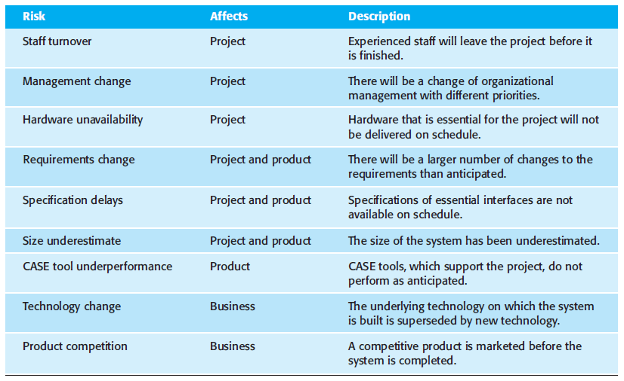
Examples of risks

Slide 42
Spiral model usage
Spiral model has been very influential in helping people think about iteration in software processes.
introducing the risk-driven approach to development.
But the model is rarely used as published for practical software development.

Slide 43
Summary
Coping with change.
Sources of change
Cost of change
How to reduce cost of change
Prototyping
Incremental development and delivery
Spiral model
midocean.edu.km

Slide 44


Thank You

