Slide 1

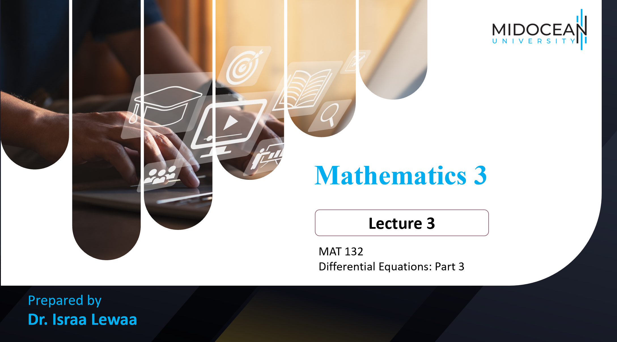
Mathematics 3 – MAT132

Slide 2

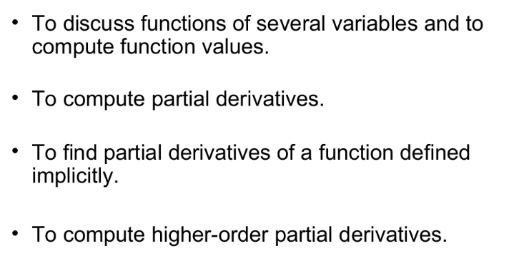
Lecture
09
Lecture Objectives
Lecture Objectives

Slide 3
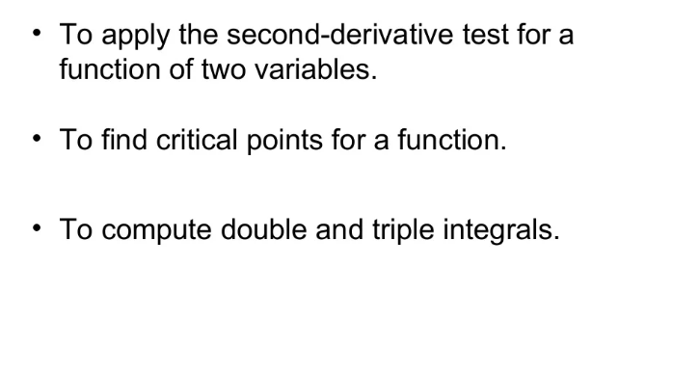
Lecture
09
Lecture Objectives
Lecture Objectives

Slide 4
Lecture
09
Lecture Outline
Lecture Outline
Functions of Several Variables
Partial Derivatives
Implicit differentiation
Maxima and Minima for functions of Two Variable

Slide 5
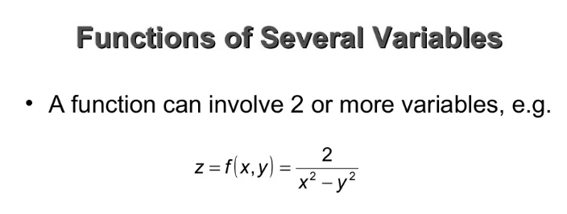
Lecture
09
Functions of Several Variables
Functions of Several Variables

Slide 6
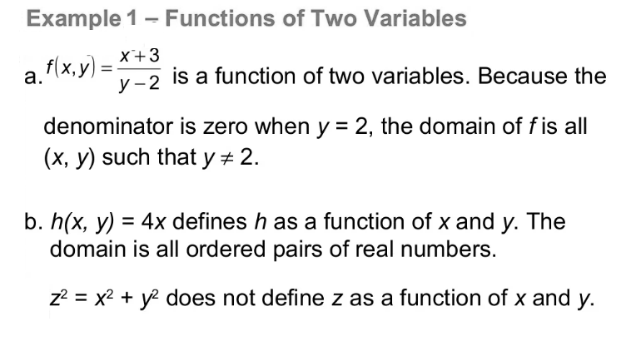
Lecture
09
Example
Example

Slide 7
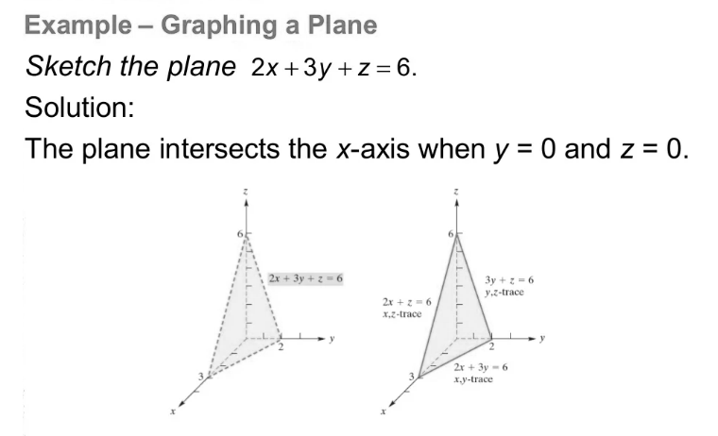
Lecture
09
Example
Example

Slide 8
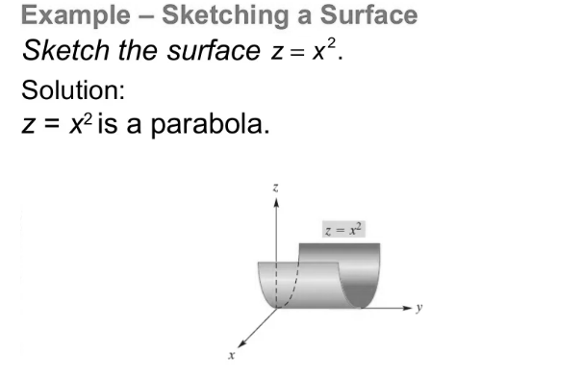
Lecture
09
Example
Example

Slide 9
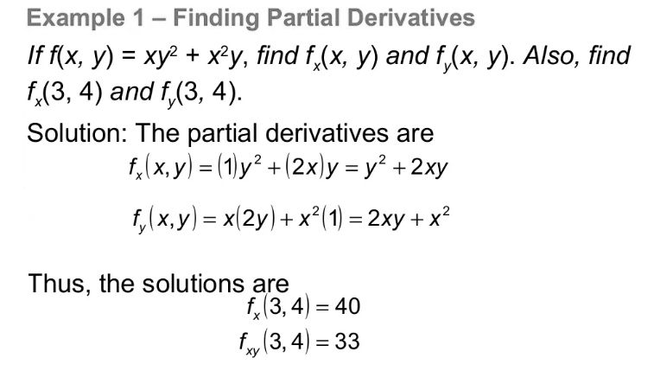
Lecture
09
Example
Example

Slide 10
Lecture
09
Example
Example

Slide 11
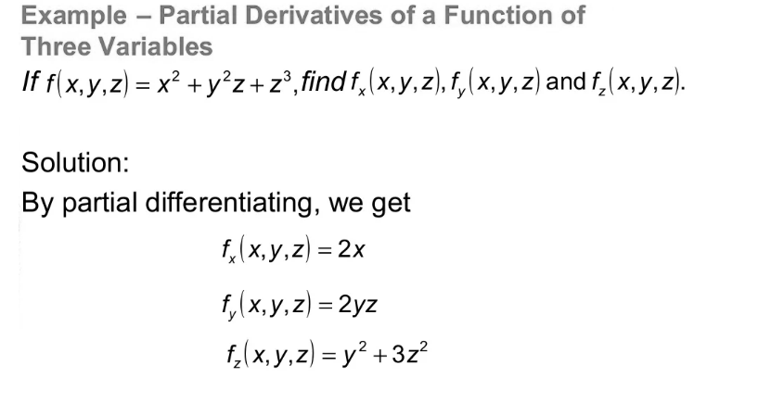
Lecture
09
Partial Derivative
Partial Derivatives

Slide 12
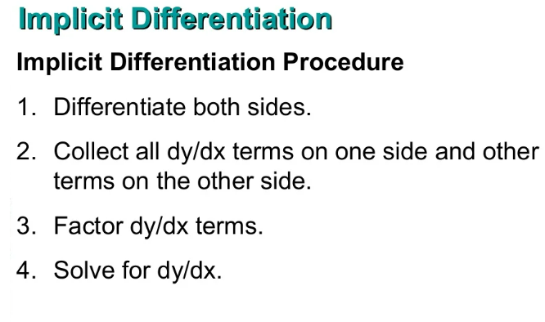
Lecture
09
Implicit Differentiation
Implicit Differentiation

Slide 13
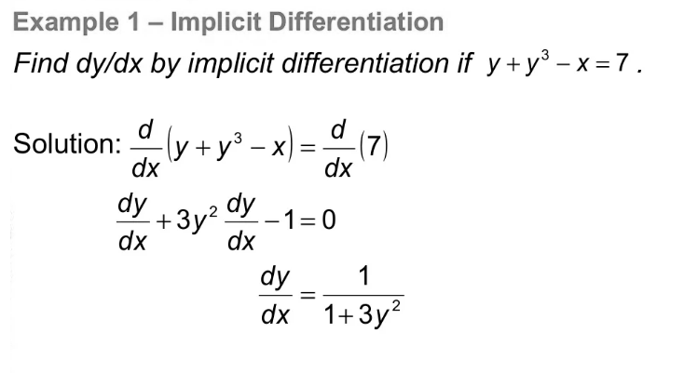
Lecture
09
Example
Example

Slide 14
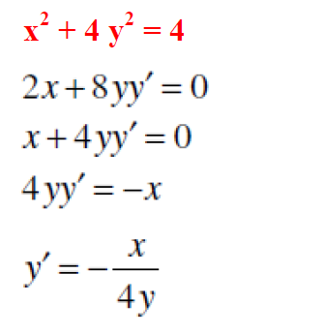
Lecture
09
Example
Example

Slide 15
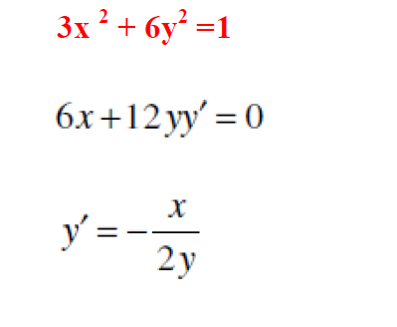
Lecture
09
Example
Example

Slide 16
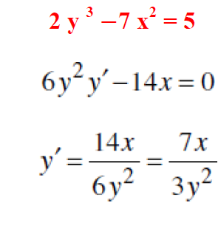
Lecture
09
Example
Example

Slide 17
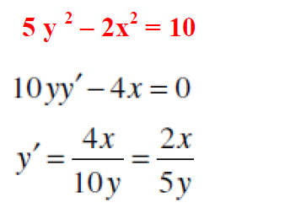
Lecture
09
Example
Example

Slide 18
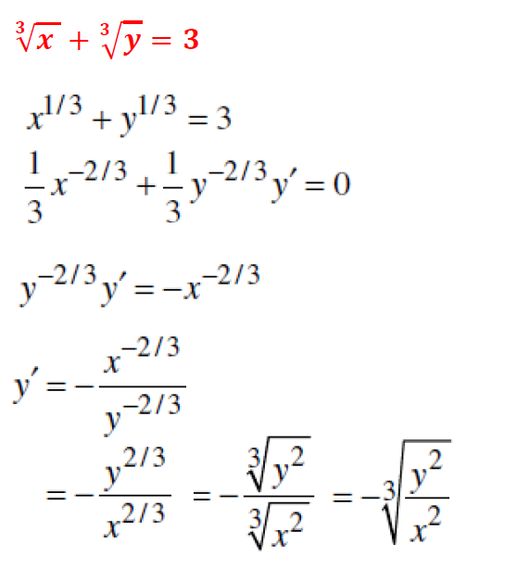
Lecture
09
Example
Example

Slide 19
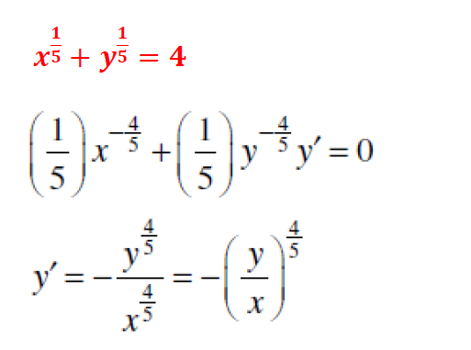
Lecture
09
Example
Example

Slide 20
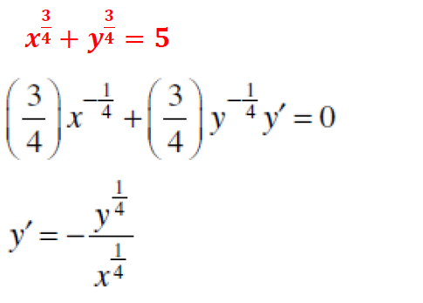
Lecture
09
Example
Example

Slide 21
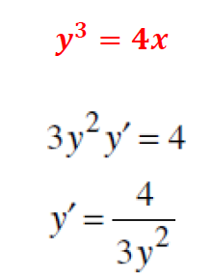
Lecture
09
Example
Example

Slide 22
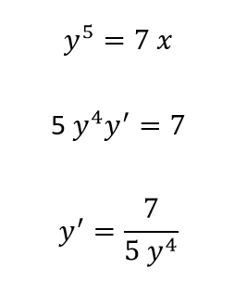
Lecture
09
Example
Example

Slide 23
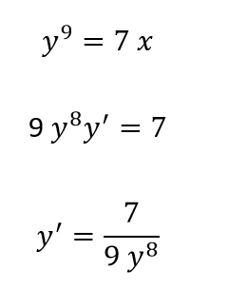
Lecture
09
Example
Example

Slide 24
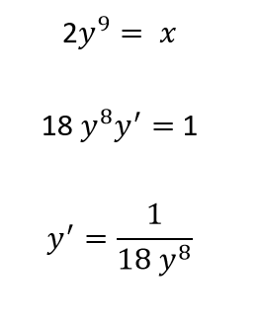
Lecture
09
Example
Example

Slide 25
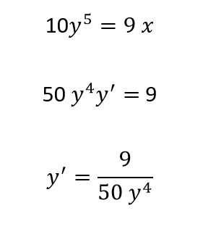
Lecture
09
Example
Example

Slide 26
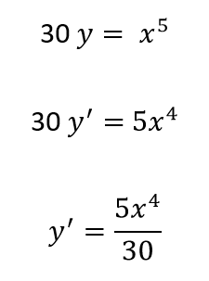
Lecture
09
Example
Example

Slide 27
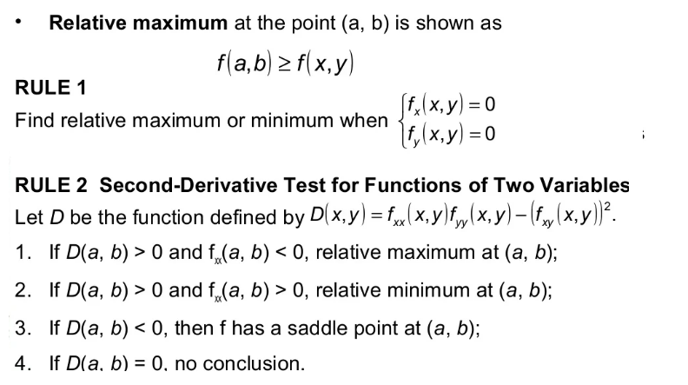
Lecture
09
Maxima and Minima for functions of Two Variable

Slide 28
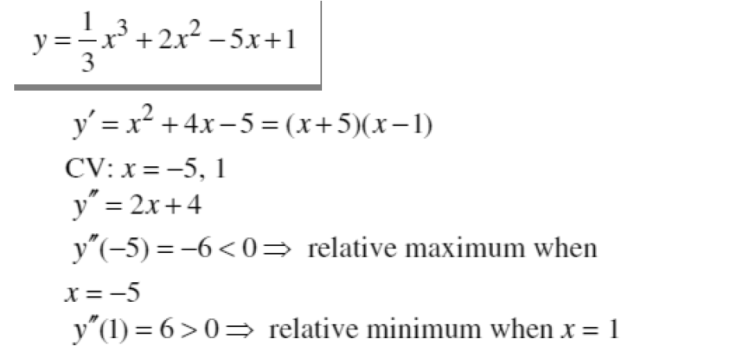
Lecture
09
Example
Example

Slide 29
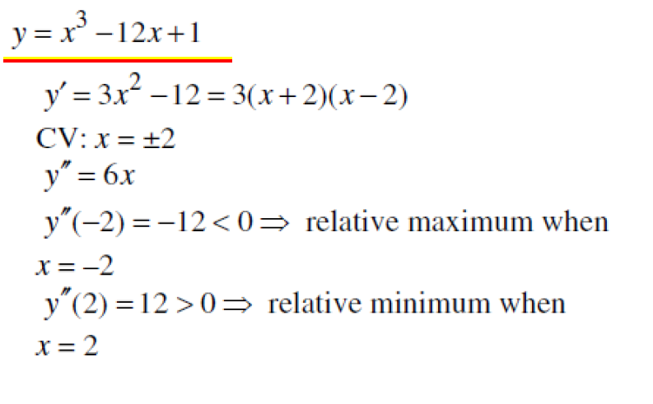
Lecture
09
Example
Example

Slide 30
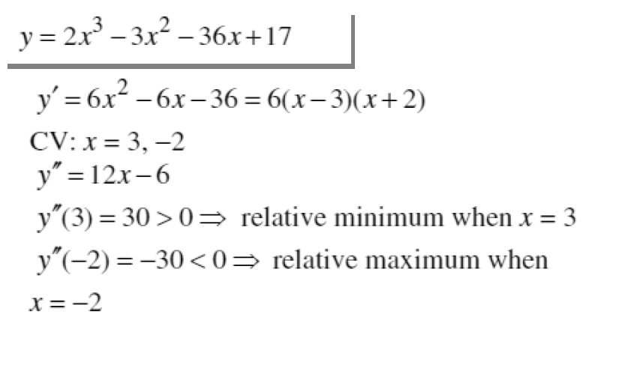
Lecture
09
Example
Example

Slide 31
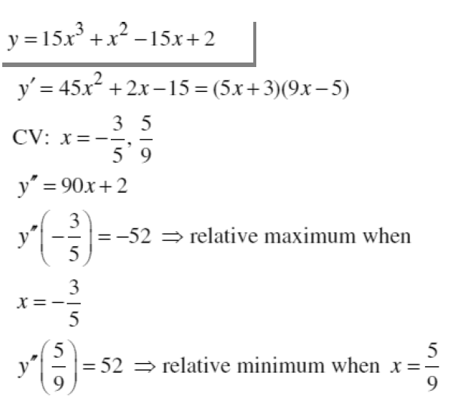
Lecture
09
Example
Example

Slide 32
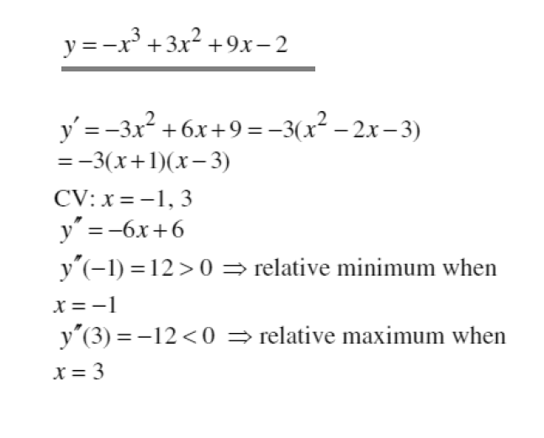
Lecture
09
Example
Example

Slide 33
Lecture
09
Lecture Summary
Lecture Summary
Functions of Several Variables

Slide 34
Lecture
09
Lecture Summary
Lecture Summary
Partial Derivatives

Slide 35
Lecture
09
Lecture Summary
Lecture Summary
Implicit differentiation

Slide 36
Lecture
09
Lecture Summary
Lecture Summary
Maxima and Minima for functions of Two Variable

Slide 37



Thank You

