Slide 1


Machine Learning
for Finance
Prepared by Dr. Diaa Salama
FNT633
Data Preprocessing , Data Normilization
Lecture 4

Slide 2




Machine Learning
for Finance
Lecture
FNT633
Data Preprocessing , Data Normalization
Prepared by
Dr. Diaa Salama
www.midocean.ae

Slide 3
Week
05
Today
Data
Data Preparation (Preprocessing)
Data Integration and Normalization
www.midocean.ae

Slide 4
Week
05
Data
www.midocean.ae

Slide 5
Week
05
Data Objects and Attributes Types
OBJECTS AND ATTRIBUTES
    data object represents an entity
    Also, sample, example, instance, data point, or object (in a DB : Data Tuple)-
    e.g. customers, students, patients, books
    Attribute
        data field, representing a characteristic or feature of a data object
        Also noun attribute, dimension, feature, and variable (DB and DM
        DWs, ML. Statistics)
        e.g. name, age, salary, gender. grade.
        Attribute (feature) vector
            - A set of attributes that describe an object
www.midocean.ae

Slide 6
Week
05
What is Data?
Attributes
Collection of data objects and their attributes
An attribute is a property or characteristic of an object
    Examples: eye color of a person, temperature, etc.
    Attribute is also known as variable, field, characteristic, dimension, or feature
A collection of attributes describe an object
  Object is also known as record, point, case, sample, entity, or instance
Objects
www.midocean.ae

Slide 7
Week
05
Data Objects and Attributes Types
    NOMINAL ATTRIBUTES
    Symbol or names of things
    Each value represents category, code, or state
        also referred to as categorical
        e.g. hair color, marital status, customer ID
        Possible to be represented as numbers (coding)
www.midocean.ae

Slide 8
Week
05
Attributes Types :(Binary Attributes)
    Nominal with only two values representing two states or categories: 0 or 1 (absent or present)
    Also, Boolean (true or false)
    Qualitative
    Symmetric:
        both states are equally valuable and have the same weight-
        e.g. gender
        Asymmetric-
            states are not equally important
            e.g. medical test outcomes
www.midocean.ae

Slide 9
Week
05
Attributes Types :(Ordinal Attributes)
        * Qualitative*
          Values have a meaningful order or ranking, but magnitude between successive values is not known
              e.g. professional rank, grade, customer satisfaction-
              Useful for, data reduction of numerical attributes
www.midocean.ae

Slide 10
Week
05
Attributes Types :(Numeric Attributes)
    Quantitative
    Interval-scaled:*
        measured on a scale of equal-size units-
        e.g. temperature, year-
        Do not have a true zero point-
        Not possible to be expressed as multiples
    Ratio-scaled:-
        have a true zero point-
        A value can be expressed as a multiple of another-
        e.g. years of experience, weight, salary
www.midocean.ae

Slide 11
Week
05
Discrete and Continuous Attributes
    Discrete Attribute:
        has a finite or countably infinite set of values, integers or otherwise
            - e.g. hair color, smoker, medical test, Customer_D-
            Customer_ID is countably infinite à infinite values but one-to-one correspondence with natural numbers*
            If an attribute is not discrete, it's continuous-
                e.g. height, weight, age
www.midocean.ae

Slide 12
Week
05
Discrete and Continuous Attributes
Discrete Attribute
  Has only a finite or countably infinite set of values
  Examples: zip codes, counts, or the set of words in a collection of documents
  Often represented as integer variables.
  Note: binary attributes are a special case of discrete attributes
Continuous Attribute
  Has real numbers as attribute values
  Examples: temperature, height, or weight.
  Practically, real values can only be measured and represented using a finite number of digits.
  Continuous attributes are typically represented as floating-point variables.
www.midocean.ae

Slide 13
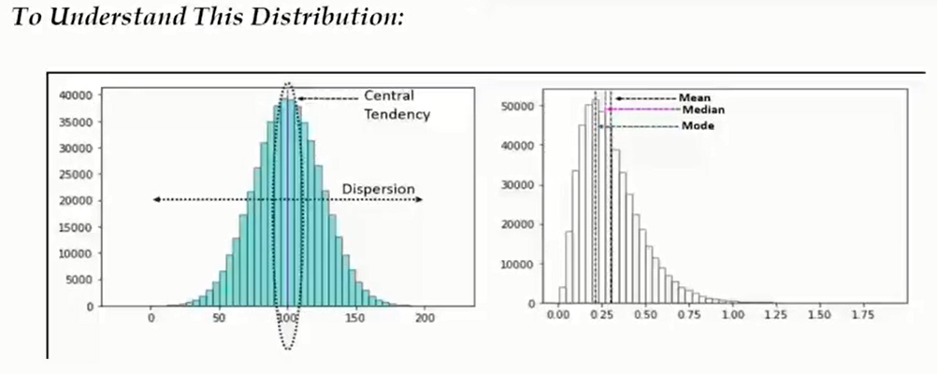
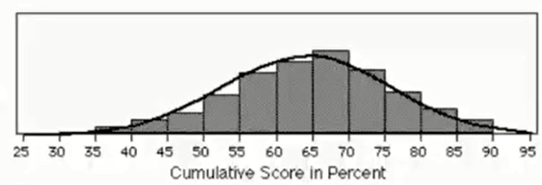
Week
05
Basic Statistical of data
www.midocean.ae

Slide 14
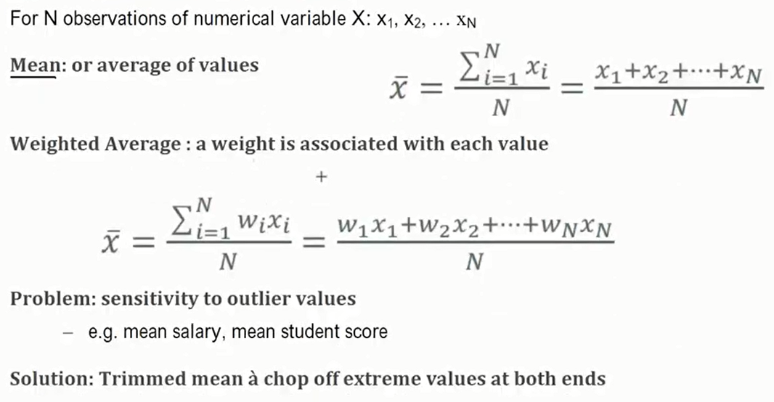
Week
05
Measuring Central Tendency (Mean)
www.midocean.ae

Slide 15
Week
05
Measuring Central Tendency (Median ,Mode)
    Median
      middle value in set of ordered values*
          N is odd à median is middle value of ordered set*
          N is even à median is not unique à average of two middlemost values*
          Expensive to compute for large # of observations
          Mode:
          value that occurs most frequently in the attribute values*
                Works for both qualitative and quantitative attributes •*
                Data can be unimodal, bimodal, or trimodal - no mode?
www.midocean.ae

Slide 16
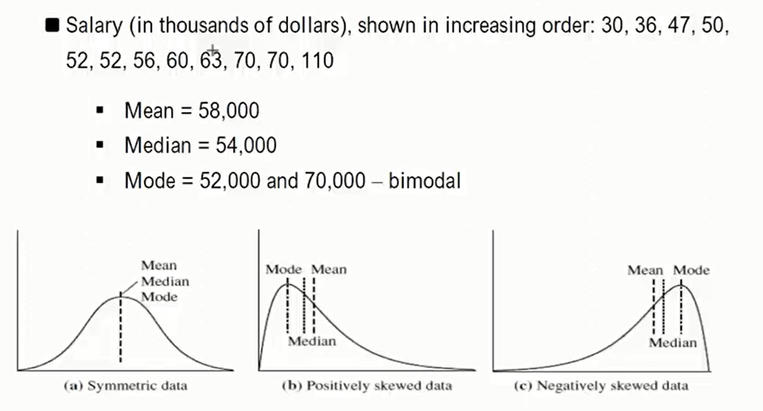
Week
05
Example 1 : Central Tendency
www.midocean.ae

Slide 17
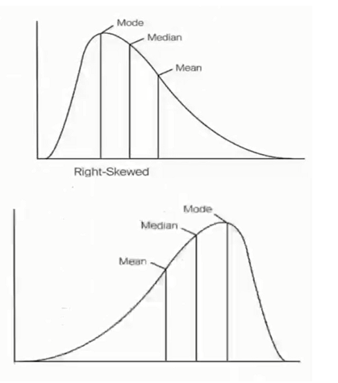
Week
05
Central Tendency (+V and –V Skewed)
    Right Skewed or Postive Skewed-
      long tail that extends to the right or positive side of the x axis, same as the below plot.
      mean greater than the mode
      median greater than the mode
      mean greater than median
      Left Skewed or Negative Skewed-
        which is left skewed have a long tail that extends to the left or negative side of the x axis, same as the below plot.
        mean less than the mode
        median less than the mode
        mean less than median
www.midocean.ae

Slide 18
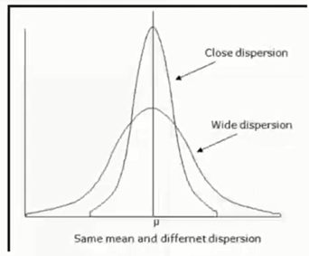
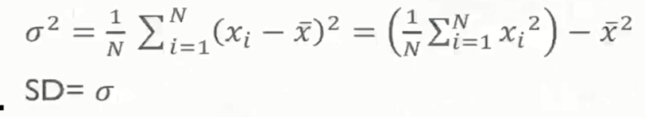
Week
05
Dispersion Measures
    Variance & SD
      Indicate how spread out a data distributed is
      Low SD: data observations tend to be very close to the mean
      High SD: data is spread out over a large range of value
www.midocean.ae

Slide 19
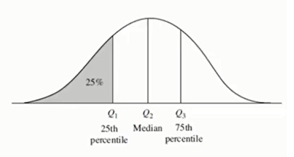
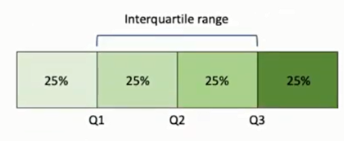
Week
05
Measuring of Dispersion data
    For N observations of numerical variable X: X1, X2, ... XN
    Rang: difference between the largest and smallest values
          Quantiles:
            points taken at regular intervals of a data distribution, diving it into (almost) equal-size consecutive sets
            Interquartile Range:= Q3 - Q1* the middle 50% of values when
              ordered from lowest to highest
www.midocean.ae

Slide 20
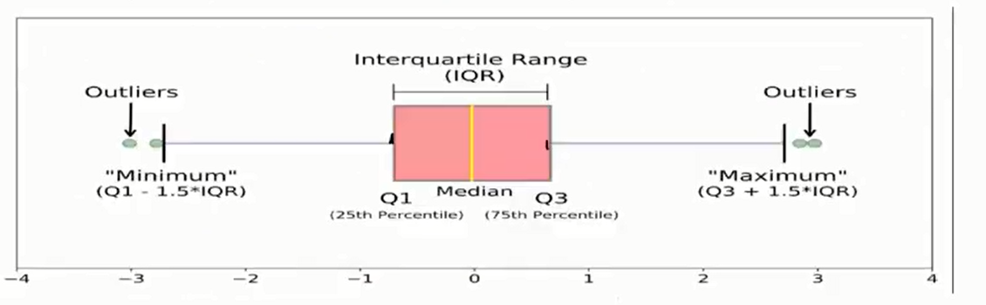
Week
05
Five Number Summary
www.midocean.ae

Slide 21
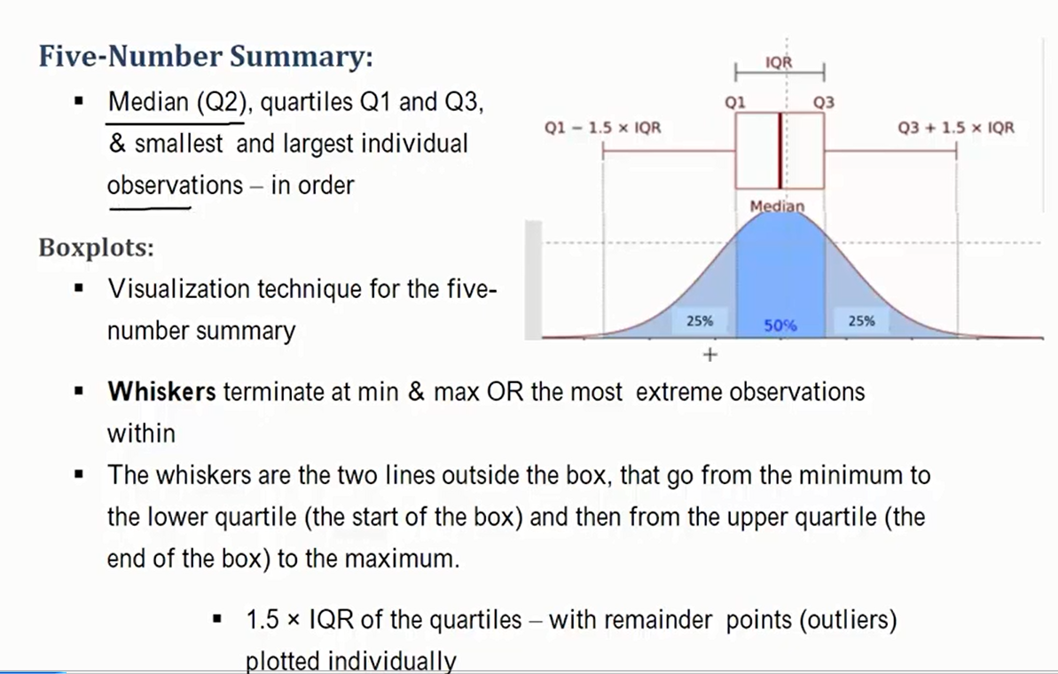
Week
05
Five Number Summary
www.midocean.ae

Slide 22
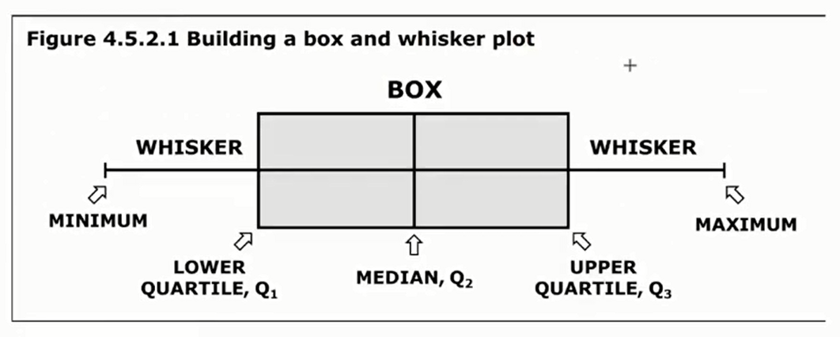
Week
05
Five Number Summary
www.midocean.ae

Slide 23
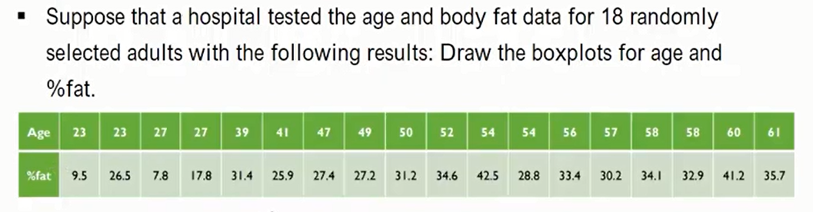
Week
05
Quiz
www.midocean.ae

Slide 24
Week
05
Quiz Solution
    Problem Solution:
    Draw the boxplots for age and %fat.
      For Age
        Q1=39, median= 51, Q3=57, min=23, max=61-
        IQR= 57-39= 18, 1.5 IQR= 27*
        newMin= 39-27= 12, newMax= 57+27= 84
        For Fat
          Q1=26.5, median= 30.7, Q3=34.1, min=7.8, max=42.5
          IQR= 34.1 - 26.5= 7.6, 1.5 1QR= 11.4
          new Min= 26.5-11.4 = 15.1,newMax= 34.1+11.4= 45.5
www.midocean.ae

Slide 25
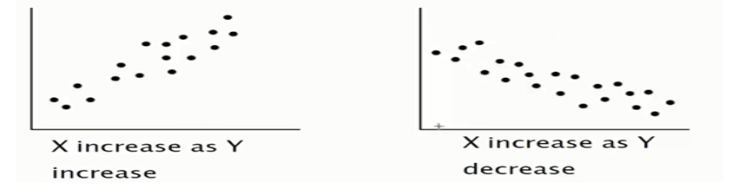
Week
05
Visual Representation of Data
    1. Histograms
    2. Scatter Plots
      each pair of values is treated as a pair of coordinates and plotted as points in plane
          X and Y are correlated if one attribute implies the other
          positive, negative, or null (uncorrelated)
          For more attributes, we use a scatter plot matrix
www.midocean.ae

Slide 26
Week
05
Data Preparation
(Data Preprocessing )
www.midocean.ae

Slide 27
Week
05
Reasons for Data Cleansing
The data to be analyzed may be:
  Incomplete; where the data is missing (empty record)
  Noisy; where data may contain errors (data that have incorrect values -Gender Z )or outlier values (Outliers are data values that deviate from expected values of the rest of the data set) (Age 2500)
  Inconsistent; where data may contain discrepancies in the values (age – birthdate ) , (Total-price and (unit-price and quantity).
www.midocean.ae

Slide 28
Week
05
How can Data be Cleaned?
Filling-in Missing Values
Smoothing Noisy Data (Validation and correction – Standardization)
Identifying and Removing Outliers Using Inter-quartile Range
Resolving Inconsistency (age – birthdate )
www.midocean.ae

Slide 29
Week
05
Dealing with Incomplete Data
There are several ways to deal with missing data:
Replace the missing value with some default value
Replace the missing value with the field mean for the fields that take numerical values or the mode (if exists) for the fields that take categorical values
Replace the missing values with a value generated at random from the field distribution observed
www.midocean.ae

Slide 30
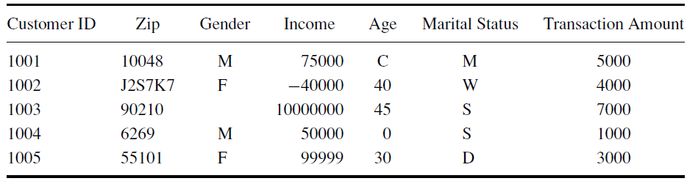
Week
05
Handling Outliers
Sample Table
Data Set
Possible Outlier Values
Outliers are data values that deviate from expected values of the rest of the data set
Outliers are extreme values that lie near the limits of the data range or go against the trend of the remaining data.
Normally, outliers need more investigation to make sure that they don’t occur due to mistakes during data entry
www.midocean.ae

Slide 31
Week
05
Handling Outliers Using Inter-quartile Range
Q1
Q3
75% of data items
Sorted Data Items
25% of data items
50% of data items
Q2
A Quartile is any of the three values which divide the sorted data set into four equal parts
First quartile (Q1) cuts off lowest 25% of data
Second quartile (Q2) cuts data set in half (it is the median of the data set)
Third quartile (Q3) cuts off highest 25% of data, or lowest 75%
www.midocean.ae

Slide 32
Week
05
Computing Q1, Q2, and Q3
to compute Q1, Q2, and Q3, use the following method:
  Order the given data set in ascending order.
  Use the median to divide the ordered data set into two halves. This median is second quartile (Q2). Exclude this median (if it is one of the data items) from any further computation.
  The first quartile (Q1) value is the median of the lower half of the data.
  The third quartile (Q3) value is the median of the upper half of the data.
www.midocean.ae

Slide 33
Week
05
Detecting Outliers using Inter-quartile Range
Compute the Inter-Quartile Range (IQR) as follows:
IQR = Q3 − Q1
A data value is an outlier if:
  its value is <= (Q1 – 1.5*IQR), or
  its value is >= (Q3 + 1.5*IQR).
www.midocean.ae

Slide 34
Week
05
Noisy Data
Noisy data are the kind of data that have incorrect values
Some reasons for noisy data:
    Data collection instruments may be faulty
    Human or computer errors may occur during data entry
    Transmission errors may occur
    Technology limitations like buffer size, may occur during data-entry
www.midocean.ae

Slide 35
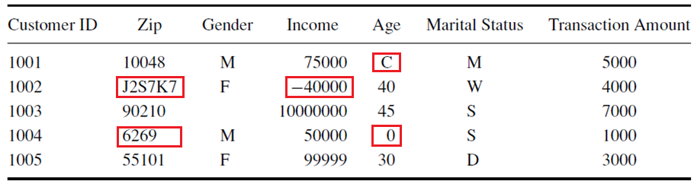
Week
05
Noisy Data
Examples of Noisy Data
www.midocean.ae

Slide 36
Week
05
Smoothing Noisy Data
By smoothing noisy data we can correct the errors
Smoothing noisy data is performed by:
    Validation and correction
    Standardization
www.midocean.ae

Slide 37
Week
05
Data Inconsistency
Data inconsistency means that different data items contain discrepancies in their values
It can occur when different data items depend on other data items and their values don’t match; for example:
Age and Birth-date; age can be computed from the birth-date, hence the value of Age must match the value computed from the birth-date
City and Phone-area-code; each city has certain area-code
Total-price and (unit-price and quantity); total-price can be computed from the unit-price and quantity
These dependencies can be utilized to detect errors and substitute missing values or correct wrong values
www.midocean.ae

Slide 38
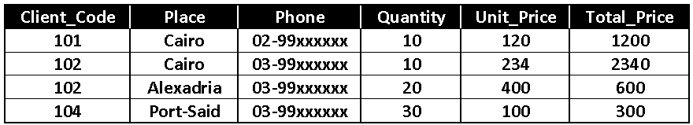
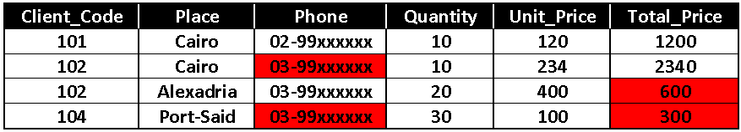
Week
05
Data Inconsistency Example
38
Example of Inconsistent Data
Data Inconsistency Marked in Red
Incorrect Area-Code
Total_Price doesn’t equal (Quantity*Unit_Price)
www.midocean.ae

Slide 39
Week
05
Data Integration , Transformation and Normalization
www.midocean.ae

Slide 40
Week
05
Methods for Collecting Raw Data
Manually
    Using Surveys
    Using Observations
    Based on Contributions from experts
Using special computer peripherals equipments (instruments and/or sensors)
    Bar-code readers
    Computer-based medical imaging system
    Remote sensing instruments
    Atmosphere sensing instruments
Web-based systems
    Becomes very popular to collect clients’ feedback via web
    Examples are online polls and questionnaires
www.midocean.ae

Slide 41
Week
05
Data Sources Classifications
Internal data sources
    Internal sources are data sources that are housed within a company
    An organization’s internal data are about people, products, services, and processes
Personal data sources
    Employees may document their own expertise by creating personal data. These data are not necessarily just facts, but may include concepts, thoughts, and opinions. They include, for example, opinions about what competitors are likely to do, and certain rules and formulas developed by the users
External data sources
    There are many sources for external data, ranging from commercial databases to data collected by sensors and satellites
    Internet and commercial database sources also considered as external sources
www.midocean.ae

Slide 42
Week
05
Data integration
Data Integration means that we need to merge data coming from multiple sources
This is normally happened in data warehousing and data mining systems
www.midocean.ae

Slide 43
Week
05
Issues to be considered during data integration
Entity Identification Problem (we have attributes (coming from different data sources) with different names that represent the same entity (Student ID , Student no)
Redundancy (An attribute is redundant if it can be derived from another attribute (correlation))
Data Value Conflicts (For the same entity, attribute values from different sources may differ (meter, kilogram )
Duplication (there are two or more identical records for a given unique data entry(discarding all duplication))
www.midocean.ae

Slide 44
Week
05
Entity Identification Problem
Means that we have attributes (coming from different data sources) with different names that represent the same entity
Example: we may have all the following attributes that represent the same entity:
    Student_No
    Bench_No
    Student_Id
All of these attributes could represent the same entity
During data integration these attributes must be identified to reduce data redundancy and inconsistency
www.midocean.ae

Slide 45
Week
05
Redundancy
An attribute is redundant if it can be derived from another attribute
Some redundancy can be detected by correlation analysis
www.midocean.ae

Slide 46
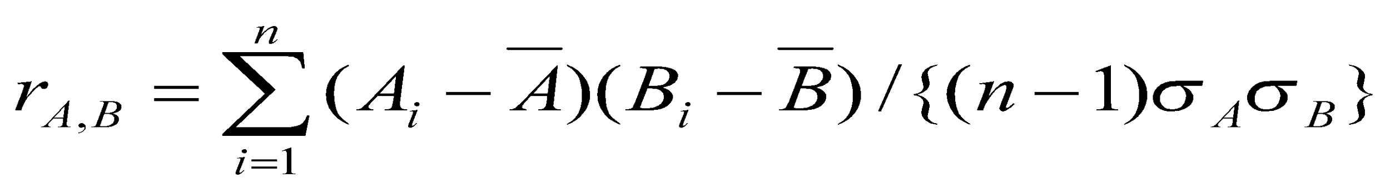
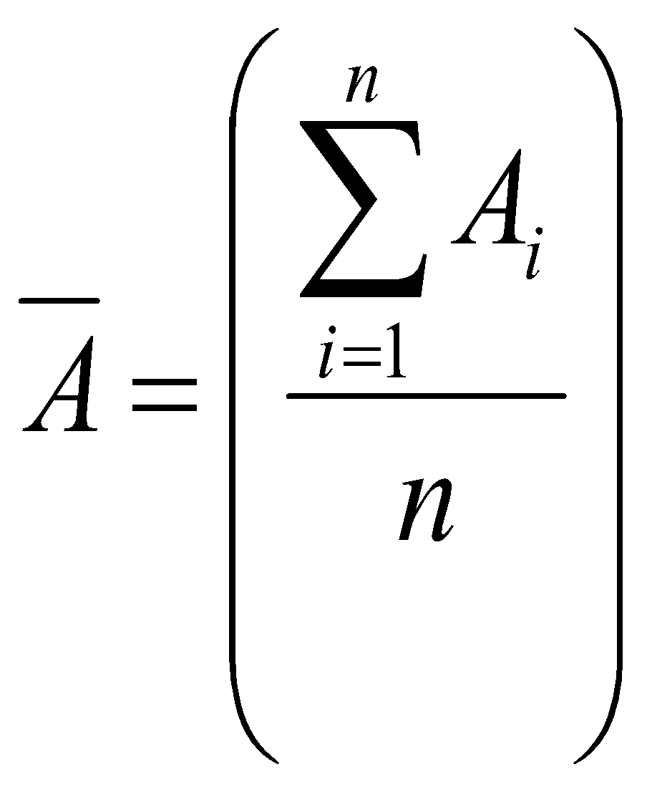
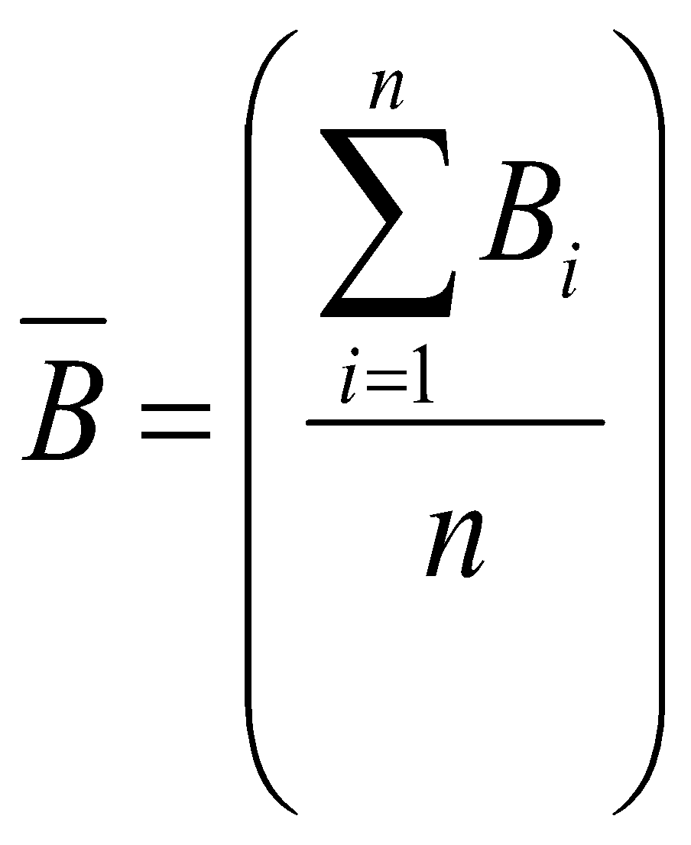
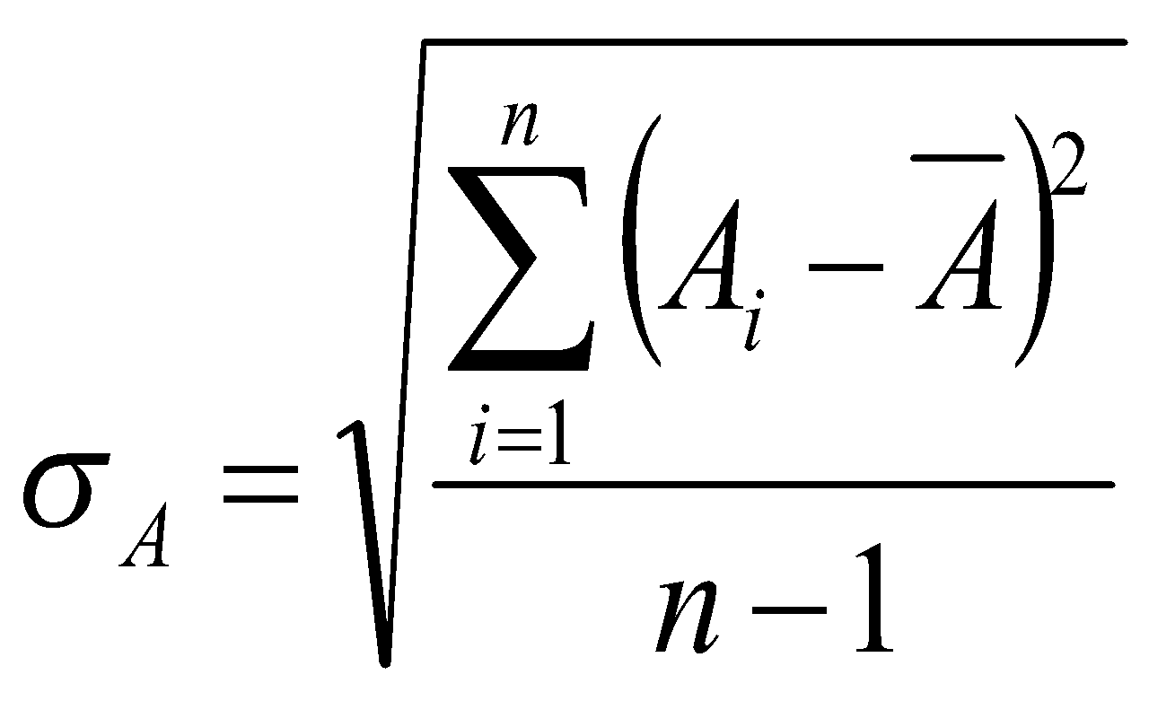
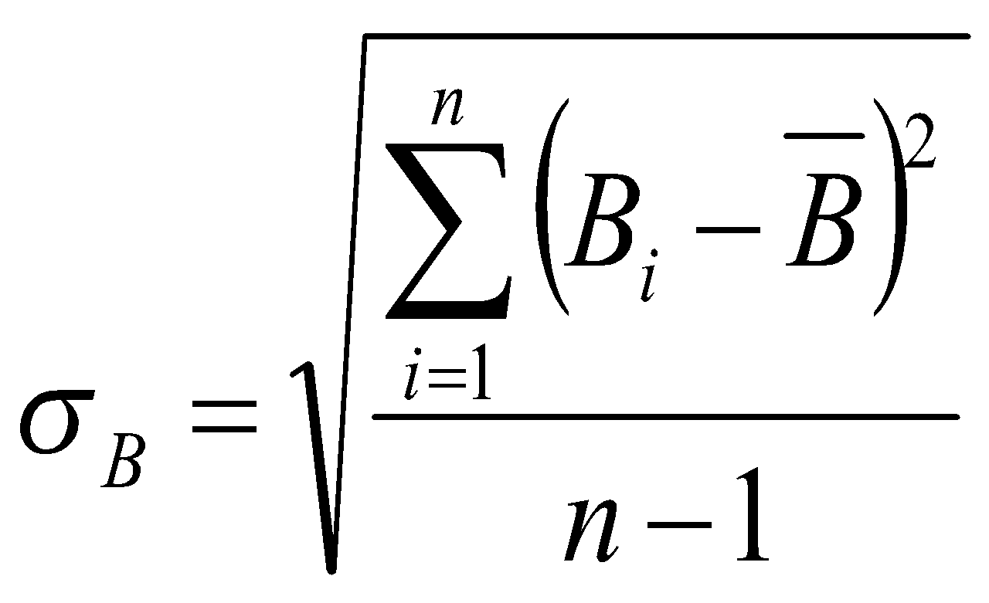
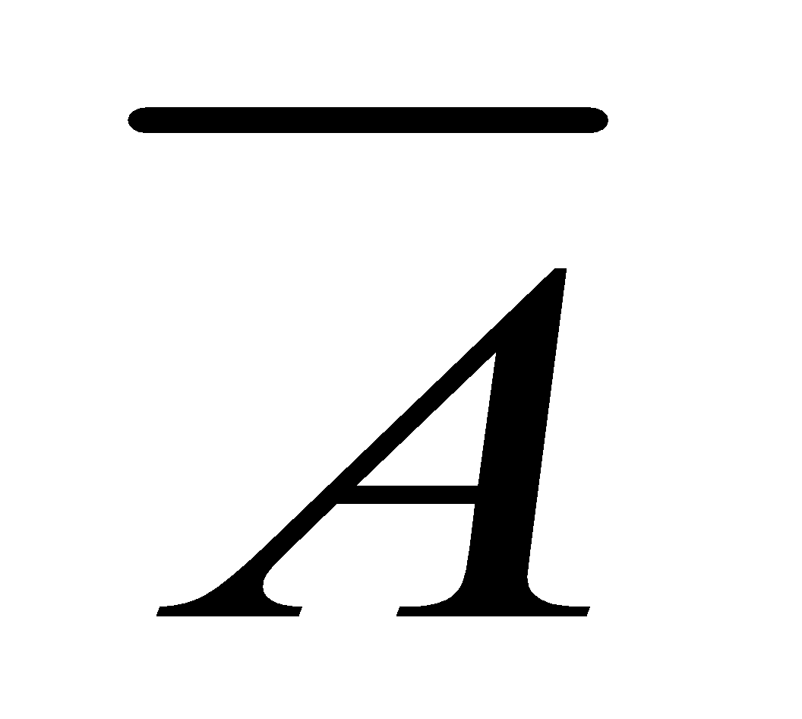
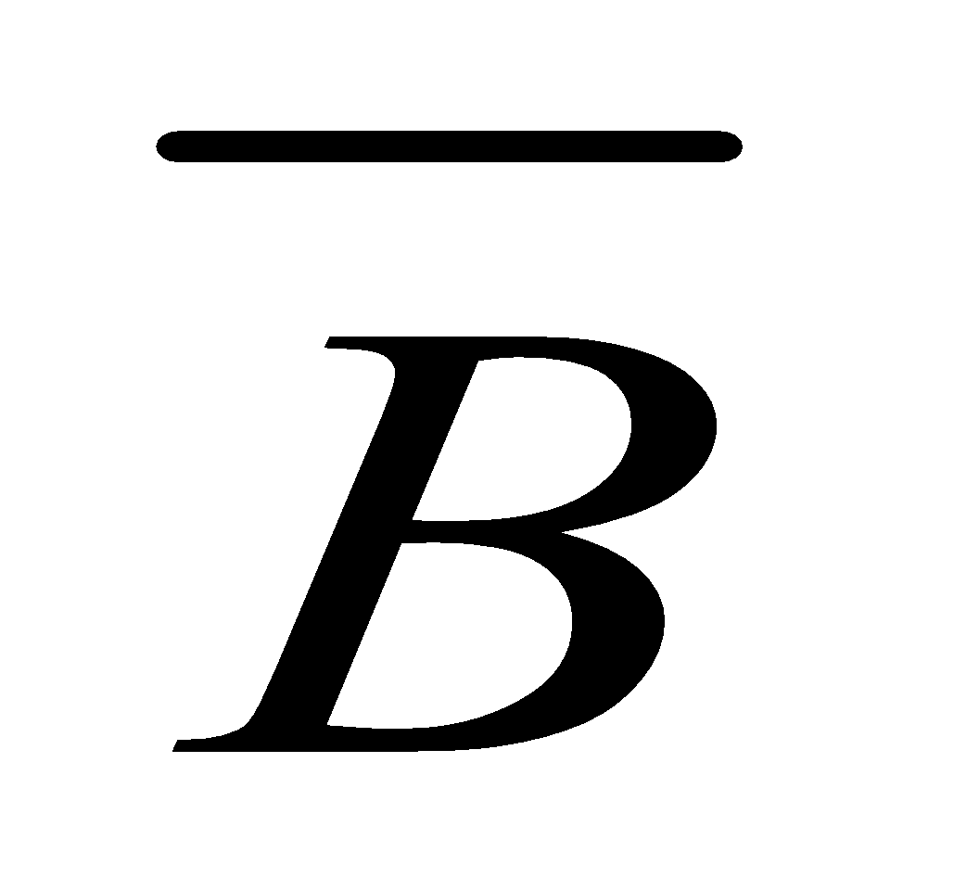
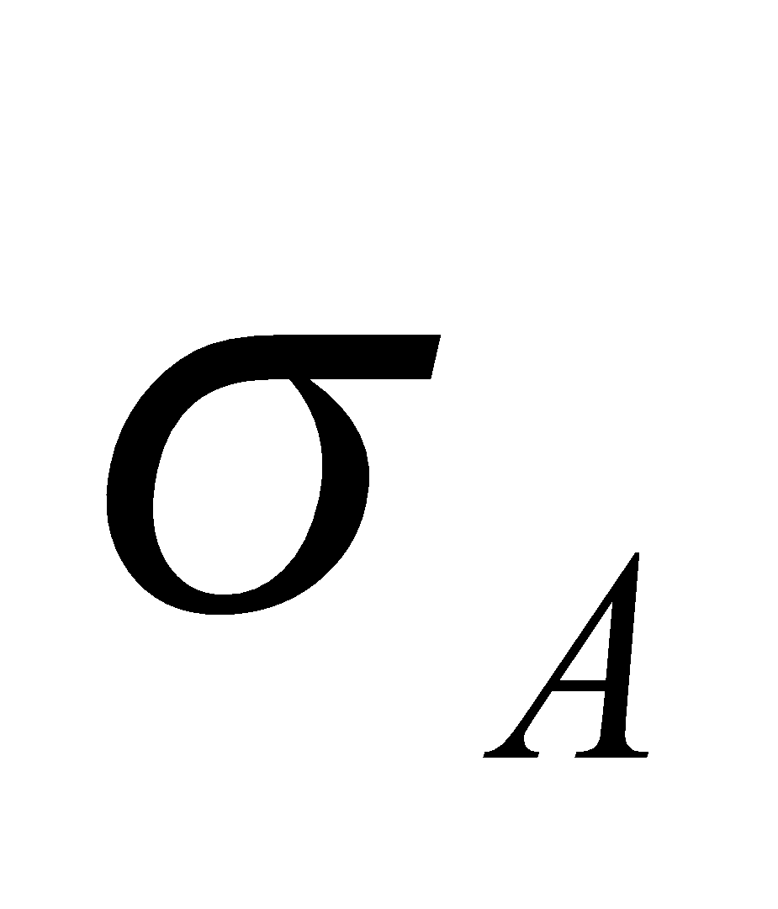
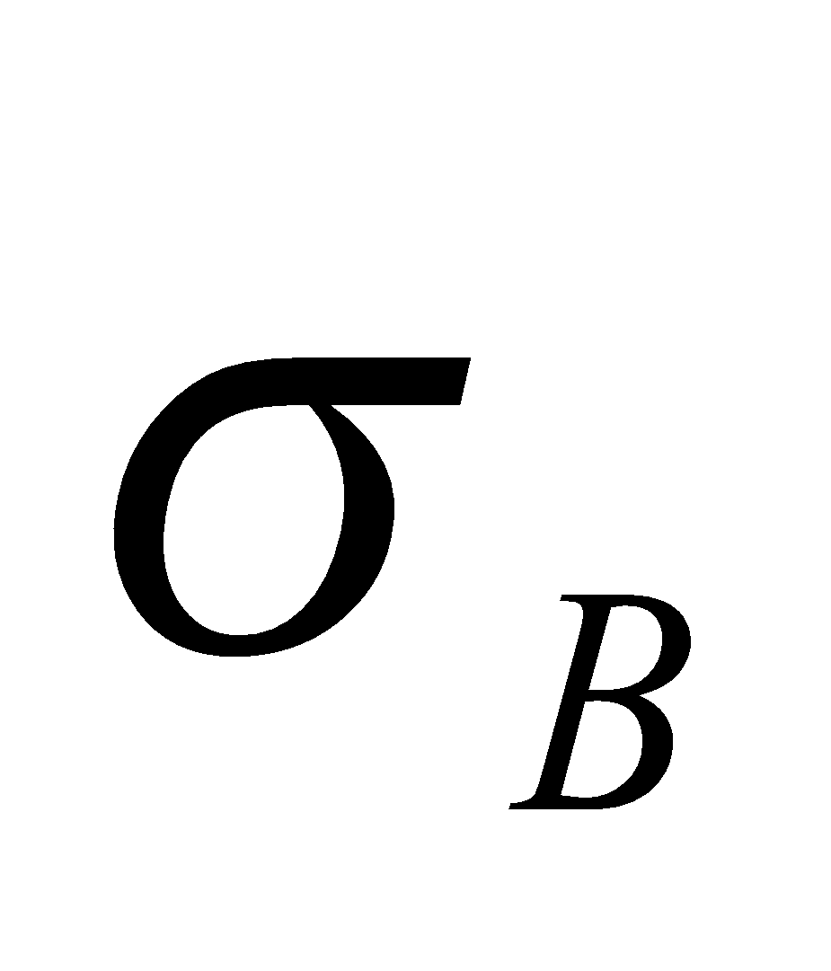
Week
05
Detecting Redundancies using Correlation Analysis
Consider two attributes A and B coming from two different data sources. The correlation between attributes A and B can be measured by the correlation coefficient rA,B:
  Where n is the number of data items in A or B (assuming they have the same number of data items), and are the mean values of A and B, and and are the standard deviations of A and B
Where
and
www.midocean.ae

Slide 47
Week
05
Detecting Redundancies using Correlation Analysis
If the rA,B is greater than 0 then A and B are positively correlated
If A and B are positively correlated then the values of A increase as the values of B increase
The higher the value of rA,B the more each attribute implies the other
So, a high value of rA,B implies that either A or B may be removed as a redundancy but not both of them
www.midocean.ae

Slide 48
Week
05
Detecting Redundancies using Correlation Analysis
If the rA,B is 0, then A and B are independent, hence there is no redundancy and we cannot remove any of them
If rA,B is less than 0 then A and B are negatively correlated
This implies that the values of one attribute increase as the values of the other decrease and also we cannot remove any of the attributes
www.midocean.ae

Slide 49
Week
05
Data Value Conflicts
For the same entity, attribute values from different sources may differ
This may be due to differences in representation, scaling, or encoding
Example: a weight attribute may be stored in metric units (meter, kilogram …) in one system and British units (Pound, inch …) in another
The price of different hotels may involve not only different currencies but also different services and taxes
Hence, these conflicts must be resolved before integrating data sources
Resolving these kinds of conflicts is done by converting one unit to the other so that we use a unified unit for all integrated data sources
Careful integration of data from multiple sources helps in reducing and avoiding redundancy and inconsistency in the resulting data sets
www.midocean.ae

Slide 50
Week
05
Duplication
Duplication means there are two or more identical records for a given unique data entry
It occurs when you have the same record coming from different data sources
Resolving it can be done by discarding all duplication and leaving single unique data entry for each entity
www.midocean.ae

Slide 51
Week
05
Data Normalization
Data Normalization means that the attribute data are scaled to fall within a small specified range such as –1.0 to +1.0, or 0.0 to 1.0
Normalization is important for data classification and analysis by data mining techniques
www.midocean.ae

Slide 52
Week
05
Data Normalization
Data normalization is a critical preprocessing step in data analysis and machine learning to bring data into a standard format or scale, ensuring that different features contribute equally to the analysis and preventing issues caused by varying scales.
There are various methods of data normalization, each suited to specific types of data or analysis. Here are some common types of data normalization:
www.midocean.ae

Slide 53
Week
05
Data Normalization
Min-Max Scaling (Normalization)
Z-Score Standardization (Standard Scaling)
Decimal Scaling
Robust Scaling (Scaling by Median and IQR)
Logarithmic Transformation
Box-Cox Transformation
Quantile Transformation
Rank Transformation
Unit Vector Transformation
Sparse Data Normalization
Image Normalization
www.midocean.ae

Slide 54
Week
05
Min-Max Normalization: Example
Also known as feature scaling, it scales the data between a specified range, typically [0, 1].
    Formula: X_normalized = (X - X_min) / (X_max - X_min)
Useful when you have features with varying ranges and want to bring them into a common scale.
www.midocean.ae

Slide 55
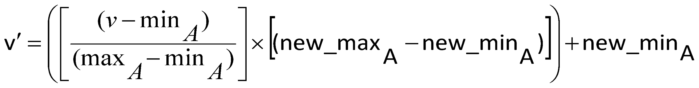
Week
05
Min-Max Normalization
Min-Max normalization performs a linear transformation on the original data
Suppose that minA and maxA are the minimum and maximum values of an attribute A
Min-Max normalization maps any value v of A to v’ in the range[new_minA, new_maxA] by computing:
Min-max normalization preserves the relationships among the original data values
www.midocean.ae

Slide 56
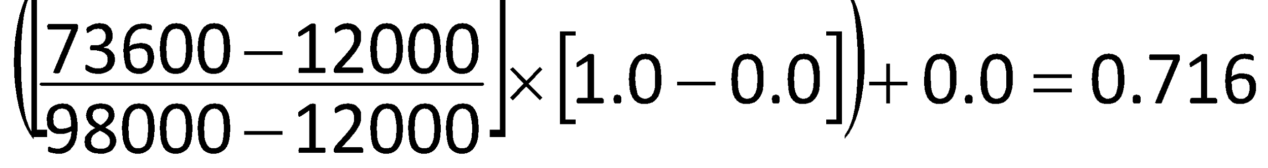
Week
05
Min-Max Normalization: Example
Let the minimum and maximum values for the attribute income be $12000 and $98000
To map income to the range [0.0, 1.0], we have:
minA = 12000 maxA = 98000
new_minA = 0.0 new_maxA = 1.0
By min-max normalization, a value of $73600 for income is transformed to:
www.midocean.ae

Slide 57
Week
05
Z-Score Normalization
In Z-Score normalization,
It scales the data to have a mean of 0 and a standard deviation of 1.
Formula: X_standardized = (X - mean(X)) / std(X)
Useful when you want to center data around zero and have it in units of standard deviations.
www.midocean.ae

Slide 58
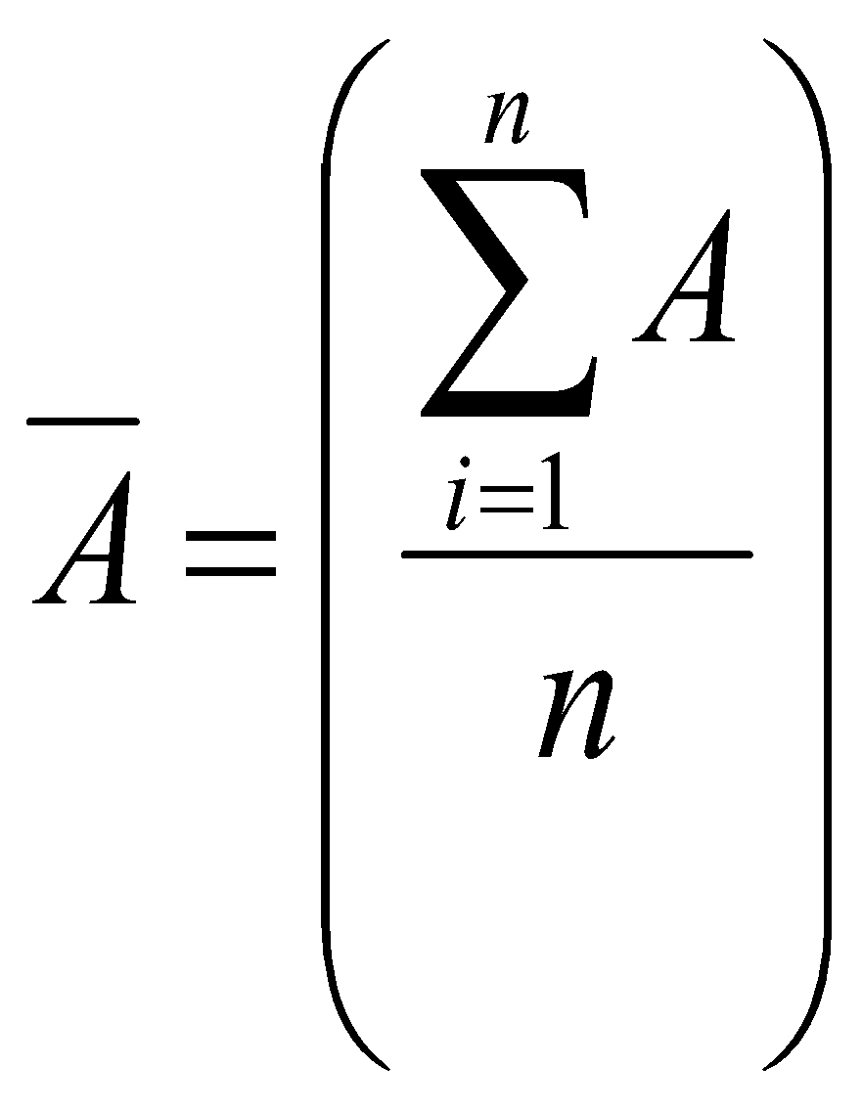
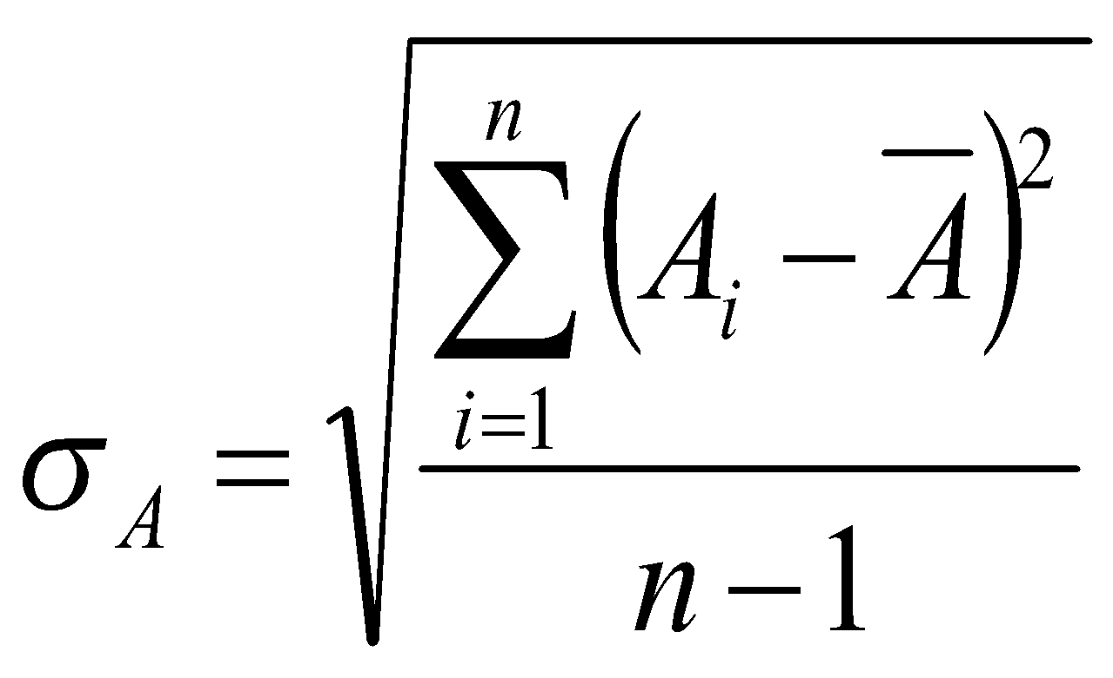
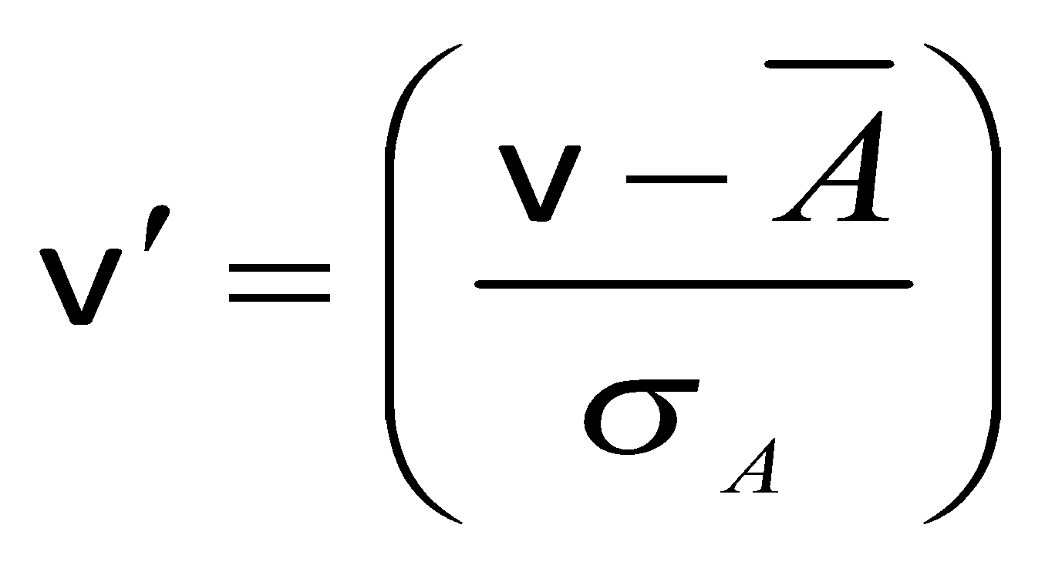
Week
05
Z-Score Normalization
In Z-Score normalization, the values for an attribute A are normalized based on the mean and standard deviation of A
A value v of A is normalized to v’ by computing:
Where is the mean value of A and is the standard deviation of A
The Z-Score normalization method is useful when the actual minimum and maximum of attribute A are unknown, or when there are outliers that dominate the min-max normalization
Where
and
www.midocean.ae

Slide 59
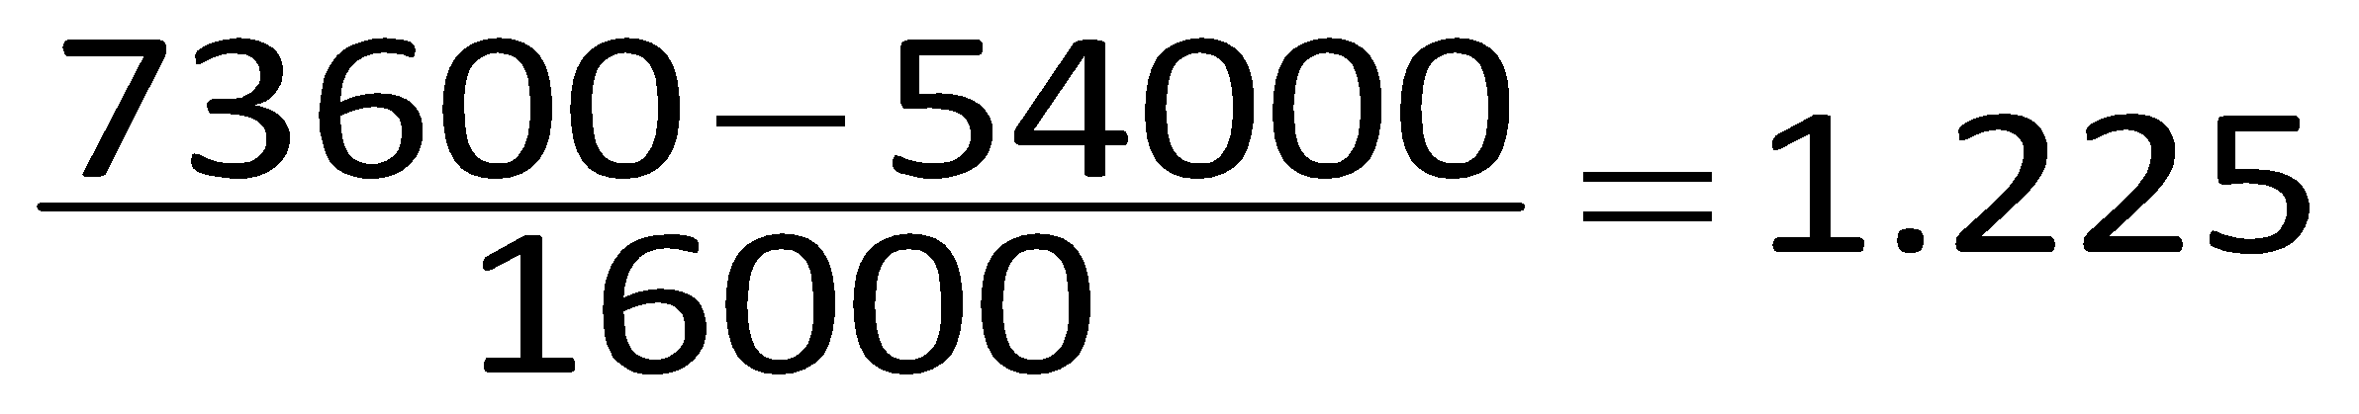
Week
05
Z-Score Normalization: Example
Suppose that the mean and standard deviation of the values for the attribute income are $54000 and $16000, respectively
With Z-Score normalization, a value of $73600 for income is transformed to
www.midocean.ae

Slide 60
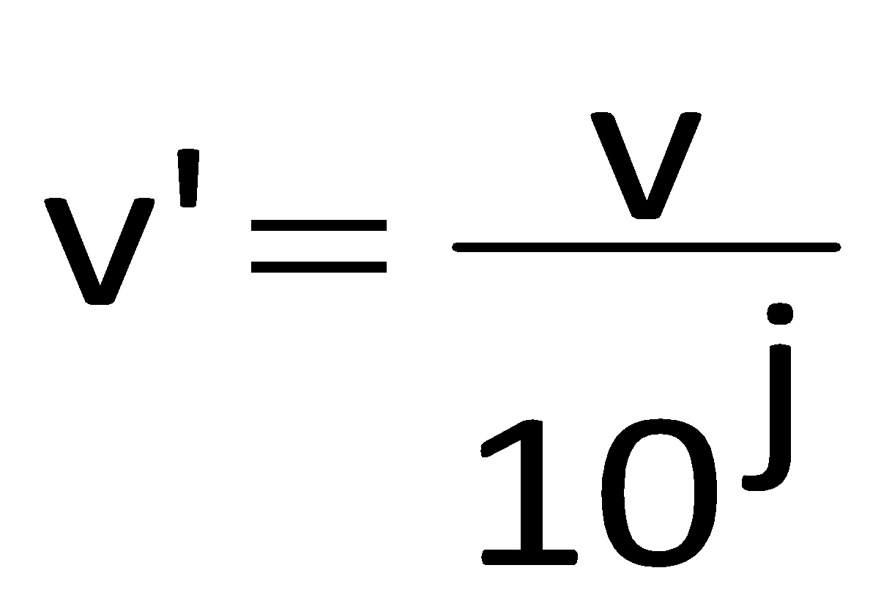
Week
05
Normalization by decimal scaling
This method normalizes by moving the decimal point of values of attribute A
The number of decimal points moved depends on the maximum absolute value of A
A value v of A is normalized to v’ by computing:
Where j is the smallest integer such that Max(|v'|) < 1
www.midocean.ae

Slide 61
Week
05
Normalization by decimal scaling: Example
Let the values of A range from -986 to 917
The maximum absolute value of A is 986
To normalize by decimal scaling, we divide each value by 1000, which means j = 3
Hence, -986 normalizes to -0.986
www.midocean.ae

Slide 62
Week
05
Robust Scaling (Scaling by Median and IQR):
Let Scales data based on the median and the interquartile range (IQR) to minimize the effect of outliers.
      Formula: X_robust = (X - median(X)) / IQR(X)
Useful when your data has outliers, and you want a scaling method that is robust to extreme values.
www.midocean.ae

Slide 63
Week
05
Robust Scaling (Scaling by Median and IQR):
Robust scaling, also known as scaling by the median and interquartile range (IQR), is a data normalization technique that minimizes the effect of outliers on your data. It's particularly useful when your dataset contains extreme values that can significantly affect other scaling methods like standardization (z-score).
Let's walk through a solved example to demonstrate how to perform robust scaling:
www.midocean.ae

Slide 64
Week
05
Robust Scaling (Scaling by Median and IQR):
to Ages (in years):
18, 21, 22, 25, 29, 31, 34, 35, 42, 170
Step 1: Collect Data
Suppose you have a dataset representing the ages of individuals in a small town, and it contains some outliers
Step 2: Calculate the Median and IQR
First, calculate the median (M) and the interquartile range (IQR) of your data. The IQR is the range between the 75th percentile (Q3) and the 25th percentile (Q1).
Median (M): To find the median, first sort your data and find the middle value. In this case, the sorted ages are:
The middle value is 29, so the median (M) is 29.
www.midocean.ae

Slide 65
Week
05
Robust Scaling (Scaling by Median and IQR):
Step 3: Perform Robust Scaling Now that you have the median (M) and the IQR, you can scale your data using the robust scaling formula:
    X_robust = (X - M) / IQR
Apply this formula to each data point:
For 18 years old:
    X_robust = (18 - 29) / 16 ≈ -0.6875
For 21 years old:
    X_robust = (21 - 29) / 16 ≈ -0.5
Continue this process for all data points, including the outlier (170 years old).
www.midocean.ae

Slide 66
Week
05
Robust Scaling (Scaling by Median and IQR):
Step 4: Analyze the Scaled Data
After performing the robust scaling, you have a new dataset of scaled values. These values are less affected by the outlier, and the entire dataset is now on a similar scale, making it suitable for various statistical analyses and machine learning algorithms.
Robust scaling is valuable when you want to normalize your data while minimizing the impact of extreme values like outliers, as it relies on the robust statistics of the median and IQR.
www.midocean.ae

Slide 67
Week
05
Logarithmic Transformation
Takes the logarithm of the data values.
Useful when dealing with data that follows an exponential distribution or has a large range of values, making it right-skewed
www.midocean.ae

Slide 68
Week
05
Logarithmic Transformation
Logarithmic normalization is a data transformation technique commonly used to reduce the skewness in data that follows a highly right-skewed distribution. This technique is particularly useful when dealing with data that spans several orders of magnitude, such as income or population data.
By applying a logarithmic transformation, you can make the data more symmetric and amenable to analysis.
Here's a step-by-step example of logarithmic normalization using a simple dataset:
www.midocean.ae

Slide 69
Week
05
Logarithmic Transformation
Step 1: Collect Data
Let's assume you have a dataset representing the income of individuals in a small town:
Income (in dollars):
$10,000
$20,000
$30,000
$50,000
$80,000
$120,000
$200,000
$300,000
www.midocean.ae

Slide 70
Week
05
Logarithmic Transformation
Step 2: Calculate the Logarithm
To perform logarithmic normalization, you'll take the natural logarithm (base e) of each data point. You can use a calculator or a programming language like Python to do this. The formula is:
Logarithm (x) = ln(x)
Applying this to our dataset:
Logarithm(10,000) ≈ 9.210
Logarithm(20,000) ≈ 9.903
Logarithm(30,000) ≈ 10.308
Logarithm(50,000) ≈ 10.819
Logarithm(80,000) ≈ 11.289
Logarithm(120,000) ≈ 11.695
Logarithm(200,000) ≈ 12.206
Logarithm(300,000) ≈ 12.611
www.midocean.ae

Slide 71
Week
05
Logarithmic Transformation
Step 3: Analyze the Transformed Data
Now that you've applied the logarithmic transformation to your data, you can analyze the transformed values. Notice that the transformed data is much less skewed and spans a smaller range compared to the original income values. This makes it easier to work with in various statistical analyses.
Step 4: Interpretation
When interpreting the results, keep in mind that the transformed values represent the logarithm of income rather than income itself. For example, an income of $30,000 corresponds to a logarithmic value of approximately 10.308. To get back to the original income scale, you can take the antilogarithm, which is the inverse operation:
Income = e^(Logarithm)
Logarithmic normalization is useful when you want to make data with a wide range of values more suitable for analysis, particularly when dealing with skewed datasets.
www.midocean.ae

Slide 72
Week
05
Box-Cox Transformation:
A family of power transformations that can handle data with different shapes.
It includes the logarithm transformation as a special case.
Useful when you want to stabilize variance or make data more normally distributed.
To perform the transformation, use the formula:
Transformed Value = (X^λ - 1) / λ, if λ ≠ 0
ln(X), if λ = 0
www.midocean.ae

Slide 73
Week
05
Box-Cox Transformation:
to compute Q1, Q2, and Q3, use the following method:
  Order the given data set in ascending order.
  Use the median to divide the ordered data set into two halves. This median is second quartile (Q2). Exclude this median (if it is one of the data items) from any further computation.
  The first quartile (Q1) value is the median of the lower half of the data.
  The third quartile (Q3) value is the median of the upper half of the data.
www.midocean.ae

Slide 74
Week
05
Box-Cox Transformation:
to compute Q1, Q2, and Q3, use the following method:
  Order the given data set in ascending order.
  Use the median to divide the ordered data set into two halves. This median is second quartile (Q2). Exclude this median (if it is one of the data items) from any further computation.
  The first quartile (Q1) value is the median of the lower half of the data.
  The third quartile (Q3) value is the median of the upper half of the data.
www.midocean.ae

Slide 75
Week
05
Box-Cox Transformation:
Step 2: Determine the Lambda (λ) Parameter
The Box-Cox transformation involves raising each data point to the power of a lambda (λ) parameter, which you need to determine. To do this, you can use statistical software or libraries in Python or R to find the lambda that maximizes the normality of the transformed data. We'll assume that the lambda for this dataset is approximately 0.25.
Step 3: Apply the Box-Cox Transformation
Now that you have the lambda parameter (λ = 0.25), you can apply the Box-Cox transformation to each data point:
www.midocean.ae

Slide 76
Week
05
Box-Cox Transformation:
To perform the transformation, use the formula:
Transformed Value = (X^λ - 1) / λ, if λ ≠ 0
ln(X), if λ = 0
In our case, λ is approximately 0.25, so we use the first part of the formula.
    For $150,000:
    Transformed Value = (150,000^0.25 - 1) / 0.25 ≈ 121.67
    For $200,000:
    Transformed Value = (200,000^0.25 - 1) / 0.25 ≈ 141.42
Continue this process for all data points.
www.midocean.ae

Slide 77
Week
05
Box-Cox Transformation:
Transformed House Prices:
    $121.67
    $141.42
    $149.70
    $162.28
    $174.92
    $193.53
    $206.14
    $218.18
    $226.16
    $243.34
www.midocean.ae

Slide 78
Week
05
Box-Cox Transformation:
Step 4: Analyze the Transformed Data
  After applying the Box-Cox transformation, you have a new dataset of transformed values. This transformed data is expected to have a reduced degree of heteroscedasticity and be closer to a normal distribution. You can use this transformed data for statistical analyses that assume normality or when you want to improve the performance of certain machine learning models.
  Keep in mind that the lambda parameter is essential, and it should be chosen carefully to maximize the normality of the transformed data. Different datasets may require different lambda values to achieve the desired transformation.
www.midocean.ae

Slide 79
Week
05
Quantile Transformation:
Maps the data to a specified quantile distribution, often resulting in a uniform distribution.
Useful when you want to ensure that the data follows a specific distribution or remove the effect of outliers
Quantile transformation is a data normalization technique that maps the data to a specified quantile distribution, often resulting in a uniform distribution. This transformation is useful when you want to ensure that the data follows a specific distribution or remove the effects of outliers. Here's a solved example of quantile transformation:
www.midocean.ae

Slide 80
Week
05
Quantile Transformation:
Step 1: Collect Data
Suppose you have a dataset representing the scores of students on a difficult exam:
Exam Scores:
45
60
62
70
80
90
95
100
www.midocean.ae

Slide 81
Week
05
Quantile Transformation:
Step 2: Specify the Desired Quantile Distribution
In this example, let's assume we want to transform the data into a uniform distribution between 0 and 1. This means we'll map the data to the percentiles of a uniform distribution.
Step 3: Calculate the Percentiles of the Original Data
To perform quantile transformation, you need to calculate the percentile ranks of each data point. You can use a formula like:
    Percentile Rank = (Number of values below X + 0.5) / Total number of values
www.midocean.ae

Slide 82
Week
05
Quantile Transformation:
Apply this formula to each data point:
For 45:
  Percentile Rank = (0 + 0.5) / 8 ≈ 0.0625
For 60:
  Percentile Rank = (1 + 0.5) / 8 ≈ 0.1875
Continue this process for all data points.
www.midocean.ae

Slide 83
Week
05
Quantile Transformation:
Step 4: Map the Percentiles to the Desired Distribution
Now that you have calculated the percentile ranks for each data point, you can map these percentiles to the desired uniform distribution (0 to 1). The mapped values become the transformed data.
For a percentile rank of 0.0625, the transformed value would be:
    Transformed Value = 0 + 0.0625 * (1 - 0) = 0.0625
    For a percentile rank of 0.1875, the transformed value would be:
    Transformed Value = 0 + 0.1875 * (1 - 0) = 0.1875
    Continue this process for all percentile ranks.
www.midocean.ae

Slide 84
Week
05
Quantile Transformation:
Step 5: Analyze the Transformed Data After applying the quantile transformation, you have a new dataset of transformed values that follow a uniform distribution between 0 and 1. This transformation can be useful when you want to work with data that conforms to a specific distribution, such as uniformity, and it can be especially beneficial in statistical analyses that assume uniformity.
Keep in mind that the choice of the desired distribution and the mapping of percentiles may vary based on your specific goals and the characteristics of your data.
www.midocean.ae

Slide 85
Week
05
Rank Transformation
Assigns ranks to data points, converting them into a uniform distribution.
Useful when you want to make the data more robust to outliers and non-normality.
Step 1: Collect Data
Suppose you have a dataset representing the test scores of students in a class:
Test Scores:
78
85
92
70
65
88
95
60
www.midocean.ae

Slide 86
Week
05
Rank Transformation Example
Step 2: Rank the Data
To perform rank transformation, you need to assign a rank to each data point. Ranks are assigned based on the order of the data values, with the lowest value receiving a rank of 1, the second lowest a rank of 2, and so on. Ties are typically handled by giving tied values the average rank.
Let's rank the data based on ascending order:
Rank of 60: 1
Rank of 65: 2
Rank of 70: 3
Rank of 78: 4
Rank of 85: 5
Rank of 88: 6
Rank of 92: 7
Rank of 95: 8
www.midocean.ae

Slide 87
Week
05
Rank Transformation Example
Step 3: Replace Data with Ranks
Replace the original data with their corresponding ranks:
Ranked Test Scores:
4
5
3
1
2
6
7
8
www.midocean.ae

Slide 88
Week
05
Rank Transformation Example
Step 4: Analyze the Transformed Data
After performing the rank transformation, you have a new dataset of ranked values. This transformation can be beneficial when you want to make the data more robust to outliers and make it suitable for non-parametric statistical tests or analyses that assume uniformity.
Keep in mind that rank transformation does not change the order of values relative to each other. It simply replaces the original values with their positions in the sorted order. This can be useful when you want to focus on the order or rank of data points rather than their absolute values.
www.midocean.ae

Slide 89
Week
05
Unit Vector Transformation:
Scales each data point to have a length of 1, turning it into a unit vector.
Often used in text mining and natural language processing to normalize word frequency data
Unit vector transformation, also known as vector normalization, is a data preprocessing technique used to scale data vectors to have a length or magnitude of 1. This normalization is often used in machine learning, particularly in algorithms like cosine similarity or K-nearest neighbors (K-NN). Let's go through an example of unit vector transformation:
www.midocean.ae

Slide 90
Week
05
Unit Vector Transformation Example:
Step 1: Collect Data
Suppose you have a dataset of three-dimensional vectors representing the positions of points in a 3D space:
    Vector 1: [2, 3, 4]
    Vector 2: [1, 0, 1]
    Vector 3: [4, 1, 2]
www.midocean.ae

Slide 91
Week
05
Unit Vector Transformation Example:
Step 2: Calculate the Magnitude of Each Vector
To perform unit vector transformation, you first need to calculate the magnitude (length) of each vector using the Euclidean distance formula:
Magnitude (||V||) = sqrt(x^2 + y^2 + z^2)
For each vector, calculate its magnitude:
Magnitude of Vector 1:
||[2, 3, 4]|| = sqrt(2^2 + 3^2 + 4^2) = sqrt(4 + 9 + 16) = sqrt(29)
Magnitude of Vector 2:
||[1, 0, 1]|| = sqrt(1^2 + 0^2 + 1^2) = sqrt(1 + 0 + 1) = sqrt(2)
Magnitude of Vector 3:
||[4, 1, 2]|| = sqrt(4^2 + 1^2 + 2^2) = sqrt(16 + 1 + 4) = sqrt(21)
www.midocean.ae

Slide 92
Week
05
Unit Vector Transformation Example:
Step 3: Normalize the Vectors to Unit Vectors
To normalize each vector to a unit vector, divide each component of the vector by its magnitude:
Unit Vector 1:
[2/sqrt(29), 3/sqrt(29), 4/sqrt(29)]
Unit Vector 2:
[1/sqrt(2), 0/sqrt(2), 1/sqrt(2)]
Unit Vector 3:
[4/sqrt(21), 1/sqrt(21), 2/sqrt(21)]
These are the unit vectors corresponding to the original vectors. They all have a magnitude of 1, and they point in the same direction as the original vectors but have been scaled down to have unit length.
www.midocean.ae

Slide 93
Week
05
Unit Vector Transformation Example:
Step 4: Analyze the Transformed Data
After applying the unit vector transformation, you have a new dataset of unit vectors. These unit vectors are useful when you want to compare the directions or similarities between vectors without being influenced by their magnitudes.
Unit vector transformation is often used in various applications, such as text analysis (for representing documents as unit vectors) and recommendation systems (for finding similar items based on user preferences).
www.midocean.ae

Slide 94
Week
05
Sparse Data Normalization (TF-IDF):
Specialized normalization techniques for sparse data, such as TF-IDF (Term Frequency-Inverse Document Frequency) for text data.
The goal is to normalize non-zero values without affecting the zeros. Here's an example of sparse data normalization using a simple document-term matrix:
www.midocean.ae

Slide 95
Week
05
Sparse Data Normalization (TF-IDF):
Step 1: Collect Data
Suppose you have a document-term matrix that represents the frequency of words in three documents:
Term Frequency Matrix:
term1 term2 term3 term4
Doc1 2 0 1 0
Doc2 1 3 0 2
Doc3 0 0 1 1
In this matrix, most of the entries are zeros, indicating the absence of a term in a document.
www.midocean.ae

Slide 96
Week
05
Sparse Data Normalization (TF-IDF):
Step 2: Normalize the Non-Zero Values
To normalize the non-zero values in a sparse matrix, you typically use one of the standard normalization techniques like Min-Max scaling, z-score standardization, or TF-IDF (Term Frequency-Inverse Document Frequency). Let's use TF-IDF as an example:
Term Frequency (TF): Calculate the term frequency for each term in each document. This is the count of how many times each term appears in the document divided by the total number of terms in the document.
Inverse Document Frequency (IDF): Calculate the inverse document frequency for each term. This is a measure of how important a term is across all documents. It's calculated as the logarithm of the total number of documents divided by the number of documents containing the term.
www.midocean.ae

Slide 97
Week
05
Sparse Data Normalization (TF-IDF):
Here's a simplified example of TF-IDF calculation:
TF-IDF Matrix:
term1 term2 term3 term4
Doc1 0.7071 0.0000 0.3010 0.0000
Doc2 0.3010 0.7071 0.0000 0.3010
Doc3 0.0000 0.0000 0.3010 0.3010
In this TF-IDF matrix, the non-zero values have been normalized based on their term frequency and inverse document frequency, while the zeros remain unchanged.
www.midocean.ae

Slide 98
Week
05
Sparse Data Normalization (TF-IDF):
Step 3: Analyze the Transformed Data
After applying sparse data normalization, you have a new matrix where the non-zero values have been scaled and normalized. This is particularly useful in NLP tasks like text classification or information retrieval, where you want to focus on the importance of terms in documents without being affected by the varying document lengths or the presence of many zeros in the data.
Sparse data normalization helps capture the relative importance of terms and documents in a sparse matrix, making it a crucial step in many text analysis applications.
www.midocean.ae

Slide 99
Week
05
Image Normalization:
Specific techniques for normalizing pixel values in images, such as mean subtraction and standard deviation scaling.
www.midocean.ae

Slide 100



Thank You

