Slide 1
Training and Development

Slide 2
Some Important Definitions
Learning is the broadest term of all, the act of acquiring knowledge or skill, learning is the Permanent changes in a person that is related to past experiences and the opportunity to acquire skills and knowledge
Training must be directed to acquiring a new skill in work, even if the training program is about giving knowledge only then this knowledge must be aimed at the facilitation of the new skill
Development activities are not job related but are oriented to both
personal
and organizational growth. The focus of such activities is on broadening the learner’s conceptual and perceptual base in areas not previously explored or experienced by the individual.
Education is Theoretical learning in the classroom or any institution is education which is a process of systematic learning something in an institution that develops a sense of judgment and reasoning in employees.

Slide 3
Difference between Training and Development
Employee development is a joint, on-going effort on the part of an employee and the organization for which he or she works to upgrade the planned growth and expansion of knowledge and expertise beyond the present job requirements. This is accomplished through systematic training, learning experiences, work assignments, and assessment efforts. Training is the acquisition of knowledge, skills and competencies as a result of teaching. Development teaches how to become more productive and effective at work and at the company. In other words, training provides the skill and development maximizes it.
Employee development depends upon the individual employee whether employee is willing to participate or not. Employee development also depends upon the organization culture, attitude of top management, and limited opportunities of promotion.
Development is education that focuses on the future. An employee’s developmental plan focuses on what he doesn’t know that he will need to know for a future promotion.
Development helps round out an employee’s skills in his current job -- perhaps through cross training -- and prepares him for a different job in the future. It can include classes in management, working with a mentor in another department or another form of preparation for a new position.
HR professionals need to look at training and development together versus pulling them apart. There are facets of both training efforts and development efforts that have value.
With a strong, constructed strategy and vision, incorporating these two things is actually very natural. Training and development are a partnership; they’re a process, not an event.They are both value driven.

Slide 4
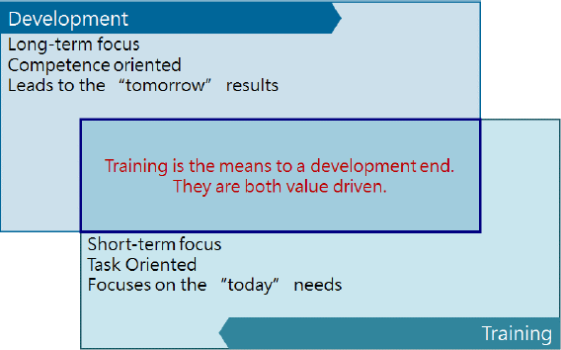

Slide 5
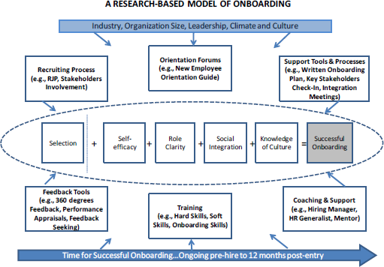
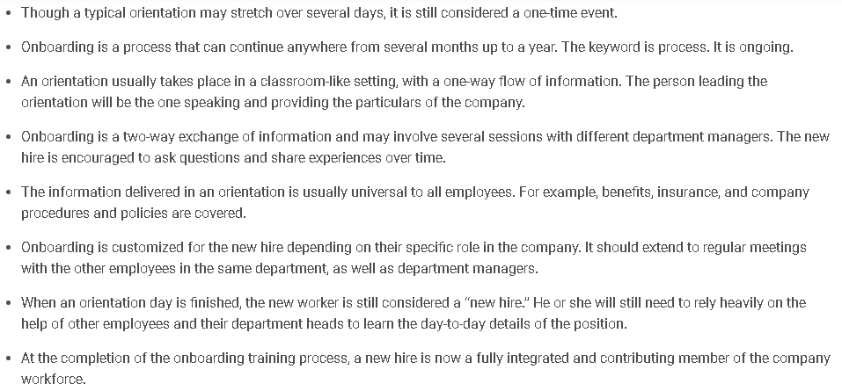
Onboarding and Orientation (Induction)
First, what is the difference between orientation and onboarding?
Well, Orientation is one phase of 6 phases in the onboarding process as shown below in the figure:
Here are the main differences between Orientation and Onboarding:

Slide 6
Can't do / won't do model
Can't do is simply when the employee has a missing link with his / her knowledge and skills but he / she wants to get the job done but simply can't, this is perfectly normal and acceptable and can be solved through training…
But not every "Can't do" employee is cured by training; here are some reasons for the "Can't do" employees:
They were never trained and were hired with the employer knowing that they were not fully competent and would need training.
They do not have the materials or equipment to do the job.
Not enough staff is provided for the work that needs to be done.
There is a lack of communication or miscommunication.
The job is unsafe.
The Won't do employee is the employee who has the knowledge and the skills but does not want to get the job done because of lack of the right attitude
Here are some reasons for the "Won't do" employees:
They are lazy.
They are underpaid.
They lack motivation.
The absence of job fit.
Training won't do any good for the "Won't do" employees.
Competency Autonomy | Knowledge and Skills | Attitude | Action
Type 1 Habiba | 🗸 | 🗸 | Minimum Interference / Development
Type 2 Disha | 🗸 | 🗴 | Coaching
Type 3 Rwan | 🗴 | 🗸 | Training
Type 4 HR Mistake | 🗴 | 🗴 | Coaching then Training
Attitude problem = Won’t doلمعي زياع شم
Knowledge and Skills problem = Can’t doلمعي رداق شم

Slide 7
Training Cycle
The is the generic process traditionally used by instructional
ADDIE model
designers and training developers. The five phases—Analysis, Design, Development, Implementation, and Evaluation—represent a dynamic, flexible guideline for building effective training and performance support tools. While perhaps the most common design model, there are a number of weaknesses to the ADDIE model which have led to a number of spin-offs or variations.
1) Analysis
Data is collected to identify gaps between actual and desired organizational performance. If those gaps point to a lack of employee knowledge and skills, then specific training objectives are established to address the training needs.
According to the ADDIE model, the first thing you should do when you’re
handed a new training project is a detailed analysis.
There are types of analysis to do in this phase:
three
a) Training Needs Analysis
The training coordinator must understand the training programs needed through training needs analysis which is done on three levels:
Individual analysis: this is done as a result of the performance appraisal.
Team Analysis: this is done as a result of the understanding of the departmental goals
Strategic Analysis: this is done as a result of understanding of the strategic goals
b) Audience Analysis
Once you validate that the training is indeed needed, it’s time to analyze your
learners. Knowing key and
about your
demographics
background information
learners will help you identify the information they need to know and the best way to present it to them.
c) Task Analysis
Now that you know what your course is about and who will be taking it, it’s time to take a close look at the specific processes and tasks you’ll be training learners on by breaking them down into step-by-step chunks.
This phase is not concluded unless the training coordinator has provided the most important document; The Annual Training Plan…

Slide 8
2) Design
With the analyses out of the way, you’re ready to start development, right?
Wrong!
Don’t skip the first “D”! Starting to develop your course without completing the design phase is like building a house without a blueprint. It makes much more sense to start with a clear plan of how everything in the course will be laid out and how the text, multimedia, and navigation will fit together. Exactly which deliverable you create as a result of the design phase depends on your time, budget, resources, and what you’ve outlined in your project plan, but typically one of two deliverables comes out of the design phase:
Prototype: This is typically a model or sample of a course that is created to test and identify whether specific features or concepts work. The prototype lets a stakeholder get a feel for how the course looks and functions before developing the entire course and all of its features.
Training Objectives: Training or learning objectives are the intended measurable outcome that your learners will achieve once they’ve finished a course. They should detail the information that will be acquired and what learners will be able to accomplish through learning this information.
Development
You have the training program and you have its details, let’s go get it…
  Training Provider: you contact several training providers (from your experience and from the feedback in the market)
  Content Creation: In this phase you choose and add the final graphics, multimedia, colors, and fonts to make your course look polished and professional. You’ll also use your authoring tool to build out activities, quizzes, interactions, and functional navigation to create an engaging course.
  Testing: Once you’ve created your content, you need to test it. Things that need to be tested and reviewed include spelling, grammar, learning objectives, navigation, and flow. Testing is typically done during the development process instead of after, so that as testers identify problem areas, the developer can make changes to the final product.
  Documents: Prepare the roster and the training evaluation documents.
  Facility Management (Logistics): Choose and prepare the location.
  Calendar Management: Inform the department and section heads' with the training date and location

Slide 9
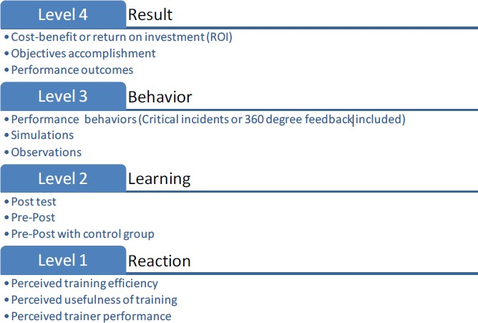
4) Implementation
Once your course is fully developed and thoroughly tested, you’re ready to
share it with your learners.
It is for the better that the Training coordinators attend a percentage of the time in any given session.
You shall provide the material to the learners through three ways:
Hand to hand: print the material and hand it to the learners
Web: If you don’t need to track learner behavior, you can upload content directly to the web and provide a URL link for your learners to access the training. However, since learner activity isn’t tracked, you won’t know whether they completed the course, how long it took them to do so, or if they went wrong somewhere.
Learning Management System: If you do need to track your learners and their progress, your best bet is to share your content through an LMS. Every LMS offers different features and functionalities, but they share some tracking capabilities, such as whether learners completed a module and how long it took them.
5) Evaluation
Training evaluation basically helps with the discovery of training gaps and opportunities in training employees. Training evaluation collects information that can help determine improvements on training programs and help trainers decide if certain programs should be discontinued. The training evaluation process is essential to assess training effectiveness, help improve overall work quality, and boost employee morale and motivation by engaging them in the development of training programs.
There are 4 ways to evaluate training:

Slide 10
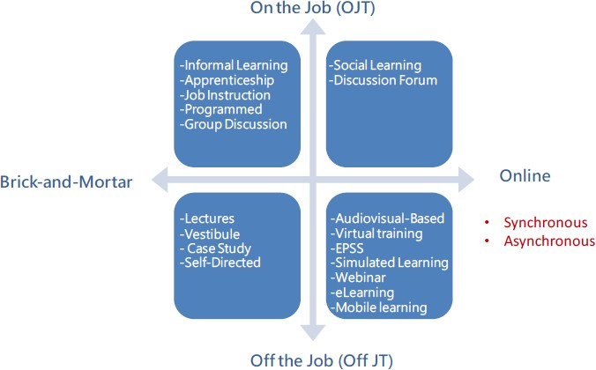
Training Types
OJB & Brick and Mortar
Informal Learning (not included in the TP)
It involves learning through day-to-day unplanned interactions between the new worker and his/her colleagues.
Apprenticeship Training (not included in the TP)
It is a structured process by which people become skilled workers through a combination of classroom instruction and on-the-job training.
Job Instruction (not included in the TP)
It refers to teaching a new employee the logical sequence of steps in a job step by step.
Programmed Learning
It is a step-by-step self-learning method: 1) presenting questions, facts, or problems to the learner; 2) allowing the person to respond; and 3) providing feedback on the accuracy of the answers.
Group Discussion
Group discussions provide a forum for the exchange of this information. They allow participants to learn from one another. Discussions can occur in many sizes (partners, small or large groups) and could be led by the instructor or not. (Standup meetings)

Slide 11
Off the job & Brick and Mortar
Lectures
Just like in school, it is a quick and simple way to provide knowledge to large groups.
Vestibule
It is a method in which trainees learn on the actual or simulated equipment they will use on the job, but are trained off the job. It can be considered a combination of on and off-the-job training.
Case Study
A case study provides a realistic situation for students to analyze and then use for practice of their new skills or knowledge.
Self-Directed
Self-directed study allows learners to progress at their own pace through a set of training materials such as workbooks or CD-ROM or Web-based materials, usually without the aid of an instructor.
OJB and Online
Social learning
IT posits that people learn from one another, via observation, imitation, and modeling. The theory has often been called a bridge between behaviorist and cognitive learning theories because it encompasses attention, memory, and motivation.
Discussion Forum
It is the same as the group discussion but online
Off the job and Online
Audiovisual based
Tools include films, PowerPoint presentations, video conferencing, audiotapes, and videotapes.
Virtual Training
A trainer in a central location teaches groups of employees at remote locations via television hookups. Videoconferencing – allows people in one location to communicate live via a combination of audio and visual equipment with people in different locations – another city or country or with groups in several cities.

Slide 12
Electronic performance Support Systems (EPSS)
The systems are sets of computerized tools and displays that effectively automate and integrate training, documentation, and phone support, thus enabling individuals to provide support that’s faster, cheaper, and more effective than the traditional methods.
Simulated learning
It is a variety of different activities including but not limited to virtual reality- type games, step-by-step animated guides, role playing and software training.
Webinar
A webinar is a presentation, lecture, workshop or seminar that is transmitted over the Web using video conferencing software. A key feature of a Webinar is its interactive elements is the ability to give, receive and discuss information in real-time.
E-Learning
E-learning is the delivery of formal and informal training and educational materials, processes, and programs via the use of electronic media. E-learning includes Web based learning, computer-based training (CBT), and virtual classrooms. Delivery might be over the Internet, an organization's intranet/extranet, satellite broadcast or other means. There is a major problem with e-Learning in long-term retention of curriculum content as a result of the speed with which the learner completes the course.
Generally, e-Learning is a cost-effective method that should be used in conjunction with other training methods.
Mobile Learning
Mobile learning involves the use of mobile technology, either alone or in combination with other information and communication technology (ICT), to enable learning anytime and anywhere. Learning can unfold in a variety of ways: people can use mobile devices to access educational resources, connect with others, or create content, both inside and outside classrooms. Mobile learning also encompasses efforts to support broad educational goals such as the effective administration of school systems and improved communication between schools and families.

Slide 13
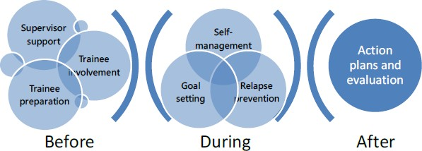
Training Transfer
Ultimately, the goal of implementation is transfer of training, or on-the-job use of knowledge, skills, and behaviors learned in training. Transfer of training requires that employees actually learn the content of the training program. Training transfer is performing certain activities before, during, and after training sessions that enable employees to more effectively and quickly apply the skills learned in training on the job.
Training transfer is the goal when employees are involved in any internal or external training activity, session, seminar, or on-the-job training.

Slide 14
General Concepts
1. Adult learning
There are 5 concepts to understand about Adult Learning:
The need to know: adult learners need to know why they need to learn something before undertaking to learn it.
Learner self-concept: adults need to be responsible for their own decisions and to be treated as capable of self-direction
Role of learners' experience: adult learners have a variety of experiences of life, which represent the richest resource for learning. These experiences are however imbued with bias and presupposition.
Readiness to learn: adults are ready to learn those things they need to know in order to cope effectively with life situations.
Orientation to learning: adults are motivated to learn to the extent that they perceive that it will help them perform tasks they confront in their life situations.
2. Learning Styles
There are three types of learners as below:
Visual learners remember best what they see pictures, diagrams, flow charts, time lines, films, and demonstrations.
Auditory learners, called verbal learners; it’s a learning style in which a person learns through listening. An auditory learner depends on hearing and speaking as a main way of learning.
Kinesthetic learners, also known as tactile learners, learn best through a hand on approach. They prefer to actively explore the physical world around them.
3. Levels of learning
Knowledge simply means that the learner can recall facts.
Comprehension allows the learner to translate or interpret information.
Application is the ability to use learned information in a new situation.
Analysis means understanding information to the level of being able to break it down and explain how it fits together.
Synthesis is the level at which the learner would be able to respond to new situations and determine trouble-shooting techniques and solutions.
Evaluation is the highest level of learning because it allows one to make judgments.

Slide 15
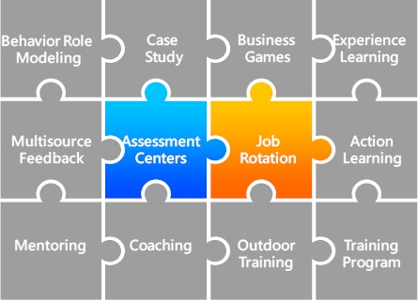
Development Cycle
Succession Planning
Succession planning is different from replacement planning. It does not focus on finding internal backups from within departments; rather, it examines the needs by level (such as the move from middle to senior manager). All talent at each level is "pooled". Talent pools are thus defined as all people who are considered promotable to the next level up on the organization chart regardless of department. When need is great – such as may occur when all members of a group (like senior executives) are at or near retirement age – then a special focus may be placed on accelerating the development of the talent pool. Such a group, targeted for faster development, is called an acceleration pool.
The organization commits to develop all who express interest in promotion – and that is by no means everyone. But organizational leaders manage expectations by indicating that when a vacancy occurs, the best applicant to meet the organization’s needs will be chosen – and that may mean someone from outside the organization.
Development Methods

Slide 16
Behavior Role modeling
The method uses a combination of demonstration (or videotape) and role playing to enhance interpersonal skills. Small group so of trainees observe someone demonstrate how to handle a particular type of interpersonal problem, then they practice the behavior in a role play and get nonthreatening feedback.
Case Study
Cases are descriptions of events in an organization and used in a variety of ways in courses to develop management skills, such as practice analytical and decision-making skills. The benefits of using case study are to increase understanding about situations managers encounter and effective managerial behavior.
Business Games
Simulations require trainees to analyze complex problems and make decisions. After decisions are made, trainees usually receive feedback about what happened as a result of their decision. Business games can be used also to assess training needs, the success of prior training, or the validity of a manager’s mental model for a particular decision situation.
Experience Learning
Much of the management skill essential for effective leadership is learned from experience rather than from formal learning programs. Appropriate values and behaviors can be learned from competent superiors who provide positive role models to emulate.
Experiencing failure may not result in beneficial learning and change unless a person accepts some responsibility for it, acknowledges personal limitations, and finds way to overcome them.
Also, growth and learning are greater when job experiences are diverse as well as challenging. It is beneficial for managers to have early experience with a wide variety of problems that require different leadership behavior and skills.
The obstacles to learning from experience are greatest at higher level of management. Hard-driving, achievement-oriented managers are more likely to be successful early in their careers, but these traits may also interfere with their capacity to changing situations.

Slide 17
Multisource Feedback
This approach is called by various names, including 360-degree feedback and multi rater feedback. This approach can be used for variety of purposes, but the primary use is to assess the strengths and developmental needs for individual managers.
Assessment Centers
These methods may include interviews, aptitude tests, personality inventories, a short autobiographical essay, a speaking exercise, and a writing exercise. AC can enhance self-awareness, help to identify training needs, and facilitate subsequent development of interpersonal and leadership skills, while managers who serve on the staff of these centers may also experience an increase in their managerial skills.
Job Rotation
Managers who are assigned to work in a variety of different functional subunits of the organization for periods of time can learn about the unique problems and processes in different subunits and the interdependencies among different parts of the organization. Also, it provides managers the opportunity to develop a large network of contact.
8. Action Learning (Forever Strong Movie)
The emphasis is on developing cognitive and interpersonal skills rather than technical knowledge. The managers meet periodically with a skilled facilitator to discuss, analyze, and learn from their experiences.
9. Mentoring (Eva’s Company: Coffee with the CEO)
Mentoring is a relationship in which a more experienced manager helps a less experienced protégé; the mentor is usually at a higher managerial level and is not the protégé’s immediate supervisor.
10. Executive Coaching
Having a coach provides the unusual opportunity to discuss issues and try out ideas with someone who can understand them and provide helpful, objective feedback and suggestions, while maintaining strict confidentiality. Executive coaching is especially useful in conjunction with techniques that provide information about developmental needs but do not directly improve skills.
The person who provides the coaching may be external or internal consultant.

Slide 18
Outdoor training
The methods, often called outdoor training, involve physical activities performed by a group of people in an outdoor setting. An experienced facilitator conducts the activities, provides coaching and encouragement, and helps participants understand the link between their experiences in an activity and organization life. The perceptions of teamwork and individual problem solving increased for participants, especially when intact groups were used.
Training Program
Any ordinary training program with the intent of development.

