Slide 1


Storage Technologies
IT403
Prepared by
Dr. Ahmed El-Douh
Lecture 7

Slide 2



Storage Technologies
Lecture 7
IT403
Common Advanced Storage Technologies
Prepared by
Dr. Ahmed El-Douh

Slide 3
Objectives
Upon completion of this module, you will be able to:
  Understand the principles of advanced storage optimization technologies such as SmartThin and SmartTier.
  Describe the mechanisms of Smart QoS and SmartPartition for performance control and resource isolation.
  Explain the role of Snapshot in data protection and recovery scenarios.
  Understand how SmartQuota manages and allocates storage resources effectively.
www.midocean.ae

Slide 4
Chapter
Outlines
07
SmartThin
SmartTier
Smart QoS
SmartPartition
Snapshot
SmartQuota
www.midocean.ae

Slide 5


Chapter
07
SmartThin
www.midocean.ae

Slide 6
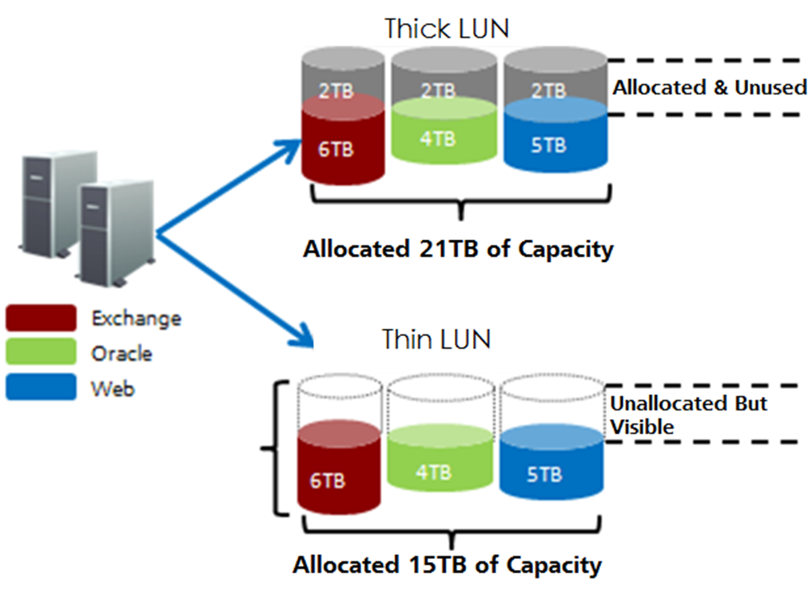
Overview of Thin Provisioning
www.midocean.ae

Slide 7
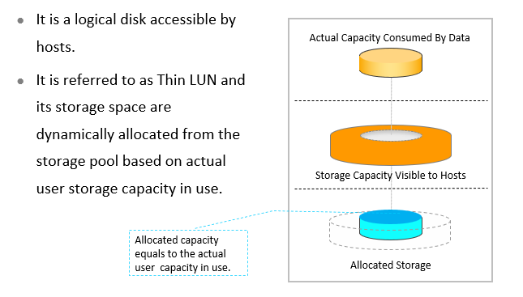
Thin LUN
www.midocean.ae

Slide 8
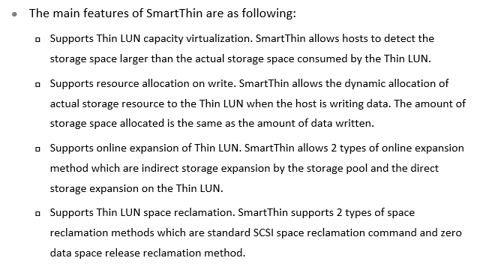
Main Features of SmartThin
www.midocean.ae

Slide 9
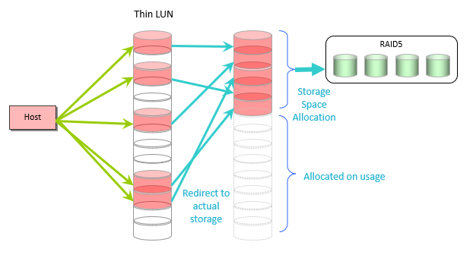
Thin LUN Capacity Virtualization
www.midocean.ae

Slide 10
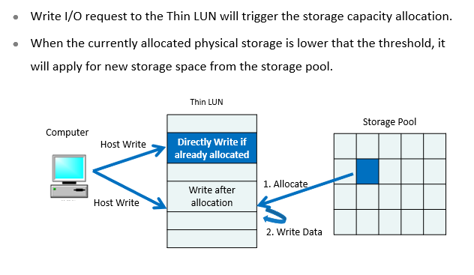
Capacity - on - write
www.midocean.ae

Slide 11
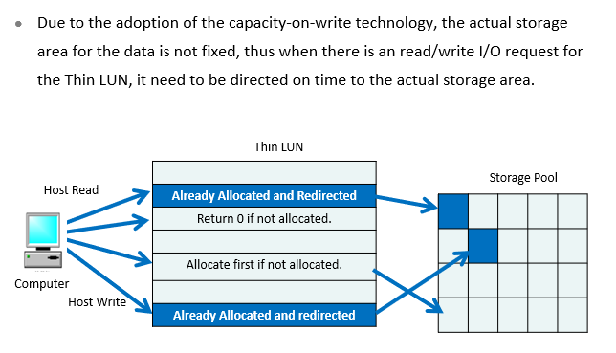
Direct - on - time
www.midocean.ae

Slide 12
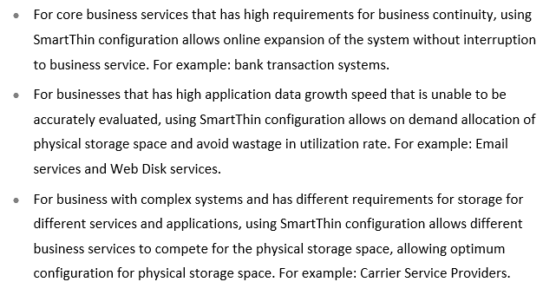
Application Scenario
www.midocean.ae

Slide 13
Chapter
07
SmartTier
www.midocean.ae

Slide 14
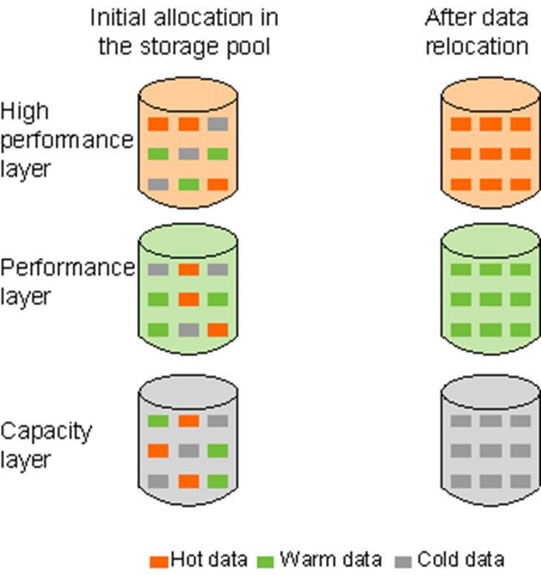
Overview of Storage Tiers
www.midocean.ae

Slide 15
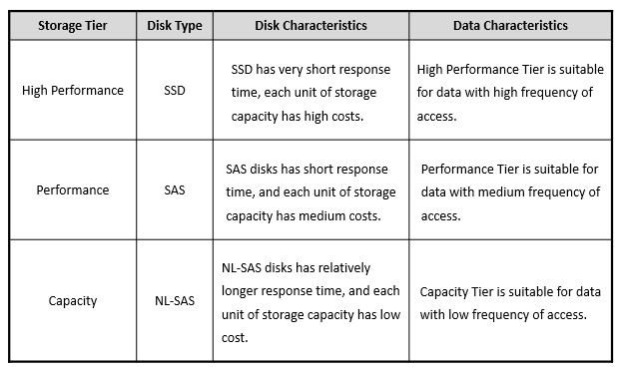
Levels of Storage Tier
www.midocean.ae

Slide 16
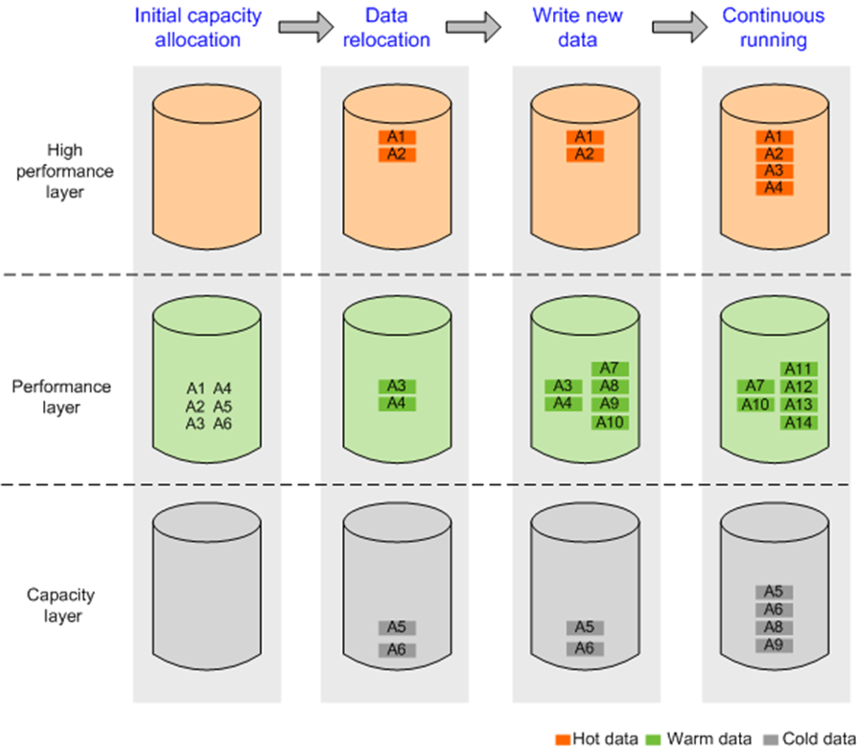
Working Principles
www.midocean.ae

Slide 17
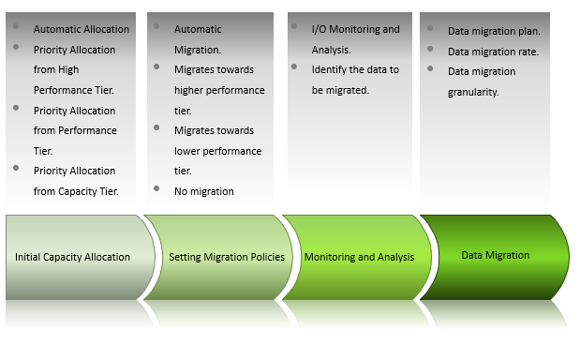
Key Technologies
www.midocean.ae

Slide 18
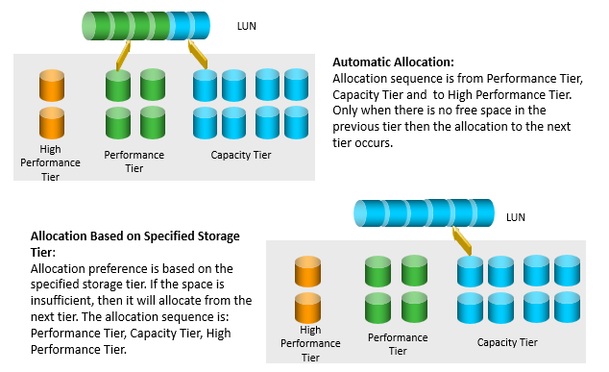
Initial Capacity Allocation
www.midocean.ae

Slide 19
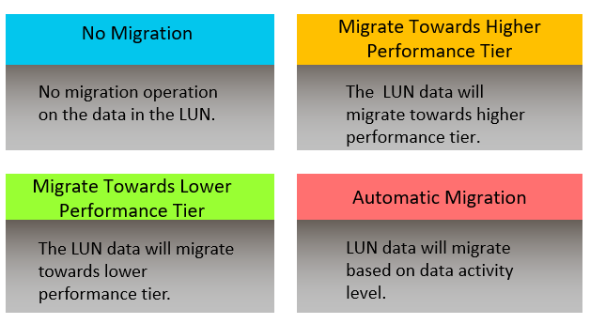
Migration Policies
www.midocean.ae

Slide 20
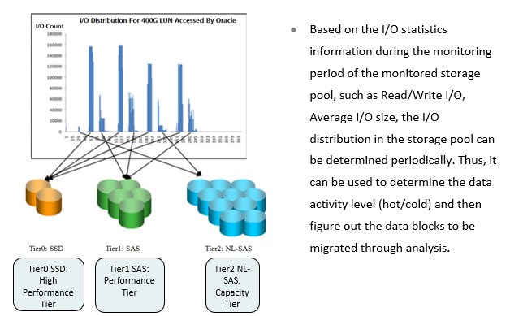
I/O Monitoring and Analysis
www.midocean.ae

Slide 21
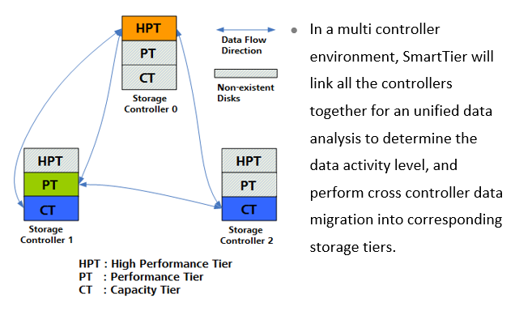
Data Migration
www.midocean.ae

Slide 22
Chapter
07
SmartQoS
www.midocean.ae

Slide 23
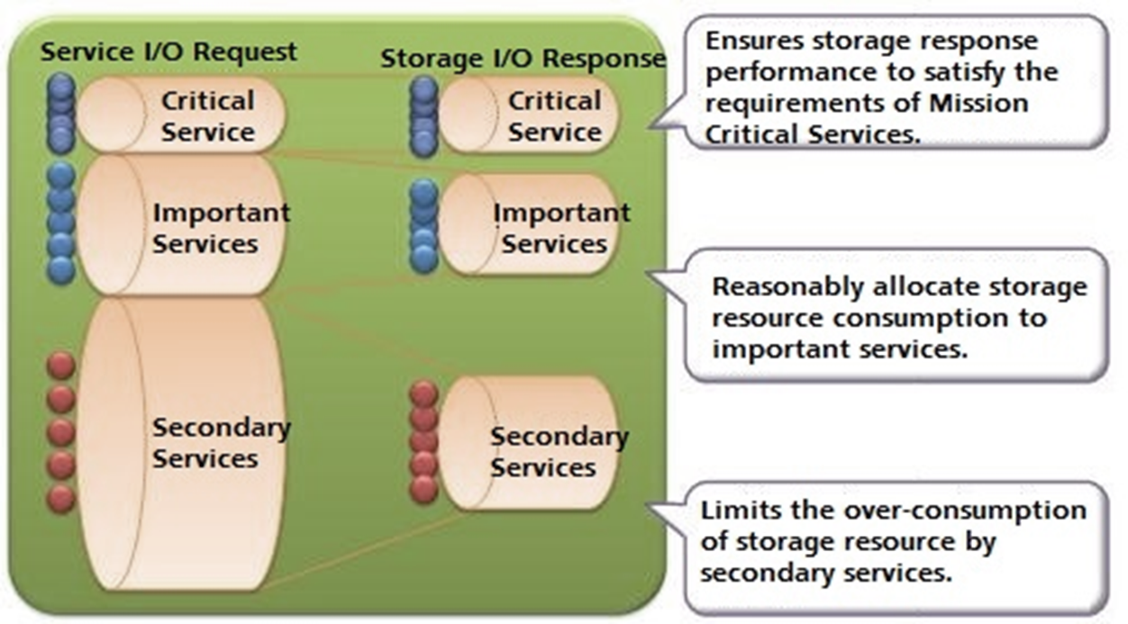
Overview
www.midocean.ae

Slide 24
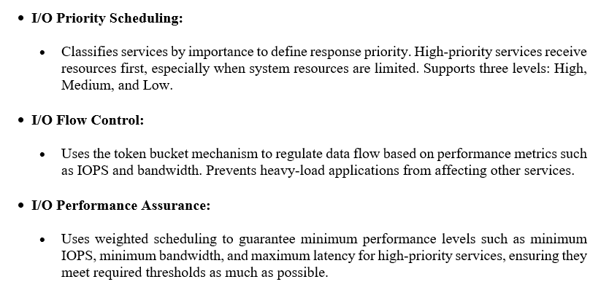
Working Principles of SmartQoS
www.midocean.ae

Slide 25
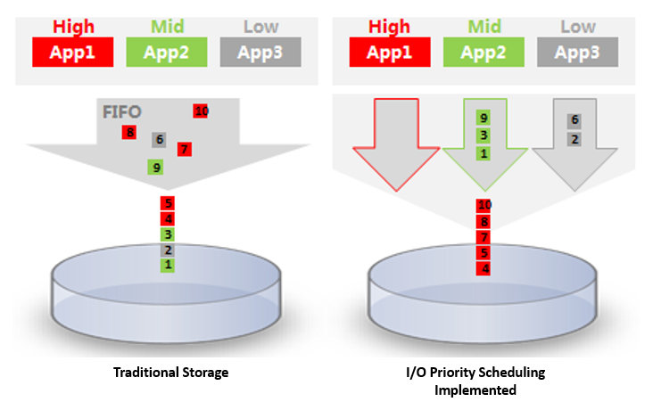
I/O Priority Scheduling
www.midocean.ae

Slide 26
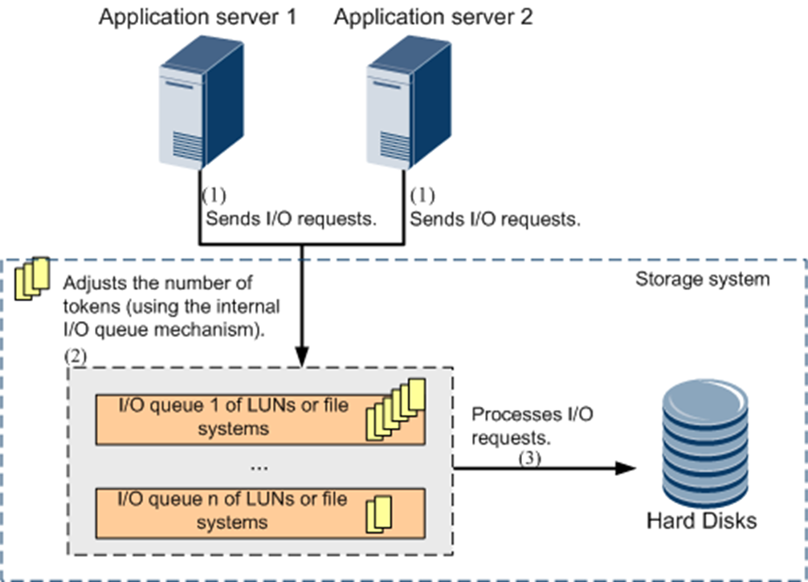
I/O Flow Control
www.midocean.ae

Slide 27
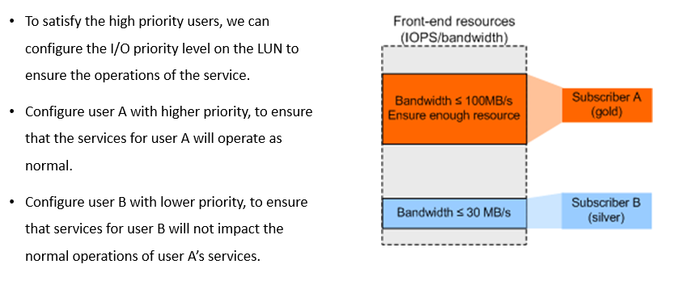
Application Scenario - Ensure Service Performance of High Priority Users
www.midocean.ae

Slide 28
Chapter
07
SmartPartition
www.midocean.ae

Slide 29
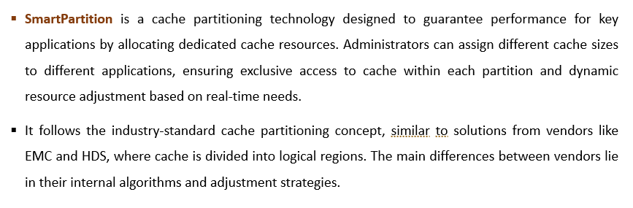
Overview of SmartPartition
www.midocean.ae

Slide 30
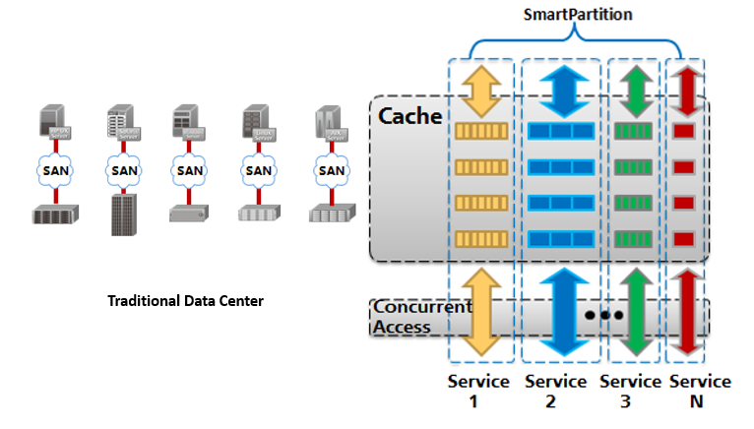
The Storage Requirements of the Converging Trend of IT Architecture

Slide 31
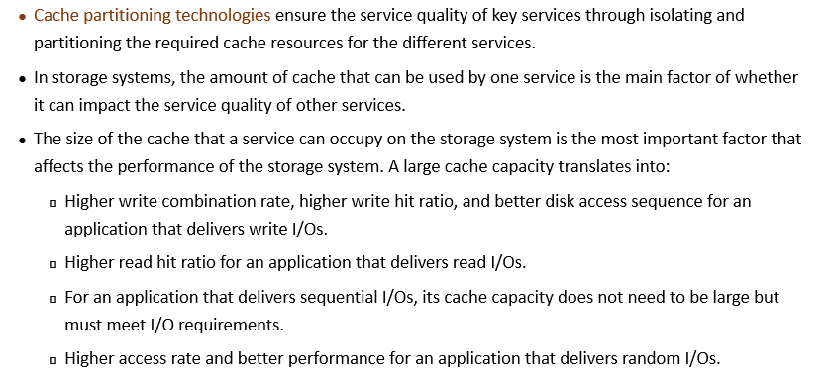
Working Principles
www.midocean.ae

Slide 32
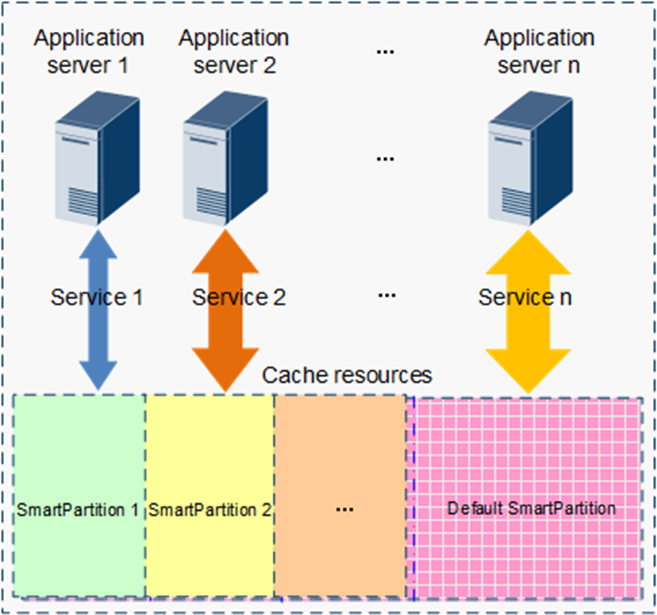
Scheduling of Multiple Applications
www.midocean.ae

Slide 33
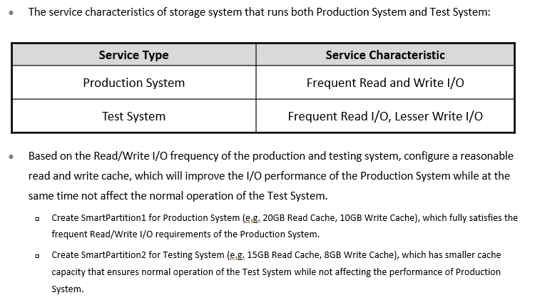
Application Scenario - Ensuring Core Service Performance In Multi - Service Scenario
www.midocean.ae

Slide 34
Chapter
07
Snapshot
www.midocean.ae

Slide 35
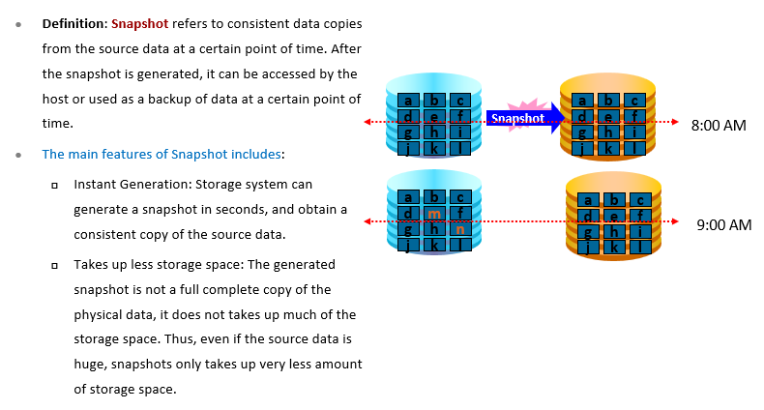
LUN Snapshot Overview
www.midocean.ae

Slide 36
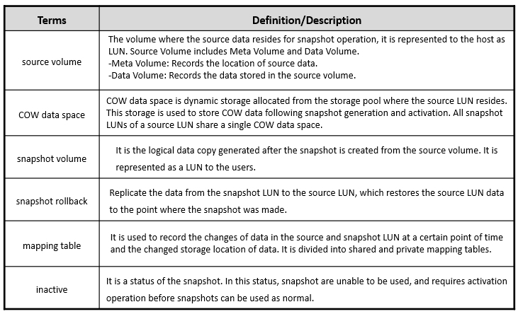
Related Concepts
www.midocean.ae

Slide 37
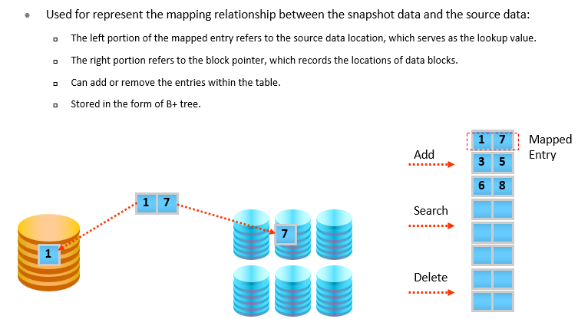
Mapping Table
www.midocean.ae

Slide 38
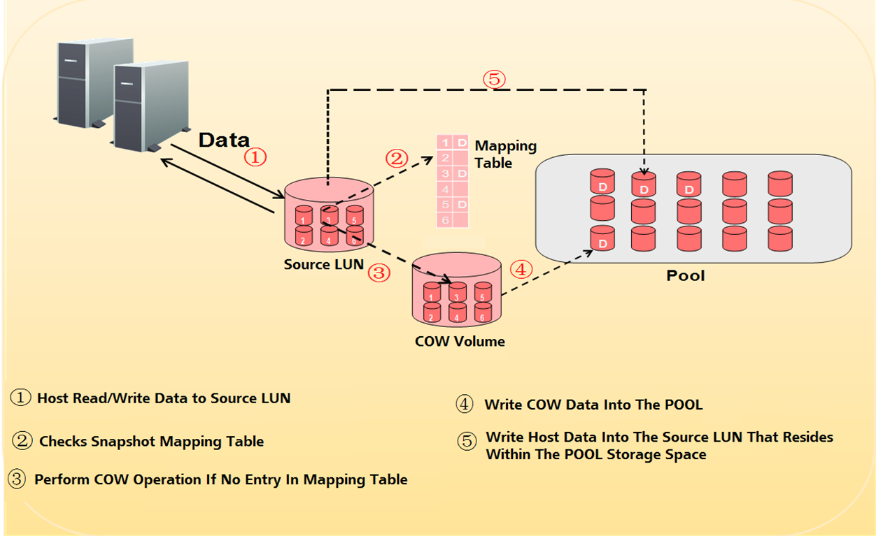
Copy On Write (COW)
www.midocean.ae

Slide 39
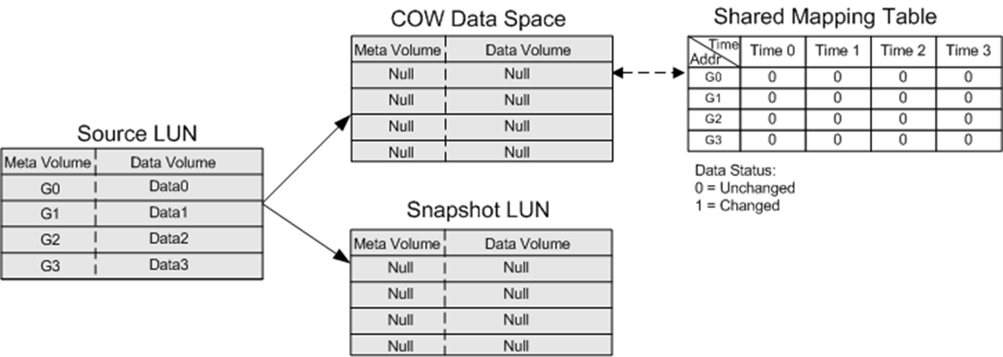
Snapshot Working Principles
www.midocean.ae

Slide 40
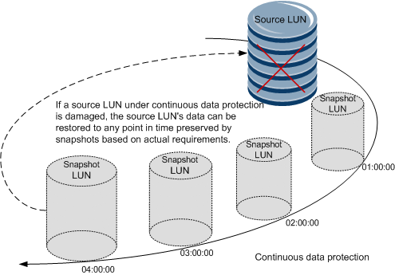
Application Scenario - Continuous Protection of Data
www.midocean.ae

Slide 41
Chapter
07
SmartQuota
www.midocean.ae

Slide 42
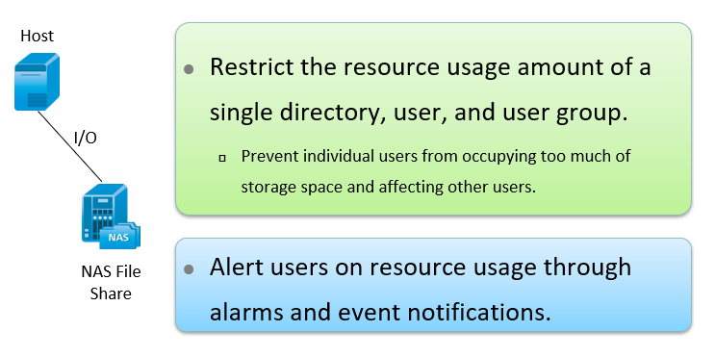
Overview of Smart Quota
www.midocean.ae

Slide 43
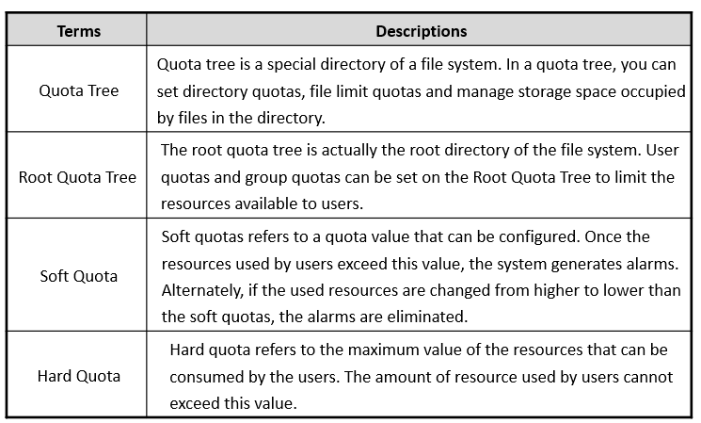
Related Terms
www.midocean.ae

Slide 44
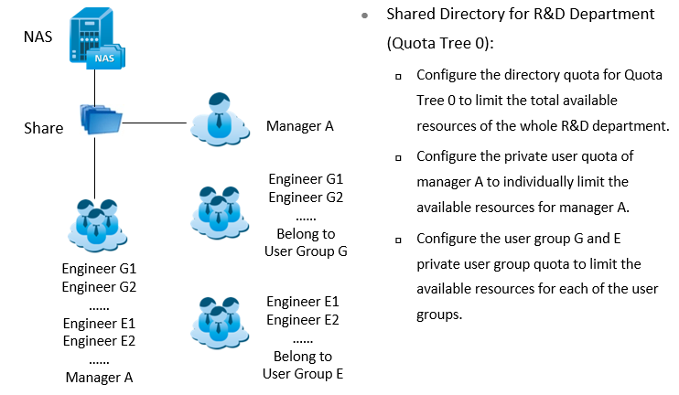
Application Scenario - Flexible Restriction of the User Resources
www.midocean.ae

Slide 45



Thank You

