Slide 1


Introduction to
Research Methods
Prepared by Associate Professor
Ahmed Rageh Ismail
MGM333
Introduction to research methods
Lecture 0

Slide 2


Chapter
Importance and Purpose of Research
0
Research is formalized curiosity.
Purpose of the course
- Provide a reference guide for the research process.
- Emphasize the essential nature of research skills for business students.
Significance
- Facilitates the identification and solution of workplace problems.
www.midocean.ae

Slide 3
Chapter
Goals and Approach of the Course
0
Aims
- Provide insight into the research process.
- Present choices and opportunities in research endeavors.
- Encourage the development of individual research approaches.
Philosophy
- Research as an adventure and a joy.
- Promote infinite curiosity and desire to discover the unknown.
www.midocean.ae

Slide 4
Chapter
Important Information
0
The trimester is 13 weeks long (including two weeks for the final exam).
Lecture times and discussion sessions are based on Mecca time for all programs.
The duration of the recorded lecture is 70-90 minutes, and it is uploaded to the Moodle platform.“
The weekly lecture will be uploaded to Moodle every Saturday at 12 noon, Riyadh time.
Discussion sessions are optional for students, which aims at discussing what was presented in the recorded lecture for that week. (Please check the schedule for the specific time and duration of the course.)
www.midocean.ae

Slide 5
Chapter
Important Information
0
The first week is an orientation week.
Everything related to the semester is uploaded to the Moodle page.
A short test with simple general questions for will be uploaded, serving as training on timing and the number of questions.
The short test is uploaded weekly at the same time as the lecture on Saturday of each week at 10 PM, and it remains open for a week, then it closes on the following Saturday at 9 PM."
www.midocean.ae

Slide 6
Chapter
Important Information
0
The short test questions: MCQ / Matching / true & false / audio questions.
-- Answering the short test is considered attendance for the student.
-- The short test is worth 8 marks / 8 questions. (Total 80 marks)
-- The allowable time for the short test is 24 minutes.
-- The final exam will be through Moodle.
-- Final exam questions: MCQ / Matching / true & false / audio questions.
-- The final exam is 20 marks.
www.midocean.ae

Slide 7

Chapter
The Research Hierarchy
0
Figure 0.1 describes relationships between various levels of the research hierarchy.
www.midocean.ae

Slide 8
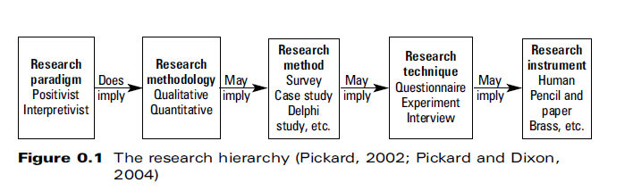

Slide 9
Chapter
Paradigms
0
Paradigms are 'constellation of beliefs, values, techniques' shared by a scientific community (Kuhn, 1970, 146).
Provide solutions or exemplars for solving scientific problems (Seale, 1998, 12).
Paradigms guide the subject, activity, and nature of research outputs (Corbetta, 2003, 11).
www.midocean.ae

Slide 10
Chapter
Paradigms and Methodologies
0
Paradigm implies a methodology;
worldview often dictates research nature.
Ideally, the research question should dictate the nature of the 'asking'.
www.midocean.ae

Slide 11
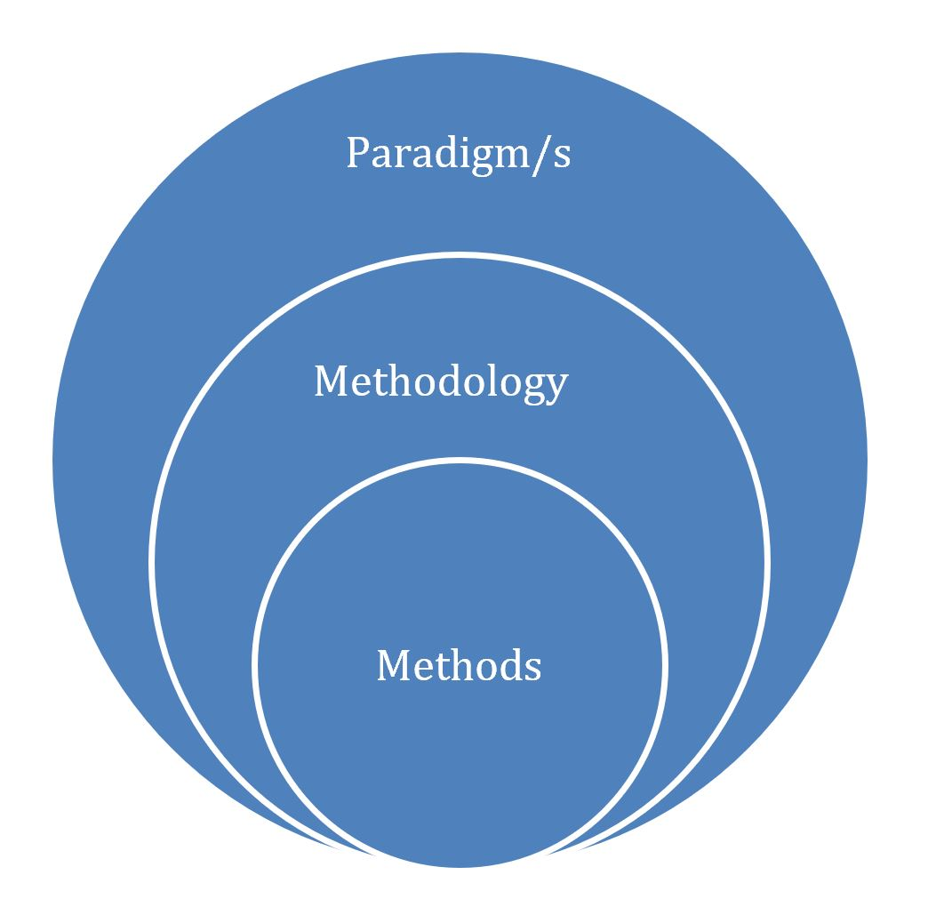

Slide 12
Chapter
Paradigm: Positivism vs. Interpretivism
0
Positivism: This paradigm is based on the idea that the social world can be studied with the same scientific methods used in the natural sciences.
Methodology: Uses quantitative methods such as surveys, experiments, and statistical analysis to test hypotheses.
Worldview: Positivists believe in objective reality that can be measured and quantified.
Research Nature: Research under this paradigm seeks to identify general laws and patterns in social behavior through empirical, objective observation and analysis.
www.midocean.ae

Slide 13
Chapter
Paradigm: Positivism vs. Interpretivism
0
Interpretivism: This paradigm emphasizes understanding the subjective meaning of social phenomena from the perspective of those experiencing it.
Methodology: Employs qualitative methods such as interviews, ethnography, and participant observation to gain in-depth insights.
Worldview: Interpretivists believe that reality is socially constructed and can only be understood through the subjective experiences of individuals.
Research Nature: Research focuses on understanding the meaning and context of social phenomena, often prioritizing depth over generalizability.
www.midocean.ae

Slide 14
Chapter
Research Question: How do social media platforms influence political engagement among young adults?
0
Nature of the 'Asking’
This question could be approached using a mixed-methods strategy, as it involves both the measurement of engagement levels and the exploration of user experiences.
Methodology
Quantitative: Use surveys to measure the frequency and types of political engagement (e.g., signing petitions, attending protests) among young adults who use social media.
Qualitative: Conduct in-depth interviews to understand how and why young adults engage with political content on social media, and how it affects their political views and actions.
www.midocean.ae

Slide 15
Chapter
Qualitative Analysis
0
Discussion on narrative analysis and other qualitative methods.
Importance of understanding the context and nuances in qualitative data.
www.midocean.ae

Slide 16


Slide 17


Slide 18
Chapter
Research Methods
0
Definition
- Bounded system for empirical investigation, often called a 'strategy'.
- Research method is defined by the driving purpose, not techniques.
Examples of Research Methods
- Case study
- Survey
- Action research
www.midocean.ae

Slide 19

Chapter
Research Techniques
0
Definition
- Individual data collection techniques within a method.
Examples of Techniques
- Interviews
- Questionnaires
- Focus groups
www.midocean.ae

Slide 20
Chapter
Research Instruments
0
Definition
- Device designed or trained to collect necessary data.
Examples of Instruments
- 'Pencil and paper' instruments: physical or online questionnaires
- 'Human' instruments: researchers collecting data in natural settings
Usage
- Instruments vary based on the type of research and setting.
www.midocean.ae

Slide 21
Chapter
Overview of Contents - Part 1
0
Part 1: Starting the Research Process
- Focus on generic issues necessary for most research investigations.
- Brief discussion of three major research paradigms in the business filed.
Purpose
- Provide an overview of current thinking within the field.
- Discuss qualitative and quantitative methodologies and their rigour.
www.midocean.ae

Slide 22
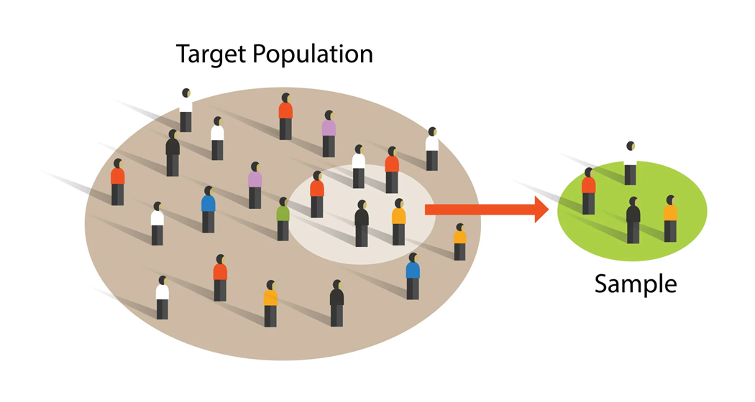
Chapter
Key Topics in Part 1
0
Key Topics Covered
- Literature reviewing
- Defining the research
- Sampling
- Preparing a research proposal
www.midocean.ae

Slide 23

Chapter
Overview of Contents - Part 2
0
Part 2: Research Methods
- Focus on various research methods and potential approaches.
- Describes a research method and its suitable questions.
- Instructions on designing each method.
www.midocean.ae

Slide 24

Chapter
Overview of Contents - Part 3
0
Data Collection Techniques
- Focus on techniques for social or 'person-centred' research.
- Includes techniques for examining and developing systems.
- Discusses 'virtual' research techniques as adaptations of conventional ones.
www.midocean.ae

Slide 25
Chapter
Part 4: Data Analysis and Research Presentation
0
Introduction to Data Analysis
Focus on both quantitative and qualitative analysis techniques.
Brief overview of statistical analysis techniques.
Application of appropriate procedures to gathered data.
www.midocean.ae

Slide 26
Chapter
Challenges in Research Presentation
0
Highlight the difficulty many researchers face in effectively presenting their research.
Emphasize the importance of clear and impactful communication of research findings.
Strategies for Effective Presentation
Techniques for structuring and organizing research outputs.
Tips on engaging the audience and conveying key messages succinctly.
www.midocean.ae

Slide 27

Chapter
Final Thoughts
0
Importance of passion and continual learning in becoming an expert.
Encouragement to embrace mistakes as learning opportunities.
Invitation to share in the passion and dedication to research.
www.midocean.ae

Slide 28



Thank You

