Slide 1


Marketing Management
MGM612
Dr. Ayman Hassan
  Lecture - 8 -
Designing and Managing Integrated Marketing Communications

Slide 2

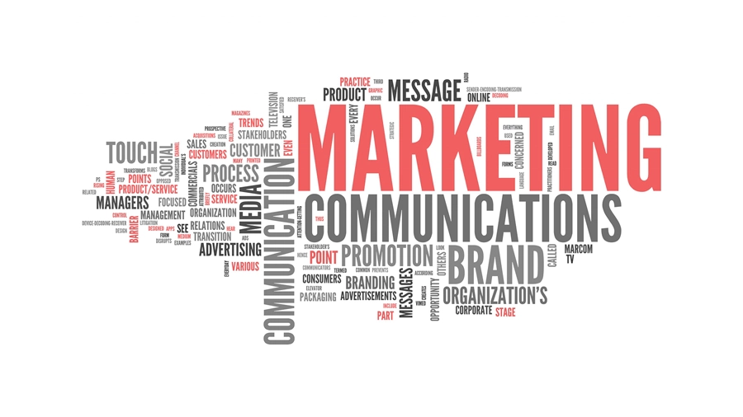
Chapter
7-8
Designing and Managing Integrated Marketing Communications
Lecture : 8
Dr. Ayman Hassan

Slide 3
In the previous lecture,
We have discussed
In the previous lecture, we presented the topic of the Branding, We explained a set of topics, which are as follows:
Explain how companies find and develop new-product ideas
List and define the steps in the new-product development process and the major considerations in managing this process
Describe the stages of the product life cycle
Describe how marketing strategies change during the product’s life cycle
Discuss two additional product and services issues: socially responsible product decisions and international product and services marketing

Slide 4
Learning Outcomes
Chapter
7-8
After studying this chapter you will be able to know all of the following:
Explain the role of marketing communications
Describe How do marketing communications work
Discuss the major steps in developing effective communications
the communications mix and how should it be set
Explain an integrated marketing communications program

Slide 5
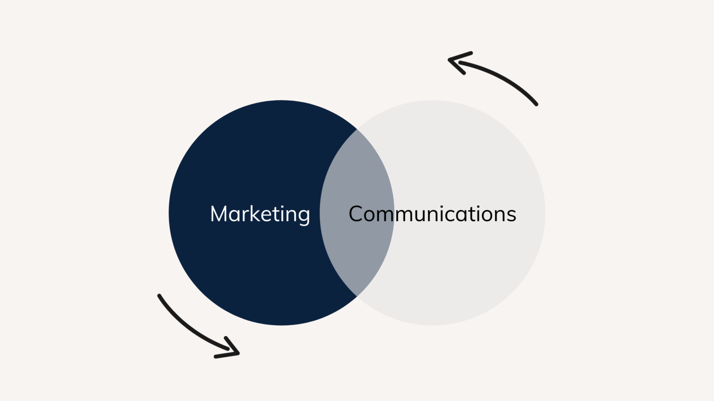
Chapter
7-8
What are Marketing Communications?
Marketing communications are the means by which firms attempt to inform, persuade, and remind consumers, directly or indirectly, about the products and brands they sell.
In a corporate context, we define communications as the dissemination of messages to the company’s targeted internal and/or external audiences in order to reinforce its position and values.
While marketing is “customer-centric,” communications is all about the “audience.”

Slide 6
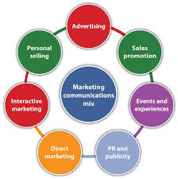
Chapter
7-8
Modes of Marketing Communications
Advertising
Sales promotion
Events and experiences
Public relations and publicity
Direct marketing
Interactive marketing
Word-of-mouth marketing
Personal selling

Slide 7
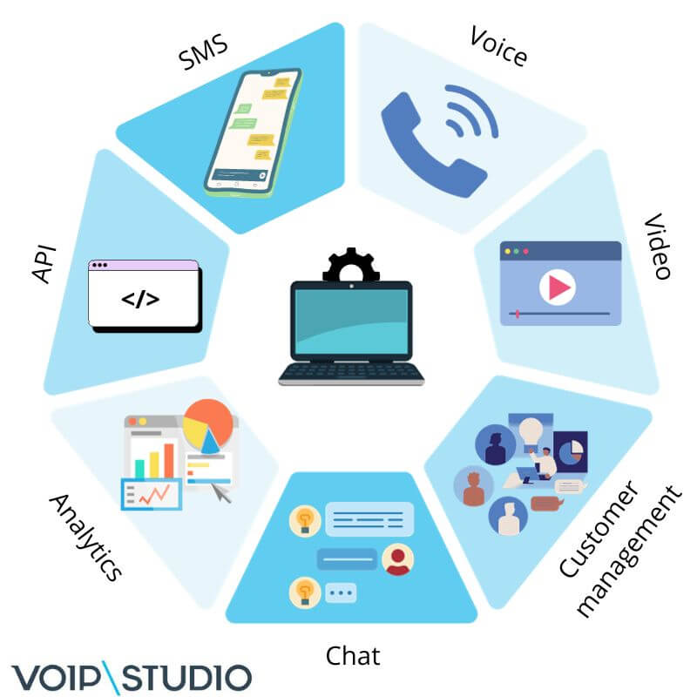
Chapter
7-8
Communication Platforms
Advertising
Print and broadcast ads
Packaging inserts
Motion pictures
Brochures and booklets
Posters
Billboards
Logos
Videotapes
Sales Promotion
Contests, games, sweepstakes
Premiums
Sampling
Trade shows, exhibits
Coupons
Rebates
Entertainment
Continuity programs

Slide 8

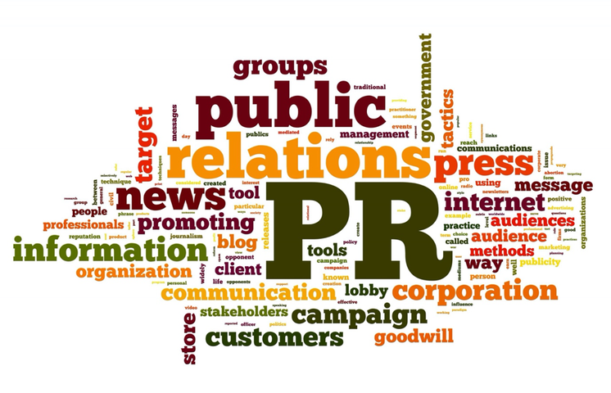
Chapter
7-8
Communication Platforms
Events/ Experiences
Sports
Entertainment
Festivals
Art
Causes
Factory tours
Company museums
Street activities
Public Relations
Press kits
Speeches
Seminars
Annual reports
Charitable donations
Publications
Community relations
Lobbying
Identity media
Company magazine

Slide 9
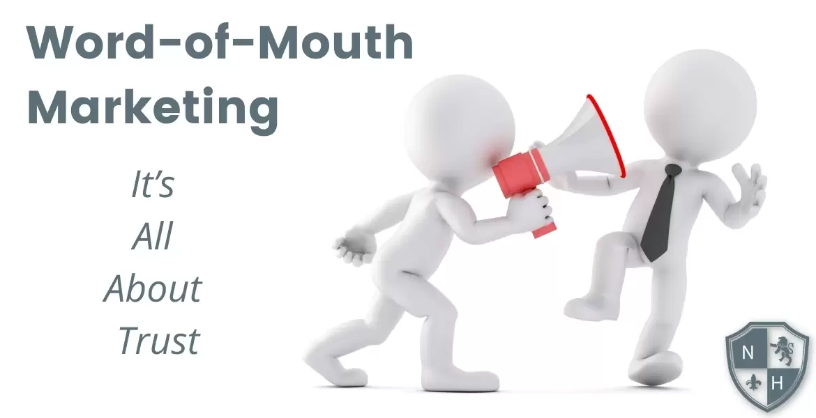

Chapter
7-8
Communication Platforms
Personal Selling
Sales presentations
Sales meetings
Incentive programs
Samples
Fairs and trade shows
Direct Marketing
Catalogs
Mailings
Telemarketing
Electronic shopping
TV shopping
Fax mail
E-mail
Voice mail
Blogs
Websites
Word-of-Mouth Marketing
Person-to-person
Chat rooms
Blogs

Slide 10
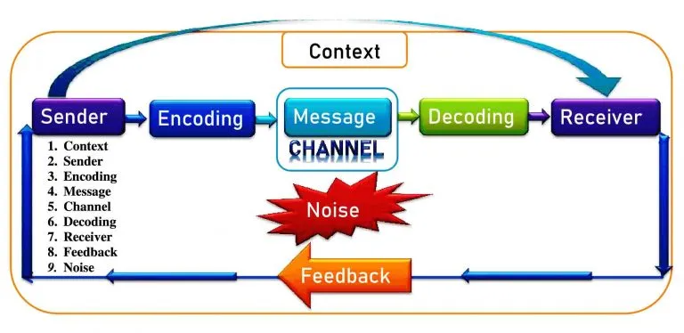
Chapter
7-8
Elements in the Communications Process
Sender
Encoding
Message
Decoding
Receiver
Response
Noise
Feedback

Slide 11
Chapter
7-8
Communication Theory
SENDER
MESSAGE
MESSAGE
RECIEVER
Channel
encoding
Barriers
or
Noise
decoding
FEEDBACK
RESPONSE

Slide 12
Chapter
7-8
An Ideal Ad Campaign
The right consumer is exposed to the message at the right time and place
The ad causes consumer to pay attention
The ad reflects consumer’s level of understanding and behaviors with product
The ad correctly positions brand in terms of points-of-difference and points-of-parity
The ad motivates consumer to consider purchase of the brand
The ad creates strong brand associations

Slide 13
Chapter
7-8
Communications Objectives
Category need
Brand awareness
Brand attitude
Purchase intention
Motivating People/Audiences
Promoting the brand, product or service

Slide 14


Chapter
7-8
Steps in Developing Effective Communications
Identify target audience
Determine objectives
Design communications
Select channels
Establish budget
Decide on media mix
Measure results/manage IMC

Slide 15
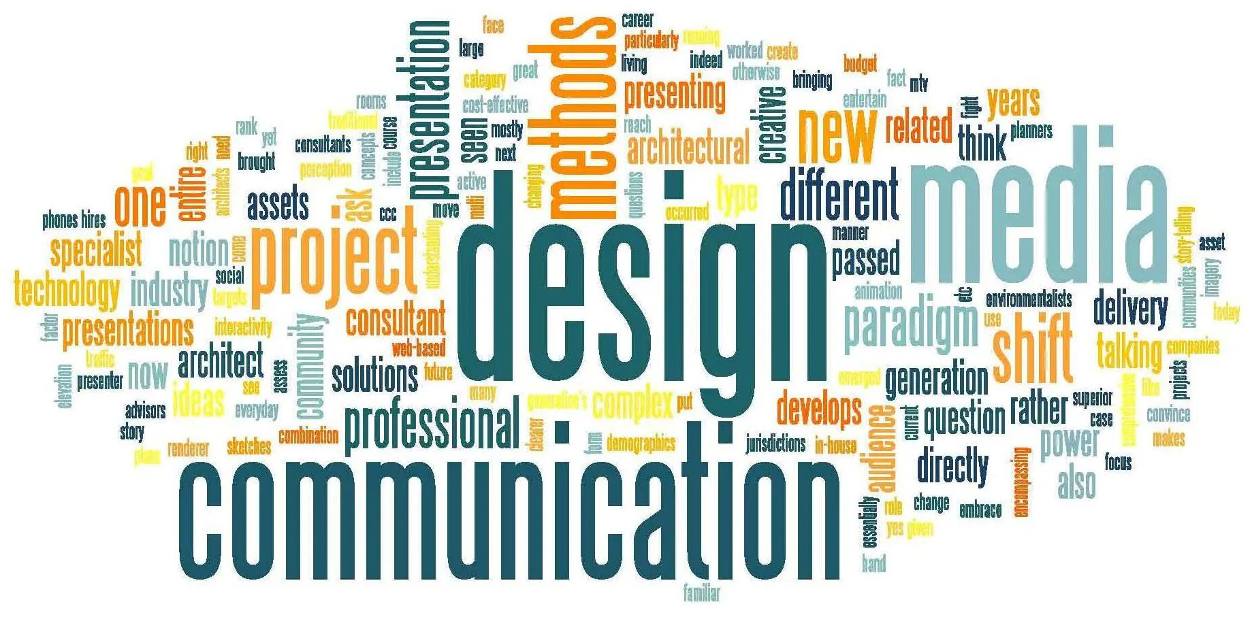
Chapter
7-8
Designing the Communications
Message strategy
Creative strategy
Message source
Global adaptation

Slide 16
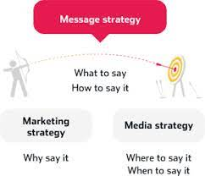
Chapter
7-8
Designing the Communications
1- Creative strategy
Informational and transformational appeals
Positive and negative appeals
  Fear
  Guilt
  Shame
  Humor
  Love
  Pride
  Joy
2- Message strategy
simply put, message strategy is deciding what to say and how to say it — in order to achieve an ultimate business goal. It's how you turn marketing into communications, and communications into results
3- Message source
Celebrity Characteristics
  Expertise
  Trustworthiness
  Likeability

Slide 17
Chapter
7-8
Designing the Communications
Issues Facing Global Adaptations
Is the product restricted in some countries?
Are there restrictions on advertising the product to a specific target market?
Can comparative ads be used?
Can the same advertising be used in all country markets?

Slide 18
Chapter
7-8
Select Communication Channels
Select Communication Channels
Personal channels
Non personal channels
Integration of channels

Slide 19
Chapter
7-8
Personal Communications Channels
Personal channels
Advocate channels
Expert channels
Social channels

Slide 20
Chapter
7
Stimulating Personal Influence Channels
Identify influential individuals and devote extra attention to them
Create opinion leaders
Use community influential in testimonial advertising
Develop advertising with high “conversation value”
Develop WOM referral channels
Establish an electronic forum
Use viral marketing

Slide 21
Chapter
7
Non personal Communication Channels
Non personal channels
Media
Sales promotion
Events & experiences
Public relations

Slide 22
Chapter
7
Objective-and-Task Method
Establish the market share goal.
Determine the percentage that should be reached.
Determine the percentage of aware prospects that should be persuaded to try the brand.
Determine the number of advertising impressions per 1% trial rate.
Determine the number of gross rating points that would have to be purchased.
Determine the necessary advertising budget on the basis of the average cost of buying .

Slide 23
Chapter
7
The Communications Mix
Advertising
Personal Selling
Sales Promotion
Public Relations and Publicity
Direct Marketing
Word-of-Mouth Marketing
Events and Experiences

Slide 24
Chapter
7
Characteristics of the Marketing Communications Mix
Public Relations and Publicity
High credibility
Ability to catch buyers off guard
Dramatization
Events and Experiences
Relevant
Involving
Implicit

Slide 25
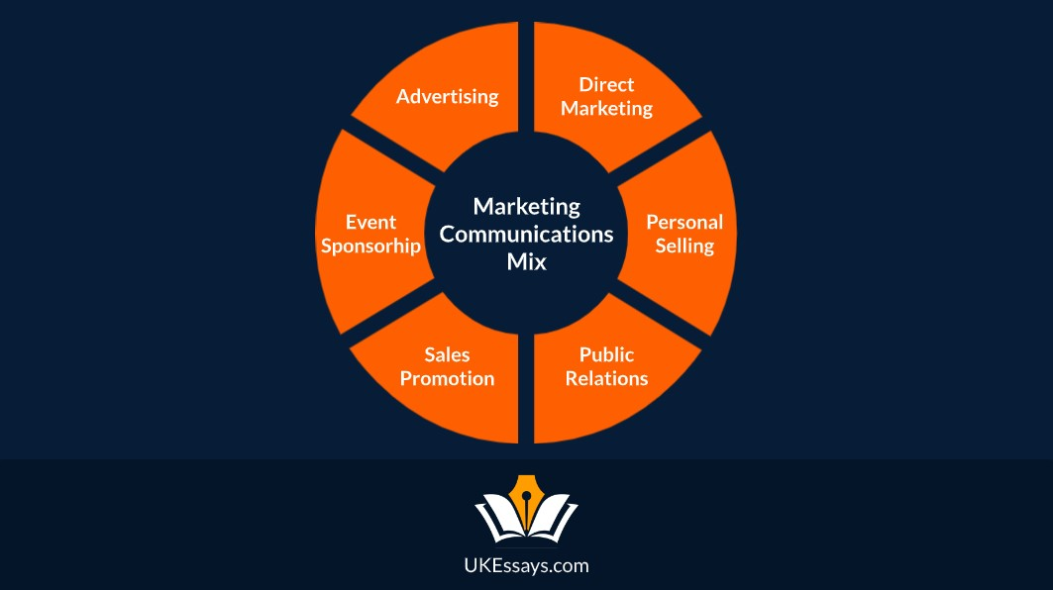
Chapter
7
Characteristics of the Marketing Communications Mix
Direct Marketing
Customized
Up-to-date
Interactive
Personal Selling
Personal interaction
Cultivation
Response
Word-of-Mouth Marketing
Credible
Personal
Timely

Slide 26
Chapter
7
Factors in Setting Communications Mix
Type of product market
Buyer readiness stage
Product life cycle stage

Slide 27
Chapter
7
Steps in Developing Effective Marketing Communication
Identify the target audience
Determine the communication objectives
Design the message
Choose the media
Select the message source

Slide 28
Chapter
7
Steps in Developing Effective Marketing Communication
Identifying the Target market
What will be said
How it will be said
When it will be said
Where it will be said
Who will say it

Slide 29
Chapter
7
Steps in Developing Effective Marketing Communication
Determining the Communication Objectives
Marketers seek a purchase response that results from a consumer decision-making process that includes the stages of buyer readiness

Slide 30
Chapter
7
Steps in Developing Effective Marketing Communication
Designing a Message
AIDA Model
The AIDA model describes the four stages a consumer goes through before making a purchasing decision: Attention, interest, desire, and action.“
Get Attention
Hold Interest
Arouse Desire
Obtain Action

Slide 31
Chapter
7
Steps in Developing Effective Marketing Communication
Designing a Message
Message content is an appeal or theme that will produce the desired response
Rational appeal
Emotional appeal
Moral appeal

Slide 32
Chapter
7
Steps in Developing Effective Marketing Communication
Designing a Message
Rational appeal
relates to the audience’s self-interest
Emotional appeal
is an attempt to stir up positive or negative emotions to motivate a purchase
Moral appeal
is directed at the audience’s sense of right and proper

Slide 33
Chapter
7
Steps in Developing Effective Marketing Communication
Choosing Media
Personal communication
involves two or more people communicating directly with each other
Face to face
Phone
Mail
E-mail
Internet chat

Slide 34
Chapter
7
Steps in Developing Effective Marketing Communication
Choosing Media
Personal communication is effective because it allows personal addressing and feedback
Control of personal communication
Company
Independent experts
Word-of-mouth

Slide 35
Chapter
7
Steps in Developing Effective Marketing Communication
Choosing Media
Personal Communication
Opinion leaders
are people within a reference group who, because of their special skills, knowledge, personality, or other characteristics; exerts social influence on others
Buzz marketing
involves cultivating opinion leaders and getting them to spread information about a product or service to others in their communities

Slide 36
Chapter
7
Steps in Developing Effective Marketing Communication
Non personal Communication Channels
Non personal communication
is media that carry messages without personal contact or feedback, including major media, atmospheres, and events that affect the buyer directly

Slide 37
Chapter
7
Steps in Developing Effective Marketing Communication
Non personal Communication Channels
Major media
include print, broadcast, display, and online media
Atmospheres
are designed environments that create or reinforce the buyer’s leanings toward buying a product

Slide 38
Chapter
7
Steps in Developing Effective Marketing Communication
Non personal Communication Channels
Events are staged occurrences that communicate messages to target audiences
Press conferences
Grand openings
Exhibits
Public tours

Slide 39
Chapter
7
Steps in Developing Effective Marketing Communication
Selecting the Message Source
The message’s impact on the target audience is affected by how the audience views the communicator
Celebrities
  Athletes
  Entertainers
Professionals
  Health care providers

Slide 40
Chapter
7
Steps in Developing Effective Marketing Communication
Collecting Feedback
Involves the communicator understanding the effect on the target audience by measuring behavior resulting from the behavior

Slide 41

Chapter
7
Socially Responsible Marketing Communication
Communicate openly and honestly with consumers and resellers
Avoid deceptive or false advertising
Avoid bait-and-switch advertising
Conform to all federal, state, and local regulations
Follow rules of “fair competition”
Do not offer bribes
Do not attempt to obtain competitors’ trade secrets
Do not disparage competitors or their products

Slide 42
See you in the next lecture

Slide 43
Resources and References
Personale Selling - Définition, Types, Techniques, Exemples, Pros & Cons
What is Word-of-Mouth Marketing? – Noble House Media
9 Elements of Communication Process With Examples

Slide 44

Thanks for listening.
01
Best wishes
Dr. Ayman Hassan

