Slide 1


Master Of Real Estate
Management
Prepared by Dr. Ahmad Muhammad
MKT600
Digital Marketing Concepts
Lecture 7

Slide 2



Master Of Real Estate
Management
Lecture 7
MKT600
Digital Marketing Concepts
Prepared by
Dr. Ahmad Muhammad

Slide 3

Chapter
Video and Virtual Tour Marketing
07

Slide 4

Chapter
07
Lecture Objectives
Analyze the core elements of impactful storytelling—tone, imagery, plot, and context—derived from traditional oral storytelling practices, and apply them to craft a compelling real estate brand narrative. Explain the significance of visual storytelling in digital marketing, citing statistics that demonstrate the influence of images and video on the human brain and consumer behavior. Differentiate the principal categories of marketing videos (educational, corporate culture, product/service, testimonial/experience) and align each with the most appropriate marketing objective in the real estate sector. Identify suitable channels for distributing video content, and apply platform specific technical specifications (dimensions/aspect ratios, duration, and file format) to optimize performance on each platform. Employ key performance indicators (KPIs)—such as audience retention, click through rate (CTR), and conversion rate—to evaluate and optimize the effectiveness of the video marketing strategy. Distinguish among virtual tour modalities (panoramic, video based, 3D models, and live tours) and determine the most suitable technology for each stage of real estate marketing (off plan/on map properties versus completed units). Recognize the competitive value of virtual tours in overcoming geographic barriers, building client trust, shortening the sales cycle, and enhancing the overall customer experience.

Slide 5
Chapter
07
Storytelling
Storytelling: A core skill for any digital marketer is the ability to tell compelling stories. As a result, storytelling is a critical element of any digital marketing strategy. So, let’s explore storytelling. When learning something new, we often look to the masters for insights, inspiration, and guidance and when it comes to storytelling, Indigenous Peoples across the world have been and continue to be master storytellers!
Indigenous Peoples are distinct social and cultural groups that share collective ancestral ties to the lands and natural resources where they live, occupy, or from which they have been displaced. The land and natural resources on which they depend are inextricably linked to their identities, cultures, livelihoods, as well as their physical and spiritual well-being. Many Indigenous peoples still maintain a language distinct from the official language or languages of the country or region in which they reside. According to World Bank, there are currently approximately 476 million Indigenous Peoples worldwide, in over 90 countries. As a result, Indigenous Peoples and their stories span the entire globe and most of us are connected, at the very least ancestrally, to these precious societies and cultures.

Slide 6
Chapter
07
Storytelling
Throughout history, Indigenous societies have relied on stories to share and pass down their histories, lessons, historical records, and other knowledge to maintain and sustain their cultures and identities. These Indigenous stories reflect the perceptions, relationships, beliefs and attitudes of the Indigenous Peoples and form the foundation of many Indigenous societies. While some may view these stories as peripheral, even in business today, we see the powerful influence of Indigenous storytelling in how marketers share stories with target audiences, convey historical information about their organizations, highlight “organizational identities and cultures”, and build communal experiences. Given this extensive history and expertise in Indigenous storytelling, we can learn a lot from these talented Indigenous storytellers who have been sharing and honing the art of storytelling for millennia.
From First Nations Indigenous storytellers, we learn that their Indigenous storytelling involves:
Expert use of the voice
Vocal and body expression
Intonation
The use of verbal imagery
Facial animation
Context
Plot and character development
Natural pacing of the telling, and
Careful authentic recall of the story

Slide 7
Chapter
07
Storytelling
So, how can we apply these indigenous storytelling techniques to our own organizational stories?
Tone and Brand Voice: What tone and voice resonates best with your target audience? Are you using the language and words that they use? While many marketers focus on the message and what they want to communicate, it is equally important to spend time thinking about the tone, language, dialog, and voice being used to communicate.
Consider these questions related to tone and voice:
• What is my intent? Am I trying to inform or to persuade?
• What tone and voice is most appropriate for the target audience?
• Are the tone and voice respectful?
• How can the content be presented so it is informative and persuasive but not condescending?
• What words demonstrate sensitivity to the audience’s views and feelings?
• Have any insensitive words or examples been presented that are likely to cause offence to the readers or viewers?

Slide 8
Chapter
07
Storytelling
Imagery: Imagery is not just visual. Building on the previous point, there is visual imagery and verbal imagery. Visual imagery describes what we see and is what we traditional think about when we think of imagery, e.g., photographs, charts, icons, etc. Verbal imagery represents the words and sounds one uses to paint a clear picture in your audience’s minds. In many ways, verbal imagery can trigger stronger memories or emotions by connecting key words and sounds to important concepts, ideas, feelings, and yes, even brands. This is why jingles can be so effective in branding activities.
Facial Animation: As more marketers explore videos and images, what facial expressions and animations are you including? The facial expressions shared can have a significant impact on your viewers. Are the people in your video smiling or frowning? Are they excited or indifferent? Are they puzzled or enlightened? And remember that even when writing a story, think about the words you are using (verbal imagery) to describe that facial expression and/or animation in your story.
Context (or Setting): All stories require context. Context orients us in place and time. Context tells the audience what the presented information means to them and why they should care. But be careful about just providing facts. Great marketers and storytellers provide rich context. Rich context goes beyond merely sharing what is the context and explores why this context is important or how this context might be applicable to even further-reaching circumstances. Rich context has multiple layers allowing it to resonate with a wider range of audiences.

Slide 9
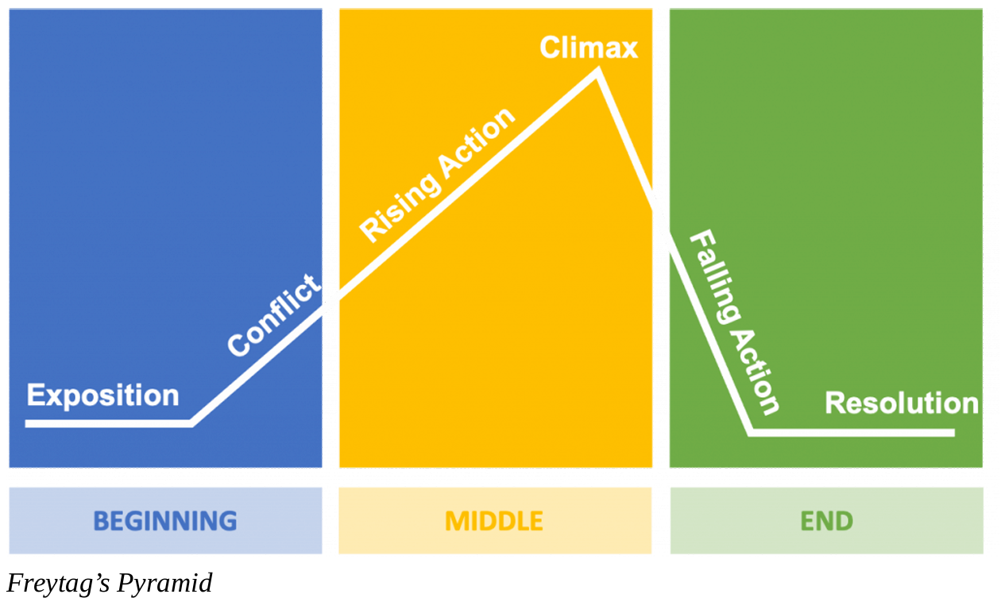
Chapter
07
Storytelling
Plot and Character Development: Every story must have a beginning, middle, and end. The following image, also known as Freytag’s Pyramid, is a commonly used framework when developing stories. Please note that this approach can be used for any length of story – short or long.

Slide 10
Chapter
07
Storytelling
Freytag’ Pyramid
• Exposition: Exposition is the beginning of your story that introduces the 3 Cs: conflict (key issue / problem), characters (customers, perhaps?!), and the context.
• Rising Actions: Rising actions present the events before the climax, where your characters attempt to solve the problem (conflict) but fail.
• Climax: The climax represents the turning point or point of greatest suspense / action in your story.
• Falling Actions: Falling Actions are the actions and events that happen after the climax.
• Resolution: End of the story where the conflicts or problems are solved.
When you are telling your organizational stories, are you clearly including all of these elements? And are you walking your audiences through this entire storytelling journey?

Slide 11
Chapter
07
Storytelling
Natural Pacing of the Telling: You need to spend time building your story by setting the foundational pieces in the beginning and middle of your story. Getting to your resolution too quickly can undermine the journey and steps required to get to that point. Take the appropriate time to build your story so that your climax truly presents a turning point in the audiences’ journey.
Careful Authentic Recall of the Story: The best stories are those that are authentic, truthful, and clearly present the issues (conflict) and resolution. While many marketers may try to embellish their stories, stick to the facts and let the story tell the compelling narrative. If you feel the story needs to be embellished to make it more captivating, you may not have a story worth sharing.
Reflect: Most of us heard Indigenous stories as children. (Remember that Indigenous Peoples and their stories span the entire globe; there are Indigenous Peoples of Africa, North America, South America, Asia, Australia, Europe, etc.) What made those Indigenous stories so impactful and how did those stories embody many of the best practices listed above?

Slide 12
Chapter
07
Storytelling
As you can see, Indigenous storytelling’s guidance and characteristics still apply today. It is why these stories have spanned millennia and continued to be shared. As marketers, we can learn how to best share compelling stories, as well as how to build and support engaged communities from these impressive Indigenous storytellers. And, as you begin to create your own organizational stories, think about the following questions:
• What kind of story are you creating? ◦ employee story ◦ customer story ◦ organizational story ◦ market or industry story.
• Who is your audience? (This should align with the kind of story you are creating.) ◦ employees ◦ customers (potential and/or existing) ◦ industry ◦ market.
• What do you want your audience to: ◦ know ◦ feel ◦ see ◦ do.
• How will it resonate with your audience’s: (This should align with what you want your target audience’s responses to be.) ◦ needs ◦ interests ◦ goals / fears ◦ doubts / misconceptions.
And, don’t forget that the core of your story should be based on the foundational principles and structure highlighted in Freytag’s pyramid.

Slide 13
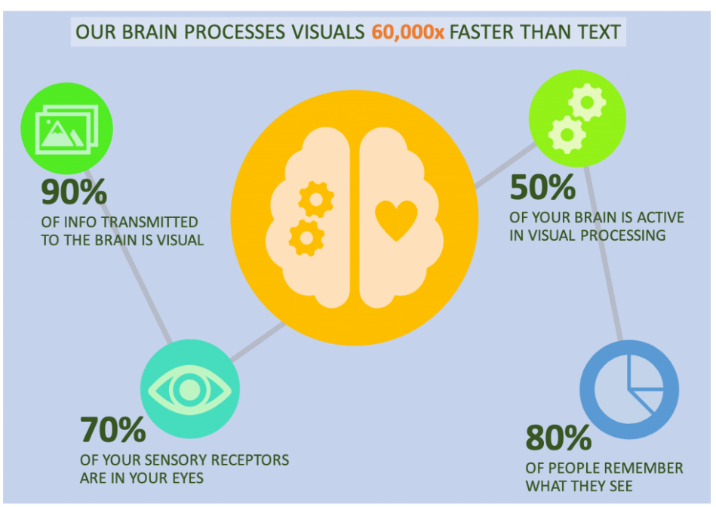
Chapter
07
Visual Storytelling
Now that we’ve discussed how to tell compelling stories, let’s look at visual storytelling and how it has become a critical way stories are told and shared today.
“Visual storytelling (also visual narrative) is a story told primarily through the use of visual media. The story may be told using still photography, illustration, or video, and can be enhanced with graphics, music, voice and other audio.”
Once of the reasons visual storytelling is so powerful is because our brains are wired “visually”. Here are several mind-boggling statistics that explain why visual storytelling is so critical to the digital world we now live in:
• 90% of information transmitted to the brain is visual.
• 50% of your brain is active in visual processing.
• 70% of your sensory receptors are in your eyes.
• It takes only 13 milliseconds for the human brain to process an image.
• Our brain processes visuals 60,000 times faster than text.
• 80% of people remember what they see, 6 compared to ten percent what they hear and 20 percent of what they read.
But, what if some of the above information were presented as follows?
Do you prefer the bullets or the infographic?

Slide 14
Chapter
07
Visual Storytelling
In responses to a 2014 survey, 95% of B2B buyers said that they wanted shorter and highly visual content. And, organizations that feature visual content grow traffic 12 times faster than those who don’t.
Also, in comparison, we don’t have much patience for text.
• Most people only read 20-28% of the words on the page.
• 80% of people will watch a video10 but only 20% of people will read text on a page.
• 55% of website visitors spend less than 15 seconds actively reading.
Unfortunately, we are not great listeners, either. When people hear information, they’re likely to remember only 10% of that information three days later. However, if a relevant image is paired with that same information, people retained 65% of the information12 three days later.
We also love to consume and share pictures, infographics, and videos:
• More than 100 million photos and videos are posted daily on Instagram.
• Tweets with images receive 150% more retweets than tweets without them.
• On Facebook, photos have an interaction rate of 87%, compared to 4% or less for other types of posts, such as links or text.
• 100 million hours of video are watched every day on Facebook- 85% of them with the sound off.
• 6 billion video adsare watched online each year.
• Posts that include images produce 650% higher engagement than text-only posts.
• People share infographics three times more than any other type of content.
• Using the word “video” in an email subject line boosts open rates by 19% and clickthrough rates by 65%.

Slide 15
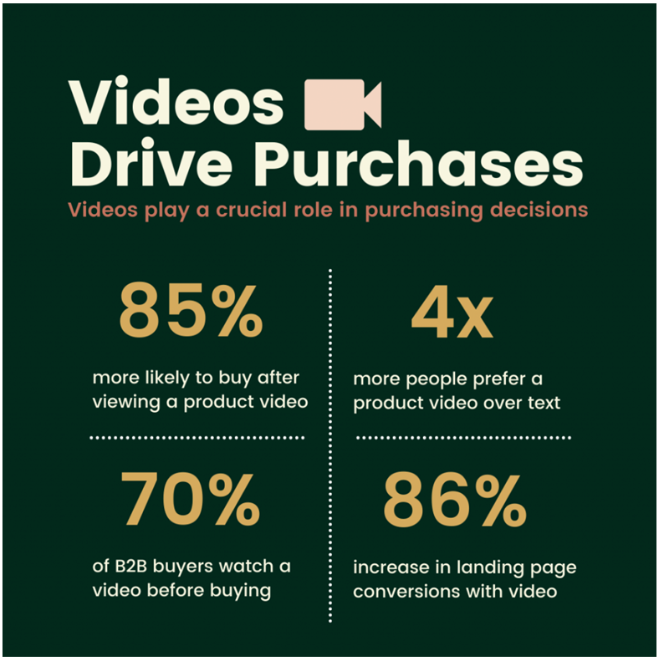
Chapter
07
Visual Storytelling
And, finally, from an organizational perspective, video drives our purchasing and/or conversion decisions:
• 70% of B2B buyers and researchers watch a video during their purchase process.
• Four times as many consumers would rather watch a videoabout a product than read about it.
• People are 85 percent more likely to buy a product after viewing a product video.
• Videos on landing pages increase conversions by up to 86%.
Visuals are an important and inherent part of how we process information. And, as marketers with global audiences, relying on universal imagery, instead of specific written languages or words, allows your messages and stories to be much more accessible to a wider audience. So, if you are looking to have the greatest impact, internally or externally, you will need to understand how to present your story and information in a visual way that grabs your audience’s attention and tells a compelling story – which brings us to our next topic: visual language and sketchnoting.

Slide 16
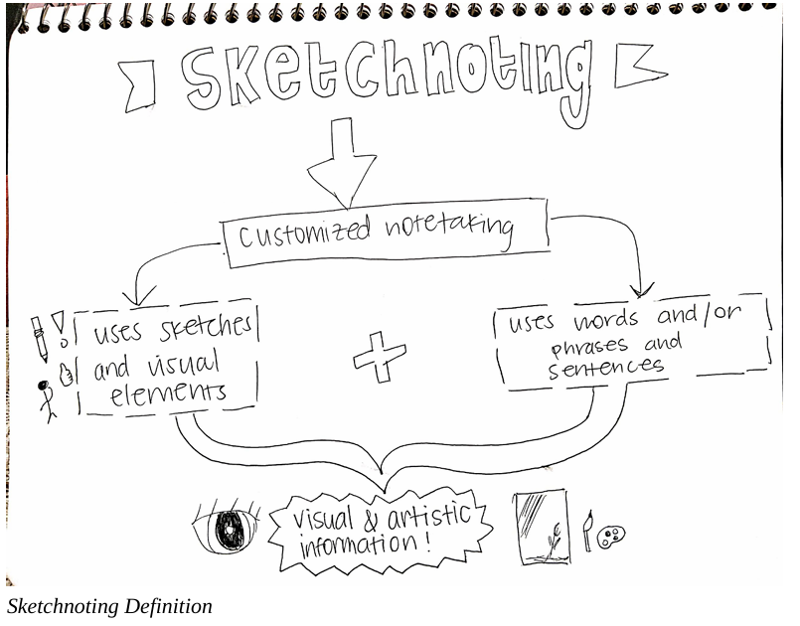
Chapter
07
Thinking & Speaking Visually
Now that we’ve discussed the key elements to developing a story and the importance of visual storytelling, let’s explore what it means to visually express it. In order to think visually, you need to have the equivalent of visual “letters”, words, and vocabulary to express your ideas visually. Often, we rely on written words to document or capture our thinking. But how might you express your thoughts and ideas visually?
While some people may think this requires exceptional drawing or artistry skills, that is incorrect. Anyone can express themselves visually and the best way to start practicing this is to start using a combination of text and “visual images” whenever you take notes or are jotting down ideas. Keep in mind that, much like handwritten notes, these “visual images” are not intended for broad consumption (or even viewing) by others. Rather they simply capture your ideas or perceptions using a visual icon, doodle, sketch, or basic drawing. This practice is commonly referred to as sketchnoting. Sketchnoting, also commonly referred to as visual notetaking, is the creative and graphic process, where people record their thoughts by using illustrations, symbols, structures, and texts (see example below).

Slide 17
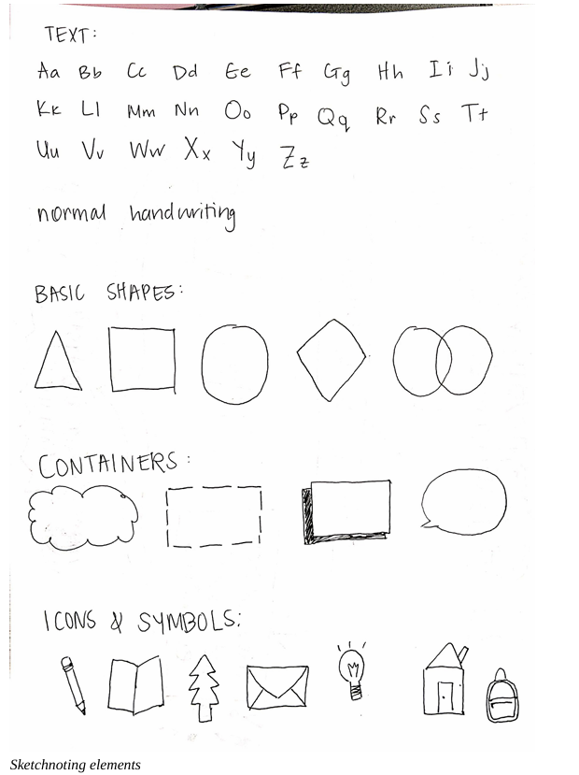
Chapter
07
Thinking & Speaking Visually
In general, by engaging in visual notetaking, you can enhance your own learning, become a better problem solver, and better connect and share ideas. In the following image, you will see that by combining handwritten text, basic shapes, containers, and many icons or symbols, it is possible to build a visualization that communicates your ideas and concepts much more clearly and with fewer words / text. And, remember that our brains are programmed to consume information visually. So, not only will this help you, but it will also be easier for others, regardless of their native language, to understand, as well!

Slide 18

Chapter
07
Thinking & Speaking Visually
Surprisingly, most elements can be drawn using 5 basic drawing elements (see image): • Circle • Square • Triangle • Line • Dot.
If you want some inspiration on how to hand-draw icons or symbols, you can either perform a Google image search on any term (concept, product, etc.) plus the word “icon”, e.g., “ad impression icon”.

Slide 19
Chapter
07
Visual Storytelling
In order to create better visual stories, you will need to practice using visual language yourself. Visual notetaking is a great way to practice for yourself and to begin thinking much more visually. Beyond thinking visually, it is essential to also understand how your visual stories can deliver value to your target audience.
Key Takeaways:
Visual storytelling is an engaging way to share stories, ideas, and values.
• In order to tell stories visually, it is important to have a “visual language”.
• Sketchnoting is great way to train yourself to start thinking more visually and in visual metaphors.
• Sketchnoting may only be for your own consumption, but can be used to draft ideas and explore visual ways to present visual stories and ideas.
Like many new things, sketchnoting may feel challenging at first and may also take more time than simply writing down words. But, with practice, it does get easier and faster. Here are some exercises that can help you practice:
• Watch an educational, tutorial, or procedural video on a topic you find interesting. As you are watching it, document what you are learning by sketchnoting. Feel free to pause the video to think about how you can visually best represent your learnings and key takeaways. You can do the same with an educational, tutorial, or procedural podcast.
• List several key industry concepts or terms and come up with several possible symbols, icons, or sketches that could represent these terms.
• Take a written sentence or paragraph and “translate” it visually using sketchnotes.

Slide 20
Chapter
07
Visual Storytelling
Additional Visual & Audio Storytelling Tools & Resources
Many marketers argue that they are not creative or graphic designers. However, there are many online resources that provide beautiful templates as a starting point. As a result, marketers can focus on developing their story’s narrative and key messages and use the following free tools to visual their ideas: (Some of these tools offer paid premium versions.)
• Videvo (Stock Videos)
• Vexteezy (Vector Art, Stock Photos & Videos)
• Powtoon (Animated Videos & Presentation Maker)
• Biteable (Animation & Video Maker)
• Pixton (Comic Strip Maker)
• Animaker (Animated Videos)
• Moovly (Video)
• StoryBoardThat (StoryBoard / Comic Strip Maker)
• iMovie (Apple) (Video Production)
• Microsoft Photos (Microsoft) (Video Production)
• Adobe Spark (Cloud-based Video Production)
• Buzzsprout (Audio Podcasts)
• Podbean (Audio / Video Podcasts)
• RedCircle (Audio Podcasts)
• Anchor.fm (Audio Podcasts)
• Bensound (Free Audio Loops / Clips)
• Canva (General Purpose Visual Media Designs & Editor)
• Piktochart (Infographic / Visual Document Creator)
• Visme (Visual Document Creator)
• Free Stock Photos –
◦ Freepik
◦ Pexels
◦ Pixabay
◦ Unsplash
◦ Canva Free Photos

Slide 21
Chapter
07
Video marketing
Video marketing refers to the strategic use of video to promote and market products or services, increase engagement across digital and social channels, educate consumers, and reach audiences through a rich, multimodal medium. In an attention-driven economy, video stands out because it is easier to process and can convey complex information swiftly and vividly. Beyond information delivery, video enables brands to evoke emotions and appeal to audience needs, thereby strengthening persuasion and recall.
Effective video marketing depends on deliberate choices about platforms, the purposeful use of diverse video formats, and rigorous planning to ensure that content is engaging, clear, and aligned with communication objectives. Today, video has become one of the most powerful means of reaching audiences. Advances in social media and mobile technologies have democratized production and distribution, making it possible for both organizations and individuals to create and publish video content at low cost across channels such as video-sharing platforms and social networks.

Slide 22
Chapter
07
The Importance of Video Marketing
Video has become a core pillar of contemporary marketing strategies due to the rapid rise of digital channels and social media. Its prominence continues to expand year over year and is expected to grow further, driven by the medium’s capacity to convey dense information quickly through a combination of visuals, motion, and audio. In an attention-constrained environment, video enables efficient message delivery and supports richer storytelling than text-only formats.
Marketers consistently report that video delivers superior return on investment compared with many other content types, and it has become one of the most widely used formats in content marketing. This momentum is strongly linked to sustained consumer demand for video content across platforms.
What began as a discrete tactic has evolved into a comprehensive strategy spanning the entire customer lifecycle. Importantly, this shift is not confined to business-to-consumer contexts; business-to-business marketers increasingly employ video to generate qualified leads and accelerate pipeline progression. The disruptions of the COVID 19 period—such as the cancellation of live events and in-person meetings—further accelerated this transformation, prompting organizations to rely on video to attract, convert, and delight customers at scale.

Slide 23
Chapter
07
The Importance of Video Marketing
Multiple factors underpin video’s effectiveness. Videos are easy to consume, quick to share across social networks, and memorable; large segments of viewers can recall ads weeks after exposure, and audiences are roughly twice as likely to share video compared to many other content formats. Technological advances and social platforms have also democratized production and distribution, enabling high-quality outputs at relatively low cost. Narrative structures paired with emotive imagery strengthen persuasion, while interactivity enhances engagement and dwell time. From a discoverability standpoint, pages that include relevant video content are substantially more likely to appear on the first page of search results, reflecting video’s strong synergy with search engine optimization.
Within an effective video marketing strategy, content typically serves three primary goals: informing, entertaining, and educating. Unlike traditional broadcast-era models where messages were pushed to captive audiences, today’s audiences actively seek out content. Consequently, videos must provide tangible value—whether through entertainment, information, training, or practical utility—to earn attention and drive outcomes. Subsequent sections will further examine audience engagement and the metrics used to evaluate video marketing success.

Slide 24
Chapter
07
Types of Marketing Videos
Overview. Because video serves diverse communication objectives, marketing videos can be organized into four overarching categories: Educational, Company Culture, Product/Service, and Experience. Each category aligns with specific goals across the customer journey—from awareness and consideration to conversion and loyalty.
1) Educational
Purpose: Build credibility and trust by transferring knowledge, clarifying solutions, and guiding decision making.
•How to Tutorials: Step by step walkthroughs that teach audiences how to use a product or service and demonstrate practical value.
•Industry Updates: Timely summaries of trends, regulations, or innovations to position the brand as a knowledgeable authority.
•Explainer (including animated): Concise narratives that define a problem, present the solution, and articulate why it matters.
•Infographic Videos: Data driven visuals that distill statistics or frameworks into an easily digestible sequence.
•Listicle Videos: Structured, enumerated insights (e.g., “top five tips”) presented in a slideshow style format.
•Webinars: Long form sessions that educate, capture leads, and move prospects deeper into the funnel.
•Personalized Videos: Tailored messages that acknowledge individual context to strengthen relevance and intent.

Slide 25

2) Company Culture
Purpose: Humanize the organization, articulate values, and strengthen brand affinity and trust.
•Brand/Corporate Stories: Mission and vision led narratives that convey purpose and identity.
•Company Introductions: Overviews of teams, capabilities, and value propositions for new audiences or recruits.
•Event Coverage: Highlights from internal or external events to expand reach and social proof.
•Comedic Brand Pieces: Lighthearted segments that enhance likability and memorability.
•Current Affairs Responses: Timely perspectives that demonstrate awareness and relevance.
•Corporate Social Responsibility: Impact oriented content showcasing initiatives, partnerships, and outcomes.
Chapter
07
Types of Marketing Videos

Slide 26
3) Product/Service
Purpose: Demonstrate features, reduce uncertainty, and stimulate conversion.
•Demos: Guided tours, software walk throughs, unboxings, or product tests that show utility in context.
•Product Launch: Announcements that articulate differentiators, use cases, and availability.
•Product Tutorials: Instructional content focused on specific functions, workflows, or best practices.
•Promotion/Teaser: Short, high impact spots emphasizing benefits and calls to action.
•Presentation Videos: Structured explanations of an offering, concept, or proposal for stakeholders.
•Direct Response/Sales Offers: Clear, persuasive appeals designed to trigger immediate action.
Chapter
07
Types of Marketing Videos

Slide 27
4) Experience
Purpose: Leverage external voices and interactions to build authority, reduce perceived risk, and increase engagement.
•Social Proof (Case Studies/Customer Testimonials): Evidence based stories that link challenges, solutions, and outcomes.
•Employee Testimonials: Insider perspectives that reinforce authenticity and employer brand.
•Interviews (Experts/Influencers/Thought Leaders): Credibility enhancing dialogues that transfer insight and endorsement.
•Video Polls & Interactive Prompts: Audience participation formats that surface preferences and drive two way engagement.
Note: These categories are functional rather than mutually exclusive; effective strategies often blend formats based on audience needs, channel norms, and funnel stage.
Chapter
07
Types of Marketing Videos

Slide 28
Chapter
Video Marketing Channels and Video Specifications
07
Selecting the appropriate distribution channels is a critical step in video marketing. Channel choice should align with the video’s objective, content type, technical specifications, and target audience in order to deliver the message efficiently and effectively. Common distribution environments include major social platforms, specialized video hosts, and owned media such as organizational websites and blogs. Survey results consistently place YouTube and Facebook at the top of marketers’ usage, with reported adoption rates around 89% and 70%, respectively.
Channel–format fit: Each platform enforces or favors distinct technical parameters—dimensions, duration, orientation, aspect ratio, file size, quality, and container/codec. Optimizing for these constraints is essential to preserve visual fidelity, reduce friction in playback, and maximize engagement across devices. Because audiences consume video on varied screens (mobile, tablet, desktop, TV), a single master asset typically needs to be versioned into multiple aspect ratios and lengths to suit each channel’s norms.
Illustrative example (YouTube): YouTube is optimized for landscape playback and excels on desktop and connected TV. A 16:9 aspect ratio paired with high resolutions (up to 3840×2160) delivers a superior viewing experience. The platform accommodates long form content by allowing uploads up to 128 GB and 12 hours in duration, with frame rates up to 60 FPS. MP4 is the recommended container for broad compatibility and quality-to-size efficiency.

Slide 29
Chapter
Video Marketing Channels and Video Specifications
07
Operational implications: To maximize cross channel performance, teams should plan for multi format rendering and distribution from the outset:
•Mastering and versioning: Produce a high quality master, then render derivatives for landscape (16:9), square (1:1), and vertical (9:16) where applicable, alongside short cuts for stories/reels and longer edits for YouTube or websites.
•Bitrate and compression: Balance visual quality against platform limits and expected network conditions to minimize buffering on mobile.
•Captions and accessibility: Include closed captions and burned in subtitles as needed to support sound off contexts and accessibility requirements.
•Thumbnails and metadata: Optimize thumbnails, titles, descriptions, tags, and chapters to improve discoverability and click through.
•Quality assurance: Validate color, audio loudness, legibility of on screen text, and safe area compliance across device classes.
•Analytics driven refinement: Monitor watch time, audience retention, click through rates, and completion to guide iterative edits and future creative decisions.
Conclusion: Channel selection and specification aware production are mutually reinforcing. By mapping objectives to channels and engineering assets to platform specific requirements, marketers enhance delivery quality, minimize friction, and increase the likelihood of meaningful engagement at scale.

Slide 30
Chapter
07
Creating Engaging Marketing Videos
An engaging marketing video sustains attention, evokes emotion, and prompts viewers to react or share—outcomes that expand reach and improve the likelihood of achieving communication and conversion goals. Engagement is not accidental; it results from a deliberate blend of audience insight, psychological triggers, technical execution, and continuous optimization.
Foundational Content Principles:
To merit attention and build trust, marketing videos should embody five core attributes:
•Searchable: Organized and described so they can be easily discovered via platform search and external search engines (clear titles, descriptions, keywords, chapters).
•Shareable: Designed for social circulation with distinctive hooks, memorable moments, and value worth passing on.
•Supportive: Directly helpful—answering the questions audiences actually have and guiding them toward the next step.
•Specialist: Focused in scope, aligning audience needs with domain expertise to deliver authoritative insight.
•Sustainable: Published with consistency and cadence appropriate to each channel, maintaining relevance over time.

Slide 31
Chapter
07
Creating Engaging Marketing Videos
Psychological Levers of Engagement:
•Curiosity: Signal a knowledge gap early—pose a compelling question, promise a concrete payoff, and preview what viewers will gain.
•The Opening Hook: Capture attention within the first seconds through movement, conflict, a bold claim, or a surprising visual; pace briskly and front load value.
•Storytelling: Use narrative structure (context → challenge → resolution → outcome) and emotive imagery to deepen connection, increase memorability, and move viewers from interest to action.
Technical and Creative Execution:
•Quality Thresholds: Meet a standard slightly above average for resolution, bitrate, and audio clarity to prevent drop offs, without overspending where returns diminish.
•Sound Strategy: Employ suitable music and relevant voiceover; ensure the story remains clear with or without sound (captions/subtitles, visual cues).
•On Screen Text: Use sparingly and legibly; prioritize short lines, high contrast, and safe area compliance for mobile viewing.
•Titles, Thumbnails, and Metadata: Craft precise, benefit oriented titles; design high contrast thumbnails with a focal subject; enrich descriptions with keywords and chapters to improve discoverability.
•Accessibility: Provide accurate captions, descriptive text for key visuals, and color choices that support readability for diverse audiences.
•Platform Fit: Version assets to match channel norms (e.g., 16:9, 1:1, 9:16) and expected session lengths; align the call to action with user behavior on each platform.

Slide 32
Chapter
07
Creating Engaging Marketing Videos
Measurement and Iteration:
•Core Metrics: Audience retention curves, average watch time, completion rate, click through rate (from thumbnail and title), and engagement actions (likes, comments, shares, saves).
•Diagnostics: Identify early drop off points to refine the hook; test pacing, structure, and visual density; compare performance across aspect ratios and lengths.
•Optimization Loop: A/B test thumbnails, titles, and first 15 seconds edits; iterate scripts and visuals based on observed retention and conversion patterns.
Practical Production Checklist:
•Define the audience, problem, and promised payoff; articulate a single primary goal.
•Write a script that front loads value and introduces the call to action early.
•Plan shots to communicate the narrative visually; minimize on screen text.
•Record clean audio; normalize loudness and remove noise.
•Add captions; verify readability on small screens.
•Export platform specific versions; validate playback on multiple devices.
•Launch with optimized metadata; monitor analytics within the first 24–72 hours and iterate.

Slide 33
Chapter
07
Measuring a Successful Video
Not all outcomes of marketing videos are directly measurable—especially those aimed at brand building, reputation, and long term preference. Nevertheless, attention and engagement based indicators provide reliable proxies of success even when financial returns are indirect or lagged. In practice, video often contributes positively to business results even when teams optimize for intermediate metrics (e.g., watch time, retention, shares) rather than immediate sales.
What “Engagement” Means?
In digital marketing, engagement denotes how audiences interact with a brand’s content across accessible channels (e.g., likes, comments, shares, saves, clicks, subscriptions). The exact signals differ by platform:
•YouTube: views, likes/dislikes, comments, shares, subscriptions, watch time, audience retention, impressions, impressions click through rate (CTR), unique viewers, clicks, conversions.
•Other social platforms (e.g., Facebook): reactions, comments, shares, saves, link clicks, profile actions, mentions, and views. Understanding each platform’s engagement model is essential to setting appropriate goals and interpreting performance.

Slide 34
Chapter
07
Measuring a Successful Video
Core YouTube Metrics for Success:
1.Audience Retention: Shows how much of each video viewers watch and where they drop off.
Use cases: Diagnose weak openings, identify compelling segments, and inform future scripting, pacing, and editing.
Benchmarks: The average percentage viewed helps compare a video’s stickiness against other videos on the same channel.
2.Reach Metrics: Reveal how widely content is surfaced and how effectively it converts exposure into views.
Impressions: How many times a thumbnail is shown on YouTube surfaces.
Impressions CTR: The share of impressions that convert to views—an indicator of title/thumbnail effectiveness.
Views: The number of times users watch a video (for longer videos and ads, a view generally implies a minimum watch threshold).
Unique Viewers: An estimate of how many distinct users watched over a period—useful for gauging active audience size.
3. Watch Time and Retention Quality: Total minutes/seconds viewed across sessions. Watch time is a stronger indicator of content value than raw views and is closely tied to discovery and recommendation systems. Improving early segment retention (e.g., the first 15–30 seconds) is often the fastest lever for raising overall watch time.

Slide 35
4.Clicks and CTR (Video & CTA Elements):
Video CTR: Clicks divided by impressions of the thumbnail/title.
CTA CTR (cards, end screens, buttons): Clicks on a specified action divided by its views.
Conversion Rate: Completions of the desired action (e.g., signup, purchase) divided by CTA clicks.
5. Outcome Metrics: Depending on the campaign, outcomes may include conversions, leads, subscribers gained, returning viewers, or assisted conversions (view through influence).
Chapter
07
Measuring a Successful Video

Slide 36
Chapter
07
Measuring a Successful Video
KPIs Must Match Objectives:
Define success by the primary objective and choose KPIs accordingly:
•Awareness: Impressions, reach/unique viewers, views, view rate, average view duration for the first 30 seconds, share rate.
•Consideration: Watch time, average percentage viewed, audience retention curve health, video CTR, engaged views, traffic to owned properties.
•Conversion: CTA CTR, clicks, conversion rate, cost per conversion, revenue or pipeline influenced (as applicable).
•Loyalty/Advocacy: Returning viewers, subscribers gained, save/share rates, comment quality, repeat session watch time.
Tip: Track one primary KPI per objective (to avoid metric dilution) and 2–3 diagnostic KPIs to guide creative optimization.
Paid vs. Organic Exposure:
Distinguish between paid and organic delivery in analysis. Paid distribution can boost impressions and views quickly, but diagnostic metrics (e.g., retention, average percentage viewed) still reveal creative strength. Keep attribution windows and view through influence in mind when comparing outcomes across campaigns.

Slide 37
Chapter
07
Measuring a Successful Video
Practical Measurement Framework:
1.Set SMART goals (specific, measurable, attainable, relevant, time bound).
2.Establish baselines using prior videos or industry aligned targets.
3.Instrument consistently (UTMs, distinct CTAs, standardized titles/thumbnail conventions).
4.Run controlled tests (A/B thumbnails, first 15 seconds edits, CTA placement).
5.Read the retention curve to fix early drop offs and refine pacing.
6.Report by objective (awareness/consideration/conversion/loyalty) and by delivery type (paid vs. organic).
7.Iterate in cycles—apply insights to the next upload rather than seeking perfection in a single asset.
Conclusion: Because video value spans both measurable outcomes (watch time, CTR, conversions) and intangible effects (brand equity, trust, preference), success should be assessed through a layered KPI model tied to objectives, with YouTube’s retention and watch time metrics at the analytical core.

Slide 38
Chapter
07
Virtual Tour
A virtual tour is a digital experience that enables users to explore a spatial environment or product in 2D/3D through an interactive interface—via 360° panoramas, 3D models, interactive video, or digital twins. Tours may be self guided or live guided. Core features include navigation between hotspots, informational overlays (text/audio/video), and a narrative structure that steers users along a path aligned with defined marketing or educational objectives.
Virtual tours reduce uncertainty through pre experience, showcasing true scale and context, strengthening trust and purchase intent. They differentiate brands, extend dwell time, and generate leads via embedded calls to action. They also support awareness and organic discovery through rich landing pages and serve as a versatile asset repurposed across social channels and ads.
Design begins with audience, objective, and value promise. Structure the tour into concise scenes with clear wayfinding (compass/map/breadcrumbs) and low cognitive load. Use early visual hooks, distribute information through hotspots, and balance free exploration with guided cues. Place clear, repeated calls to action (book, contact, download) at strategic points without causing friction.
Production options include 360° panoramas, 360° video, 3D scanning/modeling, or hybrids. Common formats: equirectangular 2:1 imagery/video (mono or stereo), high resolution (e.g., 4K–8K), and suitable frame rates (30–60fps). On the web, use WebGL/WebXR engines with efficient compression (H.264/H.265) and performance tactics (lazy loading, scene chunking, texture optimization). Test across phones, tablets, desktops, and XR headsets.

Slide 39

Accessible design is essential: keyboard navigation, sufficient color contrast, alt text for images, captions for audio content, motion/speed controls, and options to mitigate cybersickness. Optimize for small screens with legible typography and safe areas, and support localization (UI language, translated hotspots, correct text direction).
Distribute via dedicated landing pages, website embeds, 360° video platforms, mobile apps, QR codes in print/events, or interactive kiosks. Instrument tracking with tagged links and campaign parameters. Version assets (vertical/horizontal/square) for social channels, and use short teasers to drive traffic to the full tour.
Virtual Tour

Slide 40
Chapter
07
Virtual Tour
Types of Virtual Tours (VTs):
1.Static 360° panoramic tours: Spherical images linked via interactive hotspots and interactive floor plans, delivered on web/mobile to facilitate spatial comprehension and room to room navigation within a single interface. ‎
2.360° video walkthroughs: A pre authored, continuous narrative of movement through the property with less user redirection than panoramic VTs, suited to conveying temporal flow and ambiance. ‎
3.Model based 3D/digital twin tours: Geometry accurate representations that enable measurement, layered annotations, and later integration into extended reality applications.
4.Live guided virtual open houses: Real time agent led streams with Q&A to broaden reach and pre qualify interest before in person showings.
•The VTs above are non immersive (screen based, mouse/touch interaction). Augmented reality (AR) overlays digital content—furnishings, finishes, contextual labels—onto the user’s physical environment via phones/tablets, enabling in situ design scenarios. ‎‎
•Immersive virtual reality (VR) places users inside a fully simulated environment typically built from high fidelity 3D assets, delivering stronger size/flow perception than screen based browsing through cinematic, engine rendered scenes.
These modalities form a continuum: web based, non immersive VTs can be promoted to AR and VR using the same underlying digital twin assets, enabling cross channel reuse without rebuilding content from scratch. Advanced real time engines further streamline this pipeline from interactive web tours to AR overlays and fully immersive VR experiences.

Slide 41
Chapter
07
Virtual Tour
Virtual tours convert the online discovery phase into a pre experience, letting buyers grasp flow, scale, and layout before an in person showing—thereby reducing uncertainty and nudging them deeper into the purchase funnel as housing search begins and develops online. Recent consumer trend reports show that a substantial share of buyers initiates search on digital channels and evaluates listing fit based on the visual information provided. ‎‎
When paired with interactive floor plans, tours improve spatial comprehension and strengthen listing pages as performance assets; turnkey tools for creating and embedding tours/floor plans make distribution across websites and listing portals straightforward. ‎
Beyond on demand content, live guided virtual open houses expand geographic reach and enable real time Q&A, improving lead qualification before showings and reducing operational friction for agents. ‎‎
Strategically, the 3D digital twin functions as a long lived visual asset reusable across web, AR, and immersive VR; its deeper integration into major real estate platforms underscores virtual tours as a modern standard for property presentation. ‎
Finally, these assets support measurement and continuous optimization—tracking interactions with hotspots and navigation paths—so marketers can refine messaging, thumbnails, and calls to action to lift conversion on listing landing pages.

Slide 42
Chapter
Virtual Tour
07
How Is a Virtual Tour Produced?
Many assume that producing a professional virtual tour is limited to merely capturing a few images with a specialized camera; however, the reality is more complex. The production process proceeds through several meticulous stages, beginning with the selection of appropriate capture tools and concluding with processing software that transforms raw data into a seamless experience. At its most basic level, virtual tours can be produced using free roaming cameras with ultra wide lenses or commercially available 360 degree cameras. These options are suitable for small projects and simple residential units, yet they remain limited in resolution and may suffer from visual distortions when transitioning between scenes. For larger projects that demand exceptionally high precision, three dimensional laser scanning is employed—a technique that relies on emitting millions of laser beams to measure distances with extreme accuracy and to record every detail within the space, resulting in a point cloud that constitutes an exact mathematical representation of the environment, which can subsequently be converted into a navigable and measurable model.

Slide 43
Chapter
Virtual Tour
07
After completing the capture stage, the processing stage begins, requiring specialized software that ingests the raw data and converts it into an interactive model that can be accessed via standard web browsers or dedicated applications. At this stage, differences in illumination among images are corrected, and adjacent scenes are stitched together seamlessly to conceal the boundaries between them. A navigation structure is also constructed to determine how the user will move from one room to another. The work does not stop there; rather, processing extends to adding interactive elements that constitute the essence of the virtual tour and distinguish it from a mere slideshow. Hotspots are the icons that appear within the tour and allow the user to perform specific actions, such as watching an introductory video about a particular piece of furniture, reading text explaining the type of marble used in the flooring, or moving to an exterior balcony that could not be accessed from within the room. A measurement feature is also added, enabling the user to determine the dimensions of any wall or window by simply clicking and dragging—a valuable capability for clients interested in furnishing their homes with precision. Among the most striking features is the “dollhouse” view, which transforms the entire property into a miniature three dimensional model that the user can rotate and zoom in or out, in order to understand the spatial relationships among floors and rooms in an intuitive manner not afforded by traditional architectural plans.

Slide 44
Chapter
Virtual Tour
07
The Competitive Advantage of Virtual Tours in Real Estate
A real estate developer may question the true value of investing in these technologies, especially if they have relied for years on their network and traditional advertising to drive sales. To address this question, it is essential to review the competitive advantages that virtual tours offer—advantages that are difficult to achieve by any other means. The first and most evident is the radical removal of geographical barriers: an investor based in Kuwait or London no longer needs to book a plane ticket and set aside several days to visit Riyadh merely to inspect a villa that may ultimately not suit them. Instead, within minutes they can access the virtual tour link and explore the property as if physically on site, and they can revisit the tour an unlimited number of times whenever they wish. This saves time and money, and it expands the pool of potential clients to encompass the entire world at virtually no additional cost.
The second, more profound advantage is building trust with the client, a decisive element in real estate where the contracted product is often still under construction or not fully visible. The virtual tour provides unprecedented informational transparency: the client does not only see what the developer wants to showcase, but every corner and angle, and they can zoom into fine details and scrutinize the quality of finishes, thereby substantially narrowing the expectation gap that often leads to post handover disputes. This transparency translates into trust, and trust translates into faster, more comfortable purchase decisions. This brings us to the third advantage: a marked reduction in the sales cycle. In the past, the client typically needed at least one or two site visits before making a decision and might need to bring family members for consultation, a process that would take days or weeks of scheduling and coordination. Today, the client can share the tour link with their family via WhatsApp, and they can explore together virtually, simultaneously, from their different homes, then arrive at a decision much more quickly—positively impacting capital turnover and reducing sales costs.

Slide 45
Chapter
07
Virtual Tour
Field Application of Virtual Tours in Real Estate
Virtual tours are not a one size fits all tool; rather, their technologies and applications vary according to the nature of the property and the stage the project is undergoing. Let us begin with the most straightforward case: marketing completed units that have been fully constructed and finished. Here, an exact digital replica of model villas or finished apartments is created using advanced scanning techniques. The ingenuity of this approach lies in the fact that the client sees the real product as it is—its actual finishes and realistic lighting—yet from vantage points and angles that might not occur to them during an on site visit. The client can also return to explore the property after leaving the premises, from home, thereby keeping the property persistently salient in their mind.
At the off plan stage, where no physical building exists to be photographed, the employed technology differs fundamentally and relies on photorealistic imagery generated by architectural design software. Designers construct an accurate three dimensional model of the residential unit in accordance with the approved drawings, then add materials, finishes, and virtual lighting in a manner that renders the produced image indistinguishable from a real photograph. These images are in turn converted into interactive virtual tours through which the client can navigate exactly as if the unit had already been built. True creativity emerges when these tours are integrated with virtual reality headsets: the client enters a darkened room in the sales gallery, dons the headset, and suddenly finds themselves standing on the balcony of their future apartment, which has not yet been constructed, gazing toward the distant horizon and sensing the height of the building as if it were a tangible reality—an intense emotional experience that is difficult to convey in words.
Nor can the vital role of integrating these tours with social media platforms and digital advertising be overlooked. Instead of directing advertisements to a page containing static images, they can be directed straight to the virtual tour itself. Imagine a client encountering an ad on Instagram, tapping it, and instantly finding themselves inside the villa’s living room, roaming between its spaces without needing to download any additional application. This seamless experience creates an immediate impression of professionalism and distinction, embedding the project in the client’s memory.

Slide 46
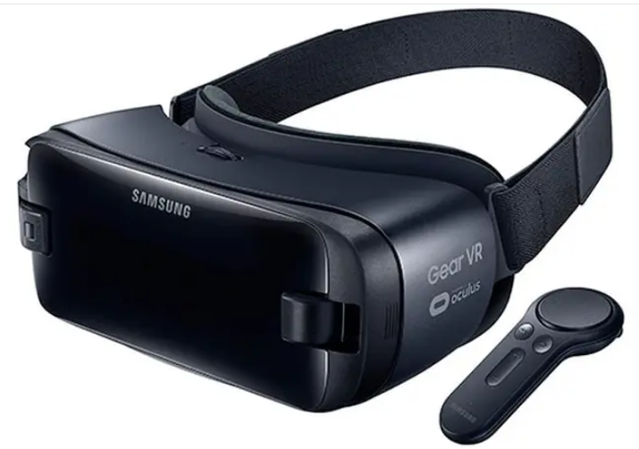

Chapter
07
Perhaps the most important question for any developer or investor concerns the financial return of these technologies. This is where measurable performance indicators become crucial in transforming virtual tours from a merely attractive marketing tool into a well‑considered investment. Modern virtual‑tour platforms provide precise analytics of customer behavior within the tour, making it possible to know how many visitors entered the tour, the average time they spent navigating, which rooms received the greatest attention, and even which hotspots were clicked more than others. These data constitute a valuable trove for the marketing team, as they reveal customers’ genuine interests. If, for example, we observe that most visitors spend a long time in kitchens and navigate through them multiple times, this indicates that kitchen quality is a decisive factor in the purchase decision, enabling the developer to concentrate their marketing efforts on highlighting this feature more prominently.

Slide 47


Thank You

