Slide 1



Business Data Analysis
MGM509
Lecture 7
Visualization for Evaluating and Communicating Performance
Prepared by
Eng. Ahmed Hussein, MBA, PfMP©, PMP©, CMP APMG

Slide 2

Lecture
What we will cover
7
Why and when to use data visualization
Types of charts and when to use them
Principles of good design and communication
Tools and platforms for visualization
7 – 2

Slide 3


Lecture
Introduction
07
7 – 3

Slide 4
Lecture
Why Visualize Data?
7
Makes complex data easier to understand
Helps identify patterns, trends, and outliers
Enhances decision-making
Communicate clearly
Support analytical reasoning
Inspire action and insight
7 – 4

Slide 5
Lecture
The Power of Visual Communication
7
Visuals are processed 60,000x faster than text by the human brain, enabling quicker understanding.
Well-designed charts help people grasp patterns and relationships without needing to interpret raw numbers.
Visuals enhance storytelling by linking data to decisions, making information more persuasive and memorable.
In presentations, data visuals increase engagement and reduce cognitive load for audiences.
7 – 5

Slide 6
Lecture
When to Use Visualization vs. Tables?
7
Use Tables when the audience needs exact numerical values, comparisons between specific points, or reference-style reporting.
Use Charts when the goal is to highlight trends, relationships, or outliers in data; ideal for presenting insights visually.
Combine Both in dashboards or reports where summaries (charts) are paired with detail (tables) for deeper analysis.
Consider your audience: executives may prefer charts for quick insights, while analysts may prefer tables for detailed examination.
7 – 6

Slide 7
Lecture
Types of Data Visualizations
07
7 – 7

Slide 8
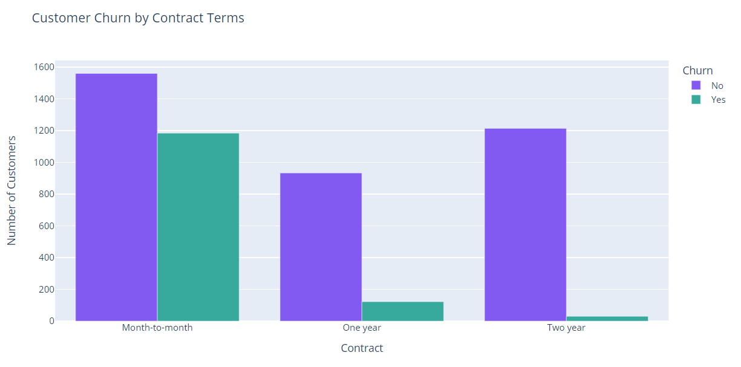
Lecture
Bar Chart – Comparing Categories
7
Best for categorical comparisons
Horizontal layout for long labels
Avoid overloading with too many bars
Ex. Use Case: Compare churn rate by contract type
Insight: Identify which contract type (Month-to-Month, One-Year, Two-Year) has the highest churn rate.
7 – 8

Slide 9
Lecture
Column Chart – Comparing Over Time
7
Use for time-series data
Maintain equal intervals
Show trends at a glance
Ex. Use Case: Monthly churn count across different billing months
Insight: Detect seasonal or monthly spikes in churn activity.
7 – 9

Slide 10
Lecture
Line Chart – Showing Trends
7
Best for continuous data
Multiple lines for comparison
Smooth vs. stepped lines
Ex. Use Case: Track total revenue generated over customer tenure
Insight: Understand how long-term customers contribute to revenue growth.
7 – 10

Slide 11
Lecture
Area Chart – Cumulative Trends
7
Good for part-to-whole over time
Use sparingly to avoid overlap
Stacked area for comparisons
Ex. Use Case: Visualize total number of active customers over time
Insight: Detect drops in customer base over months.
7 – 11

Slide 12
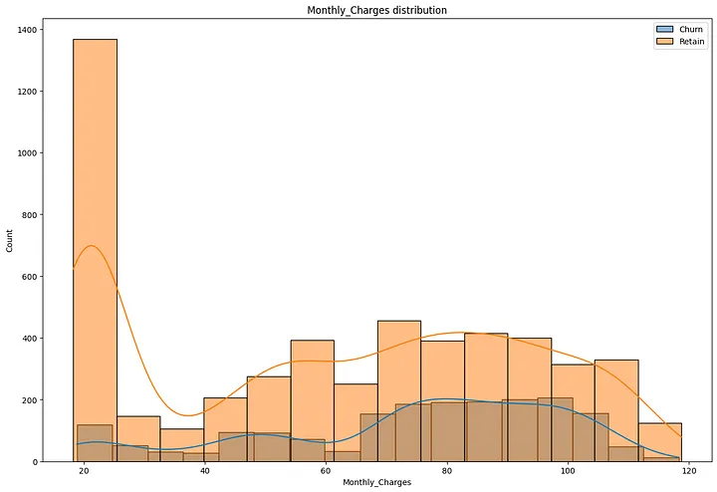
Lecture
Histogram – Frequency Distribution
7
Shows how data is distributed
Useful for identifying skewness, modality
Set appropriate bin widths
Ex. Use Case: Show distribution of MonthlyCharges
Insight: Understand common pricing bands among customers.
7 – 12

Slide 13
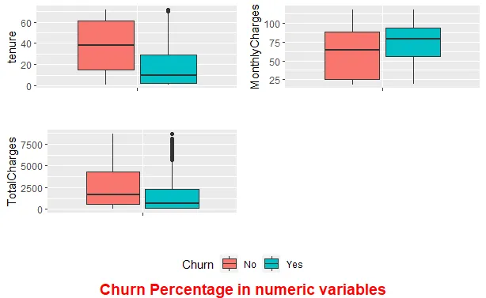
Lecture
Boxplot – Distribution Summary
7
Shows median, quartiles, outliers
Great for comparing multiple groups
Compact and information-dense
Ex. Use Case: Compare MonthlyCharges by churn status
Insight: See if customers who churn tend to pay more.
7 – 13

Slide 14
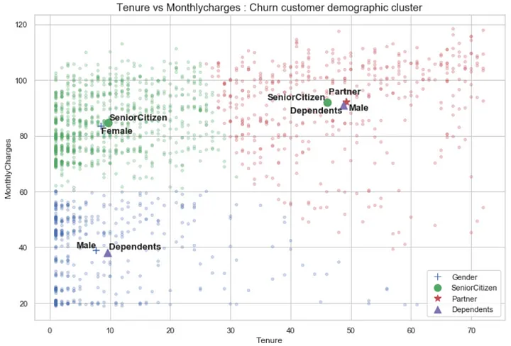
Lecture
Dot Plot – Detailed Comparisons
7
Shows exact values clearly
Minimalist alternative to bar charts
Effective for small datasets
Ex. Use Case: Visualize average tenure by customer type (gender, senior citizen, etc.)
Insight: Spot subtle differences not visible in bar charts.
7 – 14

Slide 15
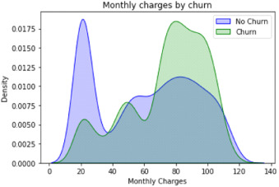
Density Plot – Smooth Distribution Shape
Lecture
7
Smoothed alternative to histogram
Highlights distribution patterns
Use kernel functions
Ex. Use Case: Compare density of monthly charges between churned and retained customers
Insight: Identify whether certain monthly charges correlate with churn.
7 – 15

Slide 16
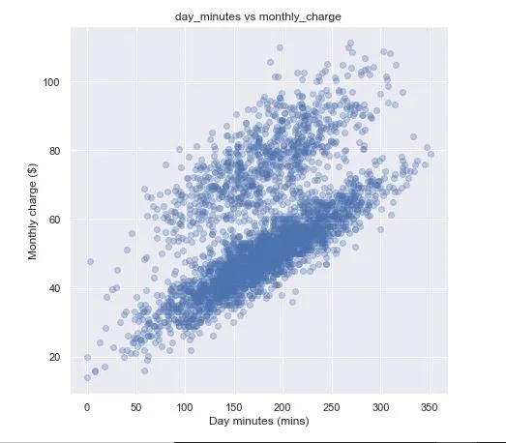
Lecture
Scatter Plot – Correlation & Clusters
7
Shows relationships between variables
Highlights outliers and trends
Can include trendlines
Ex. Use Case: Plot daily minutes vs. MonthlyCharges
Insight: Identify relationships visually.
7 – 16

Slide 17
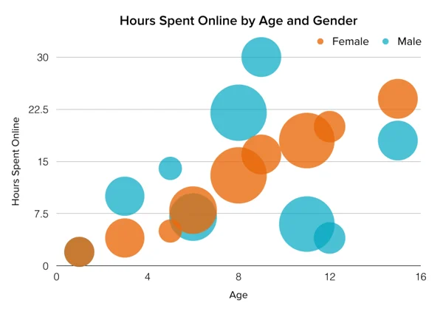
Bubble Chart – Adding a Third Variable
Lecture
7
Size indicates magnitude of third dimension
Can become cluttered
Ex. Use Case: Hours spent vs. Age with bubble size representing Gender
Insight: Explore multi-variable patterns in churn drivers.
7 – 17

Slide 18
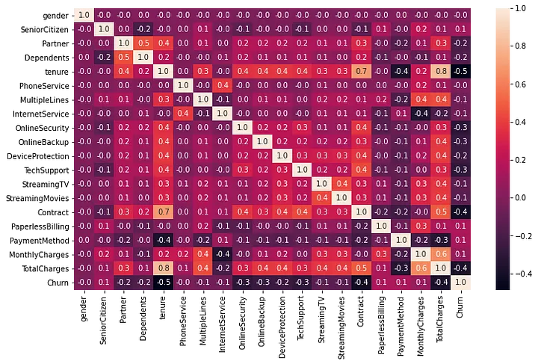
Heatmap – Visualizing Matrix-Style Data
Lecture
7
Good for comparing categories vs. categories
Use color gradients
Normalize data for readability
Ex. Use Case: Churn rate by Contract Type and Internet Service
Insight: Discover combinations that lead to high churn.
7 – 18

Slide 19
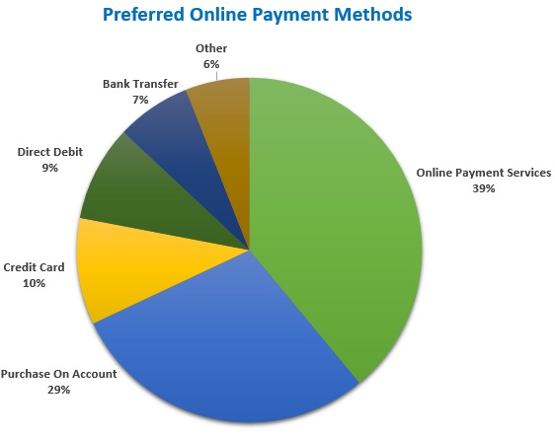
Lecture
Pie Chart (Use with Caution)
7
Effective only with few categories
Difficult to compare angles
Consider alternatives (bar, donut)
Ex. Use Case: Distribution of customer payment methods
Insight: Understand payment preferences (credit card, bank transfer, etc.).
7 – 19

Slide 20
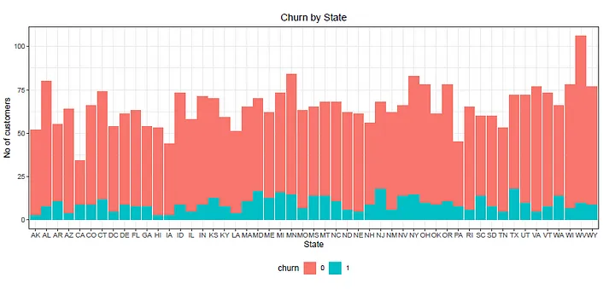
Stacked Bar/Area – Part-to-Whole Over Time
Lecture
7
Tracks multiple categories
Watch for visual overload
Use contrasting colors
Ex. Use Case: Breakdown of churn vs. no churn by state
Insight: See churn proportion across states
7 – 20

Slide 21

Word Clouds – Exploratory Text Visualization
Lecture
7
Frequency = font size
Useful for qualitative insights
Avoid over-interpretation
Ex. Use Case: Customer feedback or reasons for churn (if available as text)
Insight: Highlight most mentioned churn drivers.
7 – 21

Slide 22
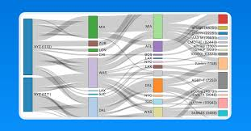
Lecture
Sankey Diagrams – Flow Relationships
7
Show process flows or transitions
Width of paths = quantity
Interactive versions add value
Ex. Use Case: Flow from contract type → internet service → churn status
Insight: Visualize customer journey and where churn occurs.
7 – 22

Slide 23
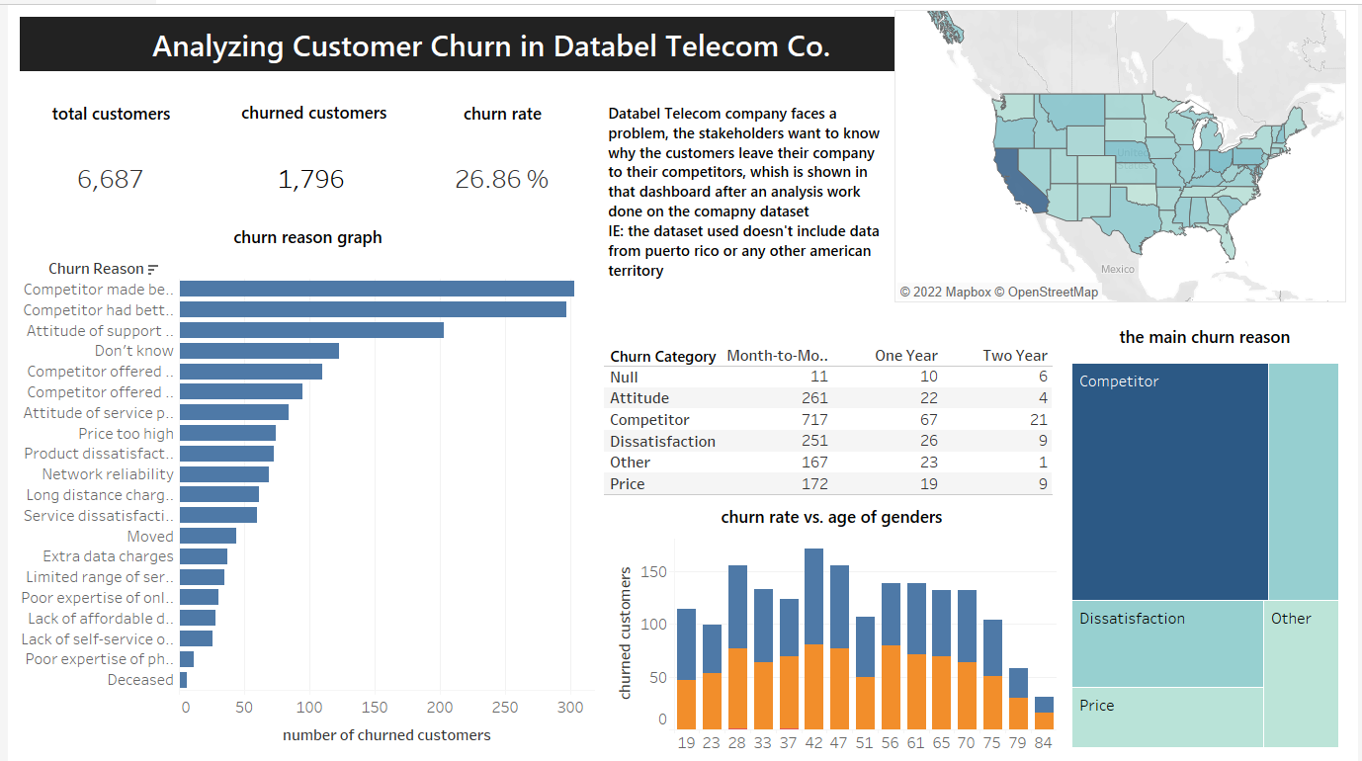
Lecture
Treemaps – Nested Categories
7
Area represents proportion
Good for hierarchical data
Use color to group subcategories
Ex. Use Case: Customer distribution by demographics and churn status
Insight: Show segment sizes in a compact format.
7 – 23

Slide 24
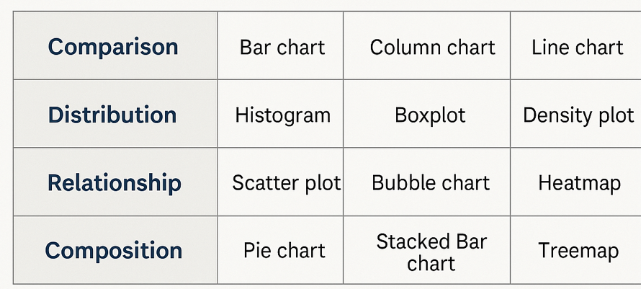
Lecture
Chart Selection Matrix
7
Start with your question: What are you trying to communicate? Trends, comparisons, proportions, or relationships?
Use this decision flow:
Consider data type: Are you showing categorical, continuous, or time-series data?
Audience matters: Executives prefer simple visuals with clear takeaways, analysts want details.
7 – 24

Slide 25
Enhancing Visuals with Design Elements
Lecture
07
7 – 25

Slide 26
Lecture
Core Principles of Visualization
7
Clarity and Simplicity:
Avoid clutter and chart junk
Use intuitive layouts and labels
Prioritize important data
Accuracy and Integrity:
Represent data truthfully
Avoid exaggerating or misrepresenting scales
Use proper baselines and proportions
Highlighting Key Patterns and Trends:
Use color and size to emphasize
Provide context (e.g., benchmarks or averages)
Show movement or change over time
Avoiding Misleading Visuals:
Watch for distorted axes or pie slices
Beware of cherry-picking data ranges
Clearly label all data and sources
7 – 26

Slide 27
Gestalt Principles for Better Visual Grouping
Lecture
Proximity
Objects placed close together are perceived as a group. Use spacing to define logical sections of a dashboard or cluster related data points.
Similarity
Elements that look similar (same shape, color, size) are seen as related. Apply consistent styles to categorize or link related metrics.
Continuity
The eye follows smooth, continuous lines and paths. Arrange data along logical flows (e.g., line charts, directional arrows) to guide the viewer’s attention naturally.
7
7 – 27

Slide 28
Lecture
Common Misuses and Mistakes
7
3D effects, excessive colors
Poor axis scaling
Using wrong chart type for goal
Emphasize simplicity and message clarity
Ask: "What do I want the viewer to understand?"
7 – 28

Slide 29
Key Design Principles for Great Data Visualization (1)
Lecture
7
Clarity
Keep it simple and remove clutter — every element should serve a purpose.
Accuracy
Ensure scales, proportions, and representations are truthful and not misleading.
Consistency
Use consistent colors, fonts, and styles to create a cohesive look.
Focus
Highlight the most important information using contrast, size, or color.
7 – 29

Slide 30
Key Design Principles for Great Data Visualization (2)
Lecture
7
Accessibility
Use colorblind-friendly palettes and ensure readability for all users.
Labeling
Always include clear titles, axis labels, legends, and source annotations.
Visual Hierarchy
Organize elements so that the viewer sees the most important information first.
Context
Provide enough context (e.g., units, benchmarks) so data makes sense.
7 – 30

Slide 31
Lecture
Color Theory in Data Visualization
7
Use color for meaning, not decoration
Avoid red-green combinations
Use palettes (ColorBrewer, Adobe)
Fonts, colors, icons, gridlines
Avoid mixed chart styles in same dashboard
Establish branding for regular reporting
7 – 31

Slide 32
Lecture
Using Shape and Size Effectively
7
Size Communicates Magnitude: Larger elements naturally draw attention and can represent higher values.
Shape Suggests Meaning: Unique shapes can distinguish categories (e.g., circles vs. squares in scatter plots).
Consistency Matters: Ensure shape and size usage is consistent across visuals—conflicting meanings confuse viewers.
Avoid Deception: Don’t distort size proportionally (e.g., area or volume) unless mathematically justified. Misleading size exaggerates or hides key insights.
Highlighting Patterns: Use shapes and size variations to highlight outliers, clusters, or trends.
7 – 32

Slide 33
Lecture
Annotations and Storytelling
7
Add callouts to key insights
Use titles to communicate the main point
Guide viewer through narrative
Group related visuals
Keep high-value insights at top/left
Align and space consistently
7 – 33

Slide 34
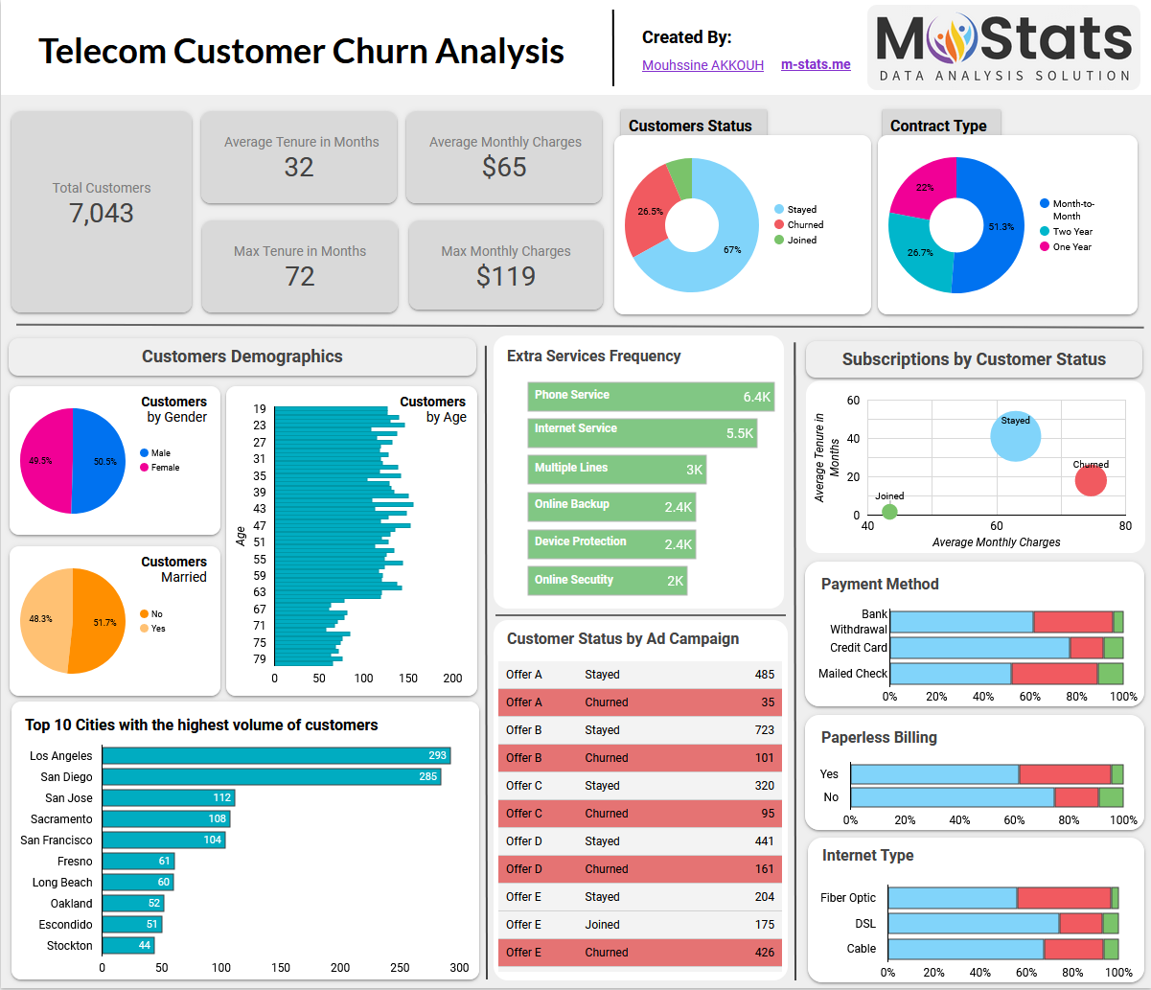
Dashboards for Telco Customer Churn Analysis
Lecture
7
7 – 34

Slide 35
Tools and Platforms for Data Visualization
Lecture
07
7 – 35

Slide 36
Lecture
Excel – Basics and Quick Wins
7
Capabilities
Data Cleaning: Easily filter, transform, and validate data using formulas and built-in tools.
Visualization: Offers bar, line, scatter, pie charts, and PivotCharts.
Statistical Analysis: Supports descriptive statistics, correlation, and regression (via Analysis ToolPak).
Forecasting: Built-in tools like Trendlines and Forecast.
Automation: Macros, VBA, and Python (in Excel 365) allow for advanced customization.
Integration: Connect to databases, use Power Query/Power Pivot, or export to Power BI.
Limitations
Limited to ~1M rows; not suited for big data.
Easy to introduce human error or overwrite formulas.
Lacks built-in support for advanced ML or AI.
Difficult to audit, reproduce, or collaborate on complex workflows.
Visualization and interactivity are limited without external tools.
7 – 36

Slide 37
Lecture
Tableau / Power BI
7
Capabilities
Interactive Dashboards: Enable real-time filtering, drill-downs, and slicers for dynamic analysis.
Advanced Visuals: Custom visualizations, heatmaps, treemaps, bullet graphs, and more.
Data Connectivity: Connect to a wide range of data sources—databases, cloud, APIs, spreadsheets.
Data Modeling: Power BI uses DAX; Tableau has calculated fields for custom logic.
Storytelling: Combine multiple charts into storyboards to present insights clearly.
Collaboration: Easy publishing and sharing of dashboards via Tableau Server/Online or Power BI Service.
Limitations
Steep learning curve for DAX (Power BI) and calculated fields (Tableau).
Performance issues when handling extremely large or complex data models.
Licensing costs can be high for enterprise users.
Limited data cleaning—complex transformations may still need Power Query, SQL, or Python.
Over-design risk—users may emphasize aesthetics over insight if not guided by best practices.
7 – 37

Slide 38
Lecture
Python (Matplotlib, Seaborn, Plotly)
7
Capabilities
Customization: Full control over every visual element; tailor charts to exact specifications.
Advanced Chart Types: Create violin plots, pair plots, heatmaps, animations, and 3D visuals.
Integration: Combine with pandas, NumPy, scikit-learn, and other libraries in seamless workflows.
Automation & Reproducibility: Code-based charts are easy to update, reproduce, and share via scripts.
Interactivity: Plotly and Dash support web-based interactive dashboards.
Limitations
Requires coding: Not as accessible to non-programmers or business users.
Steep learning curve for mastering aesthetics and syntax (especially in Matplotlib).
Setup/configuration time: Setting up environments and dependencies can be time-consuming.
Slower dashboard delivery: Building dashboards from scratch can take longer than drag-and-drop tools.
Limited default styling: Compared to Tableau/Power BI, visuals may require more effort to polish.
7 – 38

Slide 39
Lecture
R (ggplot2, Shiny), D3.js, Flourish
7
Capabilities
R (ggplot2, Shiny): Excellent for statistical data visualization with high-quality static plots and interactive web apps.
D3.js: A JavaScript library for creating complex, interactive, and animated SVG-based web visualizations.
Flourish: No-code tool to create professional-looking visual stories and embeddable graphics.
Customization & Reproducibility: Especially strong with R and D3.js for tailored, transparent code-driven visuals.
Storytelling and Publishing: Flourish and Shiny allow sharing on the web with user-friendly interfaces.
Limitations
Steep learning curve for D3.js (requires solid JavaScript and web dev skills).
R can be complex for those unfamiliar with its syntax or statistical conventions.
Limited drag-and-drop functionality compared to tools like Power BI or Tableau.
Flourish free tier is limited, and advanced visuals may require a paid license.
Deployment overhead: Hosting Shiny apps or D3-based sites may require additional setup.
7 – 39

Slide 40
Lecture
Key Points
7
Visuals Accelerate Understanding
Data visualizations help translate complex information into accessible insights, enabling faster and more informed decisions.
Choose the Right Chart for the Right Task
The effectiveness of a visualization depends on aligning the chart type with the analytical goal—comparison,
Design Principles Matter
Clarity, accuracy, and consistency are critical in building trustworthy and engaging visuals. Gestalt principles and
Dashboards Should Tell a Story
Effective dashboards prioritize layout, focus, and user needs—positioning key KPIs prominently and organizing
Tool Choice Impacts Capabilities
Whether using Excel, Tableau, Python, or R, each platform has strengths and limitations. Select tools based on data
proper use of shape, size, and color enhance comprehension.
distribution, relationship, or composition.
content logically.
size, technical expertise, and visualization goals.
7 – 40

Slide 41

For Discussion Panel and Next Lecture:
Chapter 8 “Visualizing Model Performance”
Activity:
  Using Telco Customer Datasets in Excel
  Create charts to visualize:
    Churn by State
    Churn by gender and monthly charge
    Charge vs minutes used
    Tenure vs. dependents
    Monthly charge vs internet service
Lecture
7
For Discussion Panel and Next Lecture
7 – 41

Slide 42



Thank You

