Slide 1


Change Management
Prepared by Dr.Ranya Mahfouz
MGM323
Lecture 4

Slide 2


Change Management
Lecture 4
Leading change
MGM323
Prepared by
Dr. Ranya Mahfouz

Slide 3
Agenda Leading change
Introduction
Wise leadership
The roles that leaders play
Leadership styles, qualities and skills
Different leadership for different people

Slide 4
Agenda Leading change
Introduction
Wise leadership
The roles that leaders play
Leadership styles, qualities and skills
Different leadership for different people

Slide 5

Change Management
This subject is about learning how to manage change. The world around us is changing very quickly. Almost every day, there is a new discovery or innovation, especially in science. Globalization also has a big effect on how we think about politics and business. At the same time, the problems that come with globalization are growing just as fast, which is also a big concern.

Slide 6
Agenda Leading change
Introduction
Wise leadership
The roles that leaders play
Leadership styles, qualities and skills
Different leadership for different people

Slide 7

Chapter
VISIONARY LEADERSHIP
04
The first basic ingredient of leadership is a guiding vision. The leader has a clear idea of what he wants to do – professionally and personally – and the strength to persist in the face of setbacks, even failures. Unless you know where you are going, and why, you cannot possibly get there.
Warren Bennis (1994)

Slide 8
Chapter
VISIONARY LEADERSHIP
04
The top five characteristics that emerged through a typical discussion of these significant leaders were:
Clear vision;
Determination;
Great speaker, great presence;
Tough when needed;
Able to stand alone.
Cameron Change Consultancy data, 2002

Slide 9
Chapter
VISIONARY LEADERSHIP
04
Warren Bennis identified three basic ingredients of leadership:
A guiding vision;
Passion;
Integrity.

Slide 10
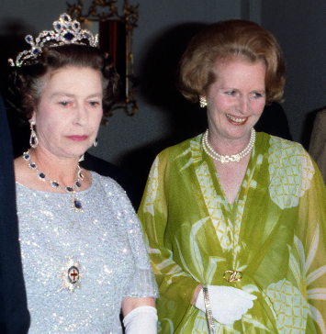
Chapter
LEADERS’ STORIES
04
Margaret Thatcher
‘Britain has lost its way in defeatism and socialism. We must reclaim the leadership from “them” (socialists, union trouble makers and the “wets”) and restore earlier grandeur.’

Slide 11
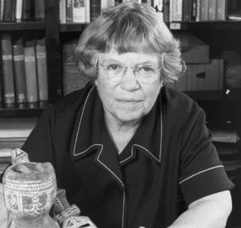
Chapter
LEADERS’ STORIES
04
Margaret Mead
‘As human beings, we can make wise decisions about our own lives by studying options that many other cultures pursue.’

Slide 12
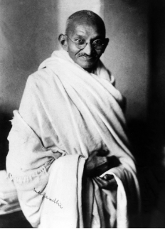
Chapter
LEADERS’ STORIES
04
Mahatma Gandhi
‘We in India are equal in status and worth to all other human beings. We should work cooperatively with our antagonists if possible, but be prepared to be confrontational if necessary.’
Leadership stories from Gardner (1996)

Slide 13
Agenda Leading change
Introduction
Wise leadership
The roles that leaders play
Leadership styles, qualities and skills
Different leadership for different people

Slide 14

Chapter
The roles that leaders play
04
1- Local line leaders
These are the front-line managers who design the products and services and make the core processes work. Without the commitment of these people, no significant change will happen. These people are usually very focused on their own teams and customers. They rely on network leaders to link them with other parts of the organization.

Slide 15
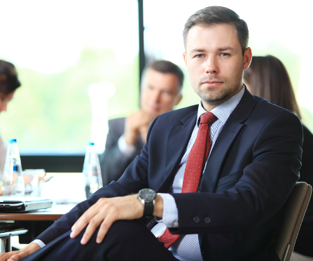
Chapter
The roles that leaders play
04
2- Executive leaders
These are management board members. Senge does not believe that all change starts here. Rather, he states that these leaders are responsible for three key things: designing the right innovation environment and the right infrastructure for assessment and reward, teaching and mentoring local line leaders, and serving as role models to demonstrate their commitment to values and purpose.

Slide 16

Chapter
The roles that leaders play
04
3- Network leaders
Senge makes the point that the really significant organizational challenges occur at the interfaces between project groups, functions and teams. Network leaders are people who work at these interfaces. They are guides, advisers, active helpers and accessors (helping groups of people to get resources from elsewhere), working in partnership with line leaders.

Slide 17

Roles in a change process

Slide 18

Chapter
The roles that leaders play
04
Roles in a change process
1- Role
Sponsor
Description
Has the authority to make the change happen. Has control of resources.
Hint
Needs to have a clear vision for the change. Identify goals and measurable outcomes.

Slide 19
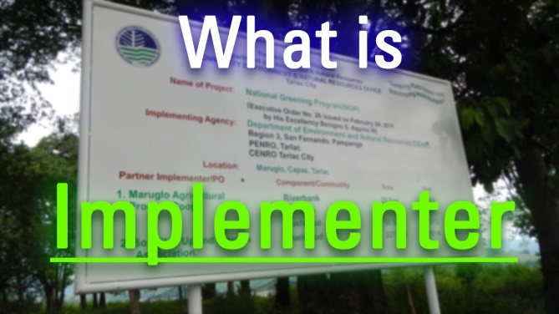
Chapter
The roles that leaders play
04
Roles in a change process
2- Role
Implementer
Description
Implements the change. Reports to sponsor.
Responsible for giving live feedback to the sponsor on change progress.
Hint
Needs to listen, enquire and clarify questions with the sponsor at the start of an initiative.

Slide 20

Chapter
The roles that leaders play
04
Roles in a change process
3- Role
Change agent
Description
Facilitator of change. Helps sponsor and implementers
stay aligned. Keeps sponsor on board. No direct authority over implementers.
Hint
Acts as data gatherer, educator, adviser, meeting facilitator, coach.

Slide 21

Chapter
The roles that leaders play
04
Roles in a change process
4- Role
Advocate
Description
Has an idea. Needs a sponsor to make it happen.
Usually highly motivated.
Hint
Must make idea appealing to sponsor.

Slide 22
Agenda Leading change
Introduction
Wise leadership
The roles that leaders play
Leadership styles, qualities and skills
Different leadership for different people

Slide 23
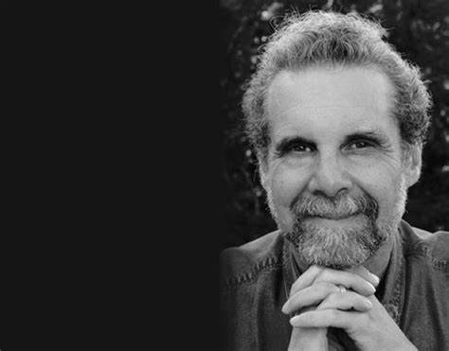
Chapter
Leadership styles, qualities and skills
04
Daniel Goleman (2000) developed a set of six distinct leadership styles through studying the performance of over 3,800 executives worldwide. These six leadership styles arise from various different components of emotional intelligence.

Slide 24
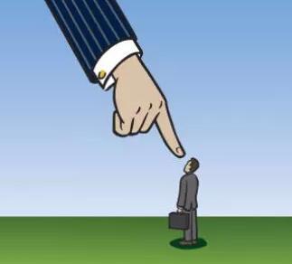
Chapter
Leadership styles, qualities and skills
04
Coercive style:
Only to be used sparingly if a crisis arises. This is a useful style to employ if urgent changes are required now, but must be combined with other styles for positive results long term. Negative effects such as stress and mistrust result if this style is overused.

Slide 25
Chapter
Leadership styles, qualities and skills
04
Coercive style:
Short Definition
Telling people what to do when.
When to use this style
When there is a crisis.
Disadvantages of this style
Encourages dependence. People stop thinking.

Slide 26

Chapter
Leadership styles, qualities and skills
04
Authoritative style:
Useful when a turn around is required and the leader is credible and enthusiastic. This is the ‘visionary’ leadership style. Goleman indicates that this style will only work if the leader is well respected by his or her people, and is genuinely enthusiastic about the change required. He acknowledges the strongly positive effect of this approach, given the right prevailing conditions.

Slide 27
Chapter
Leadership styles, qualities and skills
04
Authoritative style:
Short Definition
Persuading and attracting people with an engaging vision.
When to use this style
When step change is required. When manager is both credible and enthusiastic.
Disadvantages of this style
Has a negative effect if manager is not credible.

Slide 28

Chapter
Leadership styles, qualities and skills
04
Affiliative style:
This style helps to repair broken relationships and establish trust. It can be useful when the going gets tough in a change process and people are struggling. However, it must be used with other styles to be effective in setting direction and creating progress.

Slide 29
Chapter
Leadership styles, qualities and skills
04
Affiliative style:
Short Definition
Building Relationships with people through use of positive feedback.
When to use this style
When relationships are broken.
Disadvantages of this style
Not productive if it is the only style used.

Slide 30

Chapter
Leadership styles, qualities and skills
04
Democratic style:
This is an effective style to use when the team knows more about the situation than the leader does. They will be able to come up with ideas and create plans with the leader operating as facilitator. However, it is not useful for inexperienced team members as they will go round in circles and fail to deliver.

Slide 31
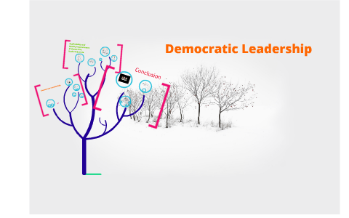
Chapter
Leadership styles, qualities and skills
04
Democratic style:
Short Definition
Asking the team what they think, and listening to this.
When to use this style
When the team members have something to contribute.
Disadvantages of this style
May lead nowhere if team is inexperienced.

Slide 32

Chapter
Leadership styles, qualities and skills
04
Pacesetting style:
This style can be used effectively with a highly motivated, competent team, but does not lead to positive results long term if used in isolation. Overuse of this style alone results in exhausted staff who feel directionless and unrewarded. The leader needs to switch out of this style to move into a change process rather than simply drive for more of the same.

Slide 33

Chapter
Leadership styles, qualities and skills
04
Pacesetting style:
Short Definition
Raising the bar and asking for a bit more. Increasing the pace.
When to use this style
When team members are highly motivated and highly competent.
Disadvantages of this style
Exhausting if used too much. Not Appropriate when team members need help.

Slide 34

Chapter
Leadership styles, qualities and skills
04
Coaching style:
This is an appropriate style to use if individuals need to acquire new skills or knowledge as part of changes being made.

Slide 35
Chapter
Leadership styles, qualities and skills
04
Coaching style:
Short Definition
Encouraging and supporting people to try new things. Developing their skills.
When to use this style
When there is a skills gap.
Disadvantages of this style
If manager is not a good coach, or if individual is not motivated, this style will not work.

Slide 36
Agenda Leading change
Introduction
Wise leadership
The roles that leaders play
Leadership styles, qualities and skills
Different leadership for different people

Slide 37
Chapter
Leadership of change phase by phase, comparing inner and outer leadership requirements
04
It has been identified both the outer leadership and inner leadership requirements of a leader of change for each phase;

Slide 38
Leadership of change phase by phase, comparing inner and outer leadership requirements
Chapter
04
1. Establishing the need for change
The leader illuminates a problem area through discussion
Outer leadership – observable actions of the leader
Influencing, understanding, researching, presenting, listening
Inner leadership – what goes on inside the leader
Managing emotions, maintaining integrity, being courageous, being patient, knowing yourself

Slide 39
Leadership of change phase by phase, comparing inner and outer leadership requirements
Chapter
04
2. Building the change team
The leader brings the right people together and establishes momentum through team work
Inner leadership – what goes on inside the leader
Social and organizational awareness, self-awareness, managing emotions, adaptability, taking initiative
Outer leadership – observable actions of the leader
Chairing meetings, connecting agendas, facilitating discussion, building relationships, building teams.

Slide 40
Leadership of change phase by phase, comparing inner and outer leadership requirements
Chapter
04
3. Creating vision and values
The leader works with the group to build a picture of success
Outer leadership – observable actions of the leader
Initiating ideas, brainstorming, encouraging divergent and creative thinking,
Inner leadership – what goes on inside the leader
Strategic thinking, taking time to reflect, social awareness, drive to achieve,

Slide 41
Leadership of change phase by phase, comparing inner and outer leadership requirements
Chapter
04
4. Empowering others
The leader entrusts those who have been involved in the creation of the new vision with key tasks
Outer leadership – observable actions of the leader
Clear target setting, good delegation, coaching
Inner leadership – what goes on inside the leader
Integrity, trust, patience, drive to achieve

Slide 42
Leadership of change phase by phase, comparing inner and outer leadership requirements
Chapter
04
5. Noticing improvements and energizing
The leader stays interested in the process. This involves the ability to juggle lots of different projects and initiatives
Outer leadership – observable actions of the leader
Playing the sponsorship role well, walking the talk, rewarding and sharing success,
Inner leadership – what goes on inside the leader
Steadiness of purpose, organizational and social awareness, empathy, managing emotions, drive to achieve

Slide 43
Case Study
Leading Change in the Saudi Ministry of Health during Vision 2030 Transformation🩺
Background:As part of Saudi Vision 2030, the Ministry of Health launched the Health Transformation Program to enhance healthcare quality and efficiency.The main challenge was the heavy reliance on paperwork and employee resistance to digital transformation.
⚙️ Stage 1: Establishing the Need for ChangeThe leadership identified delays in patient services and decided to implement a unified digital health system (Sehhaty App).
🔹 Leadership Style: Authoritative (Visionary) — the Minister provided a clear vision: “Digital Health to Serve Humanity First.”
👥 Stage 2: Building the Change TeamTeams of doctors, engineers, and IT specialists were formed, with Network Leaders in each hospital to link departments.
🔹 Leadership Style: Democratic — employees were encouraged to share ideas and suggest improvements.

Slide 44
💡 Stage 3: Creating Vision and ValuesThe vision was: “Comprehensive and preventive healthcare driven by innovation.”The leader demonstrated Wise Leadership by balancing strategy with empathy.
🚀 Stage 4: Empowering OthersThe ministry launched training programs for healthcare workers and gave them more autonomy in decision-making.🔹 Leadership Style: Coaching — empowering and upskilling staff to adapt to the new system.
🌟 Stage 5: Noticing Improvements and EnergizingWithin two years, over 1,500 facilities were digitally connected, and patient satisfaction increased by 70%.The Ministry celebrated success and honored the change teams.
📈 Result:The Saudi Ministry of Health achieved a successful organizational transformation by applying multiple leadership styles (Visionary, Democratic, Coaching).It became a regional model for effective change management combining technology and human values.

Slide 45

Textbook
Thank You

