Slide 1


English Course- Advanced Level
Prepared by
Ahmed Soliman

Slide 2



Lecture 4
www.midocean.ae

Slide 3
Lecture Outline:
Pronunciation: linking vowel to vowel (Revision)
Listening: Job Interview
Grammar: Present Perfect Tense (Revision)
Reading: Ibn Battuta
Speaking: What is your dream job?
www.midocean.ae

Slide 4
Revision
linking vowel to vowel
www.midocean.ae

Slide 5
Practice
https://pronuncian.com/linking-vowels-into-vowels
www.midocean.ae

Slide 6
Listening
(Job Interview)
www.midocean.ae

Slide 7
Vocabulary and Sample Sentences
land (verb): find a job
– My father was able to land a very good job immediately after he graduated from college.
impressive (adjective): making a strong impression, great, wonderful
– The job offer wasn’t that impressive, so I didn’t take it.
culinary arts (noun): cooking, the preparation of food for meals
– This college offers a great culinary arts program if you are interested.
tourist spot (noun): a place where tourists visit things of interest such as museums, scenery, or shopping areas
– Hawaii is a fantastic tourist spot if you enjoy surfing.
fabulous (adjective): great, wonderful
– How did you land this fabulous job with so little experience?
top-notch (adjective): of the best quality
– This school’s business program is top-notch, and for this reason, it is hard to get in.
www.midocean.ae

Slide 8
struggle (with) (verb): try hard to do something
I struggled to find a new job for one year.
How long have you struggled with that terrible work schedule?
depression (noun): a very sad or hopeless feeling or mental state
My brother has struggled with depression for a long time.
disorder (noun): a mental condition that is not normal
Some international students struggle with emotional disorders when they live overseas.
www.midocean.ae

Slide 9
Listen to the recording and answer the questions.
https://www.esl-lab.com/difficult/job-interview/
1- The man studied English and _____ at the university.
biology
psychology
sociology
2- He found his first job in Japan at a _____.
university
private language school
community college
www.midocean.ae

Slide 10
3- The man's cooking students wanted to ____.
practice English with tourists
create new food items
open their own restaurants
4- Now, the man works at a Japanese restaurant and at a ____.
modern fitness center
mental health treatment center
language training center
www.midocean.ae

Slide 11
5-The man should be a good candidate for the job because he ____.
has experience in psychological advising
has experience in sociology
specializes in grammar instruction
www.midocean.ae

Slide 12
Listening Script
Woman: Hi. Thanks for coming to the interview today. It’s nice to meet you.
Man: Yeah, well, thank you.
Woman: To begin with, why don’t you tell us a little bit about yourself?
Man: Okay. Um, yeah. Well, I’ve always been interested in teaching in a language program like this, and uh, I graduated with a degree in English and psychology eight years ago, [ Oh, really, both? ]. Yeah, [Wow] and uh then I landed my first job overseas in Japan.
Woman: Oh, wow. That’s pretty impressive. What did you do there? What kind of work?
Man: Well, I worked full time, uh, for a private language school in Tokyo for the first two years, and then I found a job at a community college.
Woman: Oh really? So, exactly what did you do in your work there then?
Man: Well, I taught English and, uh, culinary arts.
www.midocean.ae

Slide 13
Woman: You taught cooking classes?
Man: Well, well, I know it sounds like an unusual combination, but I completed a program in culinary arts before I got my, uh, English and psychology degrees.
Woman: Oh, Wow. You’ve done a lot, haven’t you? [ Yeah. ] So, what exactly, um, how did you teach and what exactly did you do?
Man: Well, um, many of my students wanted to become chefs in restaurants, or they wanted to start their own restaurants, uh, and in our area, there were many, uh, tourists tourist spots. A lot of tourists came to that particular area, and so with English, they would be able to communicate not only with suppliers, you know things that they need for restaurant’s food and so forth, but also their customers, and so I taught them English and cooking at the same time.
Woman: Wow. That’s, that’s pretty impressive. That’s interesting, so . . . [ . . . and tasty. I was . . . ] Oh, I bet. So, why did you return to the United States? How long have you been back?
Man: I’ve been back for, uh, probably about a year now.
www.midocean.ae

Slide 14
Woman: Okay, so what brought you back then?
Man: Well, one of my former students opened a sushi restaurant, uh, in town, and he asked me to work with him.
Woman: Really? What’s the name of the restaurant?
Man: Well, it’s called Flying Sushi. Have you ever heard of it?
Woman: Yes, I’ve been there. Their food is fabulous; it’s top-notch. It’s really hard just to get a reservation there.
Man: I know, and uh, well, I work there two weeknights, and uh, and then . . .
Woman: So, two nights a week you’re working there still?
Man: Right, right, [Okay, uh-huh] but now, I want to return to teaching. I’ve also been working as a therapist at a treatment center for teenagers struggling with depression and other mental health disorders.
Woman: Oh, wow, that would be a really interesting job.
Man: It is, it is.
www.midocean.ae

Slide 15
Woman: Wow. You have such a wide range of experiences. Um, you know, to be honest, we have fifteen people who are applying for this position. You’ve got quite a background, but why don’t you tell me three reasons why you would be the best person for this job.
Man: Um, well, first of all, uh, I understand that different students have different learning styles, and for that reason, I’ve used iPads, video, music, cooking, drama, role plays, and games to reach every student. [ That’s good. ] And second, I have a background in academic and psychological counseling and advising [ Uh, huh ] . . . skills that are often needed, you know, in working with international students.
Woman: Yeah, that could be really helpful.
Man: So you know, many of them struggle with, uh, emotional turmoil, you know, homesickness. . . .
Woman: Yeah, coming to a new place . . .
Man: Right, and so making the transition can be very overwhelming, and uh . . .
www.midocean.ae

Slide 16
Woman: Good. So, what’s . . . what would you say would be a third reason?
Man: And finally, I speak four different languages . . . .
Woman: Four? Wow! What languages do you speak?
Man: Well, I speak Spanish, Portuguese, and Japanese at an advanced level.
Woman: At an advanced level? [Right] Wow.
Man: And I also speak Arabic at a high-intermediate level.
Woman: Well, that’s very, very impressive. You do have an impressive resume.
Man: Thank you.
Woman: Um, what we’re doing . . . we’re gonna [going to] have two rounds of interviews. We will contact you on Friday [Okay] and let you know whether or not you’ll be coming back for the second round of interviews.
Man: Okay.
Woman: It’s been really nice meeting you, and thank you for your time.
www.midocean.ae

Slide 17
Grammar
(Present Perfect Tense)(Revision)
www.midocean.ae

Slide 18
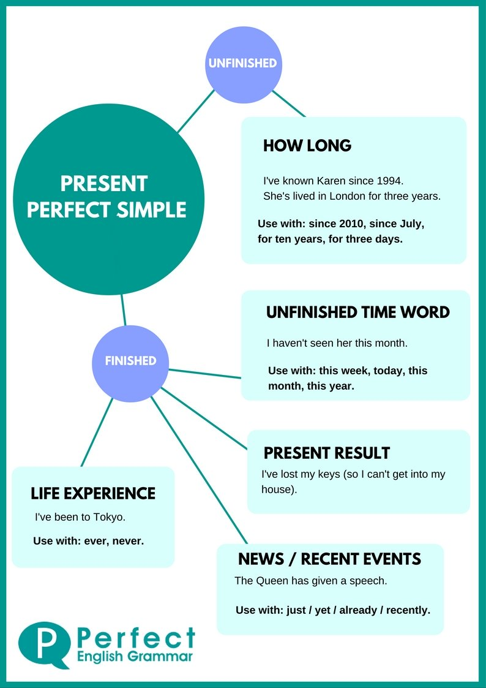
www.midocean.ae

Slide 19
The Form
Has
Subject + Have + P.P
They have seen that film six times
She has visited them frequently.
www.midocean.ae

Slide 20
Interrogative
Have / has + Subject + P.P?
Wh question + have / has + Subject + P.P?
Have you called your mom yet?
Has Anthony played basketball yet?
Have you travelled to Aswan?
Have you ever ridden a camel?
www.midocean.ae

Slide 21
Negative
Subject + hasn’t / haven’t + p.p.
They haven't lived here for years.
He hasn’t finished his homework yet.
www.midocean.ae

Slide 22
Reading
(Ibn Battuta)
www.midocean.ae

Slide 23
Read the following passage, and then choose the best answer
1. Abu Abdullah Muhammad Ibn Battuta, was a Moroccan Muslim scholar and traveler. He is known for his traveling and going on tours called the Rihla. His journeys lasted for a period of almost thirty years. This covered nearly the whole of the known Islamic world and beyond, extending from North Africa, West Africa, Southern Europe and Eastern Europe in the West, to the Middle East, Indian subcontinent, Central Asia, Southeast Asia and China in the East, a distance readily surpassing that of his predecessors. After his travel, he returned to Morocco and gave his account of the experience to Ibn Juzay.
2. Ibn Battuta, was born in Tangier, Morocco, on the 24th of February 1304 C.E. (703 Hijra). He was commonly known as Shams ad-Din. His family was of Berber origin and had a tradition of service as judges. After receiving an education in Islamic law, he
www.midocean.ae

Slide 24
chose to travel. He left his house in June 1325, and set off from his hometown on a hajj (pilgrimage) to Mecca, a journey that took him 16 months. He did not come back to Morocco for at least 24 years after that. His journey was mostly by land. To reduce the risk of being attacked, he usually chose to join a caravan. In the town of Sfax, he got married.
3. He first began his voyage by exploring the lands of the Middle East. Thereafter he sailed down the Red Sea to Mecca. He crossed the huge Arabian Desert and traveled to Iraq and Iran. In 1330, he set off again, down the Red Sea to Aden and then to Tanzania. Then in 1332, Ibn Battuta decided to go to India. He was greeted open heartedly by the Sultan of Delhi. There he was given the job of a judge. He stayed in India for a period of 8 years and then left for China.
www.midocean.ae

Slide 25
Ibn Battuta left for another adventure in 1352. He then went south, crossed the Sahara desert, and visited the African kingdom of Mali. Finally, he returned home at Tangier in 1355
4. After the completion of the Rihla in 1355, little is known about Ibn Battuta’s life. He was appointed a judge in Morocco and died in 1368.
www.midocean.ae

Slide 26
The main idea of paragraph 1 is-----------------
a. Ibn Battuta was Moroccan Muslim.
b. Talking mainly about the places Ibn Battuta traveled to
c. How Ibn Battuta returned to Morocco
d. Ibn Battuta's education
2. Ibn Battuta was ---------------years old when he set off from his hometown on a hajj (pilgrimage) to Mecca.
a. 21
b. 20
c. 30
d. 42
www.midocean.ae

Slide 27
3. . Ibn Battuta's family were famous for their services as ------------------------
a. travelers
b. judges
c. kings
d. traders
4. How old was Ibn Battuta when he died?
a. 60 years
b. 51 years
c. 35 years
d. 64 years
www.midocean.ae

Slide 28
5. Where did Ibn Battuta work as a judge?
a. In China and Mecca
b. In India and Morocco
c. In India and China
d. In Mecca and Morocco
6. The underlined pronoun He in paragraph 3 refers to---------------
a. Ibn Battuta
b. Sultan of India
c. King of Mali
d. Sultan of China
www.midocean.ae

Slide 29
Speaking
(What is your dream job?)
www.midocean.ae

Slide 30
Describe what you think would be the perfect job for you/What is your dream job?
You should say:
What job it would be
What you would do in this job
And explain why you think this would be the perfect job for you
www.midocean.ae

Slide 31




Thank You

