Slide 1

Prepared by
Dr. Hamada I. AbdulWakel
Lecture 5
CYB615
Network Programming

Slide 2
Module4: Socket Programming using
Python – Part II

Slide 3


Lecture 5
Agenda
Threading Programming.
Multiple Client/Server Model.
User Datagram Protocol.

Slide 4
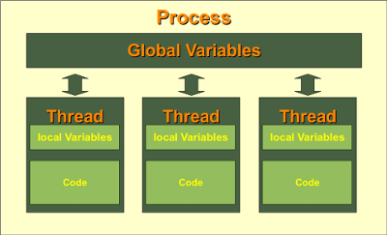
Lecture 5
Threading Programming
A Thread is defined in computer science as the smallest unit that can be scheduled in an operating system.
More than one thread can exist within the same process.
The ability of a process to execute multiple threads parallelly is called multithreading

Slide 5
Lecture 5
Threading Programming
Cont'd
Advantages:
  Significantly improve the performance of any program.
  A program can remain responsive while one thread waits for input.
  All the threads of a process have access to its global variables.
Disadvantages:
  On 1-CPU system, multithreading won’t hit the speed of computation.
  Synchronization for preventing mutual exclusion of shared resources.
  Increases the complexity of the program.
  Thread safe problem.

Slide 6
Lecture 5
Python Thread Creation Using Function
This code segment is represents a Python Function.
A function is a set of instructions that could be performed n times according to function calling in the code.
def fun1(a, b):
c = a + b
print(c)

Slide 7
Lecture 5
Python Thread Creation Using Function
Cont'd
import threading
def fun1(a, b):
c = a + b
print(c)
# args must be tuple
thread1 = threading.Thread(target = fun1, args = (12, 10))
thread1.start()

Slide 8
Lecture 5
Python Thread Creation Using Function
Cont'd
import threading, time
def fun1(a, b):
time.sleep(1) #seconds
c = a + b
print(c)
def fun2(a):
c = a * 2
print(c)

Slide 9
Lecture 5
Python Thread Creation Using Function
Cont'd
….
thread1 = threading.Thread(target = fun1, args = (12, 10))
thread1.start()
thread2 = threading.Thread(target = fun2, args = (10,))
thread2.start()
print("Total number of threads", threading.active_count() - 1)

Slide 10
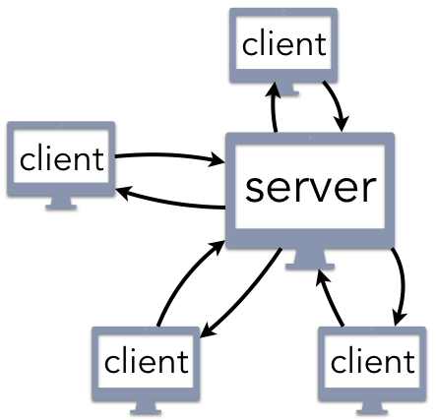
Lecture 5
Multiple Client/Server Model
In the basic model, server handles only one client at a time.
Scalable server model?!
Does not mean to implement a server for each client connection.

Slide 11
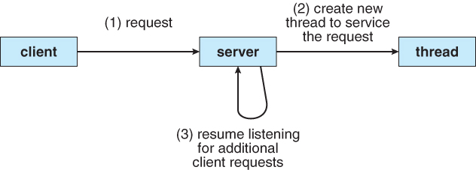
Lecture 5
Threading for Client/Server Model
Thread-1: Listen and accept connections from other clients.
Thread-N: Sending commands to an already connected clients.

Slide 12
Lecture 5
Server Using Threading
import socket, threading
PORT = 5050
SERVER = socket.gethostbyname(socket.gethostname())
print(SERVER)
ADDR = (SERVER, PORT)
server = socket.socket(socket.AF_INET, socket.SOCK_STREAM)
server.bind(ADDR)
def send(msg, client):
client.send(msg.encode("utf-8"))

Slide 13
Lecture 5
Server Using Threading
Cont'd
def client(conn, addr, clients):
print(f"{addr} is connected.")
connected = True
while connected:
msg = conn.recv(1024).decode("utf-8")
if msg == "DES":
connected = False
continue
print(f"{addr} {msg}")
msg = f"Message received: {msg}"
for client in clients:
if client != conn:
send(msg, client)
conn.close()

Slide 14
Lecture 5
Server Using Threading
Cont'd
def start():
server.listen()
print(f"The server is listening to {SERVER}")
clients = []
while True:
conn, addr = server.accept()
clients.append(conn)
thread = threading.Thread(target=client, args=(conn, addr, clients))
thread.start()
print(f"Number of active connection: {threading.active_count() - 1}")
print("The server is starting")
start()

Slide 15
Lecture 5
Client Using Threading
import threading, socket
PORT = 5050
SERVER = socket.gethostbyname(socket.gethostname())
ADDR = (SERVER, PORT)
client = socket.socket(socket.AF_INET, socket.SOCK_STREAM)
client.connect(ADDR)
def read():
msg = client.recv(1024).decode("utf-8")
print(msg)

Slide 16
Lecture 5
Client Using Threading
Cont'd
def send():
connect = True
while connect:
msg = input()
client.send(msg.encode("utf-8"))
if msg == "DES":
connect = False
else:
thread = threading.Thread(target=read)
thread.start()
continue
send()

Slide 17
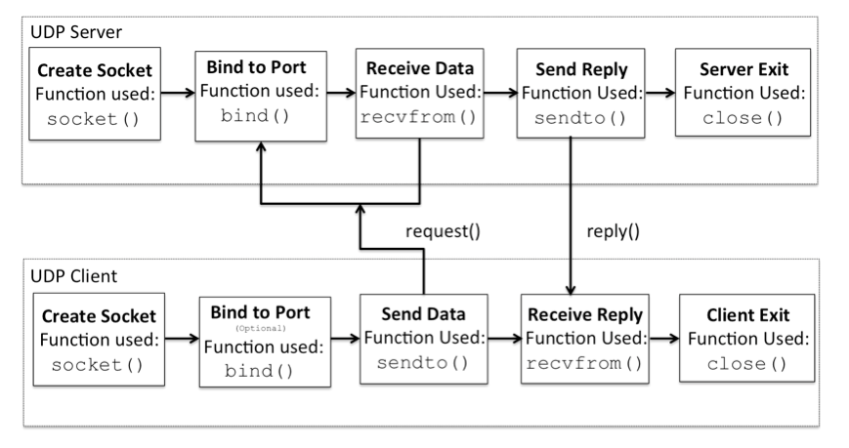
Lecture 5
User Datagram Protocol

Slide 18
Lecture 5
Simple Datagram Server
import socket
localIP = "127.0.0.1"; localPort = 20001
UDPServerSocket = socket.socket(socket.AF_INET, socket.SOCK_DGRAM)
UDPServerSocket.bind((localIP, localPort))
print("UDP server up and listening")
while True:
bytesAddressPair = UDPServerSocket.recvfrom(1024)
message = bytesAddressPair[0].decode()
address = bytesAddressPair[1]
print(f"Message from Client: {message}")
print(f"Client IP Address: {address}")
message = message.upper().encode()
UDPServerSocket.sendto(message, address)

Slide 19
Lecture 5
Simple Datagram Client
import socket
serverAddressPort = ("127.0.0.1", 20001)
UDPClientSocket = socket.socket(family=socket.AF_INET, type=socket.SOCK_DGRAM)
while True:
data = input("Enter a word: ")
data = data.encode()
UDPClientSocket.sendto(data, serverAddressPort)
msgFromServer = UDPClientSocket.recvfrom(1024)
msg = f"Message from Server {msgFromServer[0].decode()}"
print(msg)

Slide 20
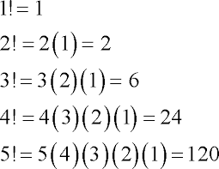
Lecture 5
Sheet
Exercise 1:
Create a UDP client/server program that calculate and send the factorial of a given number send by a client.

Slide 21
THANK YOU

