Slide 1
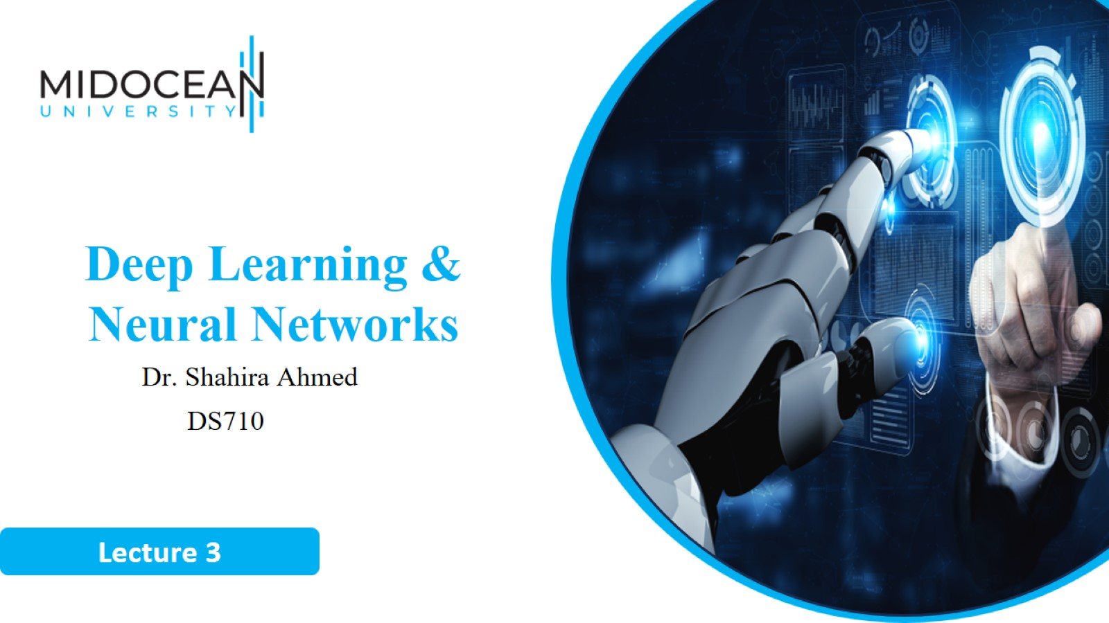

Slide 2


Slide 3
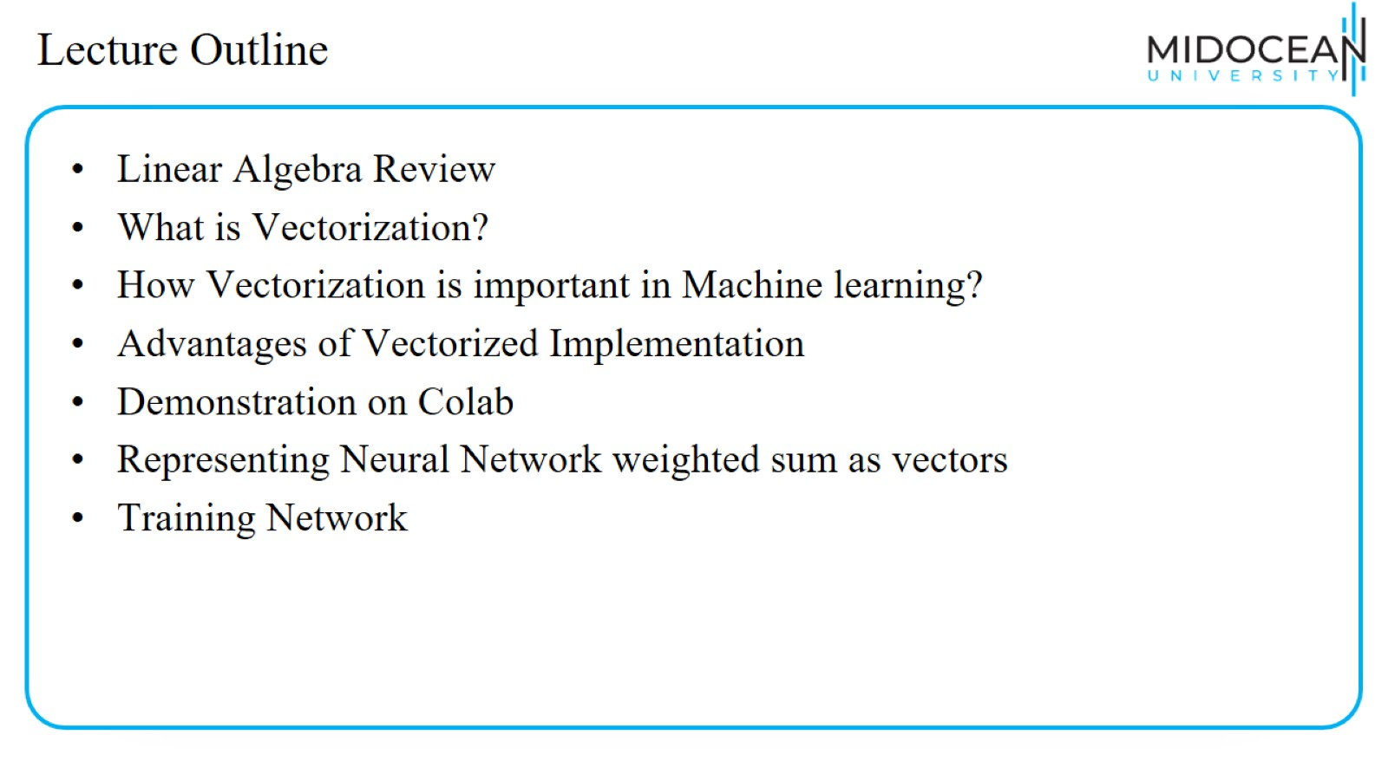
Lecture Outline

Slide 4
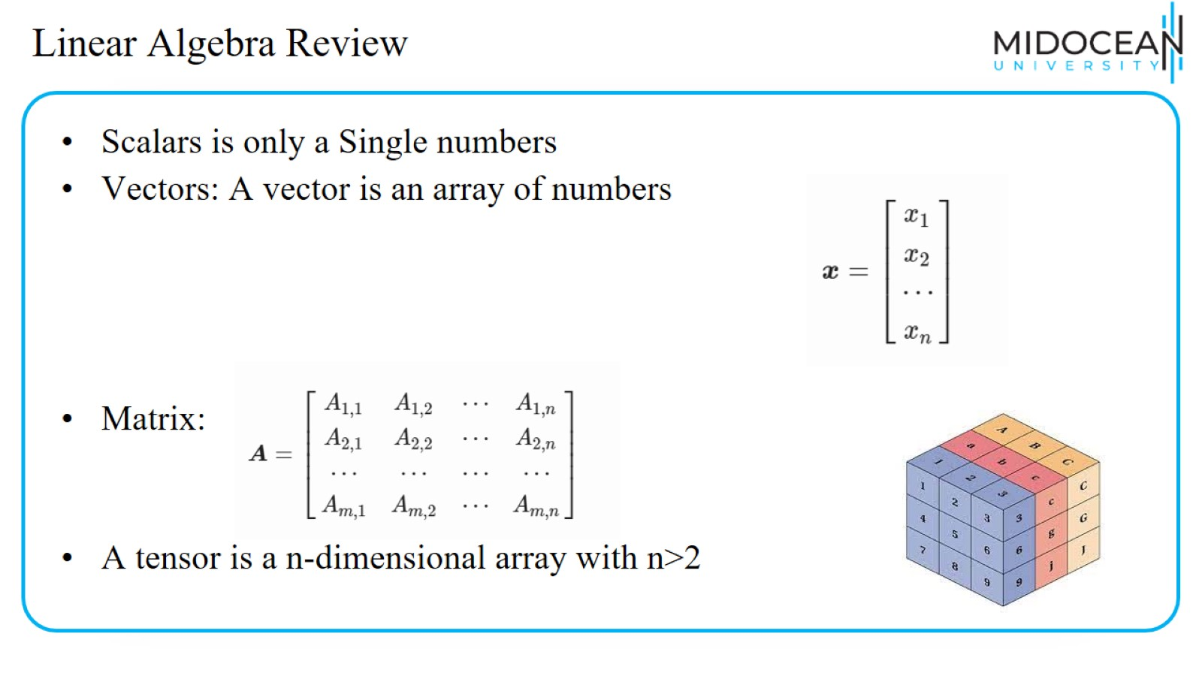
Linear Algebra Review

Slide 5
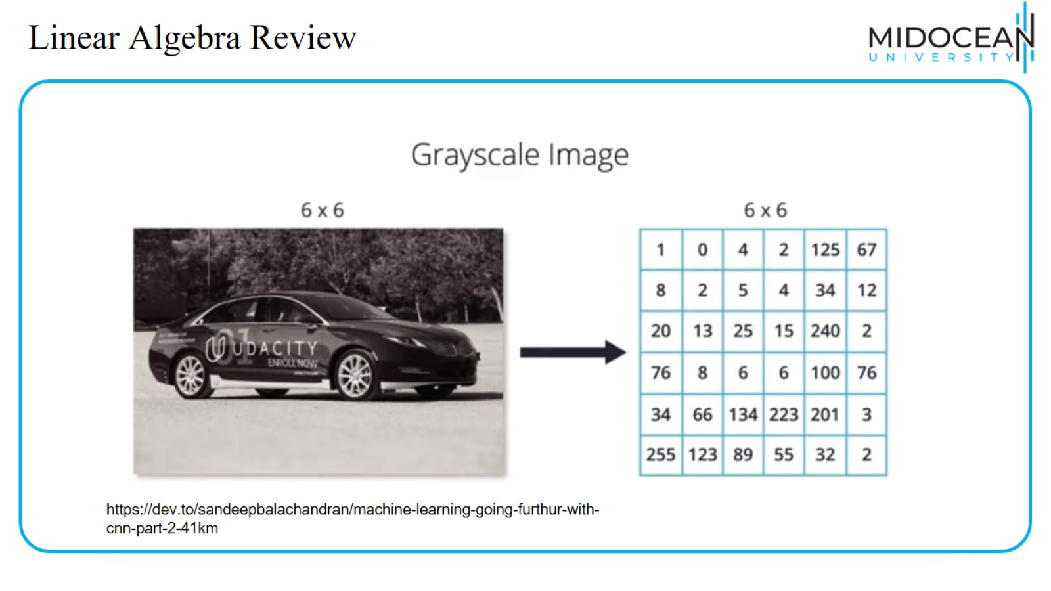
Linear Algebra Review

Slide 6
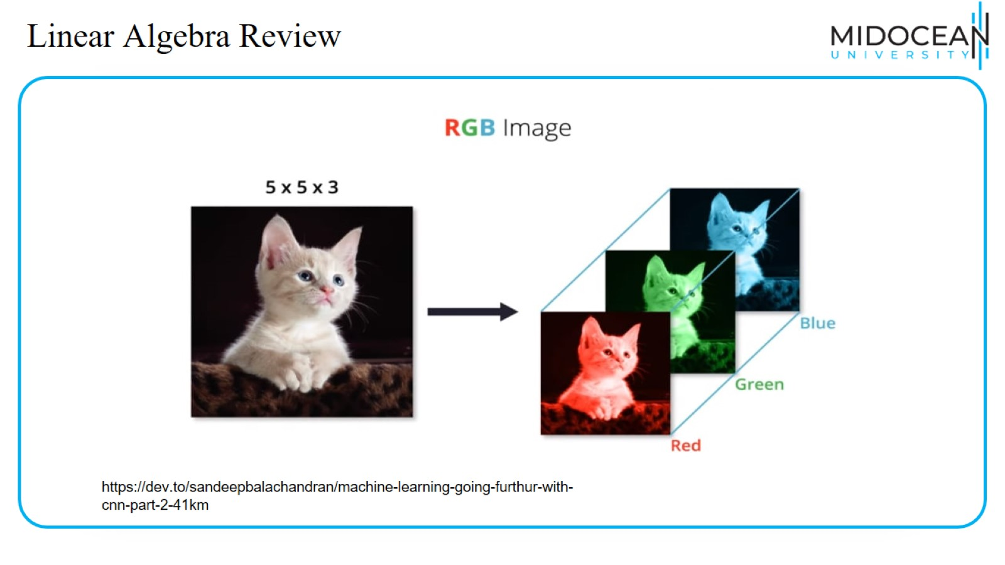
Linear Algebra Review

Slide 7
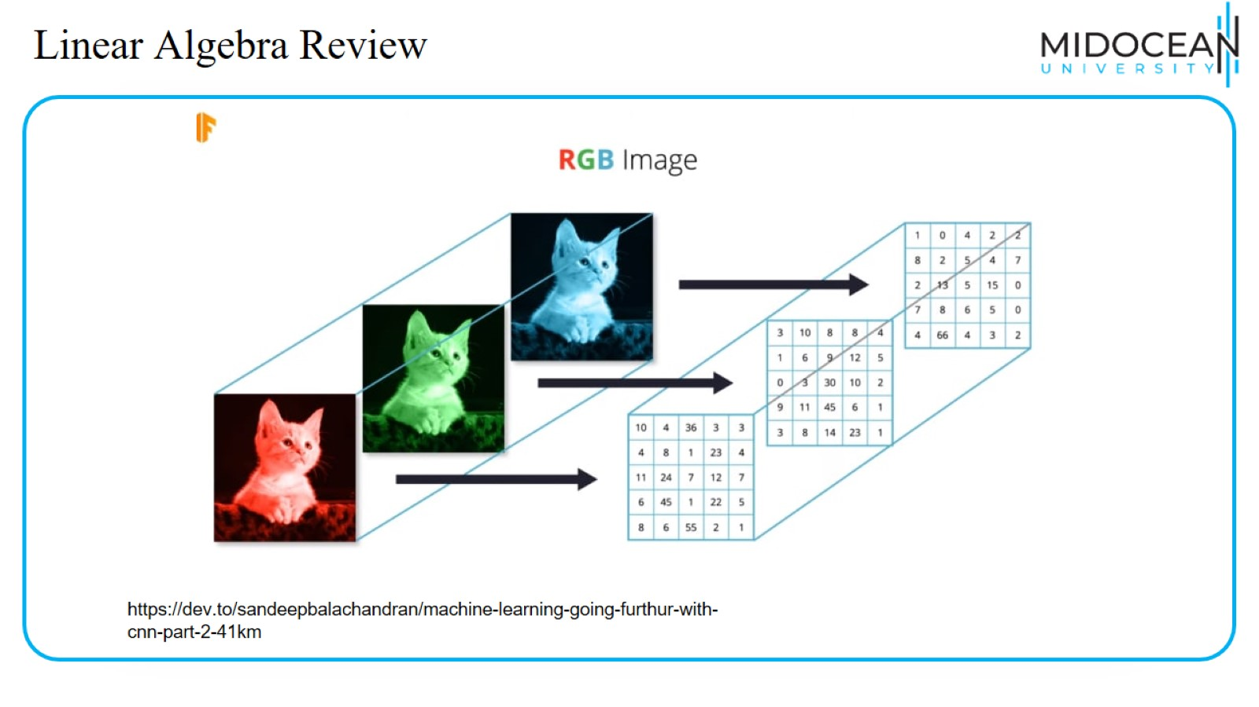
Linear Algebra Review

Slide 8
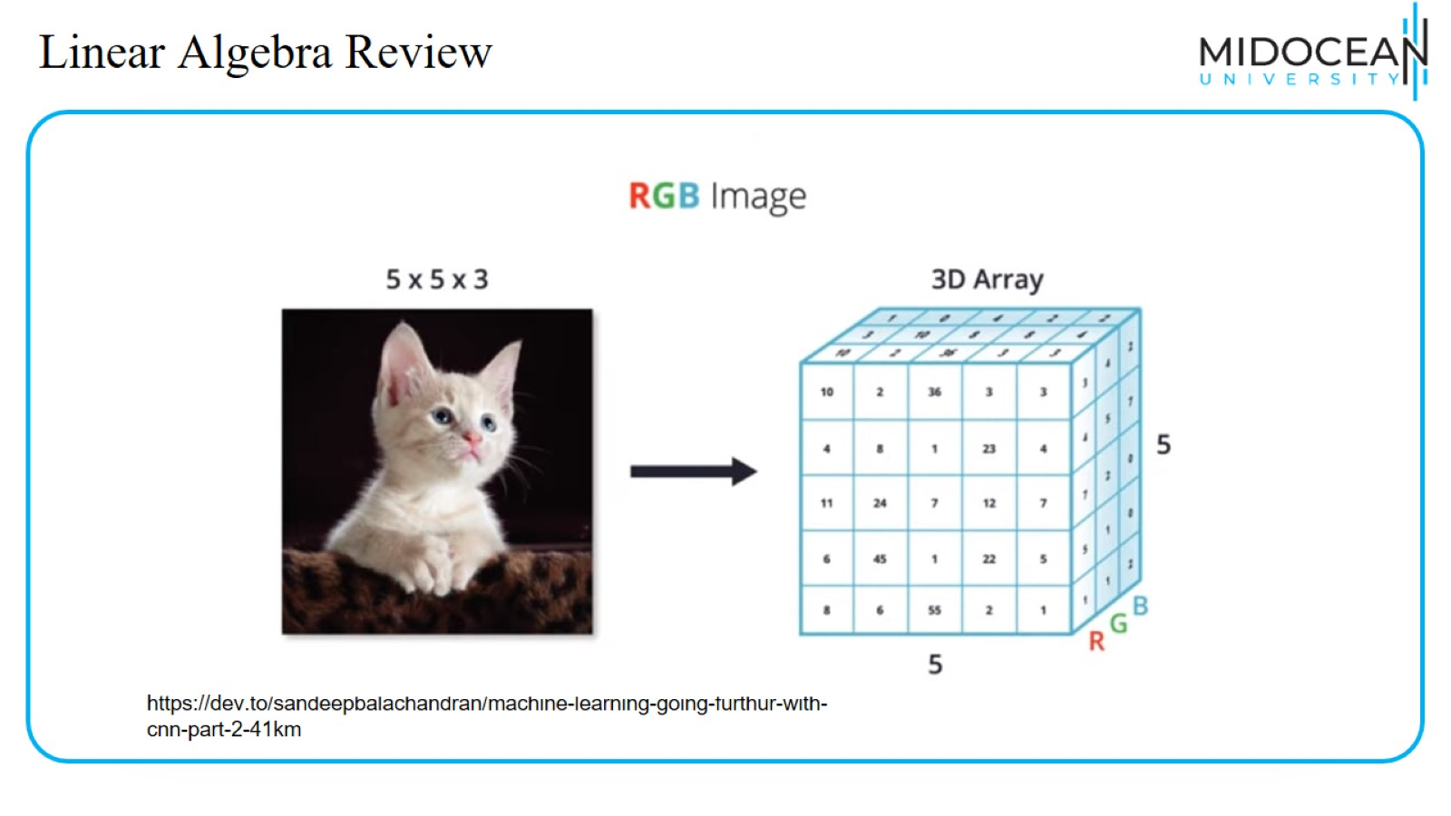
Linear Algebra Review

Slide 9
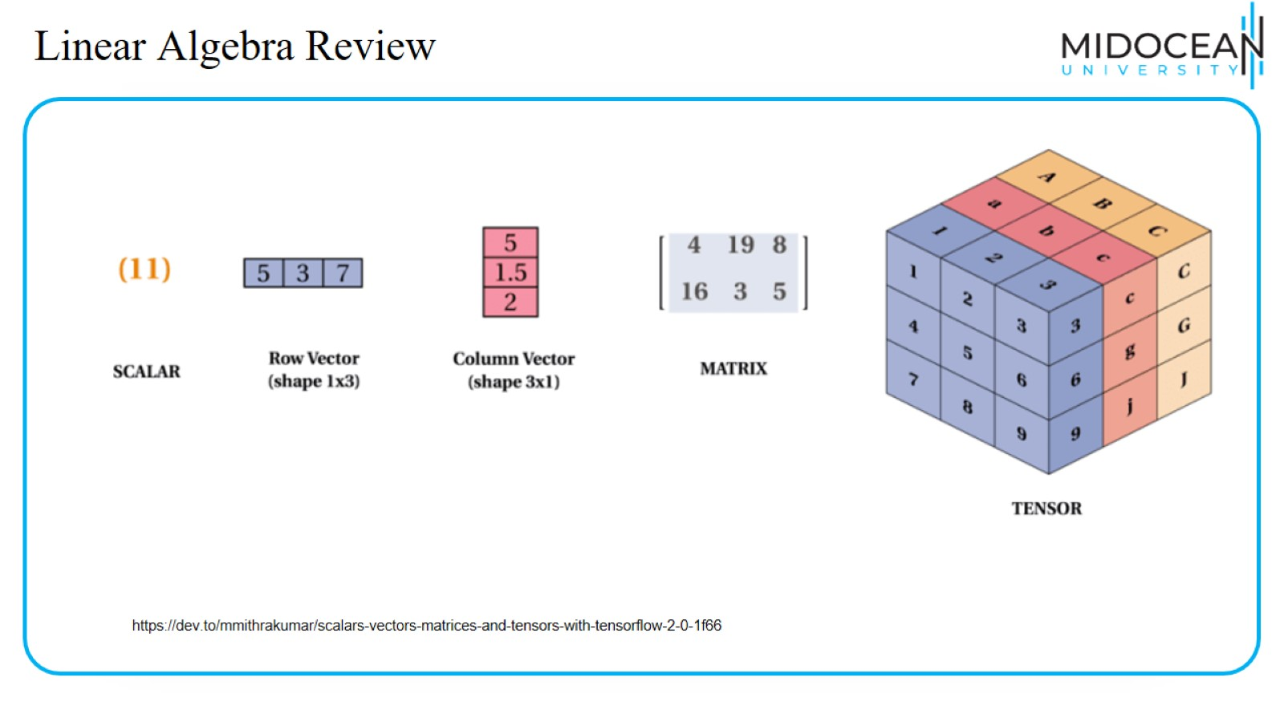
Linear Algebra Review

Slide 10
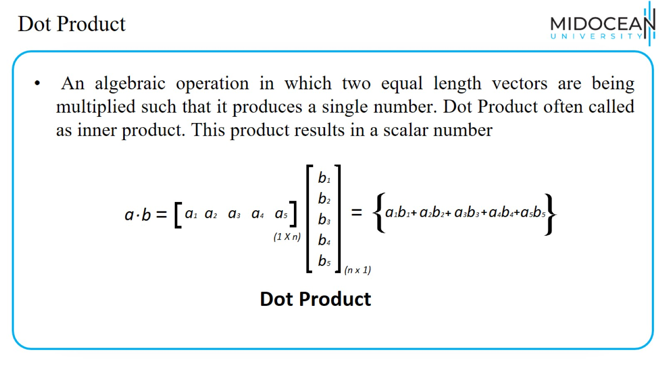
Dot Product

Slide 11
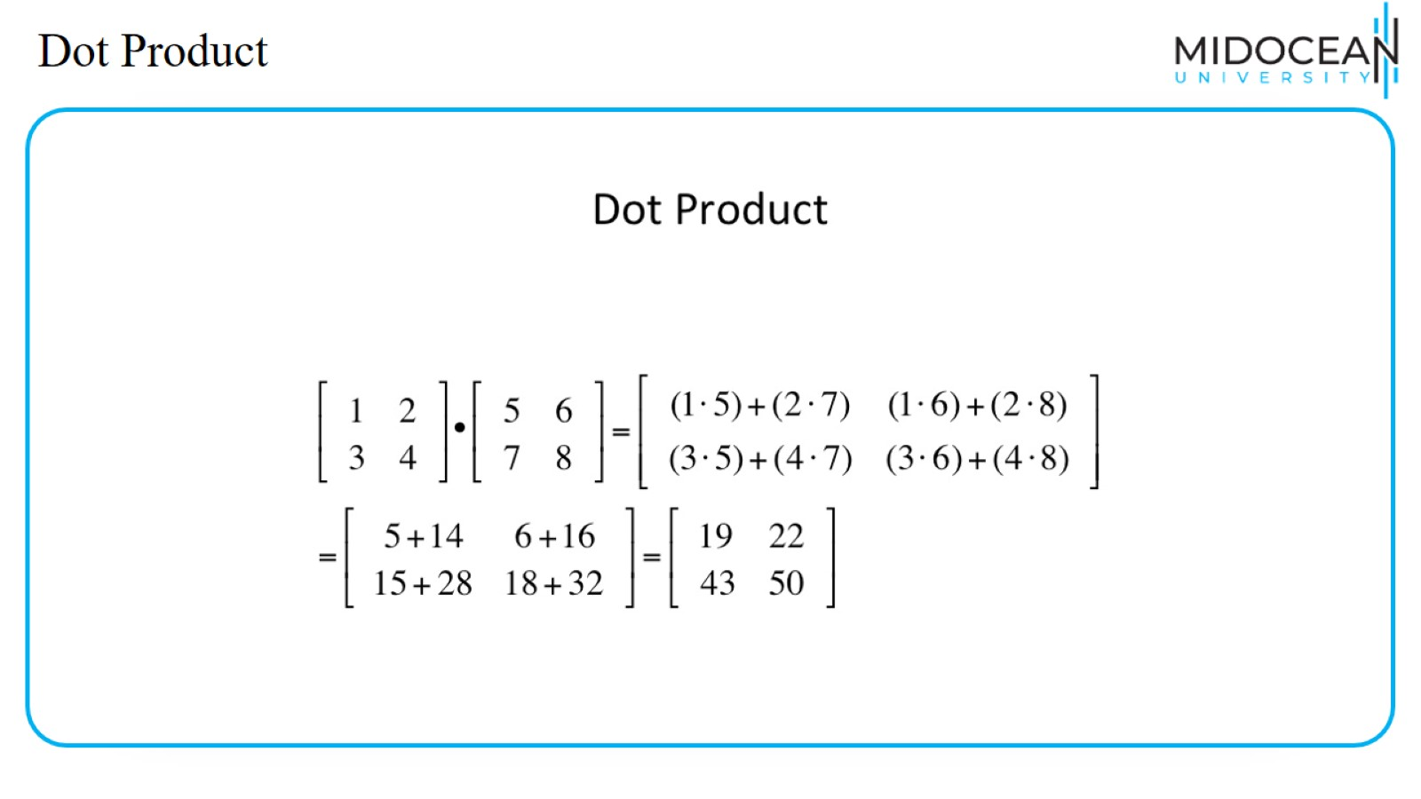
Dot Product

Slide 12
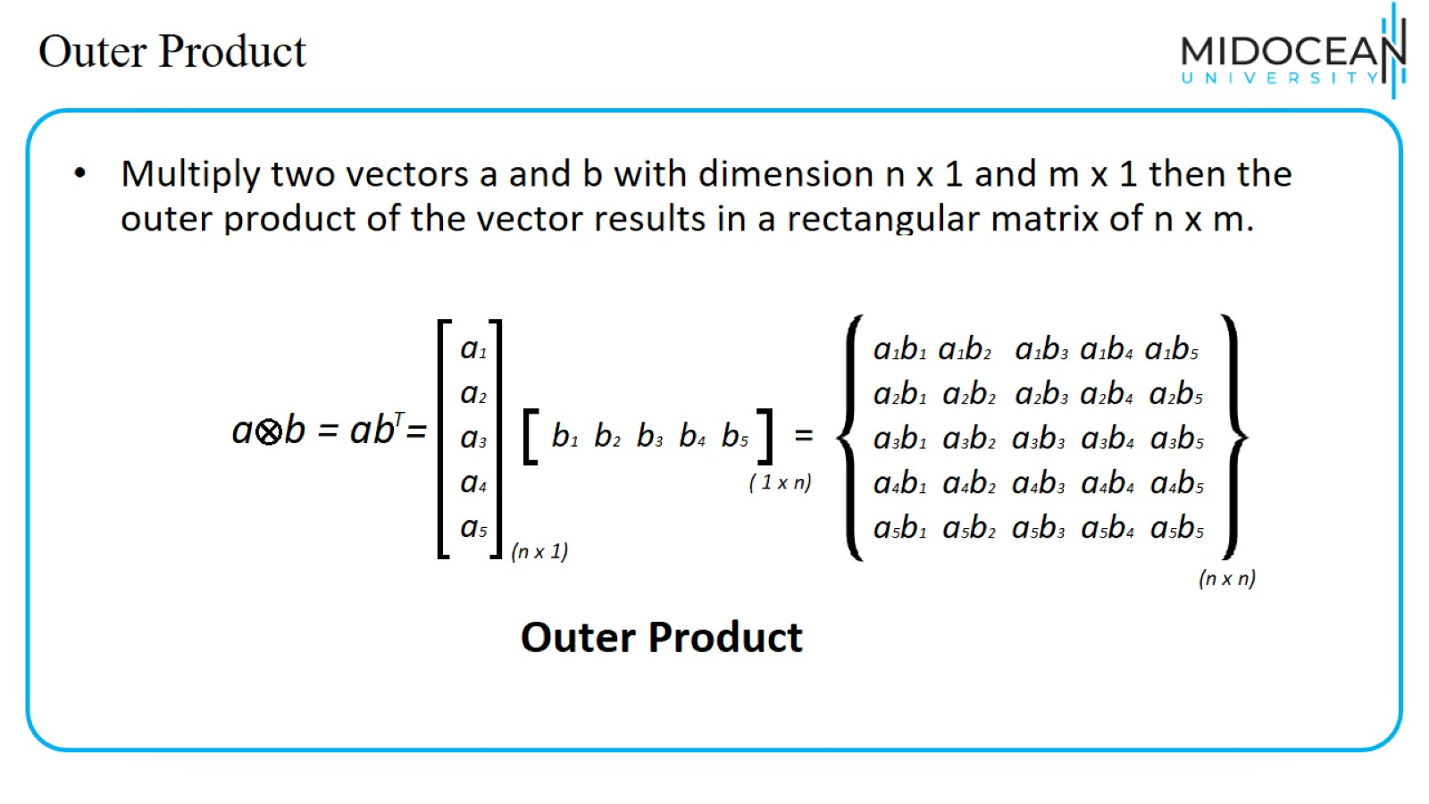
Outer Product

Slide 13
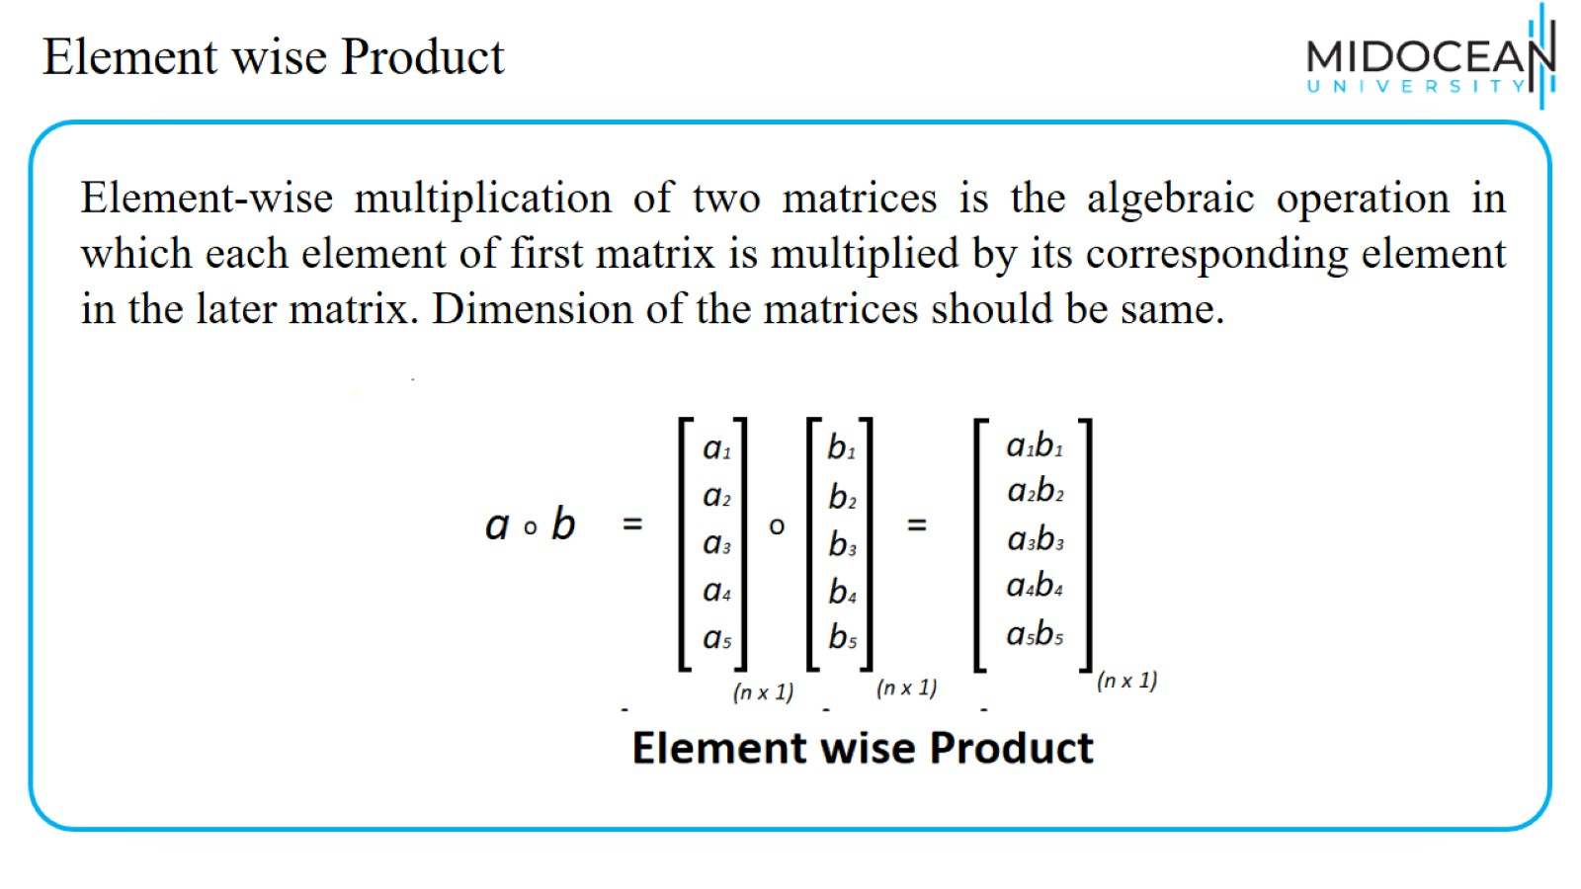
Element wise Product

Slide 14
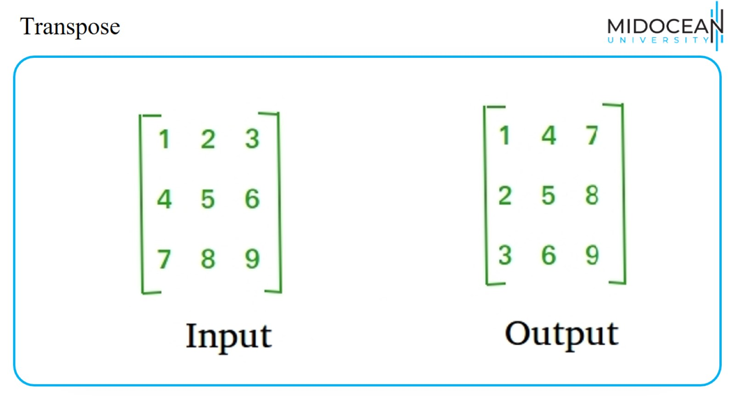
Transpose

Slide 15
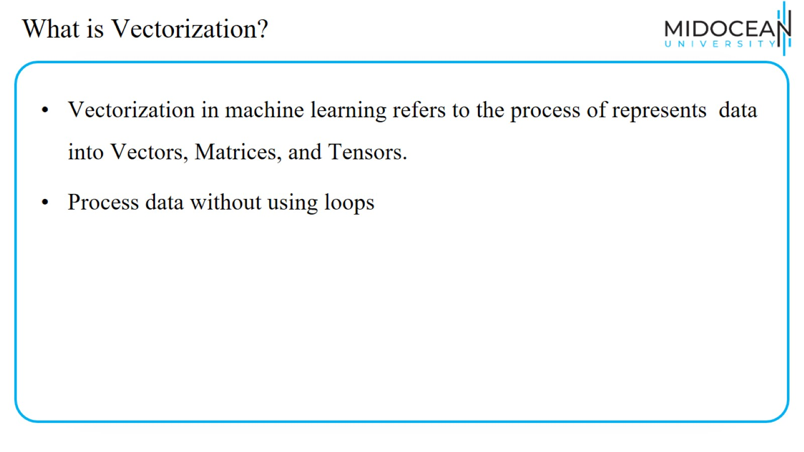
What is Vectorization?

Slide 16
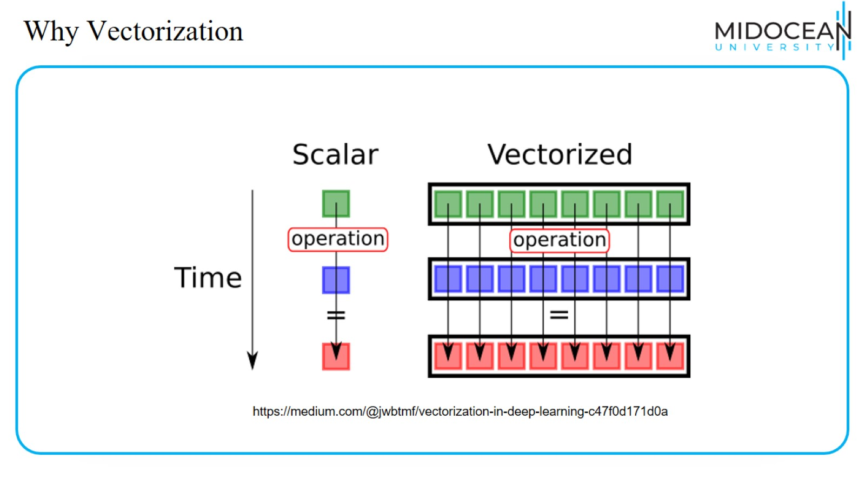
Why Vectorization

Slide 17
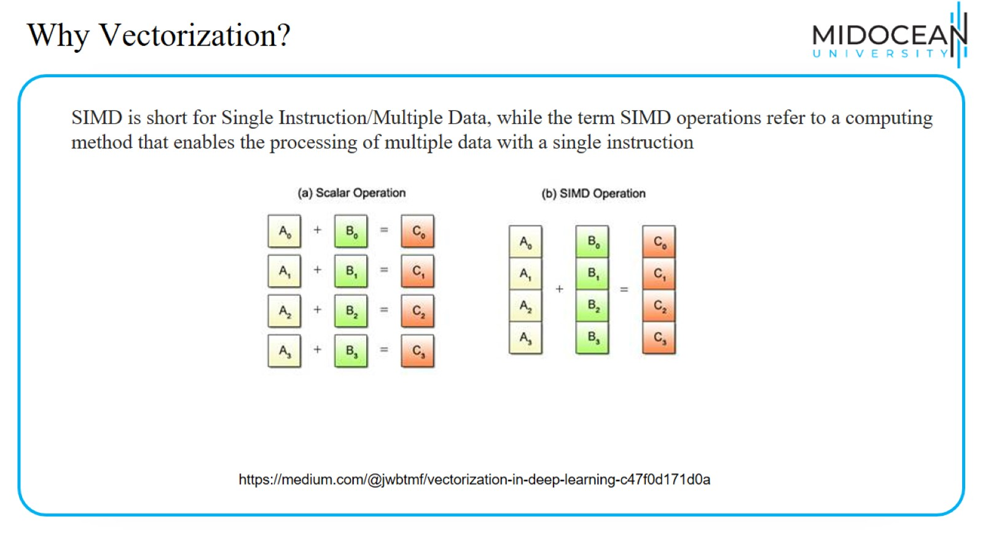
Why Vectorization?

Slide 18
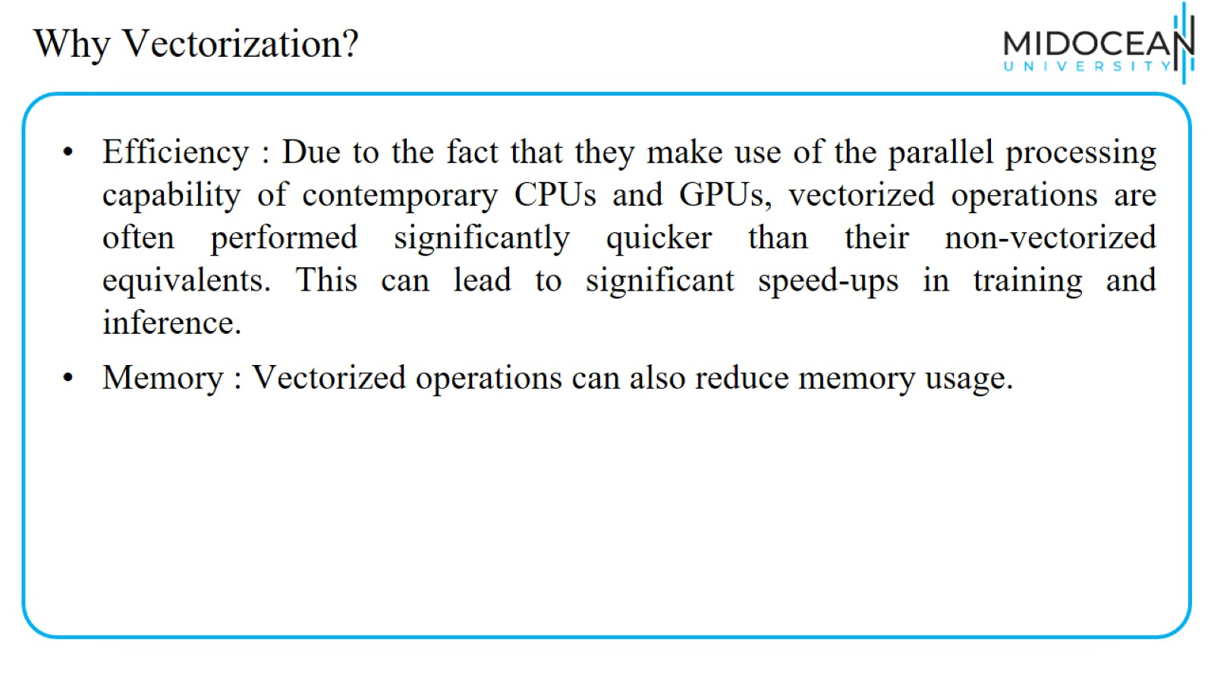
Why Vectorization?

Slide 19
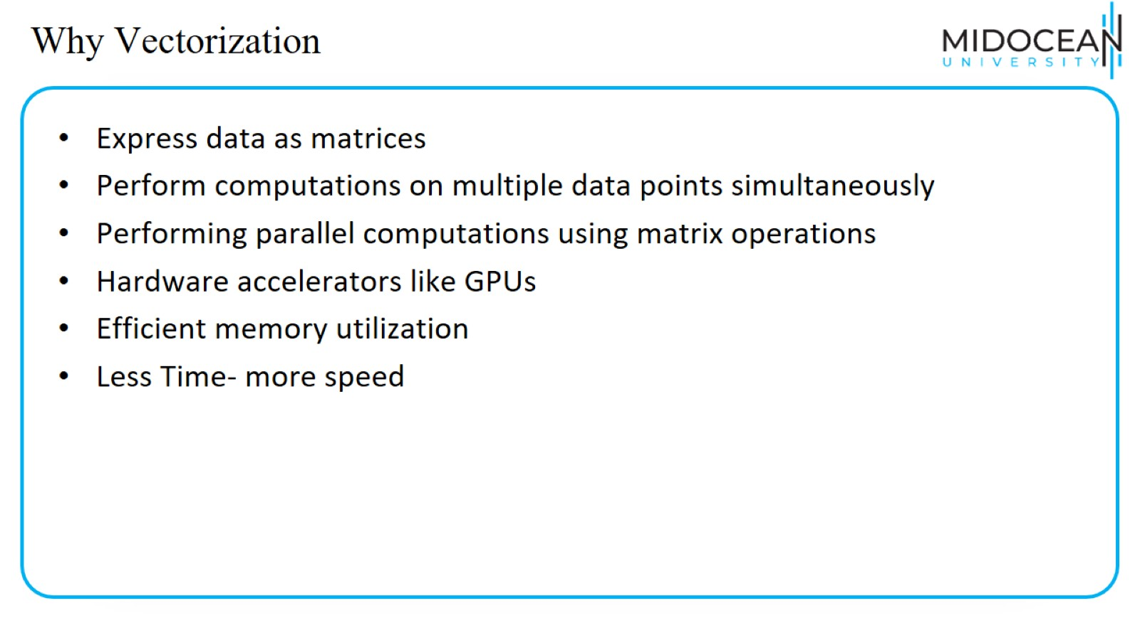
Why Vectorization

Slide 20
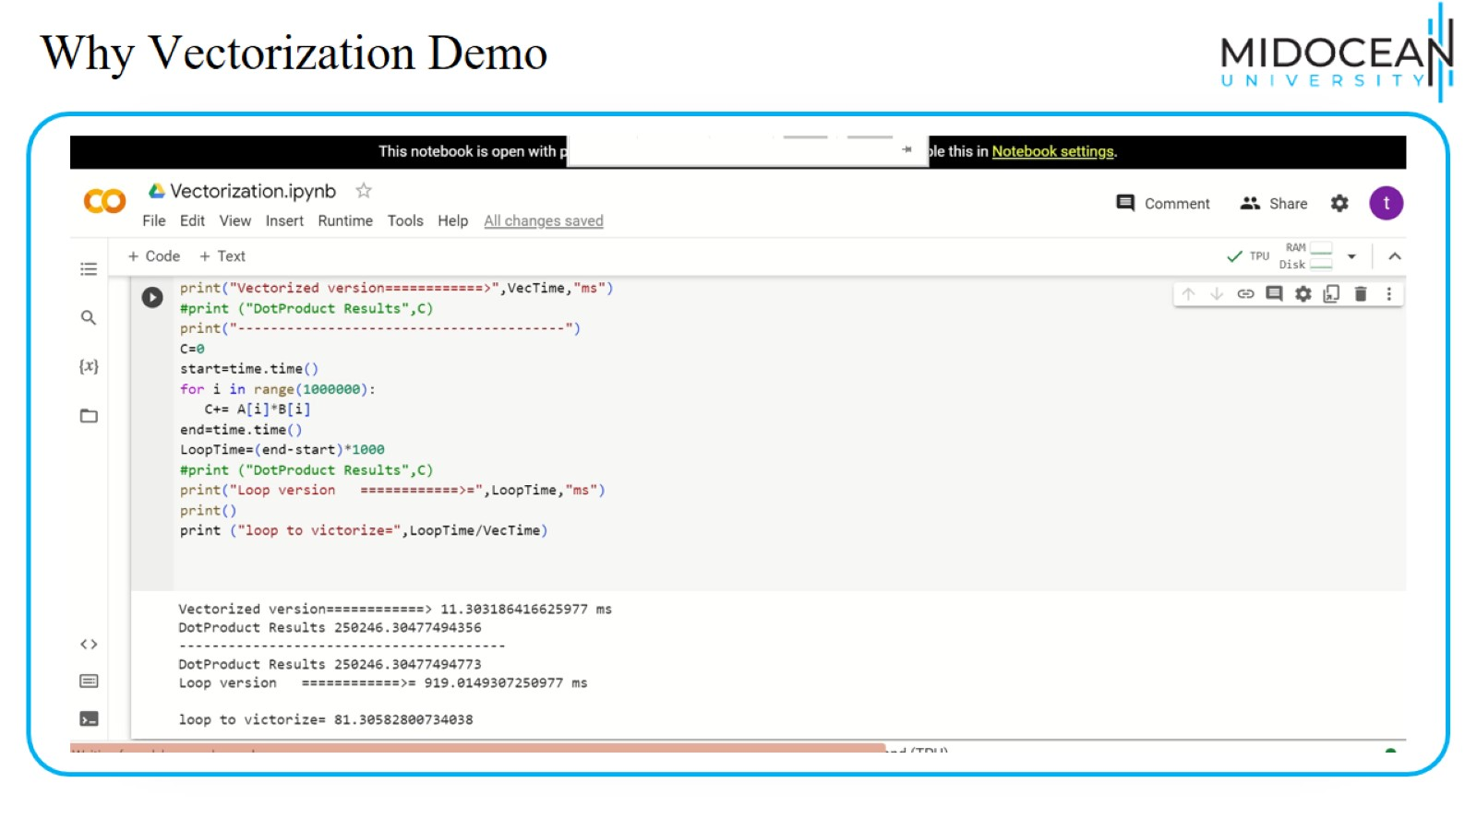
Why Vectorization Demo

Slide 21
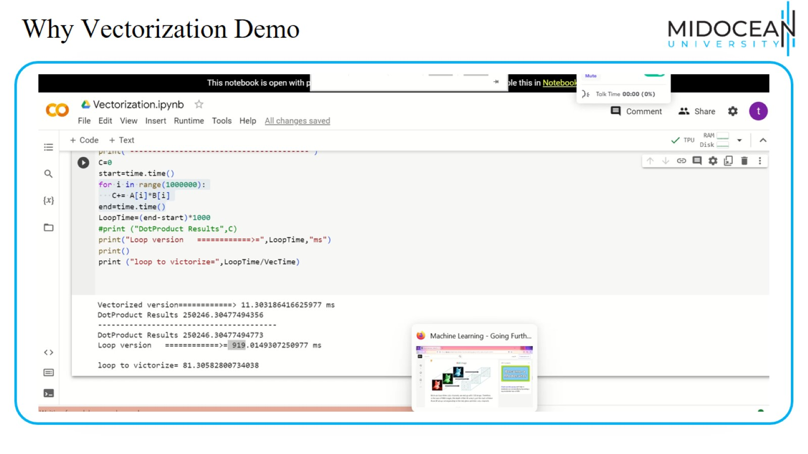
Why Vectorization Demo

Slide 22
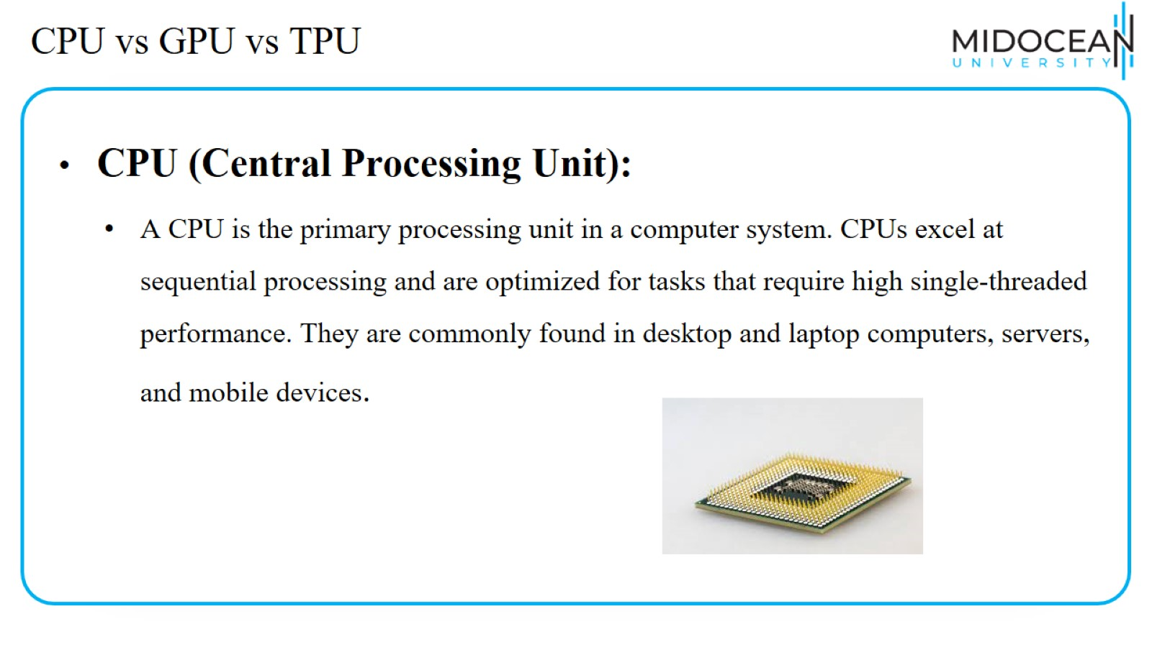
CPU vs GPU vs TPU

Slide 23
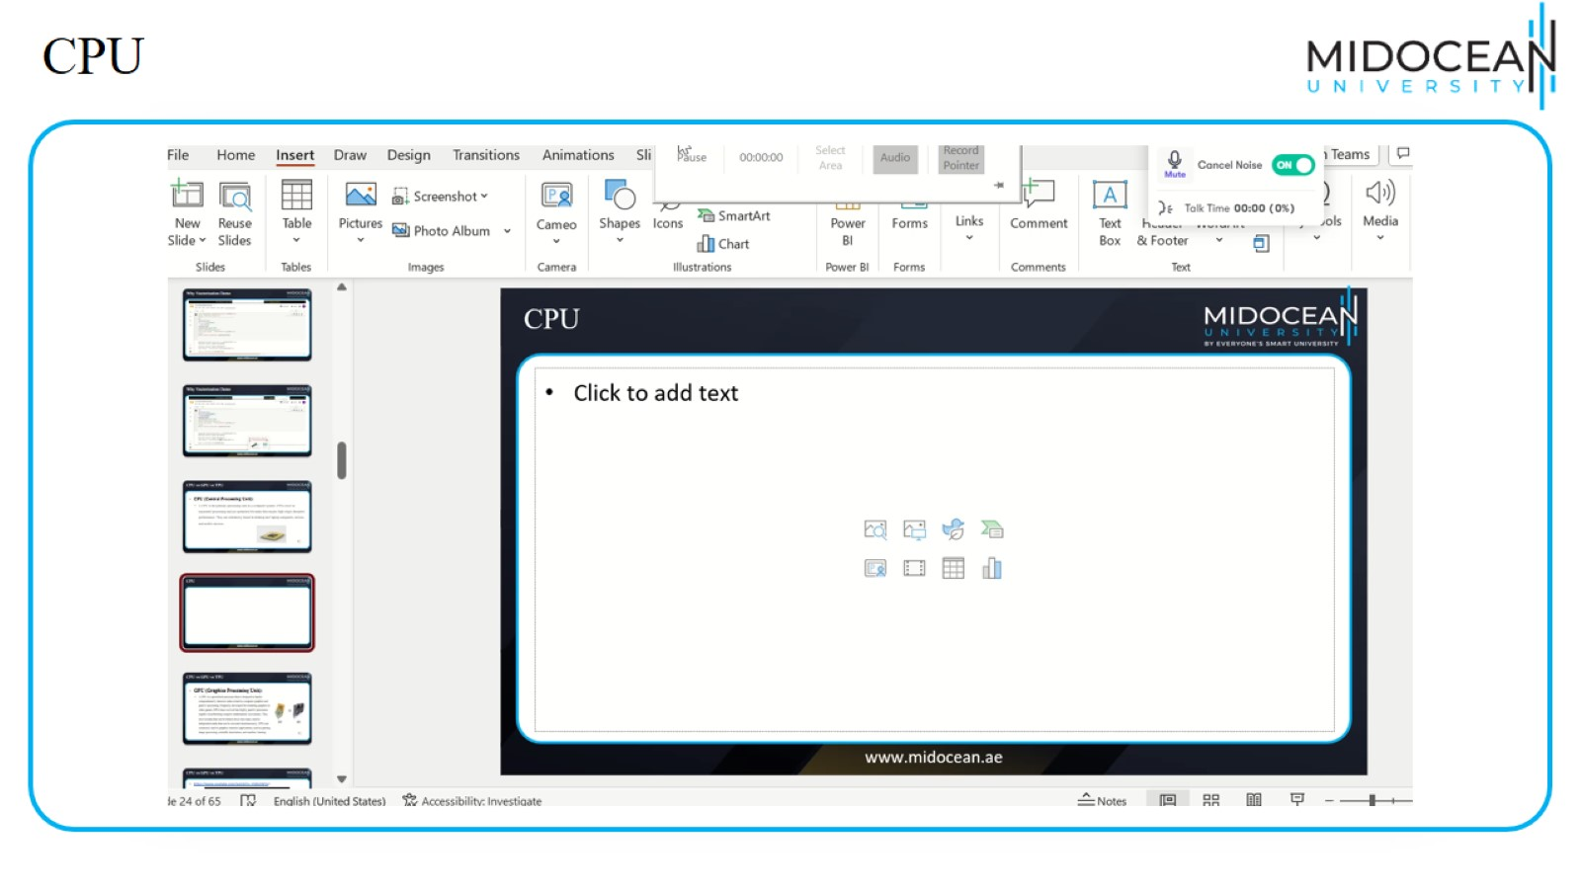
CPU

Slide 24
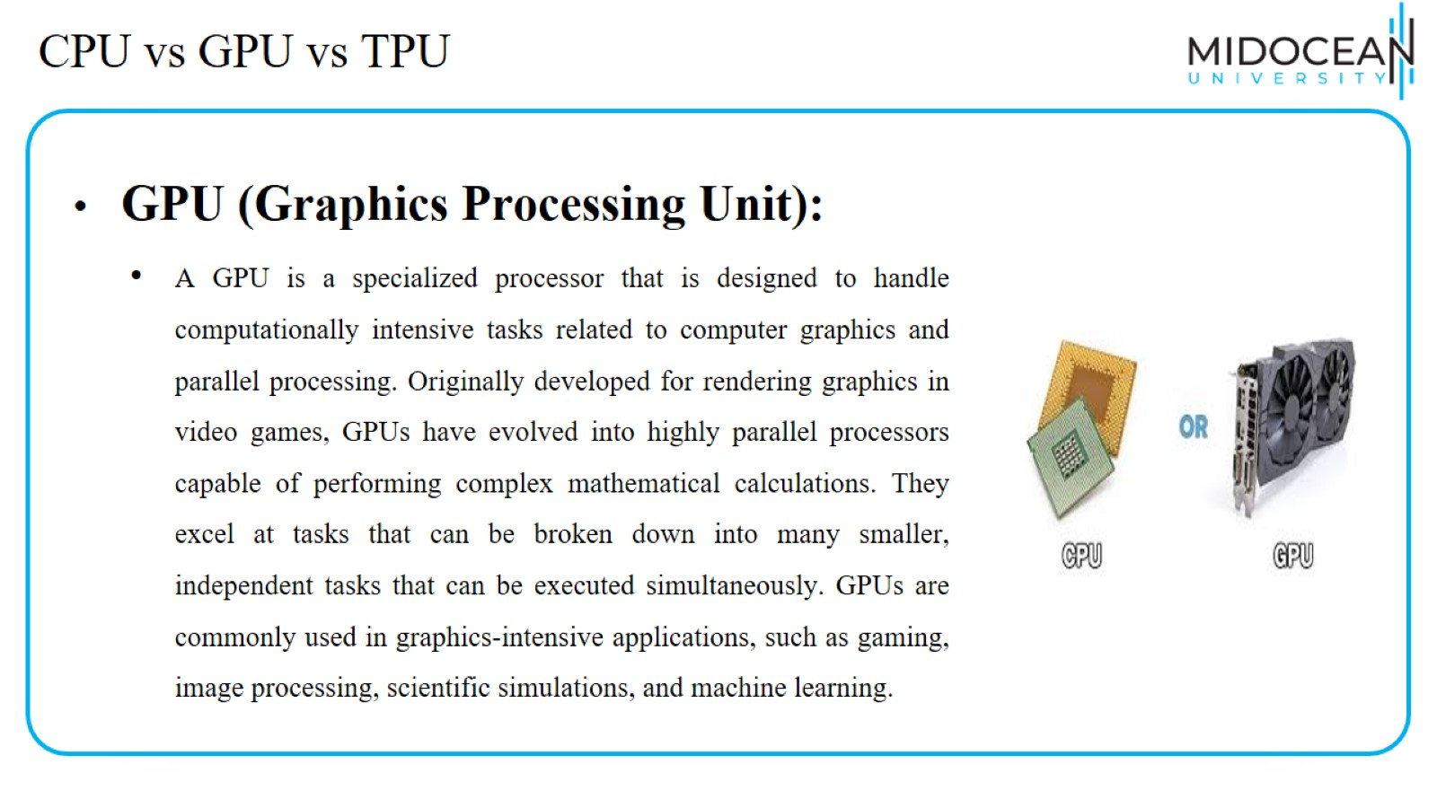
CPU vs GPU vs TPU

Slide 25
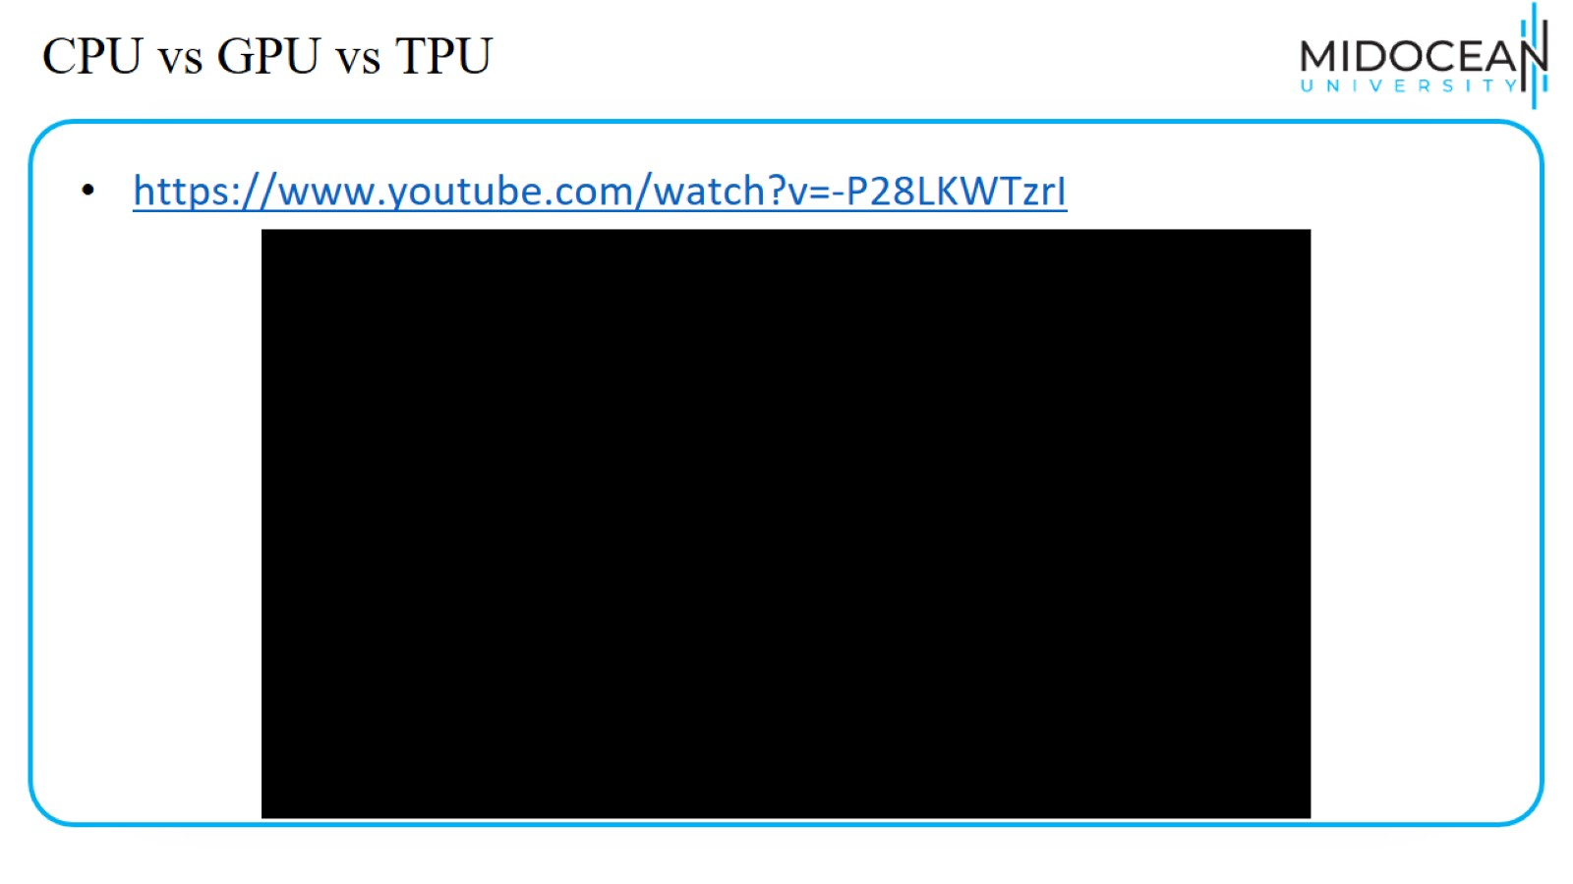
CPU vs GPU vs TPU

Slide 26
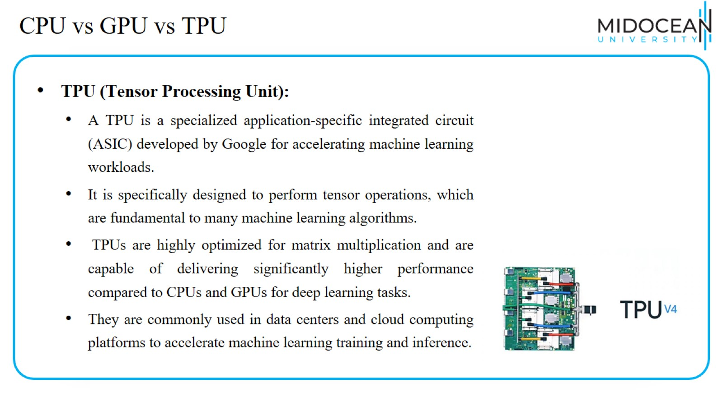
CPU vs GPU vs TPU

Slide 27
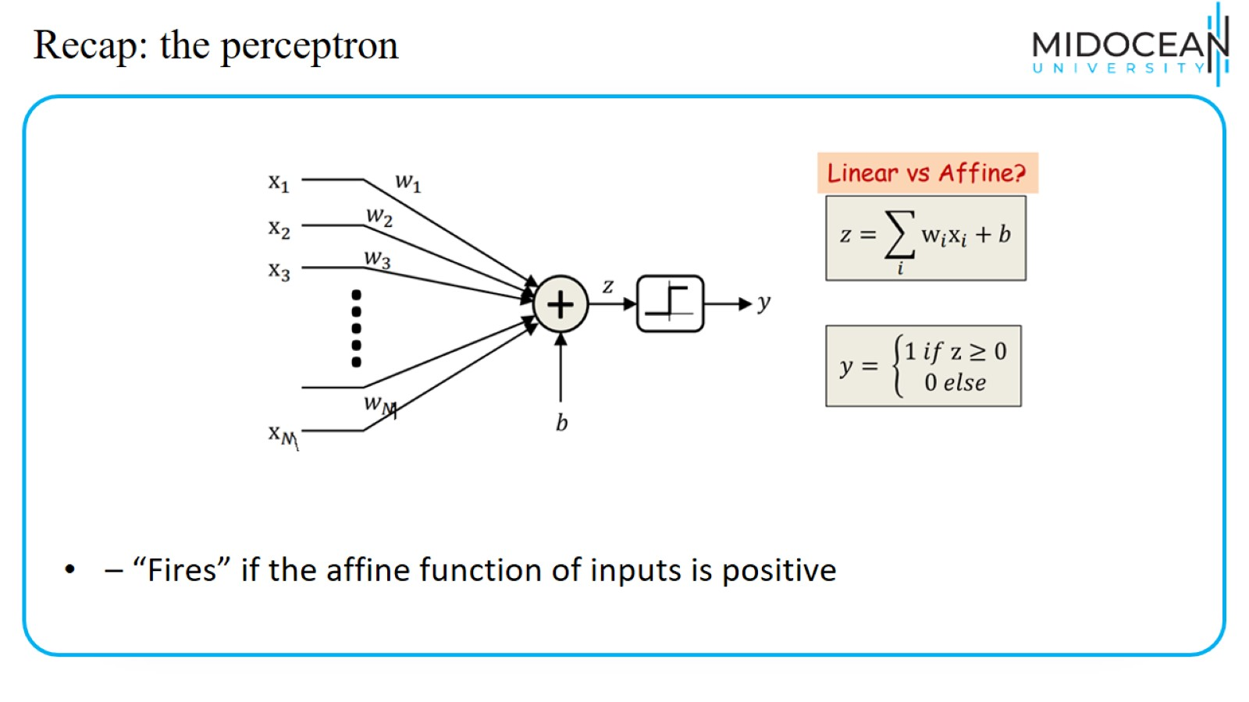
Recap: the perceptron

Slide 28
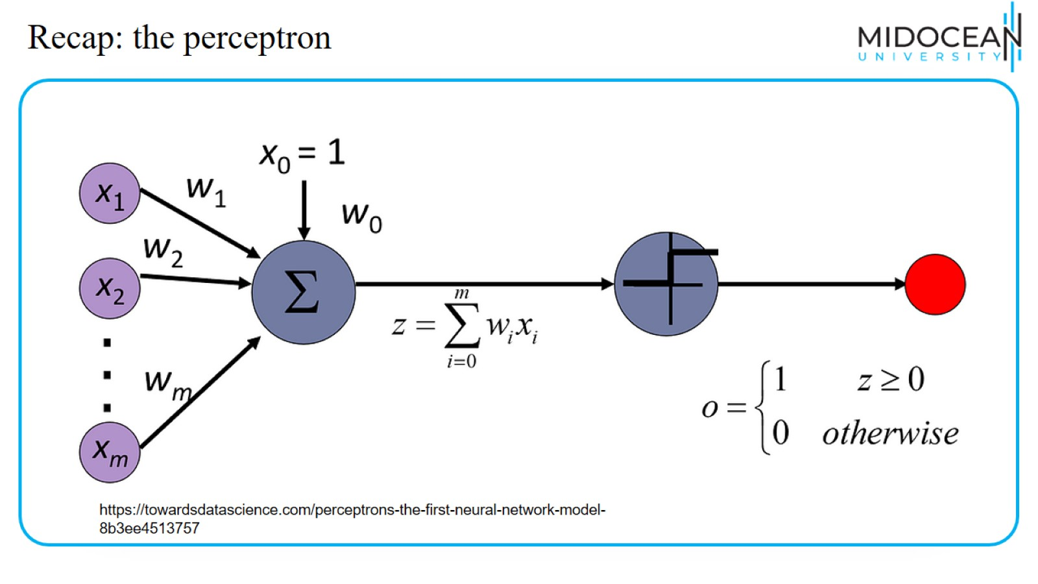
Recap: the perceptron

Slide 29
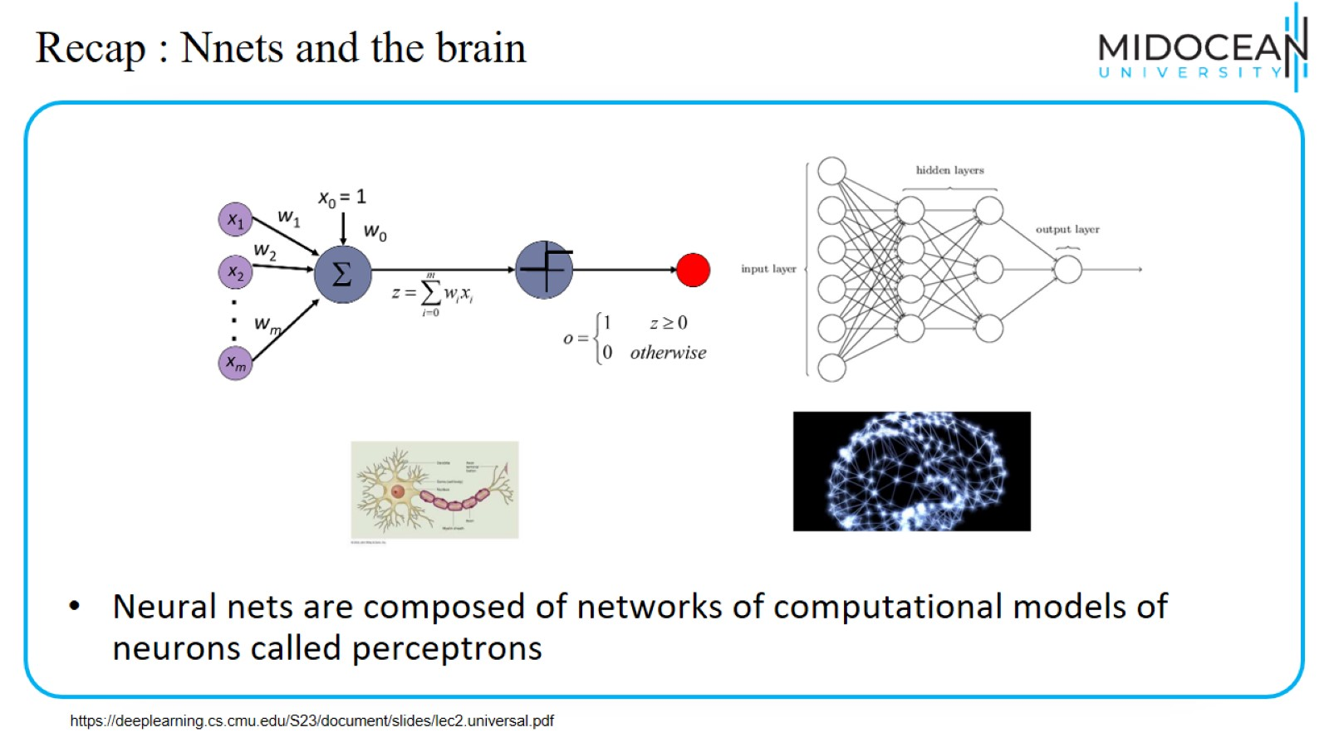
Recap : Nnets and the brain

Slide 30
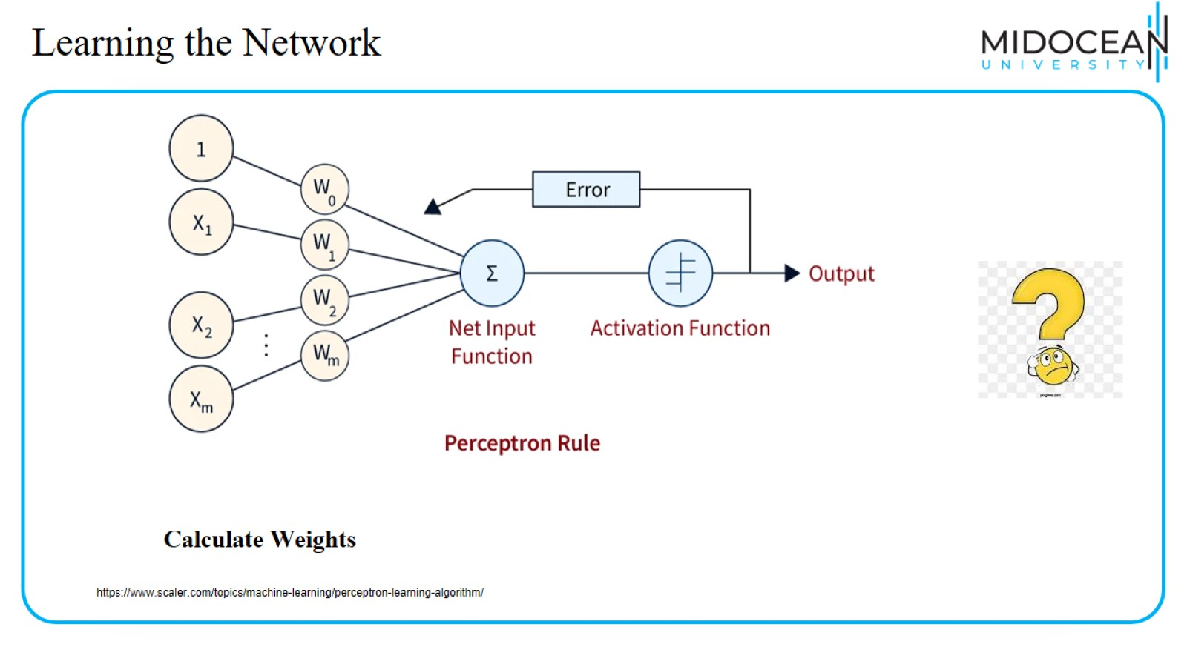
Learning the Network

Slide 31
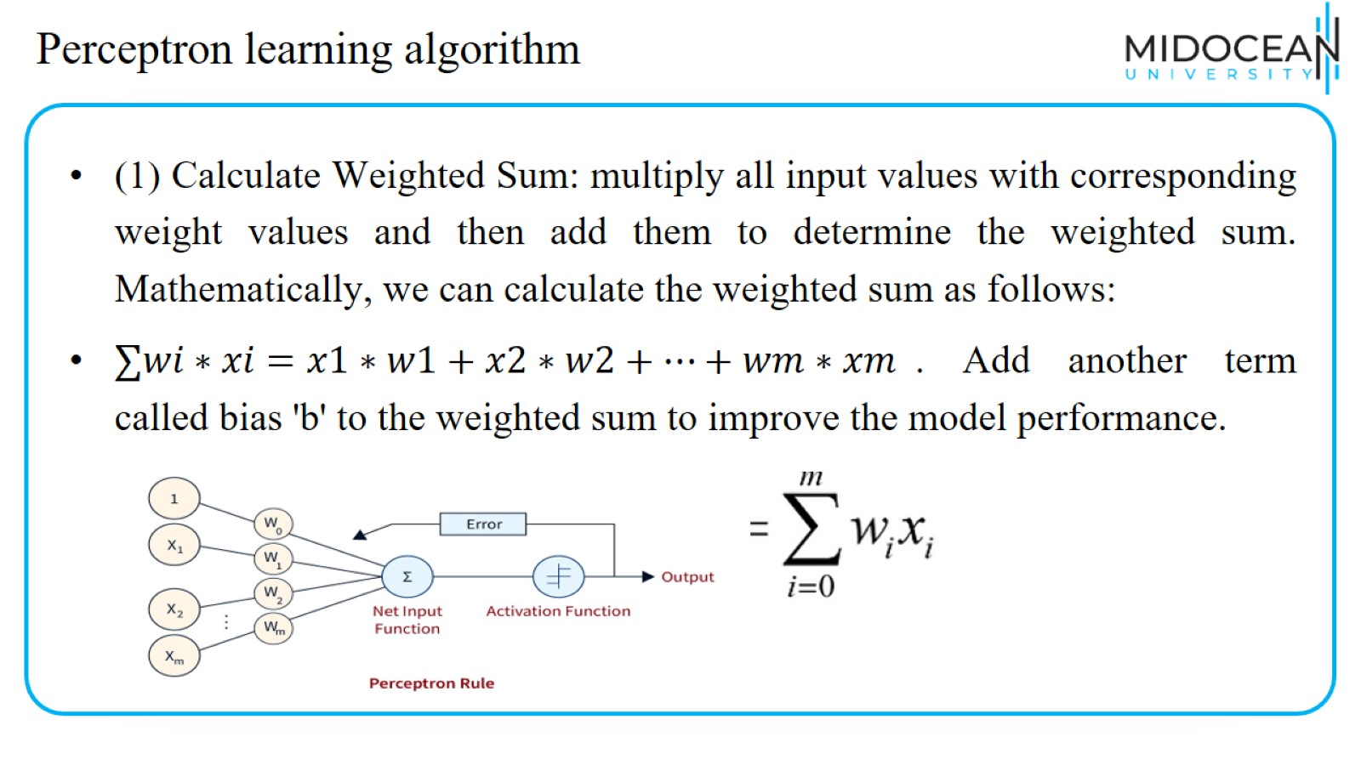
Perceptron learning algorithm

Slide 32
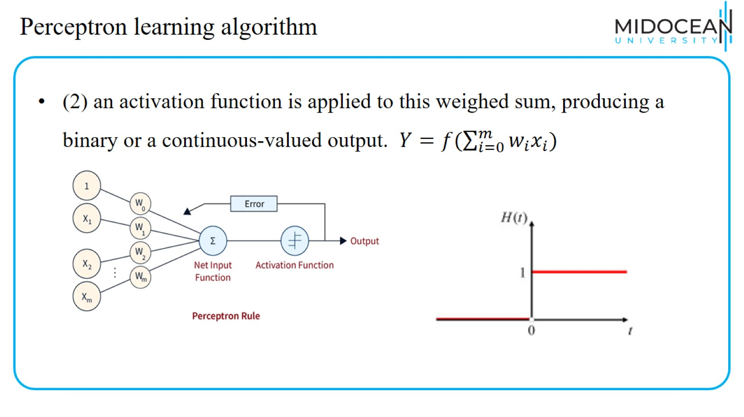
Perceptron learning algorithm

Slide 33
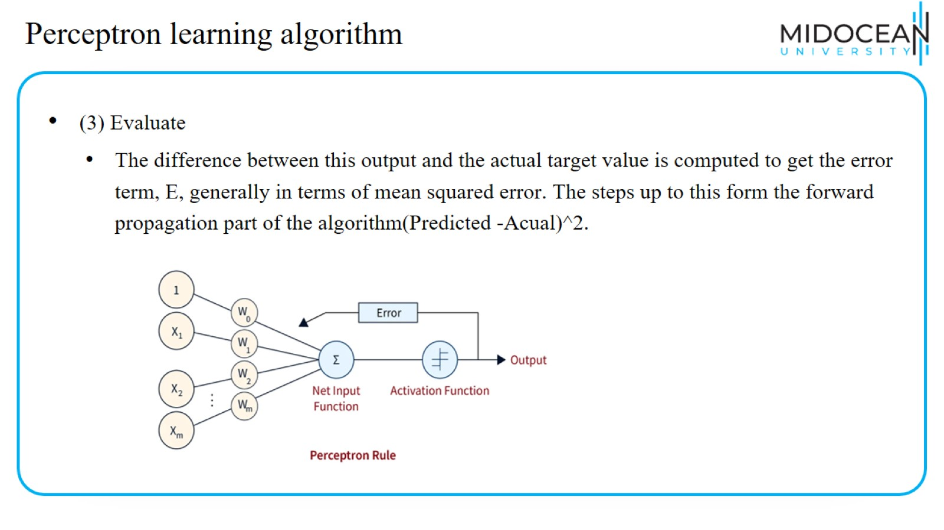
Perceptron learning algorithm

Slide 34
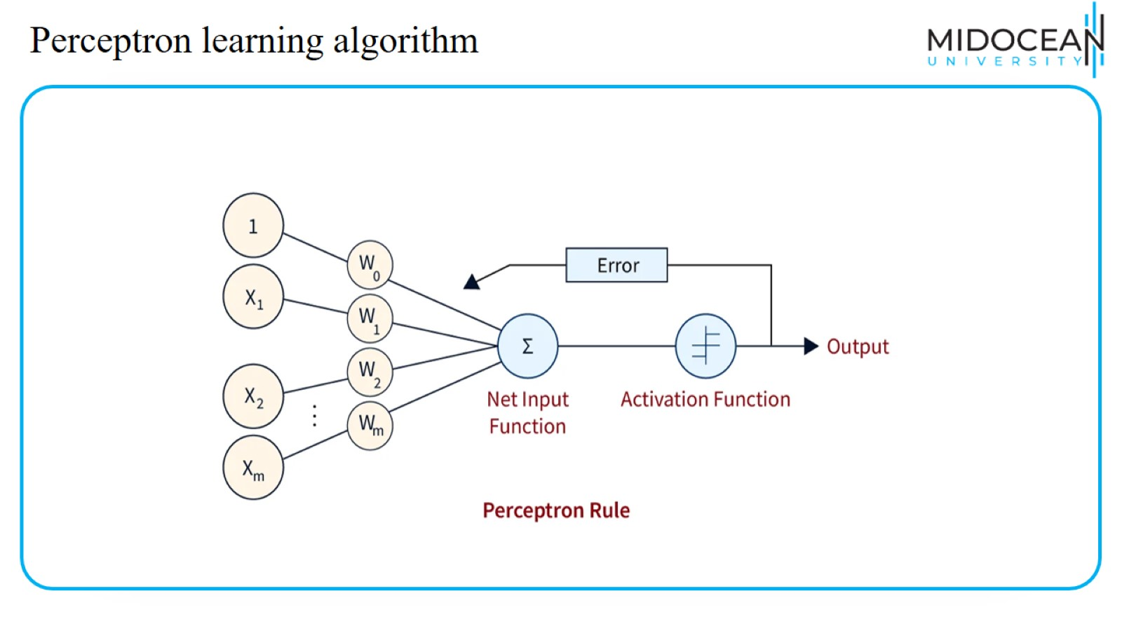
Perceptron learning algorithm

Slide 35
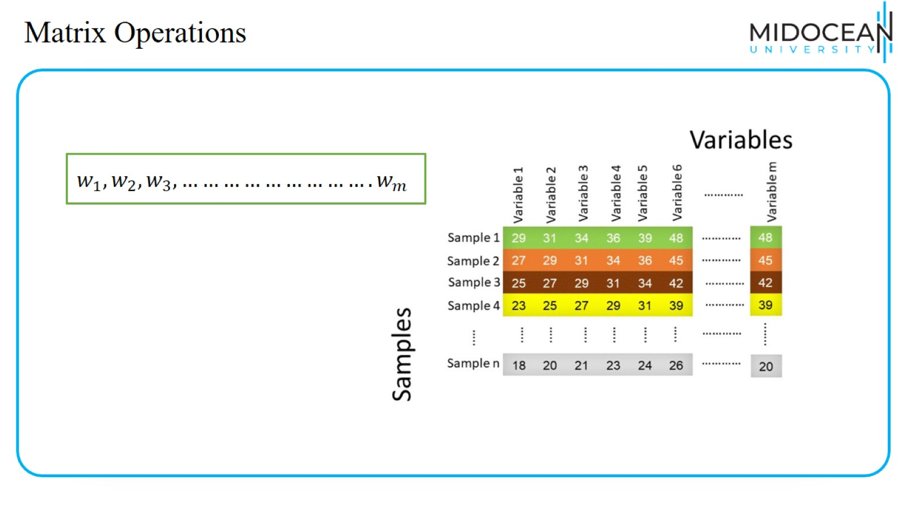
Matrix Operations

Slide 36
Matrix Operations

Slide 37
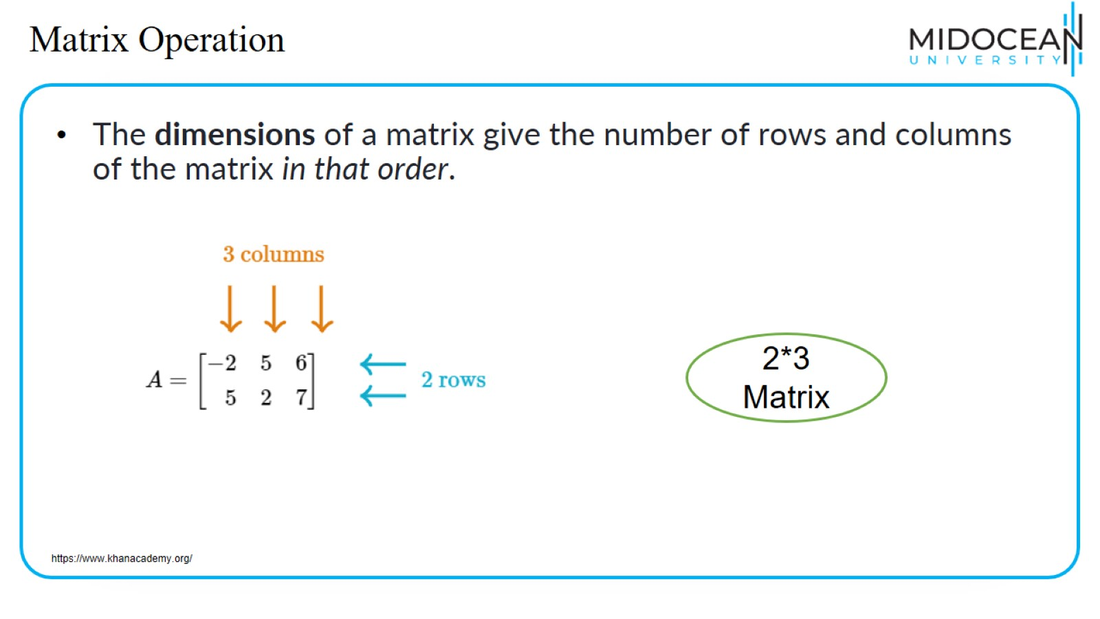
Matrix Operation

Slide 38
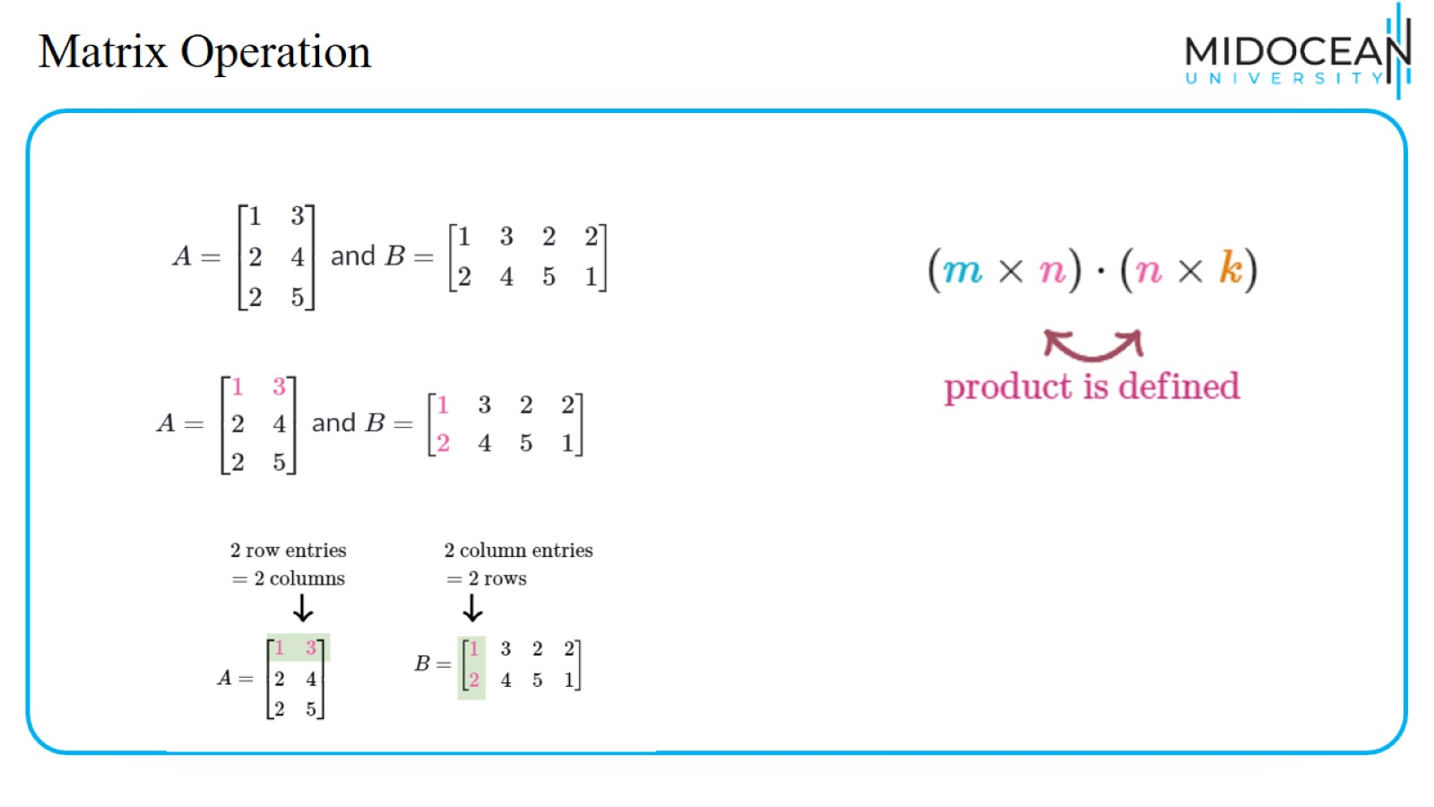
Matrix Operation

Slide 39
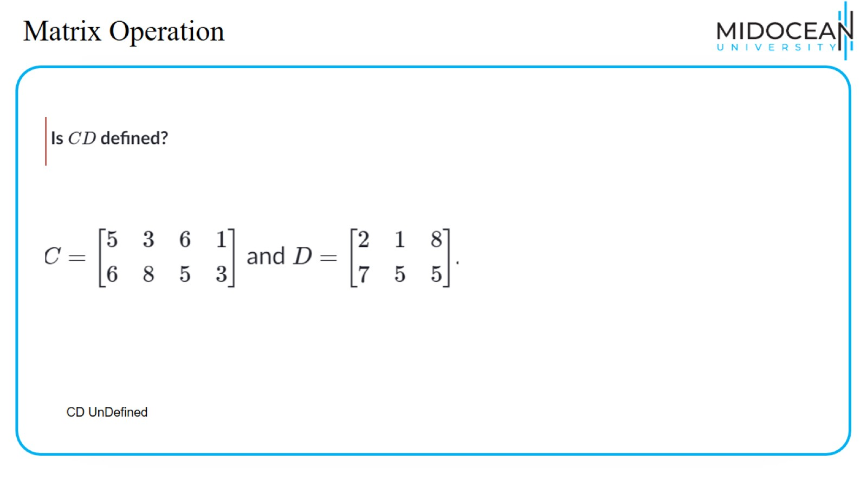
Matrix Operation

Slide 40
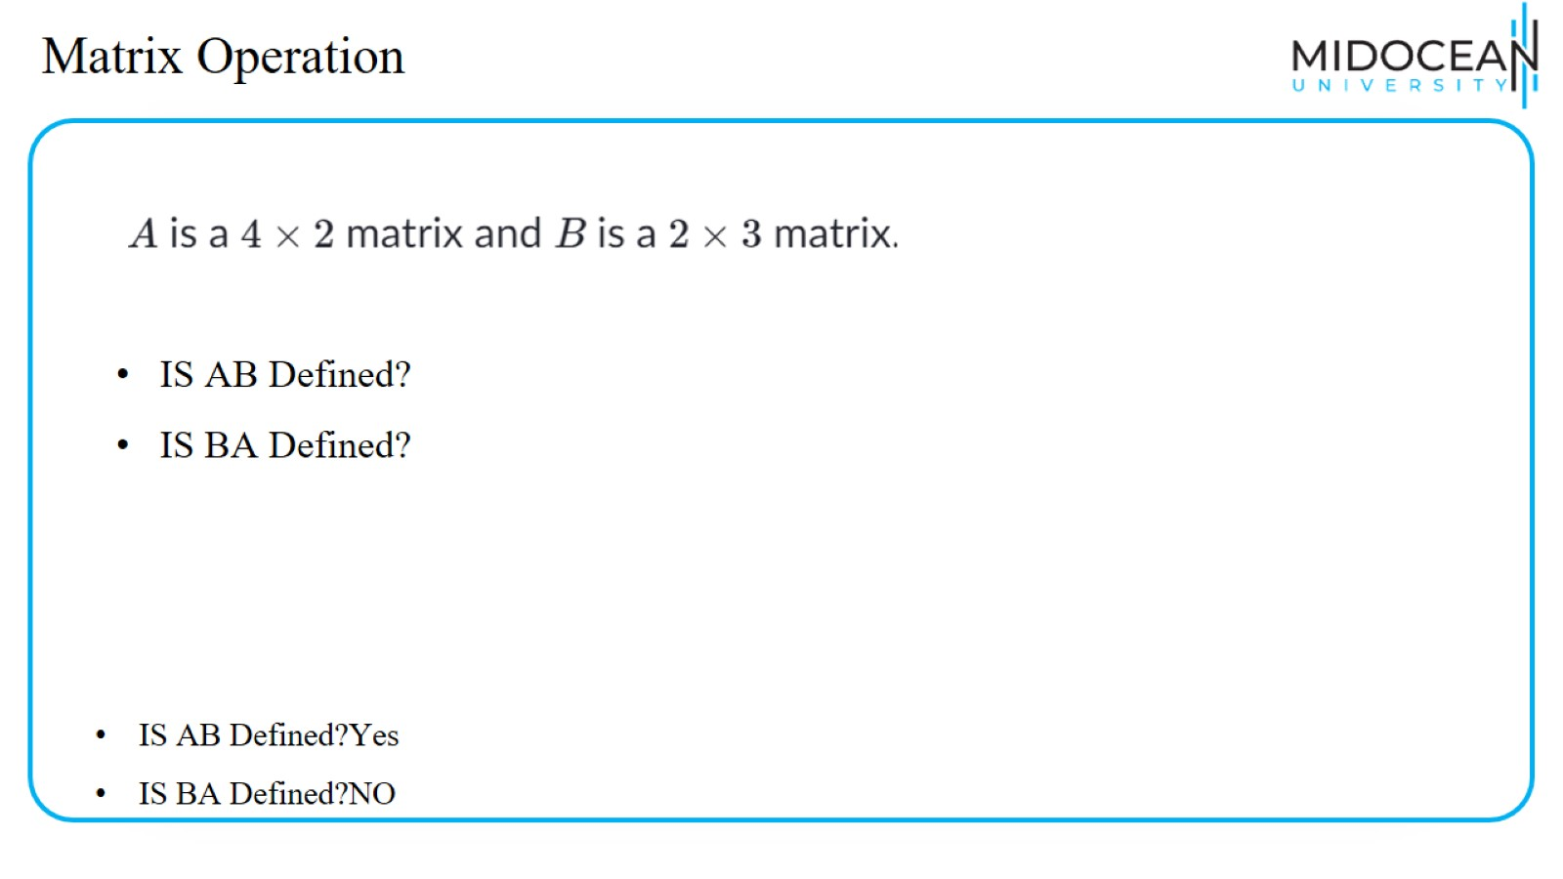
Matrix Operation

Slide 41
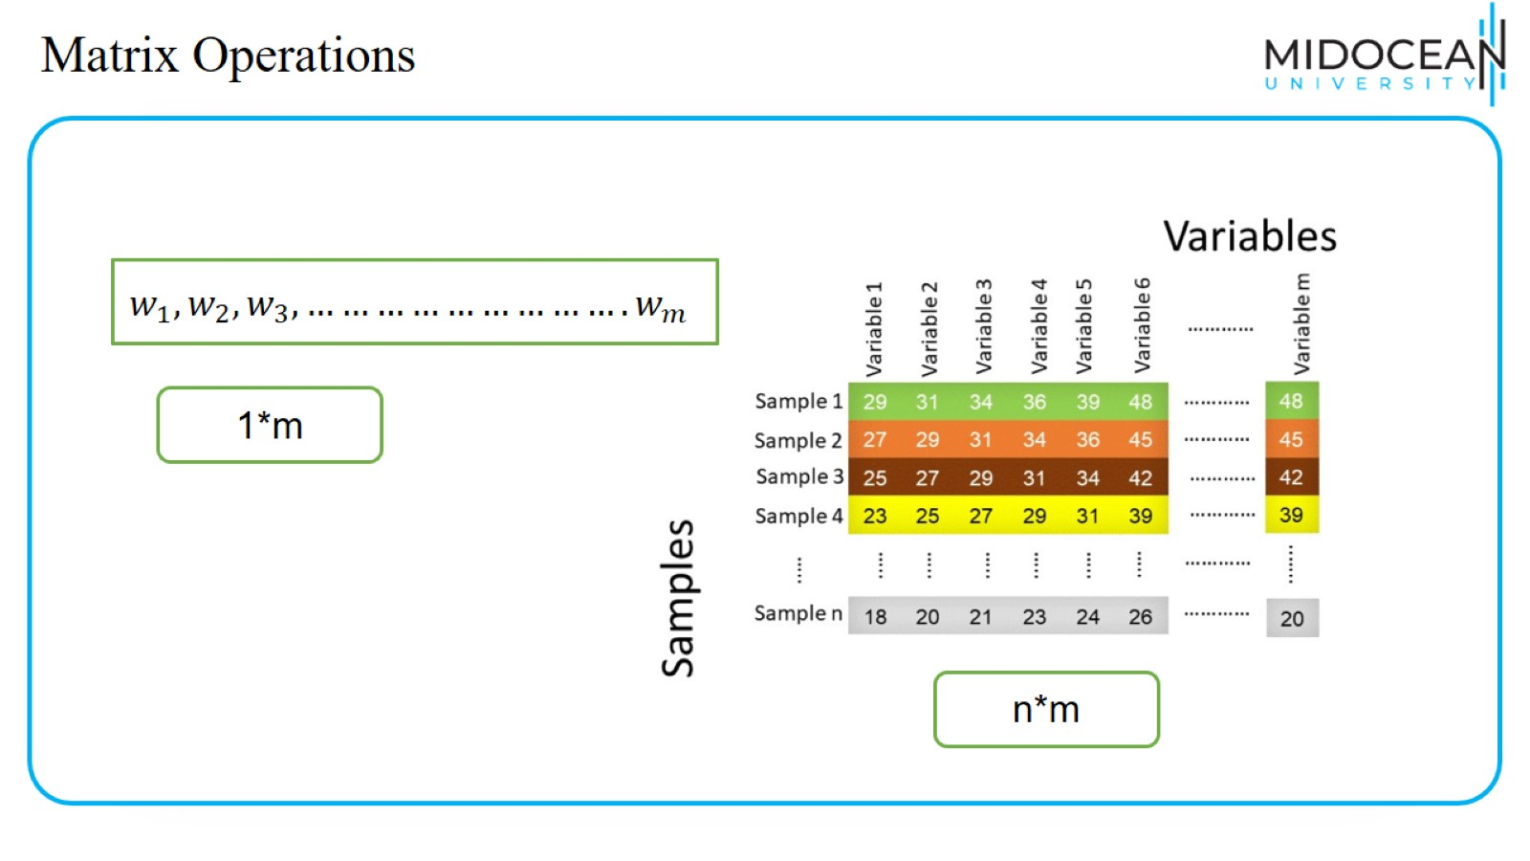
Matrix Operations

Slide 42
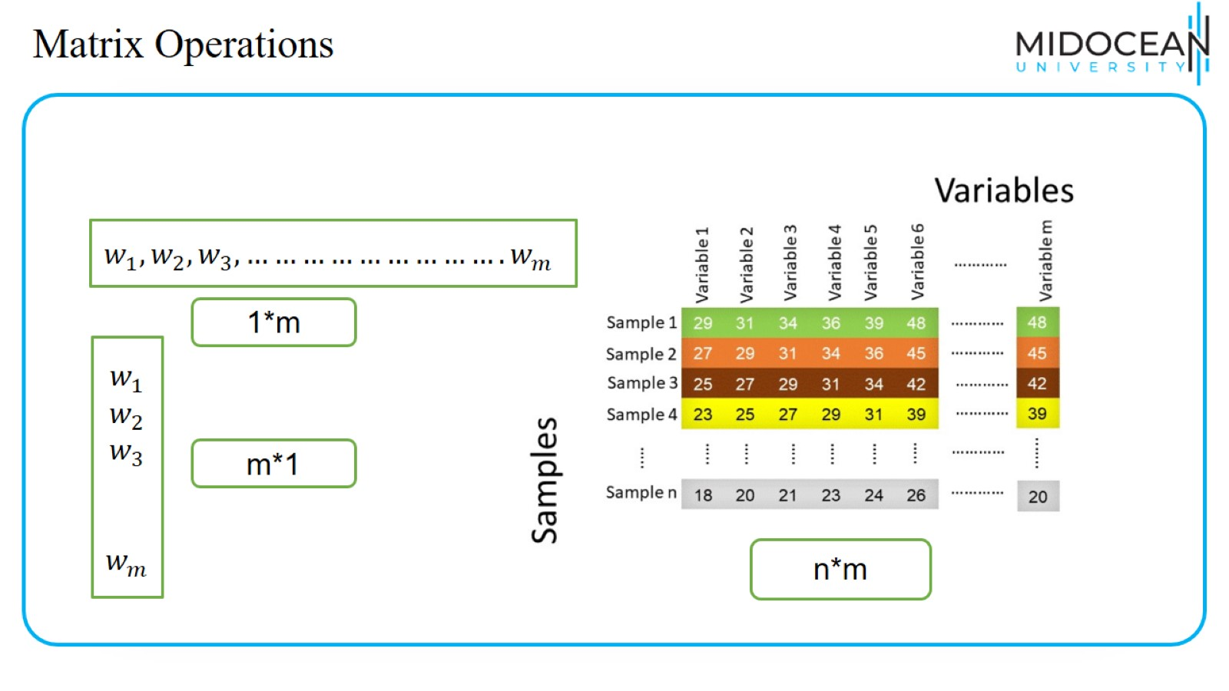
Matrix Operations

Slide 43
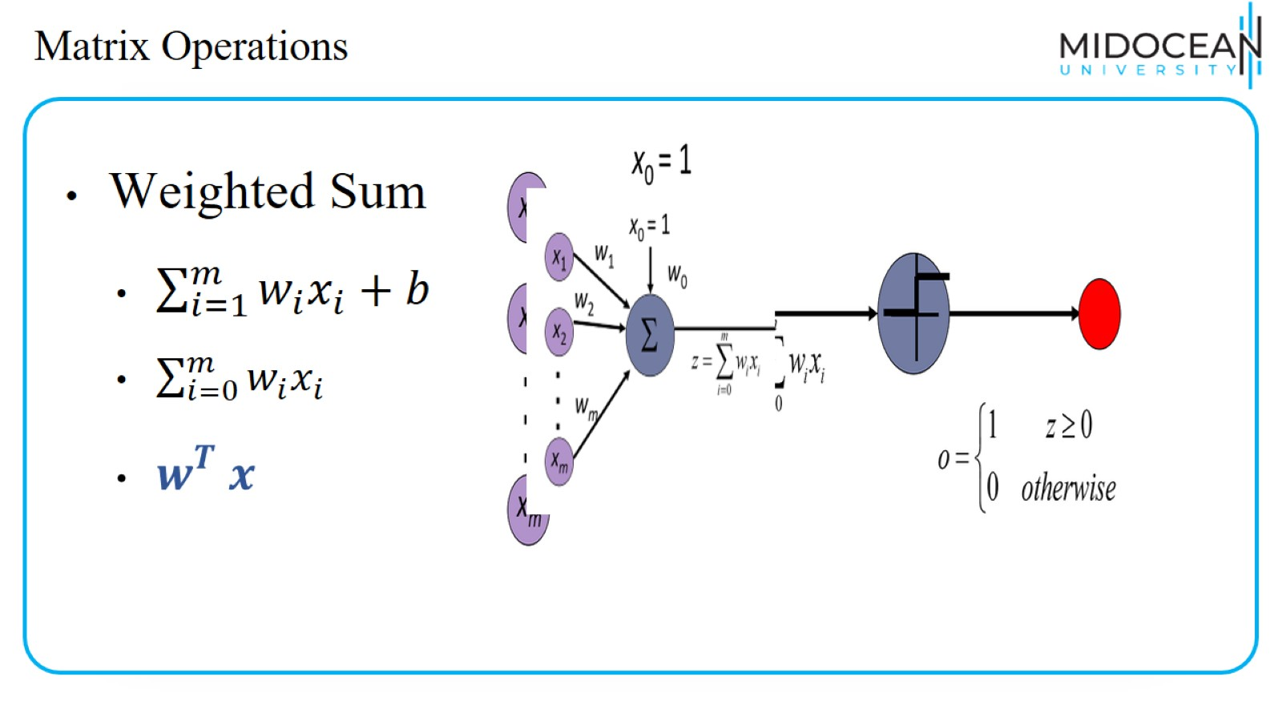
Matrix Operations

Slide 44

Learning the Network

Slide 45
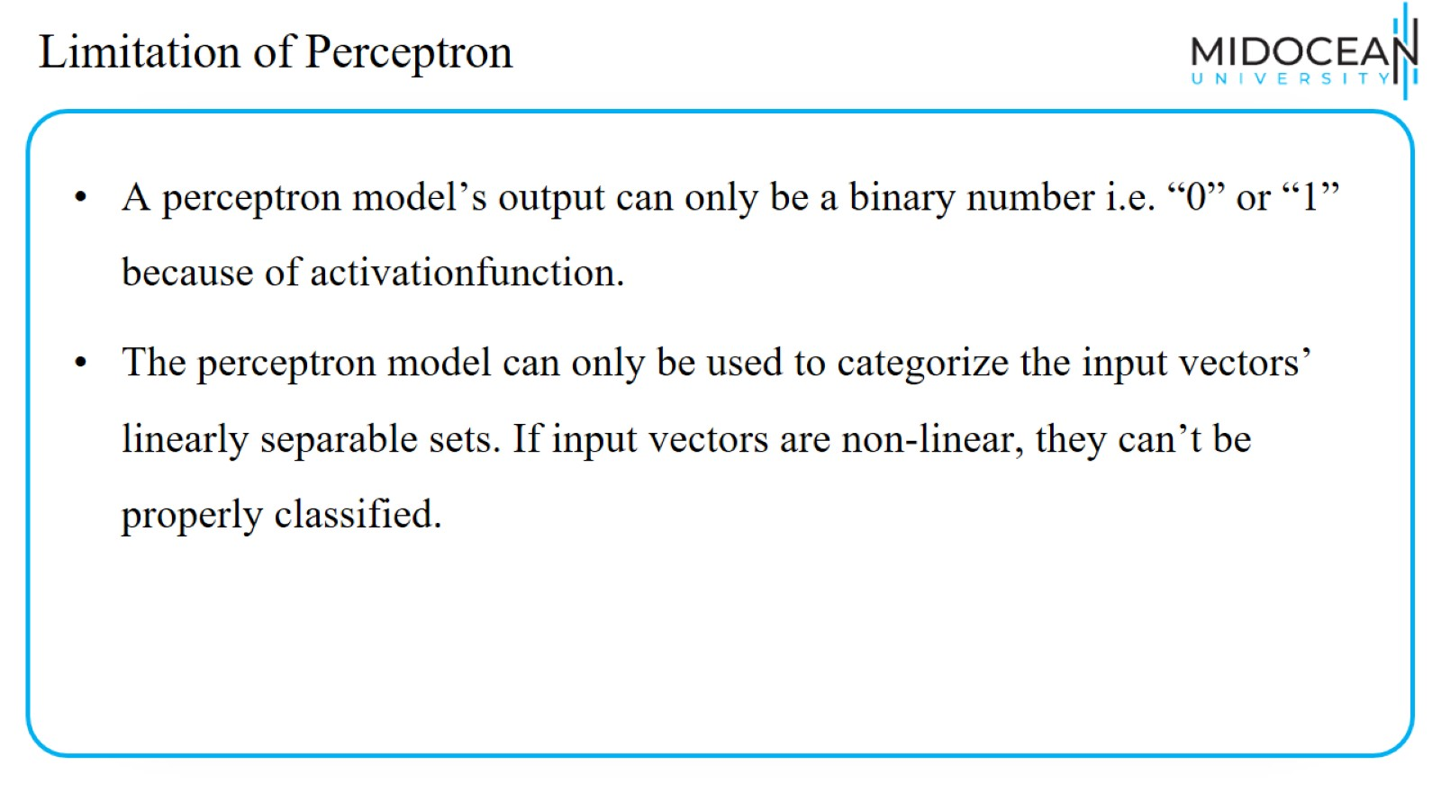
Limitation of Perceptron

Slide 46
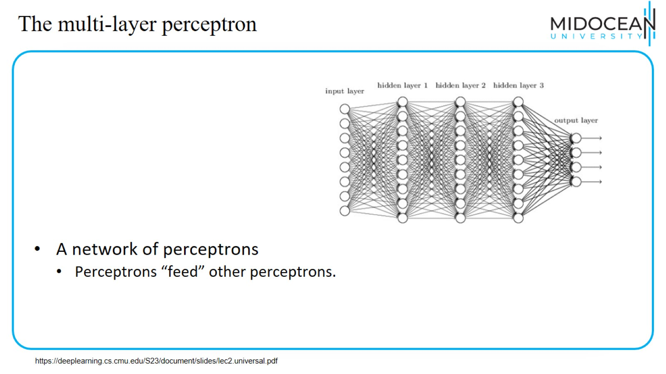
The multi-layer perceptron

Slide 47
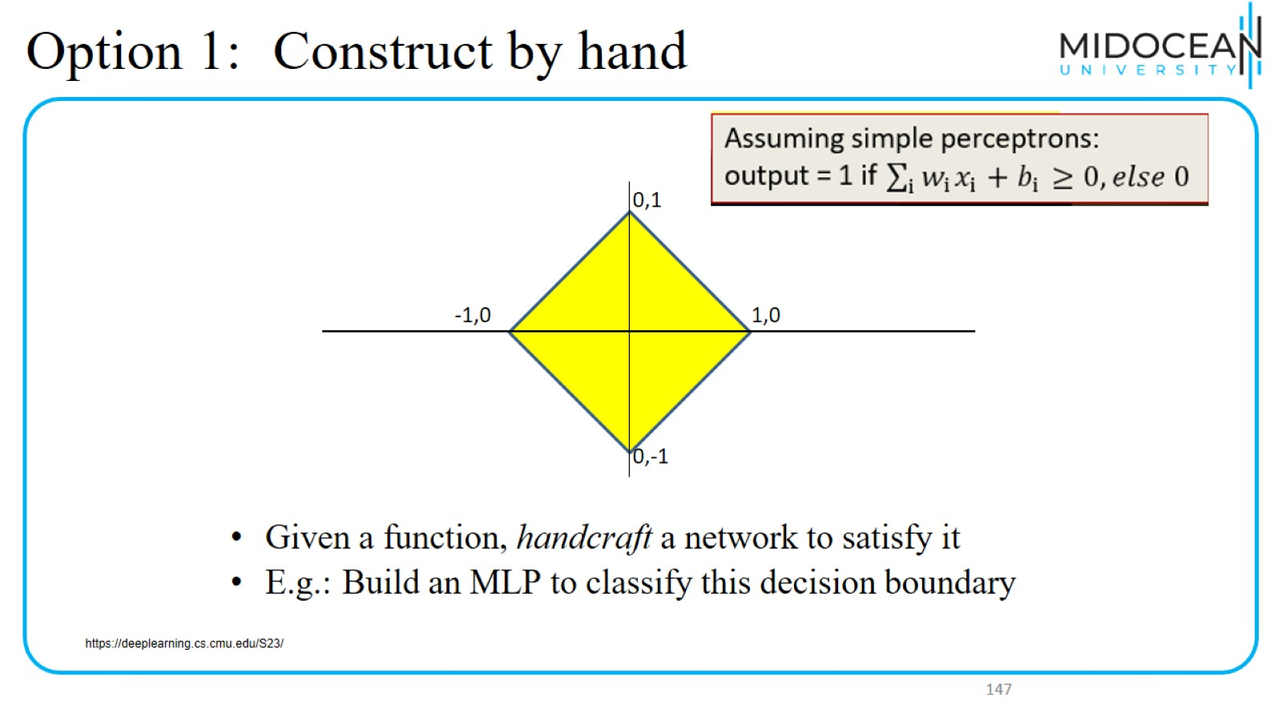
Option 1: Construct by hand

Slide 48
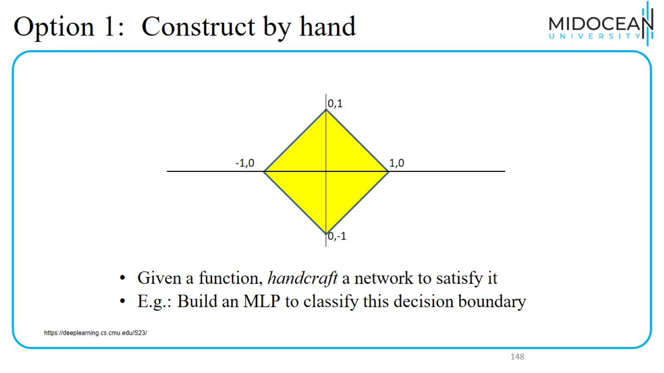
Option 1: Construct by hand

Slide 49
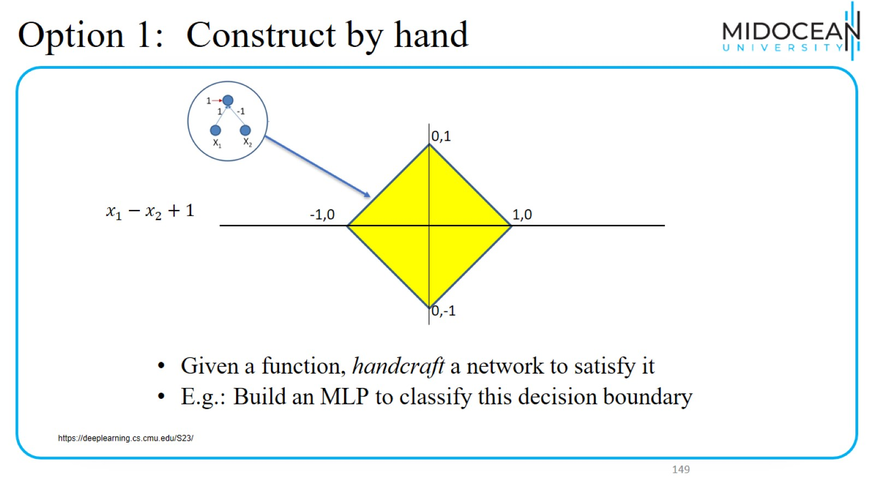
Option 1: Construct by hand

Slide 50
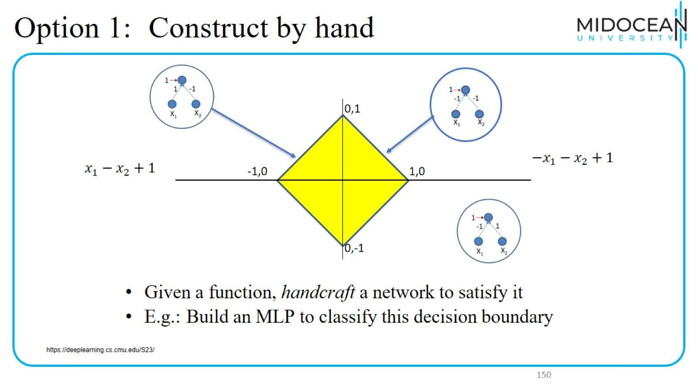
Option 1: Construct by hand

Slide 51
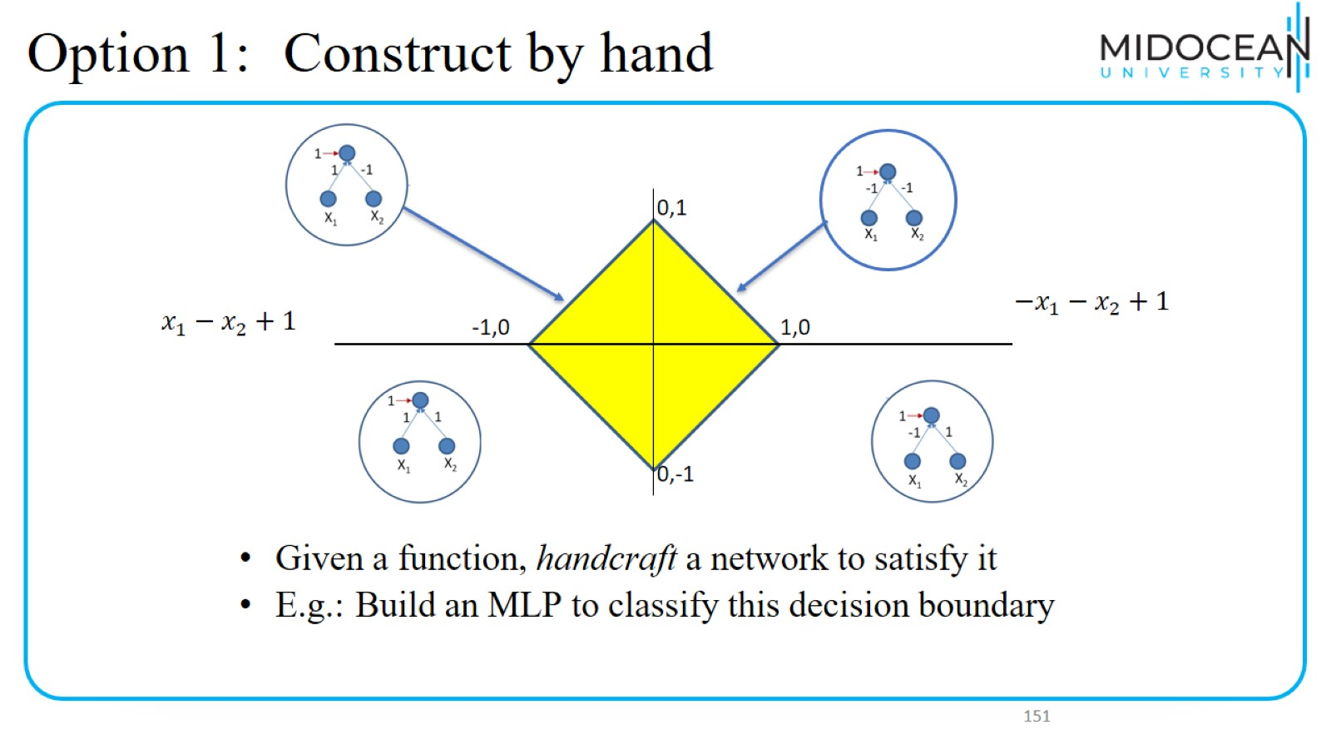
Option 1: Construct by hand

Slide 52
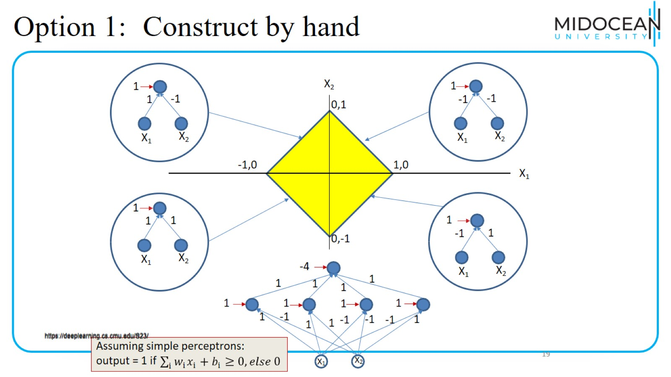
Option 1: Construct by hand

Slide 53
Option 1: Construct by hand

Slide 54
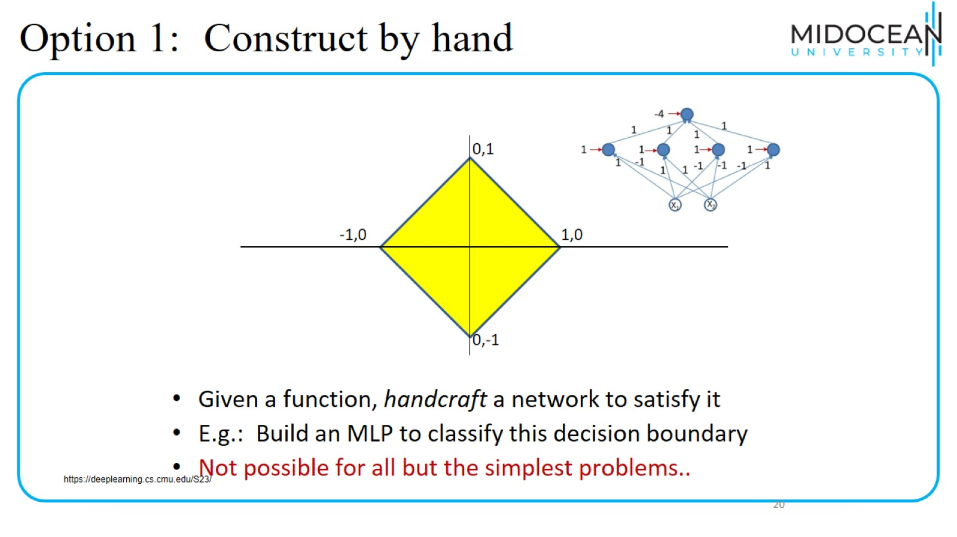
Option 1: Construct by hand

Slide 55

Summary

Slide 56


