Slide 1



Ethical Hacking Essentials (EHE)
Dr. Kamal Alieyan
Orientation Show
عرض توجيهي

Slide 2

دورة الهاكر الأخلاقي
Orientation Show
عرض توجيهي
المحاضر:
د. كمال عليان

Slide 3
Who Am I?
Dr. Kamal Alieyan
  Assistant Professor in Cybersecurity
    Ph.D from USM, Malaysia, Jun. 2018.
    M.Sc from “University of Arab Academy for Banking and Financial Science”/ Jordan, Sep.2005.
    B.Sc from “Mu’tta University” / Jordan, Jun.2003.

Slide 4



Who Am I?
  Office hours
  Discussion Time (Sunday at 9:00 PM) every week
https://scholar.google.com/scholar?hl=en&as_sdt=0%2C5&q=Kamal+Alieyan&btnG=&oq=kama
https://www.scopus.com/authid/detail.uri?authorId=57000386100
https://orcid.org/0000-0002-9021-3151

Slide 5
The course that will be taught
Ethical Hacking Essentials (EHE) is a security program covering the fundamental concepts of information security and ethical hacking.
It equips students with the skills required to identify the increasing information security threats which reflect on the security posture of the organization and implement general security controls.

Slide 6
Primary Goal of This Course
This course designed to help students to establish and govern minimum standards for credentialing entry-level information security specialists in ethical hacking measures, inform the public that credentialed individuals meet or exceed the minimum standards, and reinforce ethical hacking as a unique and self-regulating profession.

Slide 7
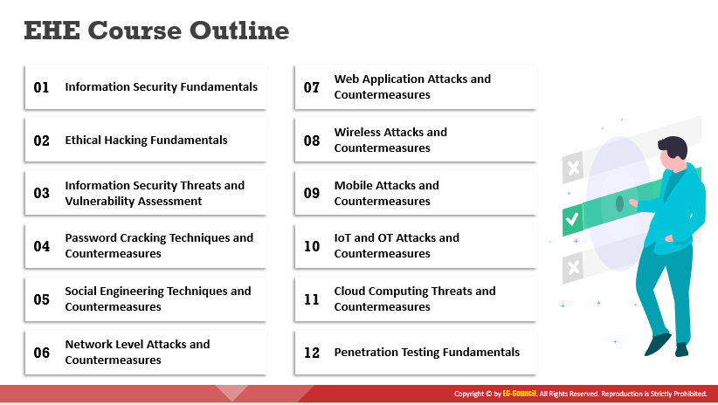
Outline of Course

Slide 8
Units of Course Contents:
# | Course Unit | No.of. Weeks | Contact Hours
1 | Lecture_1_ Module 01 – Information Security Fundamentals | 1st | 3
2 | Lecture_2_ Module 02 – Ethical Hacking Fundamentals | 2nd | 3
3 | Lecture_3_Module 03 – Information Security Threats | 3 | 3
3, 4 | Lecture_4_Module 03 Vulnerability and Vulnerability Assessment Module 04- Password Cracking Techniques and Countermeasures | 4 | 3
5 | Lecture_5_Module 05 Social Engineering Techniques and Countermeasures | 5 | 3
6 | Lecture_6 Module 06- Network Level Attacks and Countermeasures | 6 | 3
7 | Lecture_7 Module 07- Web Application Attacks and Countermeasures | 7 | 3
7, 8 | Lecture_8 Module 07 - SQL Injection Attacks and Countermeasures Module 08 Wireless Attacks and Countermeasures | 8 | 3
9 | Lecture_9_Module 09 Mobile Attacks and Countermeasures | 9 | 3
10 | Lecture_10_Module 09 IoT Attacks and Countermeasures | 10 | 3

Slide 9
Course Information
Assessment Method:
Short Exam
  80% marks
    Count of short Exam 10 (Weekly)
    8 Marks for every each of short Exam.
  20% Final Examination

Slide 10


Thank You

