Slide 1
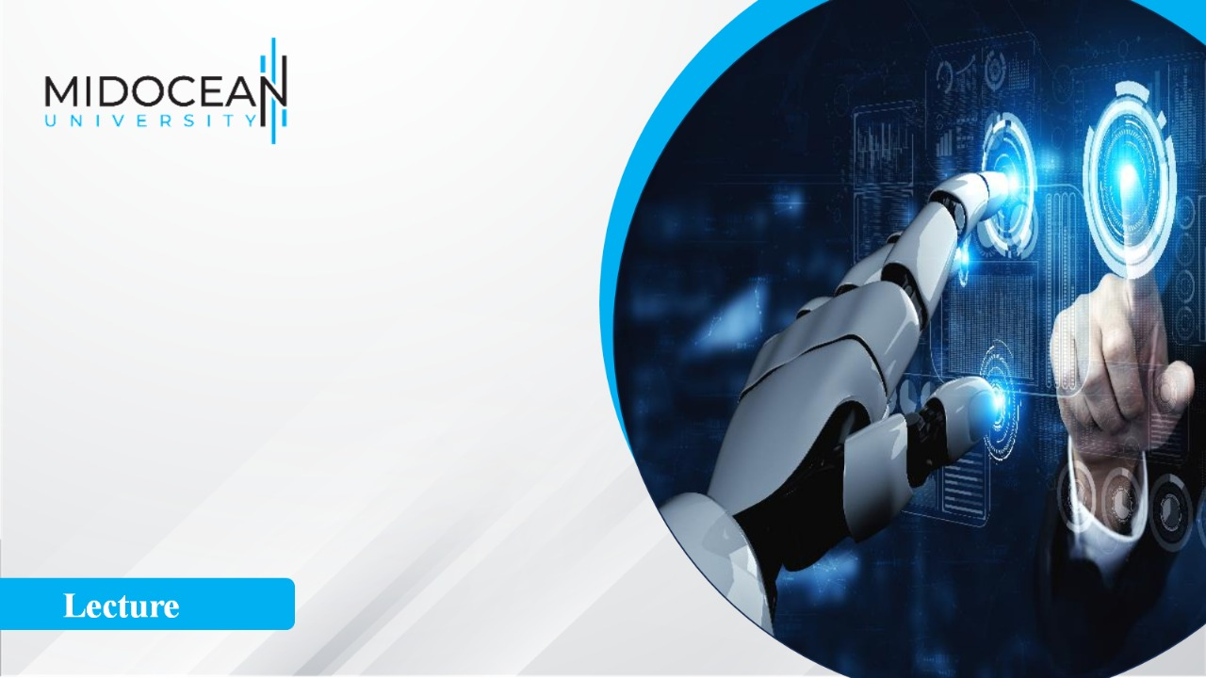
Digital
Consumer Behavior
Dr. Perihan Salah
MKT713
Master of Digital Marketing
Impact of Artificial Intelligence
on Consumer Behavior
Lecture 10

Slide 2
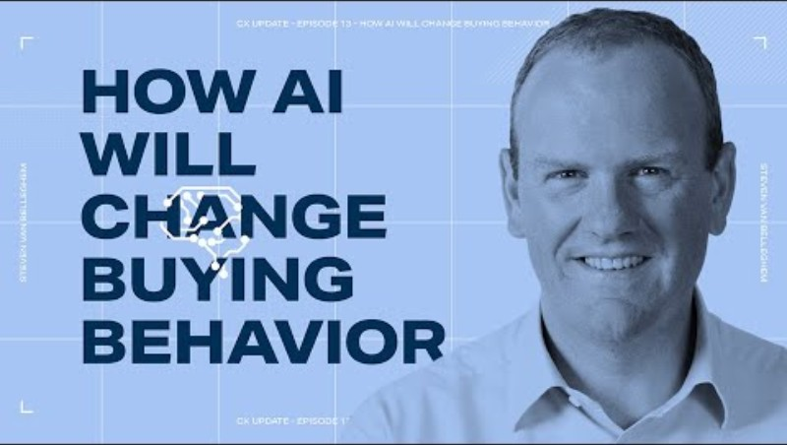

Slide 3
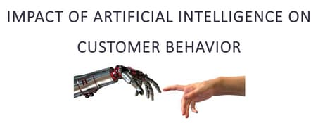
The Impact of Artificial Intelligence on Consumer Behavior
1. Introduction
Artificial Intelligence (AI) has emerged as a transformative force in the digital marketplace, significantly reshaping consumer behavior.
Through advanced data analytics, machine learning, and automation, AI enables highly personalized, efficient, and predictive interactions between consumers and brands.
This transformation has shifted consumer behavior from passive browsing to active, data-driven engagement, fundamentally altering how purchasing decisions are made.

Slide 4
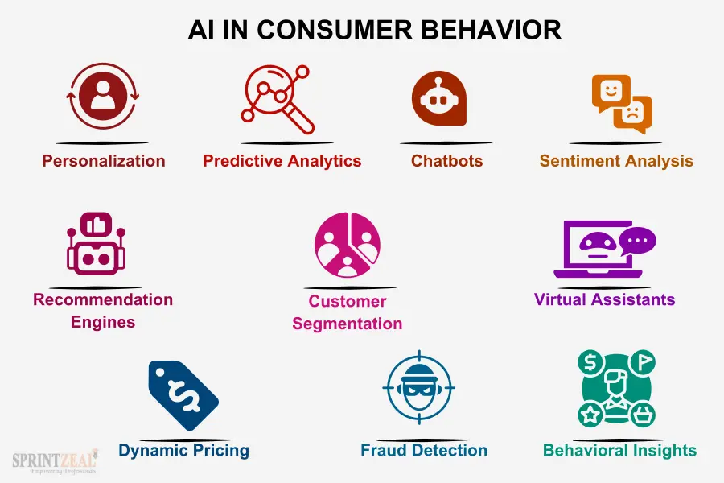
The Impact of Artificial Intelligence on Consumer Behavior

Slide 5
The Impact of Artificial Intelligence on Consumer Behavior
Artificial Intelligence (AI) has emerged as one of the most influential technological advancements shaping modern consumer behavior.
In today’s digital economy, AI is no longer a futuristic concept but a practical tool embedded in everyday consumer interactions, from online shopping to social media engagement.
AI enables businesses to collect, analyze, and interpret vast amounts of consumer data in real time. This capability allows organizations to understand consumer preferences, predict future behavior, and deliver highly personalized experiences.

Slide 6

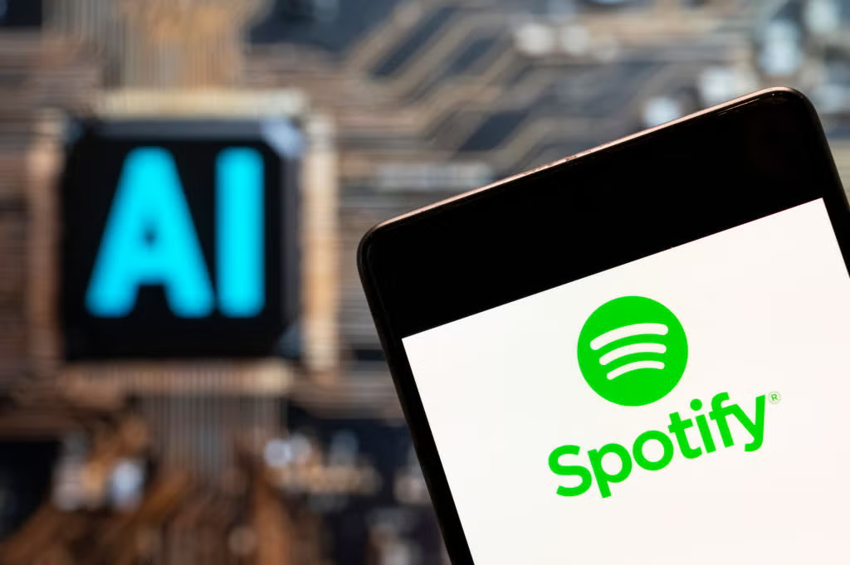
The Impact of Artificial Intelligence on Consumer Behavior
That is a spot-on assessment. We've moved from the "wow" factor of AI to it being the invisible engine under the hood of almost every digital experience.
It’s transformed from a novelty into a utility in a few key ways:
Hyper-Personalization: Whether it's a "Recommended for You" tray on Shahid or a curated Spotify playlist, AI is constantly analyzing patterns to predict what you’ll want next.
Customer Support: Chatbots have evolved from frustrating scripts to sophisticated assistants capable of handling complex troubleshooting and returns in real-time.

Slide 7
The Impact of Artificial Intelligence on Consumer Behavior
That is a spot-on assessment. We've moved from the "wow" factor of AI to it being the invisible engine under the hood of almost every digital experience.
It’s transformed from a novelty into a utility in a few key ways:
Visual Discovery: Tools like Google Lens or Pinterest's visual search allow consumers to find products simply by taking a photo, bridging the gap between the physical and digital worlds.
Content Creation: On social media, AI algorithms don't just sort content; they help creators edit videos, generate captions, and reach the specific audiences most likely to engage.
Essentially, AI has shifted the consumer expectation from "I have to find it" to "It should find me."

Slide 8
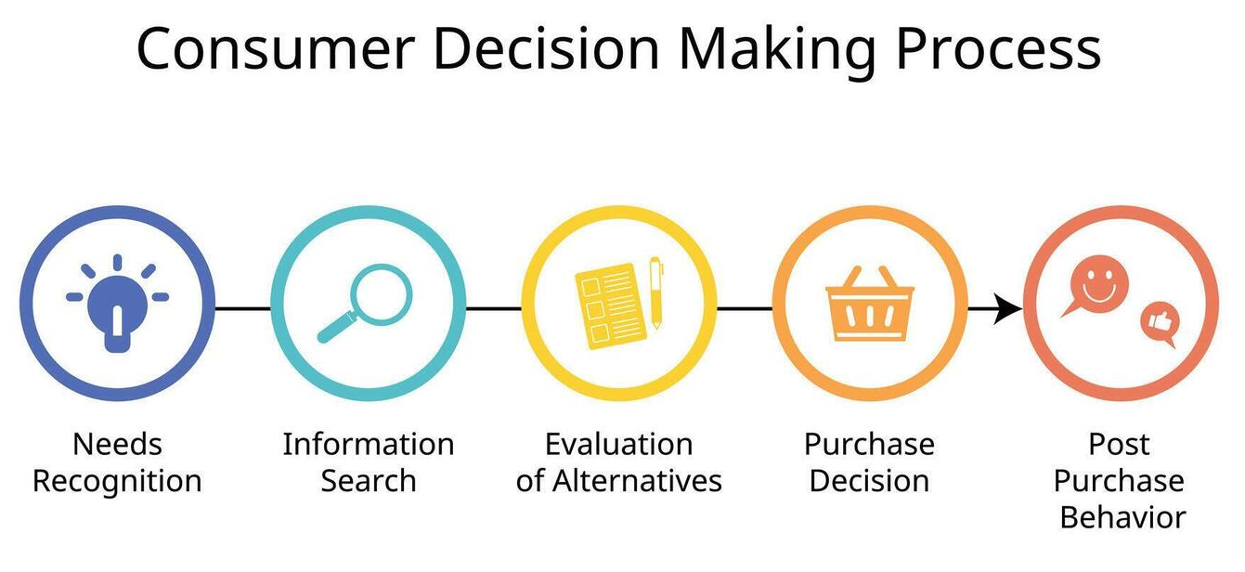
The Impact of Artificial Intelligence on Consumer Behavior
Unlike traditional marketing approaches, which relied on mass communication and general segmentation, AI-driven marketing focuses on individual-level targeting.
This shift has fundamentally transformed the way consumers:
Search for information,
Evaluate alternatives, and
Make purchase decisions.
AI has redefined the relationship between consumers and brands.
Consumers are no longer passive recipients of marketing messages; instead, they
actively engage with intelligent systems that respond to their needs instantly.
This transformation has significant implications for consumer psychology, decision-making processes, and overall market dynamics.

Slide 9
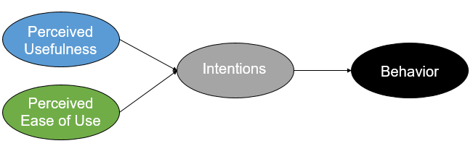
2. Foundations of Consumer Technology Adoption
2.1 Theoretical Frameworks
Understanding consumer interaction with AI technologies is grounded in two key models: the Technology Acceptance Model (TAM) and the Diffusion of Innovation (DOI) theory.
TAM explains user adoption based on:
Perceived Usefulness (PU)
Perceived Ease of Use (PEOU)

Slide 10
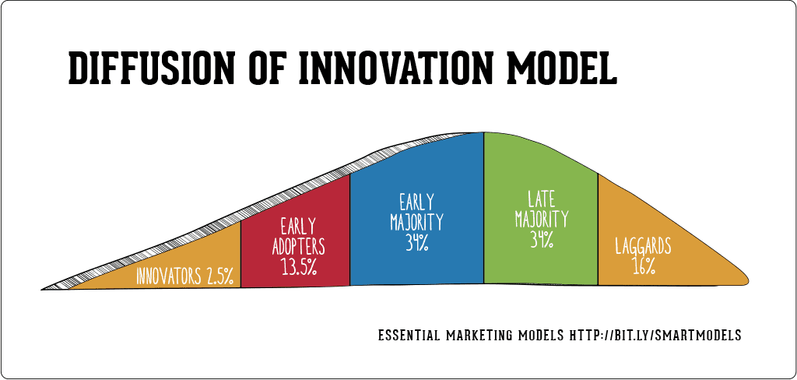
2. Foundations of Consumer Technology Adoption
2.1 Theoretical Frameworks
Understanding consumer interaction with AI technologies is grounded in two key models: the Technology Acceptance Model (TAM) and the Diffusion of Innovation (DOI) theory.
DOI categorizes consumers into:
Innovators
Early adopters
Early majority
Late majority
Laggards
These frameworks provide a foundation for analyzing how consumers accept AI-driven systems.

Slide 11
2. Foundations of Consumer Technology Adoption
Consumer adoption of AI technologies is influenced by
Trust and perceived security
Digital literacy and self-efficacy
Compatibility with user needs
Social influence
2.2 Drivers of Technology Adoption
These factors directly affect how consumers interact with AI-powered platforms and marketing tools.
The adoption of AI technologies by consumers can be understood through well-established theoretical frameworks such as the Technology Acceptance Model (TAM) and the Diffusion of Innovation (DOI) theory.

Slide 12
2. Foundations of Consumer Technology Adoption
The Technology Acceptance Model (TAM) explains that individuals are more likely to adopt a technology if they perceive it as useful and easy to use. Perceived usefulness refers to the extent to which a person believes that using a particular system will enhance their performance, while perceived ease of use refers to the degree to which using the system is free of effort.
On the other hand, the Diffusion of Innovation (DOI) theory categorizes consumers into five groups: innovators, early adopters, early majority, late majority, and laggards. These categories reflect how quickly individuals adopt new technologies.

Slide 13
2. Foundations of Consumer Technology Adoption
In addition to these frameworks, several factors influence consumer adoption of AI technologies. These include:
trust in technology,
perceived security,
social influence,
compatibility with existing habits, and
digital literacy.
For instance, younger consumers tend to adopt AI-driven platforms more quickly due to their familiarity with digital environments.
Understanding these theoretical foundations is crucial because they help explain why some consumers readily embrace AI technologies while others resist them.

Slide 14
3. Key Impacts of AI on Consumer Behavior
Hyper-Personalization: One of the most significant impacts of AI on consumer behavior is hyper-personalization. AI systems analyze browsing history, purchase patterns, and behavioral data to provide tailored recommendations. This level of personalization enhances consumer satisfaction and increases the likelihood of purchase.
2. Predictive Purchasing: Predictive purchasing is another major impact. AI algorithms can anticipate consumer needs before they are explicitly expressed. For example, online retailers may recommend products based on previous purchases or browsing activity, reducing the effort required from consumers.
3. AI Influencers & Virtual Assisstants: Rise of AI-driven influencers and chatbots creates new channels for marketing, although consumers still often prefer human interaction for complex inquiries.

Slide 15
3. Key Impacts of AI on Consumer Behavior
Enhanced Decision Making: AI also enhances consumer decision-making by providing access to curated information, product comparisons, and reviews. This reduces uncertainty and increases confidence in purchasing decisions.
Increased Impulse Buying: Furthermore, AI contributes to increased impulse buying. By presenting personalized offers at the right time, AI can trigger spontaneous purchases. This is particularly evident in online retail environments where consumers are constantly exposed to targeted advertisements.

Slide 16
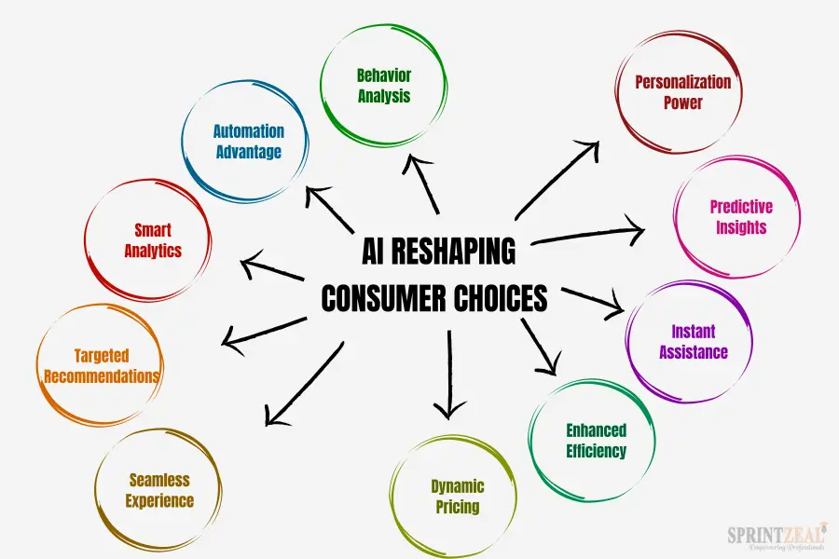
3. Key Impacts of AI on Consumer Behavior
AI-powered chatbots and virtual assistants have transformed customer interaction.
These tools provide instant responses, guide consumers through the purchase process, and offer personalized assistance, thereby improving the overall customer experience.

Slide 17
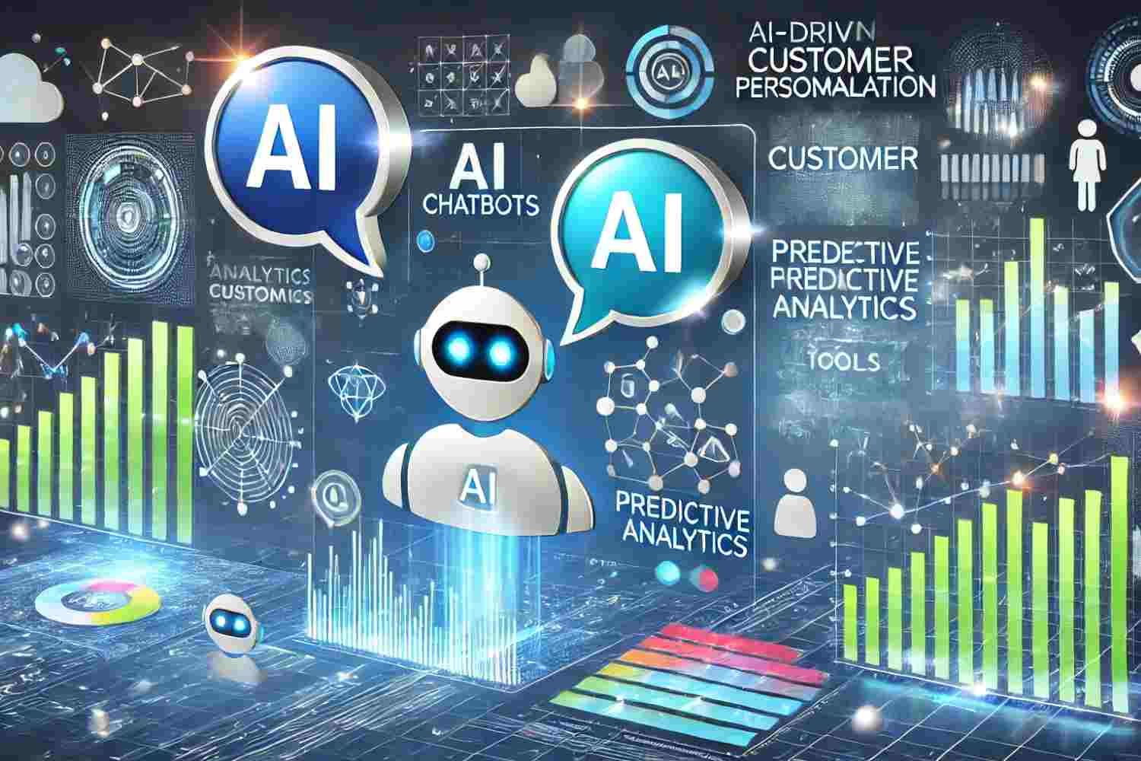
4. AI in the Digital Marketplace
AI technologies such as machine learning, natural language processing, and predictive analytics have revolutionized consumer experiences.
These tools enable:
Personalized content and recommendations
Real-time behavioral tracking
Sentiment analysis
As a result, consumers benefit from more efficient and customized interactions, while businesses achieve higher marketing effectiveness.

Slide 18
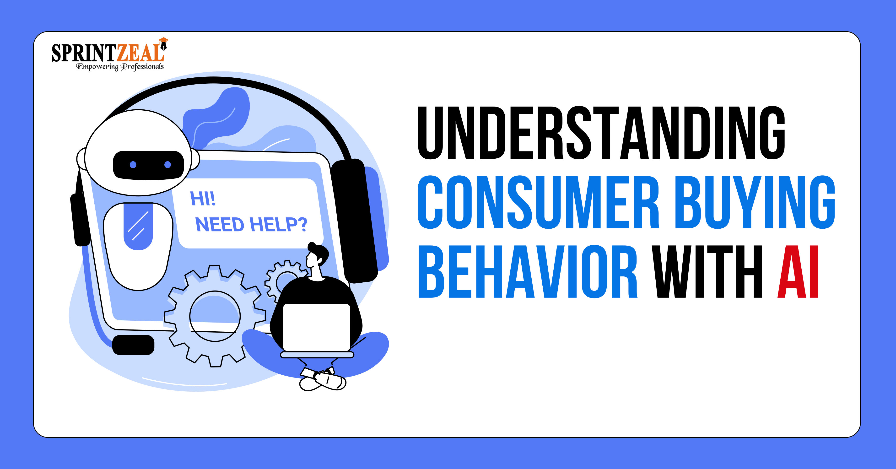
4. AI in the Digital Marketplace
In the digital marketplace, AI plays a critical role in shaping consumer experiences.
Technologies such as machine learning, natural language processing, and computer vision enable businesses to analyze consumer data and deliver personalized content.

Slide 19
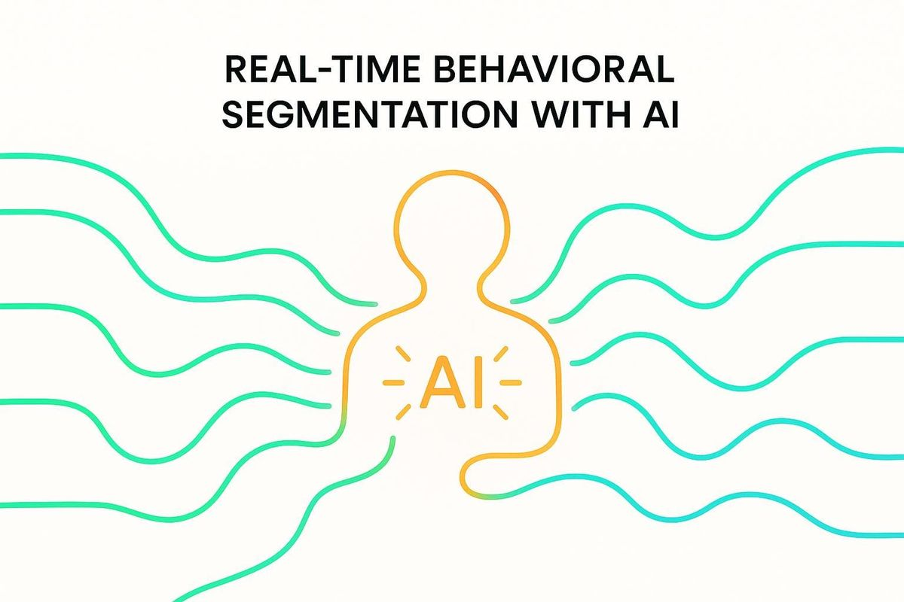
4. AI in the Digital Marketplace
AI-driven recommendation systems are widely used by platforms such as e-commerce websites and streaming services. These systems suggest products or content based on user preferences, thereby enhancing engagement and satisfaction.
AI enables real-time behavioral tracking, allowing businesses to adjust their marketing strategies dynamically.
For example, if a consumer shows interest in a particular product category, the system can immediately display relevant advertisements.

Slide 20
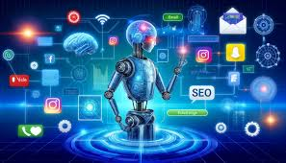
4. AI in the Digital Marketplace
Sentiment analysis is another important application of AI. By analyzing consumer feedback and social media interactions, businesses can understand consumer attitudes and adjust their strategies accordingly.
AI has transformed the digital marketplace into a highly interactive and personalized environment where consumers receive tailored experiences.

Slide 21
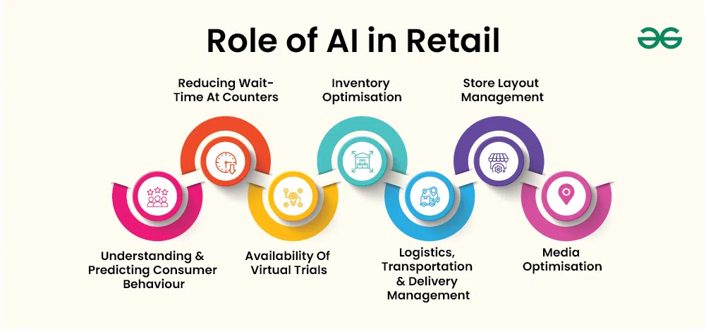
5. AI Applications in Online Retail
AI has significantly transformed the online retail industry by enhancing various aspects of the shopping experience.

Slide 22
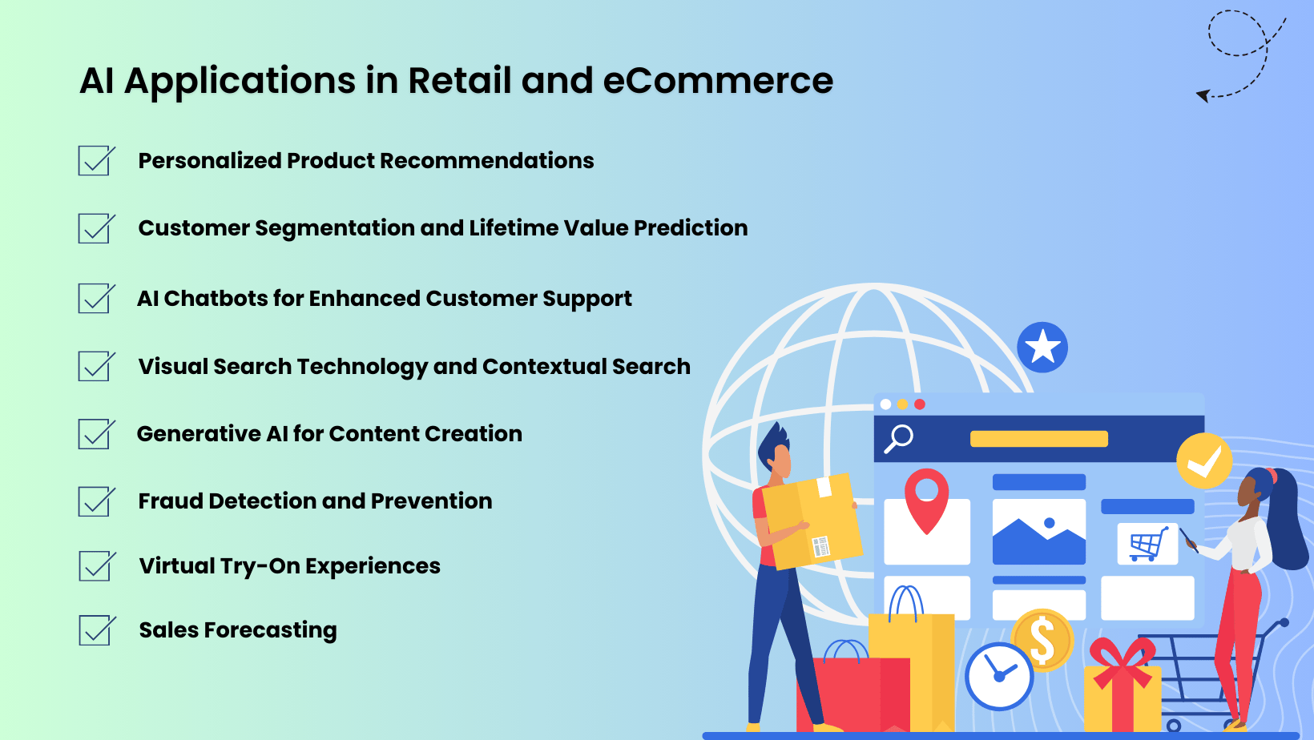

Slide 23
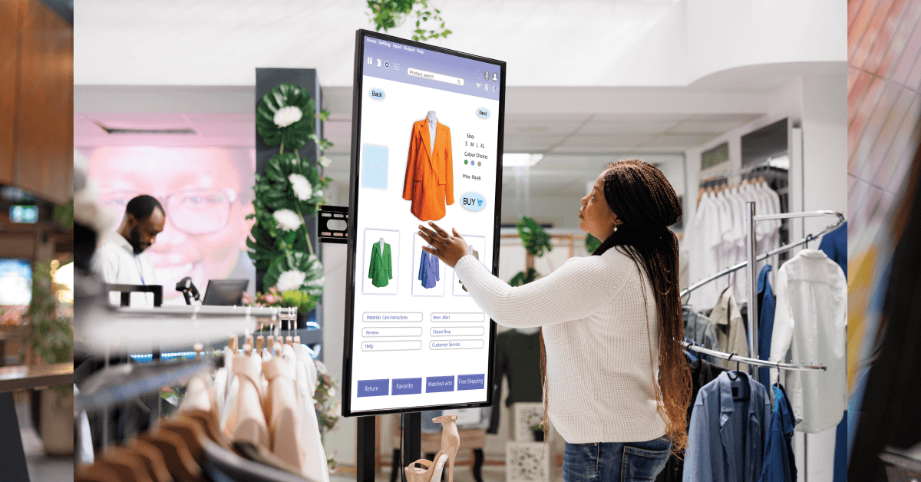
5. AI Applications in Online Retail
Personalization and Customer Experience
AI enables retailers to tailor product recommendations and marketing messages, leading to increased satisfaction and loyalty.
Personalization is a key application of AI in online retail.
Retailers use AI algorithms to analyze consumer data and provide customized product recommendations.
This not only improves customer
satisfaction but also increases sales.

Slide 24
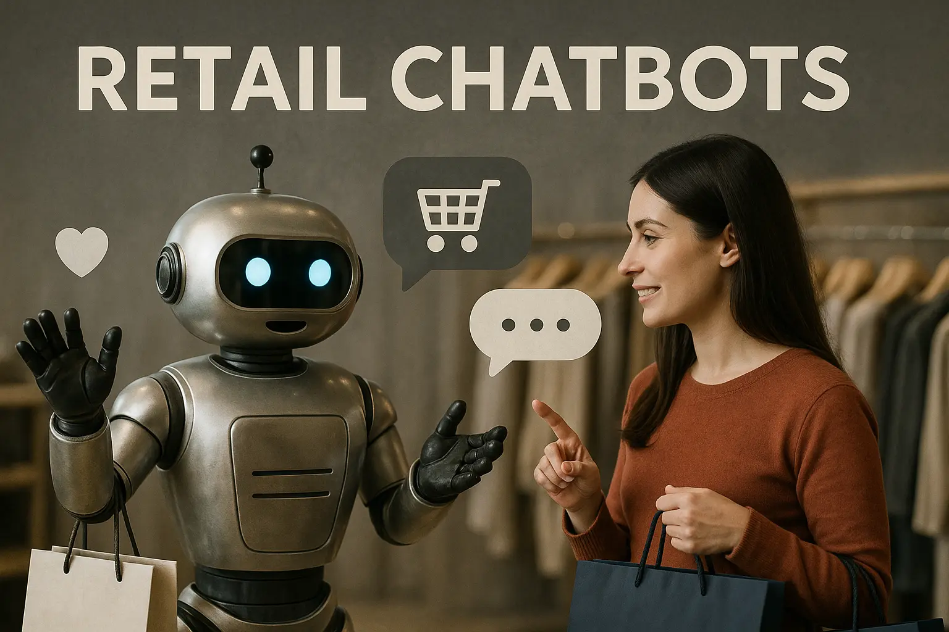
5. AI Applications in Online Retail
Chatbots and Customer Engagement
AI-powered chatbots enhance customer service by providing instant responses and personalized assistance throughout the customer journey.
Chatbots are widely used to enhance customer service. These AI-powered tools provide instant responses to customer inquiries, assist with product selection, and resolve issues efficiently.

Slide 25
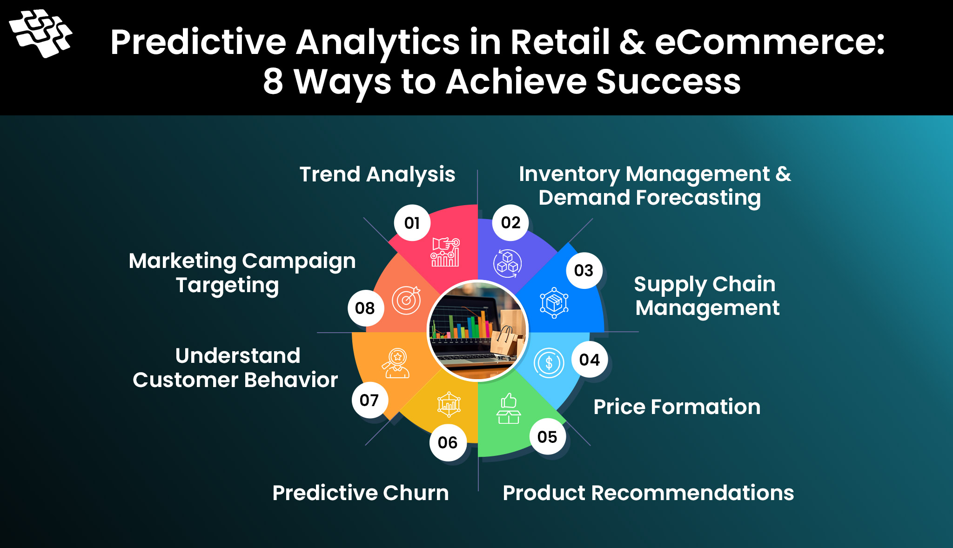
5. AI Applications in Online Retail
3. Predictive Analytics
Retailers use AI to forecast demand, optimize inventory, and identify emerging trends, improving operational efficiency.
Predictive analytics allows retailers to forecast demand and optimize inventory management.
By analyzing historical data, AI can identify trends and ensure that popular products are always available.

Slide 26
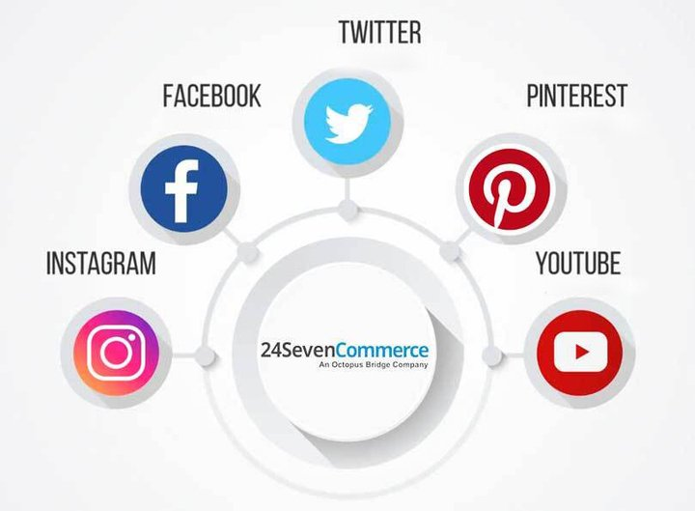
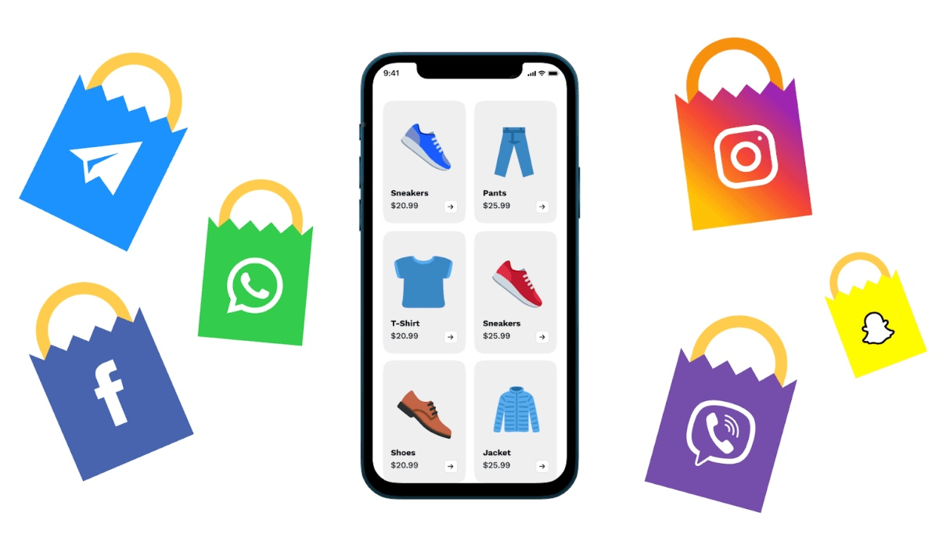
5. AI Applications in Online Retail
4. Social Media Marketing
AI analyzes user behavior on social platforms to create targeted campaigns and enhance consumer engagement.
AI also plays a crucial role in social media marketing.
By analyzing user behavior, AI can create targeted advertising campaigns that resonate with specific audiences.

Slide 27

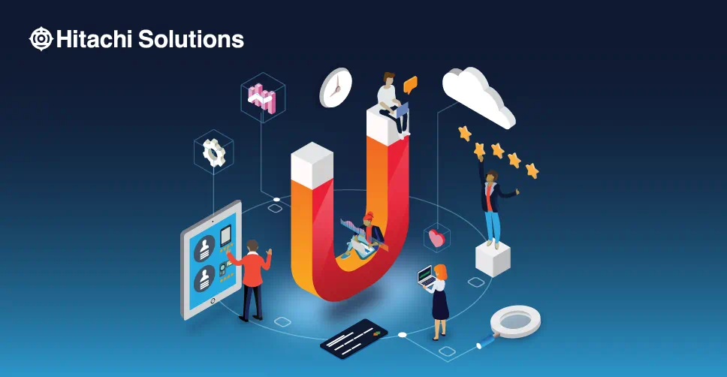
5. AI Applications in Online Retail
5. Consumer Loyalty
Personalized experiences and rewards programs strengthen customer relationships and encourage repeat purchases.
Furthermore, AI contributes to customer loyalty by enabling personalized rewards programs and improving overall customer experience.

Slide 28
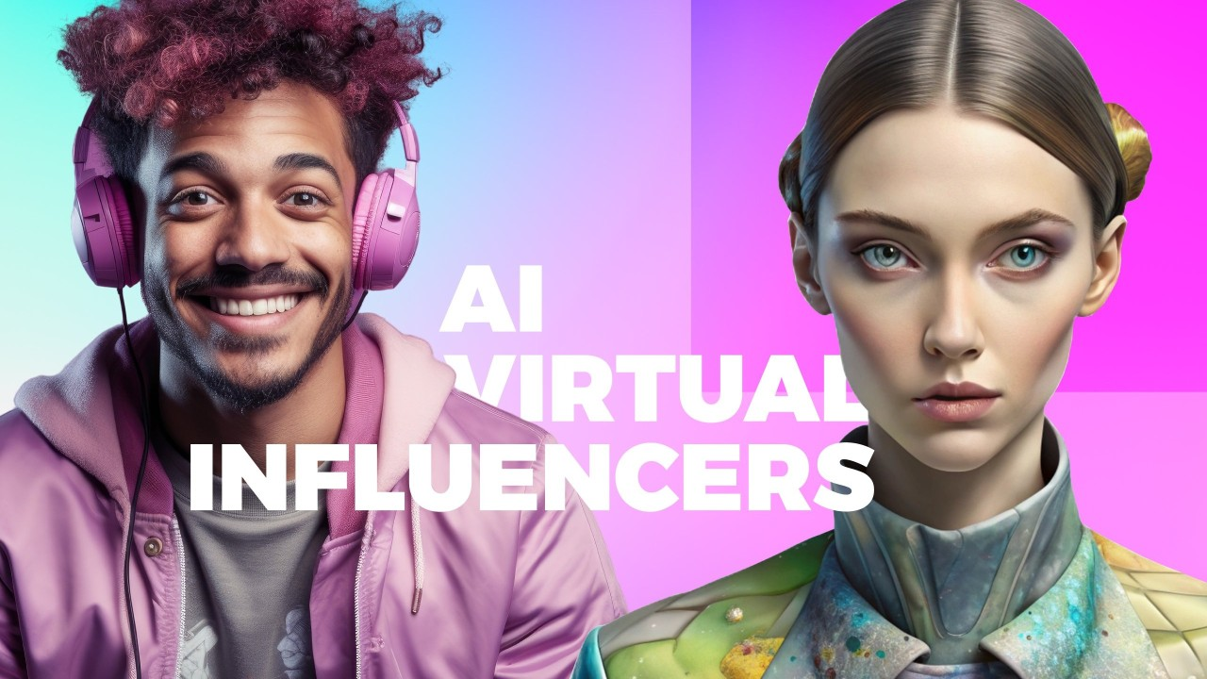
6. AI Influencers and Virtual Interaction
AI influencers are virtual characters created using computer-generated imagery and artificial intelligence.
These influencers are used by brands to promote products and engage with audiences on social media.
One of the main advantages of AI
influencers is that they are fully
controllable.

Slide 29
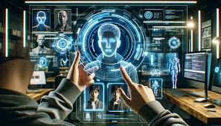
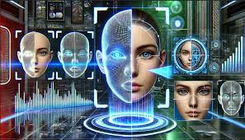
6. AI Influencers and Virtual Interaction
Brands can design their behavior, appearance, and messaging to align with marketing objectives.
AI influencers also eliminate risks associated with human influencers, such as scandals or inconsistent behavior.
However, despite these advantages, AI influencers may lack authenticity and emotional connection, which are important factors in building trust with consumers.

Slide 30

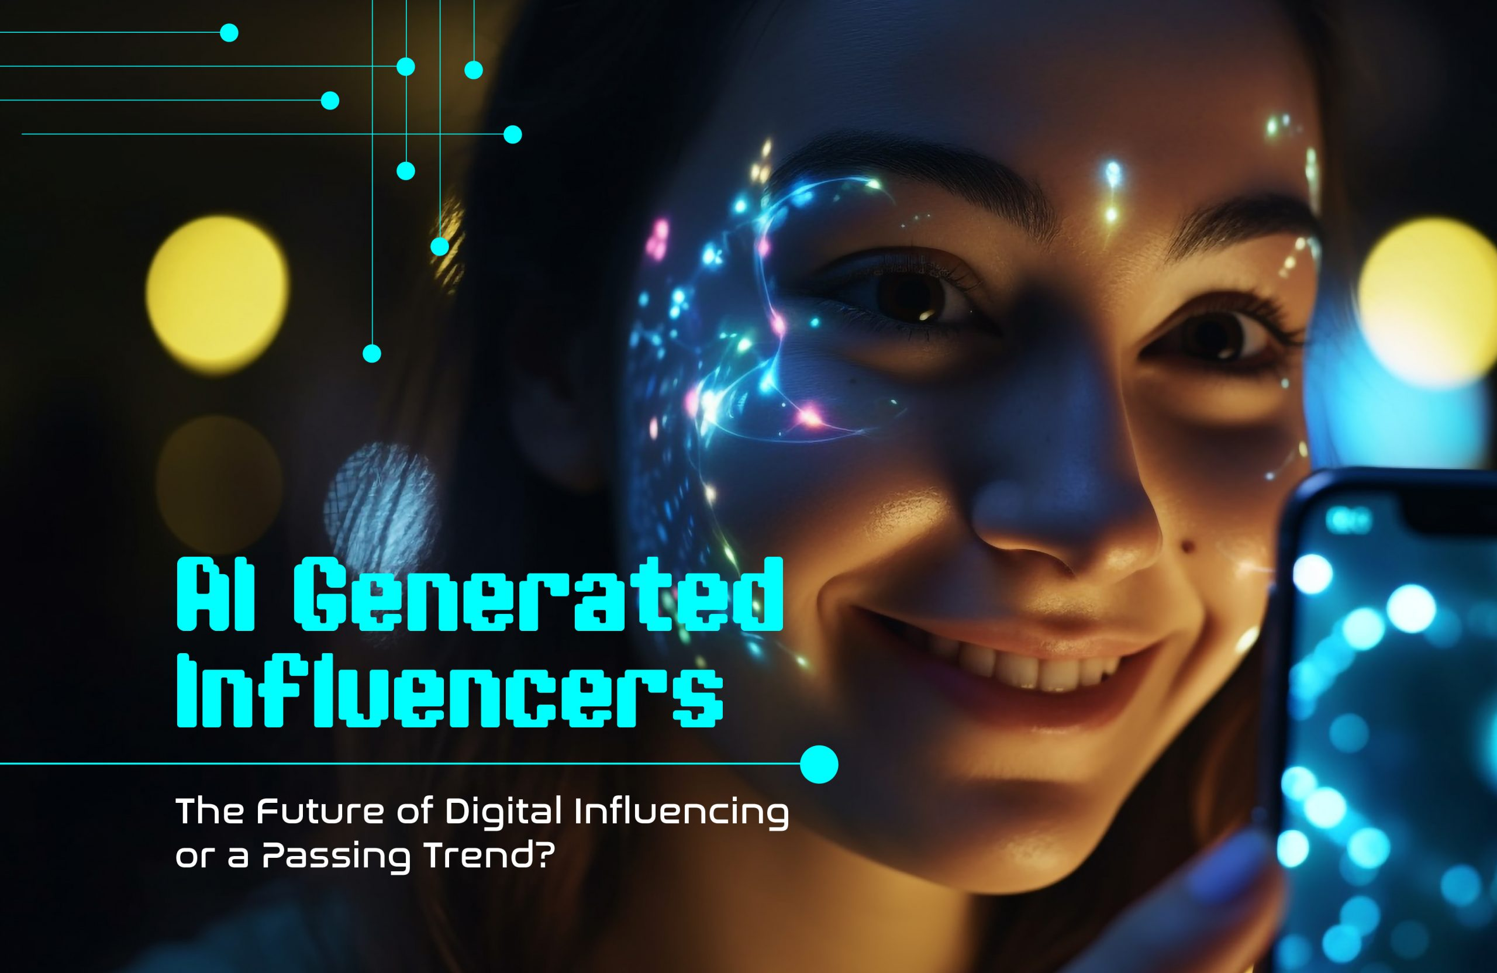
6. AI Influencers and Virtual Interaction
AI influencers are computer-generated personalities used in digital marketing. They offer several advantages:
No reputational risks
Full brand control
Cost efficiency
However, consumers may still prefer human influencers for authenticity and emotional connection.

Slide 31
7. Challenges and Ethical Considerations
Despite its numerous benefits, AI presents several challenges and ethical concerns:
1. Privacy and Data Security
Data privacy is one of the most significant issues. AI systems rely on large amounts of consumer data, raising concerns about how this data is collected, stored, and used.
Extensive data collection raises concerns about user privacy and misuse.
2. Algorithmic Bias
Algorithmic bias is another challenge. If the data used to train AI systems is biased, the outcomes may also be biased, leading to unfair or discriminatory results.
AI systems may produce biased outcomes due to flawed data or models.

Slide 32
7. Challenges and Ethical Considerations
3. Transparency and Trust
Transparency is also a critical issue. Consumers often do not understand how AI systems make decisions, which can reduce trust.
Consumers demand clarity in how AI systems make decisions.
4. Human Interaction Preference
Many consumers still prefer human interaction, particularly in complex or sensitive situations where empathy and understanding are required.
Many consumers still prefer human support in complex situations.

Slide 33
8. Limitations of AI in Consumer Behavior Analysis
AI systems face several limitations that affect their effectiveness in analyzing consumer behavior.
AI models face limitations such as:
1. Poor generalizability across diverse populations
Lack of generalizability. AI models trained on specific datasets may not perform well in different contexts or populations.
2. Sensitivity to incomplete or noisy data
Data quality. Inaccurate or incomplete data can lead to incorrect predictions and decisions.
3. Limited adaptability due to static algorithms
AI systems may struggle to adapt to rapidly changing consumer behavior, particularly in dynamic markets.

Slide 34
9. Managerial and Policy Implications
For businesses, the integration of AI offers significant opportunities to enhance marketing strategies and improve customer experience.
For Retailers
  Invest in personalization technologies
  Improve chatbot quality
  Utilize predictive analytics strategically
Retailers should invest in advanced AI technologies to deliver personalized experiences, improve customer engagement, and optimize operations.

Slide 35
9. Managerial and Policy Implications
For Policymakers
  Establish regulations for data privacy
  Ensure algorithm transparency
  Promote ethical AI use
Policymakers must establish regulations to ensure ethical use of AI.
This includes protecting consumer data, ensuring transparency, and preventing algorithmic bias.
Collaboration between businesses and policymakers is essential to create a balanced approach that promotes innovation while safeguarding consumer interests.

Slide 36


10. Real-World Examples & Mini Case Studies
Case: Amazon
Recommendation engine analyzes browsing and purchase history
Drives a significant share of sales via personalized suggestions
Uses predictive logistics to optimize delivery and inventory
Case: Zara
AI-driven demand forecasting for fast fashion cycles
Optimizes inventory and reduces waste
Rapid response to trends using real-time data

Slide 37
11. Comparison: Traditional vs AI-Driven Marketing
Aspect | Traditional Marketing | AI-Driven Marketing
Targeting | Mass/segment-based | Individual-level personalization
Data Usage | Limited, periodic | Big data, real-time analytics
Decision Making | Historical trends | Predictive & prescriptive
Customer Interaction | Human, time-bound | 24/7 chatbots/assistants
Speed & Optimization | Slow iterations | Real-time optimization
Content | Generic campaigns | Dynamic, personalized content
Measurement | Lagging KPIs | Live dashboards & attribution

Slide 38
10. Conclusion
In conclusion, AI has fundamentally transformed consumer behavior by enabling personalized, efficient, and data-driven interactions.
While the benefits of AI are substantial, addressing ethical concerns and technological limitations is crucial for sustainable development.
As AI continues to evolve, it will play an increasingly important role in shaping the future of consumer behavior and the digital marketplace.

Slide 39

AI has fundamentally transformed consumer behavior by enabling personalized, efficient, and data-driven interactions.
While the benefits of AI are substantial, addressing ethical concerns and technological limitations is crucial for sustainable development.
As AI continues to evolve, it will play an increasingly important role in shaping the future of consumer behavior and the digital marketplace.
10

Slide 40


