Slide 1


Prepared by Dr. Wesam Ahmed
IT402
Internet of Things
Lecture 3

Slide 2



IoT Architecture and Sensors
Lecture 3
IT402‎
Internet of Things
Prepared by
Dr. Wesam Ahmed

Slide 3

03
Learning Objectives:
1.1 Describe the reference IoT architecture .
1.2 Explain the different IoT sensor types and its usage
1.3 Gain knowledge about IoT actuators and its role in controlling IoT systems
1.4 Radio-Frequency Identification (RFID)

Slide 4
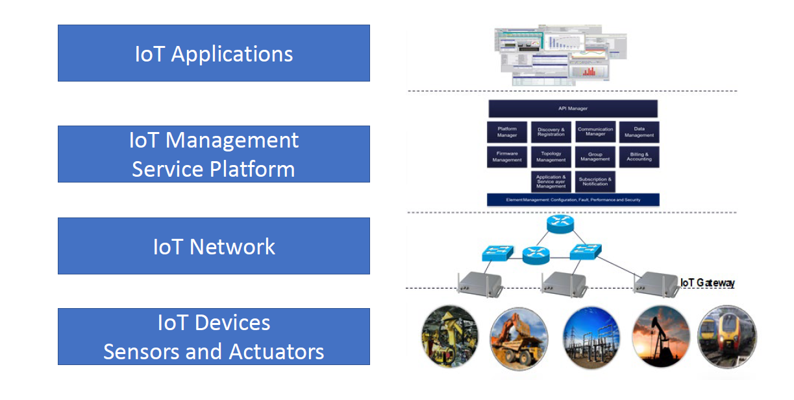
IoT Reference Architecture
03
Understand the Importance of Business Intelligence
Figure 3.1 IoT architecture

Slide 5
IoT Reference Architecture
03
Understand the Importance of Business Intelligence
IoT Reference Architecture Four Levels:
Level 1:IoT Device Level includes all IoT sensors and actuators.
- Functions:
Data sensing and collection from the physical environment.
Execution of control actions (via actuators).
Initial data preprocessing (e.g., filtering, compression).
Level 2: IoT Network Level includes all IoT network components including IoT Gateways (is a bridge between IoT devices (sensors, actuators, controllers) and the cloud or data center.), Routers, Switches.
- Functions:
Data forwarding.
Communication management and security.
Protocol translation between different IoT communication standards.

Slide 6
IoT Reference Architecture
03
Understand the Importance of Business Intelligence
IoT Reference Architecture Four Levels:
Level 3: IoT Application Services Platform Level includes the key management software functions to enables the overall management of IoT devices and network. It also includes main functions connecting the device and network levels with the application layer.
Functions:
Device and network management.
Data storage, processing, and integration.
Level 4: IoT Application Level includes all applications operating in the IoT network. This level provides the end-user applications and services that utilize IoT data to deliver value. The main function is Data visualization and decision-making tools.

Slide 7
IoT Reference Architecture
03
Understand the Importance of Business Intelligence
Example: Smart Agriculture System: Imagine a smart farm that uses IoT to monitor soil moisture, temperature, and crop health — and automatically controls irrigation.
Level 1: IoT Device Level
All the sensors and actuators installed in the field.
Examples:
Soil moisture sensors
Temperature sensors
Irrigation pumps (actuators)
Drones or cameras monitoring crops

Slide 8
IoT Reference Architecture
03
Understand the Importance of Business Intelligence
Example: Smart Agriculture System: Imagine a smart farm that uses IoT to monitor soil moisture, temperature, and crop health — and automatically controls irrigation.
Level 2: IoT Network Level
The communication infrastructure that connects devices to the cloud.
Examples:
IoT Gateway , Routers, switches, Wireless networks (Wi-Fi, 4G/5G).
Function:
The gateway gathers data from sensors and sends it to the cloud.
It may also translate between different communication protocols

Slide 9
IoT Reference Architecture
03
Understand the Importance of Business Intelligence
Example: Smart Agriculture System: Imagine a smart farm that uses IoT to monitor soil moisture, temperature, and crop health — and automatically controls irrigation.
Level 3: IoT Application Services Platform Level
The software platform that manages devices and processes data.
Examples:
Cloud-based IoT platform (like AWS IoT Core, Azure IoT Hub, or Google Cloud IoT)
Function:
Stores and analyzes data (e.g., average soil moisture per zone).
Sends alerts or instructions (e.g., “activate irrigation system in Zone A”).

Slide 10
IoT Reference Architecture
03
Understand the Importance of Business Intelligence
Example: Smart Agriculture System: Imagine a smart farm that uses IoT to monitor soil moisture, temperature, and crop health — and automatically controls irrigation.
Level 4: IoT Application Level
The end-user applications that visualize data and control systems.
Examples:
A mobile app for the farmer showing soil data in real time.
A dashboard with graphs of temperature, humidity, and water usage.
An alert system that sends notifications when crops need water.
Function: Displays processed data in an understandable form and allows the farmer to control irrigation remotely.

Slide 11
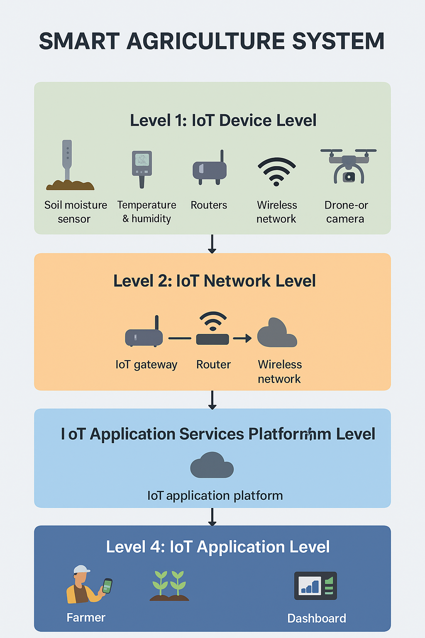
IoT Reference Architecture
03
Understand the Importance of Business Intelligence
Figure 3.2 Smart Agriculture System

Slide 12
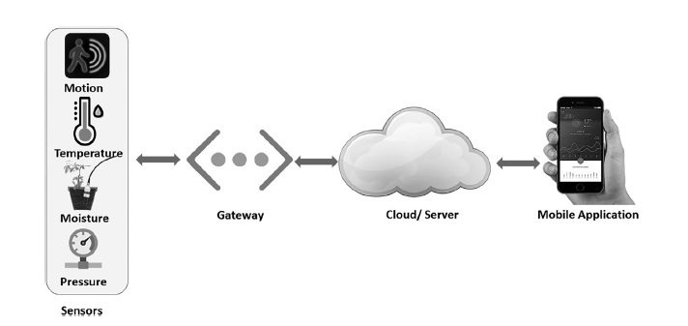
How does the IoT work?
03
Understand the Importance of Business Intelligence
Figure 3.3, illustrating how one typically works

Slide 13
How does the IoT work?
03
Understand the Importance of Business Intelligence
An IoT-based system is shown in Figure 3.3, illustrating how one typically works :
1.The IoT devices collect data from their sensors and transmit it to a gateway device.
2. The gateway device aggregates the data from multiple devices and sends it to the cloud for processing and analysis.
3. The cloud-based system processes the data, applies analytics algorithms, and generates insights and alerts.
4. The IoT applications access the processed data and present it to users in a meaningful way, such as through a dashboard, notification, or report.
5. The system may also send commands or instructions back to the IoT devices based on the processed data or user input.
6. The system continuously monitors and manages the devices, connectivity, and security to ensure reliable and secure operation.

Slide 14
How does the IoT work?
03
Gorry and Scott-Morton (1971) proposed a framework that is a 3-by-3 matrix
IoT-based systems and IoT ecosystems are different concepts, although they are related to each other. An IoT-based system is a specific implementation of IoT technology that involves a network of physical devices connected to the internet which can collect, process, and exchange data .
An IoT-based system typically includes devices, sensors, connectivity, data processing, applications, and security measures.
IoT-based System — “The Implementation”: An IoT-based system is a specific, working setup that uses Internet of Things (IoT) technology to perform a certain task or solve a problem.

Slide 15
How does the IoT work?
03
Gorry and Scott-Morton (1971) proposed a framework that is a 3-by-3 matrix
➤ Example: A smart home where:
Sensors detect motion or temperature,
Devices like lights or thermostats are connected via Wi-Fi,
Data is sent to a mobile app or cloud platform,
The user controls everything remotely.
On the other hand, an IoT ecosystem is a broader concept that encompasses all the elements involved in the development, deployment, and use of IoT technology .An IoT ecosystem includes hardware and software vendors, IoT service providers, connectivity providers, system integrators, application developers, and end-users. An IoT ecosystem is the entire environment or network that makes many IoT-based systems possible and successful.

Slide 16
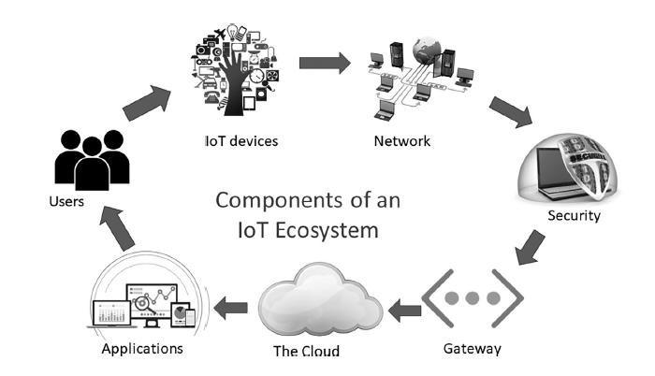
How does the IoT work?
03
Understand the Importance of Business Intelligence
Figure 3.4 , Seven components of an IoT ecosystem.

Slide 17
How does the IoT work?
03
Gorry and Scott-Morton (1971) proposed a framework that is a 3-by-3 matrix
The IoT ecosystem involves the interactions and interdependencies between these different players, as well as the regulatory and policy frameworks that govern IoT technology. In other words, an IoT-based system is a specific use case of IoT technology, while an IoT ecosystem is the larger context within which IoT technology operates.
A successful IoT-based system cannot exist on its own — it depends on the IoT ecosystem for:
Interoperability (devices from different brands must work together),
Connectivity (network infrastructure like 5G or LoRa),
Data platforms (for storage and analytics),
Security standards (to ensure safe data handling),
Support and innovation (developers, service providers, and users).

Slide 18
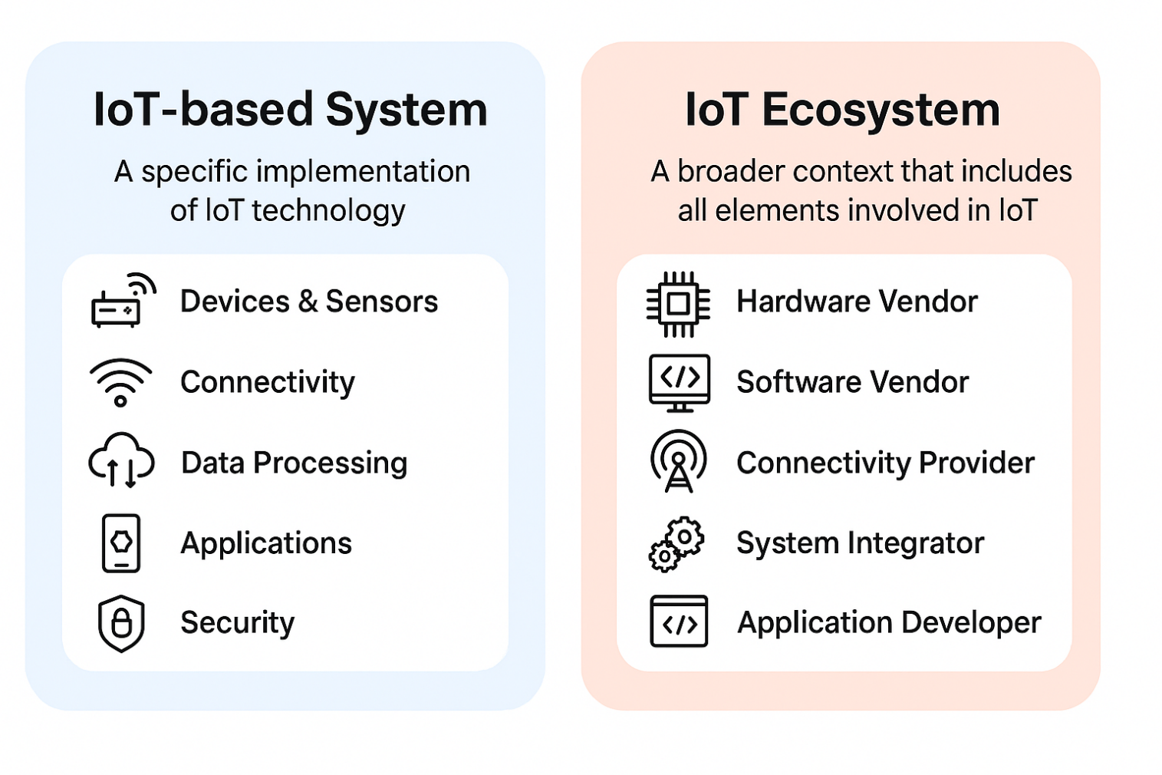
How does the IoT work?
03
Gorry and Scott-Morton (1971) proposed a framework that is a 3-by-3 matrix

Slide 19
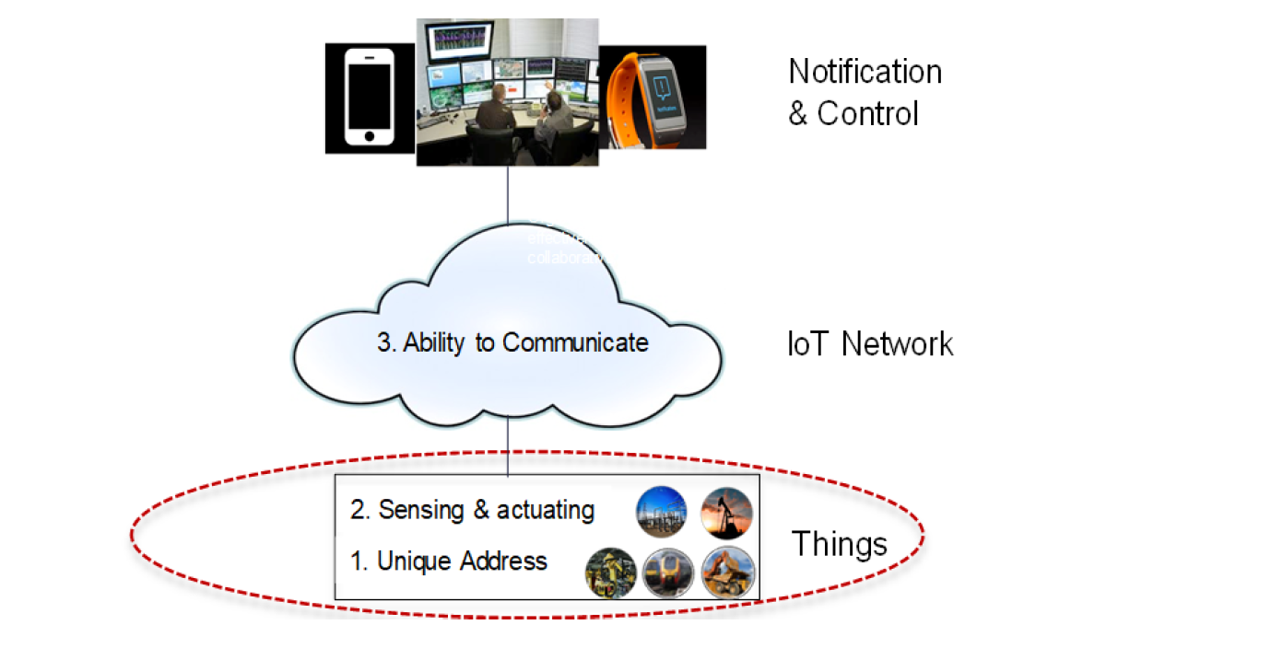
Things in IoT–Definition View
03
Gorry and Scott-Morton (1971) proposed a framework that is a 3-by-3 matrix
The diagram shows how IoT works — “Things” (devices) collect and act on data, send it through an IoT network (cloud), and allow users or systems to monitor and control them remotely.

Slide 20
IoT Sensors
03
Gorry and Scott-Morton (1971) proposed a framework that is a 3-by-3 matrix
A sensor is a device that detects events or changes in its physical environment (e.g. temperature, sound, heat, pressure, flow, magnetism, motion, chemical and biochemical parameters) and provides a corresponding output.
Sensors take analog inputs and deliver digital output (Most sensors generate analog signals — continuous signals that vary smoothly depending on the measured quantity. For instance, a temperature sensor might output 0–5 volts. However, computers and microcontrollers work with digital signals (binary: 0s and 1s).
Simple Sensors: functions to collect and transmit data
Example: A basic thermistor that sends continuous temperature readings every second — even if the temperature hasn’t changed.

Slide 21
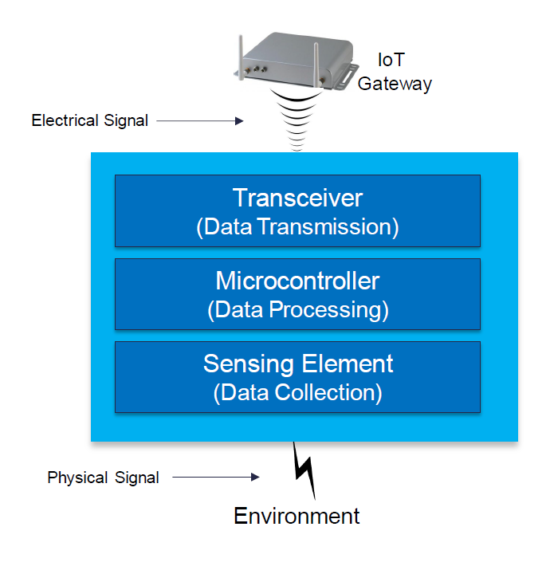
IoT Sensors
03
Gorry and Scott-Morton (1971) proposed a framework that is a 3-by-3 matrix
Smart Sensors: functions to collect and transmit data + additional functionalities to filter duplicated data and only notify the IoT Gateway when some specific conditions are met.
Smart Sensors require at least three elements –sensor(s), microcontrollers, and connectivity to send filtered data to IoT Gateway or other systems.
Example:
A smart humidity sensor that checks the environment every minute but only sends data if humidity changes by more than 5%.

Slide 22
IoT Sensors
03
Gorry and Scott-Morton (1971) proposed a framework that is a 3-by-3 matrix
Smart Sensor in an IoT System :
The sensor detects temperature = 27°C.
The microcontroller checks whether it exceeds a threshold (e.g., 30°C).
If not, it stores or ignores the data (no network message).
If yes, it activates communication and sends a digital message via Wi-Fi or Bluetooth to the IoT Gateway.
The IoT Gateway aggregates data from multiple devices and sends it to the cloud for analytics or notifications.

Slide 23
IoT Sensors
03
Gorry and Scott-Morton (1971) proposed a framework that is a 3-by-3 matrix
Temperature Sensors measure the amount of heat energy or coldness that is generated by an object or system.
Pressure Sensors measure the pressure of gas or liquid including water level, flow, speed and altitude.
Touch screen phones come with various pressure sensors Whenever slight pressure is applied on the touch screen through a finger, tiny pressure sensors determines where exactly pressure is applied and consequently generates an output signal that informs the processor.
Air Pollution Sensors: It detects and monitors the presence of air pollution in the surrounding environment.

Slide 24
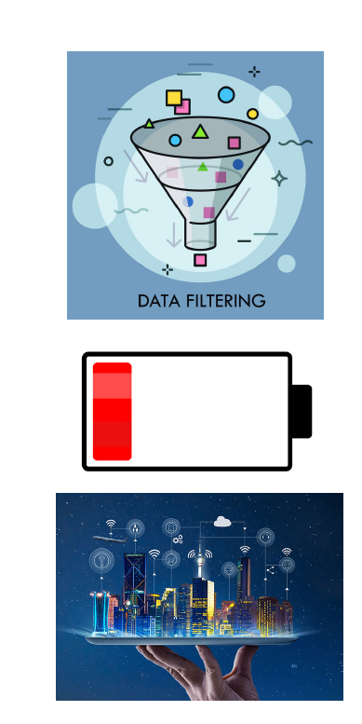
Sensor Characteristics
03
Gorry and Scott-Morton (1971) proposed a framework that is a 3-by-3 matrix
Data Filtering: Simple filtering may be required. For example, temperature sensors could be custom-programmed to produce alerts automatically when certain condition are met (e.g. temp> 70°F in a data center).
Minimum power consumption: Sensors may be placed in some environment where it is difficult to reach to replace batteries.
Compact: Space will be also be limited for most IoT verticals.
Smart Detection: Remote Sensing ( Presence detection –when just determining the absence or presence of an object is sufficient (e.g., security applications). This is the simplest form of remote sensing. Security systems: Detect when someone enters a room or area.

Slide 25
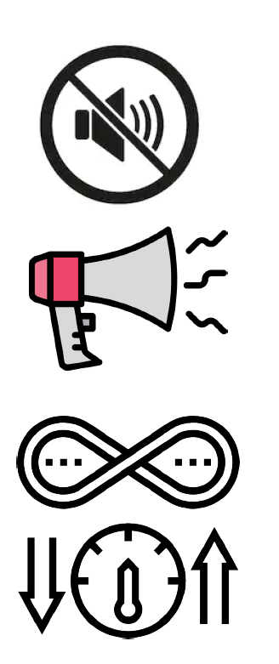
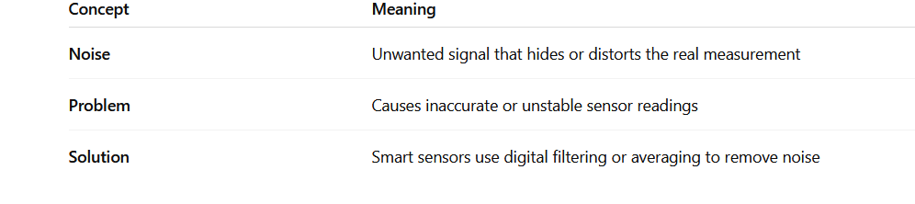
Sensor Characteristics
03
Gorry and Scott-Morton (1971) proposed a framework that is a 3-by-3 matrix
Limited Noise: All sensors produce some level of noise traffic with their output signals. Sensor’s noise is only an issue if it impacts the performance of the IoT system. Smarter sensors must filter out unwanted noise.

Slide 26
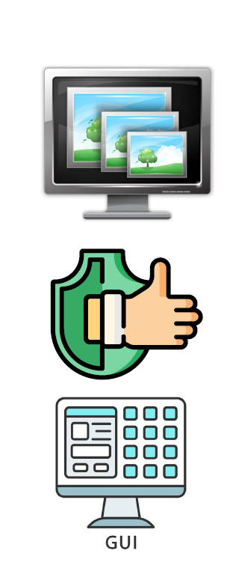
Sensor Characteristics
03
Gorry and Scott-Morton (1971) proposed a framework that is a 3-by-3 matrix
High Resolution: The resolution of a sensor is defined as the smallest detectable signal fluctuation. It is the smallest change in the input that the device can detect.
Example:
A temperature sensor with a resolution of 0.1°C can detect a change from 20.0°C to 20.1°C.
Another sensor with a 1°C resolution can only detect 20°C → 21°C .
So, the higher the resolution, the more detailed and precise the sensor’s readings are.

Slide 27
Sensor Characteristics
03
Gorry and Scott-Morton (1971) proposed a framework that is a 3-by-3 matrix
Minimum Interruption: sensors must operate normally at all time with zero or near-zero interruption and programmed to produce instance alerts on their own when their normal operation is interrupted.
Example: In a data center, temperature sensors monitor cooling systems.
  If a sensor stops working, the IoT gateway should instantly receive an alert (e.g., “Sensor 3 offline”).
  This ensures immediate maintenance and prevents overheating.

Slide 28
Sensor Characteristics
03
Ease of Use: User interfaces are considered the top requirements for any IoT systems.
IoT sensors should be easy to install, configure, and monitor — especially for users who are not engineers.
Example: A smart home temperature sensor connects automatically via Wi-Fi and shows up on your phone app within seconds.
The app shows battery status, allows setting alerts, and displays live readings — all without technical setup.
Gorry and Scott-Morton (1971) proposed a framework that is a 3-by-3 matrix

Slide 29
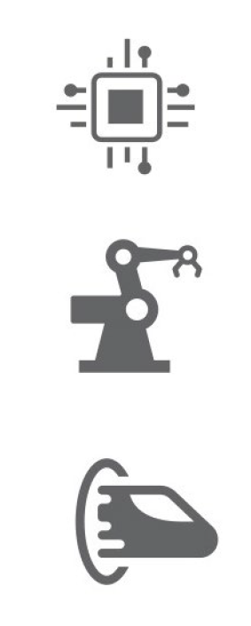
IoT Actuators
03
An actuator is a type of motor that is responsible for controlling or taking an action. It takes a source of data or energy (e.g. Hydraulic fluid pressure, other sources of power) and converts the data/energy to motion to control a system.
Actuators use sensor collected and analyzed data as well as other type of data intelligence to control IoT systems.
For example, shutting down gas flow when the measured pressure is below a certain threshold.
Gorry and Scott-Morton (1971) proposed a framework that is a 3-by-3 matrix

Slide 30
IoT Actuators
03
Gorry and Scott-Morton (1971) proposed a framework that is a 3-by-3 matrix
How It Works:
Sensor collects data
→ e.g., a pressure sensor measures gas pressure.
Data is sent to the IoT controller/gateway or cloud
→ The system analyzes the data (using AI).
Decision is made
→ Example: If pressure < safety limit, system must shut down the gas valve.
Actuator performs an action
→ The actuator receives a command and closes the valve — stopping gas flow.

Slide 31
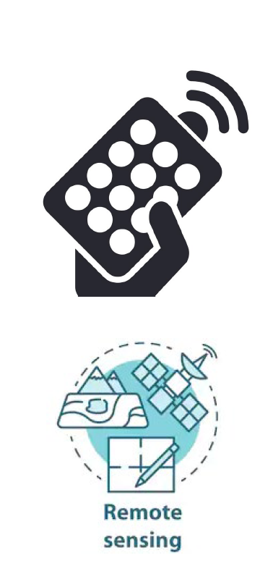
IoT Actuators
03
There are two main philosophies to monitor and control IoT devices:
Local Control requires an intelligent local controller
Example: A smart thermostat in your home controls your air conditioner without needing the internet. If the temperature sensor detects it’s too hot, the thermostat directly tells the AC to turn on.
Global Control requires moving the control onto the cloud with sensors everywhere.
Example: Instead of a local thermostat, multiple temperature sensors are placed throughout the house. The cloud application collects this data, decides how to balance temperatures, and remotely controls the air conditioner or heaters.
There are two main philosophies to monitor and control IoT devices:

Slide 32
IoT Actuators
03
There are two main philosophies to monitor and control IoT devices:
The right approach is a combination of the two approaches depending on the specific IoT vertical and environment.
Example: A smart home system might:
Use local control for safety-critical or time-sensitive actions (turning off the oven, switching on lights).
Use cloud control for energy optimization.
There are two main philosophies to monitor and control IoT devices:

Slide 33
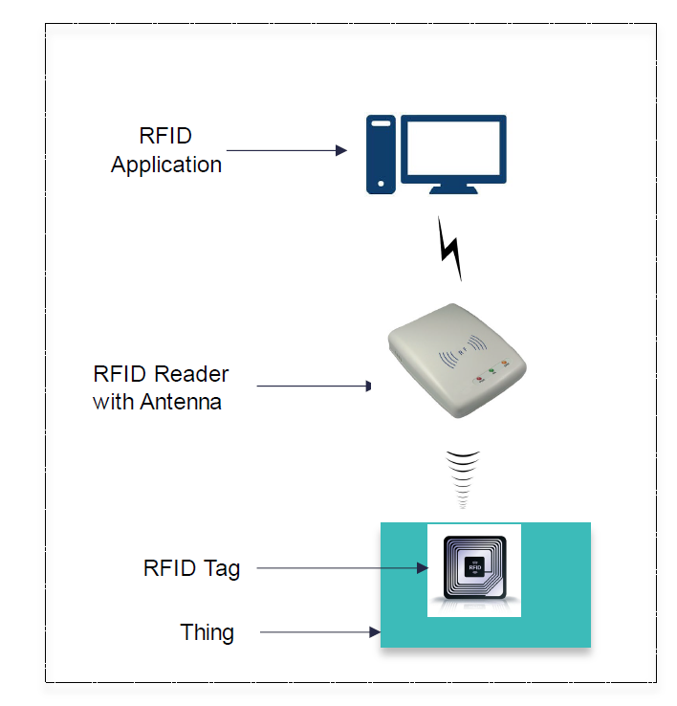
Radio-Frequency Identification (RFID)
03
RFID (Radio Frequency Identification) is a mechanism to capture info pre-embedded into
the Tag of a “thing” using radio waves.
RFID is a wireless communication technology that uses radio waves to identify, track, and manage objects automatically.
It’s one of the key technologies used in the Internet of Things (IoT) to give each object a unique digital identity.
RFID consist of two parts: a tag and a reader.
There are two main philosophies to monitor and control IoT devices:

Slide 34
Radio-Frequency Identification (RFID)
03
RFID Tag :
The tag is attached to or embedded in the object you want to identify.
It has two main parts:
Microchip:
Stores the object’s data (like ID number, product details, or status).
Antenna:
Sends and receives radio signals to and from the reader.
There are two main philosophies to monitor and control IoT devices:

Slide 35
Radio-Frequency Identification (RFID)
03
RFID Reader :
The reader communicates with tags using radio waves. It has a transmitter and receiver built in:
Transmitter emits radio waves through an antenna.
Receiver picks up signals from the tag and reads the stored data.
Then, the reader sends the data to a RFID Application (computer system) for further processing or analytics.
There are two main philosophies to monitor and control IoT devices:

Slide 36
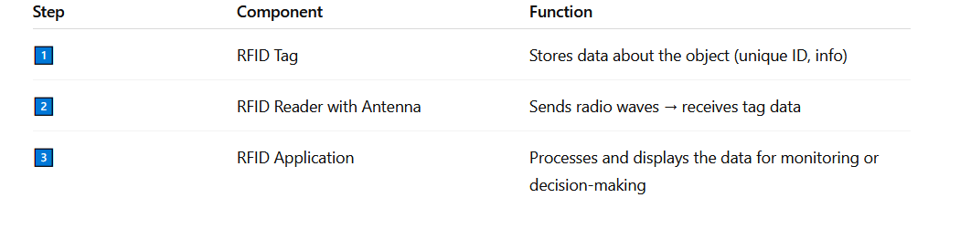
Radio-Frequency Identification (RFID)
03
There are two main philosophies to monitor and control IoT devices:

Slide 37
Radio-Frequency Identification (RFID)
03
There are two main philosophies to monitor and control IoT devices:
RFID Popular Uses:
Passport: Many department of states are using RFID passports that can be read from a reader located up to ten meters.
At airports, RFID readers at border control scan the passport from a short distance (up to ~10 meters).
The system automatically reads and verifies the stored data, speeding up customs and immigration processes.
Healthcare: to track and manage mobile medical equipment to protect healthcare workers for infections and other hazards.
Each device has an RFID tag that allows staff to locate equipment instantly through the hospital’s tracking system.

Slide 38
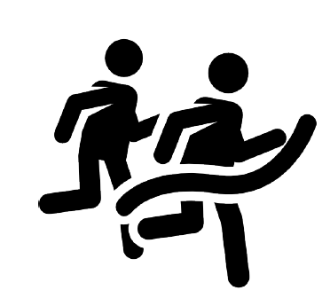
Radio-Frequency Identification (RFID)
03
There are two main philosophies to monitor and control IoT devices:
RFID Popular Uses:
Athletics and Sports Event Timing: Tracking the exact timing of runners
in marathons or races is a crucial and often a portion of a second makes
a difference.
When an athlete passes a reader, the tag transmits a unique ID.
The system calculates exact start, split, and finish times automatically.

Slide 39
Summary
03
Gorry and Scott-Morton (1971) proposed a framework that is a 3-by-3 matrix
The reference IoT architecture .
2. The different IoT sensor
3. IoT actuators
4. Radio-Frequency Identification (RFID)

Slide 40


Thank You

