Slide 1

PMG 202
Project Planning
Prepared by Dr. Maryam ZORGUI
PART I :
Initiate & Plan a Project
Lecture 5
Project Vision, Mission,
Values, Goals & Objectives

Slide 2
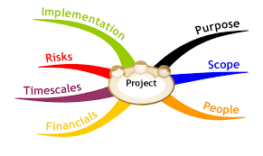
In the previous lessons…
A Project:
A Project is a series of tasks that need to be completed
to reach a specific outcome.
A Project can also be defined as a set of inputs and outputs required to
achieve a particular goal.
Projects can range from simple to complex and can
be managed by one person or a hundred.

Slide 3
In the previous lessons….
Defining the Charter of your project is essential in the business creation process.
This generally comes in 4 parts:
the Vision,
The Mission,
The Core Values
The Goals and Objectives.

Slide 4
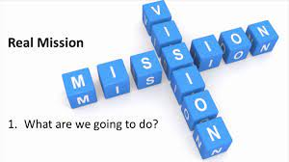

Chapter objectives
Establish the Project Vision and the Project Mission.
Identify the Project Core Values
Establish the Project Goals and the Project Objectives.
Learn the main differences between these elements.
Compare two popular goal-setting methodologies
— SMART Goals and CLEAR Goals.

Slide 5
Syllabus
.
A- Project Vision
D- Project Goals
B- Project Mission
E- Project Objectives
C- Project Core Values
Lecture 5

Slide 6

Part I:
Project Vision
Project Mission
&
Project Core Values

Slide 7

A- Project Vision
A-1- Definition
The Project Vision is the first thing that is thought, and the last thing we want to reach, is like thinking about the ideal future for this or that project,
But it is not just a perfect dream, but at the same time it is the compass and the beacon that lights the way for us from our present location to that point that we consider the ideal future.
“A project vision answers why, the essential starting point for inspiring action.” – Robert B. Sowby PMTimes

Slide 8
A- Project Vision
A clear Project Vision is key for any project success.
It gives direction, sets goals and can even solve problems before they arise.
While most companies have a good understanding of who they are and where they are going, when the time comes to write it all down issues appear.
To make sure this does not happen to you, here is what you need to know about project vision statements.

Slide 9
A- Project Vision
A-2- Vision Statements
A vision statement is the main tool to give knowledge on where the project should be going and thus should not be underestimated. It helps your team members make the right decisions.
It motivates to complete tasks that are necessary for the end goal.
And it inspires new action or solutions to achieve the desired result.

Slide 10
A- Project Vision
Once you have defined and understood the Project Vision, it is time to write your Project Vision Statement.
What words, language, and phrasing will they respond best to? Consider these following points to make sure you come up with something that inspires action.
Make it concise and easy to understand. Specify, but do not limit. Look into the future. | Make it inspirational and challenging. Don’t be too specific. Write about who you are

Slide 11
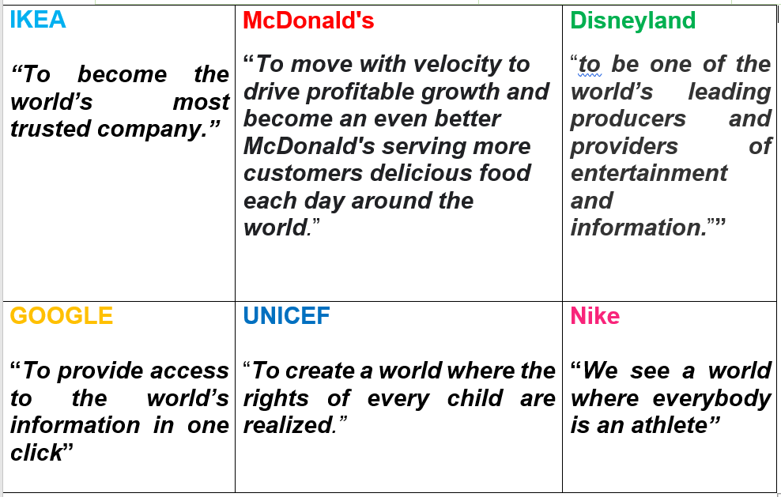
A- Project Vision
Project Vision Statements Examples

Slide 12
B- Project Mission
B-1- Definition
A Mission is not simply a description of an project by an external party, but an expression, made by its stakeholders, of their desires and intent for the project.
A Mission defines how we will reach the Project’s Objectives
It helps to identify the fundamental purpose and the identity of a company .

Slide 13
B- Project Mission
I-2- Mission Statement
A Mission Statement tells you the fundamental purpose of the Project.
It concentrates on the present. It defines the customer and the critical processes.
It informs you of the desired level of performance.
The mission statement is changeable and mutable according to the requirements.
It indicates purpose and value of the Project.

Slide 14
B- Project Mission
Without being too repetitive, remember that your mission and vision statements shouldn’t be carbon copies of each other.
Your vision is your ideal future while your mission is your purpose and plan that you will act on every day.
A good mission statement has these qualities:
*A clear purpose
*Concise and specific
*Achievable
*Inspirational (but not to the degree of a vision statement)
*Unique to the industry and competitors (highlights differentiators)

Slide 15
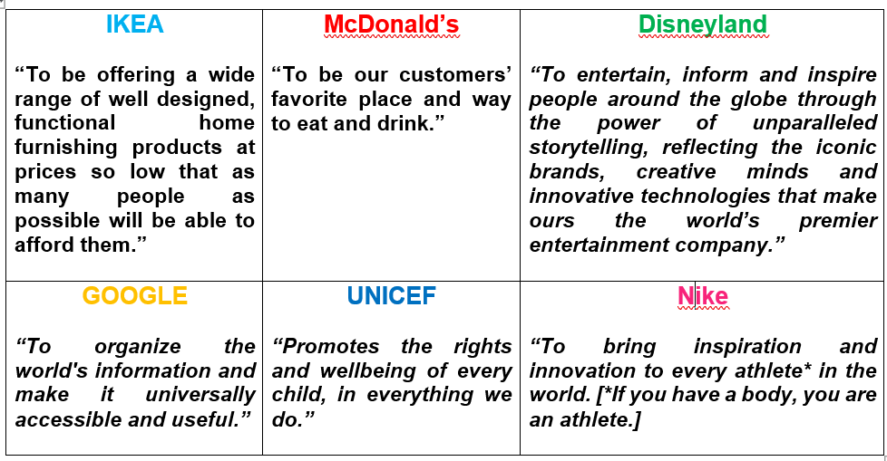
B- Project Mission
Project Mission Statements Examples

Slide 16
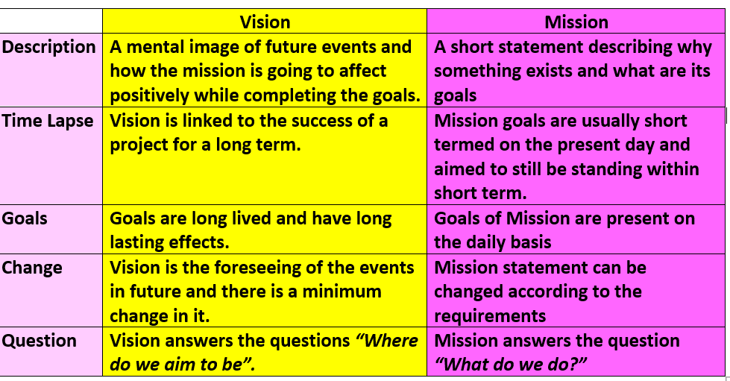
B- Project Mission
Vision vs Mission

Slide 17
C- Project Core Values
C-1- Definition
A Project’s Value is defined by the value a project creates for its stakeholders.
The Project Value could be represented by a single or any combination of efficiency, technical effectiveness and the satisfaction of a project's stakeholder with emphasis on clients and shareholders.
Project Value is not defined in a normative sense, rather it is defined in a relativistic sense as the value of a project could be determined in many different ways depending on its specific context and situation.

Slide 18
C- Project Core Values
C-2- Importance
Values can help define an Project’s personality and help it stand out from the crowd.
They can make a statement about where a project stands and what it believes in. They can give people focus and a greater sense of purpose and engagement, reinforcing a project’s broader goals and feeding into everyday decisions and work.
And crucially, values act as one of the building blocks of organizational culture, giving a consistent reference point, even in times of change.

Slide 19
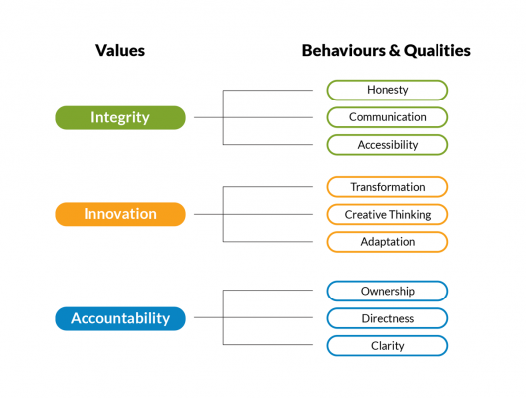

C- Project Core Values
What Are Some Common Values?
Loyalty.
Spirituality.
Humility.
Compassion.
Honesty.
Kindness.
Integrity.
Selflessness.

Slide 20
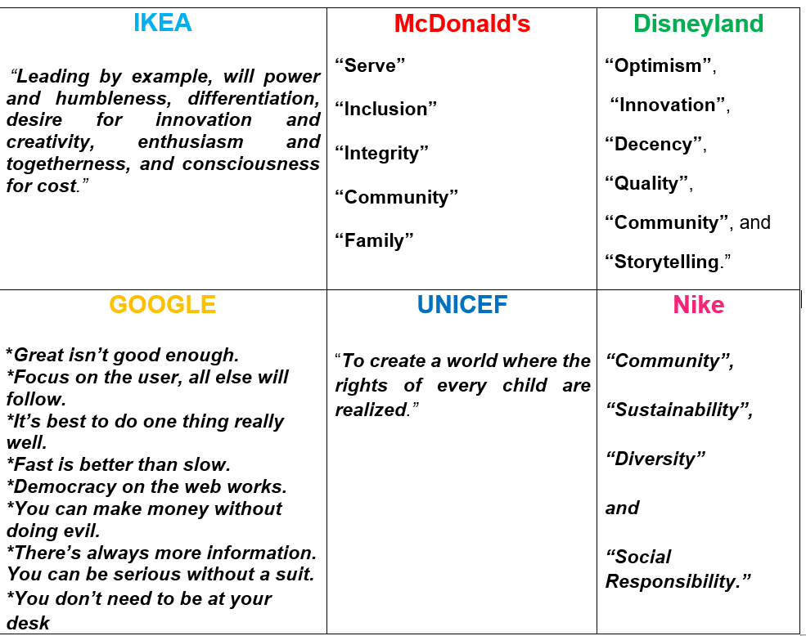
C- Project Core Values
Project Core Values Examples

Slide 21
C- Project Core Values
C-3- Relation between Project Values and Project Mission
Values and mission statements work together to form the bedrock of a company’s culture. A mission statement tells you where a company is going. Its values tell you how it will act along the way.

Slide 22

PART II:
Goals
&
Objectives

Slide 23
D- Defining Project Goals
D-1- What’s a Project Goal?
A Project Goal is a tangible statement of what a project should achieve.
A Project Goal describes the projects impact: the long-term effects that should (also) be triggered.
A Project Goal describes the desired state that should occur after a project has been executed.

Slide 24
D- Defining Project Goals
A Project Goal provides the link between the project and its direct effects (project objectives), and the overarching goals both within and outside the project.
Project Goals facilitate the planning and setting of milestones. They serve as a benchmark for success in project acceptance.
And last but not least, Project Goals have a motivating effect on the project team, helping to clearly distribute tasks and structure processes without any uncertainties.

Slide 25

D- Defining Project Goals
A well-formulated Project Goal:
Provides a concrete description of the project’s effects at the impact level;
Provides the link between the project (the Project Objective) to the overarching goals.
Most organizations set goals but few create a detailed plan for how they’ll meet them.

Slide 26
D- Defining Project Goals
D-2-Why you should define a Project Goal
Personal and profesional goals are very important because:
*Goals motivate us to keep going (even if things get hard).
*Goals give us a clear direction:
Some projects are huge in terms of budget, duration and team size. But if we are able to formulate a concise 1/2 sentence project goal, this can really help bind the project team together.
In this lesson, we will compare two popular goal-setting methodologies—SMART goals and CLEAR goals.

Slide 27

D- Defining Project Goals
D-3- SMART Goals
SMART is an acronym to help you create defined and
attainable goals.
SMART stands for:
*Specific
*Measurable
*Achievable
*Realistic
*Time-bound

Slide 28
D- Defining Project Goals
*Specific
Keep in mind that you’re setting your SMART goal to attain a specific objective—not a broad one.
*Measurable
Your goals should have some sort of objective way to measure them—whether that’s a deadline, a number, a percent change, or some other measurable element.
*Achievable
Achievable says that your goals shouldn't be totally outside the realm of possibility. Ask yourself this question: Is the goal within your Project Scope? If not, it’s not Achievable.

Slide 29
D- Defining Project Goals
*Realistic
The “A” and “R” of SMART are closely related. In addition to setting Achievable goals, you also want to set Realistic ones. For example, maybe a goal is achievable, but getting there would require every team member to work overtime for six weeks straight. Even though it might be an achievable goal, it’s not a realistic one.
*Time-bound
Your SMART goal should have an end date.
Without a time limit, your project could drag on, have unclear success metrics , and suffer from scope creep . If you haven’t already, make sure you outline a clear project timeline.

Slide 30
D- Defining Project Goals
D-3-2- What are the benefits of SMART Goals?
Clear communication and alignment
When your project team knows exactly what they’re working towards, they’re more motivated and aligned as a team.
Clarity towards project success
Have you ever gotten to the end of a project and not really known if you hit your project goals or not? SMART Goals help you set clear goals, so you can avoid vague or confusing goal language.

Slide 31
D- Defining Project Goals
Clear roadmap & finish line
With SMART goals, you know exactly what you want to achieve and which time frame you expect to achieve them by. You’ve verified that these goals are realistic and achievable. And you know you’ll be able to measure them to see if you hit them or not.
Trackable metrics
When you finish your project, SMART goals help you evaluate its success.
Notes:
Asana is a software-as-a-service platform designed to improve team collaboration and work management. It helps teams manage projects and tasks in one tool.

Slide 32
D- Defining Project Goals
D-3-3- SMART Goals -setting template
When you’re ready to set your own SMART Goals, start by writing your project goal as a sentence or two.
Then, apply each of the five SMART Goals attributes to your goal and make sure you cover all of your bases.
When you’re ready to get started, use this template:

Slide 33
D- Defining Project Goals
Initial goal: Write down whatever your initial goal is. Don’t worry about it not being completely SMART—we’ll get to that later in the template. | Make it Specific: Does your goal define exactly what you want to do? If not, re-work the language to make it specific to your particular project | Make it Measurable: Have you established how you’ll measure your goal once your project is complete? If not, add a way to measure success or failure at the end of your project.
Exp: I want to improve our company brand on social media. | Exp, continued: Improve our company brand on Instagram with company-specific hashtags. | Exp continued: Develop company-specific hashtags to generate 1,000 new Instagram followers

Slide 34
D- Defining Project Goals
4-Make it Achievable: Is your goal something you can achieve, given your project scope? Make sure this specific goal falls within your project capabilities. | 5- Make it Realistic: Can your project team reasonably hit your goal? Even if it’s a stretch goal, make sure this is something you can accomplish with your resources. | 6- Make it Time-bound: By when will you achieve your goal? Make sure you clarify your target date or project timeline in your SMART goal.
Example, continued: Develop and use company-specific hashtags, in conjunction with popular hashtags in our industry, to generate 1,000 new Instagram followers. | Example, continued: Post once daily on Instagram, and ensure every post has a mixture of company-specific hashtags and popular hashtags in our industry in order to generate 1,000 new Instagram followers. | Example, continued: Post every workday on Instagram for the first half of FY22. Ensure every post has a mixture of company-specific hashtags and popular hashtags in our industry in order to generate 1,000 new Instagram followers by June 30th.

Slide 35
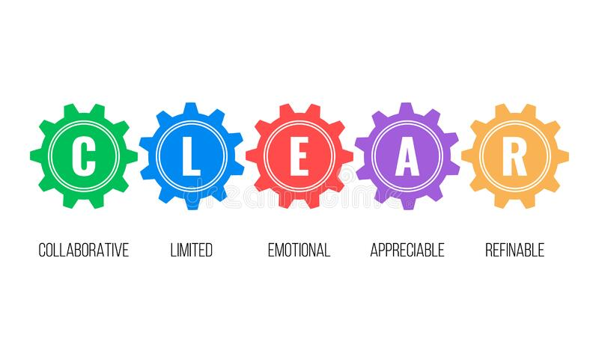
D- Defining Project Goals
D-4- CLEAR Goals
The 2nd popular goal-setting methodology is CLEAR Goals
The problem with SMART Goals is that they just haven't kept up with the faster, more-agile environment that most businesses find themselves in today.
These new business environments require a new way of setting goals, thus CLEAR goals.

Slide 36
D- Defining Project Goals
CLEAR stands for:
*Collaborative (Goals should encourage employees to work together collaboratively and in teams)
*Limited (Goals should be limited in both scope and duration)
*Emotional (Goals should make an emotional connection to employees, tapping into their energy and passion)
*Appreciable (Large goals should be broken down into smaller goals so they can be accomplished more quickly and easily for long-term gain)
*Refinable (Set goals with a headstrong and steadfast objective, but as new situations or information arise, give yourself permission to refine and modify your goals)

Slide 37
E- Project Objectives
E-1- Project Objectives vs. Project Goals
Though some teams may use these interchangeably, there is a distinct difference between Project Goals and Objectives.
In general, Project Goals are higher-level than Project Objectives.
Your project Goals should outline what happens once your project is successful, and how your project aligns with overall Project Objectives.

Slide 38
E- Project Objectives
Project Objectives, on the other hand, are more detailed and specific than project goals.
Project Objectives are more focused on your actual, specific deliverables at the end of the project.
Project Objectives are a critical element of Project management —without them, you don’t have a succinct way to communicate your goals before and during the project, nor do you have a measurable way to evaluate your success after the project ends.

Slide 39
E- Project Objectives
SMART Objectives | SMART Goals
Short-term | Long- term
Smaller steps to meet the goal | Primary goal
Divided into less complex tasks for smaller groups of people | Collective effort by the hole team
More tactical, on-the-fly-adjustments | Follows a general strategy
.

Slide 40
E- Project Objectives
E-2- Project Objectives vs. Business Objectives
Project Objectives are just that—objectives and performance indicators for individual projects. Your project objectives should apply to the project they’re about, and they should be specific enough to guide your team in evaluating project success.
Business Objectives are bigger than a single project. Unlike project objectives, your business objectives will fuel your business trajectory and velocity. Your business objectives should be long-term guidelines for your entire company or department. They will guide your company goals for a quarter or year, and they should be written in whatever goal-setting methodology your team uses, like Objectives and Key Results (OKRs).

Slide 41
E- Project Objectives
E-3- Project objectives vs. project plan
Project Plan | Project objectives
Your project plan is a blueprint of the key elements your team needs to accomplish in order to successfully achieve your project goals and objectives. However, your project plan should include several additional key elements, like your project stakeholders, deliverables, timeline, and more. | Plan to create your project objectives before working on your project plan, since your objectives will likely drive other elements of your project plan, like deliverables and success metrics. But once your project objectives are written, you’ll likely share them with stakeholders by way of the project plan.

Slide 42
E- Project Objectives
E-4- Project Objectives vs. Project Deliverables
Projects Deliverables | Project Objectives
Projects Deliverables are the assets you want to have at the end of your project—in a marketing campaign, for example, a deliverable could be a new ad or a web page. | In general, your Project Objectives will define what your deliverables are—but your objectives should also be broader than your deliverables. In addition to capturing deliverables, your Project Objectives will also define the benefits and outcomes to come from those deliverables, especially as they relate to the grander scheme of your project goals and business objectives .

Slide 43
E- Project Objectives
Without a Project Objectives, you don’t have an easy way to know if your project succeeded or failed—nor can you plan improvements for the next project you work on.

Slide 44
E- Project Objectives
A = Audience Who will be affected (targetgroup) | B = Behavior The observable change(knowledge, attitude, behavior,process) that will occur in the targetgroup because of your project.
C = Conditions How the behaviors will be observed or measured, including the instruments to be used. | D = Data Levels of attainment that mustbe met in order for your project to becalled a success (your definition).
E = Era Identifies when the effects of your program will be measured.
Measurable objectives
are as simple to write as
A-B-C-D-E

Slide 45


Slide 46
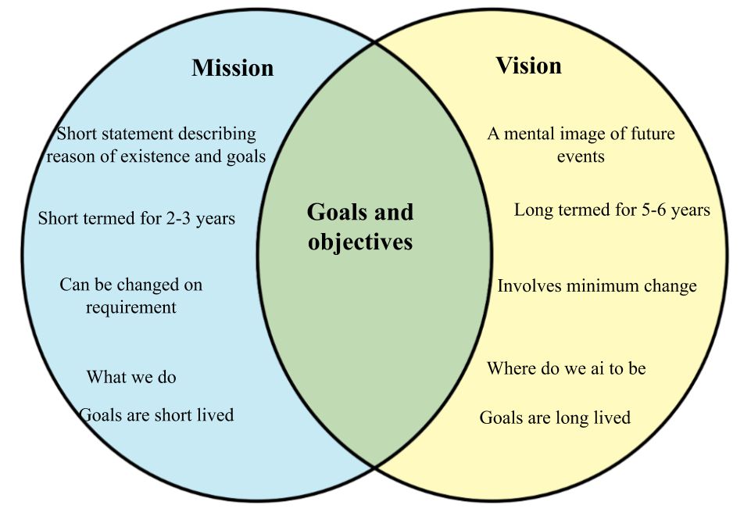


Slide 47
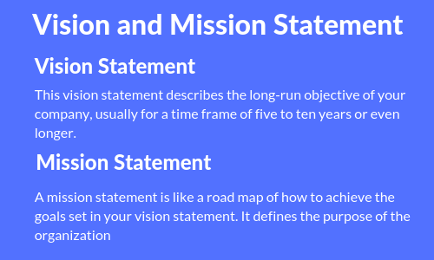

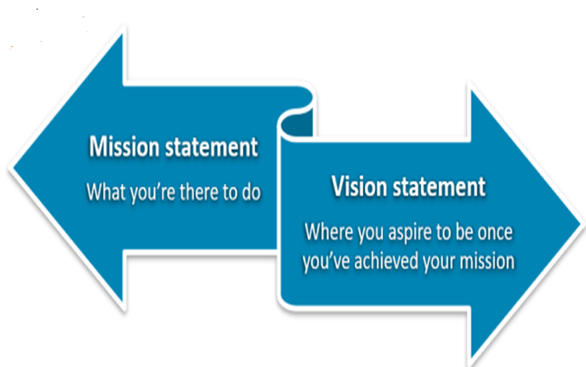

Slide 48
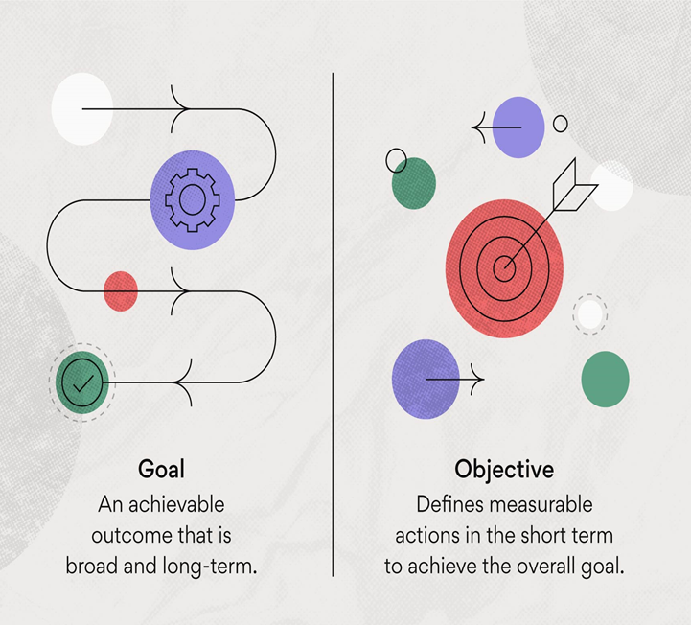
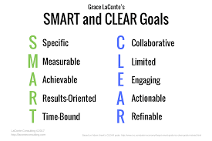

Slide 49


