Slide 1
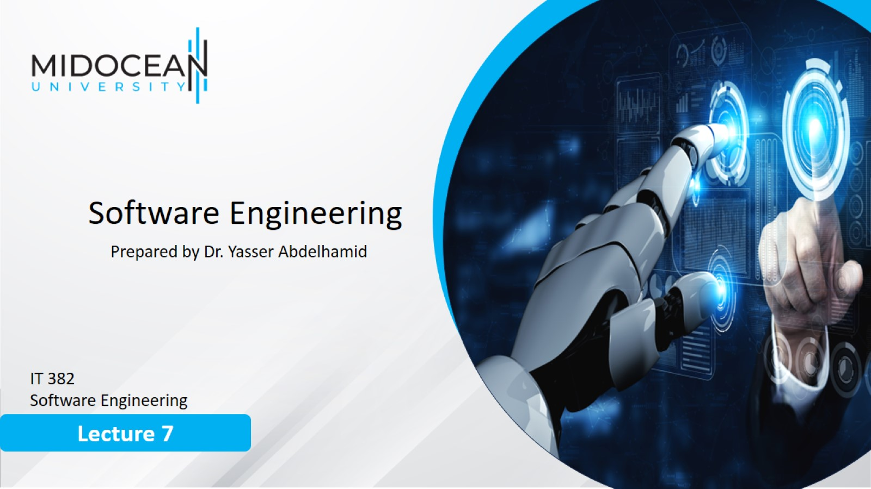

Slide 2
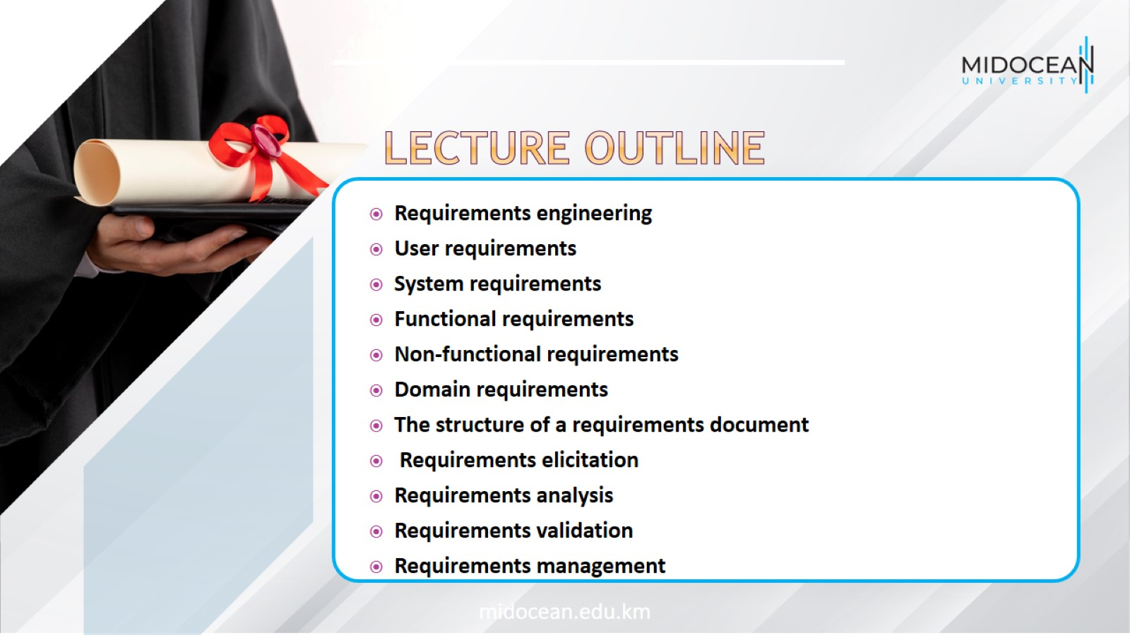

Slide 3
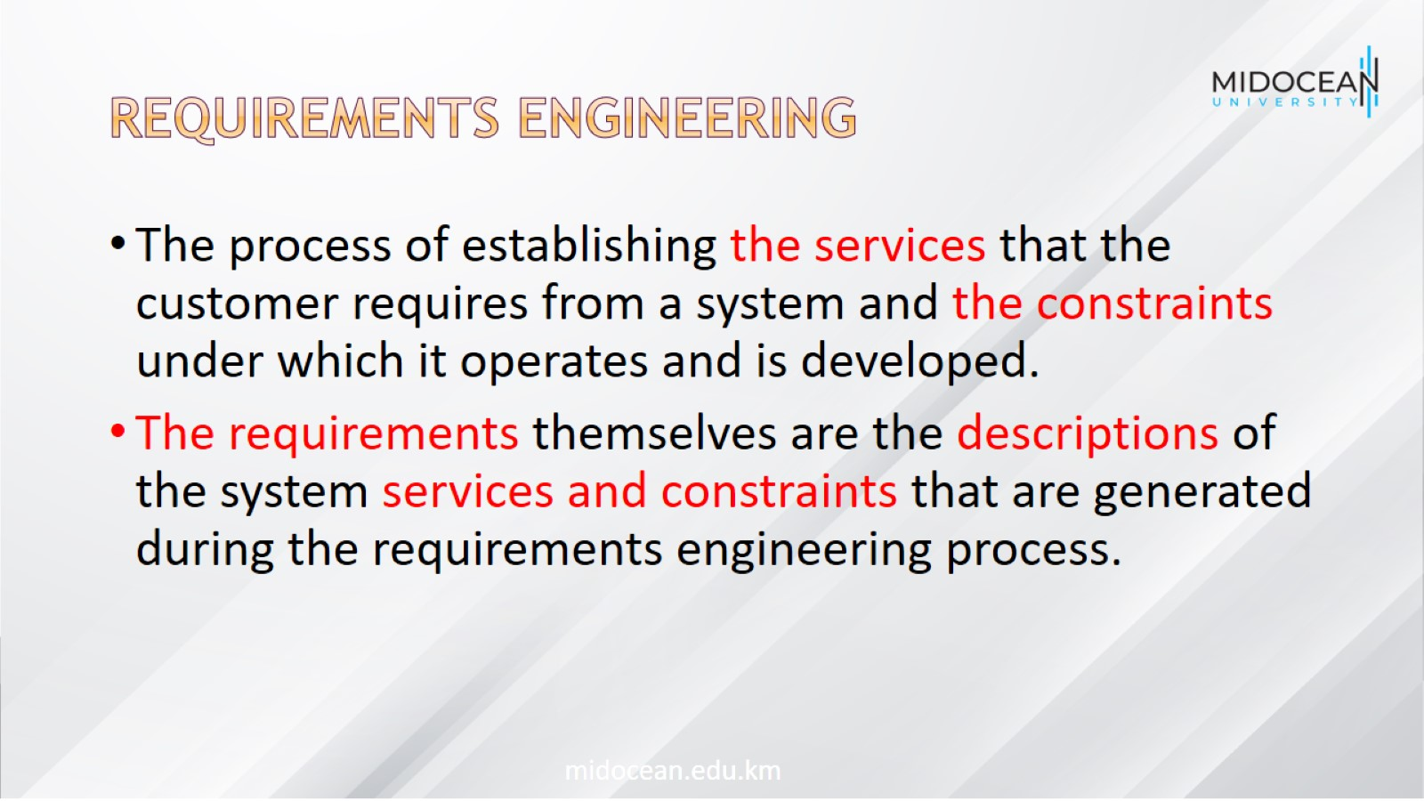
Requirements engineering

Slide 4
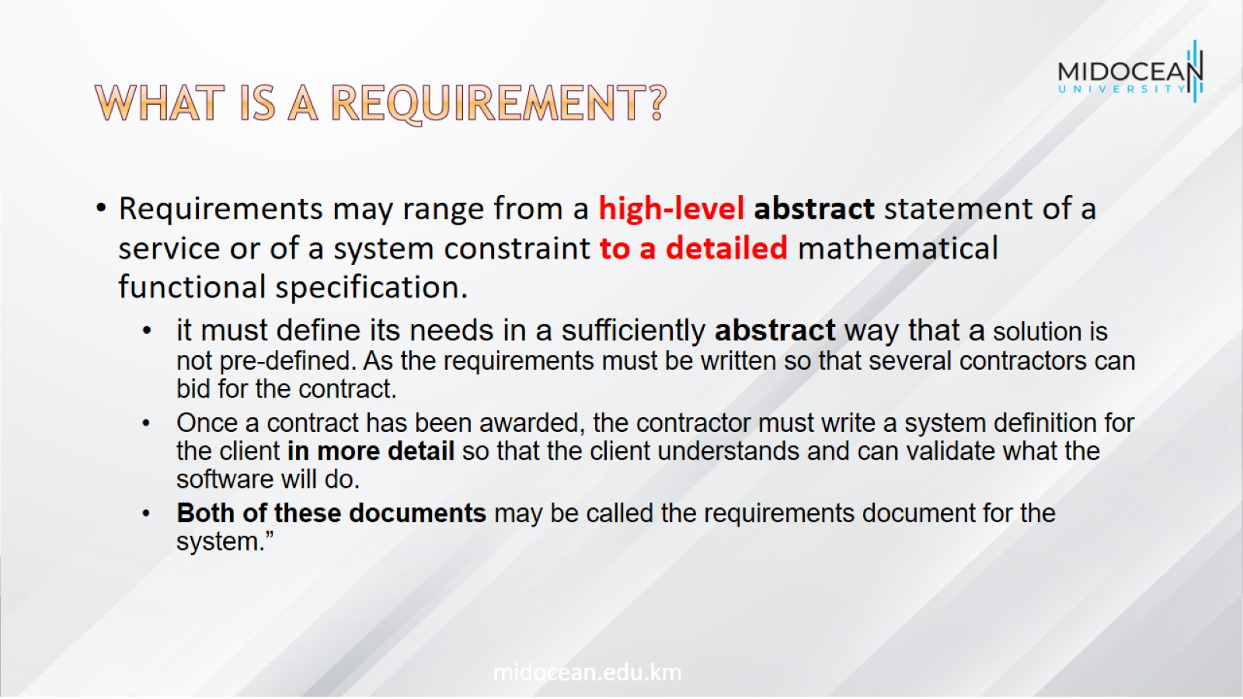
What is a requirement?

Slide 5
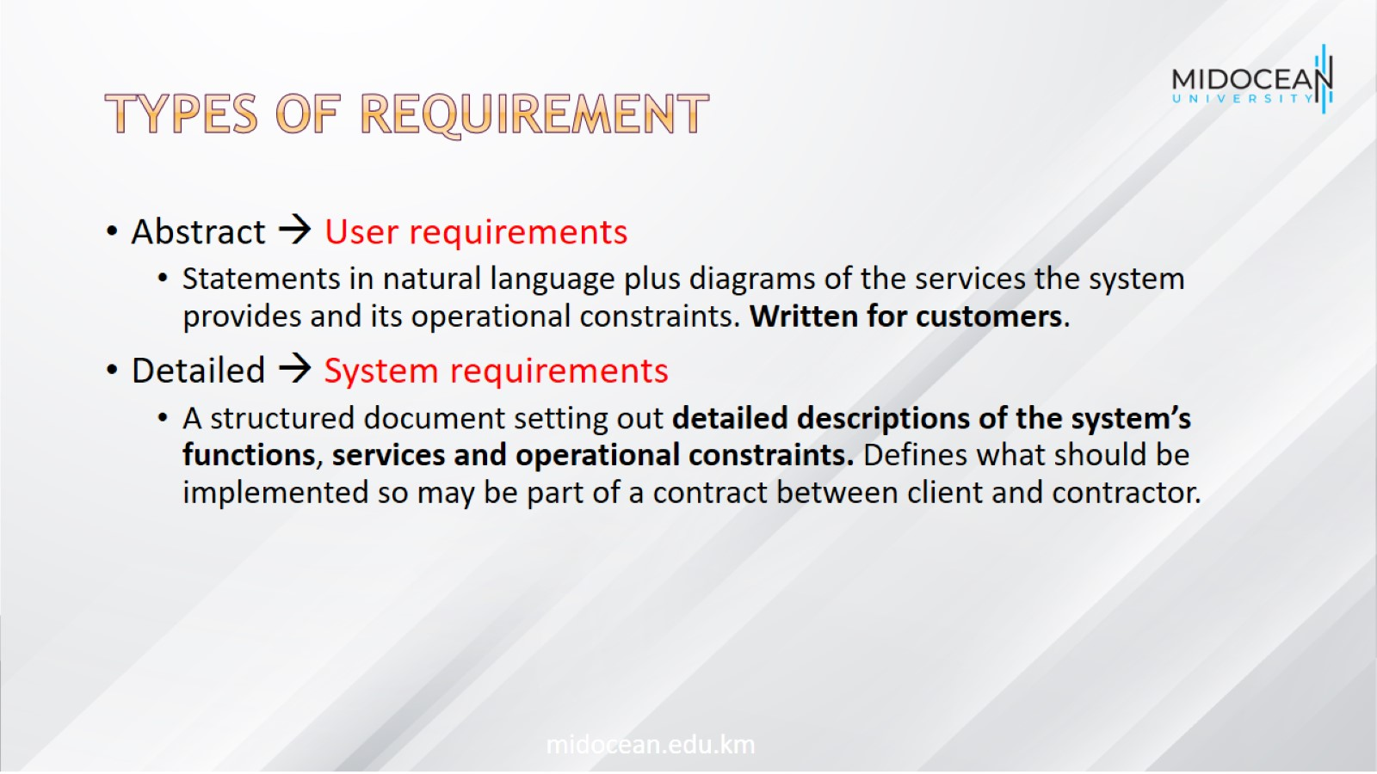
Types of requirement

Slide 6
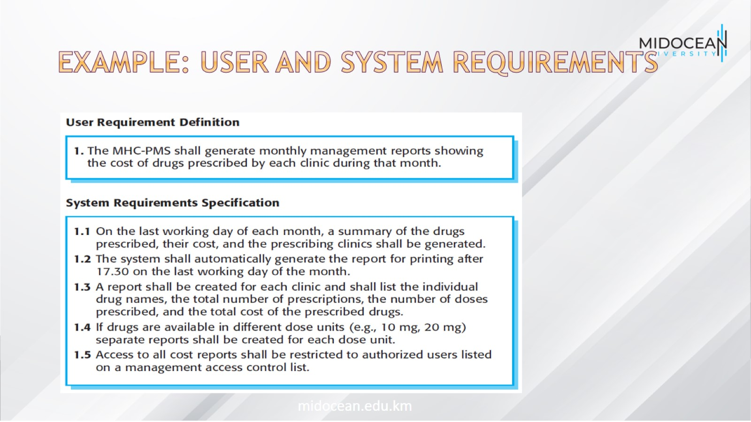
Example: User and system requirements

Slide 7
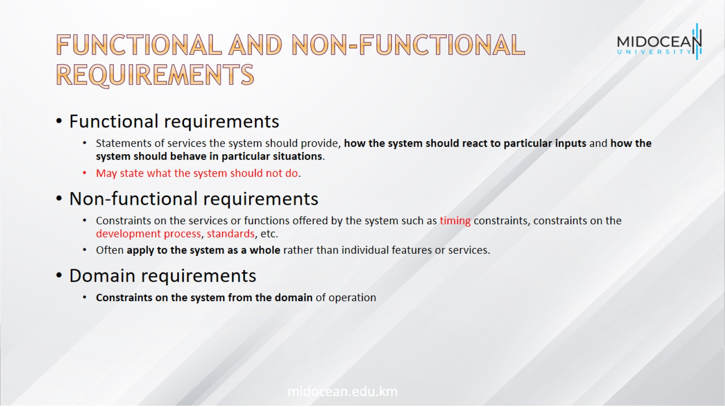
Functional and non-functional requirements

Slide 8
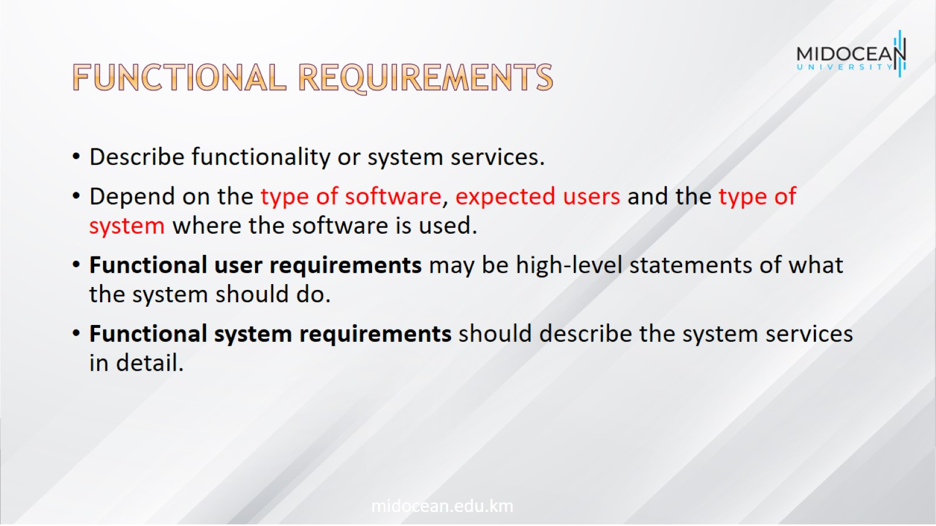
Functional requirements

Slide 9
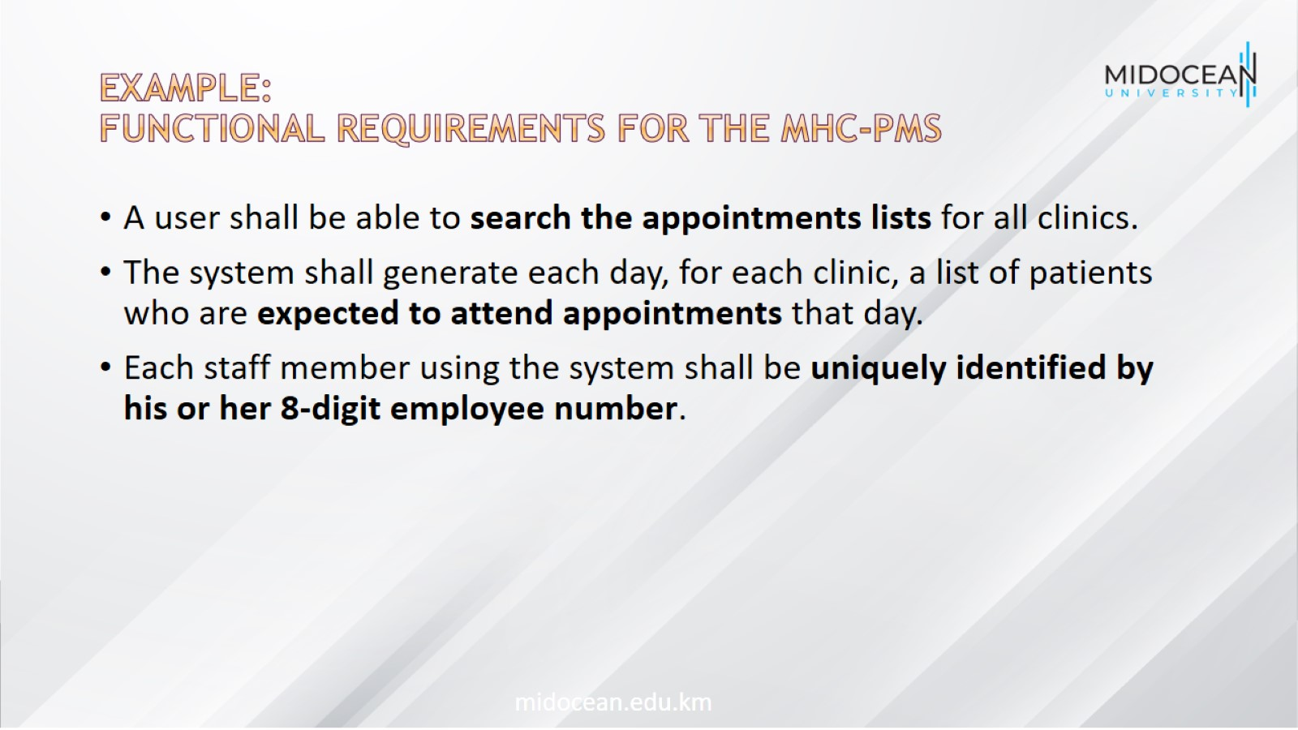
Example:
Functional requirements for the MHC-PMS

Slide 10
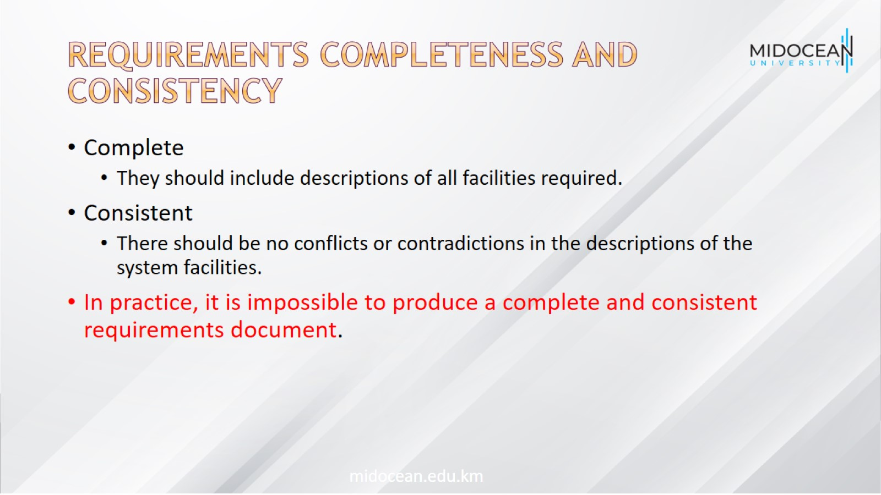
Requirements completeness and consistency

Slide 11
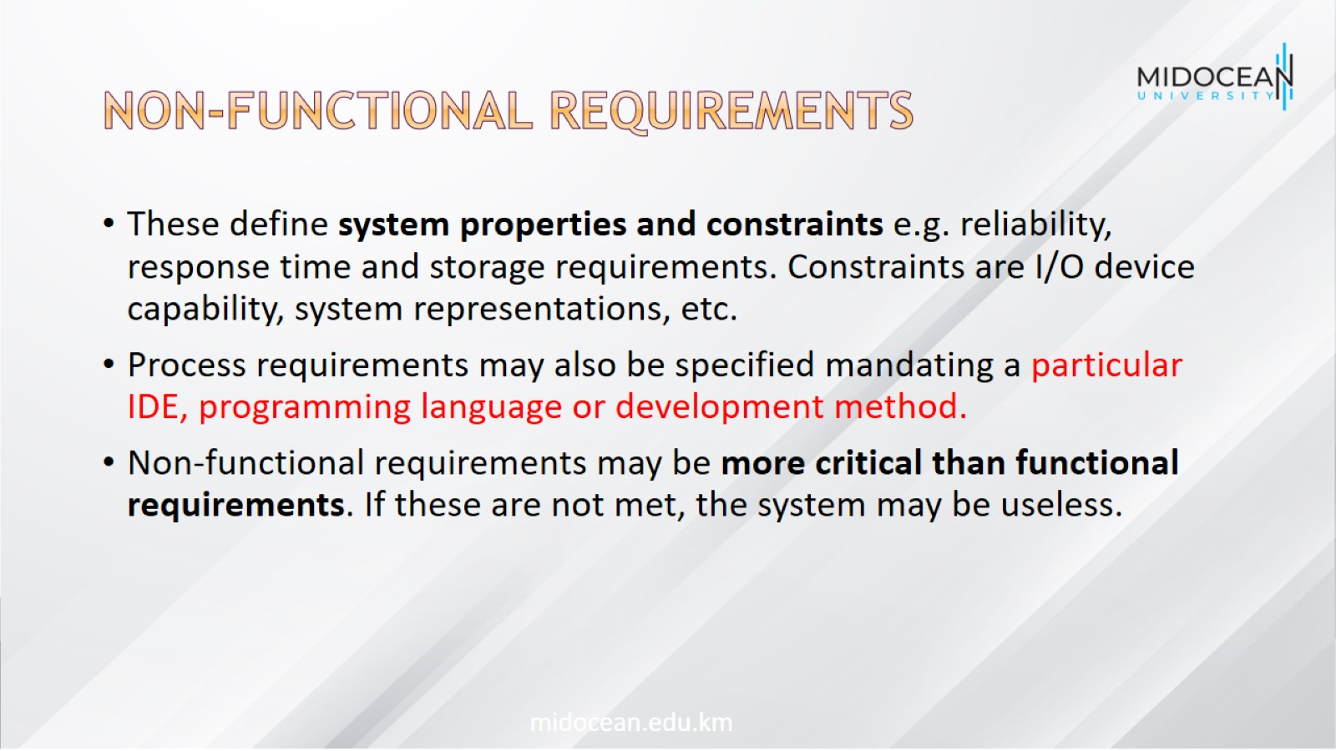
Non-functional requirements

Slide 12
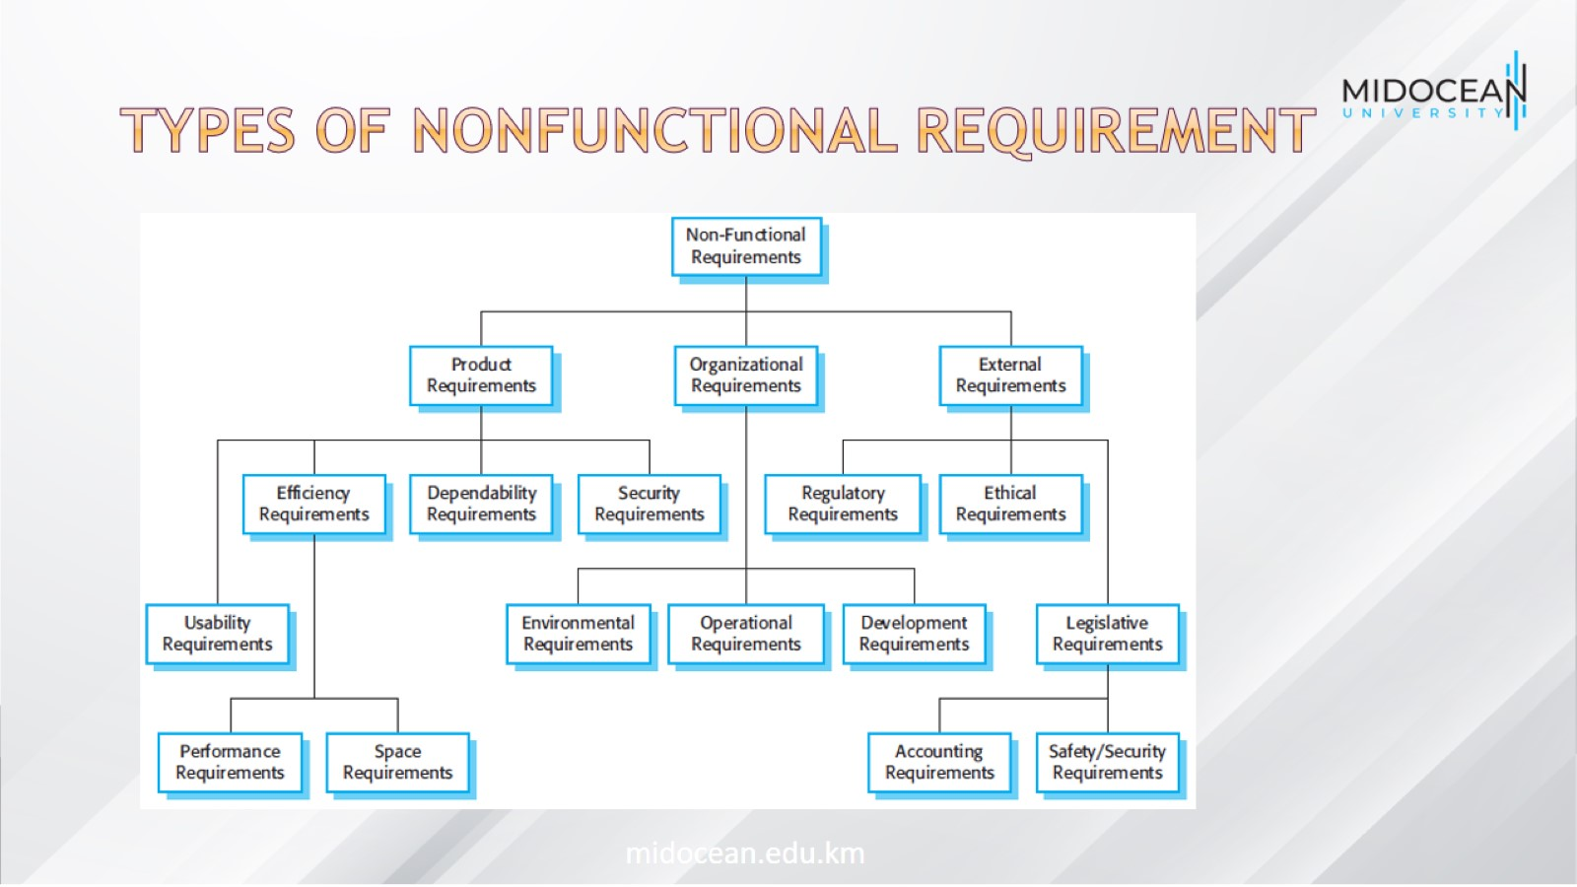
Types of nonfunctional requirement

Slide 13
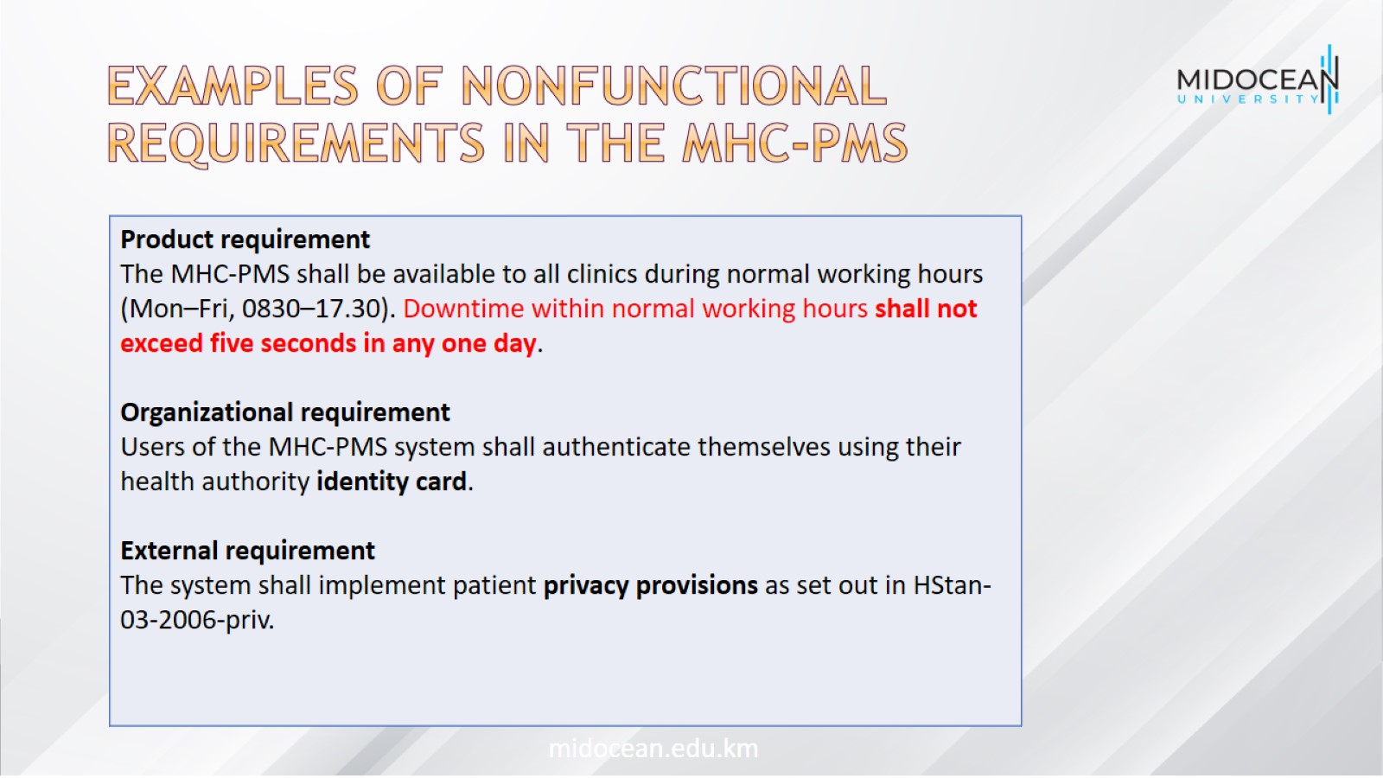
Examples of nonfunctional requirements in the MHC-PMS

Slide 14
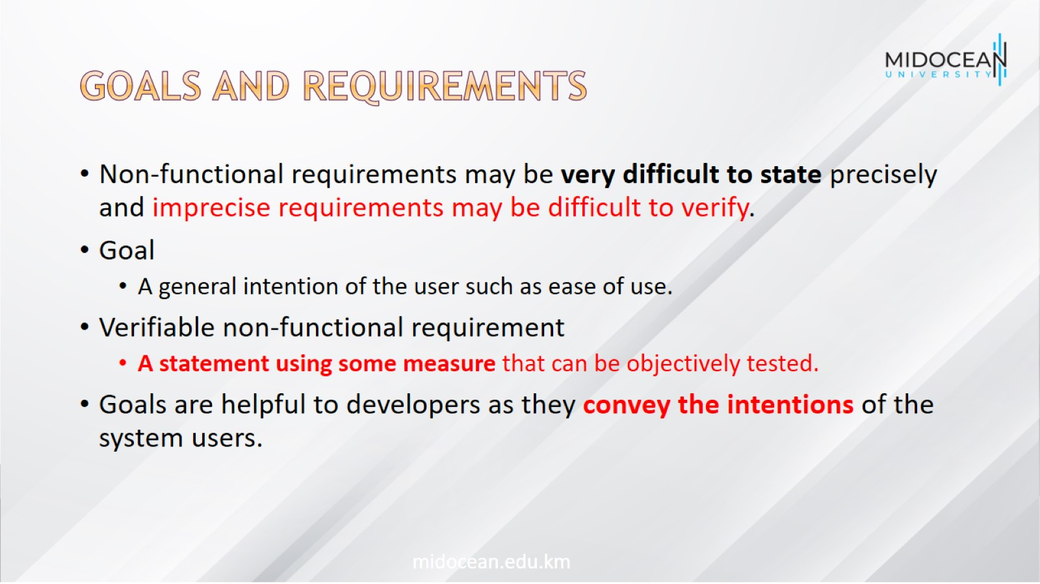
Goals and requirements

Slide 15
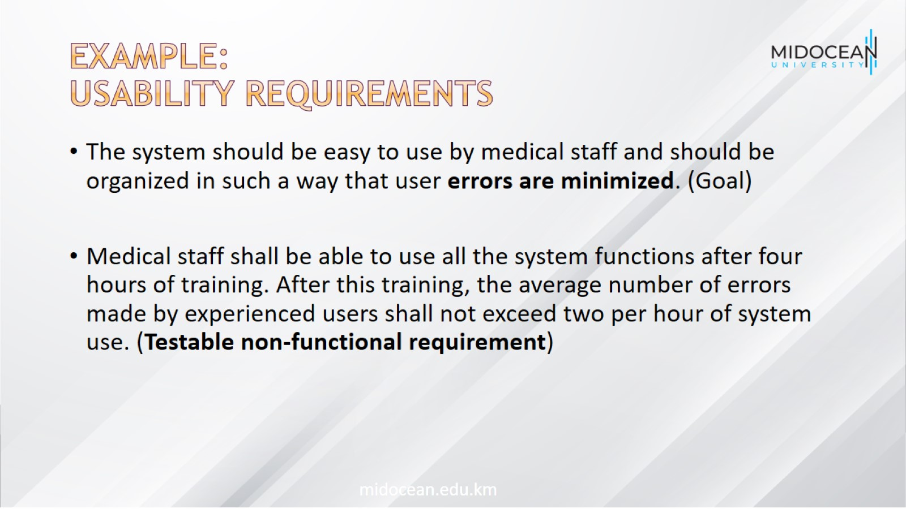
Example:
Usability requirements

Slide 16
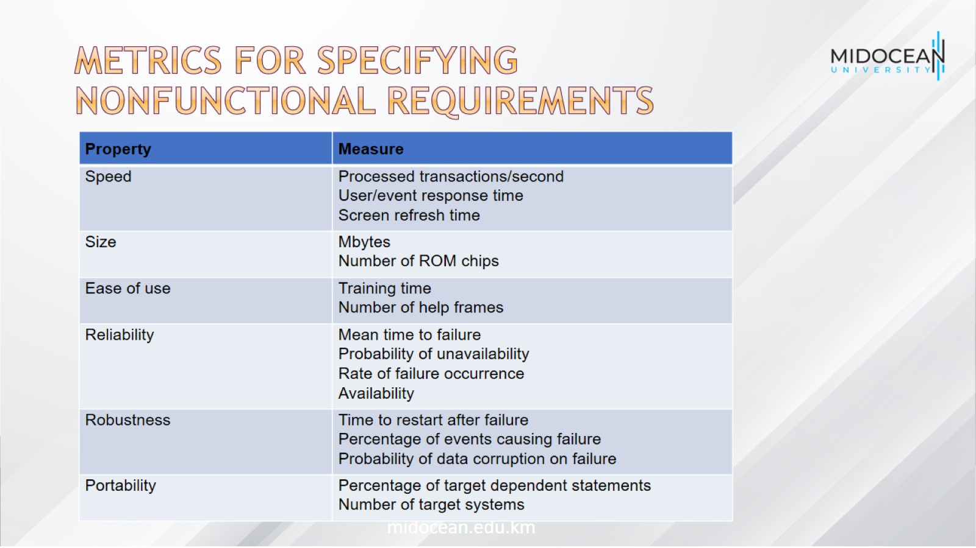
Metrics for specifying nonfunctional requirements

Slide 17
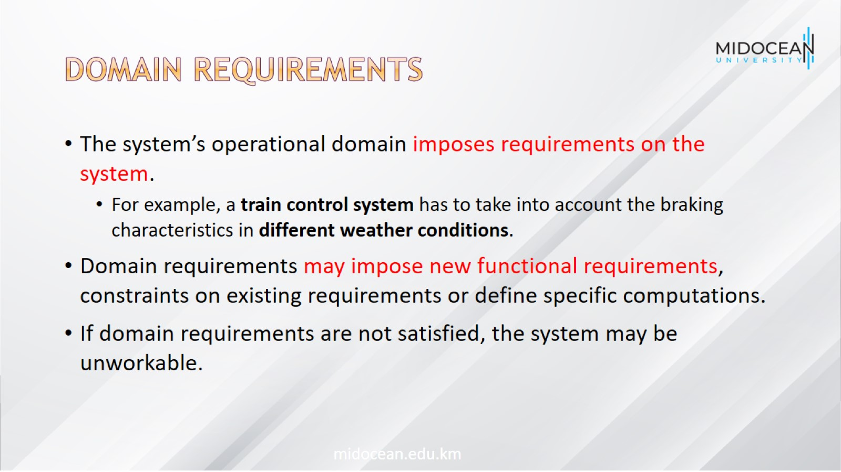
Domain requirements

Slide 18
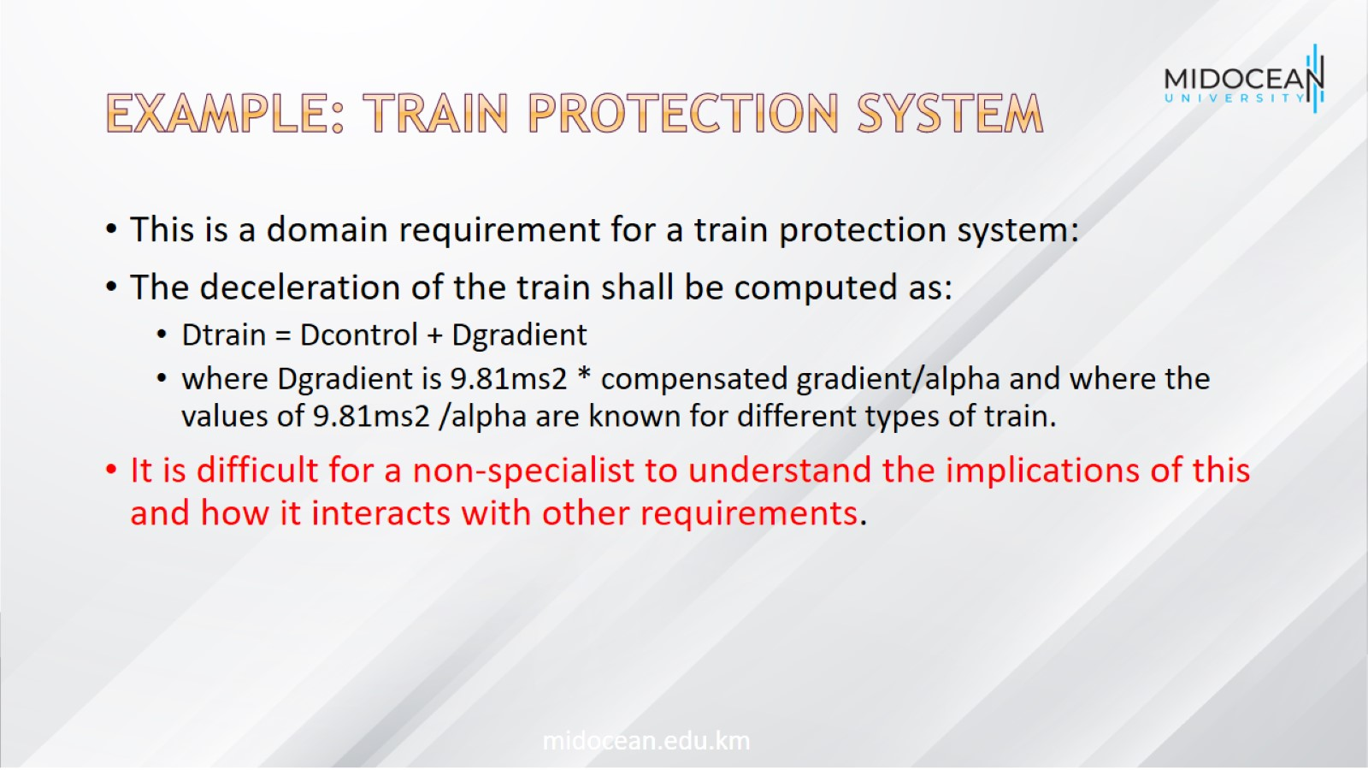
Example: Train protection system

Slide 19
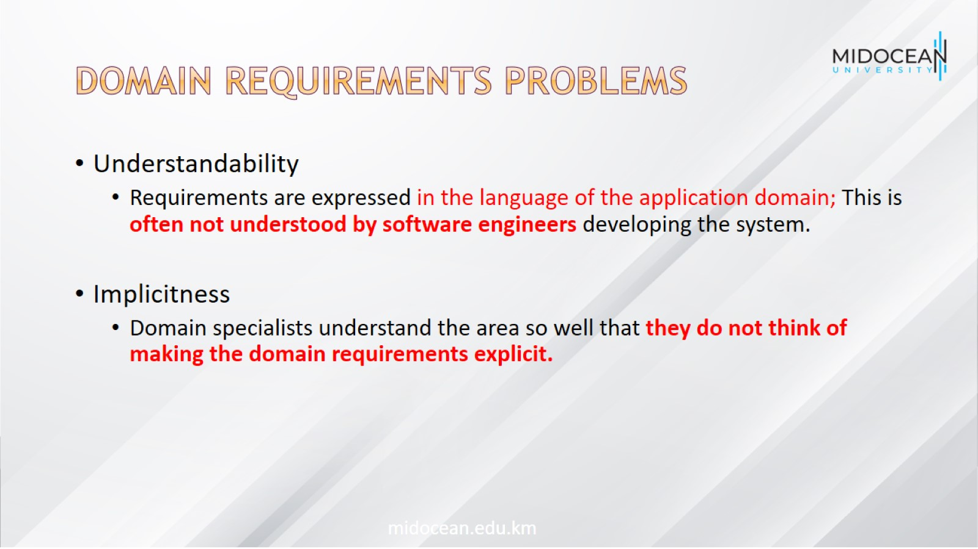
Domain requirements problems

Slide 20
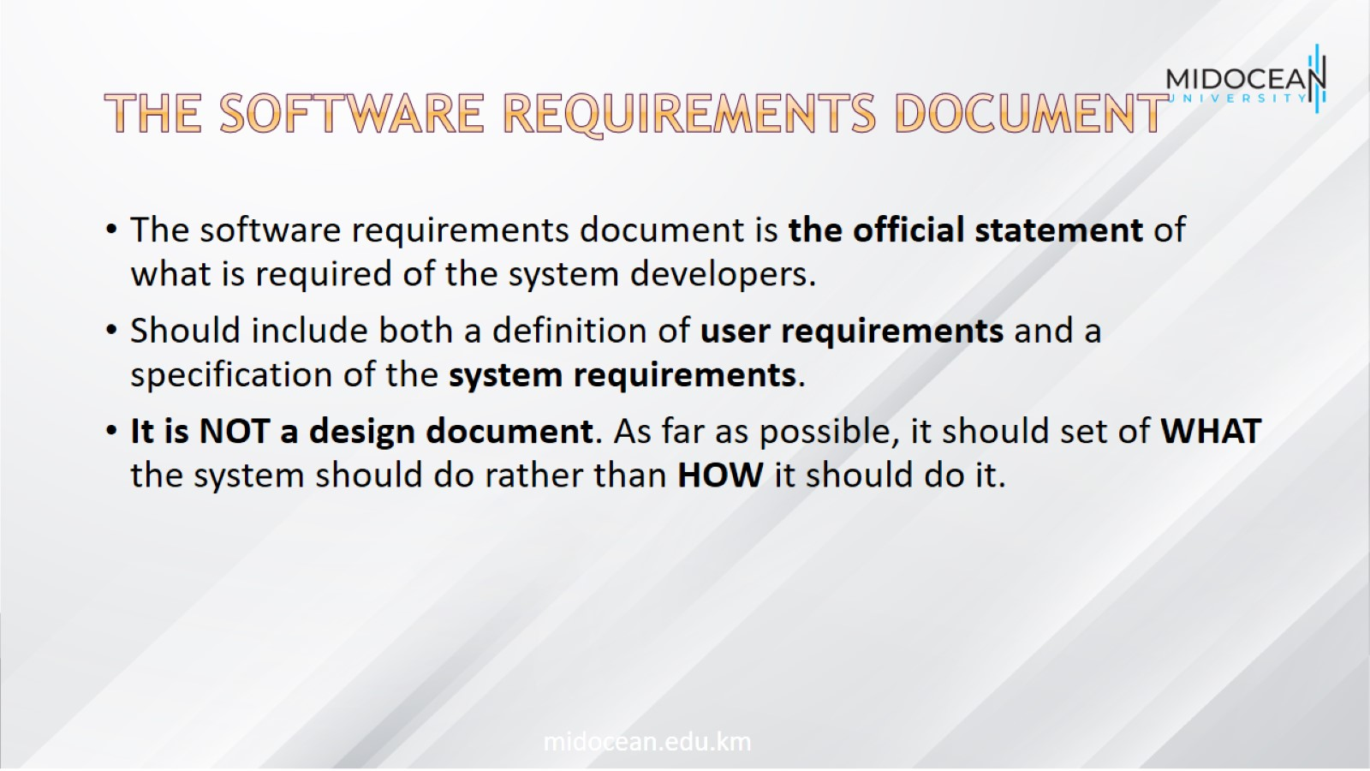
The software requirements document

Slide 21
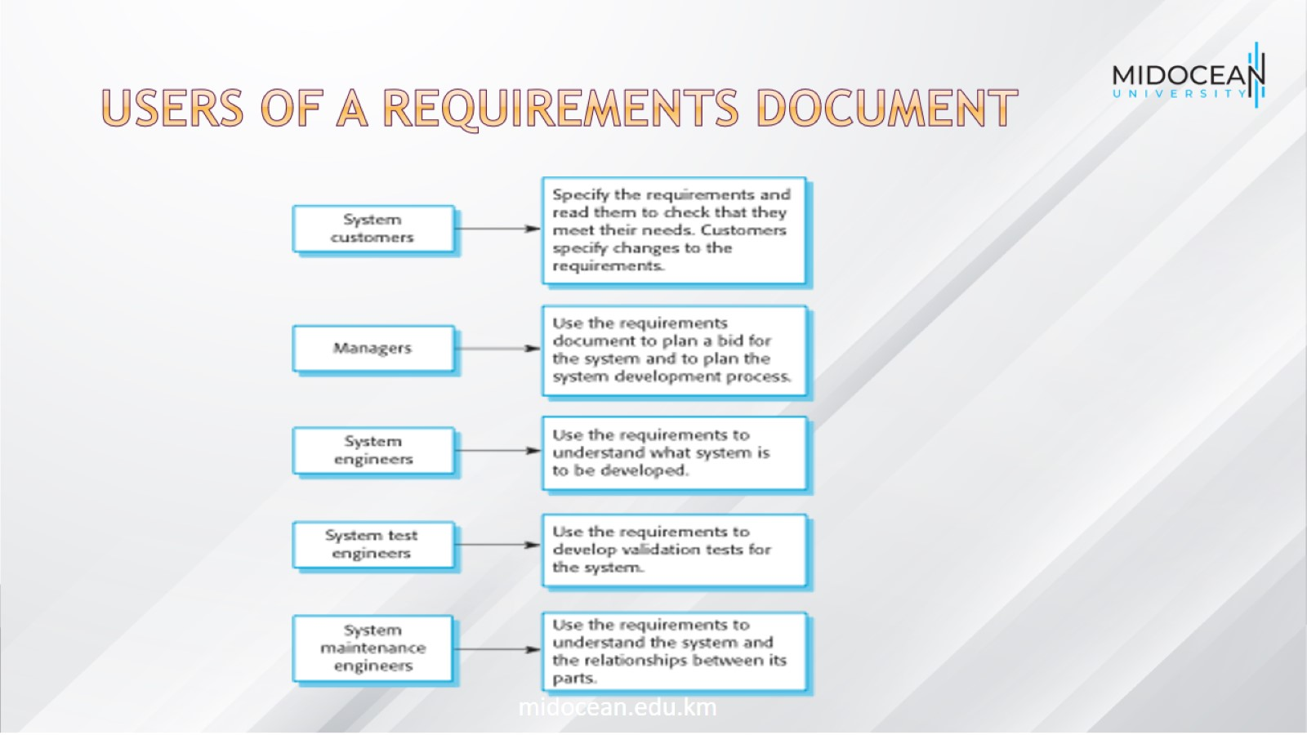
Users of a requirements document

Slide 22
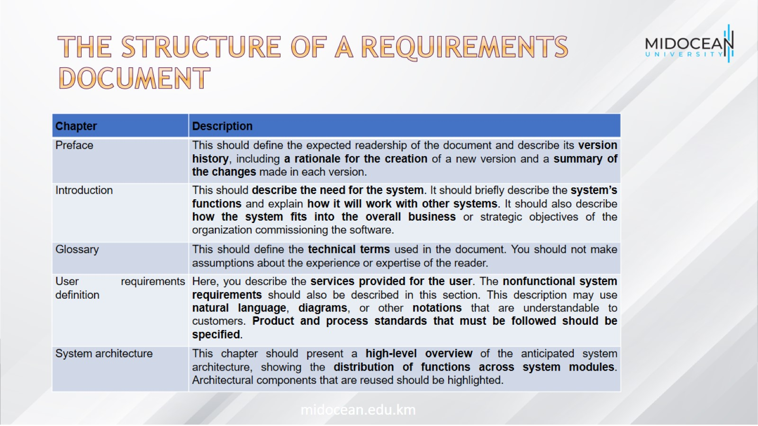
The structure of a requirements document

Slide 23
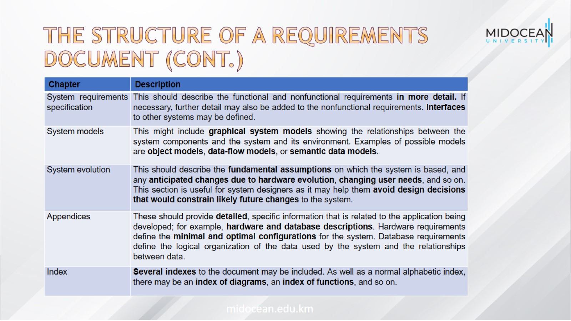
The structure of a requirements document (Cont.)

Slide 24
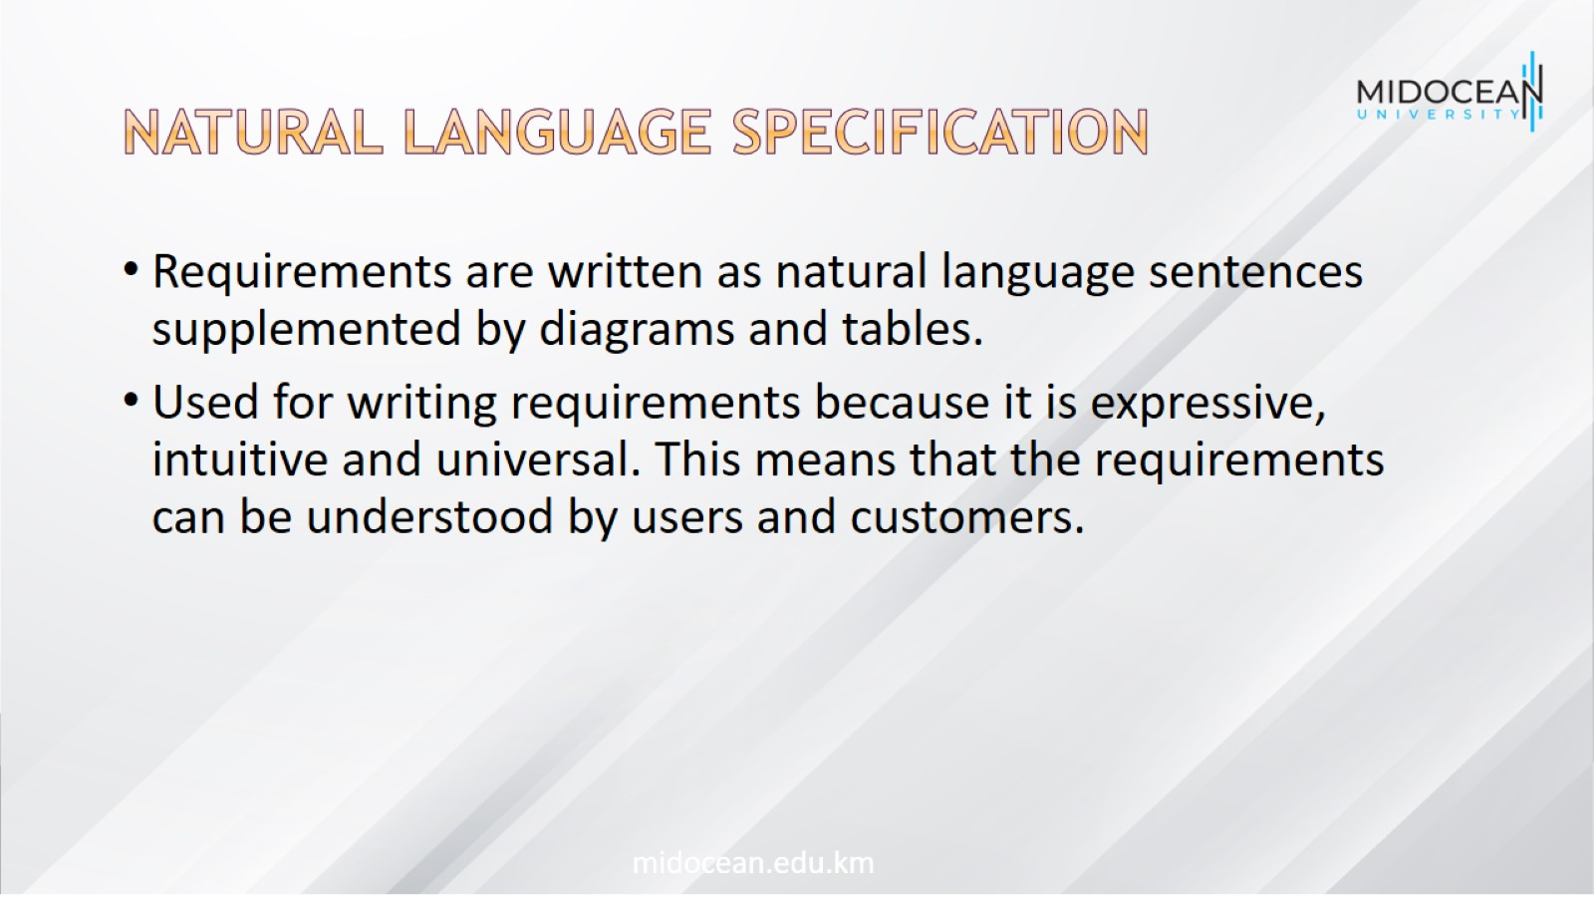
Natural language specification

Slide 25
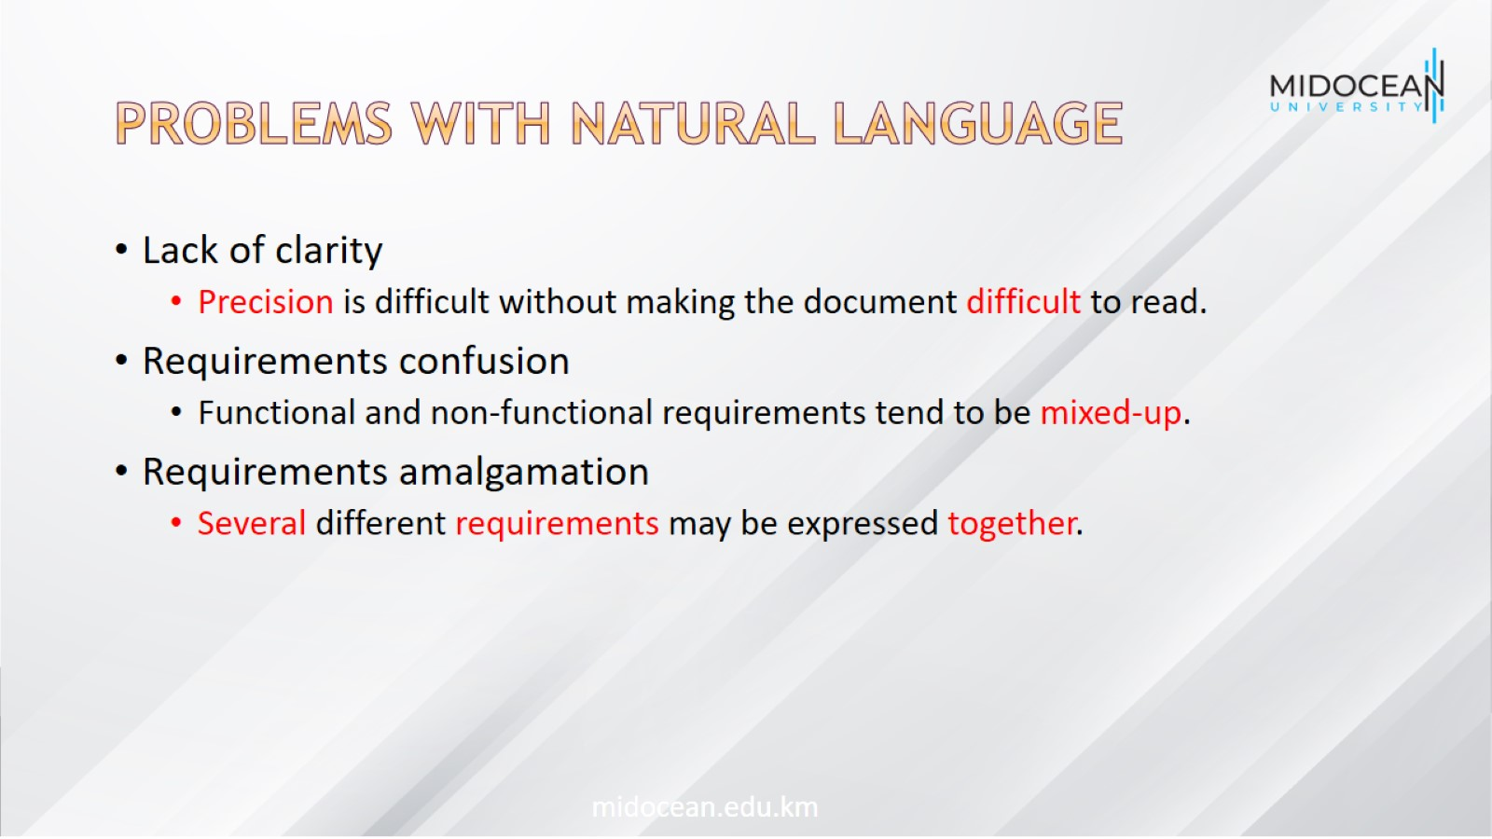
Problems with natural language

Slide 26
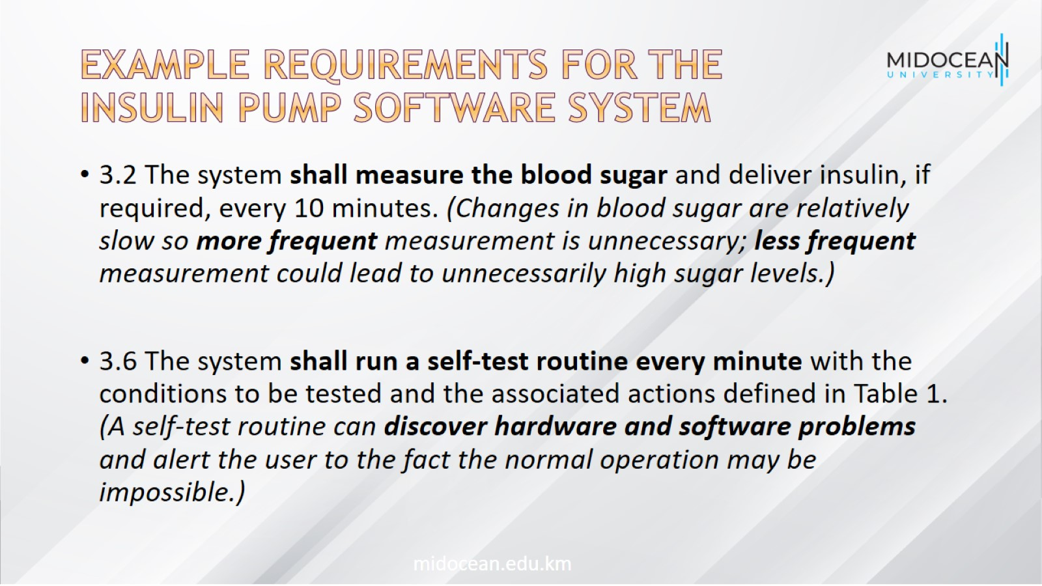
Example requirements for the insulin pump software system

Slide 27
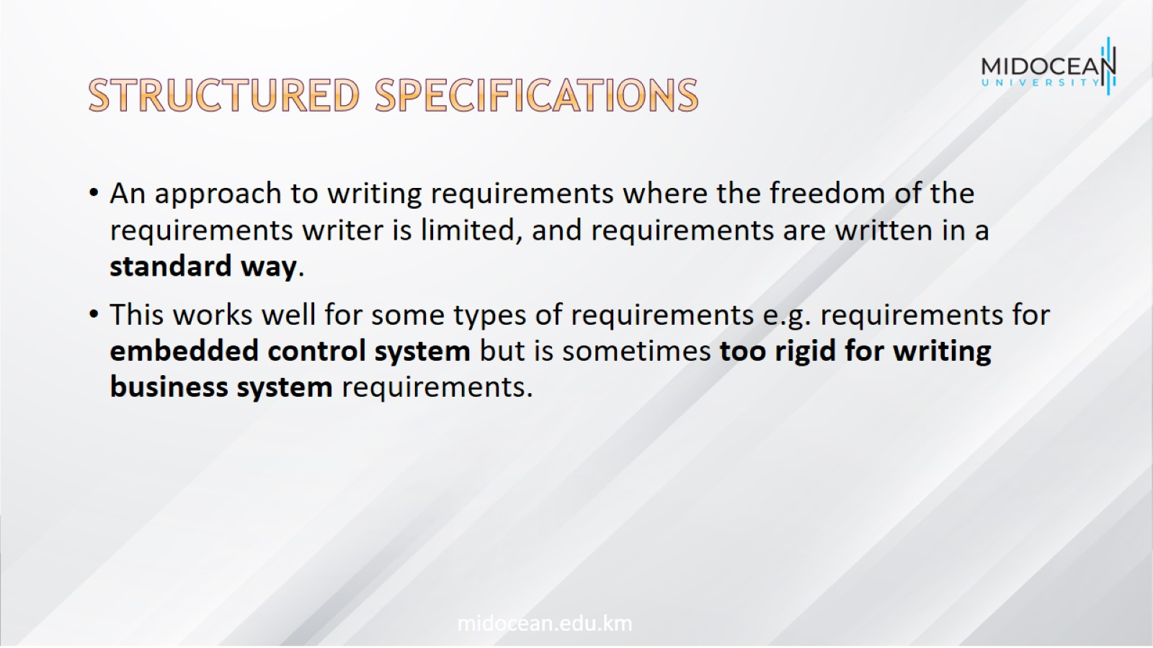
Structured specifications

Slide 28
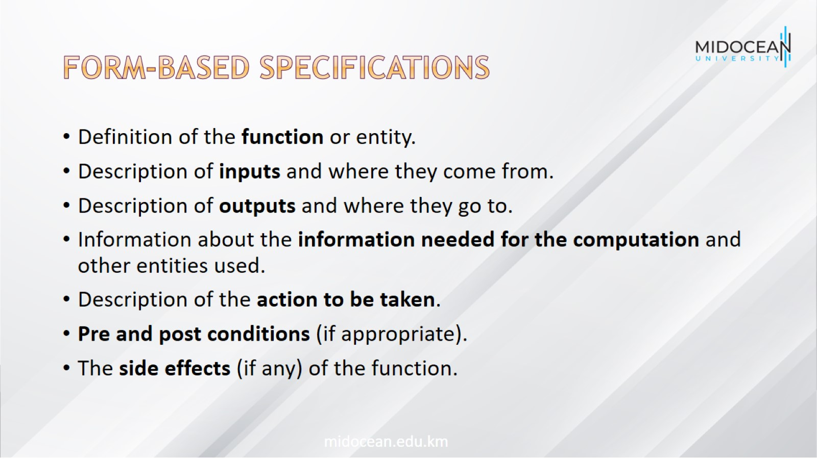
Form-based specifications

Slide 29
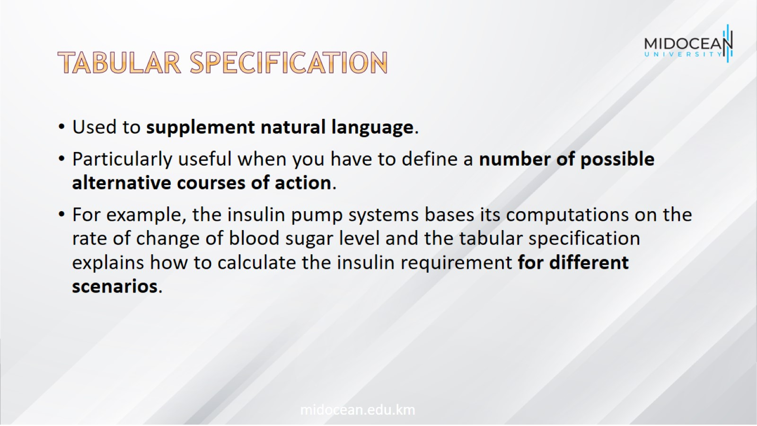
Tabular specification

Slide 30
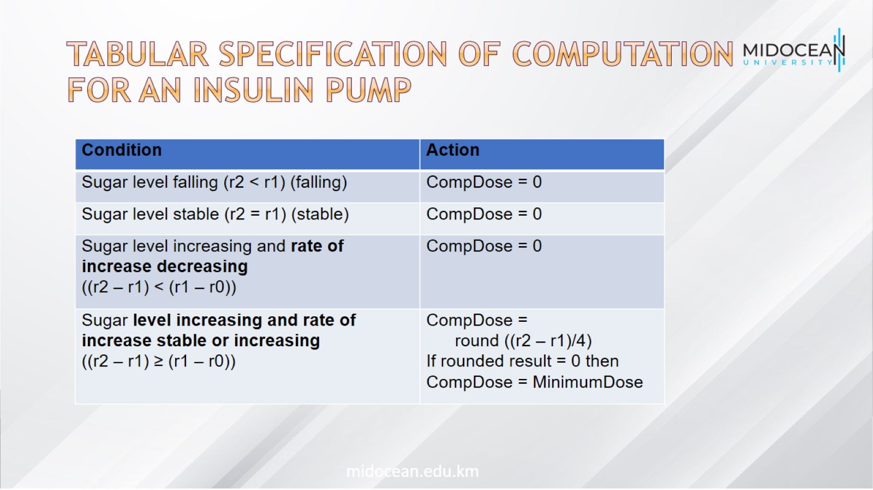
Tabular specification of computation for an insulin pump

Slide 31
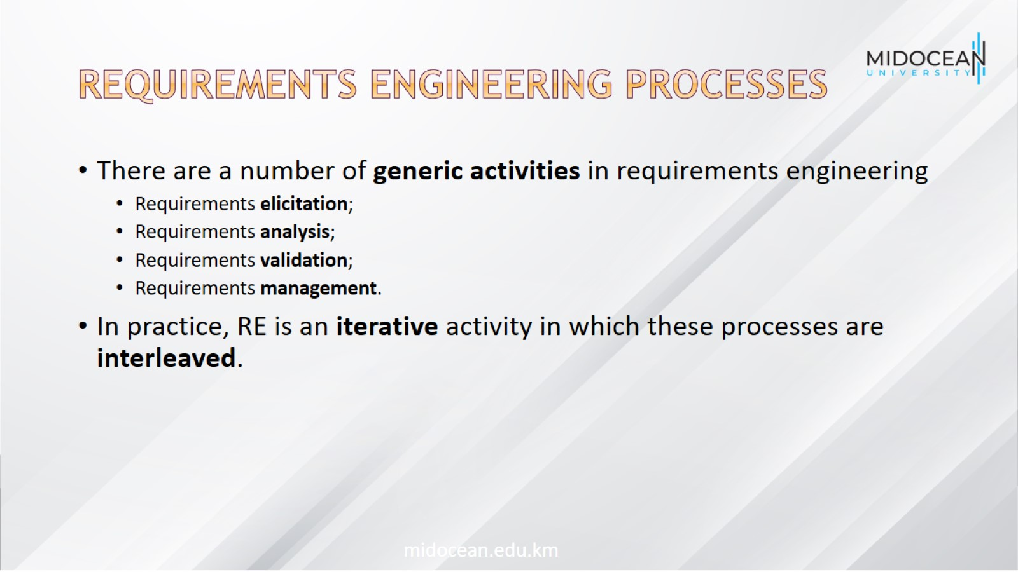
Requirements engineering processes

Slide 32
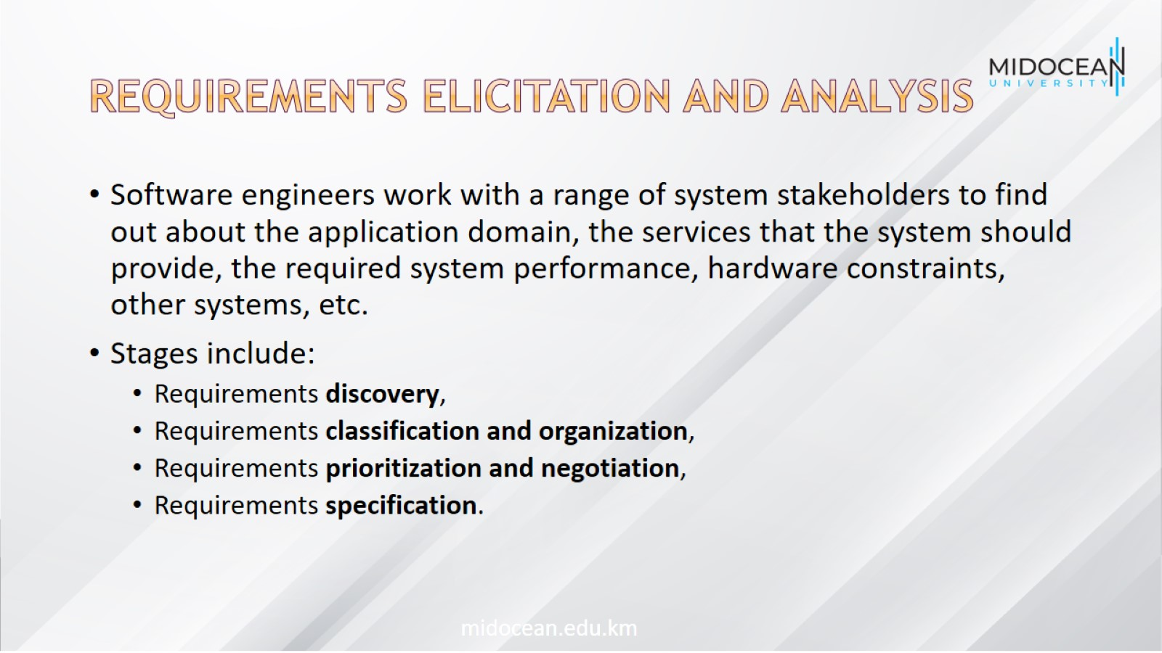
Requirements elicitation and analysis

Slide 33
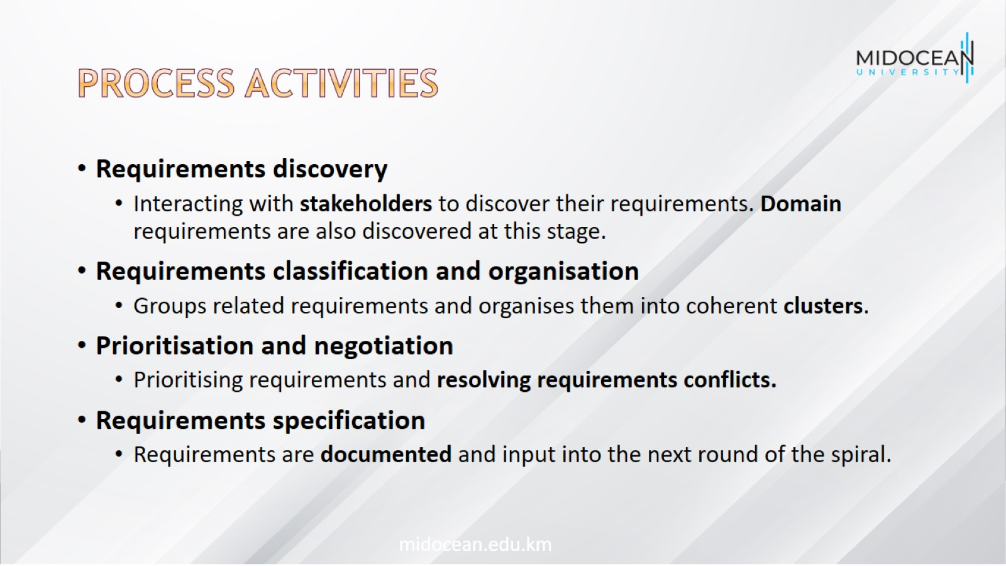
Process activities

Slide 34
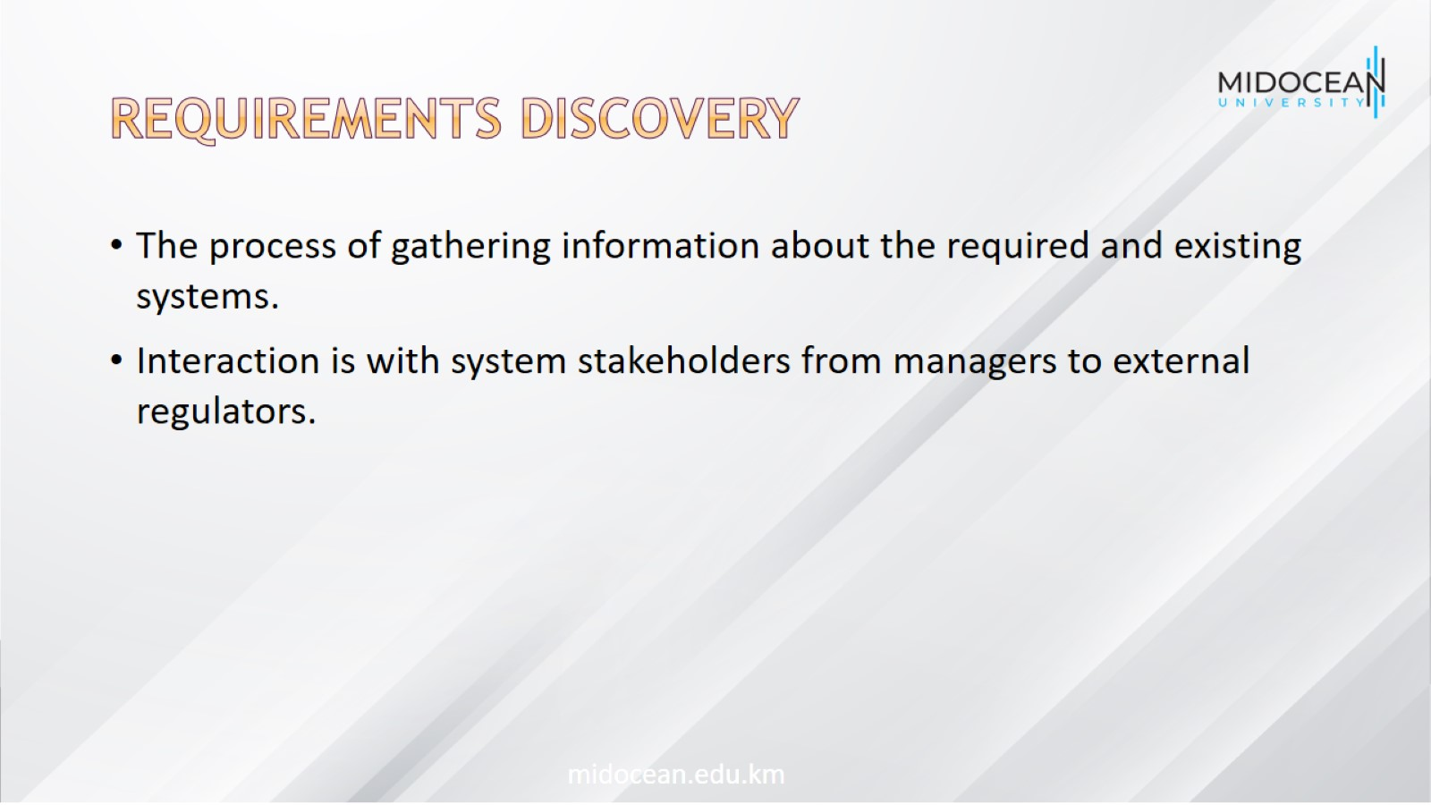
Requirements discovery

Slide 35
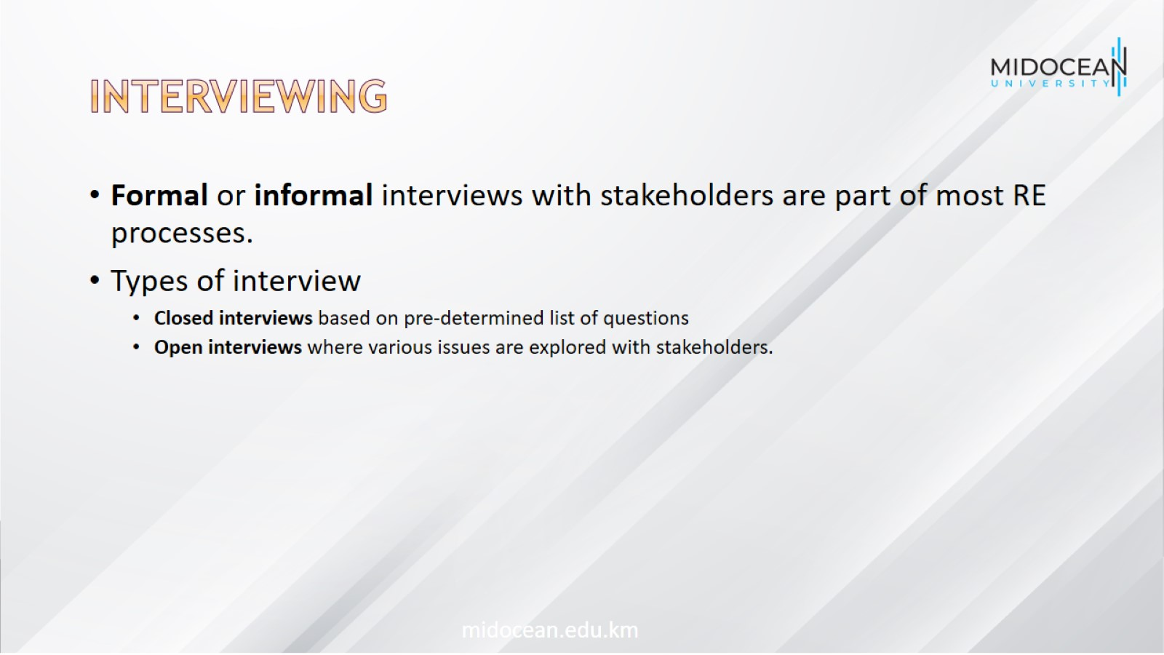
Interviewing

Slide 36
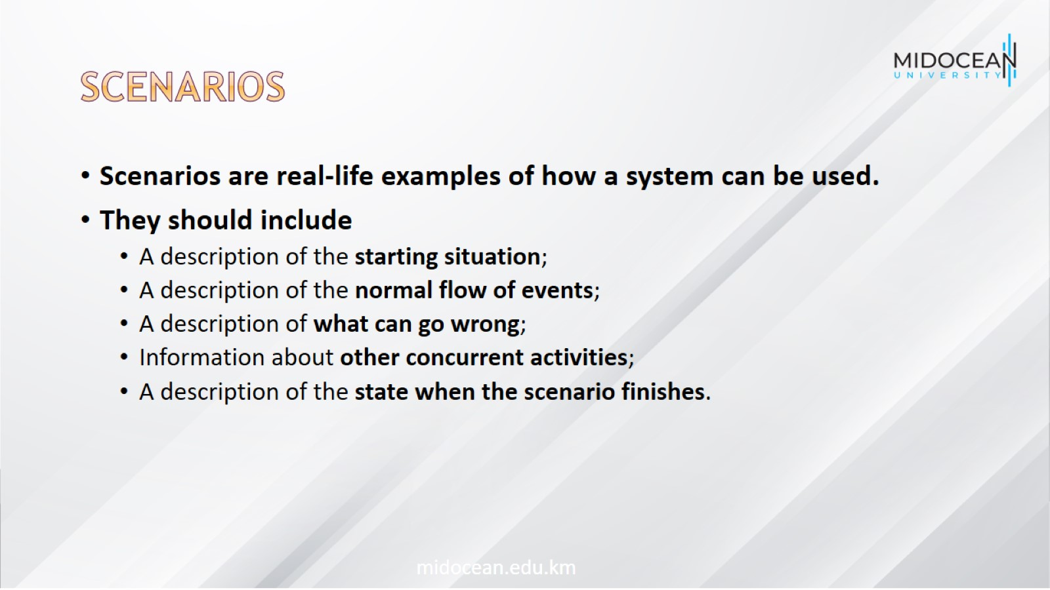
Scenarios

Slide 37
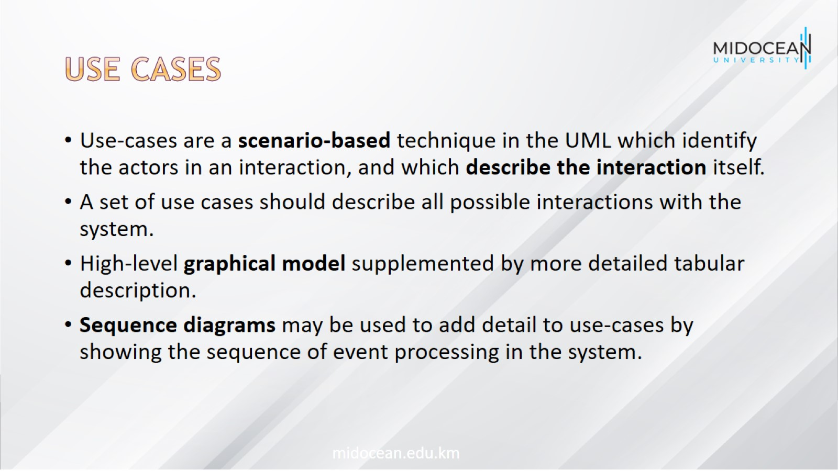
Use cases

Slide 38
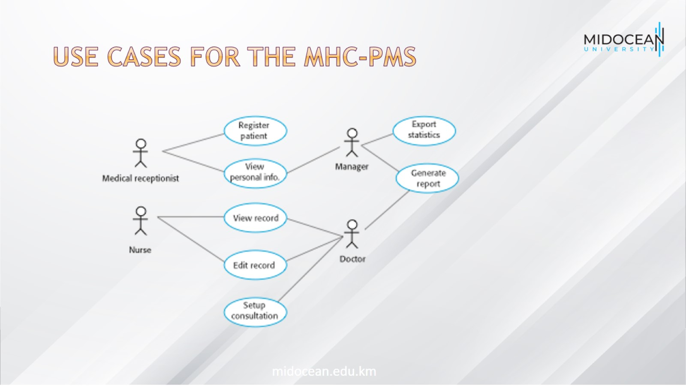
Use cases for the MHC-PMS

Slide 39
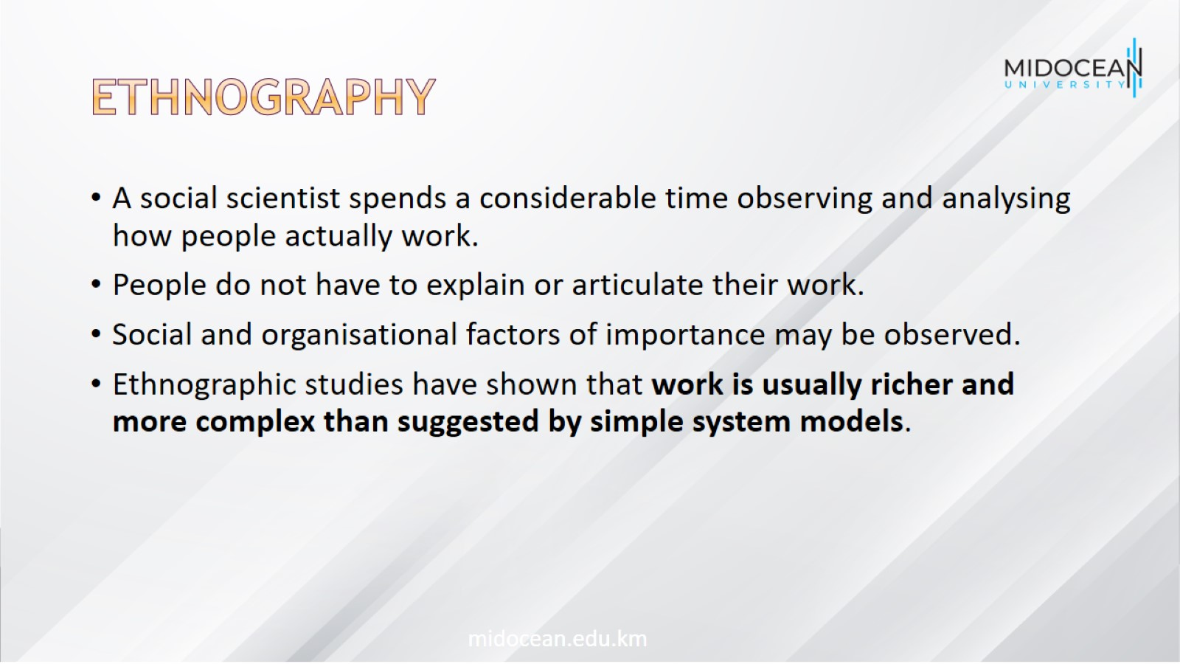
Ethnography

Slide 40
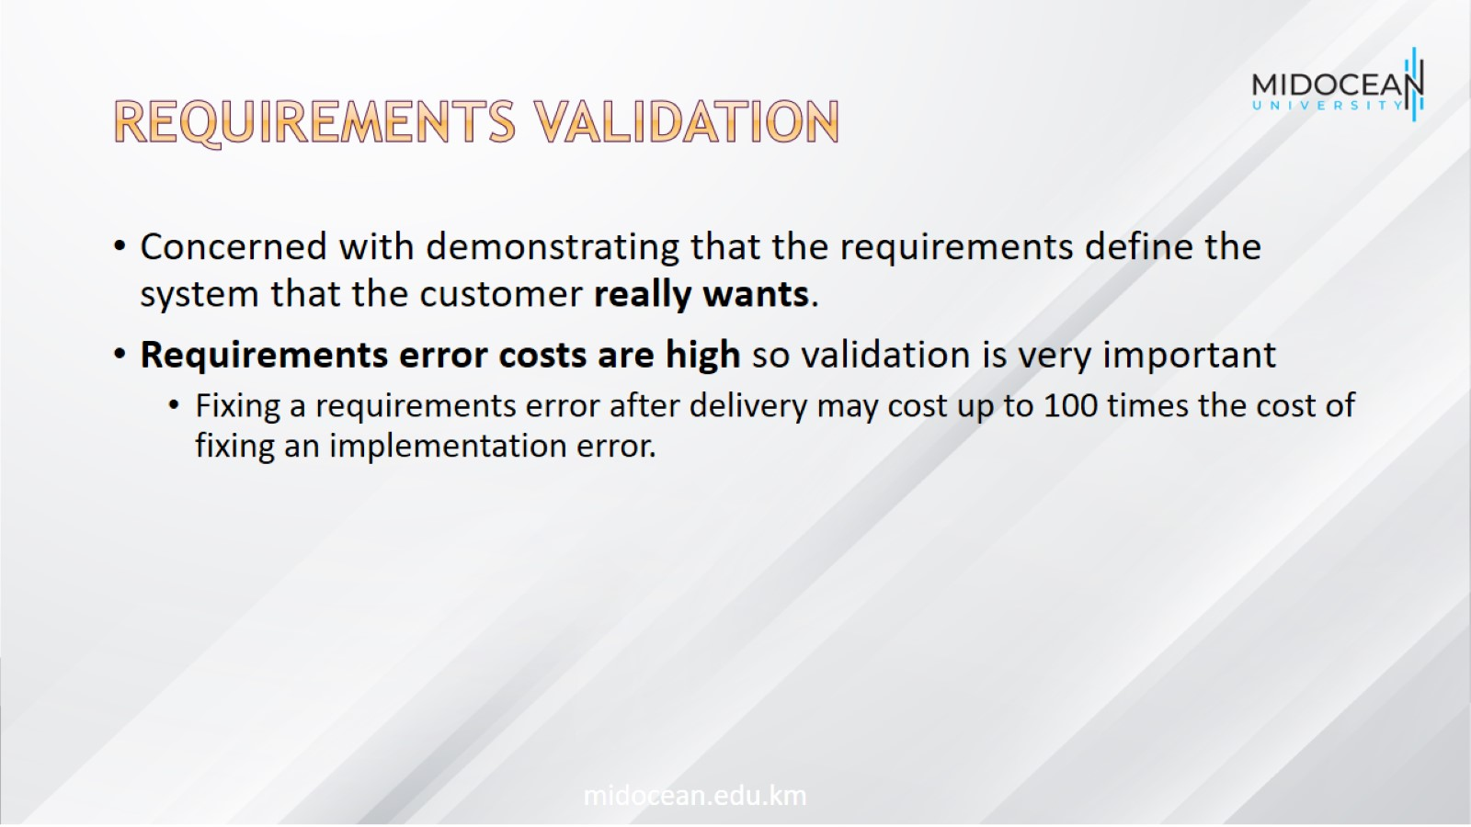
Requirements validation

Slide 41
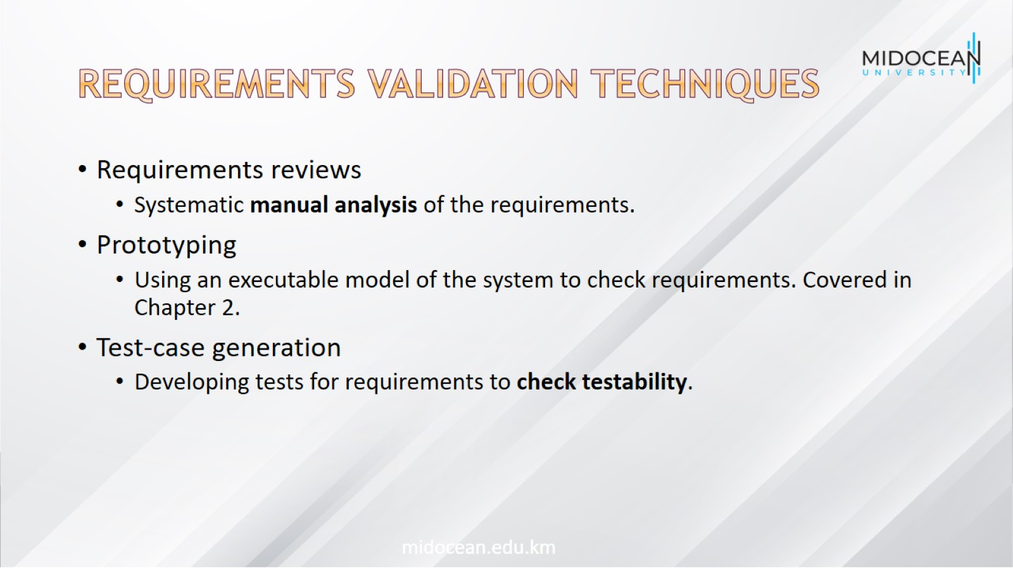
Requirements validation techniques

Slide 42
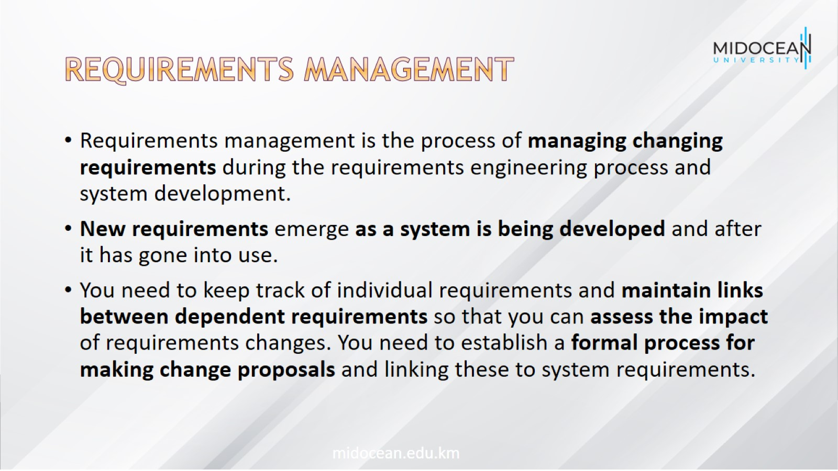
Requirements management

Slide 43
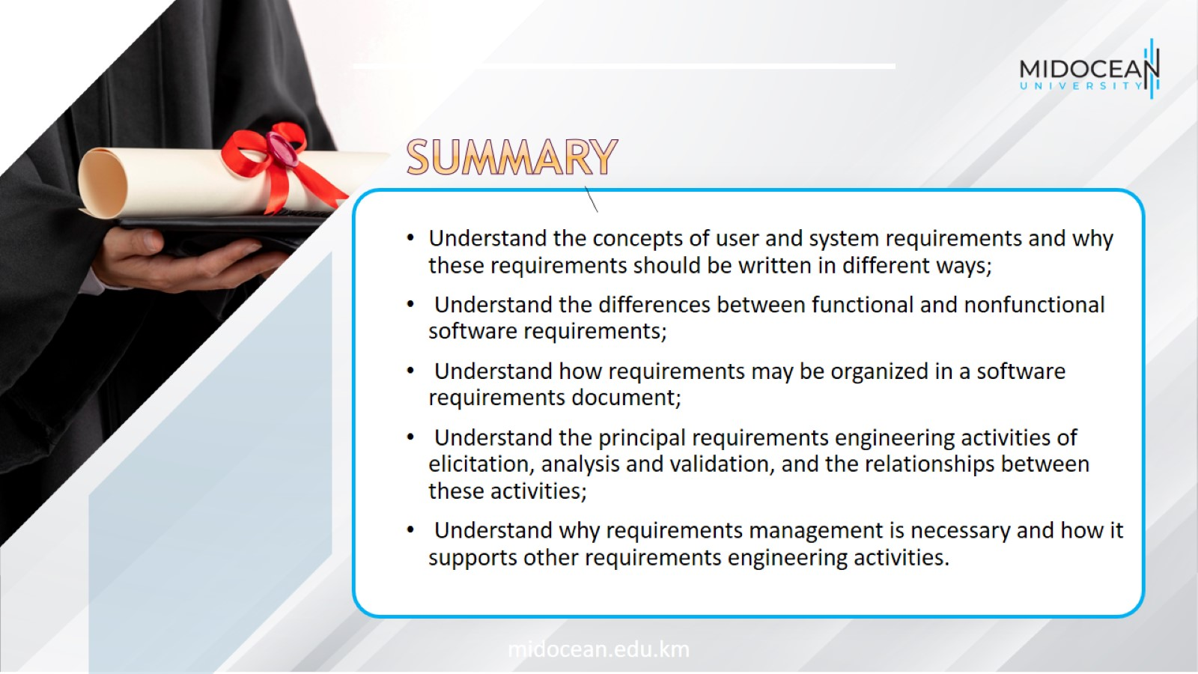

Slide 44


