Slide 1



Lecture 5
FNT 628
Blockchain and Cryptocurrencies
Prepared by Dr. Yara Ibrahim
www.midocean.ae

Slide 2
An Overview of Crypto Markets

Slide 3
Table of Contents
Introduction
The key elements of the crypto ecosystem
Structural flaws and risks
Conclusions .

Slide 4
Introduction
The market capitalisation of the crypto ecosystem – notwithstanding a significant decline in 2022 – lies in the trillions of dollars, and there are thousands of crypto coins in circulation.
The spread of crypto has been global in nature and driven by a wide range of investors.
In theory, the crypto universe builds on the premise of decentralisation.
Rather than relying on central bank money and trusted intermediaries, crypto envisages that the recordkeeping of transfers is provided by a multitude of anonymous validators.
Decentralised finance, or “DeFi”, seeks to replicate conventional financial services in a decentralised way within the crypto universe, often underpinned by the medium of exchange role of stablecoins.
DeFi incorporates innovations such as programmability and composability on blockchains Such systems are “always on”, allowing for worldwide transactions 24 hours per day, seven days per week.

Slide 5
Introduction
The report has three key takeaways.
  First, the crypto ecosystem is subject to a high degree of fragmentation and is characterised by congestion and high fees. This would have been the case even if it had stayed true to its original decentralised ethos. These structural flaws derive from the underlying economics of incentives of validators rather than from technology. And while crypto has offered some elements of genuine innovation, these can be replicated or embedded in the safer and more trusted traditional finance system (BIS (2023)).
  Second, despite an original ethos of decentralisation, crypto and DeFi often feature substantial de facto centralisation, which introduces various pain points. A prime example concerns stablecoins, which piggyback on the credibility of the central bank’s unit of account and may pose risks to monetary sovereignty.
  Third, while DeFi mostly replicates services offered by the traditional financial system, it does not finance any activity in the real economy but amplifies known risks. As growth is driven mainly by the speculative influx of new users hoping for high returns, crypto and DeFi pose substantial risks to (especially retail) investors. In sum, crypto’s inherent structural flaws make it unsuitable to play a constructive role in the monetary system (BIS (2022)).

Slide 6
The key elements of the crypto ecosystem
This section describes the main components of the crypto ecosystem. It begins by tracing the development of Bitcoin and blockchain technology. It then discusses the growing role of centralised intermediaries in the ecosystem. In particular, it discusses stablecoins, which are most often issued by centralised entities and grew from a bespoke solution to the inherent volatility of crypto assets to becoming a pillar of the crypto ecosystem. The section concludes with a discussion of smart contracts and the decentralised finance applications that build on them.

Slide 7
Unbacked crypto
The birth of crypto dates to the introduction of Bitcoin in 2009: a decentralised, peer-to-peer means of transferring value on a shared public ledger (ie a public blockchain using distributed ledger technology (DLT)). In its original formulation, crypto was characterised by not being backed by any asset, as well as by a stated claim to reduce the influence of intermediaries through decentralisation (Nakamoto (2008)).
Ownership of crypto assets and transactions with them are verified by decentralised validators and recorded on the public ledger.
If a seller wants to transfer cryptoassets to a buyer, the buyer (identified through their cryptographic digital signature) broadcasts the transaction details, eg transacting parties, amount or fees.
Validators (in some networks called “miners”) then compete to verify the transaction, and whoever is selected to verify appends the list of transactions to the blockchain and is compensated in fees paid in cryptoassets.
The updated blockchain is then shared among all miners and users. In this way, the history of all transactions is publicly observable and tied to specific wallets, while the true identities of the parties behind transactions (ie the owners of the wallets) remain undisclosed.
In this sense, transactions on blockchains are pseudo-anonymous. By broadcasting all information publicly, the system verifies that every transaction is consistent with the history of transfers on the blockchain, eg that the cryptocurrency actually belongs to the seller and has not been spent more than once.

Slide 8
Unbacked crypto
As cryptoassets started attracting broader attention from potential investors, centralised entities played a greater role in channelling funds into crypto coins.
In particular, centralised exchanges, which facilitated the conversion between Bitcoin, other cryptoassets and fiat money, contributed to rising crypto prices by attracting new participants, in a self-reinforcing loop.
Centralised intermediaries (notably platforms such as Mt Gox in the early days, and more recently Binance, Coinbase, Kraken and FTX until its sudden collapse in late 2022) have reasserted their key role in the crypto ecosystem time and time again.
This system has come to be known within the crypto space as centralised finance (CeFi), and its ups and downs have contributed to the volatility of cryptoasset prices (Graph 1.A).

Slide 9
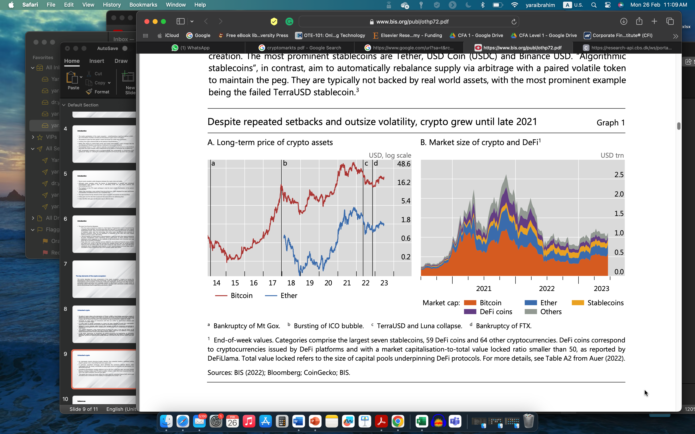

Slide 10
Stablecoins
Stablecoins have established themselves as the main medium of exchange within the crypto ecosystem and as a gateway into it.
They are so-called because they aim to maintain a stable value relative to a specified asset or pool of assets. Stablecoins are usually pegged to a numeraire, almost always the US dollar, but can also target the price of other currencies or assets (eg gold or even other cryptoassets).
In this way, they seek to overcome high volatility and low liquidity to play the role of a medium of exchange in the crypto universe. Stablecoins also play a key role in the DeFi ecosystem.
Stablecoins come in two main types, depending on how they attempt to maintain their peg (FSB (2022)).

Slide 11
Stablecoins
Most stablecoin arrangements are managed by a centralised intermediary and are “asset-backed”.
The underlying assets can include US government bonds, short-term corporate debt or bank deposits.
The centralised intermediary invests the underlying collateral and coordinates the coins’ redemption and creation.
The most prominent stablecoins are Tether, USD Coin (USDC) and Binance USD. “Algorithmic stablecoins”, in contrast, aim to automatically rebalance supply via arbitrage with a paired volatile token to maintain the peg.
They are typically not backed by real world assets, with the most prominent example being the failed TerraUSD stablecoin

Slide 12
Smart contracts and decentralised finance
Since the advent of Bitcoin, many other blockchains and associated crypto coins have entered the scene, most notably Ethereum and its associated native coin Ether in 2015 (Graph 1.B).
Ethereum and many of the newer blockchains allow for “programmability”, ie they give developers the option of building applications on top of their blockchain through the use of so-called smart contracts.
Smart contracts are self-executing code that triggers an action if certain pre-specified conditions are met.
They can automate some market functions and to some extent obviate intermediaries that are traditionally required to make decisions.
They are therefore better thought of as unattended contracts (Neilson (2021)).
The underlying code is publicly available (ie open source) and can be scrutinised.
As smart contracts cannot directly access information that resides “off-chain”, ie outside the specific blockchain, they require so-called oracles as mediators to provide such data.

Slide 13
Smart contracts and decentralised finance
An important feature of smart contracts is their “composability”, ie the capacity to combine different components in the system.
Users can perform complex transactions on the same blockchain by combining multiple instructions within one single smart contract – like “money lego”.
Programmability also opened the door to DeFi, a new ecosystem for the provision of crypto services.
DeFi aims to offer traditional financial services and products on the blockchain, with the declared objective of greater transparency and cutting out the middlemen to lower costs.
DeFi protocols combine multiple smart contracts to provide lending, borrowing and trading services within the crypto ecosystem. Decentralised applications (dApps) are graphical interfaces that allow users to interact with protocols from their computers or smartphones.

Slide 14
Smart contracts and decentralised finance
While they are not strictly necessary to interact with the DeFi ecosystem, as users could set up their own interface, they are the entry point to DeFi for all but the savviest participants.
Stablecoins play an important role in the DeFi ecosystem by serving as a medium of exchange in a wide range of activities (Graph 2.A).
For one, they provide liquidity to the DeFi ecosystem by allowing users to move in and out of decentralised applications. Relatedly, stablecoins serve as trading pairs for other cryptoassets in decentralised exchanges, thereby allowing users to trade crypto without having to convert back to fiat currency, hence reducing transaction costs.
Moreover, stablecoins are widely used on DeFi lending and borrowing platforms, where users borrow and lend stablecoins against collateral in the form of other cryptoassets. Because of this key role, turnover in stablecoins generally dwarfs that of other cryptoassets (Graph 2.B).

Slide 15
Smart contracts and decentralised finance
The main types of financial activity in DeFi, such as lending, trading and insurance, are the same as those already available in traditional finance.
Lending platforms allow users to lend out their stablecoins with interest to borrowers that post other cryptocurrencies as collateral.
Decentralised exchanges (DEXs) represent marketplaces where transactions occur directly between cryptocurrency or stablecoin traders, and prices are determined via automated mathematical formulas.
On DeFi insurance platforms, users can insure themselves against some risks within the crypto system, eg the mishandling of private keys, exchange hacks or smart contract failures, receiving cryptoassets as compensation.

Slide 16
Smart contracts and decentralised finance
Yet, DeFi activities almost exclusively involve exchanging one stablecoin or crypto coin for another, and do not finance activity in the real economy.
In this sense, the system is mostly self-referential and used for speculation in coins.
Growth is driven mainly by the continuous influx of new users hoping for high returns.
Indeed, recent evidence suggests that rising crypto prices are followed by significantly higher adoption of crypto trading apps, as new users are lured by the prospect of further gains.

Slide 17
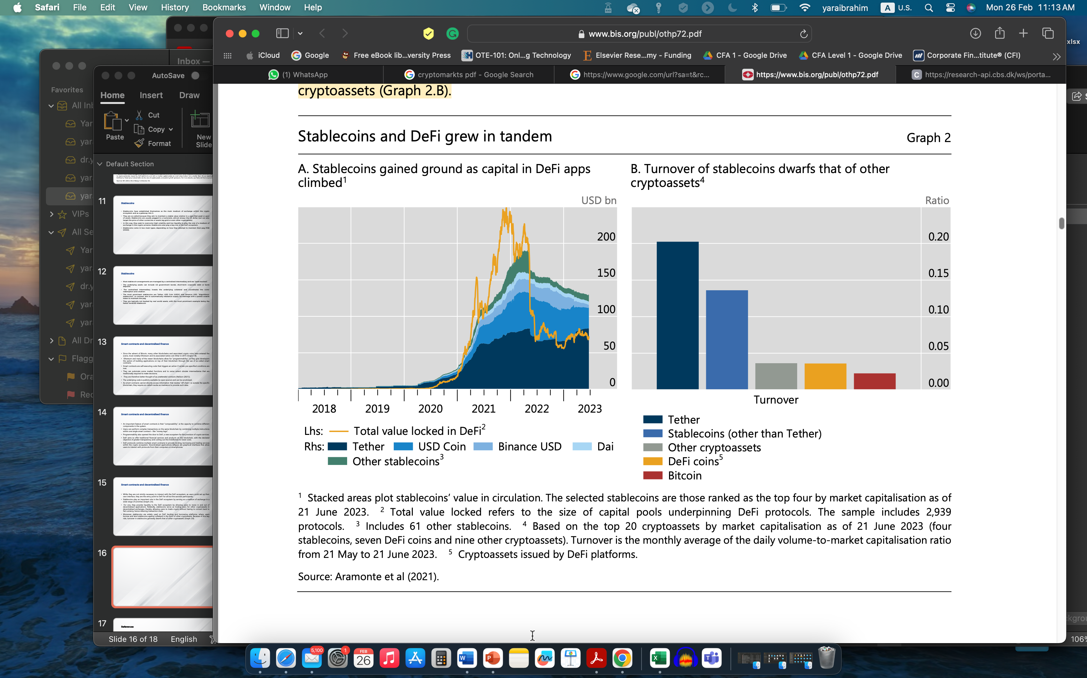

Slide 18
Structural flaws and risks
This section highlights that, despite the potential for genuine technological innovation, crypto has inherent structural flaws that pose serious risks not only to its own stability and safety, but also to the traditional financial system.
The section first reviews the main structural flaws of the crypto ecosystem, including congestion, fragmentation and the need to borrow credibility from sovereign money.
It also discusses the problems arising from the need for centralisation.
The section then summarises the main risks, splitting them into risks within the crypto ecosystem (including risks to market integrity, consumer protection and privacy), risks specific to DeFi and risks arising from the interconnectedness with the traditional financial system.
The section then discusses options for addressing the risks posed by crypto, before closing with a discussion of the data gaps that currently hinder monitoring.

Slide 19
3.1.1 Fragmentation and congestion
The blockchain capacity problem is a manifestation of the so-called scalability trilemma (Buterin (2021)).
By their nature, permissionless blockchains can achieve only two of the three properties: security, decentralisation and scalability. Security – in the sense of truthful reporting and preventing manipulation of the transaction history – is enhanced through incentives and decentralisation. But sustaining incentives entails congestion, which limits scalability.
It is this incompatibility between three key attributes that impairs blockchains’ ability to serve as an efficient payment system and crypto’s ability to serve as money.
Limited scalability has resulted in the fragmentation of the crypto universe, as newer blockchains with more capacity that possibly cut corners on security entered the fray.
These newer blockchains often aim for higher transaction limits, even if these come at the cost of greater centralisation and weaker security.
Simply put, on blockchains that rely on a larger network of validators and where each validator has only limited influence over the consensus, it is harder for one validator to manipulate the ledger.
But this also means that every transaction takes longer to be validated, implying higher costs for users, and hence higher required rewards.
Such blockchains therefore become congested more rapidly.
On blockchains with fewer validators, on the other hand, there is more potential for a smaller group of validators to manipulate the network.

Slide 20
3.1.1 Fragmentation and congestion
The Terra blockchain was just the most glaring example of a large number of new entrants (Graph 3.B).
As recently as the beginning of 2021, Ethereum accounted for almost all of the total value locked in DeFi protocols. By May 2022, this share had dropped to 50%. The widening wedge (red area) accounted for by the failed Terra blockchain is particularly striking, as the collapse of the Terra blockchain highlights the tendency to fragmentation through crypto’s vulnerability to new entrants who prioritise market share and capacity at the expense of decentralisation and security.
A system of competing blockchains that are not interoperable introduces new risks of hacks and theft.
In this context, interoperability refers to the ability of protocols and validators to access and share information, as well as validate transactions, across different blockchains.
Interoperability of the underlying settlement layers is not achievable in practice, as each blockchain is a separate record of settlements. Nevertheless, so-called cross-chain bridges have emerged to permit users to transfer coins across blockchains.
Yet, most bridges rely on only a small number of validators, which – in the absence of regulation and legal accountability – users need to trust not to engage in illicit behaviour. As the number of bridges has risen, they have stood at the centre of several high-profile hacks, highlighting vulnerabilities to security breaches stemming from weakness in blockchain governance.
Such hacks could further lower trust in the broader fintech sector, standing in the way of greater adoption (Chen et al (2023), Doerr et al (2023)).

Slide 21
3.1.1 Fragmentation and congestion
The fragmentation of the crypto universe stands in stark contrast to the network effects that take root in traditional networks.
Crypto’s reliance on decentralised validators and the attendant fragmentation leaves no role for money as a coordination device, making crypto unsuitable as a monetary system.
Traditional networks, on the contrary, are characterised by the “winner takes all” property, whereby more users flocking to a particular platform beget even more users.
Such network effects are at the heart of the virtuous circle of lower costs and enhanced trust in traditional platforms

Slide 22
Stablecoins and the search for a nominal anchor
Fiat-backed stablecoins, the dominant form of stablecoin, piggyback on the credibility of the central bank’s unit of account.
Having a unit of account means that everyone uses it as a common measure of the economic value of products and services, greatly facilitating financial and economic transactions.
In the real world, providing the unit of account for the economy is the primary role of the central bank.
While there is no such thing as a central bank in the crypto universe, it needs to have a unit of account, like any monetary system.
Stablecoins attempt to serve this unit-of-account function, but they do so by tying their value to fiat currencies, such as the dollar, whose value is guaranteed by a central bank.
In this sense, stablecoins are the manifestation of crypto’s existential search for a nominal anchor.

Slide 23
The collapse of the TerraUSD stablecoin
The use of TerraUSD (UST) grew rapidly over 2021–22 so that, prior to its collapse in mid-2022, it was the third largest stablecoin, with a peak market capitalisation of almost $19 billion.
An algorithmic stablecoin, UST aimed to keep a one-for-one peg to the US dollar by being convertible into one dollar’s worth of another cryptocurrency, Luna, on the Terra blockchain, and vice versa. For example, should Terra fall to 99 cents, a user could purchase UST on an exchange for 99 cents and then exchange their UST for $1 worth of new units of Luna on the Terra platform.
A crucial aspect of this arrangement was that users would be willing to exchange UST into Luna only if Luna’s market capitalization exceeded that of UST.
As Luna had no intrinsic value, its valuation stemmed primarily from the influx of speculative users into the Terra ecosystem.
To attract new users, the associated lending protocol Anchor offered a deposit rate of
around 20% on UST. As long as users had confidence in the stable value of UST and the sustained market capitalization of Luna, the system could be sustained.
However, once investors lost confidence in the system’s sustainability, the arrangement unravelled. In May 2022, the value of UST plummeted to almost zero (Graph A1.A).
As UST dropped below its peg, a classic run dynamic took hold as investors sought to redeem their funds. Users burned their UST on a large scale to mint one dollar’s worth of new Luna, in the hope of selling Luna while it still had some value.
However, given the size and speed of the shock, confidence evaporated, meaning that there were not enough parties willing to buy all the newly minted Luna coins – and so the price of Luna collapsed.

Slide 24
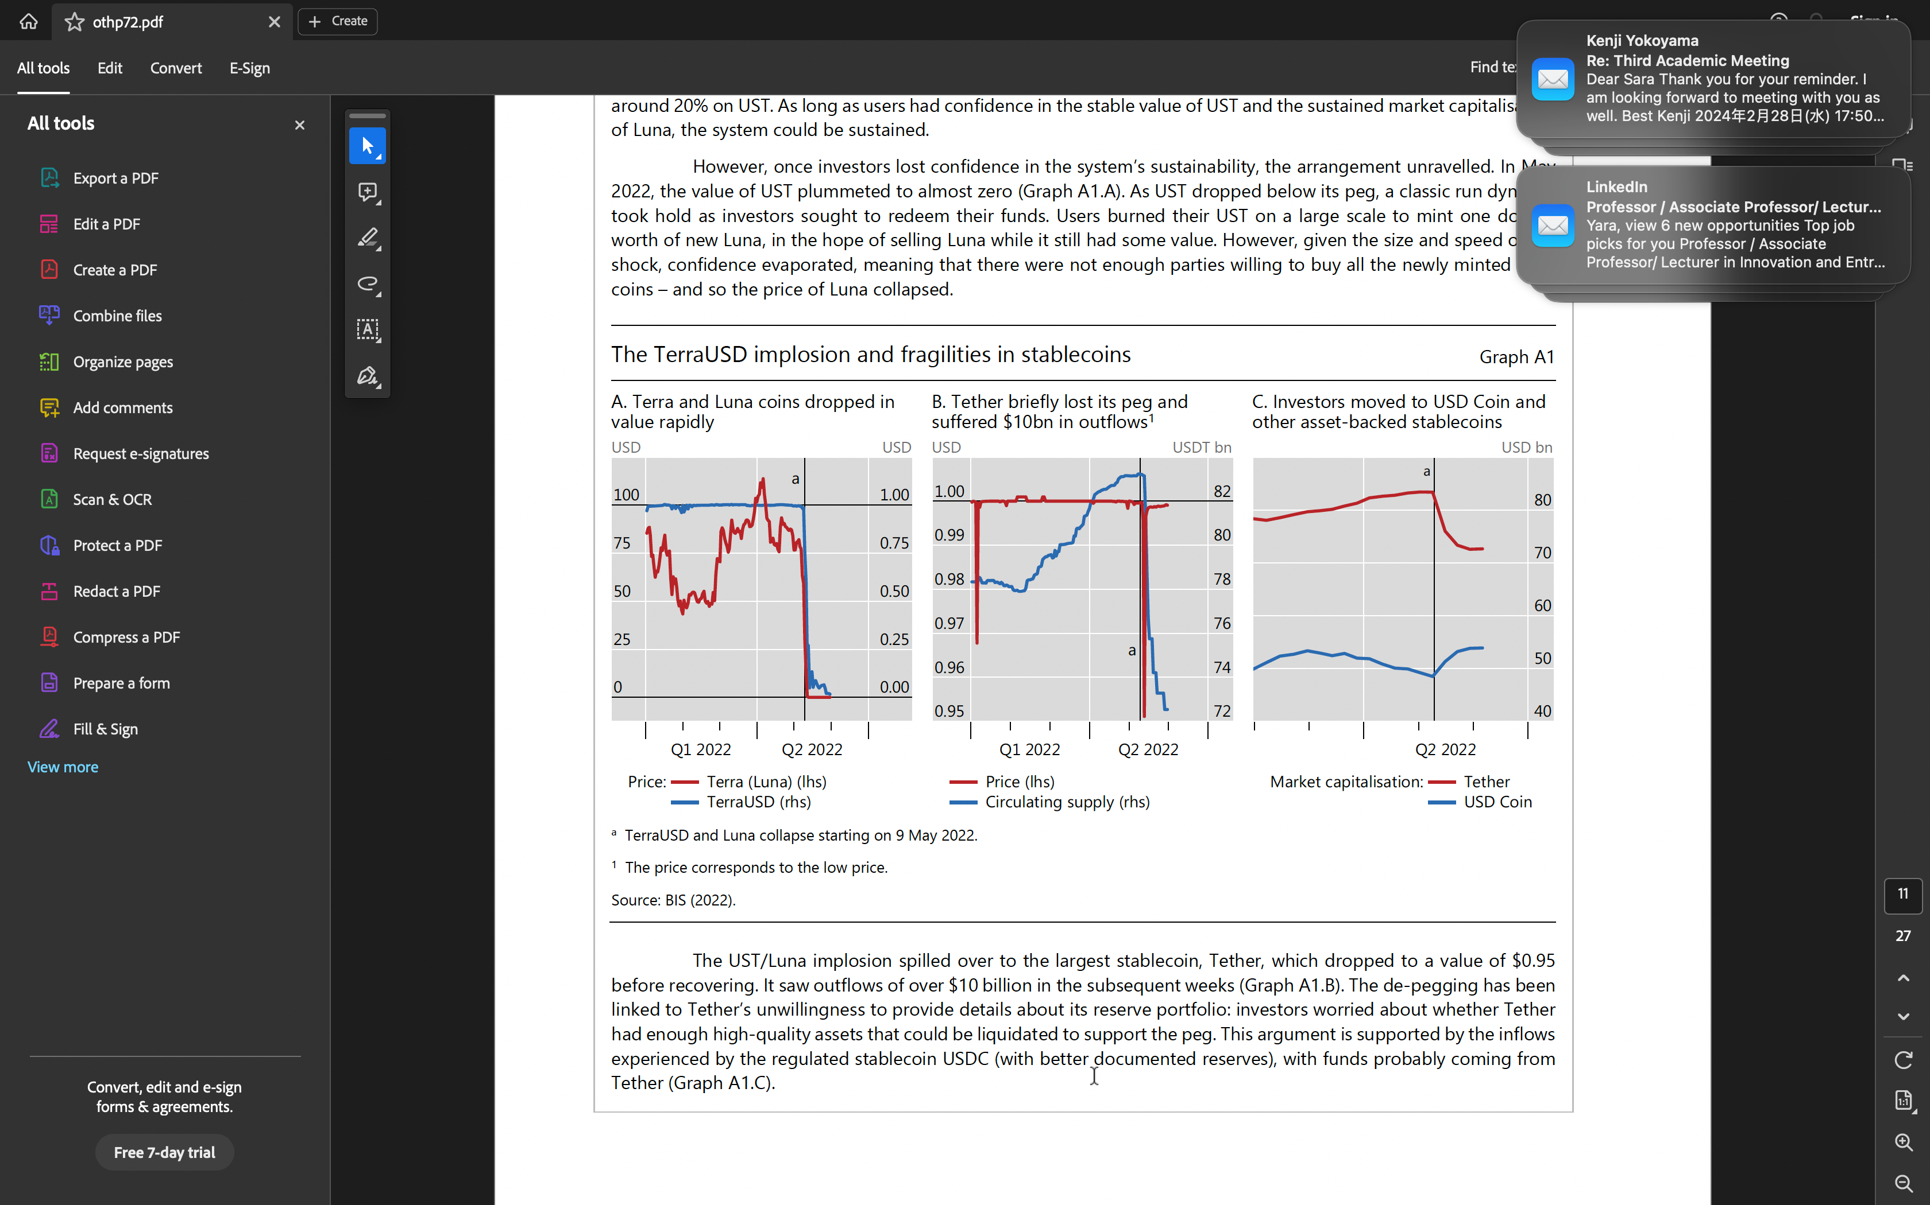

Slide 25
Risks
When discussing the risks of crypto, it is important to note that, to date, the ecosystem is largely selfreferential.
Activities almost exclusively involve exchanging one stablecoin or cryptocurrency for another, without financing any activity in the real economy.
In consequence, crypto currently poses significant risks mainly to investors in the crypto space, while links to the real world remain limited.

Slide 26
Within the crypto ecosystem
Crypto poses significant risks to investors. Rising crypto prices tend to lure retail investors into the space, with an expectation of quick and large capital gains (Graph 5.A).
These expectations are generally not met, however, as a large share of users in most economies tend to lose money (Graph 5.B).
The events of 2022 illustrate vividly the risks faced by investors, especially smaller ones.
The aftermath of the collapses of TerraUSD and FTX saw a striking pattern: the number of daily active users across the major platforms increased markedly, suggesting that users attempted to weather the storm by shifting their portfolios away from stressed tokens into safer alternatives, including asset-backed stablecoins (Graphs 6.A and 6.B).
However, behind this flurry of activity, large investors appear to have benefited at the expense of smaller holders. Indeed, owners of large wallets reduced their bitcoin holdings, whereas medium-sized and especially smaller holders increased their holdings (Graph 6.C).
The lack of control mechanisms in many crypto firms implies that investors’ money is at high risk if these firms face funding challenges or the threat of bankruptcy.
For instance, following its failure, it emerged that FTX owed more than $3 billion to its unsecured creditors – mainly users of the exchange who had transferred their funds there.
FTX was not the only case in which this happened.
Many of the customers of other crypto firms that failed in recent years have been unable to access their funds or have had to wait a very long time to do so.

Slide 27
Within the crypto ecosystem
Crypto is probably also used for illicit activities such as money laundering, the financing of terrorism and tax evasion.
Pseudo-anonymity and lack of oversight certainly contribute to these risks.
The use of crypto thereby presents important challenges for regulators and law enforcement agencies, as they may find it hard to track and trace crypto transactions.
To address these risks, measures aimed at better governance, anti-money laundering (AML) and combating the financing of terrorism (CFT) are needed.
Effective governance frameworks can ensure that market participants are operating in a transparent and accountable manner, promoting the integrity of the financial system.
The Financial Action Task Force has developed guidance on registration and licensing requirements for service providers in the crypto space (FATF (2021, 2022)).

Slide 28
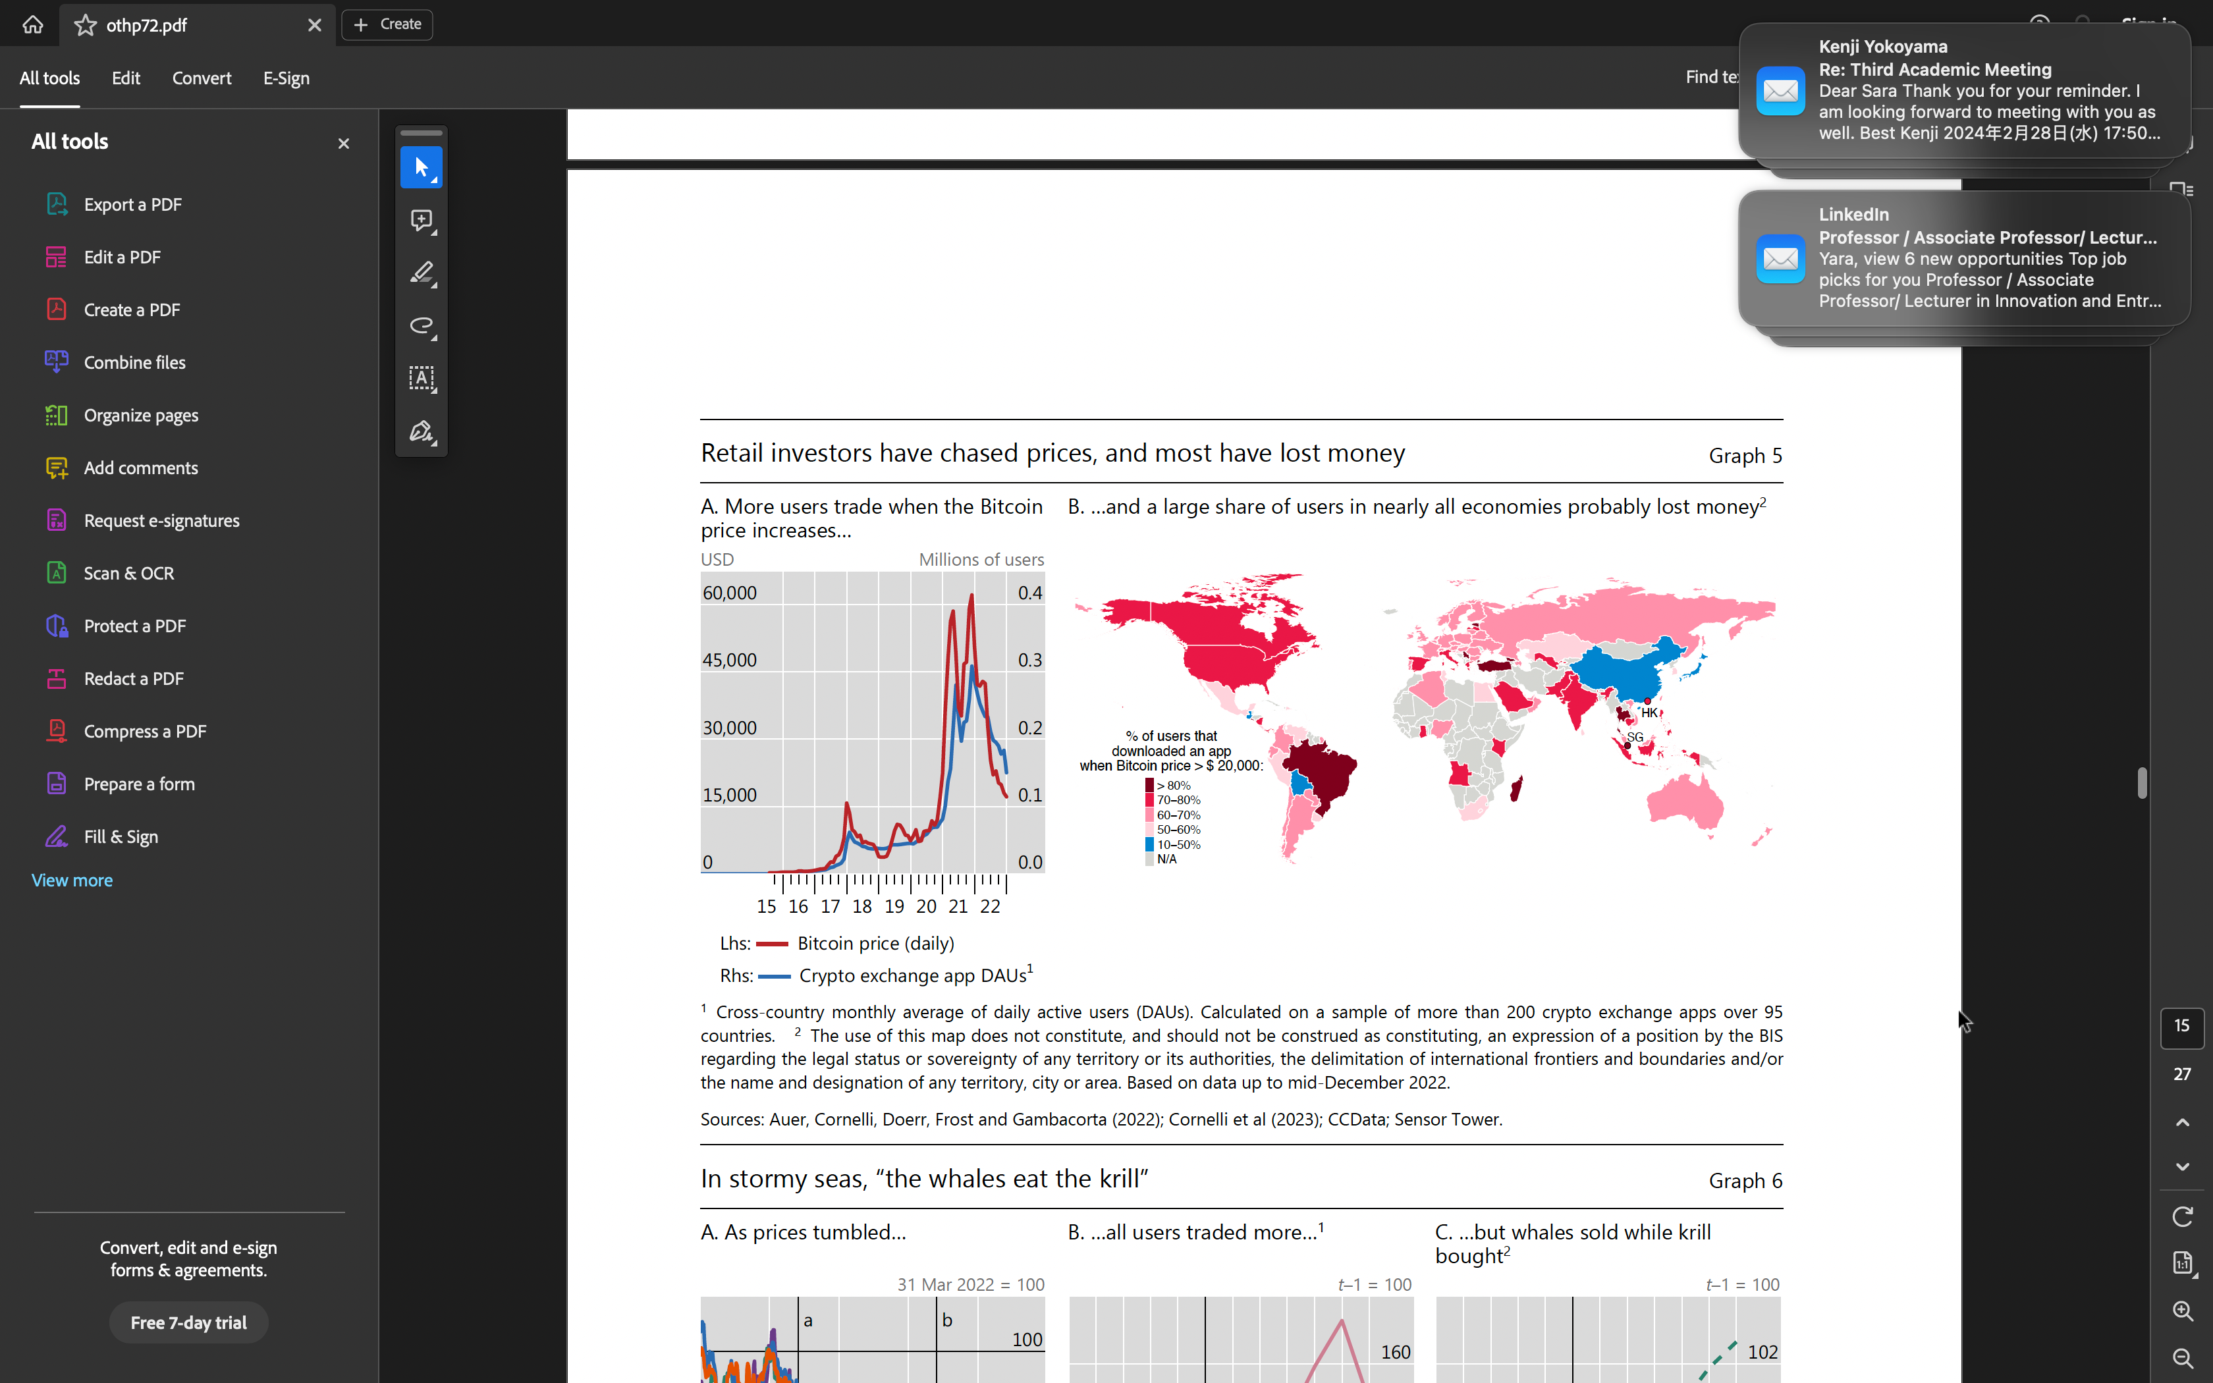

Slide 29
Risks in DeFi
The DeFi ecosystem amplifies several risks that are also present in the traditional financial system (FSB (2023)).
Of particular relevance are operational risks, its reliance on leverage and the complex web of interconnections within the system, which make it particularly prone to episodes of instability.

Slide 30
Operational risks
While all services are subject to operational risk, a number of DeFi features make such risks particularly acute.
These may cause operational disruptions and hinder the ability to deliver services and products.
The first type of operational risks in DeFi are those linked to governance frameworks.
As these frameworks are often unclear, opaque, untested and easy to manipulate, they can mislead users about the claims and safeguards of DeFi activities.
In addition, there is uncertainty over what ex post remedial protections are available to participants.
For instance, developers and founders at times lack the incentives to maintain DApps once they receive the initial investment.
This may expose users to losing their money in “rug pulls” – a risk that is compounded by the difficulty of making developers and founders accountable for their actions, as their economic incentives are unclearly expressed and poorly disclosed and the system features a pseudo-anonymous structure.

Slide 31
Collateral and leverage
Due to pseudo-anonymity, financial intermediation in DeFi largely rests on the re-use of collateral. The reason is that the identity of borrowers and lenders is hidden behind cryptographic digital signatures.
Lenders thus cannot access information such as borrowers’ credit scores, but require crypto collateral to align incentives.
The ubiquitous presence of collateral leads to procyclicality and can trigger sharp adjustments in prices that have knock-on effects on other market segments. In booms, appreciating prices mean that collateral values increase, while collateralisation ratios fall. In busts, loans are liquidated as prices – and hence collateral values – decline sharply, suppressing lending activity.
This mechanism is further amplified when borrowed cryptoassets are used as collateral for additional loans (akin to rehypothecation).

Slide 32
Collateral and leverage
The specific features of DeFi relating to the management of leverage – in particular, the automatic liquidation of collateral – are a primary reason why deleveraging dynamics in DeFi can be especially strong.
Automated risk management tools serve to protect the lender but raise financial stability concerns for the DeFi ecosystem due to their system-wide effects.
In these protocols, loans for which collateral falls in value below a certain threshold trigger an automatic liquidation.
If these liquidations occur under stressed conditions, collateral may be forcibly liquidated into a market with low liquidity, pushing collateral prices down further, leading to contagion.
In the traditional financial system, such self reinforcing dynamics can be alleviated via orderly liquidation at central counterparties or by human intervention, or it can be arrested by market circuit breakers.
Such mechanisms are absent in DeFi.

Slide 33
Intra-connectedness and complexity
DApps are considerably interconnected with each other.
Further, the DeFi ecosystem as a whole is closely intertwined with other parts of the crypto ecosystem.
Thanks to the composability properties of DeFi, DApps often employ multiple smart contracts and interact with multiple protocols, which create strong interdependencies across smart contracts.
As a result, problems in a single smart contract could propagate across the entire ecosystem.
As such, composability can amplify the reach and speed of financial contagion within DeFi or lead smart contracts to interact in unexpected ways.
Compounding this issue is the fact that smart contract code is widely re-used, such that seemingly independent contracts may in practice be subject to the same vulnerabilities.
In sum, the various components of DeFi are highly interconnected, so that assessing one element of the crypto system in isolation falls short of assessing its role in the overall ecosystem.

Slide 34
Interconnectedness with the traditional financial system
The interplay between the crypto market, traditional finance and the real economy has remained limited so far (Auer, Farag, Lewrick, Orazem and Zoss (2022)).
As crypto remains a largely self-referential vehicle used mainly for speculation, this is perhaps not surprising. In fact, the existing links result in large part from crypto’s need to interact with traditional finance to sustain its growth.
However, institutional investors and households continue to show interest in crypto despite the events of the past year.
Hence the potential for these linkages to grow further cannot be ignored.

Slide 35
Risks to emerging market and developing economies
Several risks related to crypto and stablecoins are exacerbated in emerging market and developing economies (Feyen et al (2021), UNCTAD (2023), Prasad (2023)).
First, stablecoins could pose severe risks to the integrity of the financial system, including for AML/CFT. While this risk is present in all countries, resource constraints in emerging market and developing economies (EMDEs) may make it more difficult for authorities to keep pace and adjust their surveillance, regulatory and supervisory frameworks.
Second, stablecoins pegged to foreign currencies would fluctuate in value against local currencies in EMDEs. If used for debt contracts, this would be a de facto new form of foreign exchange (FX) lending,which has been at the heart of many financial crises in EMDEs.
Third, stablecoins could import the monetary policies of the fiat currencies in the basket, which may not be optimal for most EMDEs and could thus impinge on their monetary autonomy (IMF (2023a)). Countries with large cross-border inflows in stablecoins may face difficulties in maintaining international reserves in hard fiat currencies. This has implications for the functioning of FX and interbank markets, which are shallower in EMDEs. Liquidity and redemption shocks may thus create disruptive spillovers.
Fourth, and related to the points above, the risks of cryptoisation outlined in the previous section are particularly acute for EMDEs. Stablecoins can facilitate currency substitution and the evasion of measures that EMDEs may use to defend their currencies during periods of elevated FX volatility.
Fifth, given reach, scale, network and “winner takes all” effects, EMDEs might end up as a “host” to entities in a stablecoin system that provide critical services such as governance and reserve asset management, which may be headquartered elsewhere. This could create a misalignment of incentives between “home” and “host” supervisors, impeding a holistic oversight.
As such, EMDE authorities may lack control over the broader stablecoin arrangement and its operations that involve residents. When domestically adopted at scale, this could inhibit risk monitoring and effective oversight of payments to prevent illicit use and to safeguard financial stability.

Slide 36
Addressing the risks in crypto
The numerous risks posed by crypto have naturally generated a debate on the optimal policy strategies for mitigating them.
A BIS Bulletin (Aquilina et al (2023)) outlined three non-mutually exclusive lines of action that could be pursued in the policy toward crypto – namely, a combination of containment, regulation and bans.
The Bulletin contains details of the three approaches, together with specific examples.
Several jurisdictions are already taking various policy actions along the above spectrum.
More concretely, this includes bans, restrictions, clarifications, bespoke requirements and initiatives to facilitate innovation.
Most initiatives adopted so far tend to target centrally managed activities (most notably, issuers of security tokens and stablecoins) and are a function of market developments in each jurisdiction.

Slide 37
Addressing the risks in crypto
Multilateral initiatives in this area, coordinated by the Financial Stability Board (FSB), are already taking steps to reach consensus on the appropriate regulatory actions.
The FSB has already published a proposed framework for the international regulation of cryptoasset activities (FSB (2022)).
This framework contains two core components.
First, it makes recommendations that promote the consistency and comprehensiveness of regulatory, supervisory and oversight approaches to cryptoasset activities and markets, and strengthen international cooperation, coordination and information-sharing.
Second, it sets out revised high-level recommendations for the regulation, supervision and oversight of “global stablecoin” arrangements to address the associated financial stability risks more effectively.
The IMF has also published its view on the core elements of an effective policy framework for addressing the risksposed by cryptoassets (IMF (2023b)).

Slide 38
Addressing the risks in crypto
More broadly, public authorities could also complement the above lines of action by encouraging sound innovation within the traditional financial system or through the use of central bank digital currencies (Aquilina et al (2023)).
Improving the quality and reducing the costs of payments would be an important component of such a strategy.
This could be achieved by introducing retail fast payment systems, such as the Unified Payment Interface (UPI) in India, Pix in Brazil, FedNow in the United States or initiatives such as the Single Euro Payments Area (SEPA).
Another important component of this broader strategy would be issuing central bank digital currencies that meet real needs. If properly designed and implemented, such initiatives could support sound private sector innovation, while reducing the cost of payments, enhancing financial inclusion and bolstering the integrity of the financial system.

Slide 39
Conclusions
In just over a decade, crypto has gone from niche activity to something that impinges on the mainstream financial system. While initially it was the preserve of a small set of enthusiasts, millions of retail users as well as more and more institutional investors have entered the crypto ecosystem in recent years.
Crypto offers some elements of genuine innovation, such as programmability and composability.
With these new functionalities, sequences of financial transactions could be automated and seamlessly integrated.
Together with tokenisation, this has the potential to reduce the need for manual interventions that currently delay transactions and create costs (Carstens (2023), Aldasoro et al (2023)).
That said, crypto has so far failed to harness innovation to the benefit of society.
Crypto remains largely self-referential and does not finance real economic activity.
It suffers from inherent shortcomings related to stability and efficiency, as well as accountability and integrity.
These structural flaws result from the underlying economics of incentives rather than technological limitations.
Furthermore, while DeFi and crypto for the most part replicate services offered by the traditional financial system, they can exacerbate known vulnerabilities.
Taken together, the key takeaways from this report suggest that crypto’s inherent structural flaws make it unsuitable to play a significant role in the monetary system.

Slide 40
References
The crypto ecosystem: key elements and risks (2023), Report submitted to the G20 Finance Ministers and Central Bank Governors - Bank of International Settlements.

Slide 41

Thank You

