Slide 1


Principles of
Accounting
Prepared by
Dr. Hoda Metwally
MGM 227
Lecture 1

Slide 2

Definition of Accounting
Can be defined as “the process of identifying, measuring, recording and communicating (interpreting and summarizing) economic information”.
The definition can be divided into four parts which we will call the ‘accounting process’

Slide 3

The introduction of accounting helps the decision-makers of a company to make effective choices, by providing information on the financial status of the business.
The American Institute of Certified Public Accountants (AICPA) had defined accounting as the “art of recording, classifying, and summarizing in a significant manner and in terms of money, transactions and events which are, in part at least, of financial character, and interpreting the results thereof”.

Slide 4
Today, accounting is used by everyone and a good understanding of it is beneficial to all.
Accountancy act as a language of finance. To understand accounting efficiently, it is important to understand the aspects of accounting

Slide 5
•Economic Events:
It is a consequence of a company has to undergo when the number of monetary transactions is involved. Such as purchasing new machinery, transportation, machine installation on-site, etc.
•Organization:
It refers to the size of activities and level of a business operation.

Slide 6
•Interested Users of Information-
It is about communicating important financial information to the customers, according to which they will make the correct decision.

Slide 7


Slide 8
Accounting Equation
Assets = Liabilities + Owner’s Equity

Slide 9
Fundamentals of Accounting
•Assets
The economic value of an item which is possessed by the enterprise is referred to as Assets. To put it in other words, assets are those items that can be transformed into cash or that generates income for the enterprise shortly. It is useful in paying any expenses of the business entity or debt.

Slide 10
Liabilities:
The economic value of an obligation or debt that is payable by the enterprise to other establishment or individual is referred to as liability. To put it in other words, liabilities are the obligations that are rising out of previous transactions, which is payable by the enterprise, through the assets possessed by the enterprise.

Slide 11
Owner’s Equity
Owner’s equity is one of the 3 vital segments of a sole proprietorship’s balance sheet It depicts the owner’s investment in the trade minus the owner’s withdrawal from the trade OR + his additional investment + the net income.

Slide 12
Objectives of Accounting

Slide 13
Objectives of Accounting
The main objectives of accounting are:
To maintain a systematic record of business transactions
•Accounting is used to maintain a systematic record of all the financial transactions in a book of accounts.
•For this, all the transactions are recorded in chronological order in Journal and then posted to principle book i.e. Ledger.

Slide 14
To ascertain profit and loss
•Every businessman is keen to know the net results of business operations periodically.
•To check whether the business has earned profits or incurred losses, we prepare a “Profit & Loss Account”.
To determine the financial position
Another important objective is to determine the financial position of the business to check the value of assets and liabilities.
•For this purpose, we prepare a “Balance Sheet”.

Slide 15
•To provide information to various users
•Providing information to the various interested parties or stakeholders is one of the most important objectives of accounting.
•It helps them in making good financial decisions.
To assist the management
•By analyzing financial data and providing interpretations in the form of reports, accounting assists management in handling business operations effectively

Slide 16
Characteristics of Accounting

Slide 17
Characteristics of Accounting:
The following attributes or characteristics can be drawn from the definition of Accounting:
(1) Identifying financial transactions and events
•Accounting records only those transactions and events which are of financial nature.
•So, first of all, such transactions and events are identified.
(2) Measuring the transactions
•Accounting measures the transactions and events in terms of money which are considered as a common unit.

Slide 18
(3) Recording of transactions
•Accounting involves recording the financial transactions in appropriate book of accounts such as Journal or Subsidiary Books.
4) Classifying the transactions
•Transactions recorded in the books of original entry –Journal or Subsidiary books are classified and grouped according to nature and posted in separate accounts known as ‘Ledger Accounts’.
(5) Summarizing the transactions
•It involves presenting the classified data in a manner and in the form of statements, which are understandable by the users.

Slide 19
•It includes Balance Sheet, Income statement , and Trial balance.
(6) Analyzing and interpreting financial data
•Results of the business are analyzed and interpreted so that users of financial statements can make a meaningful and sound judgment.
(7) Communicating the financial data or reports to the users
•Communicating the financial data to the users on time is the final step of Accounting so that they can make appropriate decisions.

Slide 20
What are the Different Branches of Accounting?

Slide 21
The following are the main branches of accounting:
(a) Financial accounting:
Financial Accounting is that branch of accounting which involves identifying, measuring, recording, classifying, summarizing the business transactions, i.e. it involves the steps from Identifying, Recording of transactions to Summarization, and communicating the financial data.

Slide 22
(b) Cost accounting:
Cost Accounting is that branch of accounting which is concerned with the process of ascertaining and controlling the cost of products or services.
(c) Management accounting
Management accounting refers to that branch of accounting which is concerned with presenting the accounting information in such a way that helps the management in planning and controlling the operations of a business and in decision making.

Slide 23
Steps of the Accounting Process

Slide 24
Accounting process is the process of collecting, recording, classifying, summarizing and communicating financial information to the users for judgement and decision-making.
The following steps are involved in accounting process:
Identification: It is the process of identifying and analyzing business
transactions.
Recording: For recording, we use ‘Journal’ or Subsidiary Books.
Classification of transactions: Classification means segregation of transactions on the basis of nature and posting them in a format known as Ledger Account.

Slide 25
(4)Summarization: It includes preparation of Trial Balance and financial statements.
Analysis & Interpretation: It includes an assessment of the financial reports and making some meaningful conclusions.
Communicating information to the users: It includes sharing the financial reports and interprets results to the users of financial statements.

Slide 26
Bookkeeping, Accounting and Accountancy

Slide 27
Define the term Bookkeeping, Accounting and Accountancy.
Bookkeeping | Book Keeping is a part of Accounting and it is the process of identifying, measuring, recording and classifying the financial transactions.
Accounting | Accounting is a wider concept and actually, it begins where Book Keeping ends. It includes summarizing, interpreting and communicating the financial data to the users of financial statements.
Accountancy | Accountancy refers to systematic knowledge of the principles and the techniques which are applied in Accounting.

Slide 28
What is the Difference Between
Bookkeeping and Accounting?

Slide 29
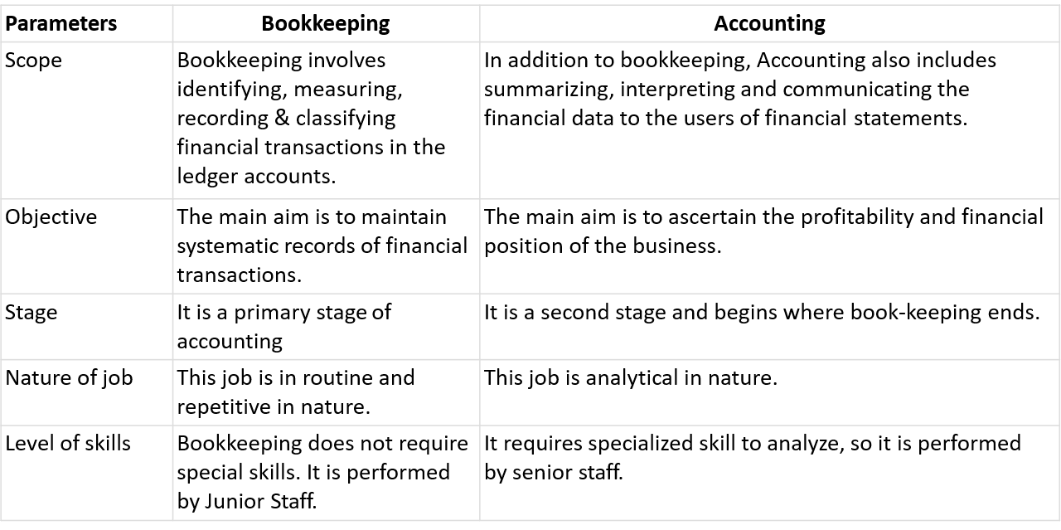

Slide 30
What are the Advantages of Accounting?

Slide 31
The following are the main advantages of accounting:
1. Provide information about financial performance
Accounting provides factual information about financial performance during a given period of time
Like, profit earned or loss incurred over a period and financial position at a particular point of time.
2. Provide assistance to management
Accounting helps management in business planning, decision making and in exercising control.
For this, it provides financial information in the form of reports.
3. Facilitates comparative study
By keeping systematic records and preparation of reports at regular intervals , accounting helps in making a comparison.

Slide 32
4. Helps in settlement of tax liability
Systematic accounting records help in settlement of various tax liabilities. Such as – Income Tax, GST, etc.
5. Helpful in raising loan
Banks and Financial Institutions grant a loan to the firm on the basis of appraisal of the financial statement of the firm.
6. Helpful in decision making
Accounting provides useful information to the management for taking decisions.

Slide 33
What Are the Limitations of Accounting?

Slide 34
What Are the Limitations of Accounting? Following are the limitations of accounting:
Accounting is not precise: Accounting is not completely free from personal bias or judgment.
Accounting is done on historic values of assets: Accounting records assets at their historical cost less depreciation. It does not reflect their current market value.
Ignore the effect of price level changes: Accounting statements are prepared at historical cost. So changes in the value of money are ignored.
Ignore the qualitative information: Accounting records only monetary
transactions. It ignores the qualitative aspects.
Affected by window dressing: Window dressing means manipulation in accounting to present a more favorable position of the business than the actual position.

Slide 35
Explain the Users of Accounting Information

Slide 36
Explain the Users of Accounting Information:
Users may be categorized into internal users and external users.
Internal Users
Owners: Owners contribute capital in the business and thus they are exposed to maximum risk. So, they are always interested in the safety of their capital.
Management: Accounting information is used by management for taking various decisions.
Employees: Employees are interested in the financial statements to assess the ability of the business to pay higher wages and bonuses.

Slide 37
(B) External Users
Banks and financial institutions: Banks and Financial Institutions provide loans to business. So, they are interested in financial information to ensure the safety and recovery of the loan.
Investors: Investors are interested to know the earning capacity of business and safety of the investment.
Creditors: Creditors provide the goods on credit. So they need accounting information to ascertain the financial soundness of the firm.
Government: The government needs accounting information to assess the tax liability of the business entity.
Researchers: Researchers use accounting information in their research work.
Consumers: They require accounting information for establishing good accounting control, which will reduce the cost of production

Slide 38
Qualitative Characteristics of Accounting Information

Slide 39
Qualitative Characteristics of Accounting Information
Qualitative characteristics are the attributes of accounting information, which enhance its understandability and usefulness:
Reliability: Reliability implies that the information must be free from material error and personal bias.
Relevance: Accounting information must be relevant to the decision-making requirements of the users.
Understandability: Information should be disclosed in financial statements in such a manner that these are easily understandable.
Comparability: Both intra-firm and inter-firm comparison must be possible over different time periods.

Slide 40
What is the Double-entry System of Accounting?
What are its advantages ?

Slide 41
Explain the System of Accounting
Double-entry system
The double entry system is based on the Dual Aspect Principle.
Every transaction has two aspects, ‘a Debit’ and ‘a credit’ of an equal amount.
This system of accounting recognizes and records both aspects of the transaction.

Slide 42
What Are the Advantages of the Double-entry System of Accounting?
The following are the main advantages of the double-entry system of accounting:
Scientific system
As compared to the other systems, this system of recording transactions is more scientific and useful to achieve the objective of accounting.
A complete record of the transaction
Since both the aspects of transactions are considered there is a complete recording of each and every transaction.
Using these records we are able to compute profit or loss easily. double-entry system of accounting.

Slide 43
Checks arithmetical accuracy of accounts
Under this system, by preparing a Trial Balance we are able to check the arithmetical accuracy of the records.
Determination of profit/loss and depiction of financial position
Under this system by preparing ‘Profit & Loss A/c’ we get to know about the profit earned or loss incurred.
By preparing the ‘Balance Sheet’ the financial position of the business can be ascertained, i.e. position of assets and liabilities is depicted.
Helpful in decision making
Administration and management are able to take decisions on the basis of factual information under the double-entry system of accounting.

Slide 44


Thank You

