Slide 1

International Business Management
Prepared by Dr.Badur elgasim
Lecture 3
MGM 506
Cultural and Behavioral

Slide 2

Learning objectives
Explain Culture definition and culture components
Introduction of corporate culture
Six Dimensions of Culture
Cultural Typology of the Organization

Slide 3

Lecture 3
Introduction
The survival of an organization depends on its ability to respond to environmental changes and societal demands. Corporate culture consists of the assumptions and values created by the manner in which the organization adapts to these changes and demands. To survive, the organization must interact effectively with its environment. This includes the relationship between corporate culture and the cultural environment. Various aspects of national culture are reflected in the culture of the firm.

Slide 4
Lecture 3
Very seldom can irreconcilable contradictions exist between the two. Any difference is either temporary or a normal variance of the national norms. Incongruity between corporate culture and societal values results in the death of the organization. The organizations that survive are those that adopt cultures reflective of the major values of the society and its dominant cultural characteristics.

Slide 5
What Is Culture?
Culture is a system of knowledge and standards for perceiving, believing, evaluating, and acting. It is a process of socially transmitted behavior patterns that serves to relate people to the environment.
Culture develops over time and is constantly and slowly evolving. A simpler definition is offered by Hofstede, who described culture as “the collective programming of the mind which distinguishes the members of one category of people from those of the other.

Slide 6
Another simple definition of culture is given by Schein who states that “culture is the way in which a group of people solves problems and reconciles dilemmas". Although there is no unified definition of culture, one common denominator is that culture is the way or a system of knowledge/standard that determines the behaviors of people in a society. Then the question is what determines the system of knowledge/standard. To answer this, we need to understand the major components of culture.

Slide 7
The Major Components of Culture
Language, ethnicity, and religion are the major components of culture.
Language The language we use to communicate with others structures the way we perceive the world. One word in a country may have various meanings if translated into different languages, because people in the world perceive the world differently. For instance, the Korean word “Jeong” can be translated in English as “affection,” “attachment,” or “warm-hearted,” but the meaning may also vary depending upon situations.

Slide 8
Ethnicity refers to as an enduring, fundamental aspect of the self that includes a sense of membership in an ethnic group and the attitudes and feelings associated with that membership.
As long as ethnicity reflects attitudes and feelings of an ethnic group, it has psychological implications of culture. Ethnicity comprises of a number of different components including self-labeling, a sense of belonging, preference for the group, ethnic interest and knowledge, and involvement in activities associated with the group.

Slide 9
Religion To better understand a culture, one must have knowledge of its religious foundation. There are several major religions and many minor ones. The major religions are Buddhism, Christianity, Hinduism, Islam, Judaism, The three major religions originating from the Middle East—Judaism, Christianity, and Islam—have much in common and share the same basic frame-work.

Slide 10
Six Dimensions of Culture
While there are similarities among cultures, no two cultures are alike. Hofsted identified six cultural dimensions:
individualism/collectivism,
masculinity/femininity (gender values differentiation and rigidity),
uncertainty avoidance,
power distance,
long-term/short-term orientation,
indulgence/restraint..

Slide 11
Corporate Culture
Corporate culture indicates organizationally shared values, beliefs, assumptions, and understandings that are the basis for relevant corporate norms and behavior patterns.
A very simplified definition of corporate culture is
“the way things work around here” .

Slide 12
Cultural phenomena are detectable in organizations at three levels:
1. Overt behavior and other physical manifestations, such as artifacts and literature, are at the first level. Formal communication style and dress code are first-level examples.
2. The second level consists of values, a sense of what “ought” to be. Promoting from within the organization and lifetime employment are examples of the second level.
3. The third level contains the basic assumptions, including methods of coping with the environment. Strategic choices and ways of dealing with competition are the third-level examples.

Slide 13
Corporate culture is a product of the firm’s environment and the interpersonal relationships among its members. Initially, the firm’s culture is influenced by the culture of the country where it initially was established. Once the firm expands its operations outside its borders and the dominance of its home culture, the influence of the host country’s national culture becomes a reality. The performance of business organizations depends on their ability to maintain internal consistency and external compatibility.

Slide 14
Internal consistency is the equilibrium and balance between the various internal components of the firm, such as hiring, promoting, and rewarding employees.
External compatibility is the harmony of the firm with its host environment, including relations with suppliers and ways of dealing with competitors. Organizations should be careful not to create too much internal inconsistency when creating external compatibility. In an effort to create external compatibility and to represent the cultural diversity of the global market in their corporate cultures, the MNCs may create a morass of cultural mismatch and cause internal inconsistency.

Slide 15
The challenge is to bring about external compatibility and at the same time manage a culturally diverse workforce without creating internal conflict.
Many believe that cultural diversity enhances organizational competitiveness. Failure to manage cultural diversity properly, however, could lead to increased conflict and communication breakdowns.

Slide 16
Cultural Typology of the Organization
Trompenaars and Hampden-Turner used two dimensions, egalitarian-hierarchical and person-task, to identify four types of corporate cultures.
The four types are metaphorically named: the family, the Eiffel Tower, the guided missile, and the incubator (see Fig. 3.1). The four types are “ideal types.” In practice, the four types are mixed and overlapping, with one culture dominating.

Slide 17
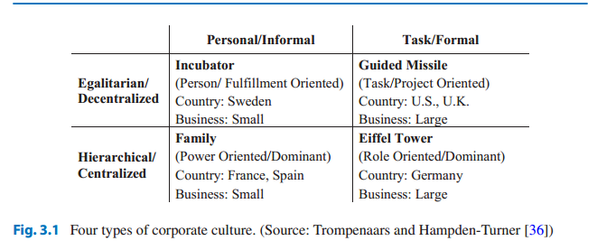

Slide 18
The Family Culture
The family culture is both personal and hierarchical, in which the “father” has much more authority and experience than his children. Such a corporate culture is power oriented, and the leader acts like a caring father, who knows what is good for them and acts accordingly. This type of power is intimate and not threatening. The atmosphere of the corporation is much like a home. By working hard and resolving conflicts, employees in this corporate culture derive pleasure from such relation-ships. Pleasing a superior (the father or elder brother) is a reward in itself.

Slide 19
The Eiffel Tower
The bureaucratic organization with the division of labor and prescribed roles and functions resembles an Eiffel Tower. These roles and functions are coordinated from the top by a hierarchy that is symmetrical and narrow at the top and broad at the base. It is rigid, stable, and robust. However, its hierarchy is quite different from that of the family culture. Each level has a clear function, and roles to perform those functions are prescribed in advance.

Slide 20
The Guided Missile
The guided missile culture is egalitarian and therefore is different from the family and the Eiffel Tower. It resembles the Eiffel Tower more because of its impersonal and task-oriented feature. But unlike the Eiffel Tower culture, where “means” are important, in the guided missile culture, the “ends” are vital. Everything must be done to accomplish the strategic mission and reach the target. It is a task-oriented organization in which teams or project groups undertake various jobs. These jobs (tasks) are not fixed in advance but will be determined as new targets are established.

Slide 21
Because it is very costly to have a workforce composed of professionals, guided missile culture is very expensive. The relative value of individual contributions to the project may not be clear as in the Eiffel Tower culture. Groups are project dependent; therefore, they are formed and dissolved as needed. However, a functioning organization requires some degree of permanency. Therefore, in practice, guided missile culture uses Eiffel Tower as a skeleton to give it stability and permanence

Slide 22
The Incubator Culture
The metaphor of incubator culture should not be confused with “business incubator.” However, the logic of both is quite similar. In both, the purpose is to enable individuals to be creative by removing the routine and mundane from daily work.
The incubator culture is both egalitarian and personal. There is almost no structure and organization; it only serves as an incubator for the individual’s self-expression and self-fulfillment. The minimum structure of the incubator is to provide for personal conveniences such as heat, light, and computer services so that individuals could tap their creative potentials.

Slide 23
Other people in the incubator culture are important in that they provide the much-needed evaluation and criticism of new ideas. They develop, procure, and provide the resources needed to produce the innovative products or services that the organization provides to the clients. Typical examples of incubator cultures are found in start-ups in the Silicon Valley, California, and Route 128 around Boston. These firms are usually entrepreneurial or founded by creative teams.

Slide 24
Cultural diversity, business organizations
Monolithic, Plural, and Multicultural Organizations
On the basis of cultural diversity, business organizations could be categorized as monolithic, plural, and multicultural. We examine these organizations using the following six factors:
acculturation,
structural integration,
informal integration,
cultural bias,
organizational identification, and
intergroup conflict

Slide 25
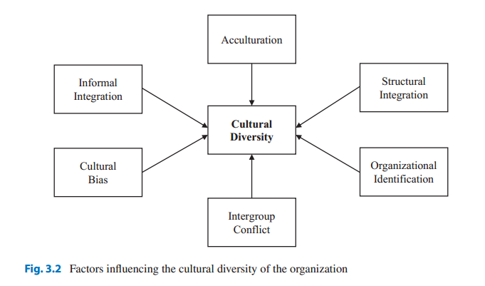

Slide 26
1. Acculturation is the method of resolving differences between the dominant culture and any minority culture. Acculturation could be by assimilation, the unilateral adoption of the norms and values of the dominant culture by other cultural groups; by pluralism, combining some elements of the dominant and any minority cultures; or by separation, where there is a little adoption from either culture.
2. Structural integration is the presence of members of different cultural groups in various organizational levels.

Slide 27
3. Informal integration is the inclusion of members of minority cultures in informal networks and activities taking place outside the ordinary work activities.
4. Cultural bias is the existence and practice of prejudice and discrimination in the organization.
5. Organizational identification is the extent to which the workforce identifies with the firm.
6. Intergroup conflict refers to friction, tension, and power struggles between various cultural groups within the firm

Slide 28
Monolithic Organization
Monolithic organizations are highly homogeneous with little structural integration. They consist of one dominant cultural group. If members of other cultural groups join the firm, they must adopt the existing cultural norms to survive. There are prejudice and discrimination against the members of the cultural minority because of the lack of structural and informal integration. Consequently, organizational identification among the host country personnel is very low. But there is little group conflict because of the homogeneity of the workforce.

Slide 29
Plural Organization
The norms and values of other cultures are usually well represented inside plural organizations because these businesses try to include host country citizens in their workforce. Human resource management practices often change because they need to tap local knowledge to learn about the host market. Also, some governments require the employment of local personnel. As a result, MNCs gain a higher level of structural integration than monolithic firms, leading to a plural organization that is culturally heterogeneous.

Slide 30
Multicultural Organization
Both plural and multicultural firms are culturally heterogeneous. Plural organizations, however, do not value their cultural diversity, while multicultural firms do. They recognize the value of cultural heterogeneity and understand the potential contributions of cultural diversity to organizational performance. Multicultural organizations adopt a synergistic approach to management and have overcome the shortcomings of plural firms.

Slide 31
Multicultural organizations are characterized by full structural and informal integration, an absence of prejudice and discrimination, and minimum intergroup conflict. Members of minority cultures identify with the organization, and acculturation happens because all participating cultures are integrated into a synergistic whole. It is doubtful whether many MNCs have reached their goal of multiculturalism, but probably the global market’s competitive environment will force MNCs to adopt a multicultural posture.

Slide 32
The Benefits of Multiculturalism
Until recently, most organizations were primarily concerned with the problems and costs created by the ethnic and gender diversity of their workforce.
They ignored the potential benefits of cultural diversity. But the diversity of the workforce could be a source of competitive advantage. The following are the major potential advantages of multiculturalism:

Slide 33
1. Reduced costs: There is evidence that as the cultural diversity of firms increases, so does the cost of poor integration. The experiences of minorities and women at work indicate that when cultural minorities are not fully integrated into the workforce, they tend to have lower job satisfaction and higher absenteeism and turnover. Firms that properly manage cultural diversity could have a cost advantage over those that do not, because of lower absenteeism and turnover rates.

Slide 34
2. Resource acquisition: With the increasing globalization of business, competition for qualified personnel has become more intense. Firms with a good reputation for handling cultural diversity attract more and better-qualified personnel. This benefit of cultural diversity is especially critical to an MNC’s international expansion. A well-qualified pool of managers adds expertise and knowledge to the firm.

Slide 35
3. Marketing advantage: The insight and cultural sensitivity of the multicultural workforce improve marketing efforts. Multicultural personnel enables MNCs to understand and adopt the cultural perspectives of their multiple markets.
4. Creativity: Creativity flourishes when there is a diversity in perspective and less emphasis on conformity. Multicultural organizations are potentially more hospitable to creativity.

Slide 36
5. Problem-solving: Multicultural firms have access to a broader and richer base of experience. Heterogeneity allows a wider range of perspectives and a more thorough critical analysis of issues. Therefore, heterogeneous groups have the potential for making better decisions.
6. Organizational flexibility: Research has demonstrated that bilinguals have a higher level of divergent thinking and cognitive flexibility

Slide 37
Resources:
Kamal Fatehi & Jeongho Choi
International Business Management
Succeeding in a Culturally Diverse World, Second Edition
Chapter 3

