Slide 1

Lecture 4:
Developing Project Scheduling Plan
PMG 605
Project Resources and Time Management
Dr. Eng.
Abdullah Jameel Halawany

Slide 2
Session Outline
Developing a Project Scheduling Plan
Last Lecture Review
Gantt Charts
Developing Project Networks
CPM
PERT
Extended Network Techniques to Come Closer to Reality

Slide 3
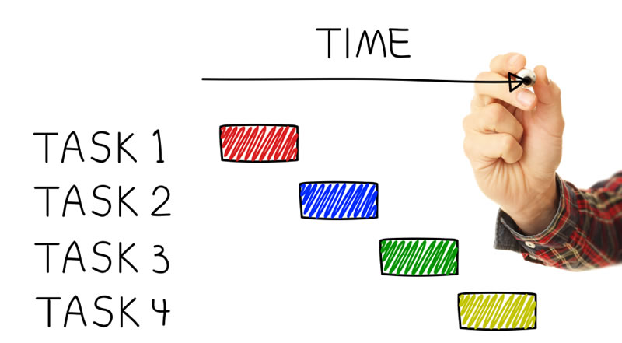

Last Lecture Review

Slide 4
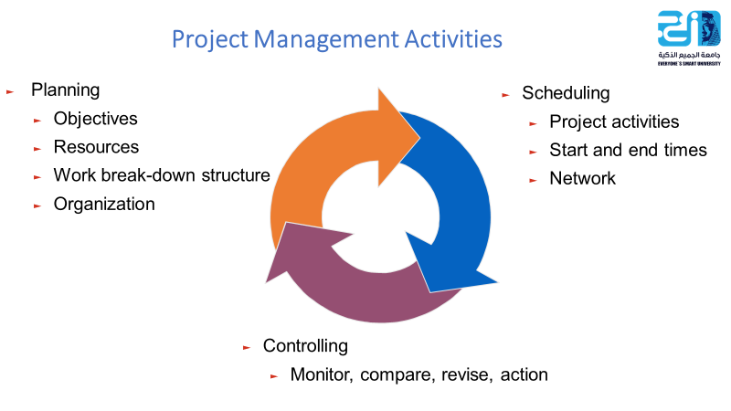
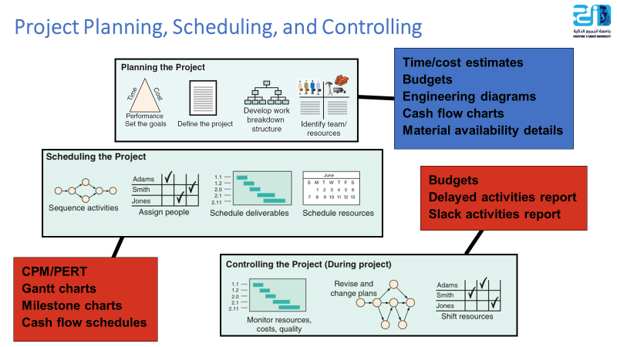
4–4

Slide 5
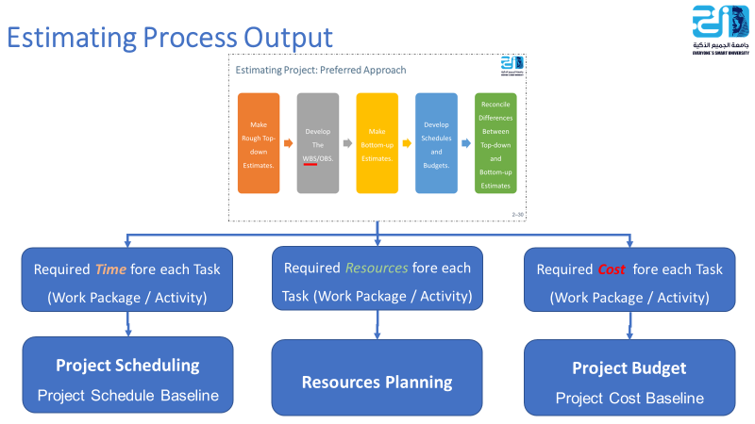
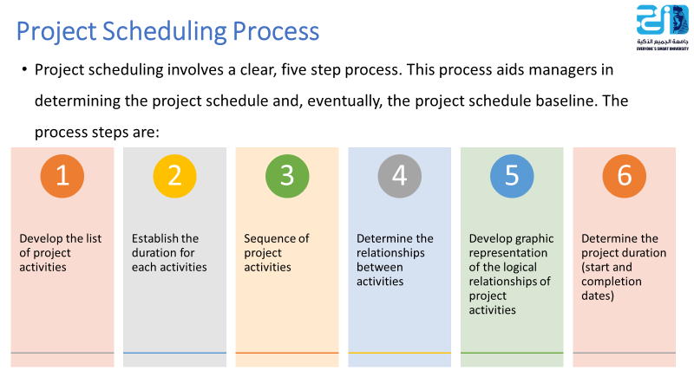
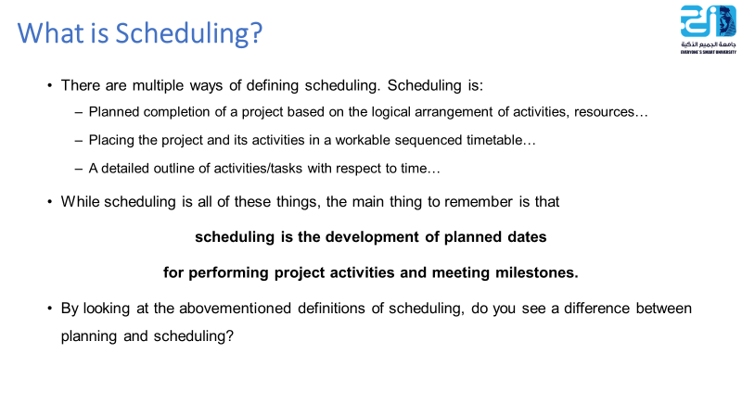
4–5

Slide 6
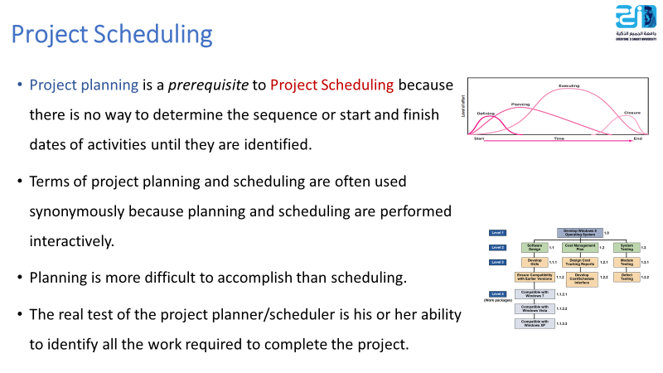
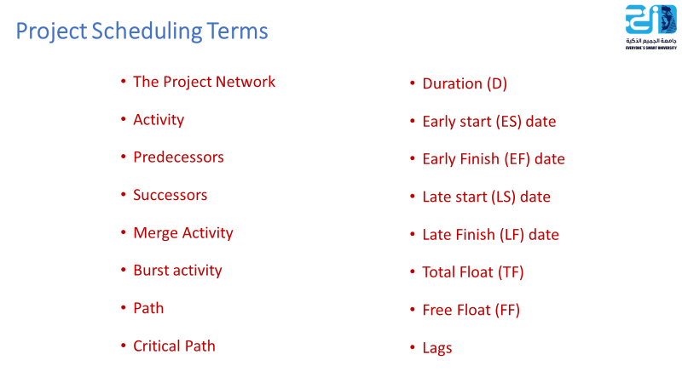
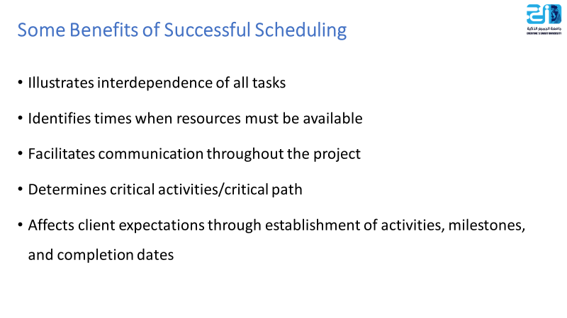
4–6

Slide 7
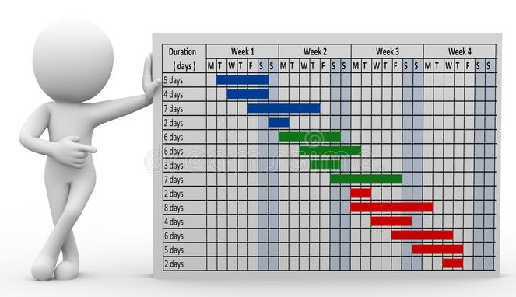
Gantt Chart

Slide 8
Gantt Chart
Establish a time-phased network
Can be used as a tracking tool
Benefits of Gantt charts
Easy to understand
Identify the schedule baseline network
Allow for updating and control
Identify resource timing needs
Easy to create
4–8

Slide 9
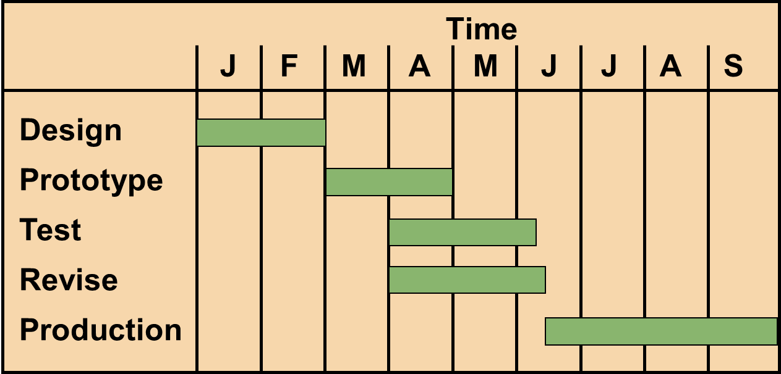
A Simple Gantt Chart
4–9

Slide 10
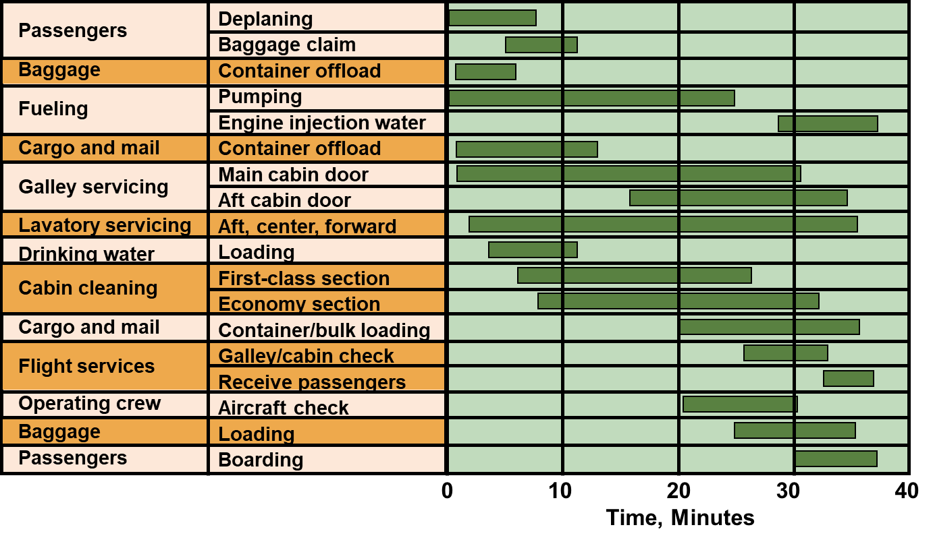
Service For a Delta Jet
4–10

Slide 11
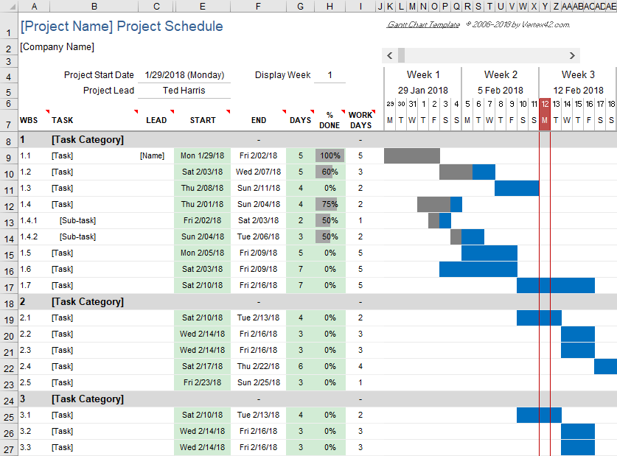
4–11

Slide 12

Developing Project Networks

Slide 13
The Project Network
  Flow chart that graphically depicts the sequence, interdependencies, and start and finish times of the project job plan of activities that is the critical path through the network.
  Provides the basis for scheduling labor and equipment
  Highlight activities that are “critical” and can not be delayed
  Enhances communication among project participants
  Provides an estimate of the project’s duration
  Provides a basis for budgeting cash flow
  Help managers get and stay on plan
4–13

Slide 14
Activity on- node (AON) and Activity-on-arrow (AOA)
Historically, two methods have been used to develop project networks: Activity on-node (AON) and Activity-on-arrow (AOA)
Over time the availability of advanced computer graphics improved the clarity and visual appeal of the AON method
Today, the activity-on-node method has come to dominate nearly all project network plans
4–14

Slide 15
8 Basic Rules to Follow in Developing Project Networks
Networks flow typically from left to right
An activity cannot begin until all preceding connected activities have been completed
Arrows on networks indicate precedence and flow. Arrows can cross over each other
Each activity should have a unique identification number
An activity identification number must be larger than that of any activities that precede it
Looping is not allowed
Conditional statements are not allowed (If successful, do something; if not, do nothing)
When there are multiple starts, a common start node can be used to indicate a clear project beginning on the network. (A single project end node can be used to indicate a clear ending)
4–15

Slide 16
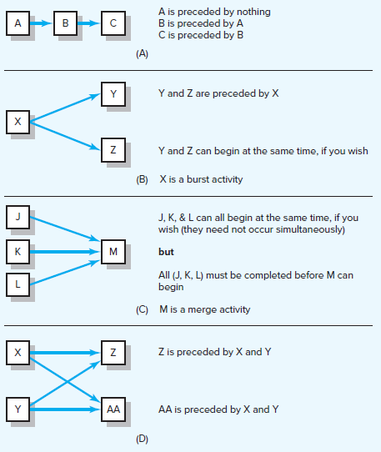
Activity-on-Node (AON) Fundamentals
4–16

Slide 17
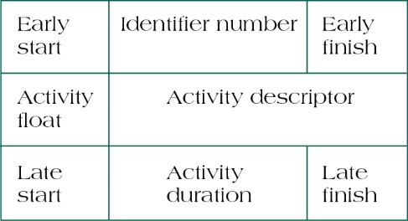
Activity-on-Node (AON) Fundamentals
Activity Format
Activity Name or Symbol
A
Earliest Finish
Earliest Start
ES
EF
Latest Start
LS
LF
Latest Finish
2
Activity Duration
4–17

Slide 18
PERT and CPM
Two major duration estimating tools can help project managers estimate the activity duration: the PERT and CPM.
Network techniques
Developed in 1950s
  CPM by DuPont for chemical plants (1957)
  PERT by Booz, Allen & Hamilton with the U.S. Navy, for Polaris missile (1958)
Consider precedence relationships and interdependencies
Each uses a different estimate of activity times
4–18

Slide 19
PERT and CPM
CPM – Critical Path Method
PERT – Program Evaluation and Review Technique
Three-time estimates can be applied to any activity:
  Optimistic (O)
  Pessimistic (P)
  Most Likely (M)
CPM
requires only a one time estimate per activity. This method uses only a Most Likely time estimate (M).
PERT uses the distribution’s mean to determine individual activity duration. Specifically, the PERT formula is
(P + 4M + O) / 6
4–19

Slide 20
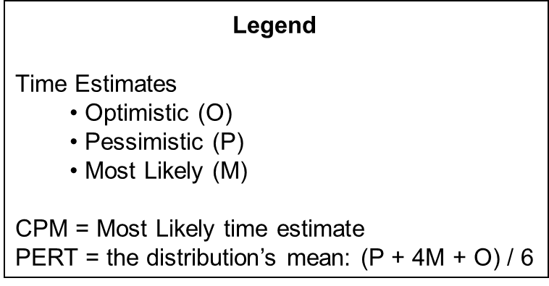
PERT and CPM
For the activity “1” the following estimates are determined:
  (O) Optimistic estimate = 6 days
  (P) Pessimistic estimate = 18 days
  (M) Most Likely = 9 days
Using PERT, the following estimate is derived: (18 + 36 + 6) / 6 = 10 days.
Using CPM, the estimate is 9 days.
4–20

Slide 21
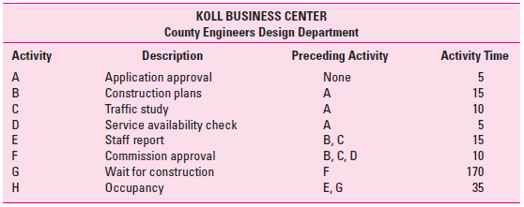
Example 1- Koll Business Center
4–21

Slide 22
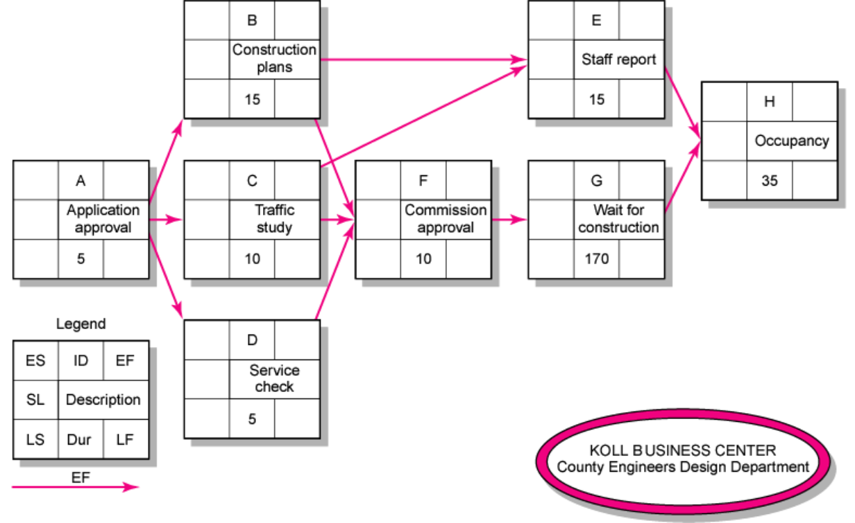
Example 1
4–22

Slide 23
Network Computation Process
Forward Pass—Earliest Times
  How soon can the activity start? (early start—ES)
  How soon can the activity finish? (early finish—EF)
  How soon can the project finish? (expected time—ET)
Backward Pass—Latest Times
  How late can the activity start? (late start—LS)
  How late can the activity finish? (late finish—LF)
  Which activities represent the critical path?
  How long can activity be delayed? (slack or float—SL)
4–23

Slide 24
Forward Pass Computation
Add activity times along each path in the network (EF = ES + Duration)
Carry the early finish (EF) to the next activity where it becomes its early start (ES) unless…
The next succeeding activity is a merge activity, in which case the largest EF of all receding activities is selected
4–24

Slide 25
Backward Pass Computation
Subtract activity times along each path in the network (LS = LF - Duration)
Carry the late start (LS) to the next activity where it becomes its late finish (LF) unless…
The next succeeding activity is a burst activity, in which case the smallest LF of all preceding activities is selected.
4–25

Slide 26
Slack (or Float)
Slack (SL) or Total Slack (TS) tells us the amount of time an activity can be delayed and not delay the project. Stated differently, total slack is the amount of time an activity can exceed its early finish date without affecting the project end date or an imposed completion date
  SL = LS - ES or
  SL = LF – EF
Free Slack/Floatis (FS) unique. It is the amount of time an activity can be delayed without delaying any immediately following (successor) activity. Or free slack is the amount of time an activity can exceed its early finish date without affecting the early start date of any successor(s)
FS = ES _{successor} - EF
4–26

Slide 27
Example 1
EF = ES + Duration
LS = LF – Duration
SL = LS - ES or
SL = LF – EF
FS = ES _{successor} - EF
4–27

Slide 28
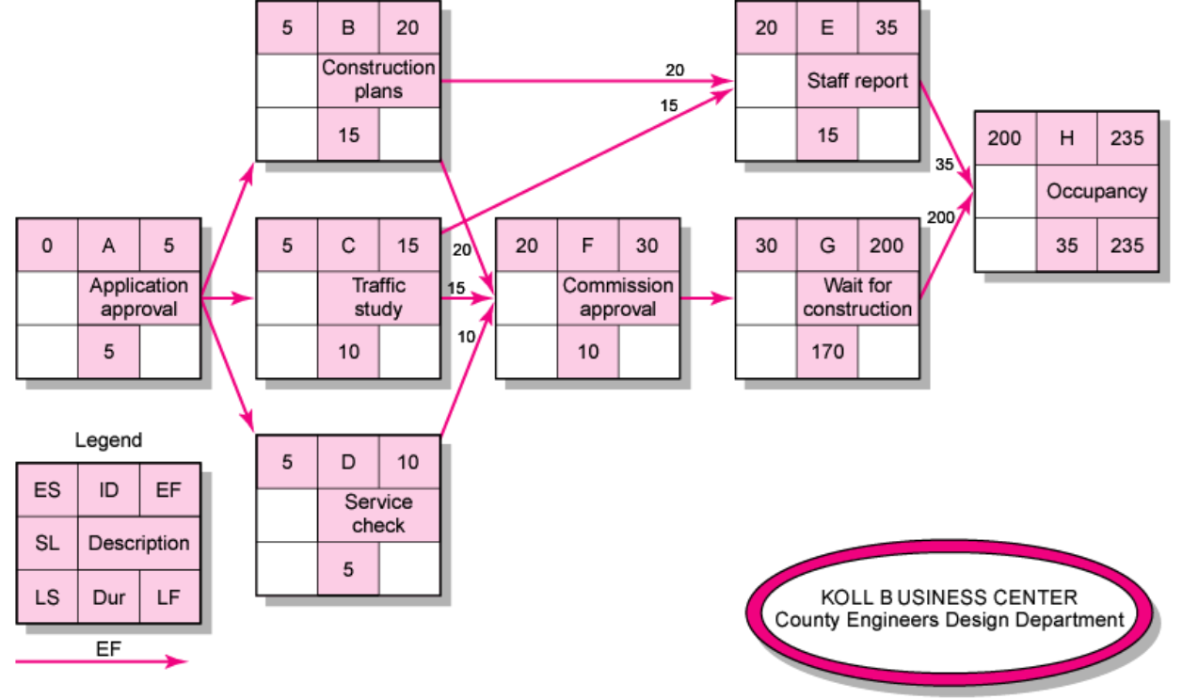
Example 1
EF = ES + Duration
LS = LF – Duration
SL = LS - ES or
SL = LF – EF
FS = ES _{successor} - EF
4–28

Slide 29
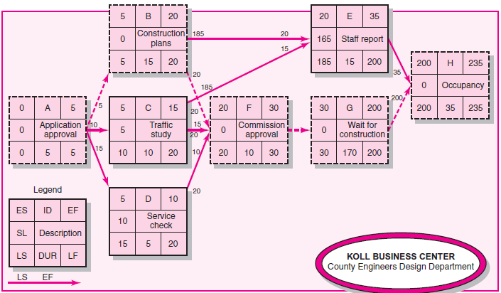
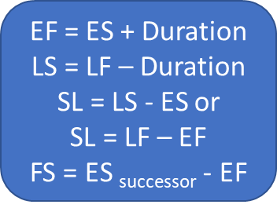
Example 1
4–29

Slide 30
Critical Path
Path: a sequence of connected, dependent activities.
Critical Path: the longest path through the activity network that where all the activities has no Slack (float)
There could be more than one critical path in the project
The Critical Path tells management the activities that are critical or essential in completing the project on time.
It is also important for management to look at activities with minor float because any delays in those activities could cause them to be on the critical path.
4–30

Slide 31
Example 1
4–31

Slide 32
Example 1 - Koll Business Center
 |  |  | Koll Business Center
Activity | Description | Preceding Activity | Earliest Start Es | Earliest Finish EF | Late Start LS | Late Finish LF | Slack LS – ES | On Critical Path
A | Application approval | - | 0 | 5 | 0 | 5 | 0 | Yes
B | Construction plans | A | 5 | 20 | 5 | 20 | 0 | Yes
C | Traffic study | A | 5 | 15 | 10 | 20 | 5 | No
D | Service Check | A | 5 | 10 | 15 | 20 | 10 | No
E | Staff report | B, C | 20 | 35 | 185 | 200 | 156 | No
F | Commission Approval | B, C, D | 20 | 30 | 20 | 30 | 0 | Yes
G | Wait for Construction | F | 30 | 200 | 30 | 200 | 0 | Yes
H | Occupancy | E, G | 200 | 235 | 200 | 235 | 0 | Yes
Activities with zero slack are on the critical path. It:
Starts at the first activity in the project
Terminates at the last activity in the project
Includes only critical activities
Critical Path: A – B – F – G – H
Project Duration: 235 days
4–32

Slide 33
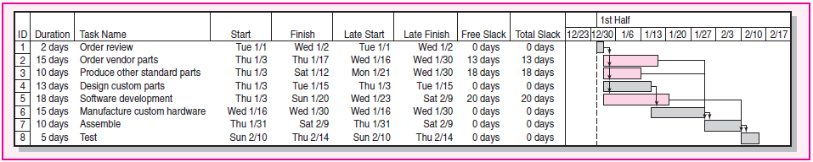
Calendar Dates
Ultimately you will want to assign calendar dates to your project activities
If a computer program is not used, dates are assigned manually. Lay out a calendar of workdays (exclude nonwork days) and number them. Then relate the calendar workdays to the workdays on your project network.
Most computer programs will assign calendar dates automatically after you identify start dates, time units, non workdays, and other information.
4–33

Slide 34
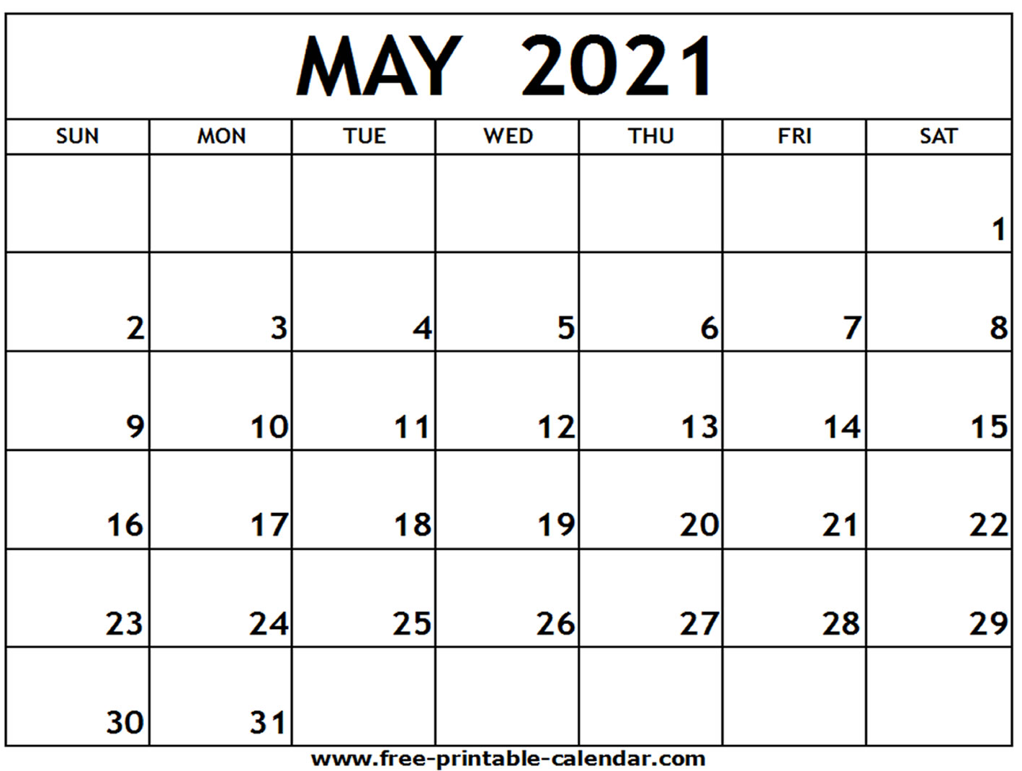
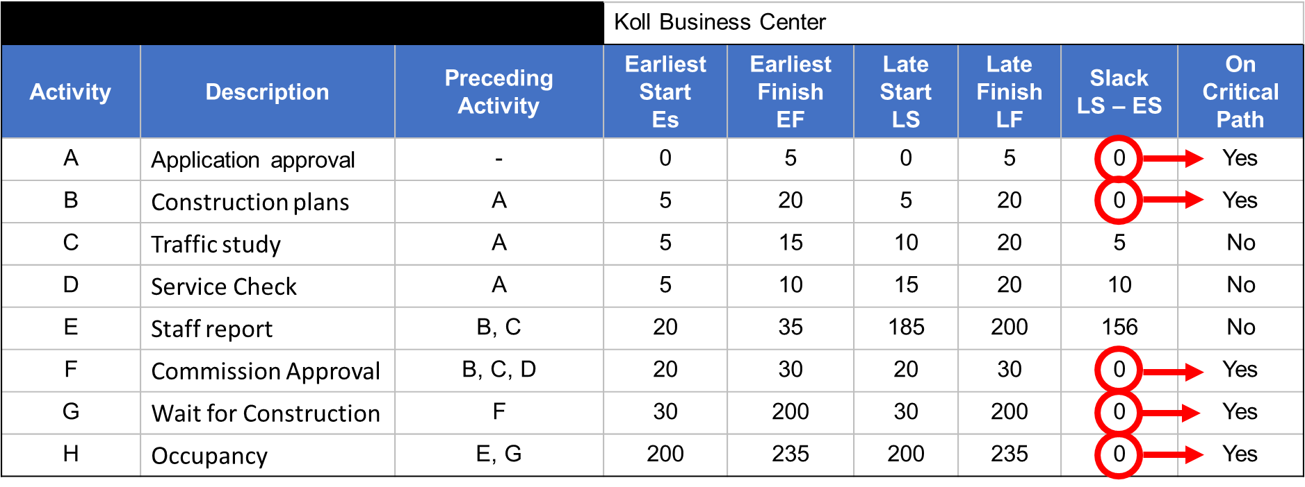
Calendar Dates
4–34

Slide 35
Extended Network Techniques to Come Closer to Reality

Slide 36
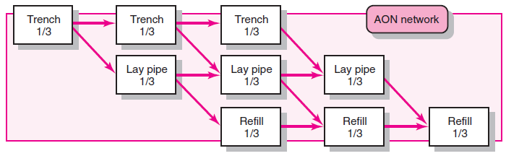
Laddering
Activities are broken into segments so the following activity can begin sooner and not delay the work
Laddering
4–36

Slide 37
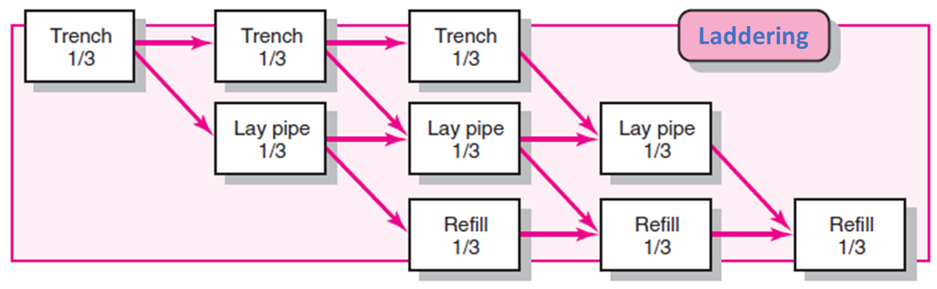
Lags
The minimum amount of time a dependent activity must be delayed to begin or end
The use of lags in project networks occurs for two primary reasons:
When activities of long duration delay the start or finish of successor activities, the network designer normally breaks the activity into smaller activities to avoid the long delay of the successor activity. Use of lags can avoid such delays and reduce network detail
Lags can be used to constrain the start and finish of an activity
4–37

Slide 38
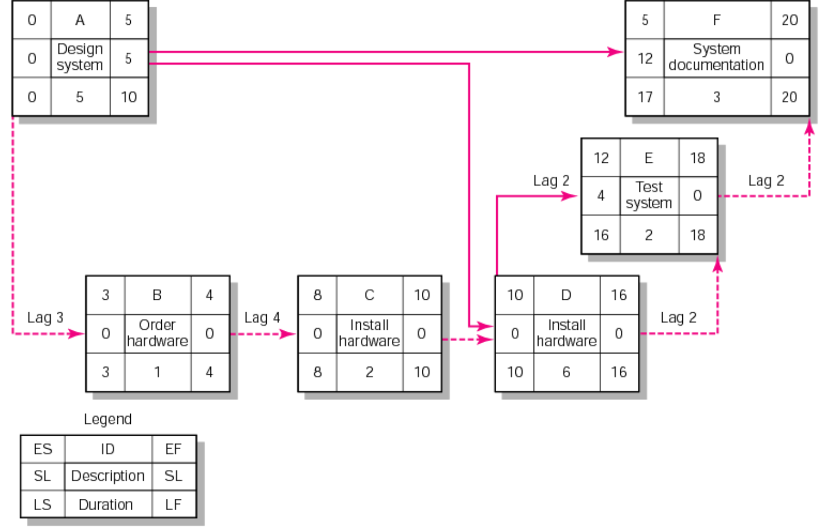
Network Using Lags
4–38

Slide 39
Example 2 - Milwaukee Paper's Project
 |  |  | Time Estimates (in weeks) for Milwaukee Paper's Project
Activity | Predecessors | Optimistic O |  | Most Likely M | Pessimistic P | Expected Time D = (P + 4M + O)/6 | Variance [(P – O)/6]²
A | — | 1 |  | 2 | 3 | (1 + 4*2 + 3)/6 = 2 | .11
B | — | 2 |  | 3 | 4 | 3 | .11
C | A | 1 |  | 2 | 3 | 2 | .11
D | A, B | 2 |  | 4 | 6 | 4 | .44
E | C | 1 |  | 4 | 7 | 4 | 1.00
F | C | 1 |  | 2 | 9 | 3 | 1.78
G | D, E | 3 |  | 4 | 11 | 5 | 1.78
H | F, G | 1 |  | 2 | 3 | 2 | .11
4–39

Slide 40
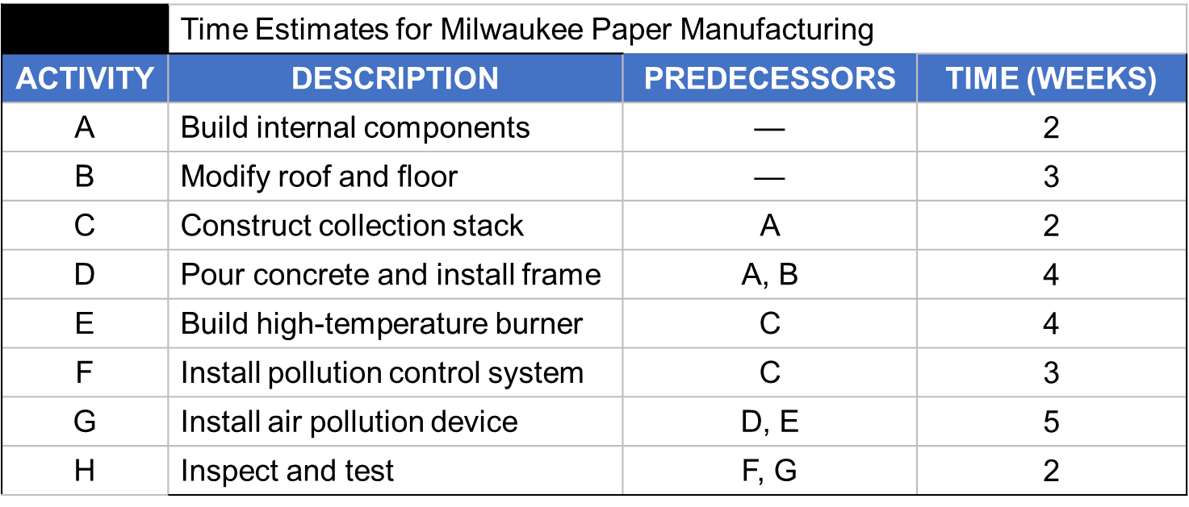
ES/EF Network for Milwaukee Paper
ES
EF = ES + Activity time
Start
0
0
0
4–40

Slide 41
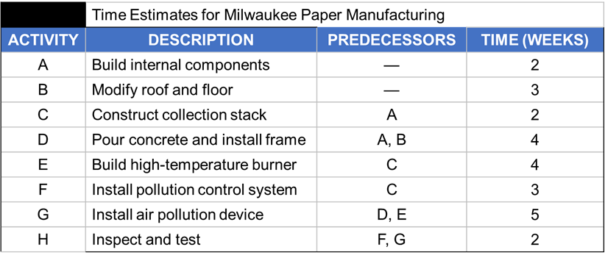
ES/EF Network for Milwaukee Paper
EF of A =
ES of A + 2
ES
of A
A
2
0
2
0
Start
0
0
4–41

Slide 42
ES/EF Network for Milwaukee Paper
A
2
0
2
EF of B =
ES of B + 3
ES
of B
0
Start
0
B
3
0
3
0
4–42

Slide 43
ES/EF Network for Milwaukee Paper
A
2
C
2
0
2
2
4
0
Start
0
0
B
3
0
3
4–43

Slide 44
ES/EF Network for Milwaukee Paper
A
2
C
2
0
2
2
4
0
Start
0
= Max (2, 3)
D
4
0
3
7
B
3
0
3
4–44

Slide 45
ES/EF Network for Milwaukee Paper
A
2
C
2
0
2
2
4
0
Start
0
0
B
3
D
4
0
3
3
7
4–45

Slide 46
ES/EF Network for Milwaukee Paper
A
2
C
2
F
3
0
2
2
4
4
7
Start
0
E
4
H
2
0
4
8
13
15
0
B
3
D
4
G
5
0
3
3
7
8
13
4–46

Slide 47
LS/LF Times for Milwaukee Paper
A
2
C
2
F
3
0
2
2
4
4
7
Start
0
E
4
H
2
0
4
8
13
15
13
15
0
LS = LF – Activity time
B
3
D
4
G
5
0
3
3
7
8
13
LF = EF
of Project
4–47

Slide 48
LS/LF Times for Milwaukee Paper
A
2
C
2
F
3
0
2
2
4
4
7
10
13
Start
0
E
4
H
2
0
LF = Min(LS of following activity)
4
8
13
15
13
15
0
B
3
D
4
G
5
0
3
3
7
8
13
4–48

Slide 49
LS/LF Times for Milwaukee Paper
LF = Min(4, 10)
A
2
C
2
F
3
0
2
2
4
4
7
2
4
10
13
Start
0
E
4
H
2
0
4
8
13
15
4
8
13
15
0
B
3
D
4
G
5
0
3
3
7
8
13
8
13
4–49

Slide 50
LS/LF Times for Milwaukee Paper
A
2
C
2
F
3
0
2
2
4
4
7
0
2
2
4
10
13
Start
0
E
4
H
2
0
4
8
13
15
0
0
4
8
13
15
0
B
3
D
4
G
5
0
3
3
7
8
13
1
4
4
8
8
13
4–50

Slide 51
Computing Slack Time
 |  | Milwaukee Paper’s Schedule and Slack Times
Activity | Expected Time | Earliest Start ES | Earliest Finish EF | Latest Start LS | Latest Finish LF | Slack Ls – Es | On Critical Path | Variance
A | 2 | 0 | 2 | 0 | 2 | 0 | Yes | .11
B | 3 | 0 | 3 | 1 | 4 | 1 | No | .11
C | 2 | 2 | 4 | 2 | 4 | 0 | Yes | .11
D | 4 | 3 | 7 | 4 | 8 | 1 | No | .44
E | 4 | 4 | 8 | 4 | 8 | 0 | Yes | 1.00
F | 3 | 4 | 7 | 10 | 13 | 6 | No | 1.78
G | 5 | 8 | 13 | 8 | 13 | 0 | Yes | 1.78
H | 2 | 13 | 15 | 13 | 15 | 0 | Yes | .11
Activities with zero slack are on the critical path. It:
Starts at the first activity in the project
Terminates at the last activity in the project
Includes only critical activities
Critical Path: A – C – E – G – H
Project Duration: 15 days
4–51

Slide 52
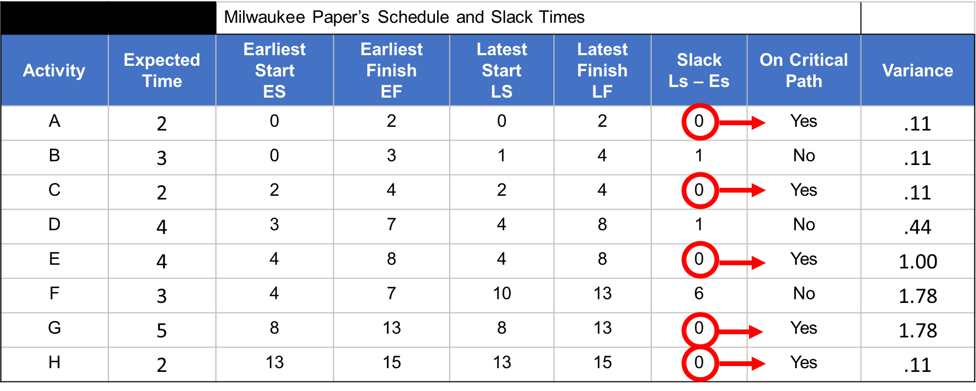
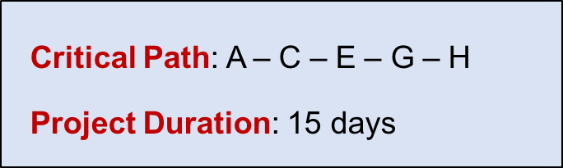
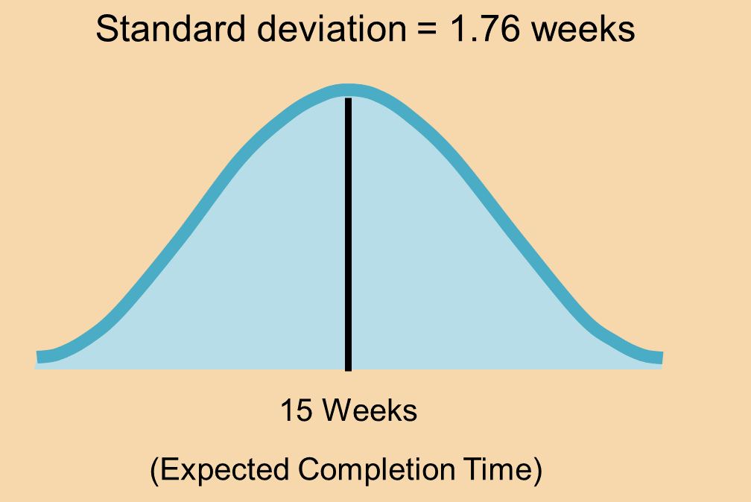
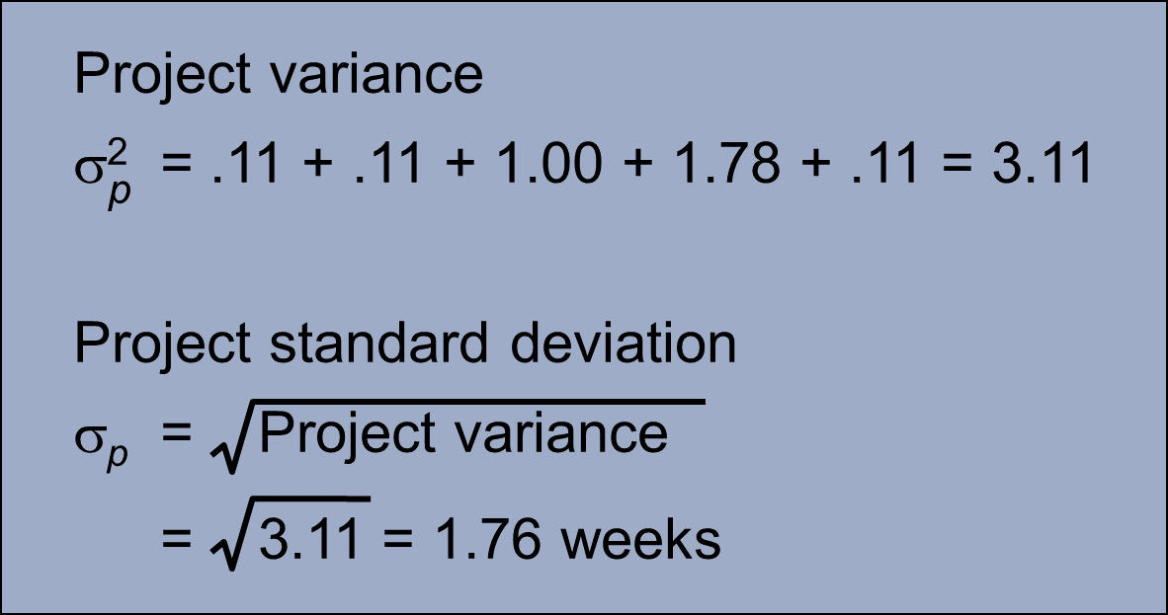
Project variance
σ² = Project variance
= ∑(variances of activities on critical path)
4–52

Slide 53
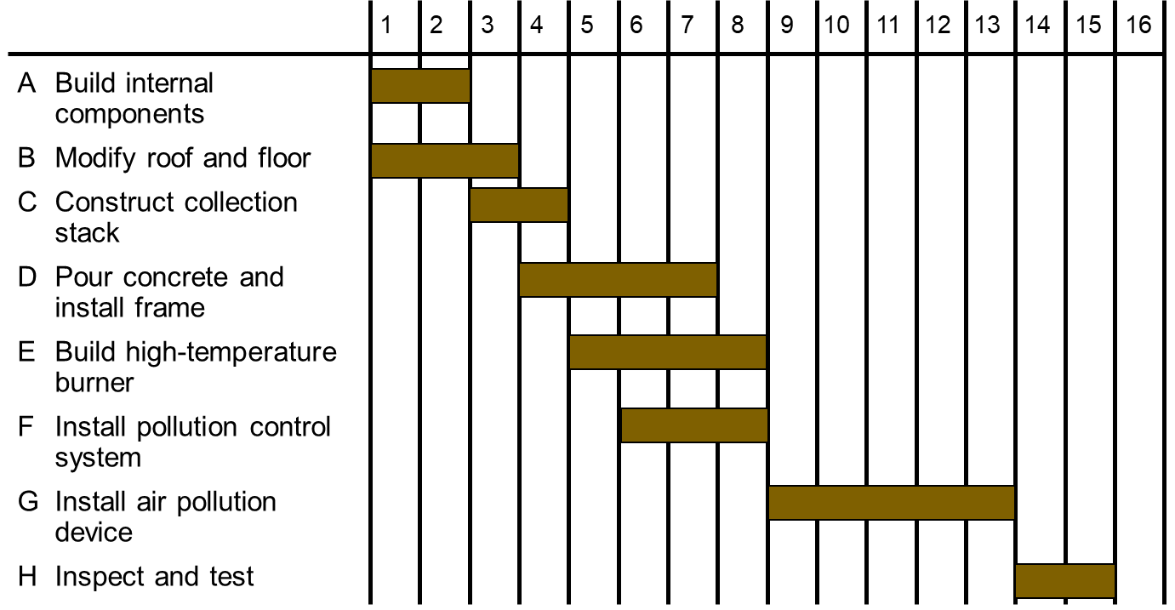
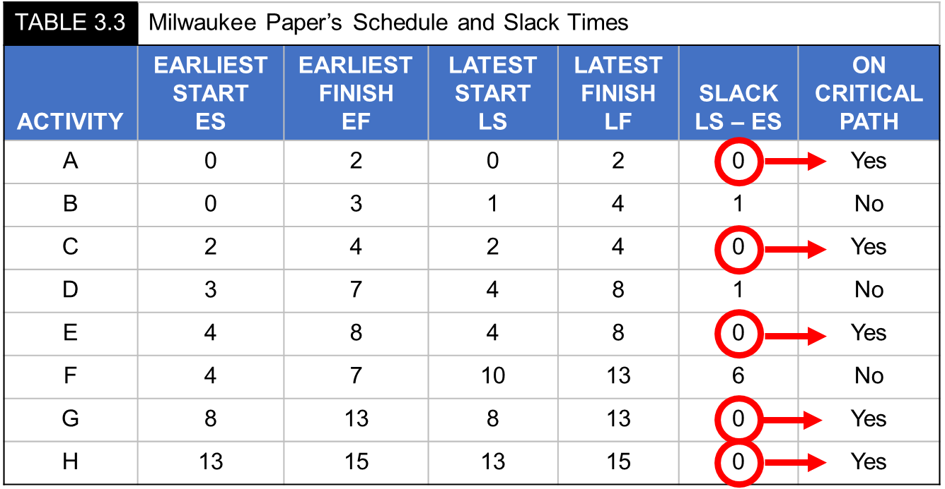
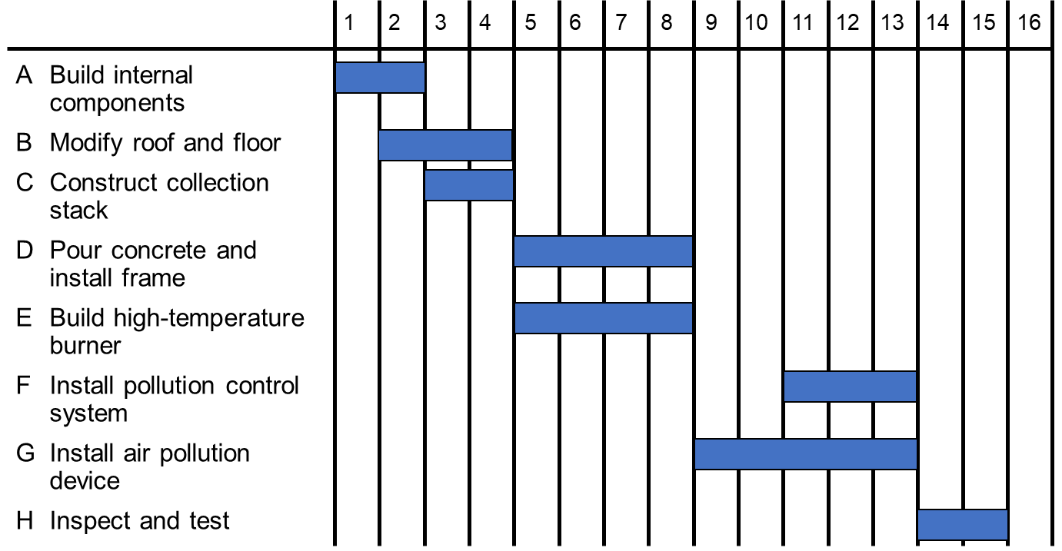
ES – EF Gantt Chart
LS – LF Gantt Chart
4–53

Slide 54
 | Time Estimates for Milwaukee Paper Manufacturing
ACTIVITY | DESCRIPTION | PREDECESSORS | TIME (WEEKS)
A | Build internal components | — | 2
B | Modify roof and floor | — | 3
C | Construct collection stack | A | 2
D | Pour concrete and install frame | A, B | 4
E | Build high-temperature burner | C | 4
F | Install pollution control system | C | 3
G | Install air pollution device | D, E | 5
H | Inspect and test | F, G | 2
 | Total time (weeks) | — | 25
4–54

Slide 55
Example 3 – Project Delta
Predecessors
-
A
A
B, C
B
D
C
E, F, G
4–55

Slide 56
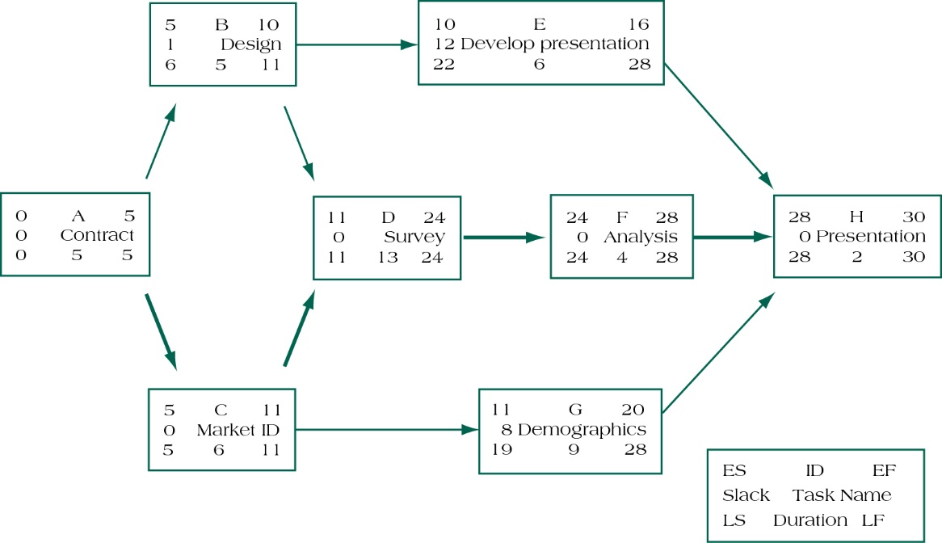
Example 3 – Project Delta
4–56

Slide 57
Summary of Today Session

Slide 58
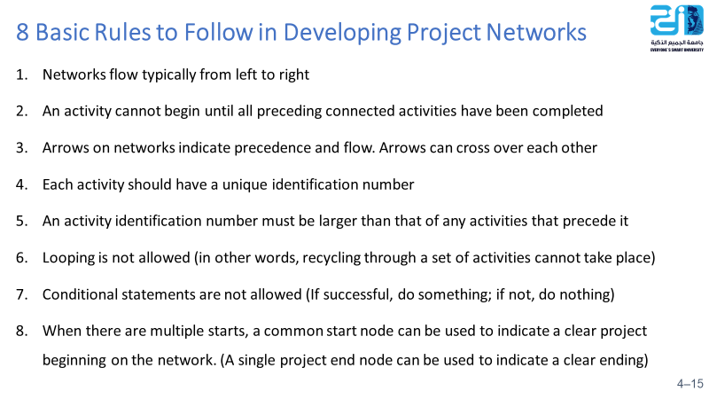
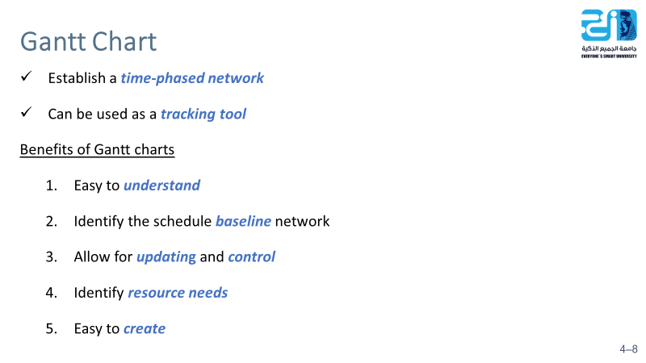
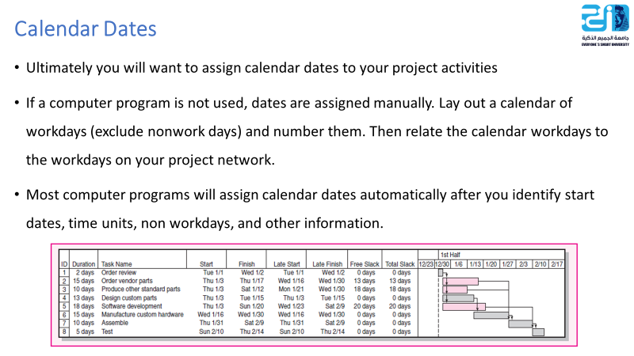
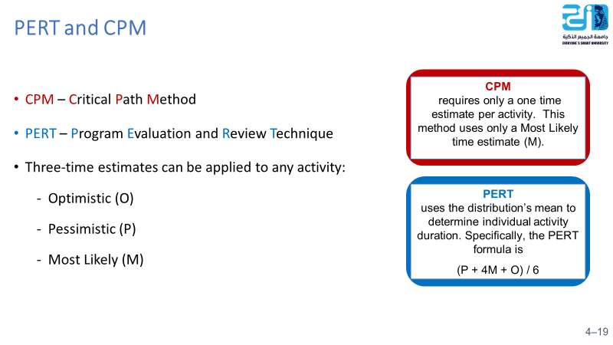
EF = ES + Duration
LS = LF – Duration
SL = LS - ES or
SL = LF – EF
FS = ES _{successor} - EF
4–58

Slide 59
Resources
Project Management
The Managerial Process
Fifth Edition
By: Erik W. Larson
Oregon State University
Clifford F. Gray
Oregon State University

