Slide 1



Influence and Negotiation Skills
Communication Skills
Prepared by:
Dr. Bothaina Mahmoud Fouad
College of
Entrepreneurship and Innovation
Code ENT623
Week 4

Slide 2

Lec. 3 Overview
The main points:
Identify the concept of communication skills
Understand the principles of effective communication

Slide 3
Communication skills =
10% words + 30% (tone +tuning) + 60% body language.

Slide 4
What is communication?
In simple words we can say that
“just to convey the message”
If we go in more detail we can say that communication is
the process of transmitting (A B) & Receiving
(B A) Messages.

Slide 5
Communication Skills
the process by which people exchange information or express their thoughts and feelings

Slide 6
What is communication?
In groups, try to come up with a definition of communication.
According to the Collins Essential English Dictionary (2006, 2nd edition), it’s a noun meaning...
1. the exchange of information, ideas, or feelings
2. something communicated, such as a message
3. communications means of travelling or sending messages
It’s an art as much as a science

Slide 7
Reason of communication
Share our ideas and opinions
Provide feedback to others
Get information from others
Gain power and influence
Develop social relationships
Maintain self-expression and our culture
other ideas you may have thought of
We communicate to:

Slide 8
What are the most common ways
we communicate?
Visual Images
Spoken Word
Written Word
Body Language

Slide 9
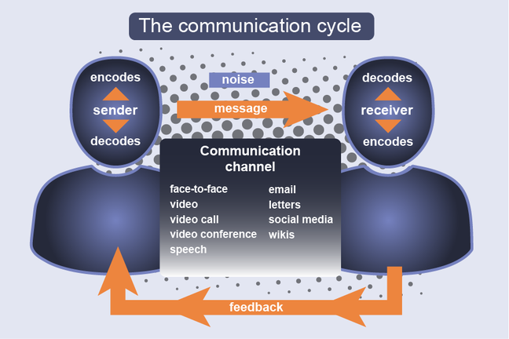
The communication process

Slide 10
Components of Communication
Context
  Internal Means
  External Means
Sender (Encoder)
Message
Medium ( channel )
Receiver (Decoder)
Feed Back

Slide 11
1. Context
tells us reason for communication and reasons may be
Internal
Internal means a company wants to Discuss an idea/Issue to its employees – the message should be either in writing or verbal
External
some query from stakeholders or from outside the organization-
You may response to query
  Email
  Fax
  Telephone
  Letter
  Verbal etc.

Slide 12
2. Sender (Encoder)
When you sending the message, you are the “Encoder” .
Here the word you mean writer/Speaker decides whether the message should be in written or oral. He/She may choose Words, Symbols, Pictures or Graphics that express the objective in the real sense.

Slide 13
3. Message
Message is basically the basic idea that you want to communicate.
The message may be
  Verbal, means (Written or Spoken)
  Non-Verbal, means( Symbols, Pictures or unspoken).
This is very much important component of communication “ Your message should be or MUST be clear and easy to understand”
The most important element in message is your receiver . You must be well aware about your receiver.
While preparing a message you should keep in mind how your receiver will interpret the message.
You (Sender) should also keep in mind your relationship with the receiver while preparing message.
some times wrong message may create a loss to your organization , to yourself.
or it can create a bad impression for you/your company.

Slide 14
4. Medium
Medium is basically channel through which your message reaches to receiver & channel vary from situation to situation.
E.g. some of effective medium it may be.
    T.V
    Radio
    Papers
    Or all of the above “keeping in view the Importance of the message.”
    When we talk at Micro /Organizational Level the medium may be writing or non-Verbal

Slide 15
5. Receiver (Decoder)
To whom the message is being sent.
e.g. in case of Govt of Pakistan's Message, Pakistani Nation is receiver (Decoder).
In simple words we can say that receiver is your reader (in case of press , letters etc.) or Listener (In case of TV, radio, Speaker Etc.)
Receiver is also known as decoder.

Slide 16
6. Feedback
Feedback is basically the response/reaction of Receiver after receiving the message.
Sender always need feedback to check wether the message effectively reached or not…? Or in other words….
Sender need feedback to examine the success or failure of the message.

Slide 17
Four facets of communication
In any communication:
  The Sender is the person trying to communicate a message
  The Receiver is the person at whom the message is directed
  A message is sent to convey information
  Information is meant to change behavior
The sender sends the message to the receiver. The message received may not be identical to that sent.
Communication is usually meant to pass on information that will lead to a change in behavior.

Slide 18
Personal Communication skills, including
  Verbal/Non-verbal communication
  Active listening
  Assertive, not aggressive
  Giving and receiving feedback
  Written communication

Slide 19
Verbal Communication
having good communication skills is all about the ability to
Verbal Communication = Speaking + Listening
Non-verbal Communication
Your appearance
Your body language
The tone and the pace of your voice
Eye Contact

Slide 20
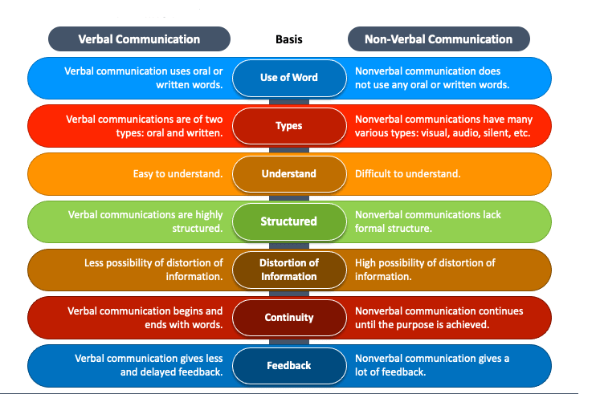
Verbal Vs Non- Verbal Communication

Slide 21
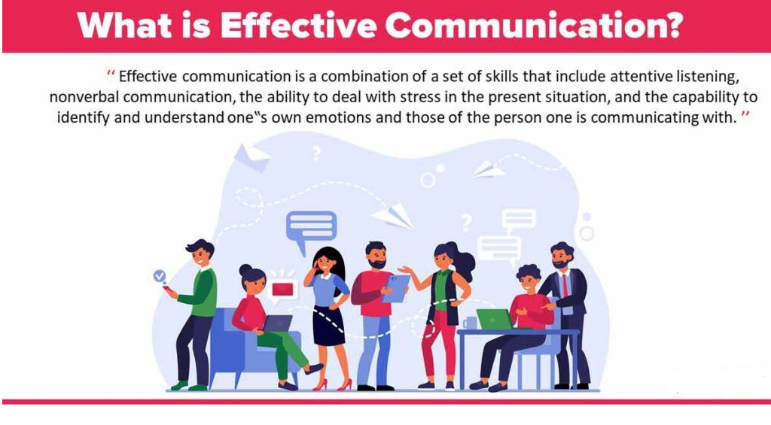
Effective communication definition
is a process of exchanging ideas, thoughts, knowledge and information such that the purpose or intention is fulfilled in the best possible manner.
In simple words, it is nothing but the presentation of views by the sender in a way best understood by the receiver.
https://theinvestorsbook.com/effective-communication.html

Slide 22
Effective Communication:
If someone achieve the desired level of objective through communication , we can say that it is “effective communication”.
e.g. If your communication get the proper response from the receiver it means that you effectively conveyed the message.

Slide 23
How to achieve effective Communication
Encourage creative and Critical Thinking
Consider audience’s information needs
Consider Audience's Technical Background
Consider Audience's Cultural Background and Gender
Consider Audience's Knowledge of the Subject

Slide 24
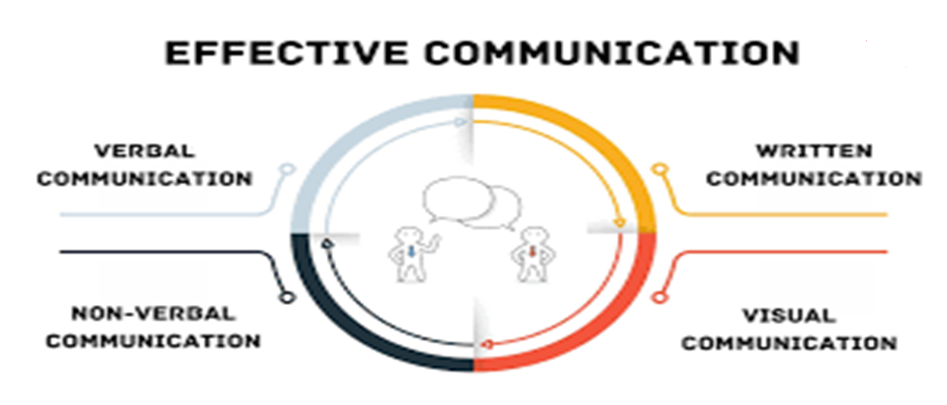
The components of Effective Communication

Slide 25
Importance of effective communication
Help us to understand a person or a situation in a better way
It enables us to solve the differences, build trust and respect In the organization
Resolve problems from both points of view and offer best decision making
Help well connection with each other
https://www.slideshare.net/ei_skola/effective-communication-71902057

Slide 26

Characteristics of Effective Communication the 7 C’s
Clear
Concrete
Concise
Courtesy
Coherent
Comprehension
Complete
https://www.slideshare.net/effectivecommunication/cs-final-ppt-11938630

Slide 27
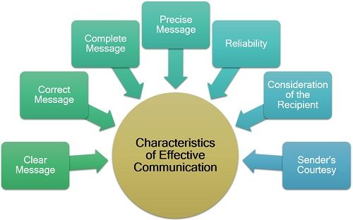

Slide 28
the 7 C’s meaning
Clear
main ideas easily identified and understood
Concise
gets to the point without using unneeded words or images
Concrete
includes specific examples or explanations
polite, professional tone
Coherent
information presented in a logical sequence
Courteous
enough information so the audience can understand
Complete
in information, word choice, and grammar
Correct ( Comprehension)
https://www.slideshare.net/effectivecommunication/cs-final-ppt-11938630

Slide 29
Which are Important points to improve communication skills?
1
Confidence
Logical presentation
6
Local language
2
Enthusiasm
7
3
Clear objective / Aim
Effective end
8
4
Self prepared script & Subject matter
Time limit
9
5
Effective start
10
Speed and Clear Voice

Slide 30
BARRIERS TO COMMUNICATION factors affect on communication
1
Wrong or poor choice of Medium
Socio-psychological Barriers
6
  Poor written or oral expression.
  Failure to recognize nonverbal signals.
2
7
3
Filtering
Physical Distractions
8
4
Selective perception
Lack of feedback
9
5
Information overload
10
Language barrier
https://www.slideshare.net/effectivecommunication/cs-final-ppt-11938630

Slide 31
Other Challenges and barriers
Gender barriers
Distractions
Physical proximity
Personalities
Conflict and Shift change
Varying communication styles
Workload

Slide 32
Barriers to Team Effectiveness
BARRIERS
Inconsistency in Team Membership
Lack of Time
Lack of Information Sharing
Hierarchy
Defensiveness
Conventional Thinking
Complacency
Varying Communication Styles
Conflict
Lack of Coordination and Follow up With Co-Workers
Distractions
Fatigue
Workload
Misinterpretation of Cues
Lack of Role Clarity
OUTCOMES
Shared Mental Model
Adaptability
Team Orientation
Mutual Trust
Team Performance
Resident Safety!!

Slide 33
HOW TO OVERCOME BARRIERS ?
01
Have a Positive attitude about Communication.
04
Make Communication goal Oriented.
Use very simple & familiar words during communication.
Approach Communication as a creative process
02
05
Help other people improve their communication skills by helping them understand their communication problem.
accept the reality of miscommunication and work to minimize its negative impacts.
06
03
https://www.slideshare.net/effectivecommunication/cs-final-ppt-11938630

Slide 34
Exercise and activity discuss it in the live session
https://www.youtube.com/watch?v=8Ox5LhIJSBE
https://www.youtube.com/watch?v=c_W6SX6SLdg

Slide 35
Case Study No. 1 to Discuss
The promising chemist who buried his results
Bruce, a research chemist for a major petro-chemical company, wrote a dense report about some new compounds he had synthesized in the laboratory from oil-refining by-products.
The bulk of the report consisted of tables listing their chemical and physical properties, diagrams of their molecular structure, chemical formulas and data from toxicity tests.
Buried at the end of the report was a casual speculation that one of the compounds might be a particularly safe and effective insecticide.
https://pressbooks.bccampus.ca/technicalwriting/chapter/casestudy-costpoorcommunication/

Slide 36
Case Study No. 1 to Discuss, Con’t
Seven years later, the same oil company launched a major research program to find more effective but environmentally safe insecticides. After six months of research, someone uncovered Bruce’s report and his toxicity tests.
A few hours of further testing confirmed that one of Bruce’s compounds was the safe, economical insecticide they had been looking for.
Bruce had since left the company, because he felt that the importance of his research was not being appreciated.

Slide 37
Case Study No. 2 to Discuss
The rejected current regulator proposal
The Acme Electric Company worked day and night to develop a new current regulator designed to cut the electric power consumption in aluminum plants by 35%. They knew that, although the competition was fierce, their regulator could be produced more affordably, was more reliable, and worked more efficiently than the competitors’ products.
The owner, eager to capture the market, personally but somewhat hastily put together a 120-page proposal to the three major aluminum manufacturers, recommending that the new Acme regulators be installed at all company plants.
https://pressbooks.bccampus.ca/technicalwriting/chapter/casestudy-costpoorcommunication/

Slide 38
Case Study No. 2 to Discuss, Con’t
It devoted the first 87 pages of the proposal to the mathematical theory and engineering design behind his new regulator, and the next 32 to descriptions of the new assembly line she planned to set up to produce regulators quickly. Buried in an appendix were the test results that compared her regulator’s performance with present models, and a poorly drawn graph showed the potential cost savings over 3 years.
The proposals did not receive any response. Acme Electric didn’t get the contracts, despite having the best product. Six months later, the company filed for bankruptcy.

Slide 39
Case study
Https://yl.sd53.bc.ca/mod/book/view.php?id=8576&chapterid=4849
https://pressbooks.bccampus.ca/technicalwriting/chapter/casestudy-costpoorcommunication/
https://debatalk.com.au/about-us/case-studies/effective-communication-case-study/

Slide 40



Thank You

