Slide 1

Risk and Decision Analytics
Prepared by Dr. Sami Alzahrani
Lecture 9
PMG 621
Judgments & Biased

Slide 2

Lecture 9
Introduction
Psychology is often a part of decision science: many investigators are interested in better understanding how people do make decisions. We would like to avoid biases and cognitive illusions. Our discussion here is about how people should make decisions.
Decision analysis is a mostly quantitative discipline. Previous chapters describe forecast and evaluation models. This chapter focuses on the expert judgments that are inputs to these models.

Slide 3
Lecture 9
Three Roles
There are three roles in the decision process, as shown in Figure 11.1:
Experts or assessors provide the judgments that go into an evaluation. Usually, the most knowledgeable people available provide these inputs.
Evaluation analysts are primarily responsible for developing the quantitative project models, models that generate scenario outcomes and forecasts for each alternative.
Decision makers review the forecasts and judge whether the analysis is credible. They make the selection (usually accepting the team's recommendation) and initiate implementation. Overlapping duties are common, as people "wear different hats."

Slide 4
Lecture 9
Judgments
A judgment is a value assessment performed by a person. There are two basic approaches to judgments, or assessments, as inputs to an evaluation:
Deterministic Assessments (non-probabilistic)
+ Single-point values (e.g., a particular cost)
+ Single-line forecasts (e.g., inflation rate over time).

Slide 5
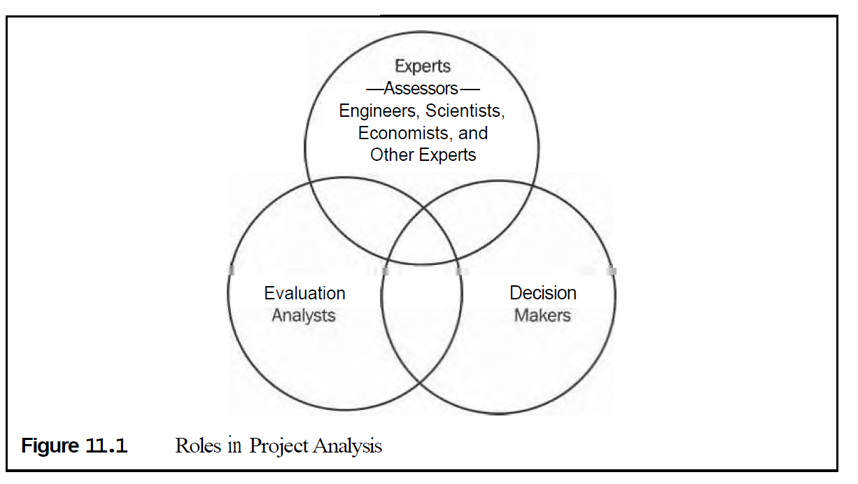
Lecture 9

Slide 6
Lecture 9
conventional deterministic analysis uses only input variable forecasts. Even in decision analysis, this is adequate to represent minor variables or those known with high confidence.

Slide 7
Lecture 9
Probabilistic Assessments (stochastic)
Continuous probability distributions (e.g., hours to complete an activity)
It Discrete probability distributions (e.g., number of subcontractors bidding)
Event probabilities-that is, whether or not an event happens (e.g., whether a task will require rework). This binary event type is the simplest of discrete distributions.
When a value is uncertain, the representation takes the form of a probability distribution. Considering a single variable alone, a probability distribution can completely represent an expert's judgment about the possible outcomes of a chance event.

Slide 8
Lecture 9
Risk analysis is the process of assessing the probability distribution for
ne or perhaps several variables. Decision analysis is more encompassing, and is about evaluating alternatives in the context of decision policy. There may be several risk analyses as part of a decision analysis.

Slide 9
Lecture 9
Objective and Subjective Probability
Because a human performs a judgment, the resulting probability distribution is called a suvective probability.
The extreme opposite is objective probability. This is supported by a comprehensive understanding of the system or by conclusive evidence: either knowing the value and likelihood of every possible element in the population, or completely understanding the stochastic process providing variable outcome values.

Slide 10
Lecture 9
Figure 11.2 shows the continuum between the two extremes. Most judgments lie somewhere in the middle, far from either end. Even with considerable data from similar situations, the expert must assess to what degree the data still apply.
With sufficiently complete data or system knowledge, which is rare, we could approach a 100 percent objective probability assessment. Fully objective assessments are rare. Examples would be probabilities associated with cards, dice, and other elements of chance, where we have essentially complete knowledge of the system.
Judgments, as inferred by their name, always involve a degree of subjectivity on the part of the expert. Subjective probability assessments reflect someone's belief. Here are two common and illogical statements: "I judge that the probability is 30 percent, but I may be wrong."

Slide 11
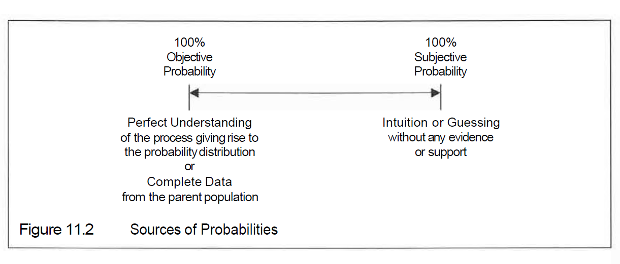
Lecture 9

Slide 12
Lecture 9
When someone judges the likelihood of an event, the assessment should be a single number. A range is nonsense (unless predicting where the final judgment will lie). The expert should settle on a single fraction, despite often incomplete information.

Slide 13
Lecture 9
It is important that judgments be as objective as possible. Being "objective“ as to source (see Figure 11.2) reduces the effect of emotion. Possibly confusing is also using "objective" when referring to judgment quality as meaning free from bias. Biases (i.e., not objective to quality) are more likely when the source of the judgment is subjective. For this reason, we often hear a question like, "How objective is that assessment?“
In decision analysis, subjective probabilities are often all that are available. In most evaluations, you will find several key variable assessments that are highly subjective. Nevertheless, appropriate use of even soft judgments about important variables leads to improved decisions. The decision model provides a logical way to use everything important that we know about the problem.

Slide 14
Lecture 9
A good decision is consistent with the data and with the organization’s decision policy, but does not guarantee a good outcome in a particular case. We use decision analysis in believing that there is a correlation between good decisions and good outcomes. Consistently making good decisions increases the likelihood of favorable results over time.

Slide 15
Lecture 9
Eliciting Judgments
Eliciting means to bring out or draw out the judgment of an expert. Unless the expert has been well trained in probability concepts, eliciting a judgment is usually best accomplished through an interview process. The interviewer, often a decision analyst, acts as an interested but objective party. Different perspectives of the variable are discussed and quantified until the expert is confident that the resulting probability distribution accurately reflects her best judgment.

Slide 16
Lecture 9
In formulating an opinion, we ask the expert to consider the possibilities. Is this the right variable? Have we clearly defined what it means? Is this the right level of detail? What is assumed in this assessment? What is the worst (or best) possible outcome? What has to go right for this to occur? What might go wrong?

Slide 17
Lecture 9
In the interview, it is important to first determine range of the distribution. Then work inward. Do not fall into the trap of starting with the best value and attempting to build a distribution around it. If you do, you will likely fall into the trap of the anchoring bias (discussed later in this chapter). Bracketing the possibilities and working inward avoids anchoring on an initial central value.

Slide 18
Lecture 9
Some experts are uncomfortable with quantlfylng their judgments directly as probability distributions. In such cases, analogs may help diffuse the probability anxiety. One means is to use a probability wheel, such as that illustrated in Figure 11.3, which uses pie-shaped sections to represent the possible outcomes. The expert adjusts the size of the pie sections until she feels that the areas are proportional to the likelihood of the respective outcomes. A scale visible only to the interviewer shows the corresponding probabilities. A similar approach would be to use a device where linear distances represent probability weights.

Slide 19
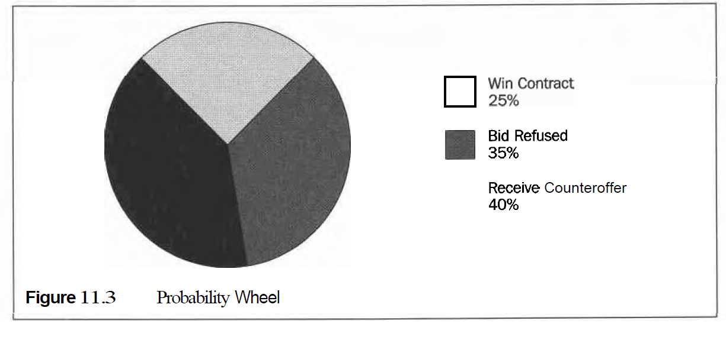
Lecture 9

Slide 20
Lecture 9
Overconfidence about Our Knowledge
Actual forecasting behavior and clinical experiments repeatedly show that people are overconfident about their knowledge. Consider persons asked to provide, say, an 80 percent confidence interval for a parameter.
An 80 percent confidence interval is defined by two bounds, such that there is only a 10 percent chance of the outcome being lower than the lower bound, and a 10 percent chance of being higher than the upper bound.

Slide 21
Lecture 9
It makes sense that the less someone knows about a variable, the wider her confidence interval should be. Typically, only about half of survey participants have the true outcomes contained in their judged 80 percent confidence intervals. That means the typical person is responding with a 50 percent confidence interval, when the request was for an 80 percent confidence interval. Other interesting results from such surveys (see Capen 1976) include:
People without knowledge of a topic are often unable to differentiate between 30 percent and 98 percent confidence intervals. Asking for a 95 percent interval typically gets about a 65 percent confidence range.

Slide 22
Lecture 9
The more people know about the general subject (not the specific question), the larger the confidence interval that they assign (they more fully appreciate the possibilities). The more a typical person knows about the topic, the less chance that their interval includes the true value. Even when told beforehand that "most persons are overconfident about their knowledge," survey participants continue to make their confidence intervals too small.

Slide 23
Lecture 9
Asking the person to judge two confidence intervals will help. For example,
first ask for a 90 percent, then a 50 percent, confidence interval.
The solution to this overconfidence bias is practice and feedback. Expert assessors should practice and be given feedback on the quality (outcomes) of their assessments. If artificial situations are necessary for practice, it helps to make the exercise as meaningful as possible, such as by putting some real money at stake.
If we elicit the judgment by using an interviewer, he will often first ask the expert for a plausible range. This represents a confidence interval, but not the whole range. Then, they can discuss reasons why more extreme values might occur.

Slide 24
Lecture 9
Biases
One hallmark of a credible evaluation is objectivity (discussed in Chapter 1). This is not objectivity used in the sense of what was the source of the probability assessment (data or intuition). In the discussion that follows, objectivity is synonymous with lack of bias.
A bias is a repeated or systematic distortion of a statistic, being too high or too low on average. The statistic of most interest is the EV. The average error (actual minus estimate) should tend toward zero over many forecasts.
Achieving objectivity, or low bias, requires attention in three areas of the evaluation:
Bias-free assessments of input variables
A value function, embodying the decision policy, which faithfully measures progress or goodness toward the organization's objective Integrity in the decision model structure, so that calculations themselves do not introduce any biases or other errors.

Slide 25
Lecture 9
Common Biases in Evaluation or Decision Policy
Decision policy has three elements, any of which can introduce bias:
Objective. If the value or quality measure does not directly correspond to the organization's purpose, there wiU be a bias. Different stakeholders have different objectives, therefore biases. Most businesses profess to maximize shareholder value, and should be measuring monetary value.
Time value. Present value discounting adjusts cash flows to reflect time value of money. Most companies use a discount rate that is too high for probability-adjusted forecasts, creating a bias against long-term projects.
Risk policy. Many managers believe that they have a responsibility to act conservatively. They will willingly sacrifice a risk premium (see Chapter 4) in terms of reduced expected monetary value, to lower risk. This practice may be intentional and appropriate. An organization's management
should look carefully at what objective is to be maximized in decision policy. An objective value measure will be a statistic that corresponds directly and logically to the objective of the organization.

Slide 26
Lecture 9
Belief and Perception Errors
Several obvious biases arise from emotions and motivational effects; others are from relying on ill-founded heuristics or rules of thumb. Additional biases arise because of poor understanding of statistics or probability theory.
There are also perception biases, similar to optical illusions, because our mental model may not be consistent with reality. Listed below are the more common biases that might be inadvertently introduced into an analysis.

Slide 27
Lecture 9
Personal feelings. The natural tendency is to shade judgments to reinforce what we want to do. If members of a project evaluation team will be able to work on an enjoyable project, they may inadvertently deliver optimistic assessments.
Feelings about the effects of certain outcomes. A contractor may have an excessive desire to win a bid in order to appear busy and successful.
Biases toward new information. People often seek new information only when a "favorable" report is expected. A study is more likely to be commissioned if the decision maker expects it to support her present opinion. "Bad news doesn't sell." Even when delivered, bad news is often discounted, faulted, or ignored.

Slide 28
Lecture 9
Believing what one wants to believe. Projects (or bids) with unreasonably optimistic projections are often selected over projects (or bids) submitted with more reasonable projections.
Insensitivity to sample size. Often there is insufficient data to draw a conclusion. People are prone to make hasty generalizations.
Availability. We remember cases that are more famous or where we were more closely involved. Some scenarios are easier to imagine than others, such as those in our industry or area of expertise. The most recent data or experience is weighted most heavily. The easier it is to imagine or remember, the higher the believed likelihood of occurrence.

Slide 29
Lecture 9
Insensitivity to prior probabilities. Discrepant and unusual events, even though rare, are given undue weight. Exceptions are remembered and weighted as if commonplace. Judgment bias occurs when the current situation is rare, neither common nor unique.
Sensitivity to the cause of the problem. People are willing to do more to save a species endangered by hunting than endangered by natural change. Life-threatening risks are more acceptable if the person has a choice about being exposed to the risk (e.g., drives a motorcycle without a helmet).

Slide 30
Lecture 9
Anchoring. People do not like to change their minds, especially if the earlier
position was publicly stated. They "anchor" to the previous position. Later, they are more likely to recognize information that reinforces the original judgment or decision.
We also mentioned anchoring when judging an uncertainty. If one has an initial impression of the best forecast, then he often keeps this constantly in mind when building-out the distribution. It is therefore difficult to objectively consider the possibilities. Psychologists have demonstrated that people assessing a probability distribution shape should not try to build around an initial "best guess." The expert inadvertently anchors to the original number. This effect is minimized if the assessment starts at the extremes of the distribution and works inward.

Slide 31
Lecture 9
Framing. We are sensitive to the wording and context of outcomes. This is called the fiarning of an event description. Very different judgments can result from the way we ask (frame) questions. Consider a major project that will earn a $20 million profit for the company if it succeeds, but will lose $2 million dollars if it fails, asking:
"What minimum probability of success would you require to be willing to approve this project?"
"What maximum probability of failure would you accept and still be willing to approve this project?"
Such questions often evoke a response different from the complement question. If any person were to answer both questions, the responses should add to 1. Often they do not. Surveys about losing (saving) jobs or lives often show that the answers depend upon the form of the questions.

Slide 32
Lecture 9
Improving Evaluations
Consistent, objective evaluations require good analysis practice. Here are some recommendations:
Make a conscientious effort to best capture the experts' judgments in assessing input variables. Some of these assessments may be highly subjective. Whether additional investigation is warranted can be evaluated as a value of information problem (see Chapter 6).

Slide 33
Lecture 9
Strive to avoid judgment biases in assessing input variables. Everyone upstream from the decision maker should be as objective as possible.
Otherwise, the analysis is questionable and of little value. Note that if everyone is slightly conservative, the resulting analysis can be overwhelmingly conservative.
Some situations demand conservative decision making. A conservative attitude is a bias-but is often appropriate. Apply a consistent risk policy. This is done, in effect, in the final stage of analysis. Most often, the decision maker simply compares risk-versus-value (or cost) profiles of the different alternatives and chooses the best one (see Chapter 3 and Chapter 4 for a more consistent, quantitative approach). We can detect some errors by validation. Sometimes we can develop models to validate outcome data. Conversely, data can be used to validate models.

Slide 34
Lecture 9
In developing a valid model, it helps to decompose the project system into submodels. Quantlfy subjective assessments, and model interrelationships between variables. A suitable stochastic method (e.g., Monte Carlo simulation) correctly propagates the probability distributions throughout the calculations.

Slide 35
Lecture 9
Recognize that biases do exist. We can avoid or minimize some of these by carefully structuring the problem. Use an appropriate value measure, and separate judgments from preferences. A common error, for example, is to increase the present value discount rate to compensate for risk. It is far better to use probabilities to deal with uncertainty, and use the discount rate only to represent preference for time value of money.

Slide 36
Lecture 9
Perhaps the most powerful way to improve decisions is post-implementation reviews, also called post-evaluations or post-audits. These are followup analyses of decisions after the general results become known. There is a psychological bias toward rationalization, and many people have difficulty reconstructing their thought processes after learning the outcome. It is important to preserve the original reasoning by documenting the analysis. Provide performance feedback to the individual assessors, and use lessons learned to improve the evaluation process.

Slide 37
Lecture 9
Summary
As professionals, most of us spend a great portion of our workdays processing or preparing information for others to act upon. This work is either evaluation itself or preparation for evaluation. Employers and clients are better served by ensuring that evaluations are objective-a hallmark of professionalism.

Slide 38
Lecture 9
A colleague approached me once, saying, "I could use the decision analysis methods i f only I had good data." When do we ever have "good inputs to planning evaluation models? Rarely!
My response is always to point out that we are going to make the decision regardless of whether we have good data. A decision analysis approach lets us do the best we can, given what we know, even when some of those inputs are very subjective. Chapter 12 continues our discussion about judgments, next focusing on relationships among variables.

