Slide 1



IoT Development History
& Overview
Lecture 1
IoT Security
Prepared by
Dr. Abdelrhman Ahmed

Slide 2
Chapter
Foreword
01
Internet of Things (IoT) is an important part of the new generation of information technologies and an important development phase in the information era.
IoT is widely used in network convergence using communications and sensing technologies, such as intelligent sensing, identification, and pervasive computing. Therefore, IoT is called the third wave of global information industry development after computers and the Internet.

Slide 3
Chapter
Objectives
01
On completion of this chapter, you will have an understanding of:
IoT development history
Basic IoT concepts
Layers of the IoT architecture

Slide 4
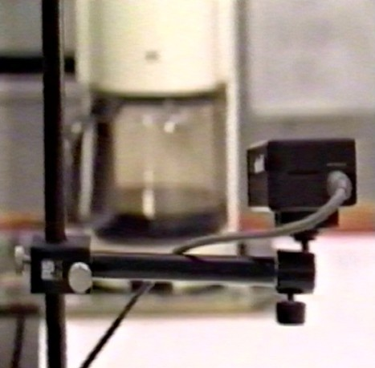
Trojan Room coffee pot in 1991: At the Trojan Room of the Computer Laboratory in Cambridge University, scientists went downstairs to see if the coffee was cooked, but often returned empty-handed.
To solve this problem, they wrote a set of programs and installed a portable camera next to the coffee pot. The camera was aimed at the coffee pot. Computer image capture technology was used to check at any time whether the coffee was cooked, eliminating the need to go up and down the stairs.
Chapter
01
Origin of the IoT

Slide 5
Chapter
Development of the IoT
01

Slide 6
Chapter
Penetration & Development of IoT in Industries
01

Slide 7
Chapter
IoT Key Events: Evolution of NB-IoT Standards
01
The standards of the narrowband cellular IoT (NB-IoT) communications technology NB- IoT were officially initiated in September 2015, and the core standards were frozen in June 2016.

Slide 8

On October 31, 2019, China Telecom, China Mobile, and China Unicom jointly announced the launch of 5G commercial services and released corresponding packages at the opening ceremony of the China International Information Communication Technology Exhibition. 5G will bring diversified and comprehensive benefits to IoT, and will also promote new solutions and industry chains.
Chapter
01
IoT Key Events: Commercial Use of 5G

Slide 9

Consumer IoT is directly applied to consumers' IoT products and services. Consumer-related IoT products and services include smart bands, VR and AR glasses, body fat scales, smart locks, smart speakers, shared bicycles and trams, and automated driving vehicles. According to a report released by Markets and Markets, the global consumer IoT market scale in 2018 was $46.8 billion USD. It is expected to reach $104.4 billion USD by 2023 with a compound annual growth rate of 17.39% from 2018 to 2023.
Chapter
01
Development Status of the IoT Industry: Consumption-Driven

Slide 10
Chapter
IoT Key Events: Evolution of NB-IoT Standards
01
Policy-driven applications mainly cover city management scenarios, such as firefighting, security, system integration, public utilities, lighting, and parking.

Slide 11
Chapter
Layers of the IoT
01

Slide 12
Chapter
Huawei 1+2+1 IoT Solution Architecture
01

Slide 13
Chapter
NB-IoT: Connecting Device Fleets Using Cellular Networks
01

Slide 14
Chapter
Industrial IoT Gateway
01

Slide 15
Chapter
Lightweight, Intelligent Huawei LiteOS
01

Slide 16



Thank You

