Slide 1



Present Tenses in Use
Lecture 2
Prepared by
Ahmed Soliman
www.midocean.ae

Slide 2

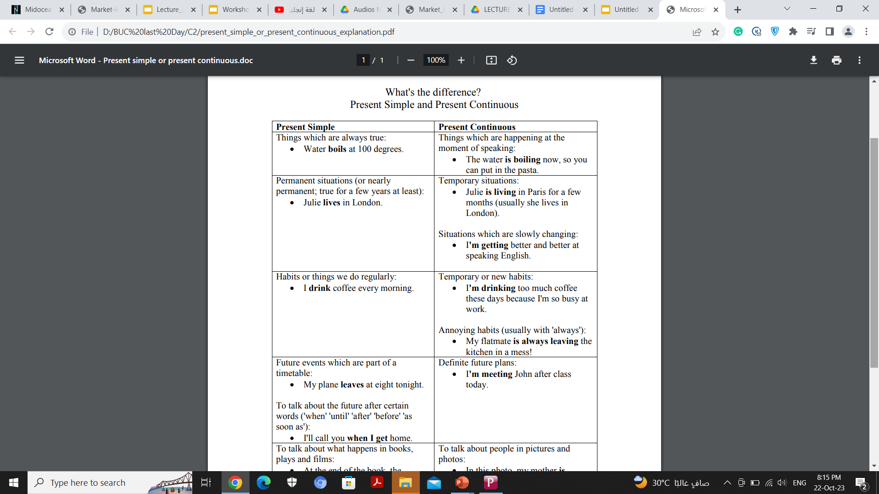
www.midocean.ae

Slide 3
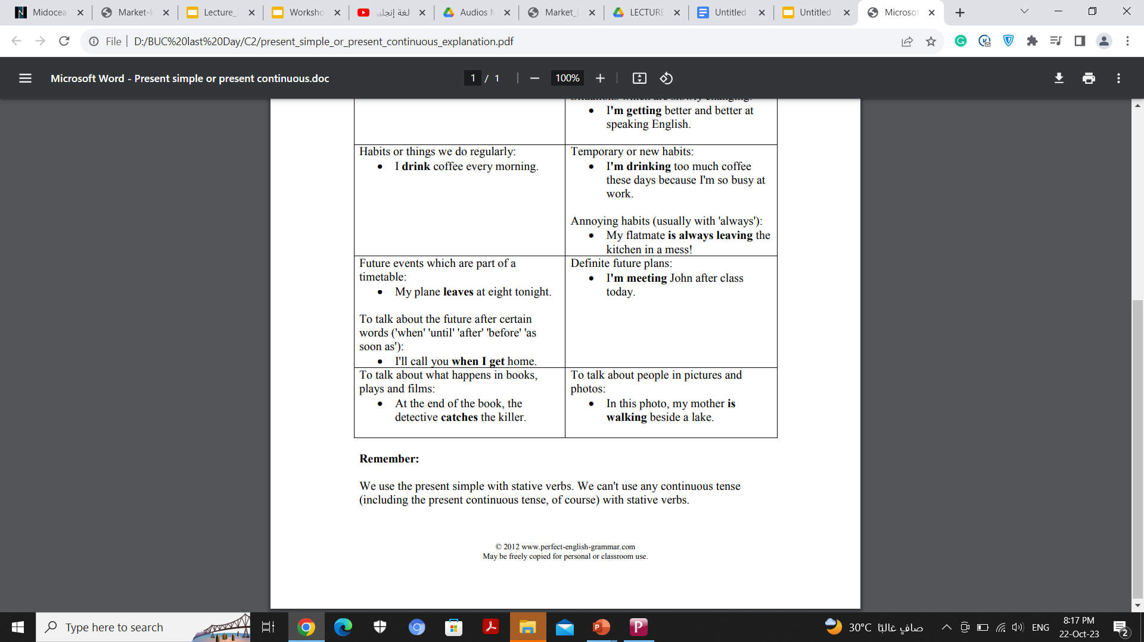
www.midocean.ae

Slide 4
Complete the sentences with the present simple or present continuous form of the verbs in brackets.
She_______(run) because she's late for her lesson.
Our teacher always_______(give) us lots of homework.
We_______(not want) to go to the concert.
What time________(you / meet) Pete tomorrow?
I________(not work) today. I'm on holiday.
People_______(speak) English in Jamaica.
Archie______(not use) his computer at the moment.
_________(Tony / live) near the park?
www.midocean.ae

Slide 5
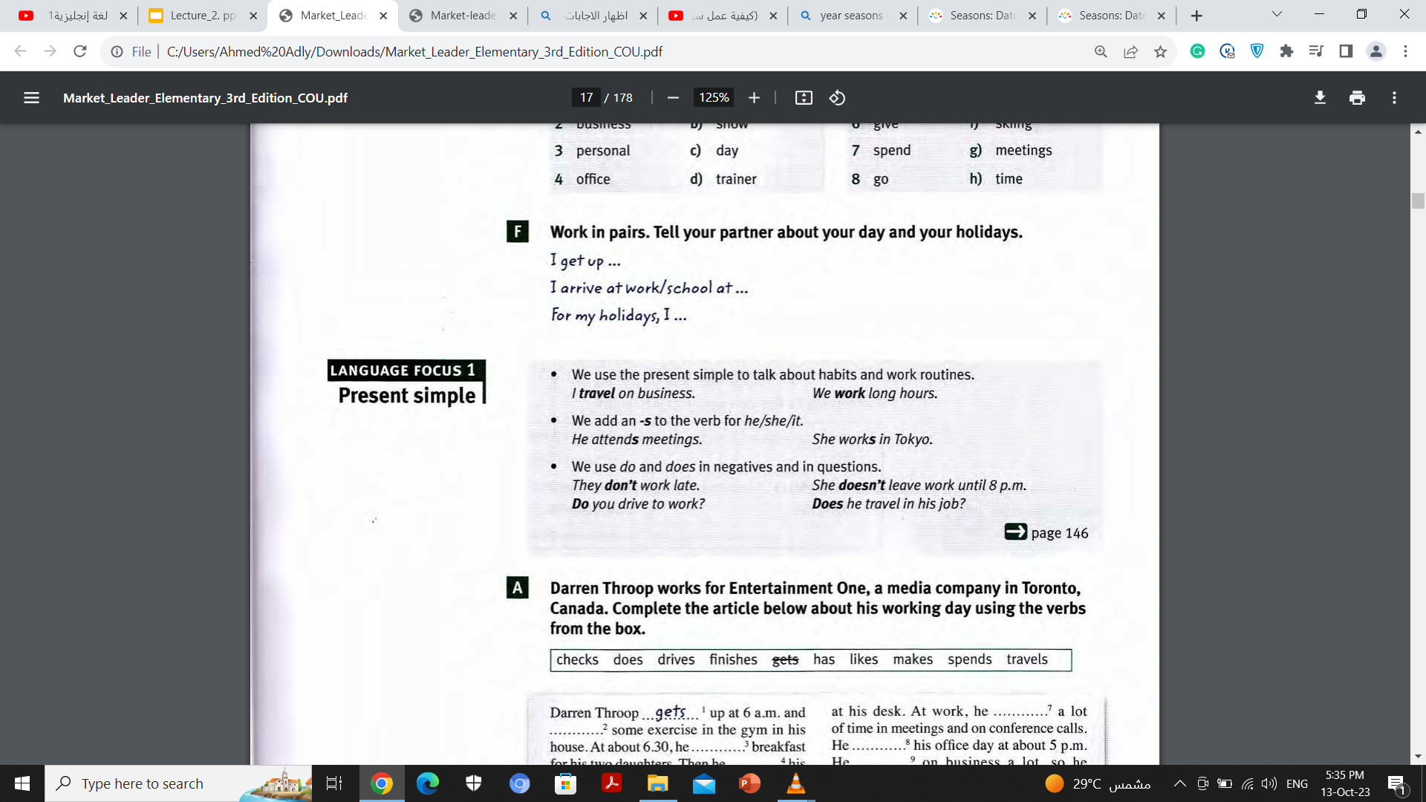
www.midocean.ae

Slide 6
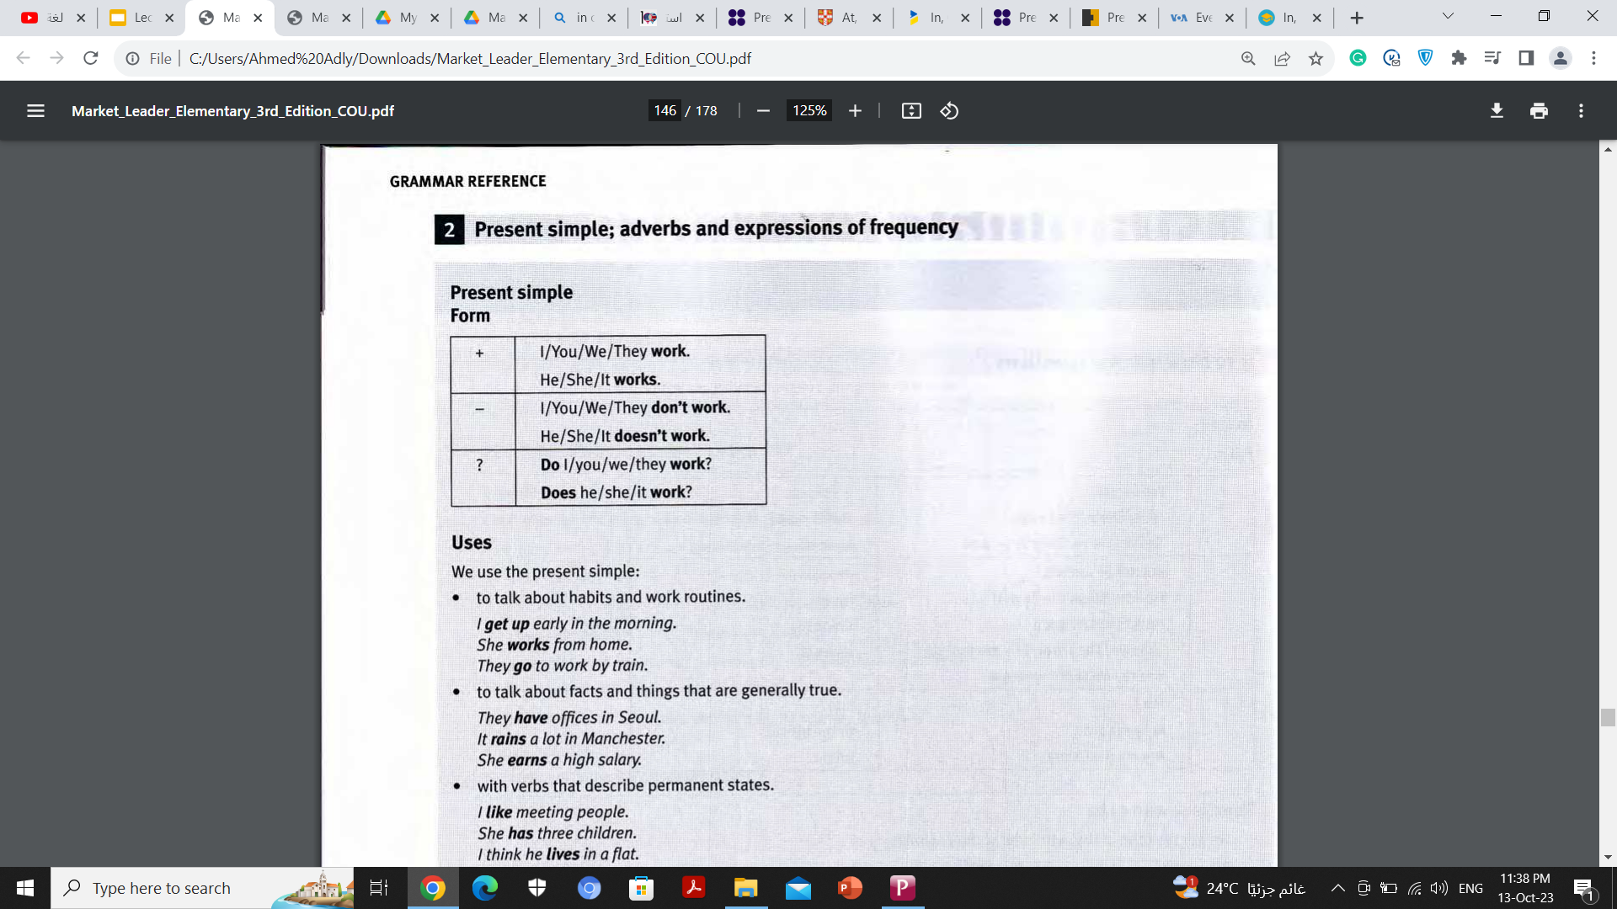
www.midocean.ae

Slide 7
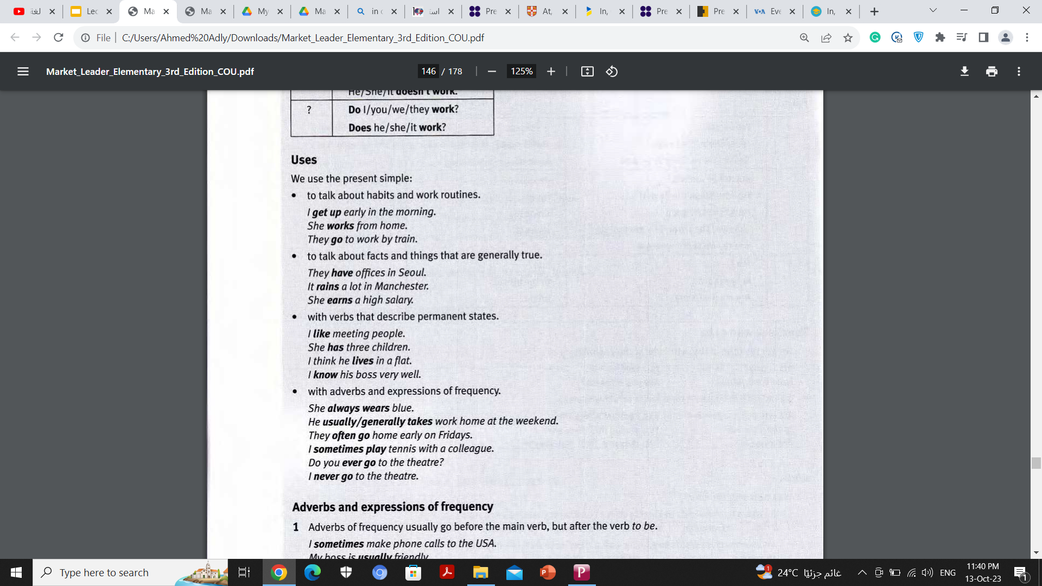
www.midocean.ae

Slide 8
www.midocean.ae

Slide 9
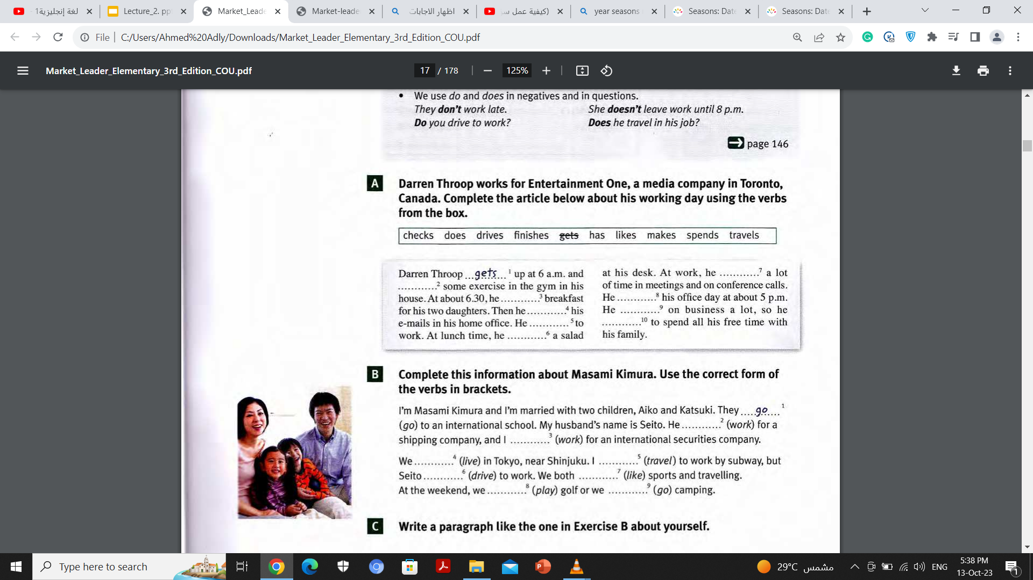
spends
does
has
finishes
checks
travels
drives
likes
makes
www.midocean.ae

Slide 10
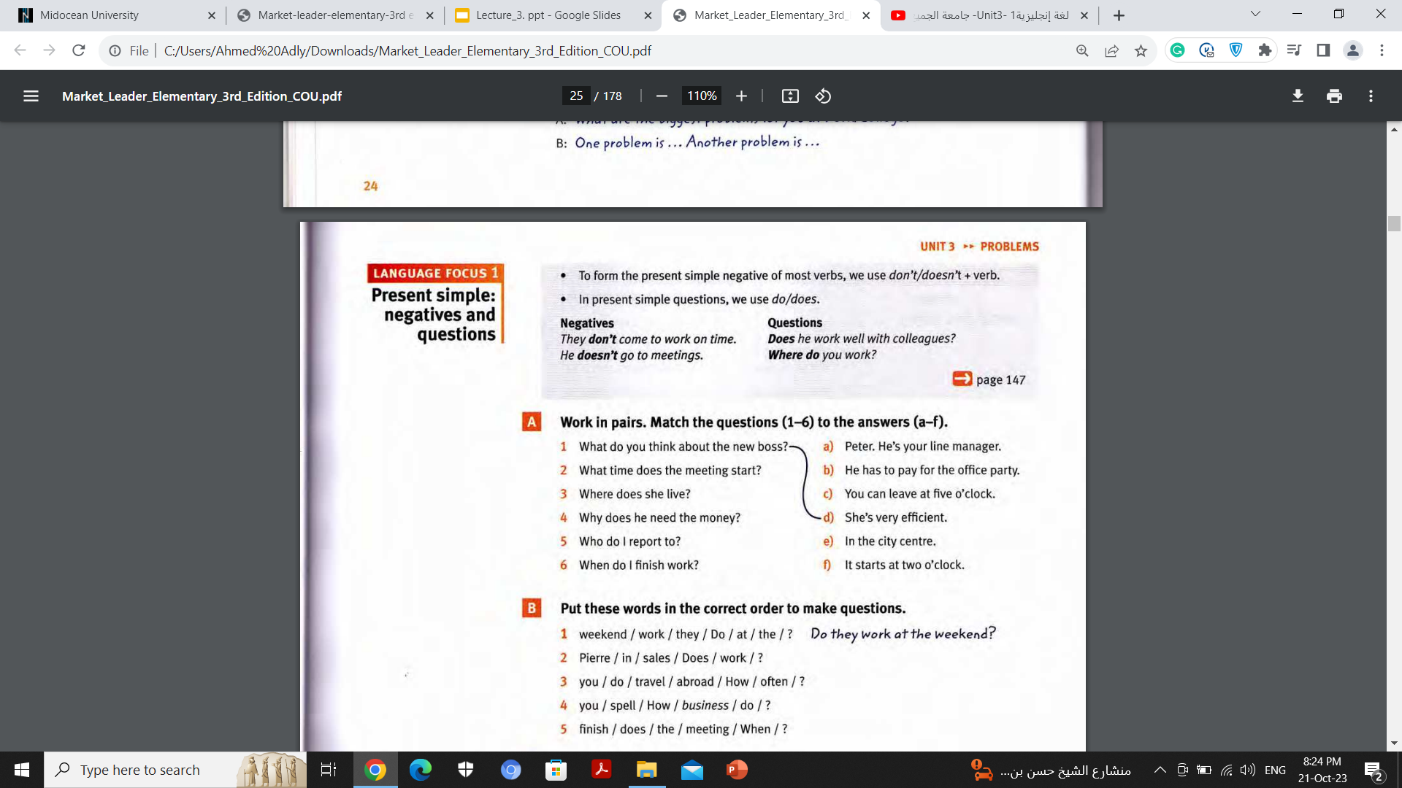
www.midocean.ae

Slide 11
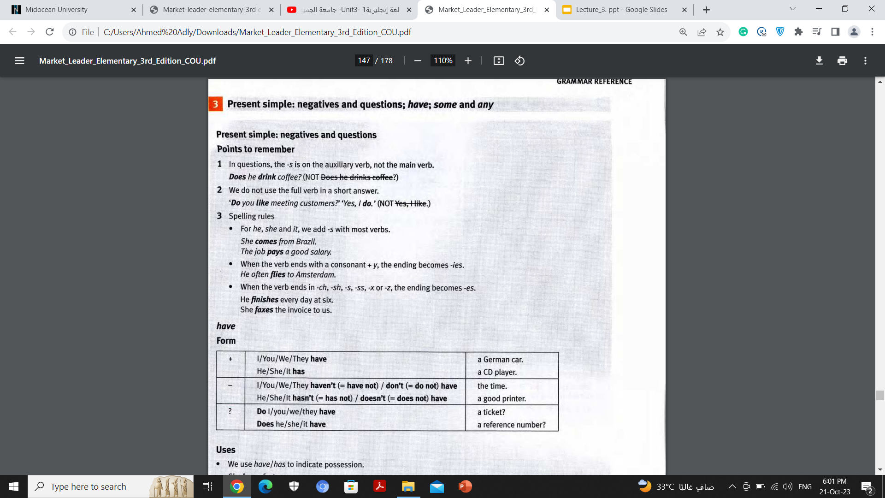
www.midocean.ae

Slide 12
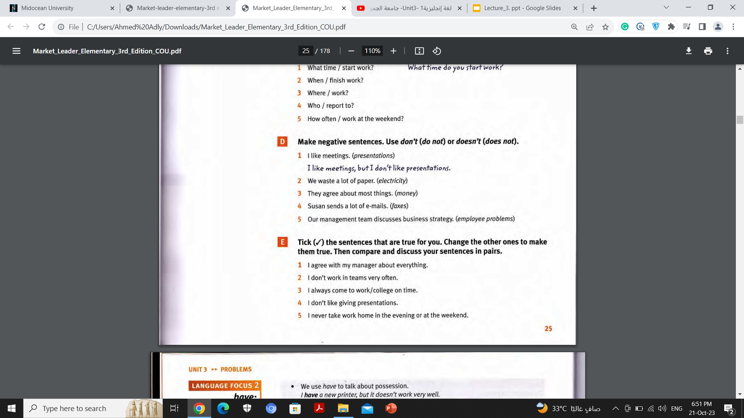
but we don’t waste electricity
but they don’t agree about money
but she doesn’t send faxes
but it doesn’t discuss employee problems
www.midocean.ae

Slide 13
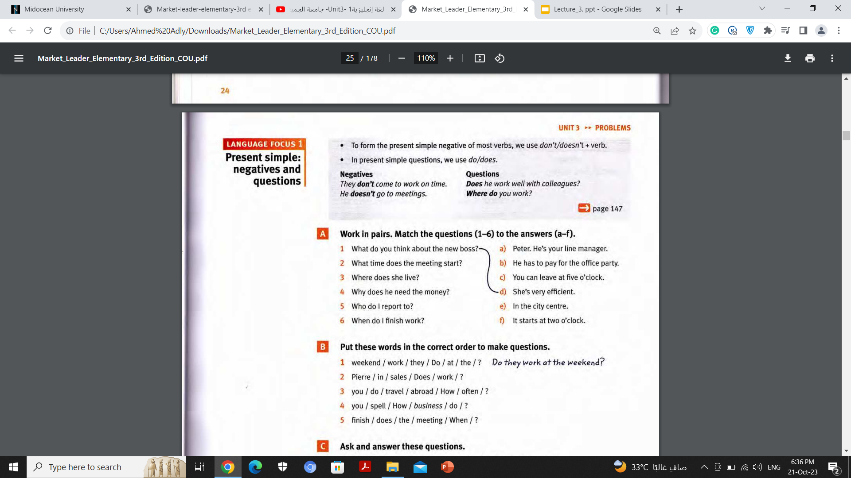
Match the questions (1-6) to the answers (a-f).
www.midocean.ae

Slide 14
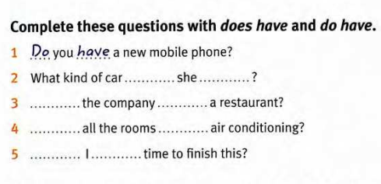
does
have
Does
have
Do
have
Do
have
www.midocean.ae

Slide 15
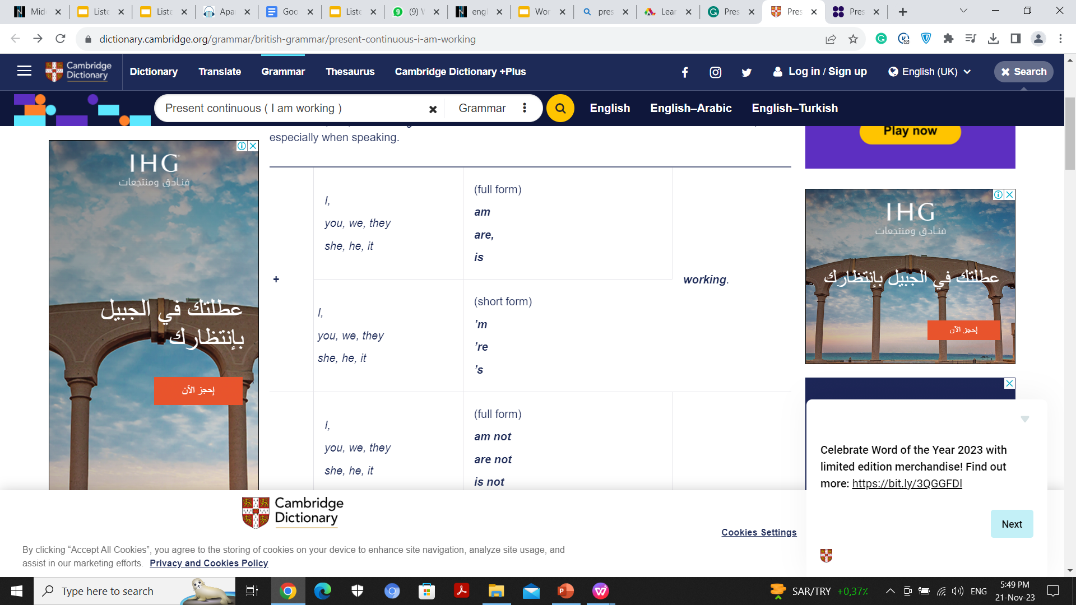
Present Continuous
Form
www.midocean.ae

Slide 16
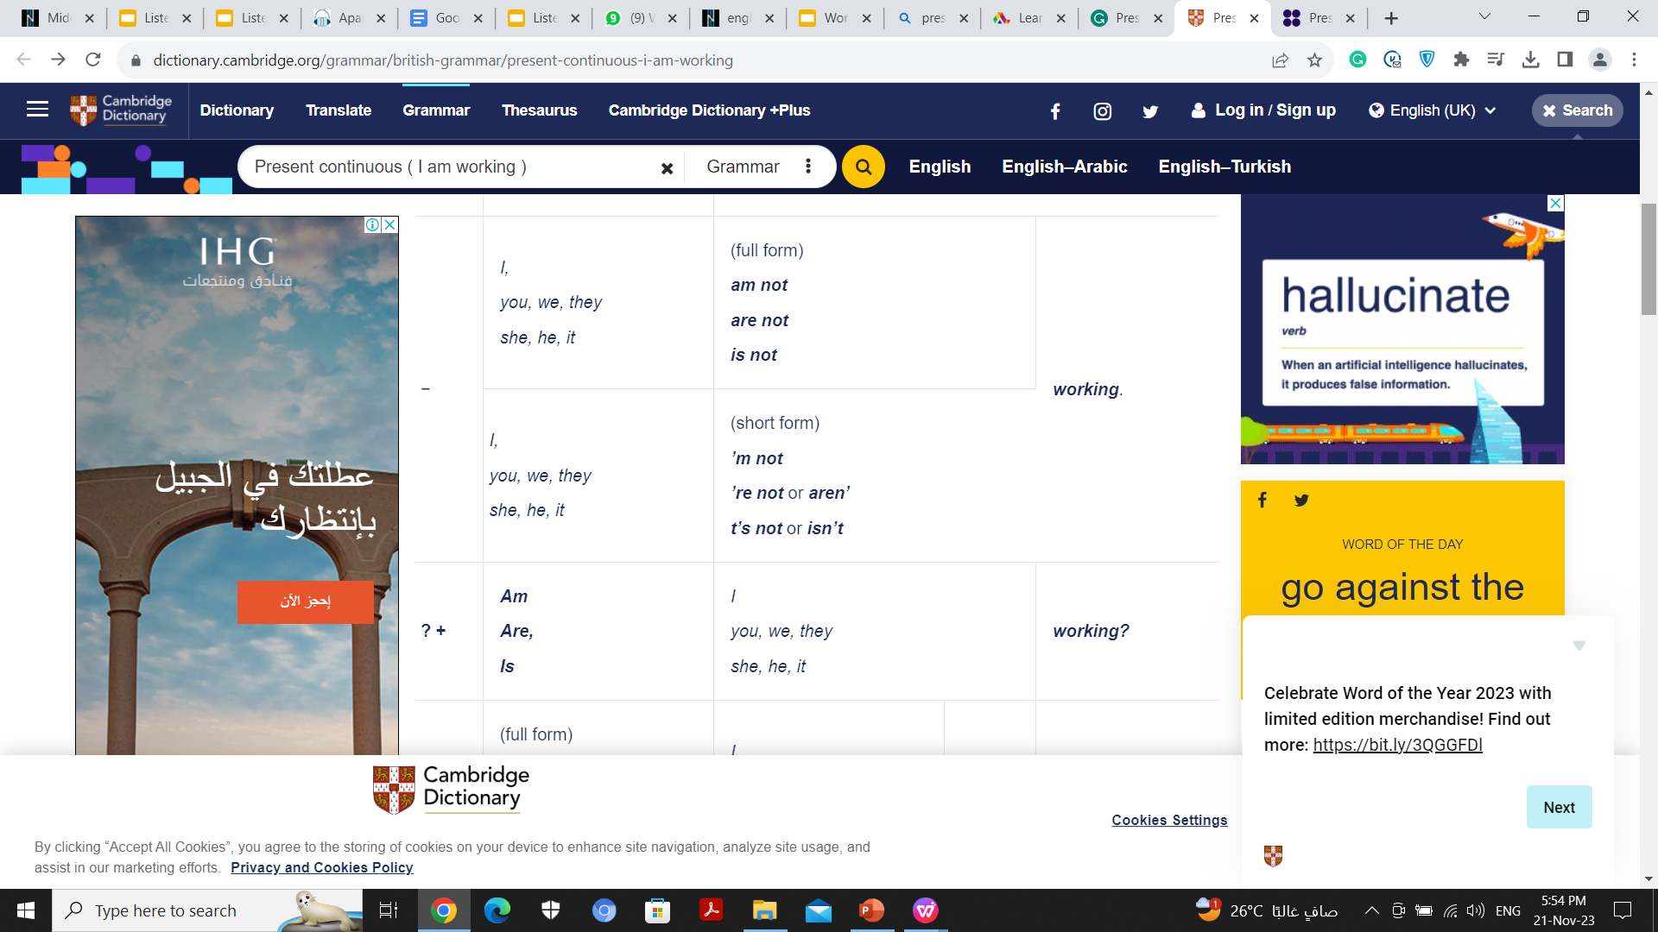
Negatives
www.midocean.ae

Slide 17
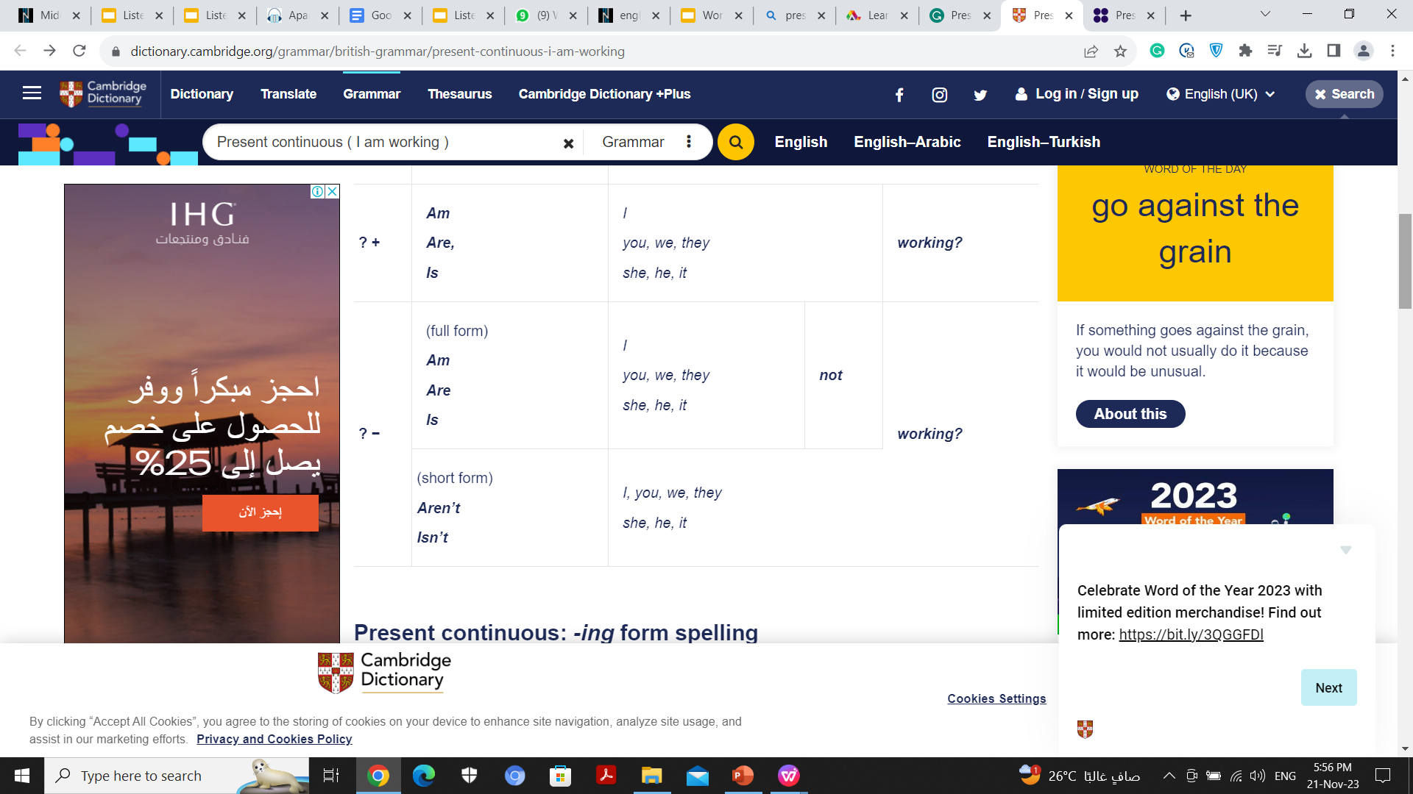
Questions
www.midocean.ae

Slide 18
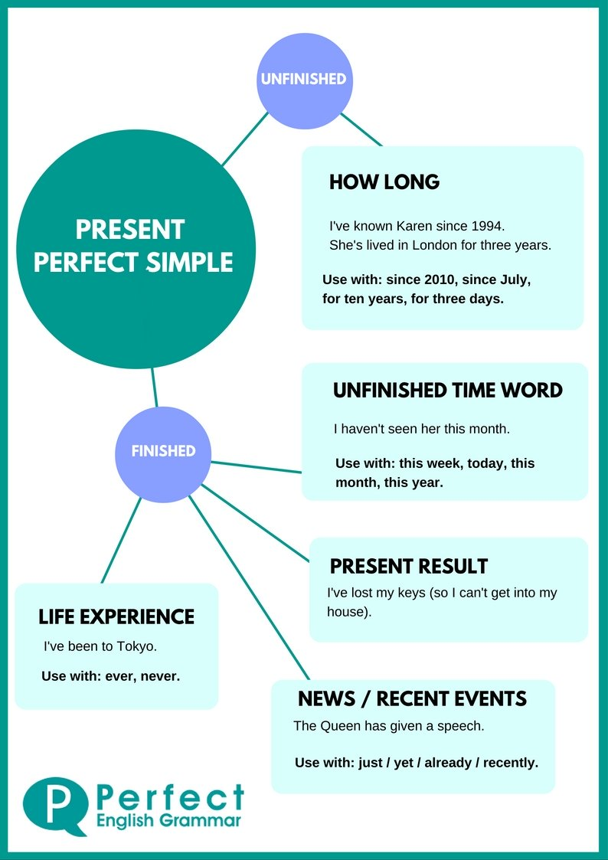
Present Perfect
Use
www.midocean.ae

Slide 19
The Form
Subject + have + P.P
has
They have seen that film six times
She has visited them frequently.
www.midocean.ae

Slide 20
Interrogative
Have / has + Subject + P.P?
Wh question + have / has + Subject + P.P?
Have you called your mom yet?
Has Anthony played basketball yet?
Have you travelled to Aswan?
Have you ever ridden a camel?
www.midocean.ae

Slide 21
Negative
Subject + hasn’t / haven’t + p.p.
They haven't lived here for years.
He hasn’t finished his homework yet.
www.midocean.ae

Slide 22


Thank You

