Slide 1

Mathematics 2
Prepared by Dr. Israa Lewaa
Lecture 5
MAT 122
Advanced Topics in Matrix Algebra

Slide 2

Lecture
05
Lecture Outline
The inverse of Matrix Definition
The inverse for 2 * 2 matrix by determinant
Solving Two Equations by Inverse matrix
The inverse for 2 * 2 matrix by Reduced Echelon Form

Slide 3
Lecture
05
Inverse of matrices
Let A be a square matrix. A matrix B such that AB=I=BA is called the inverse matrix of A and is denoted by A⁻¹.
So if A⁻¹ exists, we have AA⁻¹=I=A⁻¹A and the matrix is said to be invertible.
If a matrix has no inverse, then it is said to be non-invertible.

Slide 4
Lecture
05
Inverse of matrices
Let A be a square matrix. A matrix B such that AB=I=BA is called the inverse matrix of A and is denoted by A⁻¹.
So if A⁻¹ exists, we have AA⁻¹=I=A⁻¹A and the matrix is said to be invertible.
If a matrix has no inverse, then it is said to be non-invertible.

Slide 5
Lecture
05
Definition of Inverse Matrix
Definition:
If (A) is an n x n matrix, form the n x 2n matrix (A| I), and Perform elementary row operations until the first n columns form a reduced matrix.
We will solve the system of linear equations by unit matrix.

Slide 6
Lecture
05
The Inverse of a Matrix
Like a reciprocal in scalar math
Like the number one in scalar math

Slide 7
Lecture
05
Inverse matrix by determinants
Inverse matrix by determinants

Slide 8
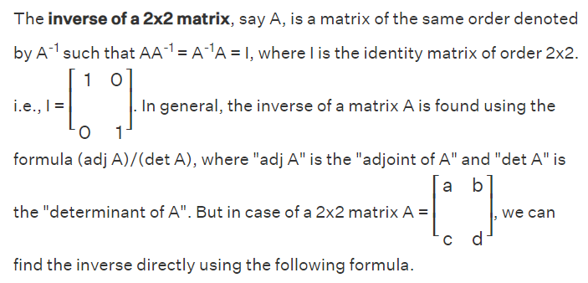
Lecture
05
What is the inverse of 2*2 Matrix

Slide 9
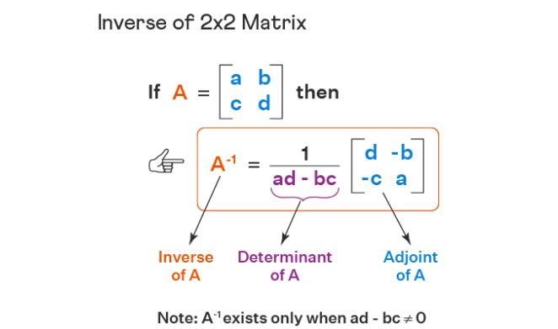
Lecture
05
Example

Slide 10
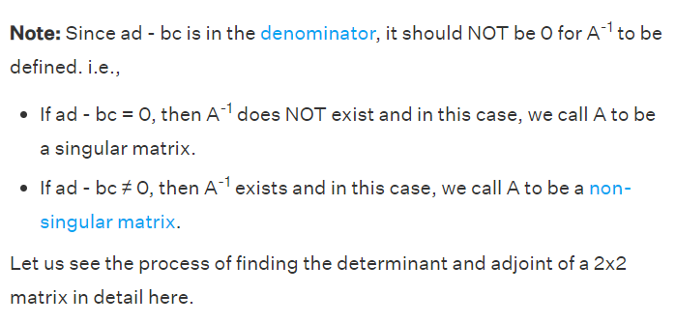
Lecture
05
Example

Slide 11
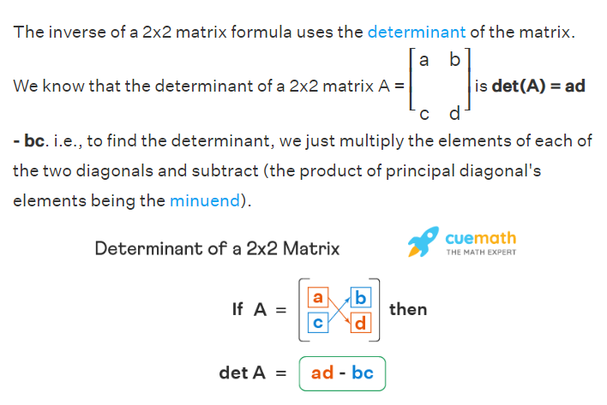
Lecture
05
Determinant of 2*2 matrix

Slide 12
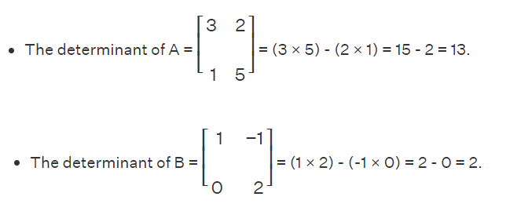
Lecture
05
Example for determinants

Slide 13
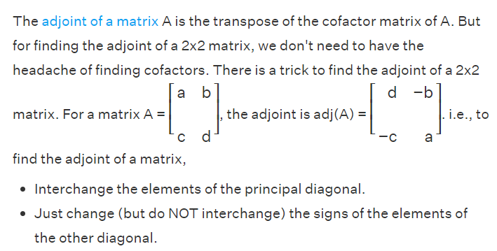
Lecture
05
Adjoint of 2*2 matrix

Slide 14
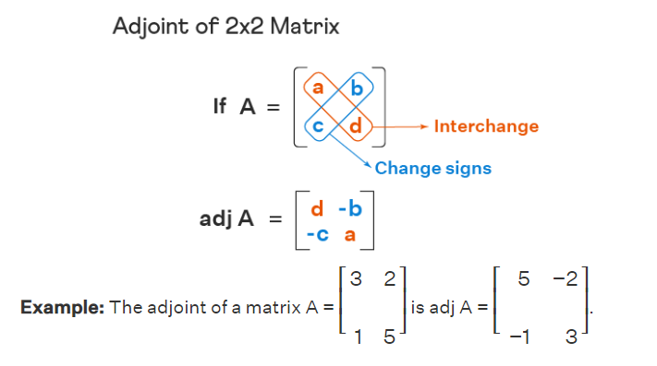
Lecture
05
Example

Slide 15
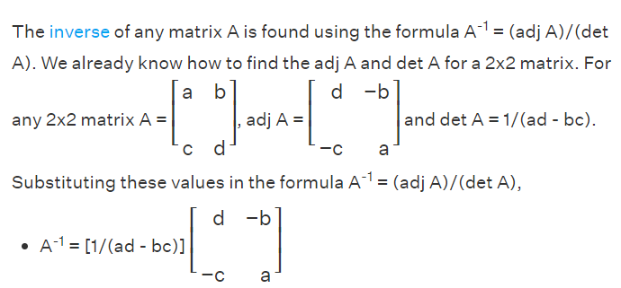
Lecture
05
Inverse of 2*2 matrix Formula

Slide 16
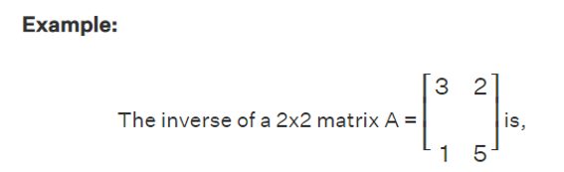
Lecture
05
Example

Slide 17
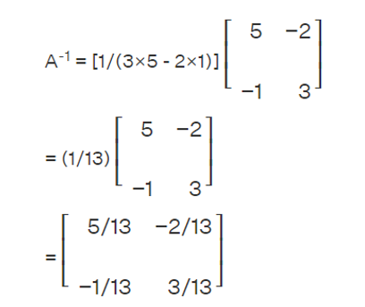
Lecture
05
Example

Slide 18
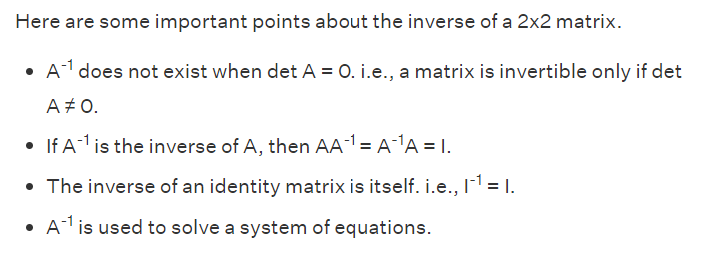
Lecture
05
Important notes on inverse for 2*2 matrix

Slide 19
Lecture
05
Solving Equations by the inverse matrix
Solving Equations by Inverse matrix

Slide 20
Lecture
05
Linear System of Simultaneous Equations
First precinct: 6 arrests last week equally divided between felonies and misdemeanors.
Second precinct: 9 arrests - there were twice as many felonies as the first precinct.

Slide 21
Lecture
05
Example
Solve the following system by using inverse
6x + 5y = 2
x + y = – 3

Slide 22
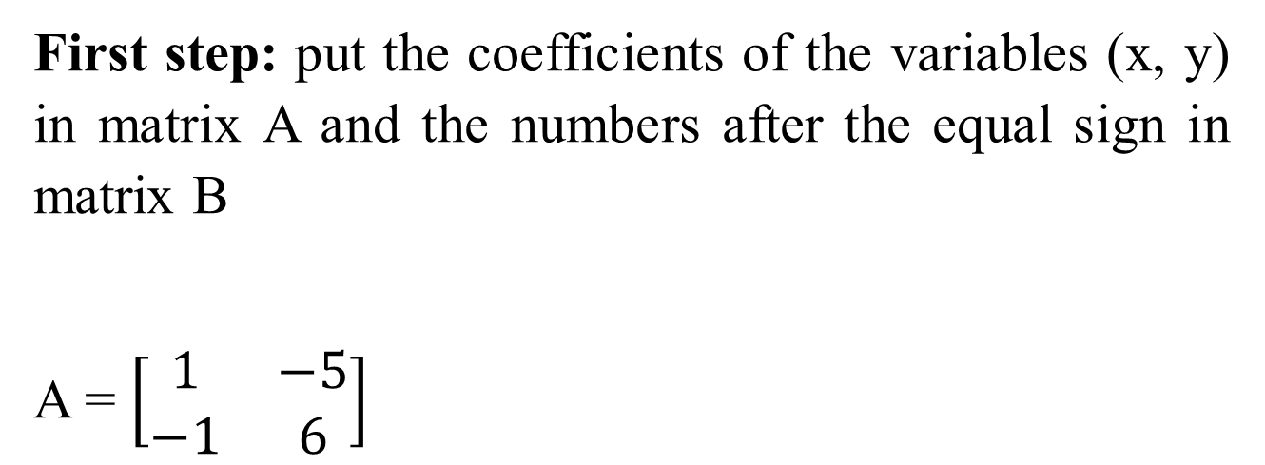
Lecture
05
Solution
First step: put the coefficients of the variables (x, y) in matrix A and the numbers after the equal sign in matrix B
A = $\left[\begin{matrix}1 & −5 \\ −1 & 6\end{matrix}\right]$

Slide 23
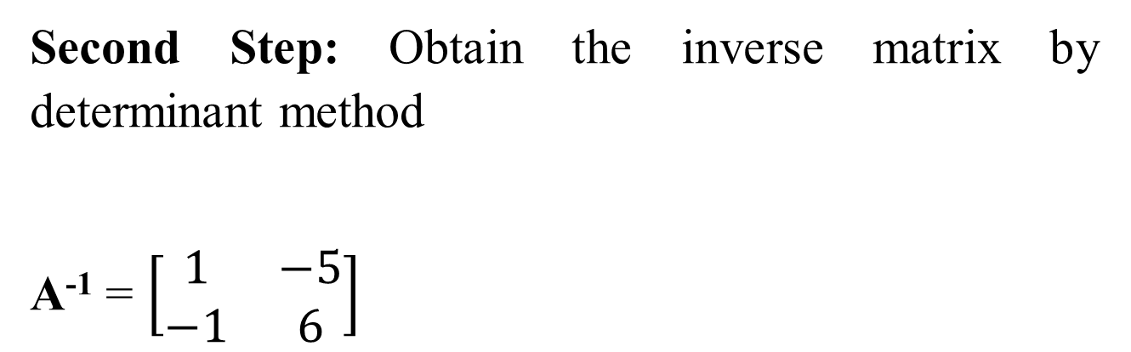
Lecture
05
Solution
Second Step: Obtain the inverse matrix by determinant method
A⁻¹ = $\left[\begin{matrix}1 & −5 \\ −1 & 6\end{matrix}\right]$

Slide 24
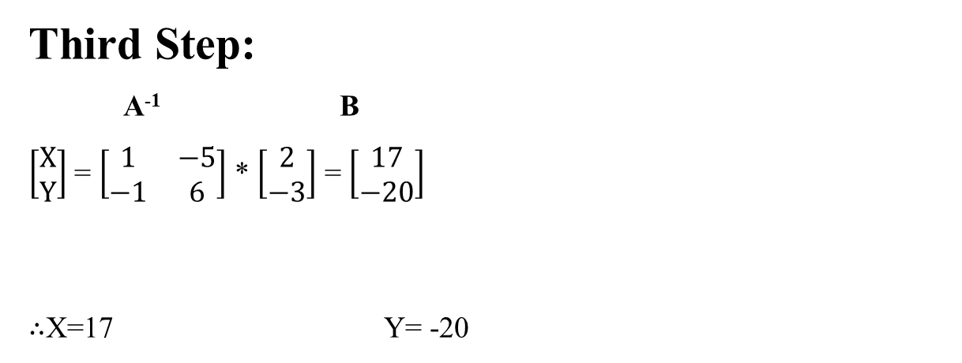
Lecture
05
Example
Third Step:
A⁻¹ B
$\left[\begin{matrix}X \\ Y\end{matrix}\right]$ = $\left[\begin{matrix}1 & −5 \\ −1 & 6\end{matrix}\right]$ * $\left[\begin{matrix}2 \\ −3\end{matrix}\right]$ = $\left[\begin{matrix}17 \\ −20\end{matrix}\right]$
$∴$X=17 Y= -20

Slide 25
Lecture
05
Reduced Echelon Form
Reduced Echelon Form

Slide 26

Lecture
05
Example
Find the inverse for matrix A using the reduced echelon form

Slide 27

Lecture
05
Solution
Add unit matrix X to matrix A
you have to convert A to I, by adding the two rows, multiplying number by row, subtracting the two rows or multiplying number by row and add or subtract it from the other one.

Slide 28
Lecture
05
Solution
So, We need to convert number 6 to 1.
So we will multiply row two by 7 and subtract row 1 from it. And write the second row as it is.

Slide 29
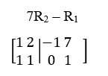
Lecture
05
Solution
So we will multiply row two by 7 and subtract row 1 from it. And write the second row as it is.

Slide 30
Lecture
05
Solution
So we will multiply row two by 7 and subtract row 1 from it. And write the second row as it is.

Slide 31
Lecture
05
Solution
Then we need to convert 1 to zero
So R₁ – R₂
and row one will be as it is.

Slide 32
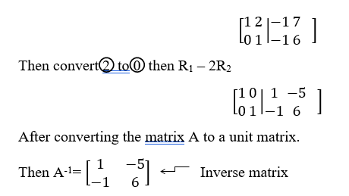
Lecture
05
Solution

Slide 33
Lecture
05
** EXTRA PRACTICE
Let’s Practice

Slide 34

Lecture
05
Example 1
Find the inverse of

Slide 35
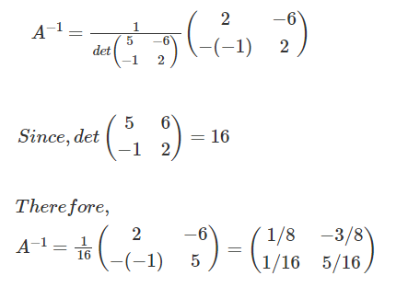
Lecture
05
Solution of Example 1

Slide 36

Lecture
05
Example 2
Find the inverse of

Slide 37
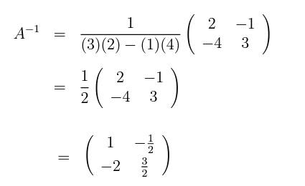
Lecture
05
Solution

Slide 38

Lecture
05
Example 3
Find the inverse of

Slide 39
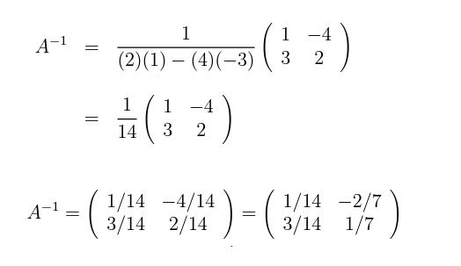
Lecture
05
Solution

Slide 40

Lecture
05
Example 4
Find the inverse of

Slide 41
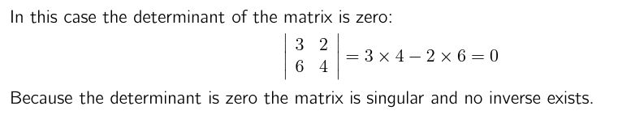
Lecture
05
Solution

Slide 42
Lecture
05
Lecture Summary
The inverse of Matrix Definition
The inverse for 2 * 2 matrix by determinant
Solving Two Equations by Inverse matrix
The inverse for 2 * 2 matrix by Reduced Echelon Form

