Slide 1


Project Leadership
Prepared by Dr. Ehab Mahmoud
PMG 511
Understanding leadership
Lecture 03

Slide 2



Project Leadership
Lecture 3
PMG 511
Understanding Leadership
Prepared by
Dr. Ehab Mahmoud

Slide 3

Chapter
OBJECTIVES
03
This lecture aims to understand the personality of leaders. Through this lecture, we will know the different styles of leaders and the pros and cons of each to know when can we use each of these styles.

Slide 4

Chapter
CONTENTS
03
The leader’s title.
Leadership styles: describe 7 basic leadership styles.
Who we lead: define 'stakeholder' in the context of a project effort.
Matching leadership with culture: define ‘culture’ in the context of a project, team, and organization.
Summary and conclusions.

Slide 5

Chapter
THE LEADER’S TITLE
03
Leader can have many titles, he can be a manager, supervisor, boss, CEO, Expert, Foreman, Monitor.
Understand that title isn't synonymous with the need or authority to engage in leadership.
It is a sit of words that supposed all correlated to actual duties of jobs.
The actual title can affect perceptions.

Slide 6
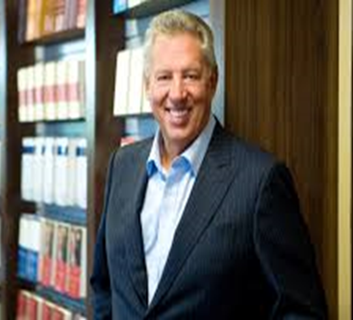
Chapter
THE LEADER’S TITLE
03
“Leadership is not about titles, positions or flowcharts. It is about one life influencing another.” - John C. Maxwell

Slide 7
Chapter
TEAM LEADERSHIP
03
The idea of team leadership is broken down into its digestible components:
Leadership styles.
Leadership theories.
Influences.
Motivators.
Influences on organizational team performance.
Culture.
Understanding of who is being led.

Slide 8
Chapter
EARLY STUDIES OF LEADERSHIP
03
Researchers began studying leadership in the early part of the twentieth century and focused on:
The person - leader trait theories.
The behaviors - how the leader interacted with his or her group members (behavior theories).
Early leadership theories focused on what qualities distinguished between leaders and followers, while subsequent theories looked at other variables such as situational factors and skill level.

Slide 9
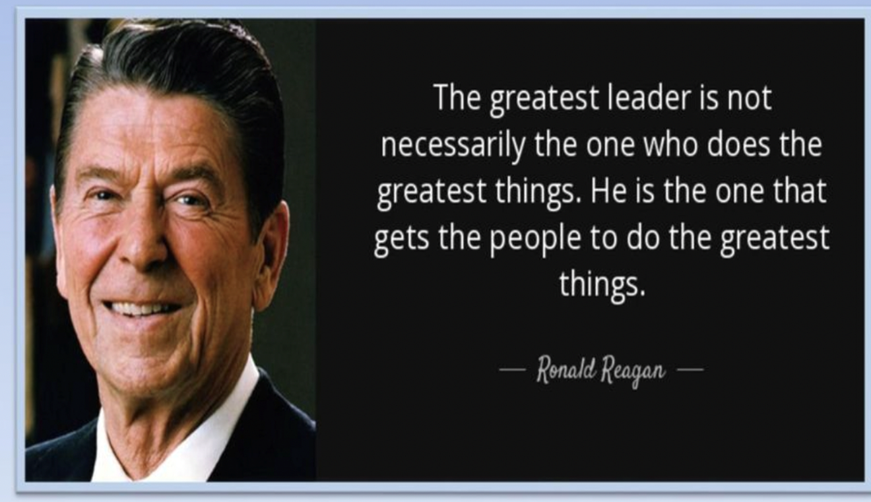
Chapter
EARLY STUDIES OF LEADERSHIP
03

Slide 10
Chapter
LEADERSHIP STYLES
03
People as a leader adopt different styles.
Leadership style should be chosen based on the team’s features, what they are trying to achieve.
Leaders have a ‘default’ style they prefer:
This may not be appropriate for their team.
Stress or circumstances can cause leaders to choose or revert to the wrong style.
There are (7 main styles covered here).

Slide 11

Chapter
AFFILIATIVE LEADERSHIP STYLE
03
In the affiliative leadership style, people come first.
This leadership style is one of 7 styles of Emotional leadership and promotes positivity, a harmonious workplace and team-building.
It focuses on conflict resolution and creating personal connections between employees and their managers to build a sense of community and trust.

Slide 12
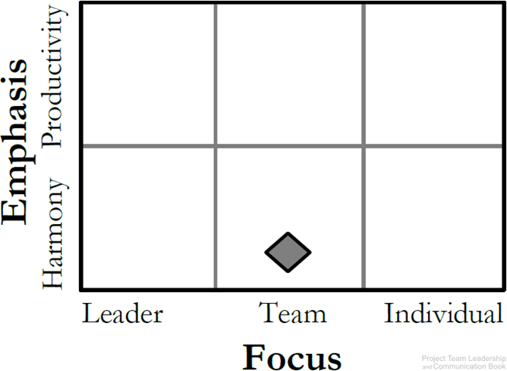
Chapter
AFFILIATIVE LEADERSHIP STYLE
03
The type of leadership a manager chooses to affect the emotional, mental and physical health of his team. Whether this effect is positive or negative.
Affiliative leadership is one of many styles of leadership that positively impacts employees.
It is Good for teams in need of a morale boost (team need to repair).

Slide 13

Chapter
AFFILIATIVE LEADERSHIP STYLE
03
Pros:
This style Emphasizes connection, harmony, and conflict resolution.
It is Good for teams in need of a morale boost (team need to repair).
Creates effective teams.
It Increase employee morale.
It Builds employee trust.
It Provides guidance during crises.
It Resolves conflicts more efficiently.
It Reduces workplace stress.

Slide 14

Chapter
AFFILIATIVE LEADERSHIP STYLE
03
Cons:
Stuff may not receive enough advice.
Allow under-performers to go unchecked.
Ineffective when faced with complex challenge.
“Affiliative is really about letting people get to know you, and you making an effort to get to know them.”

Slide 15
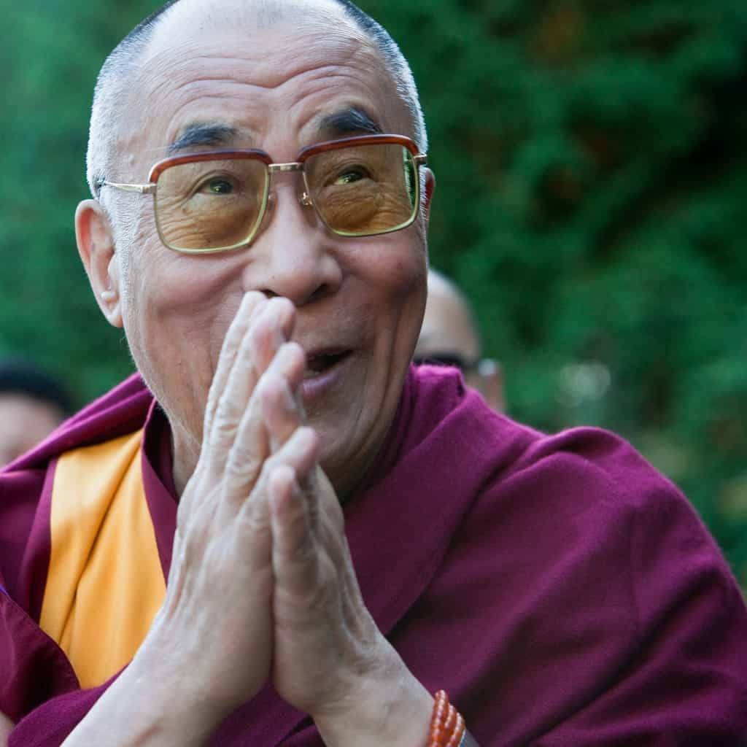
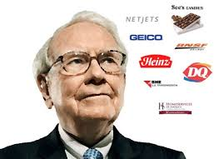
Chapter
AFFILIATIVE LEADERSHIP STYLE
03
Dalai Lama
Warren Buffett

Slide 16
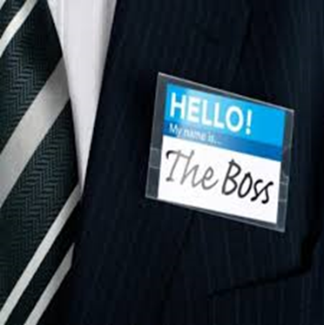
Chapter
AUTHORITARIAN LEADERSHIP STYLE
03
Authoritarian /Commanding /The Boss/Autocratic Leadership Style.
It is centered on the boss. the leader holds all authority and responsibility.
The leader centralizing decision making and limiting participation.
leaders make decisions on their own without consulting subordinates. They reach decisions, communicate them to subordinates and expect prompt implementation.
One of the famous examples for an authoritarian is of Napoleon Bonaparte and Hitler.

Slide 17
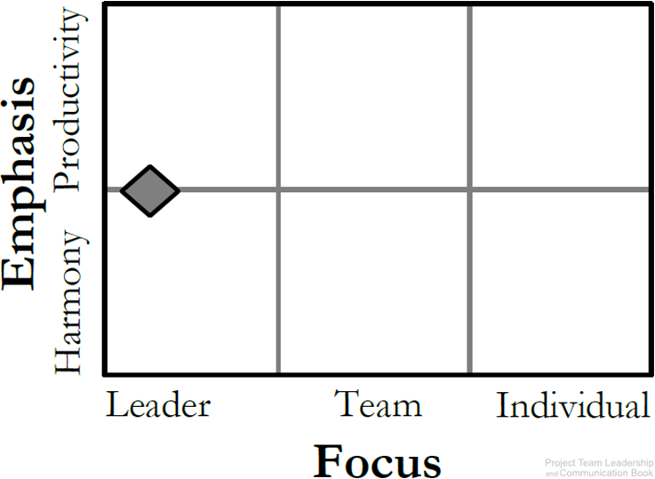
Chapter
AUTHORITARIAN LEADERSHIP STYLE
03
Leaders like this can achieve results and productivity quickly.
Best applied to situations where there is little time for group decision-making or where the leader is the most knowledgeable member in the group.

Slide 18
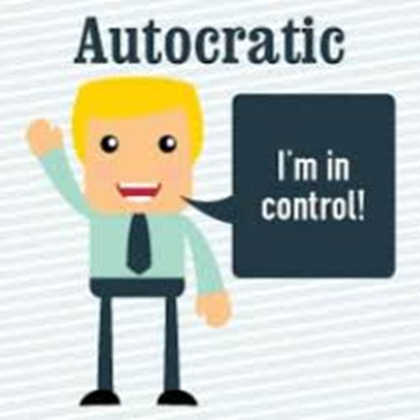
Chapter
AUTHORITARIAN LEADERSHIP STYLE
03
Pros:
Leaders like this can achieve results quickly.
Quick decision-making.
Focused target.
Close supervision.
Maintain the image of manager in making orders
Good for emergencies/crisis situations.

Slide 19
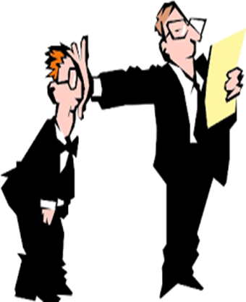
Chapter
AUTHORITARIAN LEADERSHIP STYLE
03
Cons:
Classic’ leadership structure.
Strong, dominating leader(s).
Can cause poor morale if teams aren’t used to it.
High stress, members feel stressed due to high expectation.
Group doesn't pick up from innovativeness and information of individuals, so benefits of collaboration are lost.

Slide 20
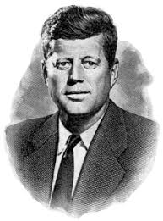
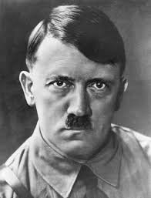
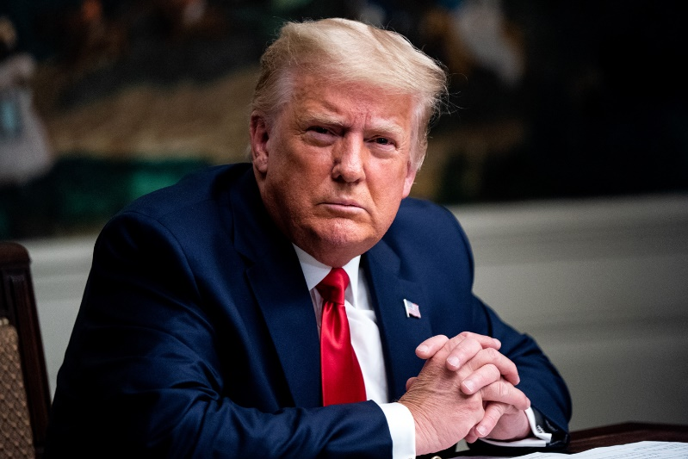
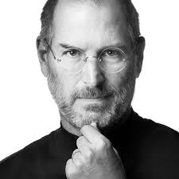
Chapter
AUTHORITARIAN LEADERSHIP STYLE
03

Slide 21
Chapter
COACHING LEADERSHIP STYLE
03
Coaching leadership involves teaching and supervising followers.
A coaching leader is highly operational in setting where results/ performance require improvement.
Basically, in this kind of leadership, followers are helped to improve their skills.
Coaching leadership does the following: motivates followers, inspires followers and encourages followers.
A coaching leader is a great mentor is a pioneer who also has a remarkable ability to instruct and train.
They prep individuals to enhance both information and skills. (build the skills of others).

Slide 22
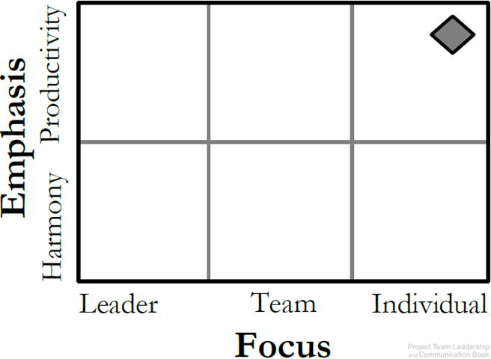
Chapter
COACHING LEADERSHIP STYLE
03
About connecting the goals and productivity of the team/project with individuals.
Best for teams who have the desire to succeed and are motivated.

Slide 23

Chapter
COACHING LEADERSHIP STYLE
03
Pros:
Leaders like this create very positive workplace.
Cons:
Results take time to achieve.
Work well if the leader has stuff already self motivated.

Slide 24

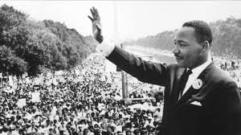
Chapter
COACHING LEADERSHIP STYLE
03

Slide 25

Chapter
DEMOCRATIC LEADERSHIP STYLE
03
In this leadership style, subordinates are involved in making decisions. Unlike autocratic.
This leadership is centered on subordinates’ contributions.
The democratic leader holds final responsibility, but he or she is known to delegate authority to other people, who determine work projects.
His style of authority depends on the group been advised and their feelings being esteemed.

Slide 26
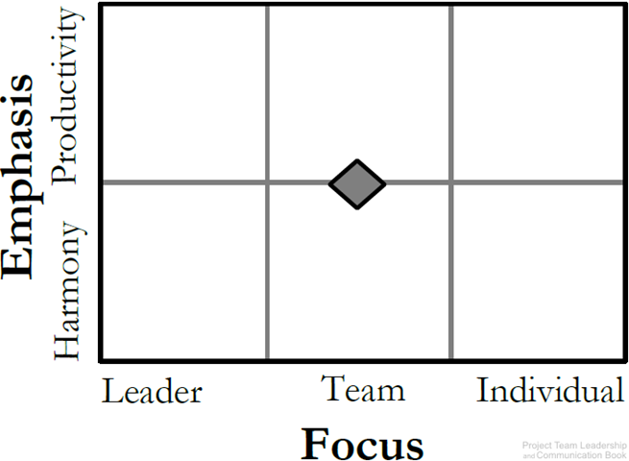
Chapter
DEMOCRATIC LEADERSHIP STYLE
03
Relies on the skills and knowledge of team members.
Group makes decisions collectively.

Slide 27

Chapter
DEMOCRATIC LEADERSHIP STYLE
03
Pros:
Higher quality work.
Allow follower to say any decision.
Create a well collaborative workplace.
Cons:
The leader depend on the followers level of knowledge.
Leader spend too much time listening.
Can be time consuming (Collaboration may take time.)
difficult for indecisive teams.

Slide 28
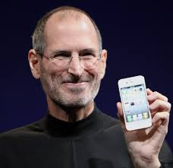
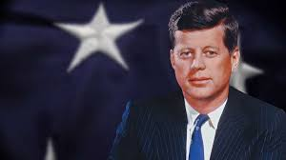
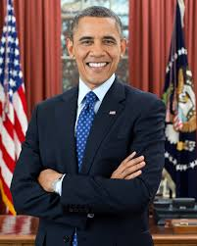
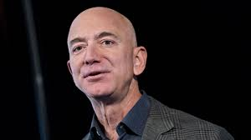
Chapter
DEMOCRATIC LEADERSHIP STYLE
03

Slide 29

Chapter
LAISSEZ-FAIRE LEADERSHIP STYLE
03
Laissez-faire leadership gives authority to employees (LEAVE IT BE).
Subordinates are allowed to work as they choose, with complete freedom to make decision. with minimal or no interference.
This kind of leadership has been always found to be the least satisfying and least effective management style.

Slide 30
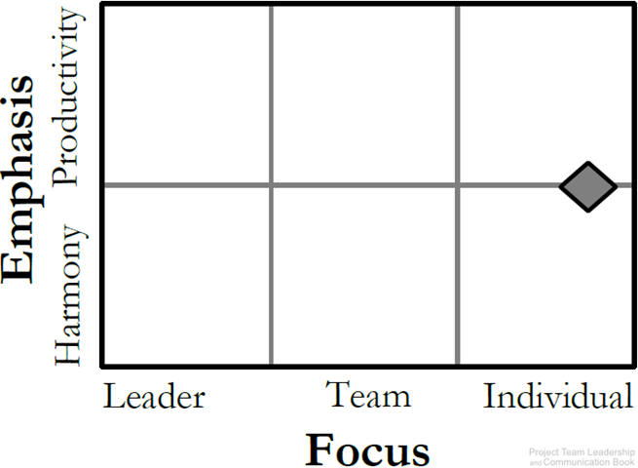
Chapter
LAISSEZ-FAIRE LEADERSHIP STYLE
03
The ‘hands-off’ approach.
Management trusts the team members to make decisions and meaningful progress.
Leaders support rather than control.
style is frequently connected when the group is extremely fit, very much inspired and composed.

Slide 31

Chapter
LAISSEZ-FAIRE LEADERSHIP STYLE
03
Pros:
Can promote creativity.
Easy management style to administer.
Complete empowerment for the followers.
Cons:
The leader plays the least role.
Requires self-motivated, hard-working, honest team members
Poor decision making may result.

Slide 32
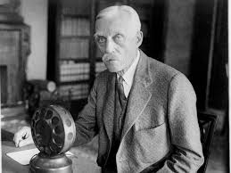
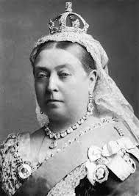
Chapter
LAISSEZ-FAIRE LEADERSHIP STYLE
03
Warren Buffett
Andrew Mellon
Queen Victoria

Slide 33

Chapter
PACESETTING LEADERSHIP STYLE
03
Pacesetting leadership is when the leader sets an example of high performance, high pace and high quality.
The pacesetting leader values results more than anything.

Slide 34
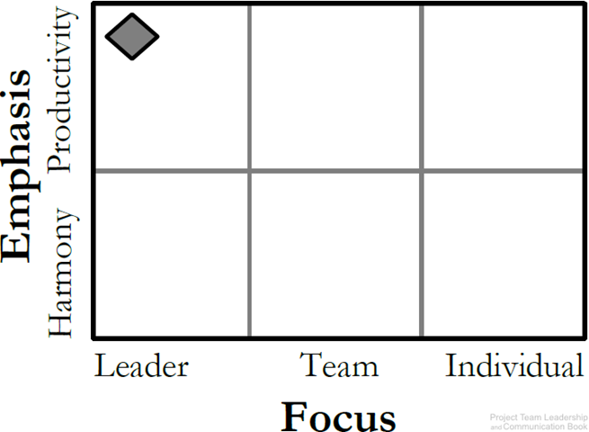
Chapter
PACESETTING LEADERSHIP STYLE
03
This is ‘lead by example’ (do as I do, now).
Leader is highly focused on performance and expects the same of the team.
Works best with teams that already perform at a high level.
Role model, high standards.

Slide 35

Chapter
PACESETTING LEADERSHIP STYLE
03
Pros:
This leadership style can be good to reach short term results.
Ability to achieve results quickly.
Outstanding performance of the team.
Cons:
Can affects on employee engagement and motivation in the long run.
Team members can feel lowering morale.

Slide 36
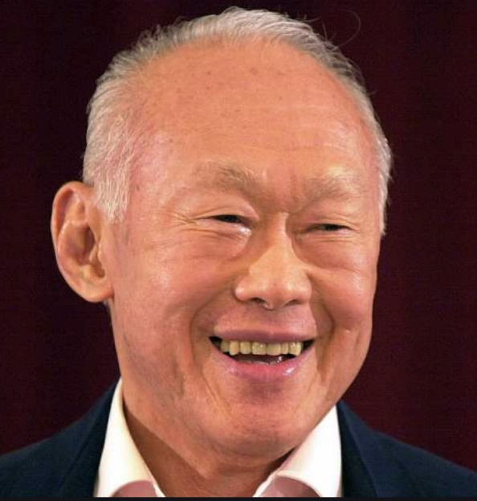
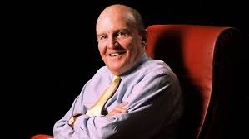
Chapter
PACESETTING LEADERSHIP STYLE
03
Jack Welch
Lee Kuan Yew

Slide 37

Chapter
TRANSFORMATIONAL/VISIONARY LEADERSHIP STYLE
03
The transformational leadership style is one of the most implemented styles.
It has integrity, defines clear goals, encourages clear steps to communication and expressive.
This type of leader inspires their team to work together towards a common target.
Transformational leaders combine the best practices and are leaders who are trusted and can motivate others.

Slide 38

Chapter
TRANSFORMATIONAL/VISIONARY LEADERSHIP STYLE
03
The transformational style requires several different skills, and its primary focus is to make change happen in our self, others, groups, and organizations.

Slide 39
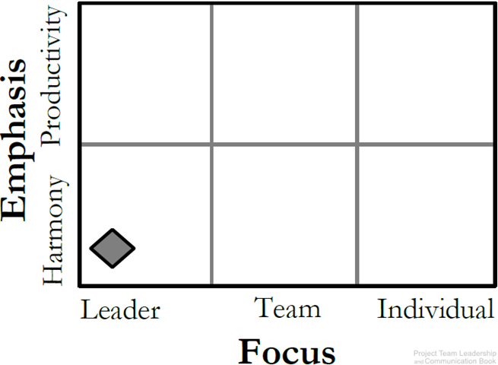
Chapter
TRANSFORMATIONAL/VISIONARY LEADERSHIP STYLE
03
The leader focuses on setting a positive vision for the future.
Team members are infused with a sense of purpose and excitement.
leaders who stimulate and inspire (transform) followers to achieve extraordinary outcomes.

Slide 40
Chapter
TRANSFORMATIONAL/VISIONARY LEADERSHIP STYLE
03
Pros:
This style of leadership encourages, motivates and supports employees, often involves recognizing and rewarding people for their good work.
Enhance innovation.
Good for teams that have recently experienced failure.
Cons:
Can become unrealistic and overly optimistic.
Conflicts if other strong individual in the organization with competing vision.

Slide 41

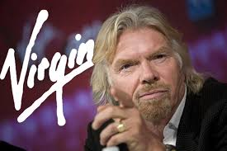
Chapter
TRANSFORMATIONAL/VISIONARY LEADERSHIP STYLE
03
Richard Branson

Slide 42

Chapter
CHARISMATIC LEADERSHIP STYLE
03
In this leadership, the charismatic leader shows his or her revolutionary power.
Charisma does not mean sheer behavioral change. It involves a transformation of followers’ values and beliefs.

Slide 43
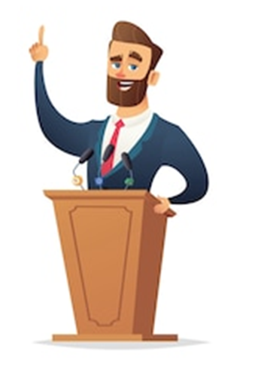
Chapter
CHARISMATIC LEADERSHIP STYLE
03
A charismatic leader is an enthusiastic, self-confident leader whose personality and actions influence people to behave in certain ways. The most comprehensive analysis of charismatic leaders identified the following personal characteristics they share:
They have a vision.
They can articulate that vision.
They are willing to take risks to achieve that vision.
They demonstrate behaviors that are out of the ordinary.

Slide 44

Chapter
CHARISMATIC LEADERSHIP STYLE
03
Pros:
Create a vision that make everyone believes that the future will be better.
Cons:
Too connected to the leader’s personality.
Leader can get out of control.

Slide 45

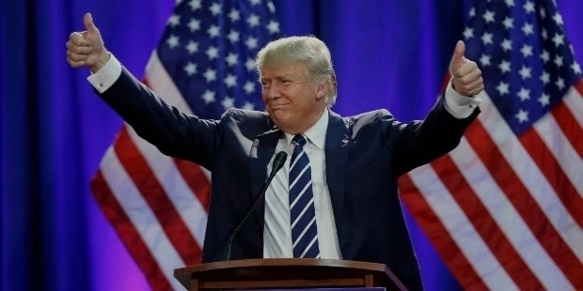
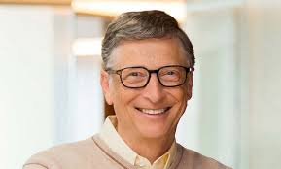
Chapter
CHARISMATIC LEADERSHIP STYLE
03

Slide 46

Chapter
WHO WE LEAD?
03

Slide 47
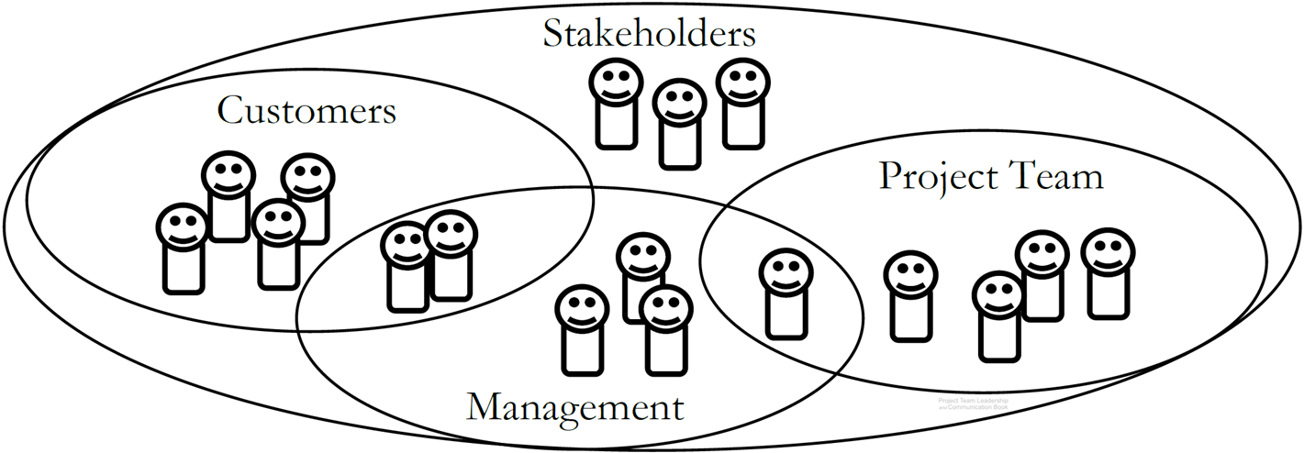
Chapter
STAKEHOLDERS
03
Stakeholders are people who can affect or are affected by the execution or outcome of a project.

Slide 48

Chapter
MATCHING LEADERSHIP WITH CULTURE
03

Slide 49
Chapter
ORGANIZATIONAL CULTURE
03
The set of behaviors or beliefs that determine how an organization or team interacts or carries out work.
Awareness of culture and different circumstances/attitudes is key.
Influenced by:
The industry, environment, customers, organizational practices.
Personalities, values, principles, etc. of the organization, leader, and team.
Influences:
Decision making, risk tolerance, decisiveness, orderliness, competitiveness .
Level of attention to detail, amount of process, emphasis on achievement.
Supportiveness, reward/punishment, team vs. individual contribution.

Slide 50
Chapter
SUMMARY AND CONCLUSION
03
A leader’s title can be everything.
Leaders adopt different leadership styles.
Culture influences every aspect of the organization and team.
Stakeholders are key to any project effort, and comprise multiple groups.

Slide 51



Thank You

