Slide 1

PMG 506
Advanced Project Management
LECTURE 5
Feb 27, 2021
Everyone’s Smart
University
Strategic Management and Project Selection

Slide 2

PMG506 Advanced Project Management (APM)
Introduction:
Lecture 1 Introduction to APM and Initial Project Strategy
Lecture 2 Project Quality Management
Project planning
Lecture 6 Initial project coordination and the project Charter
Lecture 7 Starting the project plan: The WBS
Lecture 8 Project risk management
Lecture 9 Budgeting, Estimating costs and risks
Project Initiation:
Lecture 3 Project Communication and team Management
Lecture 4 Managing conflicts and the art of communication
Lecture 5 Strategic Management and project selection
Project Execution
Lecture 10 Monitoring and information systems
Lecture 11 Project Control
Lecture 12 Project Auditing
Lecture 13 Project termination

Slide 3
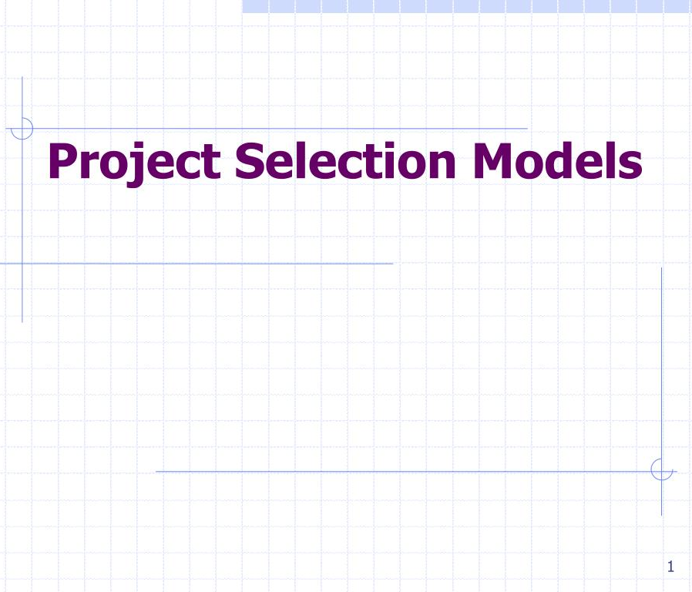


Learning Outcomes
By the end of this lecture, you will be able to:
Understand the importance of project selection for the business.
Understand what is the project selection process.
Discuss project selection model criteria.
Discuss fundamental types of project selection models.
Compare numeric and nonnumeric project selection models.
Describe the project portfolio process.

Slide 4
Importance of Project Selection
The accomplishment of important tasks and goals in organizations today is being achieved using projects.
The phrases we hear and read about daily at our work and in conversations with our colleagues, such as “management by projects” reflect this increasing trend in our society.
The rapid adoption of such a powerful tool as project management to help organizations achieve their goals and objectives is certainly awesome.

Slide 5
Importance of Project Selection
The rapid adoption of project management means:
• There are many projects that fall outside the organization’s stated mission.
• There are many projects being conducted that are completely unrelated to the strategy and goals of the organization.
• There are many projects with funding levels that are excessive relative to their expected benefits..

Slide 6

Managing Multiple projects
Three particularly common problems in organizations trying to manage multiple projects are:
1. Delays in one project cause delays in other projects because of common resource needs or technological dependencies.
2. The inefficient use of corporate resources results in peaks and valleys of resource utilization.
3. Bottlenecks in resource availability or lack of required technological inputs result in project delays that depend on those scarce resources or technology.

Slide 7

The challenges facing the organization are:
How to make sure that projects are closely tied to the organization’s goals and strategy?
How to handle the growing number of ongoing projects?
How to make these projects more successful?

Slide 8

Project selection
Project selection is the process of evaluating individual projects or groups of projects and then choosing to implement some set of them so that the objectives of the parent organization will be achieved.

Slide 9
Examples
Inside the organization:
A manufacturing firm can use evaluation/selection techniques to choose which machine to adopt in a part-fabrication process.
A TV station can select which of several comedy shows to rerun in its 7:30 p.m. weekday time-slot.
Outside the organization:
A construction firm can select the best subset of a large group of potential projects on which to bid.
A hospital can find the best mix of beds for a new wing.

Slide 10
Each project will have different costs, benefits, and risks. Rarely are these known with certainty. In the face of such differences, the selection of one project out of a set is a difficult task. Choosing several different projects, a portfolio, is even more complex.
Whether for inside or outside clients, the projects will use the organization’s own resources, and both types of projects are usually dealt with as “competing” for the same pool of resources.

Slide 11

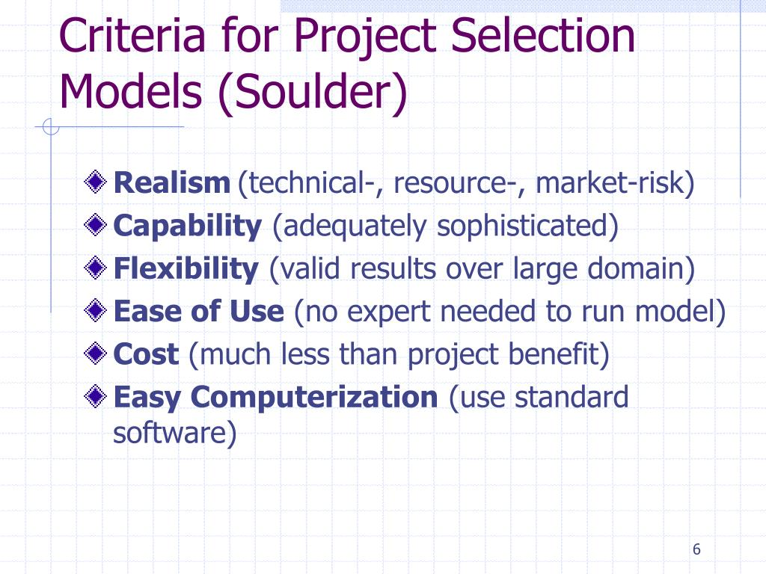

Criteria for project selection models

Slide 12

1. Realism
The model should consider the realities of the firm’s limitations on facilities, capital, personnel, and so forth, and include factors that reflect project technical and market risks: performance, cost, time, customer rejection.

Slide 13
2. Capability
The model should be sophisticated enough to deal with the relevant factors:
multiple time periods, situations both internal and external to the project (e.g., strikes, interest rate changes), and so on.

Slide 14

3. Flexibility
The model should give valid results within the range of conditions that the firm might experience. It should be easy to modify in response to changes in the firm’s environment; for example, tax law changes, new technological advancements that alter risk levels, and, above all, organizational goal changes.

Slide 15
4. Ease of use
The model should be reasonably convenient, not take a long time to execute, and be easy to use and understand. It should not require special interpretation, data that are difficult to acquire, excessive personnel, or unavailable equipment.

Slide 16
5. Cost
Data-gathering and modeling costs should be low relative to the cost of the project and less than the potential benefits of the project. All costs should be considered, including the costs of data management and of running the model.

Slide 17
6. Easy computerization
It should be easy and convenient to gather and store the information in a computer database, and to manipulate data in the model through use of a widely available, standard computer package such as Excel®.

Slide 18

Learning Summary and Evaluation 1
The main idea I have learnt?
A new word I have learnt today is? It means……
How could I apply these ideas towards my course studies and career aspiration?

Slide 19

1. What is project selection?
Project selection is the process of evaluating individual projects or groups of projects and then choosing to implement some set of them so that the objectives of the parent organization will be achieved.
2. What are the Criteria for project selection models?
Realism, capability, flexibility, ease of use, cost, and easy computerization

Slide 20
What Are The Types Of Project Selection Models?
Project Selection Models
Numeric Models
Nonnumeric Models
Both are widely used.
Many organizations use both at the same time, or they use models that are combinations of the two.
Nonnumeric models, as the name implies, do not use numbers as inputs. Numeric models do.

Slide 21
Nonnumeric Models
The Sacred Cow
The Operating Necessity
The Competitive Necessity
The Product Line Extension

Slide 22
Numeric Models
Profit/Profitability
Scoring
Real options
Window-of-Opportunity Analysis

Slide 23

1. The Sacred Cow
Senior Management wants it!!
The Sacred Cow In this case the project is suggested by a senior and powerful official in the organization. Often the project is initiated with a simple comment such as, “If you have a chance, why don’t you look into…,” and there follows an undeveloped idea for a new product, for the development of a new market, for the design and adoption of a global data base and information system, or for some other project requiring an investment of the firm’s resources. The immediate result of this bland statement is the creation of a “project” to investigate whatever the boss has suggested. The project is “sacred” in the sense that it will be maintained until successfully concluded, or until the boss, personally, recognizes the idea as a failure and terminates it.

Slide 24
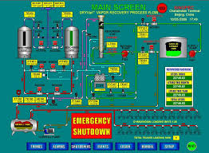
2. The Operating Necessity
The Operating Necessity If a flood is threatening the plant, a project to build a protective dike does not require much formal evaluation, which is an example of this scenario.
XYZ Steel Corporation has used this criterion (and the following criterion also) in evaluating potential projects. If the project is required in order to keep the system operating, the primary question becomes: Is the system worth saving at the estimated cost of the project? If the answer is yes, project costs will be examined to make sure they are kept as low as is consistent with project success, but the project will be funded.

Slide 25

3. The Competitive Necessity
Many business schools are restructuring their undergraduate and MBA programs to stay competitive with the more forward-looking schools. In large part, this action is driven by declining numbers of tuition-paying students and the need to develop stronger programs to attract them.
Investment in an operating necessity project takes precedence over a competitive necessity project, but both types of projects may bypass the more careful numeric analysis used for projects deemed to be less urgent or less important to the survival of the firm.

Slide 26

4. The Product Line Extension
The Product Line Extension In this case, a project to develop and distribute new products would be judged on the degree to which it fits the firm’s existing product line, fills a gap, strengthens a weak link, or extends the line in a new, desirable direction. Sometimes careful calculations of profitability are not required. Decision makers can act on their beliefs about what will be the likely impact on the total system performance if the new product is added to the line.

Slide 27
Learning Check
Can you work out where you would put the following models?
Competitive necessity
The Sacred Cow
Operating Necessity
1. The ___________________model evaluates projects based on whether implementing the project will ensure the viability of the company in the competitive market.
2. The ___________________ means that the project is required in order to keep the system operating.
3. The ______________ model means that the project is suggested by a senior and powerful official
in the organization.
How many did you get right?

Slide 28
Profit/Profitability
Payback Period
Discounted Cash Flow
Profitability Index
Internal Rate of Return

Slide 29

Payback Period
The payback period for a project is the initial fixed investment in the project divided by the estimated annual net cash inflows from the project. The ratio of these quantities is the number of years required for the project to repay its initial fixed investment.
For example, assume a project costs $100,000 to implement and has annual net cash inflows of $25,000. Then Payback period $100,000/$25,000= 4 years
This method assumes that the cash inflows will persist at least long enough to pay back the investment, and it ignores any cash inflows beyond the payback period. The method also serves as an (inadequate) proxy for risk. The faster the investment is recovered, the less the risk to which the firm is exposed.

Slide 30
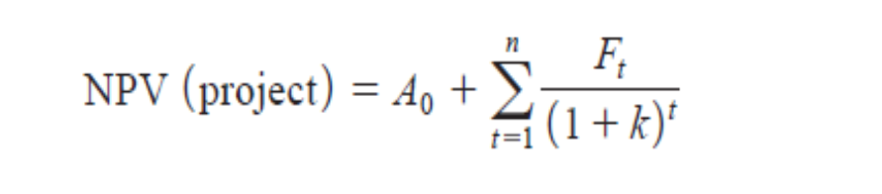
Discounted Cash Flow
Also referred to as the Net Present Value (NPV) method, the discounted
cash flow method determines the net present value of all cash flows by discounting
them by the required rate of return (also known as the hurdle rate, cutoff rate, and similar
terms) as follows:
twhere
Ft the net cash flow in period t,
k the required rate of return, and
A0 initial cash investment (because this is an outflow, it will be negative).
Early in the life of a project, net cash flow is likely to be negative, the major outflow being the initial investment in the project, A0. If the project is successful, however, cash flows will become positive. The project is acceptable if the sum of the net present values of all estimated cash flows over the life of the project is positive.

Slide 31
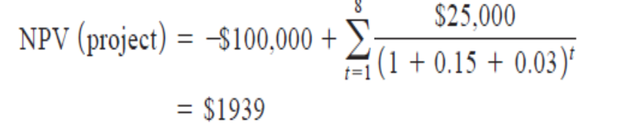
Example: Using our $100,000 investment with a net cash inflow of $25,000 per year for a period of eight years, a required rate of return of 15 percent, and an inflation rate of 3 percent per year, we have
Because the present value of the inflows is greater than the present value of the outflow— that is, the net present value is positive—the project is deemed acceptable.

Slide 32
Numeric Models: Scoring
Scoring
Unweighted 0–1 Factor Model
Unweighted Factor Scoring Model
Weighted Factor Scoring Model

Slide 33
Unweighted 0–1 Factor Model
1. A set of relevant factors is selected by management and then usually listed in a preprinted form.
2. One or more raters score the project on each factor, depending on whether it qualifies for an individual criterion.
The raters are chosen by senior managers, for the most part from the rolls of senior management. The criteria for choice are (1) a clear understanding of organizational goals and (2) a good knowledge of the firm’s potential project portfolio.
The main advantage of such a model is that it uses several criteria in the decision process.
The major disadvantages are that it assumes all criteria are of equal importance and it allows for no gradation of the degree to which a specific project meets the various criteria.

Slide 34
Sample project evaluation form
The figure shows an example of the rating sheet for an unweighted, 0–1 factor model. The columns are summed and those projects with enough qualifying factors may be selected

Slide 35
Unweighted Factor Scoring Model
The second disadvantage of the 0–1 factor model can be dealt with by constructing a simple linear measure of the degree to which the project being evaluated meets each of the criteria contained in the list. The x marks in Figure would be replaced by numbers. Often a five-point scale is used, where 5 is very good, 4 is good, 3 is fair, 2 is poor, 1 is very poor.
The column of scores is summed, and those projects with a total score exceeding some critical value are selected. A variant of this selection process might choose the highest-scoring projects (still assuming they are all above some critical score) until the estimated costs of the set of projects equaled the resource limit. However, the criticism that the criteria are all assumed to be of equal importance still holds.

Slide 36
Example 1
Using the criterion just mentioned, “ estimated annual profits in dollars,” we might construct the following scale:
Score Performance Level
5 Above $1,100,000
4 $750,001 to $1,100,000
3 $500,001 to $750,000
2 $200,000 to $500,000
1 Less than $200,000

Slide 37
Weighted Factor Scoring Model
Weighted Factor Scoring Model When numeric weights reflecting the relative importance of each individual factor are added, we have a weighted factor scoring model. In general, it takes the form
Where:
Si the total score of the ith project,
sij the score of the ith project on the jth criterion, and
wj the weight of the jth criterion.

Slide 38
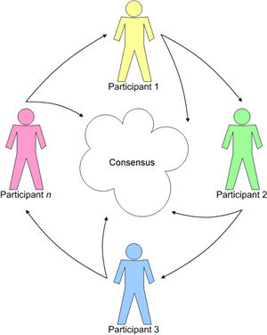
The weights, wj, may be generated by any technique that is acceptable to the organization’s policy makers. There are several techniques available to generate such numbers, but the most Effective and most widely used is the Delphi technique. It is a technique for developing numeric values that are equivalent to subjective, verbal measures of relative value

Slide 39


How to do the right projects at the right time?

Slide 40

PROJECT PORTFOLIO PROCESS (PPP)
Important inputs to this process are the organization’s goals and strategies, and we assume here that the organization has already identified its mission, goals, and strategies—by using some formal analytic method such as SWOT analysis (strengths, weaknesses, opportunities, threats), and that these are well known throughout the organization. If this is not the case, then any attempt to tie the organization’s projects to its goals is folly and the PPP will have little value.

Slide 41
WHY PROJECT PORTFOLIO PROCESS (PPP)
The PPP can serve many purposes:
• To identify proposed projects that are not really projects and should be handled through other processes
• To prioritize the list of available projects
• To intentionally limit the number of overall projects being managed so the important projects get the resources and attention they need
• To identify projects that best fi t the organization’s goals and strategy
• To identify projects that support multiple organizational goals and cross-reinforce other important projects
• To eliminate projects that incur excessive risk and/or cost
• To eliminate projects that bypassed a formal selection process and may not provide benefits corresponding to their risks and/or costs
• To keep from overloading the organization’s resource availability
• To balance the resources with the needs
• To balance short-, medium-, and long-term returns

Slide 42
The steps in this process
Step 1: Establish a Project Council
Step 2: Identify Project Categories and Criteria
Step 3: Collect Project Data
Step 4: Assess Resource Availability
Step 5: Reduce the Project and Criteria Set
Step 6: Prioritize the Projects within Categories
Step 7: Select the Projects to Be Funded and Held in Reserve
Step 8: Implement the Process

Slide 43
Learning Check
Project selection models can be classified in
A. 2 types
B. 3 types
C . 4 types
D. 6 types
2. The models designed to overcome some of the disadvantages of Profitability models are known as:
A. Factoring models
B. Scoring models
C. Evaluation models
D. Gradation models

Slide 44
Summary
This Lecture initiated our discussion of the project management process by describing procedures for strategically evaluating and selecting projects. We first described the strategic objective of using projects to help achieve the organization’s goals and strategy, and a project portfolio process to help achieve this. We then outlined some criteria for project selection models and then discussed the general nature of these models.
Specific points made in the lecture were these:
The role of projects in achieving the organization’s goals and strategy is critical.
• The eight-step project portfolio process is an effective way to select and manage projects that are tied to the organization’s goals.

Slide 45
Primary model selection criteria are realism, capability, flexibility, ease of use, and cost.
• Project selection models can generally be classified as either numeric or nonnumeric; numeric models are further subdivided into profitability and scoring categories.
• Nonnumeric models include: (1) the sacred cow; (2) the operating necessity; (3) the competitive necessity; and (4) comparative benefit.
• Profitability models include standard forms such as: (1) payback period; (2) average rate of return; (3) discounted cash flow; (4) internal rate of return; and (5) profitability index
- Scoring model include: (1) the unweighted 0–1 factor model; (2) the unweighted factor scoring model; (3) the weighted factor scoring model;

Slide 46


Remember!
Models do not make decisions—people do. The manager, not the model, bears responsibility for the decision. The manager may “delegate” the task of making the decision to a model, but the responsibility cannot be abdicated.

Slide 47
What is next?
In the next lecture, we move from organizational issues to project planning tasks. We address the topics of coordination, and project planning . We also present some extremely useful concepts and tools such as the project charter and the work breakdown structure.

Slide 48

Glossary
Decision Support System A computer package and data base to aid managers in making decisions. It may include simulation programs, mathematical programming routines, and decision rules.
Delphi A formalized method of group decision making that facilitates drawing on the knowledge of experts in the group.
Portfolio A group or set of projects with varying characteristics.
Project portfolio process An eight-step procedure for selecting, implementing, and reviewing projects that will help an organization achieve its strategic goals

Slide 49
Discussion Questions
What is the distinction between a qualitative and a quantitative measure?
What is a sacred cow? Give some examples.
What is the difference between project management, program management and portfolio management.

Slide 50
Resources

Slide 51


