Slide 1


Strategic and
Operational Management
Dr. Ahmad Al-NAIMI
MGM 630
Orientation Lecture

Slide 2



Strategic and
Operational Management
Orientation Lecture
MGM 630
Prepared by
Dr. Ahmad Al-NAIMI

Slide 3

Chapter
What Is Strategy?
Understanding the Big Picture
01
What Is Strategy?
Understanding the Big Picture

Slide 4
Chapter
01
1.1 What Do We Mean by Strategy?
A shared sense of direction
A strategy is a plan of action that helps an organisation reach its long-term goals. In everyday life you already use strategies: to pass an exam you plan when to study, what to focus on, and how to manage your time. A business does the same, only on a larger scale and over a longer period.
In business terms, strategy answers three big questions: Where are we now? Where do we want to go? And how will we get there? A good strategy gives everyone a shared sense of direction so effort is not wasted pulling in different ways.
4

Slide 5



1.2 Vision, Mission, and Values
Three statements that define what a firm stands for
Chapter
01
Vision A picture of what the organisation wants to become — inspiring and long term, e.g. “to bring affordable clean energy to every home.”
Mission What the organisation does today and who it serves — more practical, e.g. “we design and sell solar panels for ordinary families.”
Values The beliefs and standards that guide how people behave, such as honesty, quality, or care for customers.
5
4

Slide 6
1.3 The Strategic Management Process
A continuous loop, repeated as markets change
1
Set the direction by defining vision, mission, and goals.
2
Analyse the environment outside the firm (industry and competitors) and inside it (its own strengths and weaknesses).
3
Formulate the strategy by choosing how and where to compete.
4
Implement the strategy by organising people, money, and activities to carry out the plan.
5
Evaluate and adjust by checking results and changing course when needed.
6

Slide 7
Chapter 1 Summary
What Is Strategy?
Understanding the Big Picture
Key Takeaways
Key Terms
Strategy is the set of choices that help an organisation reach long-term goals and beat rivals.
Vision, mission, and values give a firm its direction and identity.
The strategic management process is a repeating cycle: set direction, analyse, formulate, implement, evaluate.
Real strategy is usually a mix of deliberate planning and emergent discovery.
A clear strategy helps firms use resources wisely and stay successful over time.
Strategy — A plan of action to reach long-term goals and outperform rivals.
Vision — An inspiring picture of what the organisation wants to become.
Mission — What the organisation does today and who it serves.
Values — The beliefs and standards that guide how people behave.
Strategic management — The ongoing process of planning, carrying out, and reviewing strategy.
Deliberate strategy — A strategy that is planned in advance.
Emergent strategy — A strategy that develops in response to events and discoveries.
9

Slide 8
TITLE OF LECTURE
Leading the Strategy:
The Manager's Role
Lecture
02
Vision, Mission, and Values
Strategic Leadership.
The Strategic Management Process.

Slide 9

TITLE OF LECTURE
Looking Outside:
Understanding the Industry
and Competition
Lecture
03
The PESTEL Framework .
Industry Structure and Firm Strategy: The Five Forces Model.
Changes over Time: Industry Dynamics.
Performance Differences within the Same Industry: Strategic Groups.

Slide 10
Lecture
TITLE OF LECTURE
Internal Analysis: Resources, Capabilities, and Core Competencies
04
Core Competencies.
The Resource-Based View.
The Dynamic Capabilities Perspective.
The Value Chain Analysis.
Implications for the Strategist.

Slide 11

TITLE OF LECTURE
Winning and
Measuring Success
Lecture
05
Competitive Advantage and Firm Performance.
Business Models: Putting Strategy into Action.

Slide 12

TITLE OF LECTURE
Choosing How to Compete:
Business-Level Strategy
Lecture
06
Business-Level Strategy: How to Compete for Advantage
Differentiation Strategy: Understanding Value Drivers
Cost-Leadership Strategy: Understanding Cost Drivers
Business-Level Strategy and the Five Forces: Benefits and Risks
Blue Ocean Strategy: Combining Differentiation and Cost Leadership

Slide 13

Lecture
TITLE OF LECTURE
Corporate Strategy: Vertical Integration and Diversification
07
What Is Corporate Strategy?
The Boundaries of the Firm:
Vertical Integration along the Industry Value Chain:
Corporate Diversification: Expanding Beyond a Single Market,

Slide 14

TITLE OF LECTURE
Organizational Design: Structure, Culture, and Control
Lecture
08
1. Organizational Design and Competitive Advantage.
2. Strategy and Structure.
3. Organizational Culture: Values, Norms, and Artifacts.
4. Strategic Control-and-Reward Systems.

Slide 15

TITLE OF LECTURE
Corporate Governance and Business Ethics
Lecture
09
1. The Shared Value Creation Framework.
2. Corporate Governance.
3. Strategy and Business Ethics.

Slide 16
Lecture
TITLE OF LECTURE
Making It Happen:
Operations Management
10
What Is Operations Management?
Operations management is concerned with how an organisation actually produces its goods and services. If strategy is the plan, operations is where the plan becomes real — the daily work of making products, delivering services, and satisfying customers.
Every organisation, from a factory to a hospital to a software company, has operations at its heart.

Slide 17
Lecture
TITLE OF LECTURE
Making It Happen:
Operations Management
10
The Transformation Process
Inputs become outputs that customers value
1
Inputs the resources used, such as materials, labour, equipment, information, and energy.
2
Transformation the activities that change inputs into something more valuable — manufacturing, assembling, or serving.
3
Outputs the finished goods or services delivered to customers.
69

Slide 18
Course Learning Outcomes
- Understand the business process and analyze the operations
- Acquire knowledge of production planning and resource management
Understand the concept of Corporate Vision - Mission and Objectives
- Understand the concept of SWOT and Portfolio Analysis
- Understand the different stages in strategy formulation process
- Understand the concept of Strategic Business Unit and Business Process re-engineering.

Slide 19
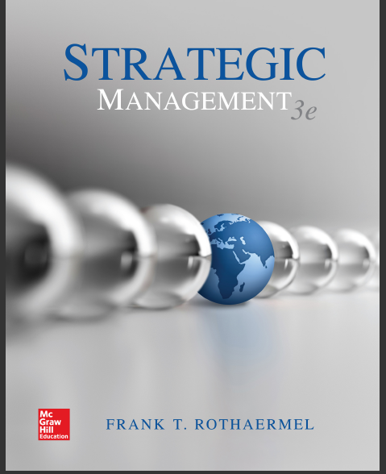
References
Strategic management, third edition, 2017 By Frank t. Rothaermel
Georgia Institute of Technology.

Slide 20
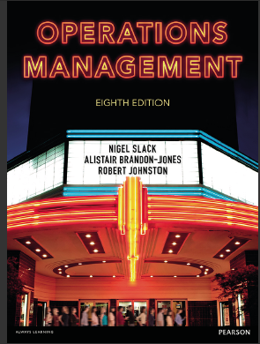
References
2. Operations management, Eighth edition By Nigel Slack Alistair Brandon-Jones Robert Johnston.

Slide 21

Strategic and Operational Management
Thank You

