Slide 1



Operational & Strategic Risk Management
PMG630
Lecture 7
Prepared by
Dr. Nael Zabel
www.midocean.ae

Slide 2
GENERALIZED STEPS FOR CCA
1. Define the system of interest.
2. Identify the primary event.
3. Generate the initiating chain (similar to FTA if applicable).
• Determine the underlying causes of the event.
• For each underlying cause, identify the causes or initiating
events.
• Repeat until the underlying cause becomes uncontrollable.

Slide 3
GENERALIZED STEPS FOR CCA
4. Generate the damage chain (similar to ETA if applicable).
  • Determine follow-up events.
  • For each follow-up event, identify the consequences.
  • Repeat until all outcomes are exhausted.

Slide 4
GENERALIZED STEPS FOR CCA
Step 1 identifies the primary event. Consider an FMEA worksheet of a brewing تختمرprocess shown in Figure 3.12. The FMEA defines the primary event from one of its failure modes, bad batch (shaded in gray). The CCA focuses on this primary event as illustrated in Figure 3.13. As shown in the example, the CCA can be used to extensively detail the causes of failure and their effects.

Slide 5
GENERALIZED STEPS FOR CCA
Step 2 generates the initiating events. The bowtie structure is applied as a simplified form of CCA. Underlying causes of a bad batch include incorrect strain of yeast سلالة من الخميرة added, too much yeast added, worth too cold, and expired or contaminated yeast.

Slide 6
GENERALIZED STEPS FOR CCA
Consider the first cause—incorrect strain of yeast added. How can this happen? It can happen when (1) the operator selects the incorrect yeast or (2) the supplier mislabels the yeast. The initiating events are ordered sequentially التسلسلfrom left to right and events that cause other events are connected by links such as those used in an FTA.

Slide 7
GENERALIZED STEPS FOR CCA
Step 3 generates the damage chain. The consequence of a bad batch is either it is scrapped or it is distributed, which can result in loss of customer, consumer getting sick, fines, or loss of license.

Slide 8
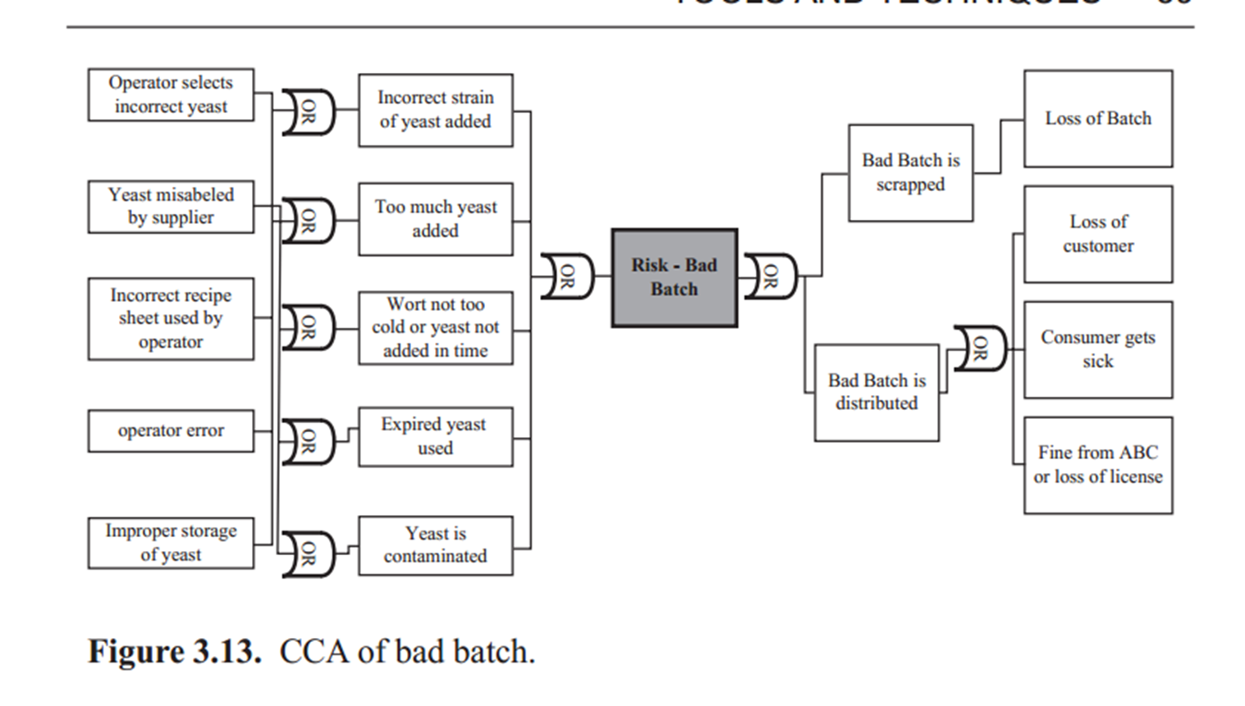
GENERALIZED STEPS FOR CCA

Slide 9
as Low as Reasonably Practicable
ALARP is a principle and not a technique like those described in the earlier sections of this chapter. The ALARP principle supports the notion فكرهthat residual risk shall be as low as reasonably practicable. Since safety (i.e., zero risk) cannot be guaranteed and the cost of addressing risk can be excessive if pursued without limits, ALARP provides an approach to help derive a justifiable level of riskiness and set tolerable risk levels.

Slide 10
as Low as Reasonably Practicable
The approach involves judgment in weighing the riskiness and the cost of attaining تحقيقsuch levels. Thus, the concept also includes accepting a certain level of risk because of the deliberate decision to bear it rather than address it. The ALARP principle is also similar to SFAIRP (so far as is reasonably practical).

Slide 11
WHERE AND WHEN TO USE ALARP
ALARP is used primarily to address the questions What can be done to detect, control, and manage them? What are the alternatives? And What are the effects beyond? Given that a risk study has been undertaken, whether through an FMEA, HAZOP, PHA, or other techniques, decision makers are then presented with recommended or proposed measures to treat the particular risk events. At this point, decision makers need to decide if a certain risk is to be addressed.

Slide 12
WHERE AND WHEN TO USE ALARP
If it is, how much of the risk should be addressedيتم تناولها. Or if it is not, whether the risk can be reasonably accepted or tolerated. ALARP is a way of thinking that aids making such decisions.
The approach can also be applied preemptively استباقيduring the recommendation step of risk studies.

Slide 13
ALARP FORMAT
In ALARP, “reasonable practicability” involves weighing a risk against the benefits. And “low” suggests a reduction of risk to a level wherein the benefits arising from further risk reduction are disproportionate غير متناسبto the time, cost, and technical difficulty of implementing further risk reduction measures.

Slide 14
ALARP FORMAT
For example, is it worth to spend $30 on a bicycle helmet to gain an 88 percent reduction in the risk of severe brain injury from riding a bike? If one chooses to make the investment, then one chooses to reduce the risk to this ALARP level. In this case, the benefit of a reduction of risk from a bike injury is worth (or even outweighs) the cost and effort of $30 and a trip to the store. Thus, the risk of injury from biking without helmet is not ALARP.

Slide 15
ALARP FORMAT
While, the reduction of risk from biking withal helmet achieves risk that is ALARP. Note that even with biking withal helmet and its corresponding risk reduction, the risk from biking is still not totally eliminated.

Slide 16
ALARP FORMAT
Conceivably, one can choose not to go biking at all, which would theoretically even further reduce the risk of head or brain injury from biking to zero. But does one forgo التخلي عن the exercise and entertainment provided by biking against this risk reduction of not engaging in the activity? Those who like biking will conclude that this particular risk reduction is not ALARP.

Slide 17
ALARP FORMAT
The benefit is not worth the cost (of not experiencing the joys of bicycling). However, one can argue that there will be extremes, the few who choose not to go biking because of the risk. For them, the choice not to go is ALARP.

Slide 18
ALARP FORMAT
As can be perceivedينظر, ALARP tends to be relatively defined محددة نسبيا, inherently subjectiveذاتي بطبيعته, and value laden قيمة محملة.
The carrot diagram in Figure 3.14 illustrates the ALARP approach and is often used to display levels of risk. The term carrot diagram comes from its appearance as an elongated triangle, which looks like a carrot.

Slide 19
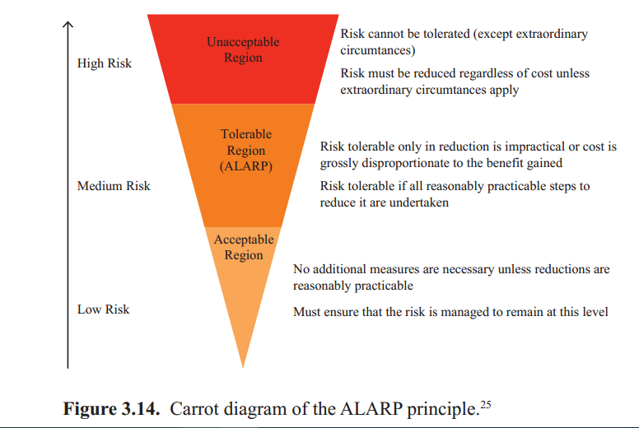
ALARP FORMAT

Slide 20
ALARP FORMAT
At the top are the high (normally unacceptable) risks. Risks that fall in the unacceptable region must be reduced regardless of cost, except in extraordinary استثنائيcircumstances. These risks are definitively not at ALARP levels. They characteristicallyمميز include those risks that may lead to death or disability.

Slide 21
ALARP FORMAT
An example of a risk in this region is not outfitting a car with seatbelts and airbags or window washing in skyscrapers without harnesses. As can be expected, many risks that fall under the unaccepted-able region are those that are mostly controlled by laws, regulations, and codes. Industry practices are good references as well for determining common preventive and control measures that achieve ALARP levels.

Slide 22
ALARP FORMAT
Other significant risks that should be identified in this region are those that may threaten the core mission of the organization. Addressing these risks that are vital to the survival and sustainability of a business should be reduced at all costs.

Slide 23
ALARP FORMAT
The low risks fall at the bottom. These risks that fall in the broadlyعموما acceptable region are risks that are tolerableمقبوله. They are more likely to be at ALARP levels. For example, the risk of being pickpocketed is so low that people do not feel the need to carry cash in separate pockets or hidden money belts.

Slide 24
ALARP FORMAT
Similarly, we manage slightly higher risks, such as crossing a neighborhood road by routine procedures (look left and right) that we were taught as children. Looking before crossing the road reduces the risk to an individual’s ALARP levels. Careful monitoring and attention must be done to ensure that risks in this region remain at this level.

Slide 25
Finding the (Im)Balance
If the costs are clearly very high and the reduction in risk is only marginal, then it is likely that the situation is already ALARP and further improvements are not required. For example, is it worth to spend $1 million to prevent 1 person in 500 getting a small bruiseكدمة per year?

Slide 26
Finding the (Im)Balance
If the answer is no, then the risk of injury (bruise) of 1 person in 500 is deemed already low as reasonably practicable (at a level ALARP). The benefit is not worth the cost and effort. The risk event of the bruise is tolerated. This risk falls in the low risk acceptable region.

Slide 27
GENERALIZED STEPS FOR ALARP
1. Identify risk.
Determine where risk falls in the ALARP region.
3. If risk falls in the top region, undertake implementation plan to
achieve ALARP.

Slide 28
GENERALIZED STEPS FOR ALARP
4. If risk falls in the bottom region, implement proposals if simple and
inexpensive; undertake monitoring and control to maintain ALARP.
5. If risk falls in the middle region, undertake further analysis (e.g.,
BC analysis, MCDM, or MCDA).

Slide 29
ALARP IN PRACTICE
Many existing industry standards and “industry good practices” are already available for risk management practices. These are widely accepted as ALARP in the industry. Survey literature and information for:
• Health and safety guidelines
• Industry standards specification
• International, federal, and state standards, laws, and regulations
• Suggestions from advisory bodies
• Comparison with similar hazardous events in other industries

Slide 30
ALARP IN PRACTICE
As knowledge and technology develop, new and better methods of risk control become available. A review of what is currently available should be studied and considered. Note that the ALARP approach should still be applied. The latest and even the best risk controls available are not necessarily reasonably practicable for a particular organization.

Slide 31
ALARP IN PRACTICE
In fact, in some cases, a risk in the unacceptable region may not be feasibly addressed because the organization or business simply does not have the resources to reduce the risk.

Slide 32
ALARP IN PRACTICE
For example, if the cost of reducing a risk puts the business in a significant financial loss and possibly bankruptcy, then the business will likely choose to bear the risk instead. It can be argued that ALARP was achieved since that level of risk (even though high) was what was reasonably practicable for that particular organization. Again, this exposes the subjective nature of ALARP.

Slide 33
ALARP IN PRACTICE
Thus ALARP entails significant stakeholder input to ensure support and establish accountability. A process of discussion with stakeholders can be done to achieve a consensus about what is ALARP. Public perception may need to be considered as well.

Slide 34
ALARP IN PRACTICE
Finally, we have to realize that the hazard or risk may actually occur at some time despite all the efforts and resources put in to address it (recall that many risks cannot be reduced to absolute zero). This is an uncomfortable thought for many people, but it is inescapableلا مفر منه
.

Slide 35
References
Resources:
Operational Risk Management
C. Ariel Pinto
Luna Mylene Magpili
Raed M. Jaradat

