Slide 1

MGM 112
Introduction to Economics
Prepared by Dr. Maryem ZORGUI
Lecture 9
The National Income Accounting

Slide 2


Introduction to Economics

Slide 3
Syllabus
I- System of National Accounts:
an overview
III-GDP Measurement and National Accounts
IV- GDP vs. GNP
II-National Income Accounting: The Measurement of Production, Income, and Expenditure
VI-Net National Product vs National Income
V- GDP per capita and the PPP

Slide 4
The System of National Accounts (SNA) is the internationally agreed standard set of recommendations on how to compile measures of economic activity.
The SNA describes a coherent, consistent and integrated set of macroeconomic accounts in the context of a set of internationally agreed concepts, definitions, classifications and accounting rules.
There are many kinds of indicators of economic well-being of society:
Gross national product (GNP), Gross Domestic Product (GDP), Net National Product (NNP), National Income (NI), Personal income(PI),
Disposable Income (DI)……
I- System of National Accounts:
an overview

Slide 5

I- System of National Accounts:
an overview
In this chapter, we’ll look for the answers to these questions:
What is Gross Domestic Product (GDP)?
What are other measures of macroeconomic activity?
How is GDP related to a Nation’s total Income and Spending?
What are the components of GDP?
How is GDP corrected for Inflation?
Does GDP measure Society’s well-being?
5

Slide 6

I- System of National Accounts:
an overview
I-1-Definition
The National Income Accounts is an accounting framework used in measuring current economic activity.
The Product approach measures the amount of output produced, excluding output used up in intermediate stages of production.
The Income approach measures the incomes received by the producers of output.
The Expenditure approach measures the amount of spending by
the ultimate purchasers of output.

Slide 7

I- System of National Accounts:
an overview
Why are the three approaches equivalent?
They must be, by definition:
  Any output produced (product approach) is purchased by someone (expenditure approach) and results in income to someone (income approach)
  The fundamental identity of national income accounting:
Total Production = Total Income = Total Expenditure

Slide 8
II-National Income Accounting
I-2-The Circular-Flow Diagram
It’s a simple depiction of the macroeconomy
It illustrates GDP as spending, revenue, factor payments, and income
Preliminaries:
  Factors of production are inputs like labor, land, capital, and natural resources.
  Factor payments are payments to the factors of production (e.g., wages, rent).
Notes:
8
If your students already know the terms “factors of production” and “factor payments,” you may wish to delete the “preliminaries” from this slide.

Slide 9
II-National Income Accounting
Households:
own the factors of production,
sell/rent them to firms for income
buy and consume goods & services
Firms
Households
Firms:
buy/hire factors of production,
use them to produce goods and services
sell goods & services
Notes:
9
This and the following slide build the Circular-Flow Diagram piece by piece.

Slide 10
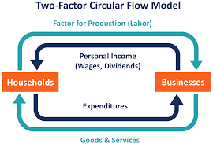
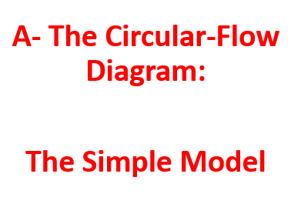
II-National Income Accounting

Slide 11
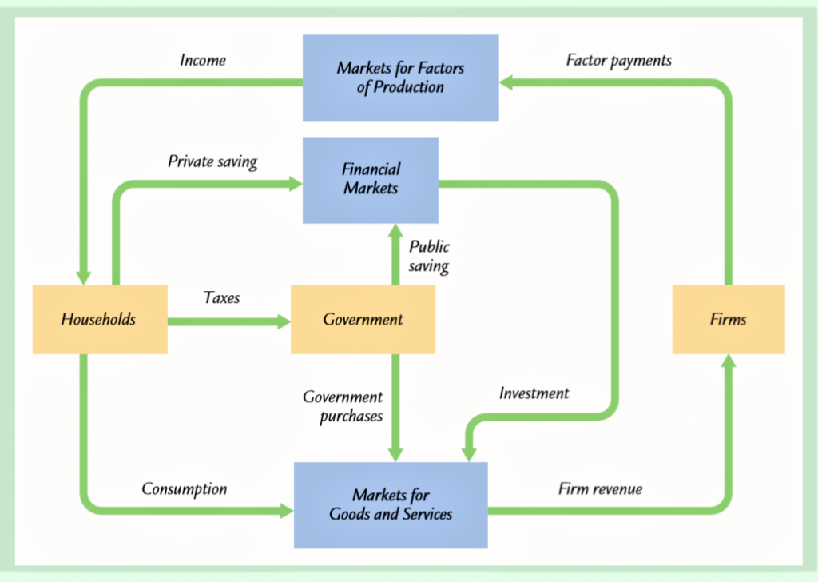
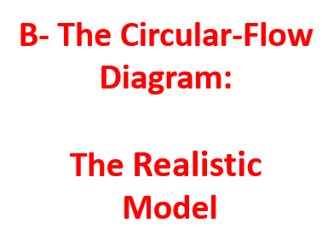
II-National Income Accounting

Slide 12

III-GDP Measurement and National Accounts
III-1- Definition of the GDP
III-2-The Components of GDP
III-3-Real GDP vs Nominal GDP
III-4-The virtue of Real GDP

Slide 13
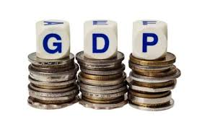
III-GDP Measurement and National Accounts
III-1- Definition of the GDP
The Gross Domestic Product (GDP) is the market value of the final goods and services produced within a country in a given time period (typically one year) without regard for the ownership of inputs.

Slide 14
III-GDP Measurement and National Accounts
III-2-The Components of GDP
Recall: GDP is total spending.
Four components for the GDP
  Consumption (C)
  Investment (I)
  Government Purchases (G)
  Net Exports (NX)
These components add up to GDP (denoted Y):
Y = C + I + G + NX
Notes:
14
Each of the four components is defined and discussed in detail on the following slides.

Slide 15
III-GDP Measurement and National Accounts
III-2-1-The Consumption (C)
It is the total spending by households on goods & services.
Note on housing costs:
  For renters:
  consumption includes rent payments.
  For homeowners:
  consumption includes the imputed rental value of the house, but not the purchase price or mortgage payments.
Notes:
15
Mostly, the term “consumption” refers to what students probably already think of as total consumer spending. The note about the treatment of owner-occupied housing is an exception, and some of the test bank questions are designed to see if students remember this exception.
(For more on this issue, see the notes accompanying the following slide.)

Slide 16

III-GDP Measurement and National Accounts
III-2-2-The Investment (I)
It is the total spending on goods that will be used in the future to produce more goods.
It includes spending on:
  capital equipment (e.g., machines, tools)
  structures (factories, office buildings, houses)
  inventories (goods produced but not yet sold)
Notes:
16
More on the treatment of owner-occupied housing:
In the national income and product accounts, a house is considered a piece of capital that is used to produce a flow of services – housing services.
When a consumer (as a tenant) rents a house or apartment, the consumer is buying housing services. These services are considered consumption, so the price paid for these services – rent – is counted in the “consumption” component of GDP .
When someone buys a new house to live in, she is both a producer and a consumer. As a producer, she has made an investment (the purchase of the house) that will produce a service. She is also the consumer of this service, which is valued at the market rental rate for that type of house. So, the accounting conventions treat this situation as if the person is her own landlord and rents the house to/from herself.
When students begin to understand this, they may wonder why certain other goods (like cars) that produce a flow of consumer services are not also treated this way. There really is no good answer. It’s just a convention of the national income and product accounts.

Slide 17
III-GDP Measurement and National Accounts
III-2-3-The Government Purchases (G)
It is all spending on the goods & services purchased by federal, state, and local Governments.
G excludes transfer payments, such as social security or unemployment insurance benefits.
They are not purchases of goods & services .
Notes:
17
You might tell your students that transfer payments, like Social Security checks, are excluded from G to avoid double-counting: retired persons spend part or all of their Social Security benefits on food, rent, prescriptions, and so forth, all of which count in consumption. If we also counted the Social Security check as part of G, then the same money would be counted twice, which would make GDP look bigger than it really is.

Slide 18

III-GDP Measurement and National Accounts
III-2-4-Net Exports (NX)
Exports represent foreign spending on the economy’s goods & services.
Imports are the portions of C, I, and G that are spent on goods & services produced abroad.
Notes:
18
The “net” in “net exports” refers to the fact that we are subtracting imports from exports. This subtraction is important, because imports are also counted in the other components of GDP; failing to subtract them would cause GDP to measure not just the value of goods produced domestically, but also goods produced abroad and imported.
For example, if a consumer spends $100 on a DVD player imported from Japan, that $100 counts in “consumption,” even though the player was not produced domestically. We subtract off that $100 import so that GDP ends up including the value of only domestically-produced goods and services.

Slide 19
III-GDP Measurement and National Accounts
Adding up all the components of GDP gives:
Y = C + I + G + NX

Slide 20
III-GDP Measurement and National Accounts
III-3-Real GDP vs Nominal GDP
Inflation can distort economic variables like GDP, so we have two versions of GDP: One is corrected for inflation, the other is not.
Inflation is the decline of purchasing power of a given currency over time.
It’s a quantitative estimate of the rate at which the decline in purchasing power occurs can be reflected in the increase of an average price level of a basket of selected goods and services in an economy over some period of time.
The rise in the general level of prices, often expressed as a percentage, means that a unit of currency effectively buys less than it did in prior periods.
Notes:
.

Slide 21
III-GDP Measurement and National Accounts
Real GDP is the value of final goods and services produced in a given year when valued at the prices of a reference base year. Real GDP is corrected for inflation (GDP in fixed prices).
Nominal GDP is the value of final goods and services produced in a given year when valued at the prices of that year. It is not corrected for inflation. (GDP in current prices).

Slide 22

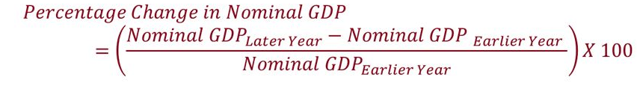
III-GDP Measurement and National Accounts
 | Corn |  | Tea
year | P | Q | P | Q
2005 | $10 | 400 | $2.00 | 1000
2006 | $11 | 500 | $2.50 | 1100
2007 | $12 | 600 | $3.00 | 1200
Compute nominal GDP in each year:
2005: $10 x 400 + $2 x 1000 = $6,000
2006: $11 x 500 + $2.50 x 1100 = $8,250
2007: $12 x 600 + $3 x 1200 = $10,800
Nominal GDP Growth Rate:
37.5%
30.9%
Notes:
22

Slide 23

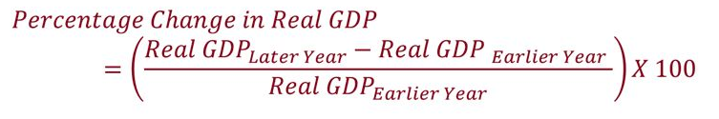
III-GDP Measurement and National Accounts
 | Corn |  | Tea
year | P | Q | P | Q
2005 | $10 | 400 | $2.00 | 1000
2006 | $11 | 500 | $2.50 | 1100
2007 | $12 | 600 | $3.00 | 1200
$10
$2.00
Compute Real GDP in each year, using 2005 as the base year:
Real GDP Growth Rate
2005: $10 x 400 + $2 x 1000 = $6,000
2006: $10 x 500 + $2 x 1100 = $7,200
2007: $10 x 600 + $2 x 1200 = $8,400
20.0%
16.7%
Notes:
23
This example shows that real GDP in every year is constructed using the prices of the base year and that the base year doesn’t change.
The growth rate of real GDP from one year to the next is the answer to this question:
“How much would GDP (and hence everyone’s income) have grown if there had been zero inflation?”
Thus, real GDP is corrected for inflation.

Slide 24
III-GDP Measurement and National Accounts
III-4-The Virtue of Real GDP
By comparing the value of production in the two years at the same prices, we reveal the change in production.
Changes in nominal GDP are driven not only by changes in physical production but also by changes in prices.
Changes in real GDP are driven solely by changes in physical production.

Slide 25

III-GDP Measurement and National Accounts
Real Gross Domestic Product (GDP) is a more accurate reflection of the output of an economy than nominal GDP.
By eliminating the distortion caused by inflation or deflation or by fluctuations in currency rates, real GDP gives economists a clearer idea of how the total national output of a country is growing or contracting from year to year.
Notes:
Deflation is a general decline in prices for goods and services, typically associated with a contraction in the supply of money and credit in the economy. During deflation, the purchasing power of currency rises over time.

Slide 26


IV- GDP vs. GNP
IV- GDP vs. GNP
IV-1-Definitions
IV-2-GDP vs GNP comparative table

Slide 27
IV- GDP vs. GNP
IV-1-Definitions
GDP (or Gross Domestic Product) and GNP (Gross National Product) measure the size and strength of an economy but are calculated and used in different ways.
GDP notion is based on the LOCATION of inputs.
GNP notion is based on the OWNERSHIP of inputs.
For majority of countries the difference between GDP and GNP is small (e.g. for US economy it is smaller than 1%).

Slide 28
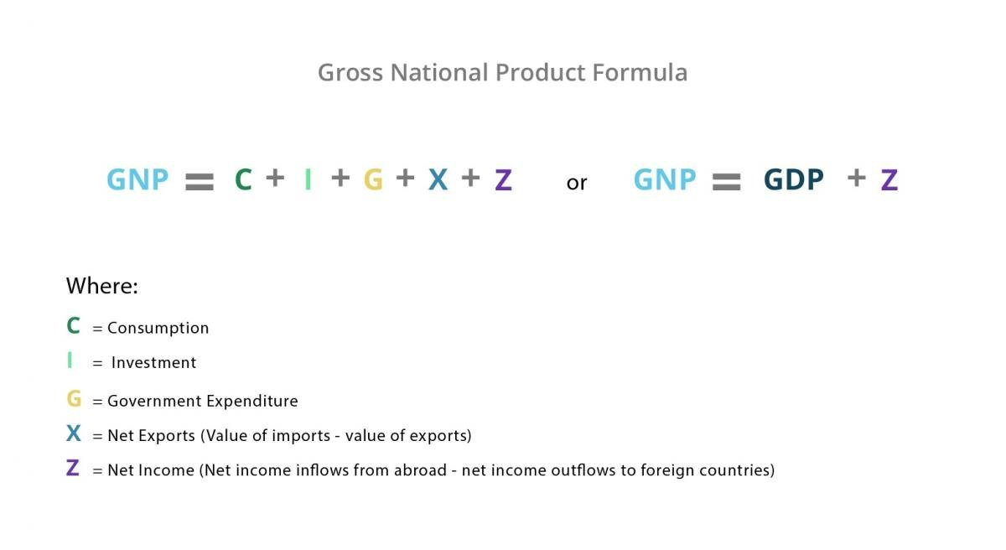
IV- GDP vs. GNP

Slide 29

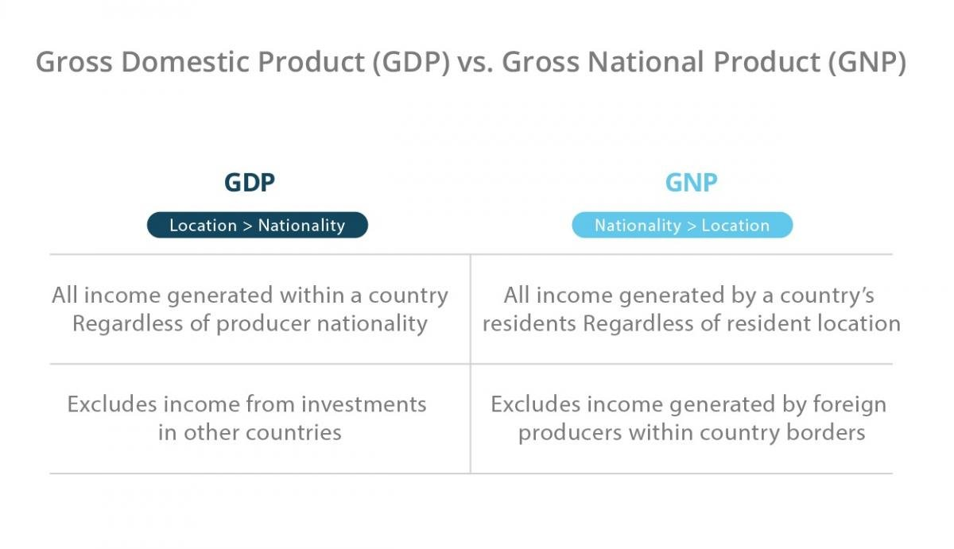
IV- GDP vs GNP
IV-2- GDP vs GNP comparative table

Slide 30
IV- GDP vs. GNP
IV-3- The GDP Deflator
The GDP deflator is a measure of the overall level of prices.
Definition:
GDP deflator = 100 x
nominal GDP
real GDP
One way to measure the economy’s inflation rate is to compute the percentage increase in the GDP deflator from one year to the next.
Notes:
30
The GDP Deflator gets its name because it is used to “deflate” (i.e., take the inflation out of) nominal GDP to get real GDP.

Slide 31

Example:
IV- GDP vs. GNP
year | Nominal GDP | Real GDP | GDP Deflator
2005 | $6000 | $6000
2006 | $8250 | $7200
2007 | $10,800 | $8400
100.0
14.6%
114.6
128.6
12.2%
Compute the GDP deflator in each year:
2005: 100 x (6000/6000) = 100.0
2006: 100 x (8250/7200) = 114.6
2007: 100 x (10,800/8400) = 128.6
Notes:
31

Slide 32
V- GDP per capita and the PPP
V-1-GDP per capita
V-2- PPP GDP per capita
V-3- What is under control in PPP GDP per capita measurement
V-4- What is NOT under control in PPP GDP per capita measurement

Slide 33
V- GDP per capita and the PPP
V-1-GDP per capita
GDP per capita = the gross Income received by the average resident of a country
GDP per capita = GDP / number of residents

Slide 34
V- GDP per capita and the PPP
V-2- PPP GDP per capita
PPP GDP per capita: GDP per capita presented on a purchasing power parity basis.
Purchasing Power Parity (PPP): an economic theory that estimates the amount of adjustment needed on the exchange rate between countries in order for the exchange to be equivalent to each currency’s
purchaising power

Slide 35
V- GDP per capita and the PPP
V-3- What is under control in PPP GDP per capita measurement
Differences in currencies among countries
Differences in prices among countries

Slide 36
V- GDP per capita and the PPP
V-4- What is NOT under control in PPP GDP per capita measurement
Division of Income in the Society.
Non-official production / underground Economy transactions that do not take place in organized markets.
Negative externalities of production (exist when individuals bear a portion of the cost associated with a good’s production without having any influence over the related production decisions).

Slide 37
VI-Net National Product (NNP) vs National Income (NI)
V-1- The Net National Product (NNP)
The Net National Product (NNP) is Gross National Product (GNP), the total value of finished goods and services produced by a country's citizens overseas and domestically, minus depreciation.
NNP = GNP – depreciation
Depreciation is the estimate of the amount of capital (invested in assets of the economy) that will wear out or will be used up in producing GNP.

Slide 38
VI-Net National Product (NNP)vs National Income (NI)
V-2- The National Income (NNP)
NI = NNP – indirect taxes Indirect taxes are subtracted because they have no equivalent in production.
Direct taxes: taxes put on income directly (income taxes)
Indirect taxes: taxes put on income indirectly (sales and excise taxes)

Slide 39


Slide 40
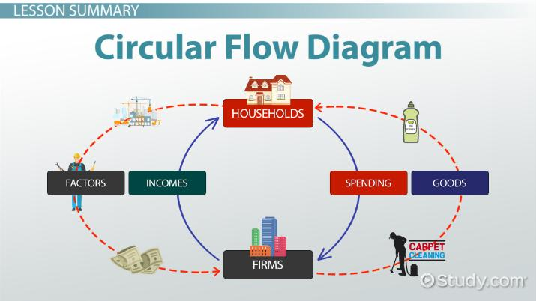
Circular flow Diagram:
Simple & Realistic Model

Slide 41
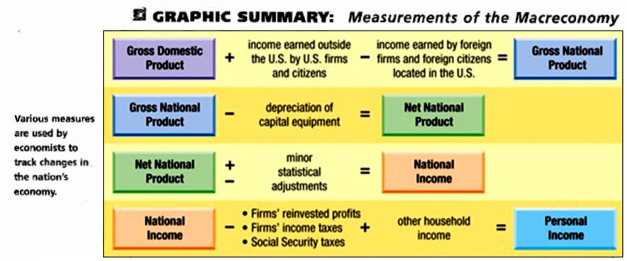
GDP GNP NNP NI

Slide 42
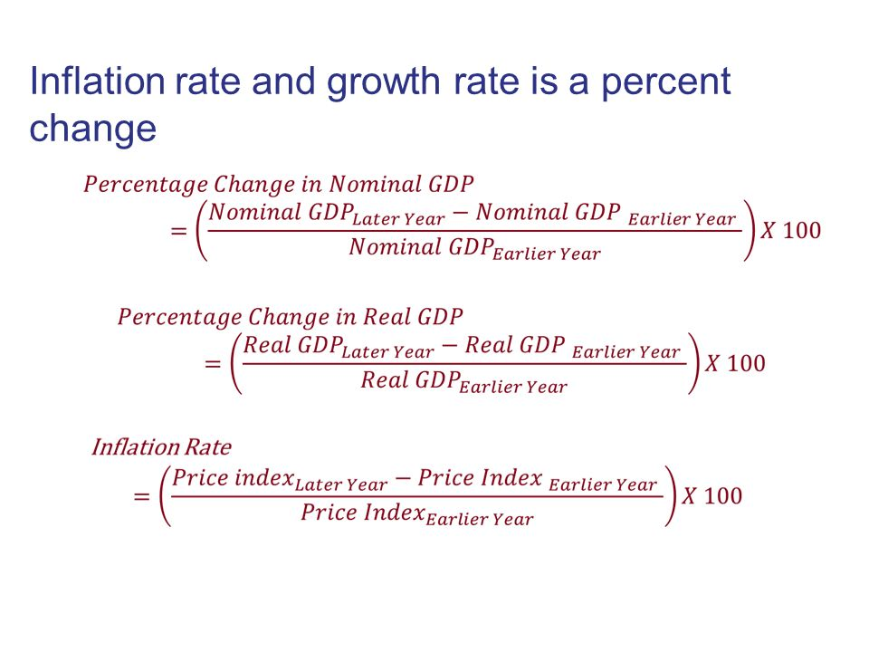
Inflation rate Growth rate

Slide 43
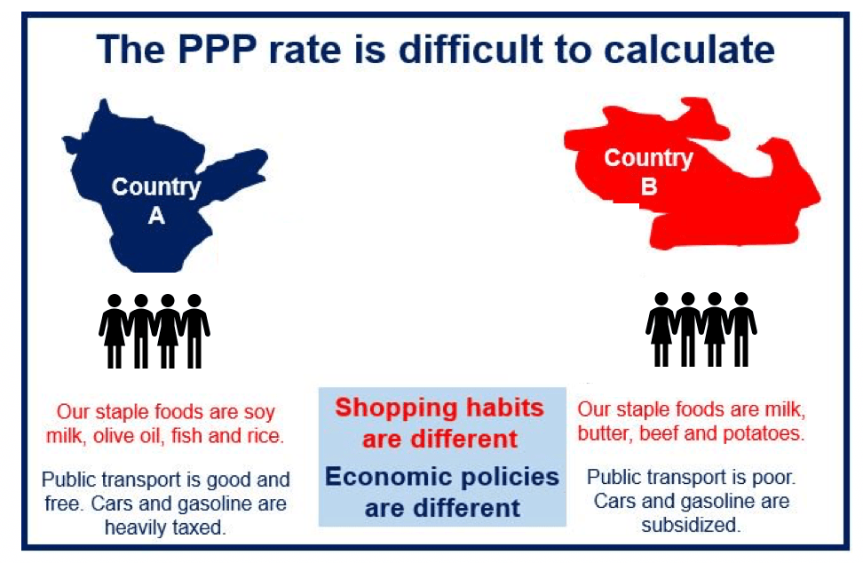

Slide 44


