Slide 2
Contents
Combinational circuits
Design procedure
Half adder
Full adder
Parallel Adder
Adder subtractor

Slide 3
Combinational Circuits
Logic circuits for digital systems may be Combinational circuit or Sequential circuit
Combinational circuit: logic circuit whose outputs at any time are determined directly and only from the present input combination.
A combinational circuit performs a specific information-processing operation fully specified logically by a set of Boolean functions.
Sequential circuit : depends on combination of inputs and state of the storage elements.
Notes:
The complexity of a logic circuit that implements a Boolean function is directly related to the algebraic expression from which the function is implemented.
truth-table representation of a function is unique, when expressed algebraically, the function appears in many different forms.
Boolean expressions may be simplified by algebraic manipulation, as discussed in Section 2.
How ever, this procedure of simplification is awkward, because it lacks specific rules to predict each succeeding step in the manipulative process and it is difficult to determine whether the simplest expression has been achieved. By contrast, the map method provides a straightforward procedure for optimizing Boolean func- tions of up to four variables.

Slide 4
Combinational Circuits
Combinational
Circuit
n inputs
m outputs
Fig.: Block Diagram of Combinational Circuit

Slide 5
Combinational Circuits
In Sum-of-Products (SOP) form, basic combinational circuits can be directly implemented with AND-OR combinations if the necessary complement terms are available.

Slide 6
An example of an SOP implementation is shown. The SOP expression is an AND-OR combination of the input variables and the appropriate complements.
A
B
ABC
C
X = ABC
+ DE
SOP
D
E
DE

Slide 7
When the output of a SOP form is inverted, the circuit is called an AND-OR-Invert circuit (AOI) . The AOI configuration lends itself to product-of-sums (POS) implementation.
An example of an AOI implementation is shown. The output expression can be changed to a POS expression by applying DeMorgan’s theorem twice.
A
B
ABC
C
X = ABC
+ DE
X = ABC
+ DE
AOI
D
X = (ABC)(DE)
DeMorgan
E
DE
X = (A + B + C)(D + E)

Slide 8
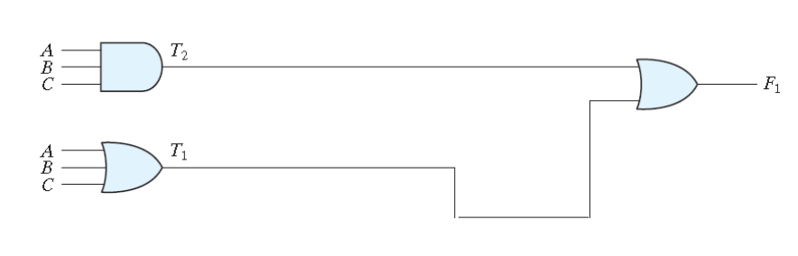
Exercise: Analyze the following circuit (give the equivalent equation)
T2 = A.B.C
T1 = A+B+C
F1 = T2 + T1 = A.B.C + (A+B+C)

Slide 9
Design Procedure
The design procedure for combinational circuits is:
  Define the problem.
  Determine the number of input/output variables.
  Assign letter symbols to input/output variables.
  Derive the truth table that defines the required relationships between inputs & outputs.
  Obtain the simplified Boolean function for each output as a function of the input variables.
  Draw the logic diagram and verify the correctness of the design.

Slide 10
Example: Exclusive-OR (XOR) Logic
Problem Definition
  XOR” an abbreviation for “Exclusively-OR.” The simplest XOR gate is a two-input combinational circuit that outputs a logical “1” if the two input values differ, i.e., its output is a logical “1” if either of its inputs are 1, but not at the same time (exclusively).
Inputs / outputs
  The Boolean expression for a two-input XOR gate, with inputs A and B and output X:

Slide 11
Example: Exclusive-OR (XOR) Logic
Truth Table:
  The symbol and truth table for an XOR is shown in Figure.
Obtain the simplified Boolean function for the output as a function of the input variables.
X = A’. B + A. B’
Inputs |  | Output
A | B | X
0 | 0 | 0
0 | 1 | 1
1 | 0 | 1
1 | 1 | 0

Slide 12
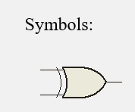
Draw the logic diagram and verify the correctness of the design.
The circuit can be drawn as
A
X
B
A⊕B

Slide 13
Example: Exclusive-NOR (XNOR) Logic
Truth Table:
  The symbol and truth table for an XNOR is shown in Figure.
Obtain the simplified Boolean function for the output as a function of the input variables.
X = A. B + A’. B’
Inputs |  | Output
A | B | X
0 | 0 | 1
0 | 1 | 0
1 | 0 | 0
1 | 1 | 1

Slide 14

Draw the logic diagram and verify the correctness of the design.
The circuit can be drawn as
A
X
B

Slide 15
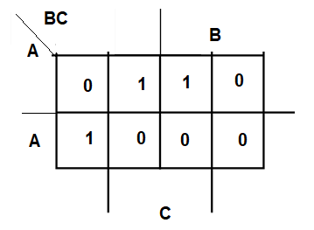
Example: Design the combinational function shown in the following truth table
F (A,B,C) = A’.B’.C + A’.B.C + A.B’.C’
Obtain the simplified Boolean function
using K Map:
F(A,B,C) = A.B’.C’ + A’.C
A | B | C | F
0 | 0 | 0 | 0
0 | 0 | 1 | 1
0 | 1 | 0 | 0
0 | 1 | 1 | 1
1 | 0 | 0 | 1
1 | 0 | 1 | 0
1 | 1 | 0 | 0
1 | 1 | 1 | 0

Slide 16
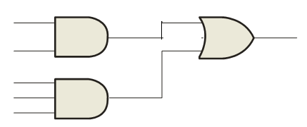
Original
A’
B’
C
A’
B
C
X = A’.B’.C + A’.B.C + A.B’C’
A
B’
C’
A’
C
A.B’.C’ + A’.C
Simplified
A
B’
C’

Slide 17
Exercise
Design a combinational circuit with three input and one output.
  The output is 1 when the binary value of the inputs is less than 3 the output is 0 otherwise.
Solution
Inputs / outputs
3 inputs, (A,B,C) and one output (F)

Slide 18
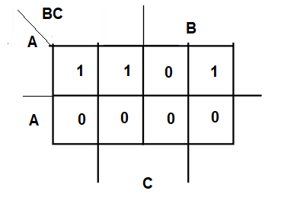
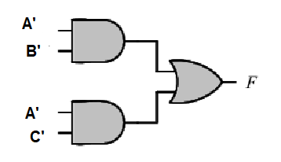
Truth Table:
  The output is 1 when the binary value of the inputs is less than 3. the output is 0 otherwise.
Obtain the simplified Boolean function for the output as a function of the input:
A | B | C | F
0 | 0 | 0 | 1
0 | 0 | 1 | 1
0 | 1 | 0 | 1
0 | 1 | 1 | 0
1 | 0 | 0 | 0
1 | 0 | 1 | 0
1 | 1 | 0 | 0
1 | 1 | 1 | 0
F(A,B,C) = A’.B’ + C’.A’

Slide 19
Exercise:
A majority circuit is a combinational circuit whose output is equal to 1 if the input variables have more 1's than 0's. The output is 0 otherwise.
  Design a three inputs majority circuit by finding the circuits truth table. Boolean equation and a logic diagram.
Solution
Inputs / outputs
3 inputs, (A,B,C) and one output (F)

Slide 20
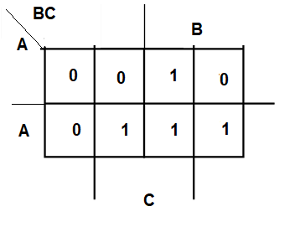
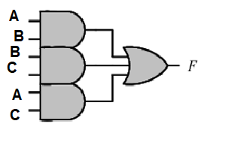
Truth Table:
Obtain the simplified Boolean function for the output as a function of the input:
A | B | C | F
0 | 0 | 0 | 0
0 | 0 | 1 | 0
0 | 1 | 0 | 0
0 | 1 | 1 | 1
1 | 0 | 0 | 0
1 | 0 | 1 | 1
1 | 1 | 0 | 1
1 | 1 | 1 | 1
F(A,B,C) = A.B + B.C +A.C

Slide 21
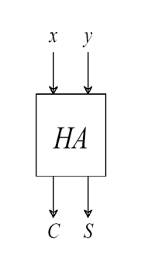
Half Adder Circuit
The most basic arithmetic operation is the addition of 2 bits. A combinational circuit that performs this operation is called a half-adder.
2 inputs and two outputs
  Inputs : X , Y
  Outputs: S , C

Slide 22
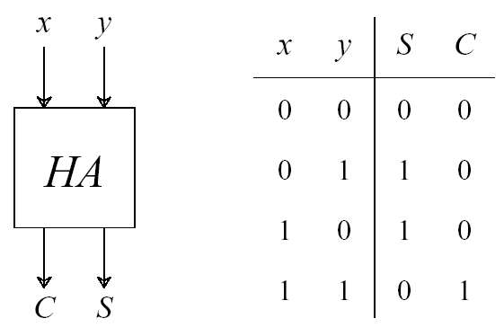
Half Adder Circuit
Truth Table.
Equations:
  S = xy’ + x’y = x⊕y
  C = xy
The sum can be found using the XOR operation and the carry using the AND operation.

Slide 23
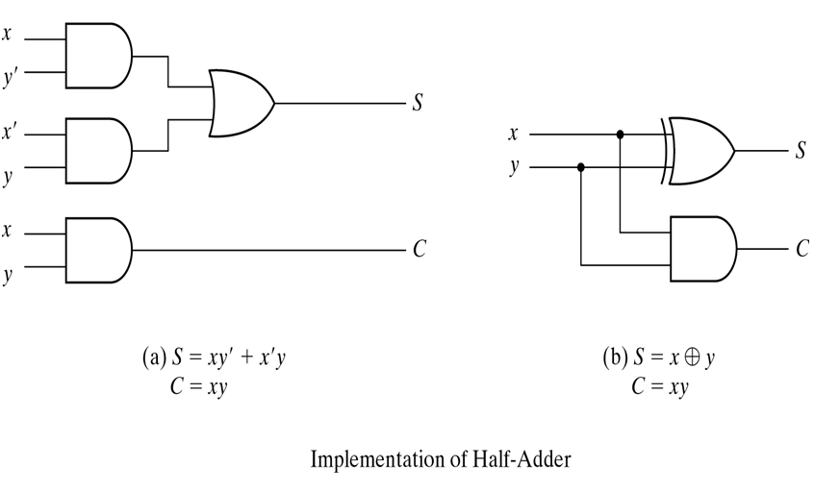
Half Adder

Slide 24
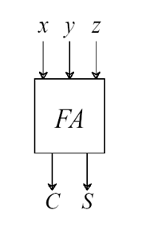
Full Adder
A combinational circuit that performs the addition of 3 bits is called a full-adder, which can be implemented by 2 half-adders.
3 inputs and two outputs
  Inputs : X , Y, Z
  Outputs: C , S

Slide 25
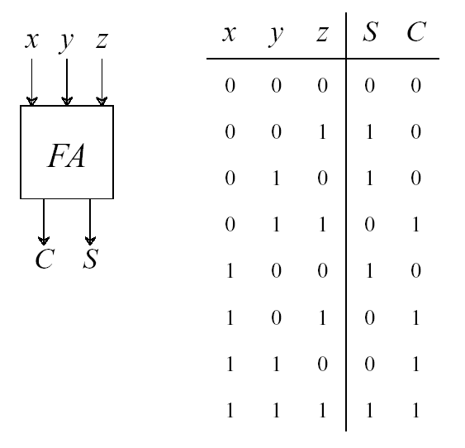
Full Adder
Truth Table.
Equations:
  Sum:
  S = xy’z’ + x’yz’ + xyz + x’y’z
  Carry:
  C = x’yz + xy’z + xyz’ + xyz

Slide 26
Full Adder
S = xy’z’ + x’yz’ + xyz + x’y’z =
z’(xy’ +x’y) + z(xy + x’y’)
= z’(xy’ +x’y) + z (xy’ +x’y)’
= z ⊕(x ⊕ y)
C = x’yz + xy’z + xyz’ + xyz
= x’yz + xy’z + xy
= z(x’y + xy’) + xy
= z(x ⊕ y) + xy

Slide 27
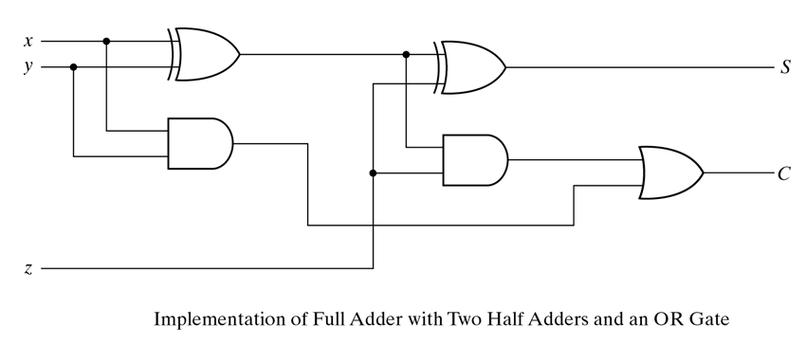
Full Adder
S = z ⊕(x ⊕ y)
C = z(x ⊕ y) + xy

Slide 28
Full Adder
X
HA
HA
S
S
S_{F}
Y
C
C
OR
gate
C_{F}
Z

Slide 29
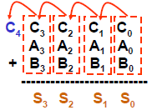
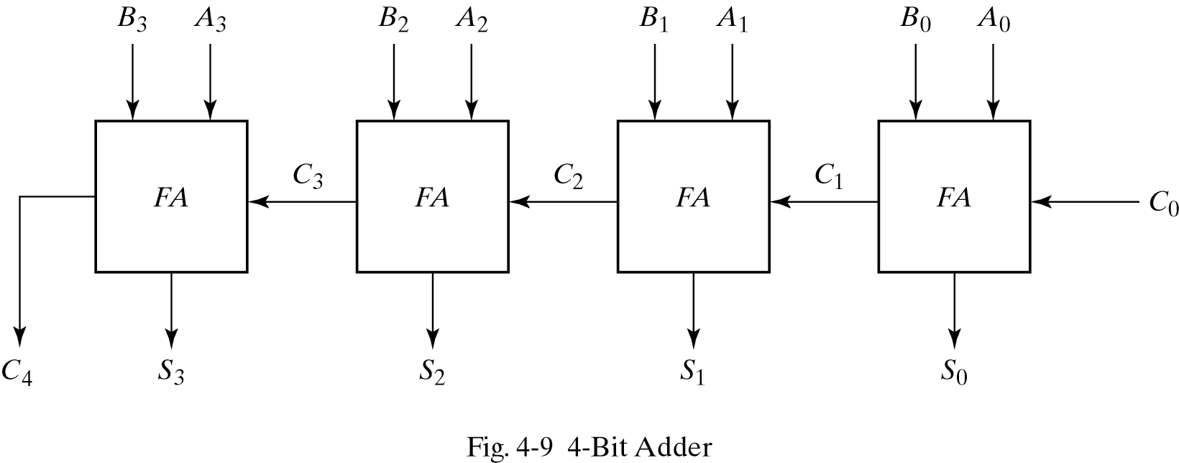
4-Bit Binary Adder (parallel adder)

Slide 30
4-Bit parallel Binary Adder
The logic symbol for a 4-bit parallel adder is shown. This 4-bit adder includes 4 Full Adder. As shown in the following graph, the 4-bit adder has 9 inputs (8inputs for the 4-bit A and B + one input for C₀) and 5 outputs (4 outputs for the 4-bit sum and one output for the carry C₄). What will be the case if we have 3-bit parallel adder or 5-bits parallel Adder?
Σ
1
2
3
4
1
2
3
4
Binary number A
4-bit sum
1
2
3
4
Binary number B
Input carry
C₀
C₄
Output carry

Slide 31
2’s Complement Adder/Subtractor
Subtraction can be done by addition of the 2's Complement.
A - B = A + B’ + 1
  Complement each bit of B(1's Complement.) [B -→ B’]
  Add 1 to the result to get 2’s complement of B. ( B’ + 1)
  A-B = A + B’+1
Actually, we can use an adder for both addition and subtraction:
Complement subtrahend for subtraction
Do not complement subtrahend for addition
Thus, to form an adder-subtractor circuit, we only need a selective complementer and an adder.
B_{0…3}
A_{0…3}
Binary Adder/Subtractor
_{M}
S_{0…3}
Notes:
Using the 2s complement, we have eliminated the subtraction operation and need only the complementer and an adder.
When performing a subtraction we comple- ment the subtrahend N, and when performing an addition we do not complement N.
The 2s complement can be obtained by taking the 1s complement and adding 1 to the least significant bit.

Slide 32
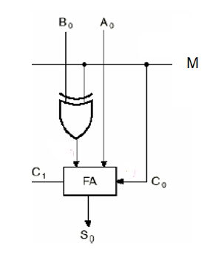
XOR TRUTH TABLE
M | B | OUTPUT
0 | 0 | 0
0 | 1 | 1
1 | 0 | 1
1 | 1 | 0
B
B’
Here XOR act as a programmable inverter:
1- when M= 0 the input is kept the same
2- when M = 1 the input is inverted or complemented

Slide 33
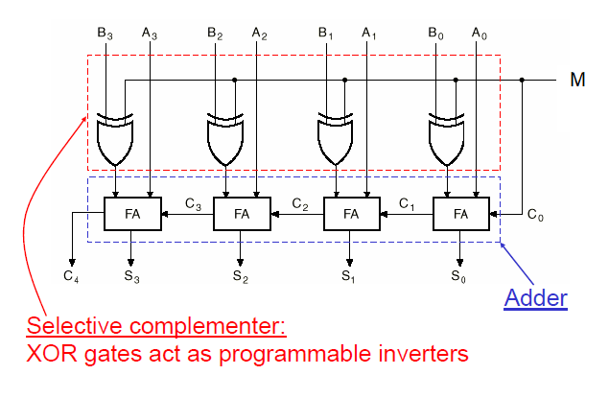
4-bit Binary Adder-Subtractor using 2’s Complement
When M = 0, the circuit performs A + B. The carry in is 0, and the XOR gates simply pass B untouched.
When M = 1, the circuit performs A – B.
A-B= A+ 2’s comp. of (B) =A+(B’+1)

Slide 34
Addition cases and overflow
00
0010
0011
--------
0101
01
0011
0110
--------
1001
11
1110
1101
--------
1011
10
1101
1010
--------
0111
00
0010
1100
--------
1110
11
1110
0100
--------
0010
2
3
5
3
6
-7
-2
-3
-5
-3
-6
7
2
-4
-2
-2
4
2
OFL
OFL

Slide 35
Addition cases and overflow
As a conclusion:
If the last two carries are Different, then there is an overflow, and the sum result is incorrect
If the last two carries are the same, then there is no overflow and the sum result is correct

Slide 36
End of Chapter 6

