Slide 1


Slide 2
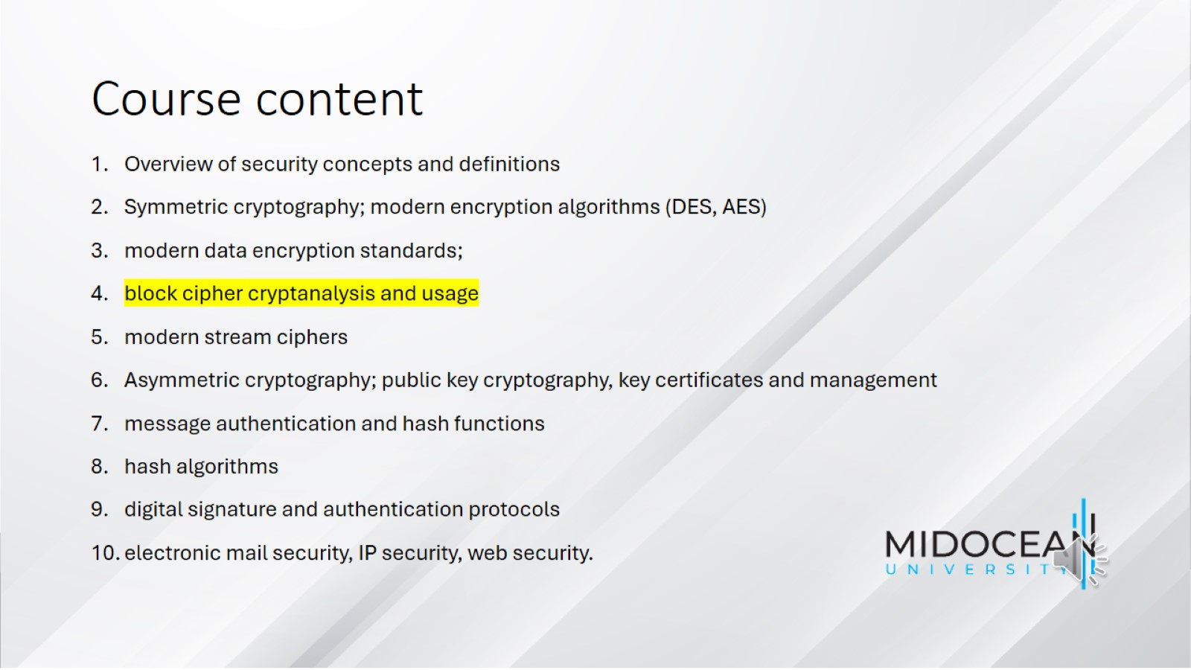
Course content

Slide 3
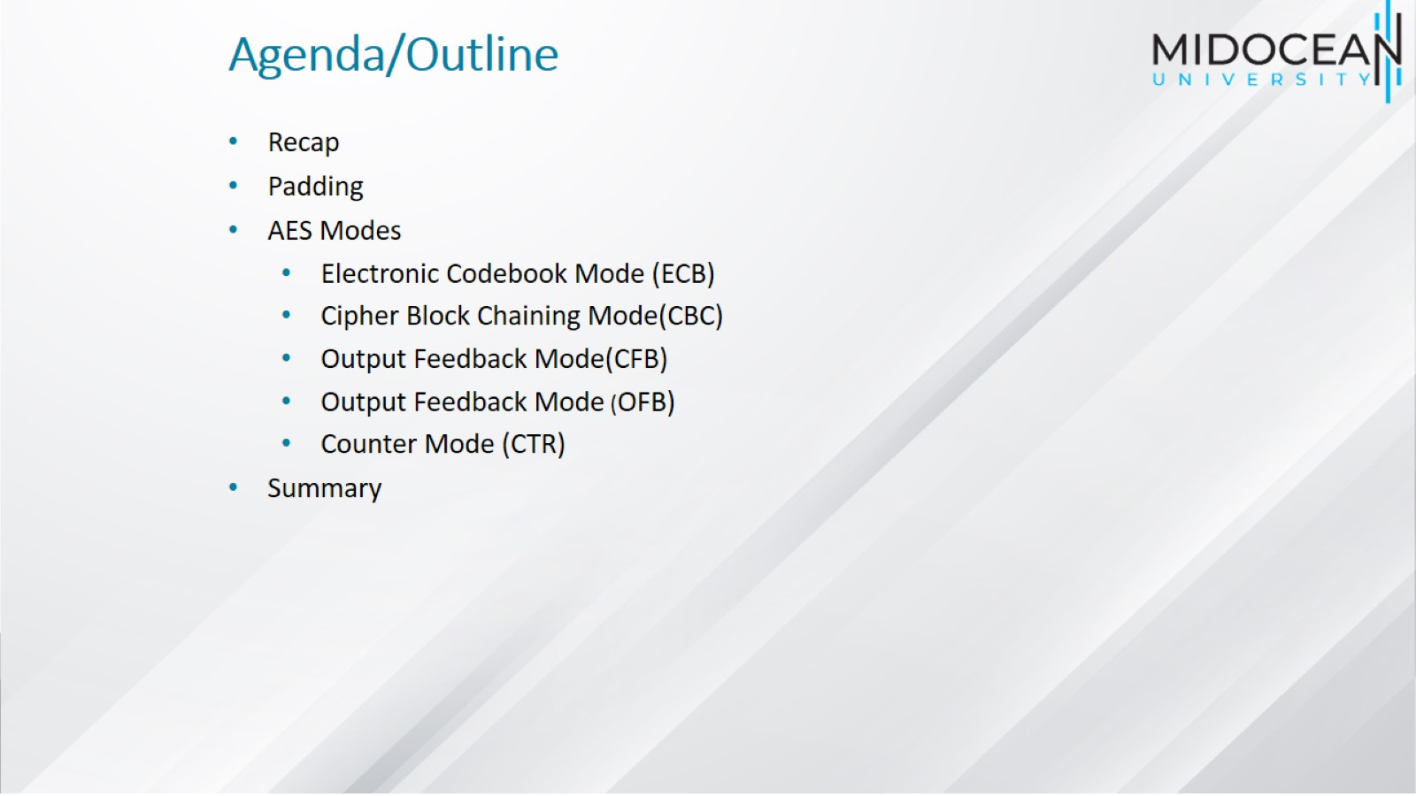
Agenda/Outline

Slide 4
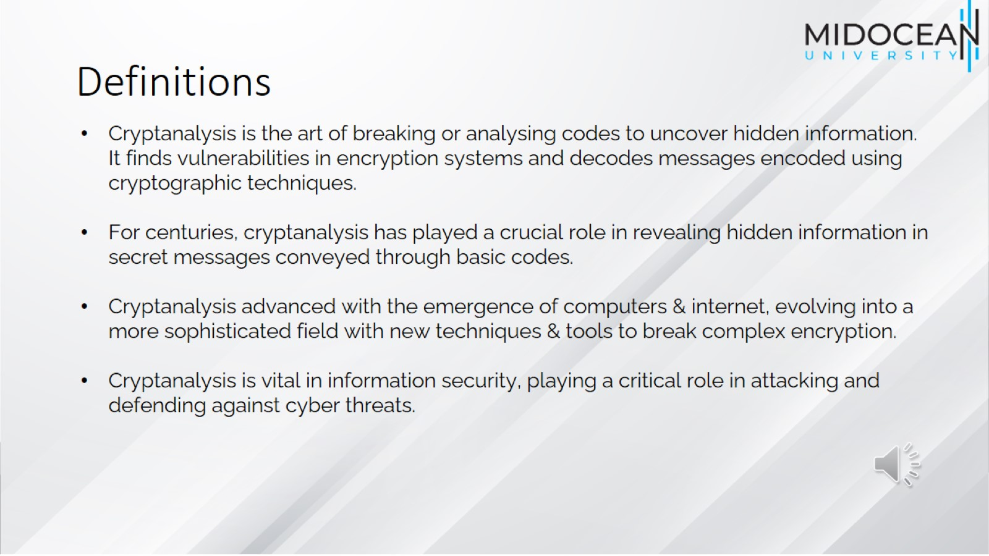
Definitions

Slide 5
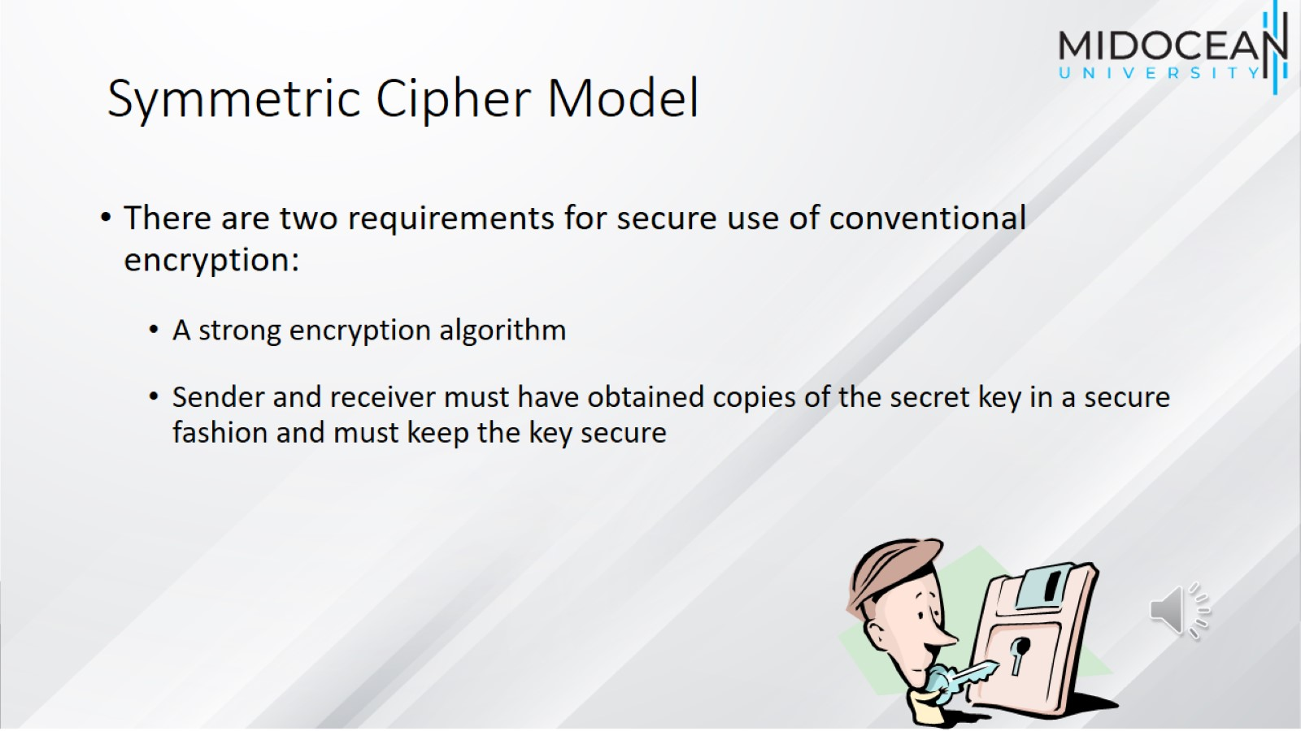
Symmetric Cipher Model

Slide 6
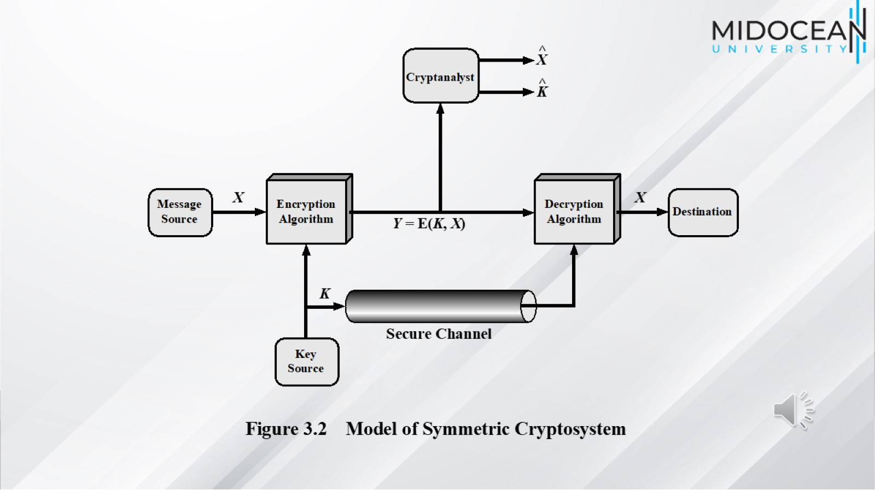

Slide 7
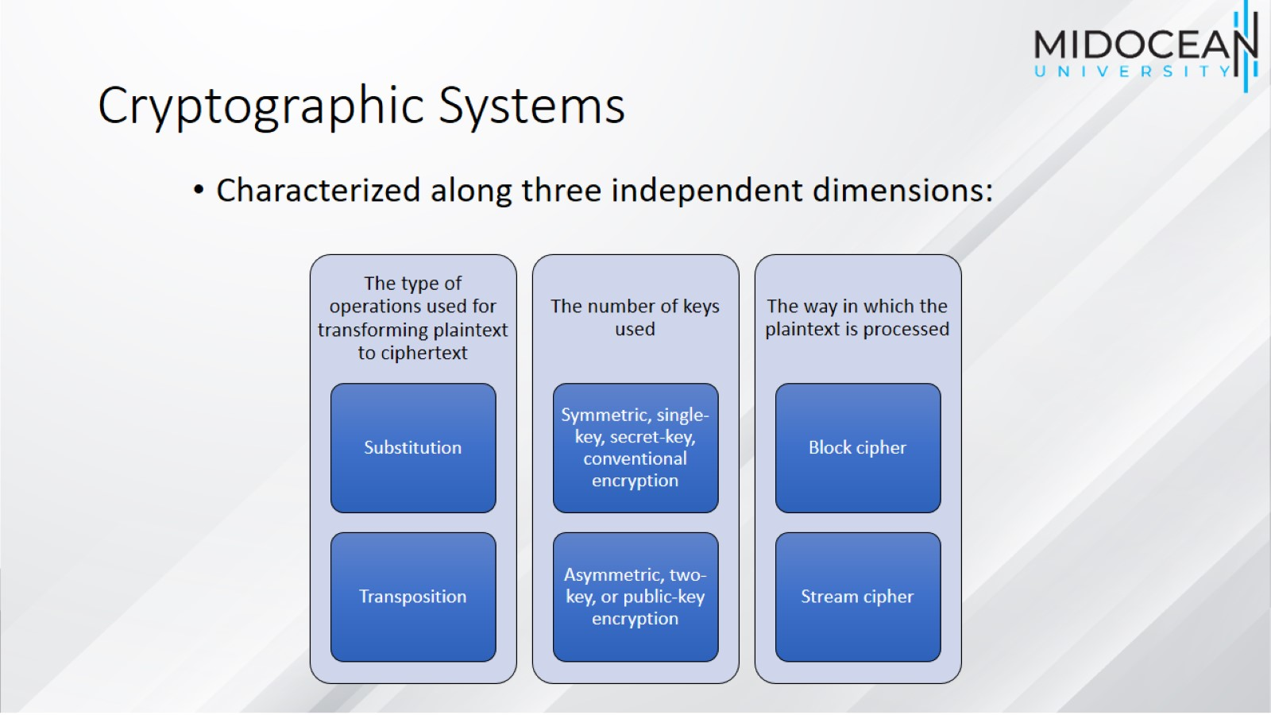
Cryptographic Systems

Slide 8
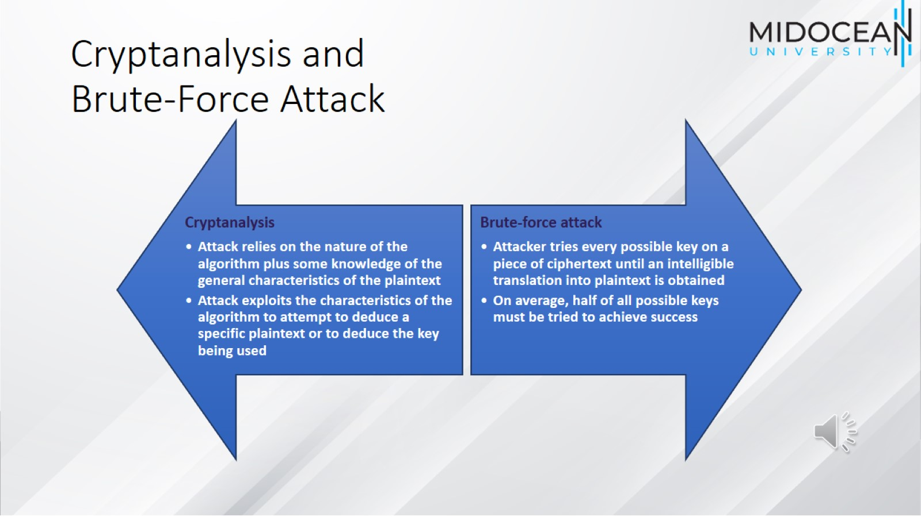
Cryptanalysis and
Brute-Force Attack

Slide 9
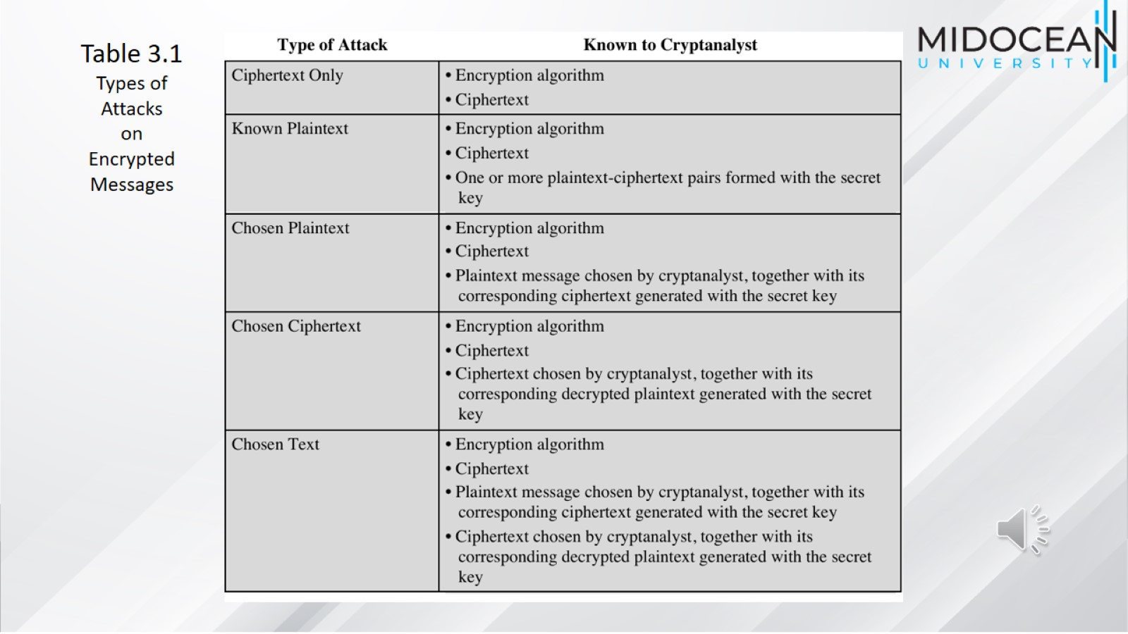

Slide 10
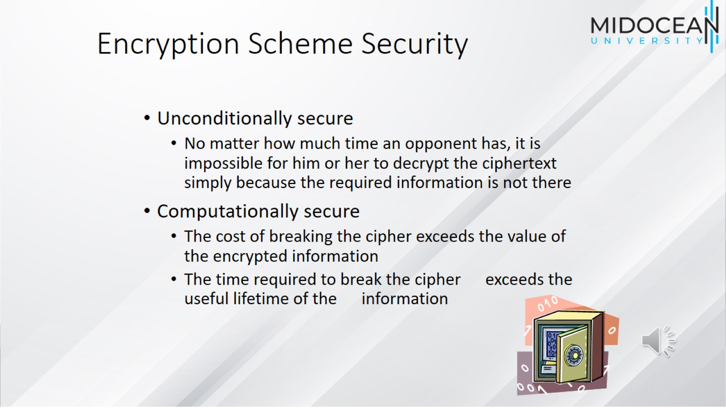
Encryption Scheme Security

Slide 11
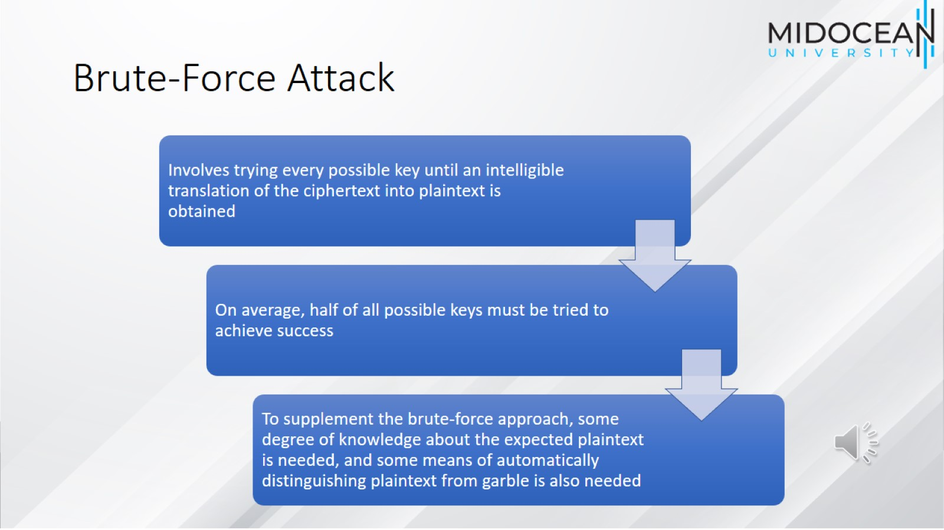
Brute-Force Attack

Slide 12
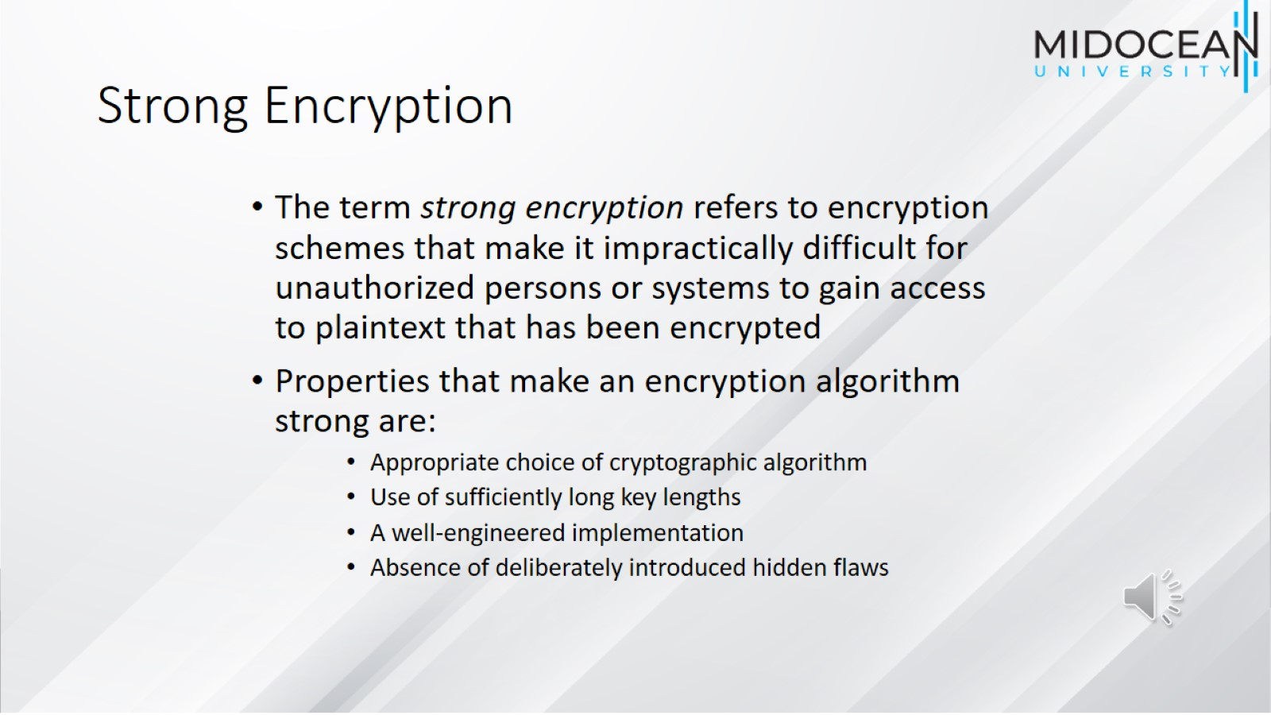
Strong Encryption

Slide 13
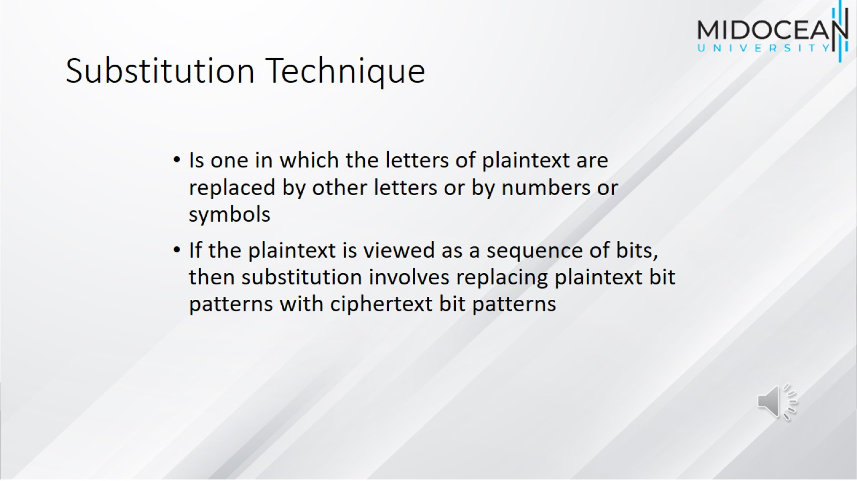
Substitution Technique

Slide 14
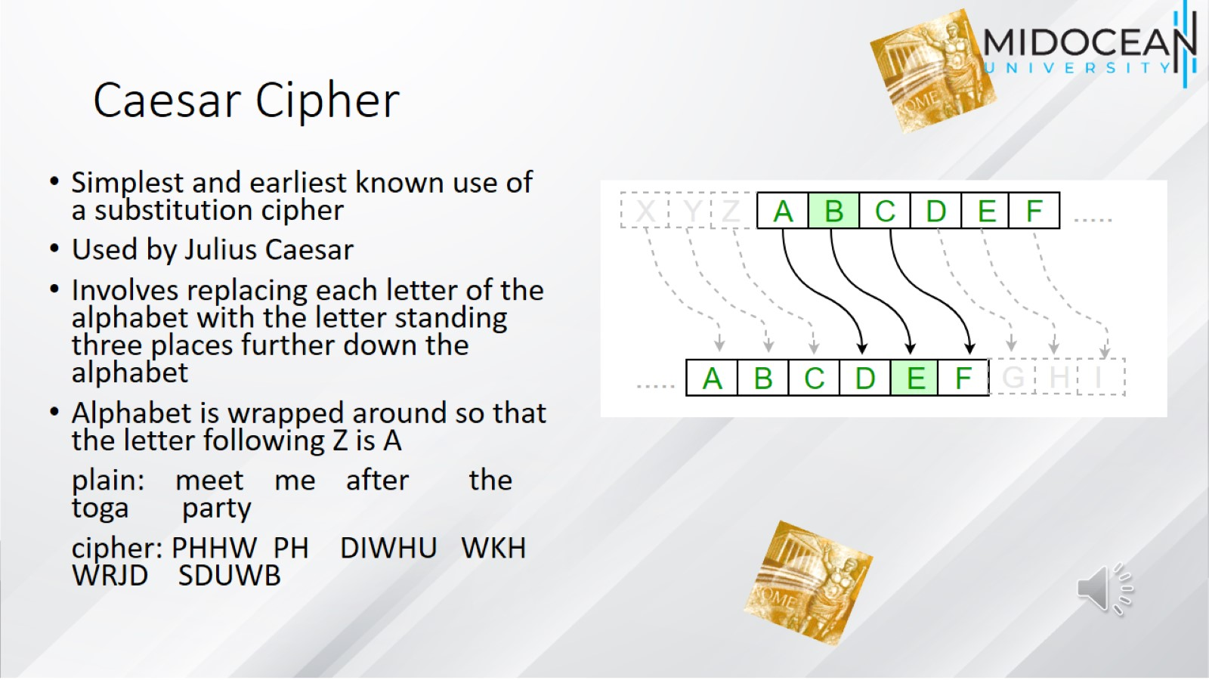
Caesar Cipher

Slide 15
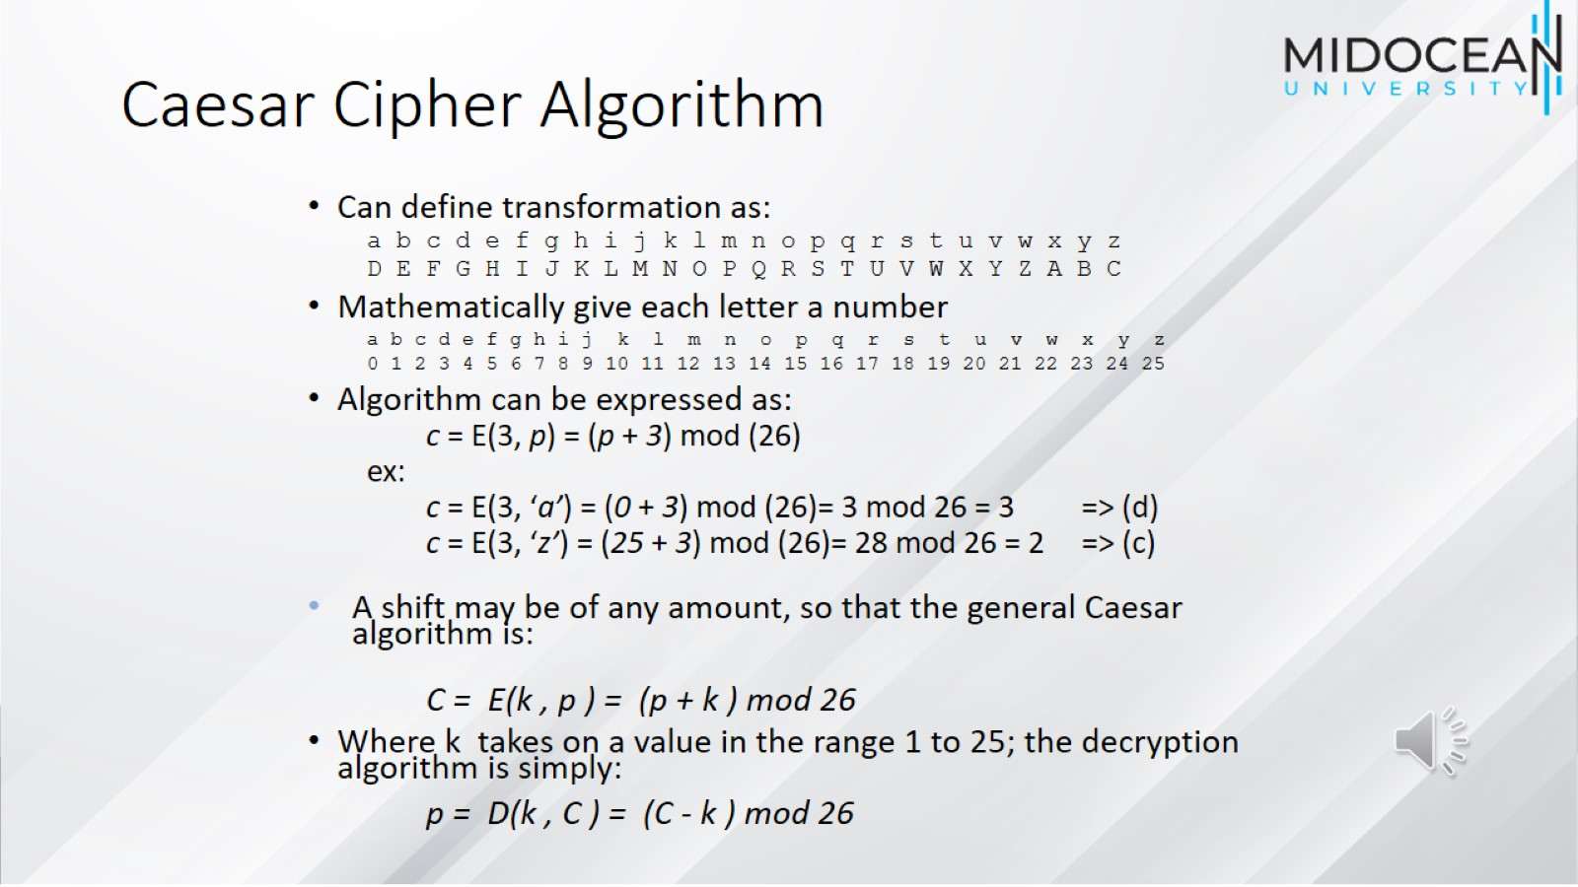
Caesar Cipher Algorithm

Slide 16
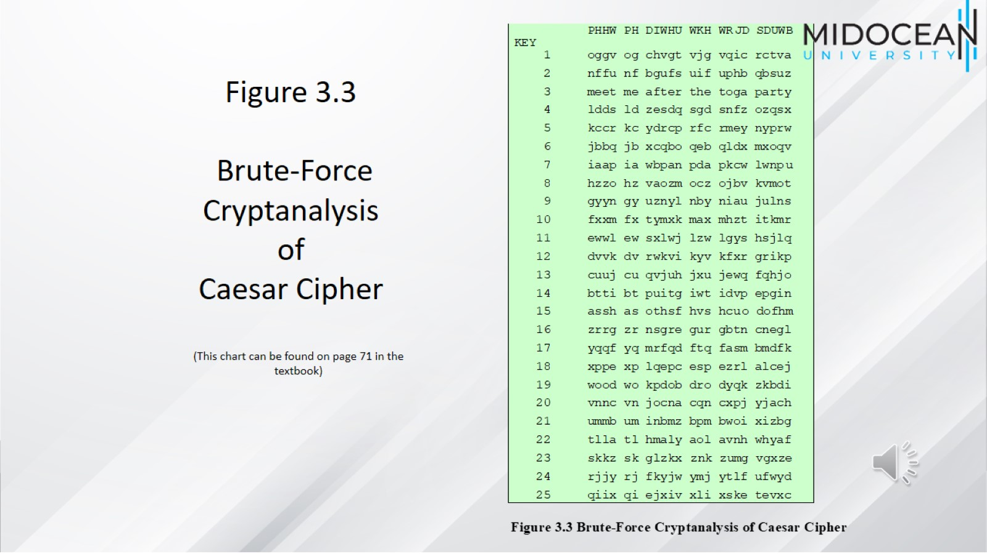

Slide 17
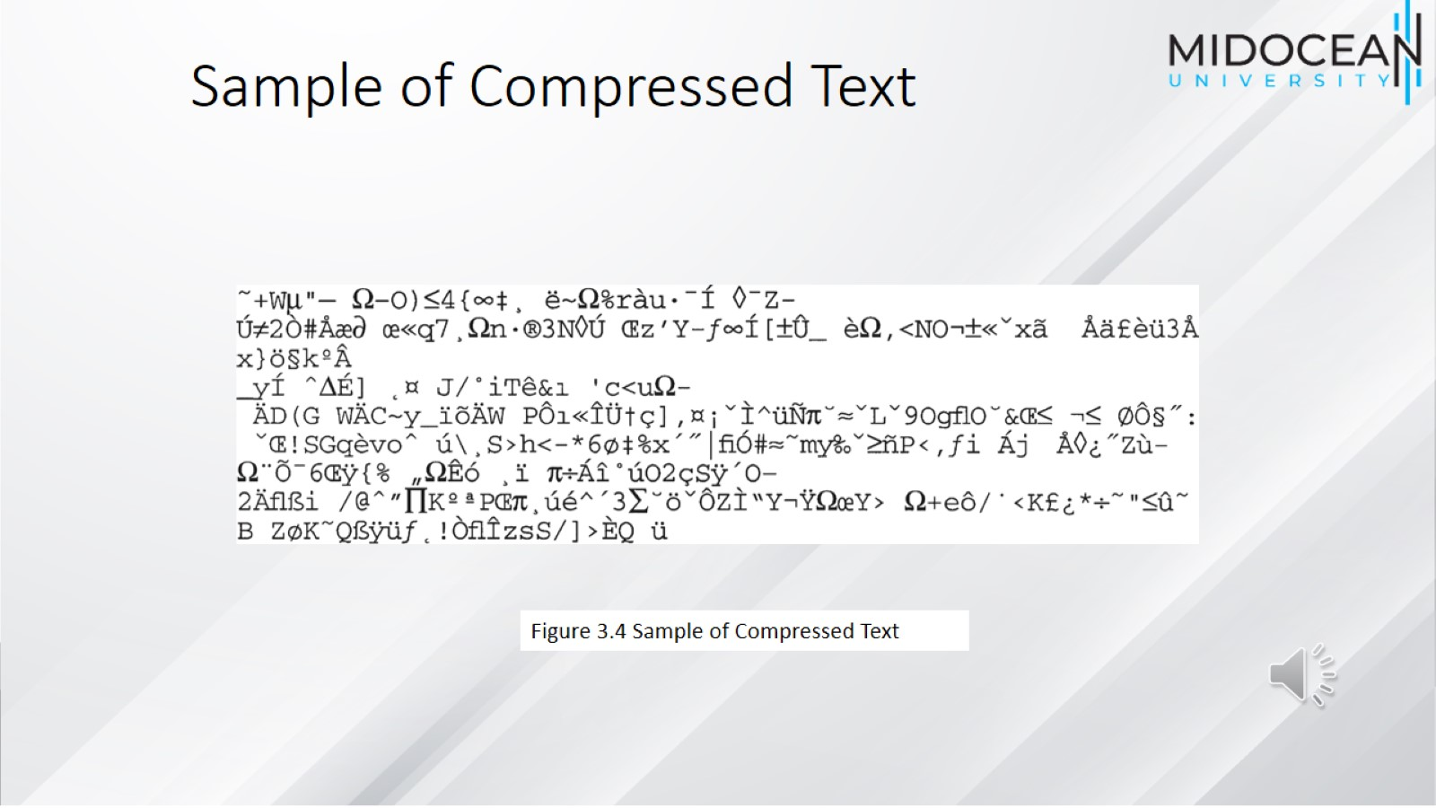
Sample of Compressed Text

Slide 18
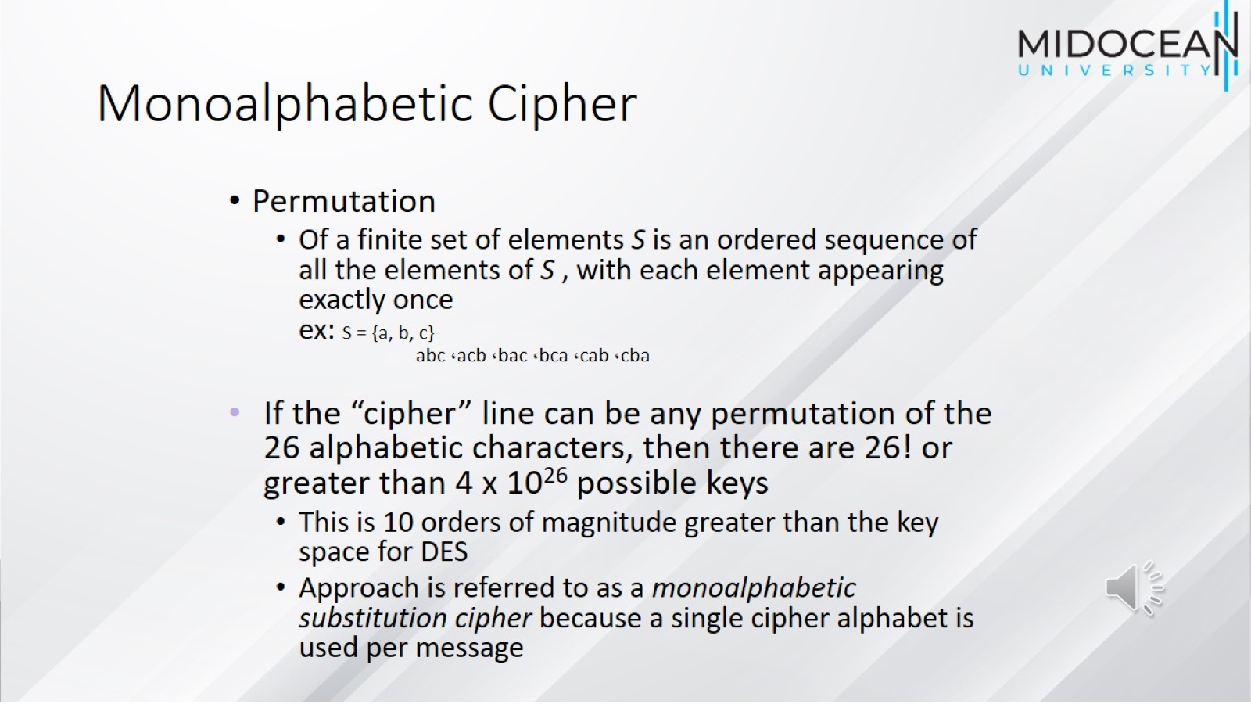
Monoalphabetic Cipher

Slide 19
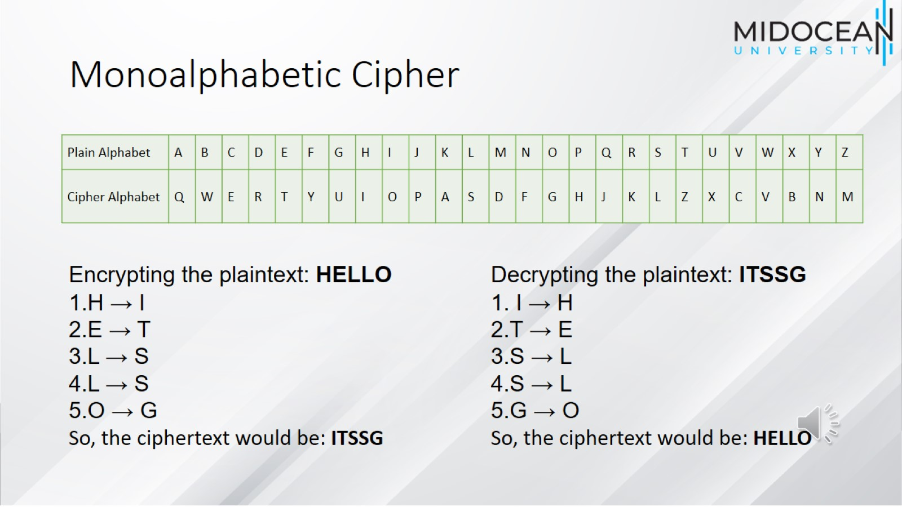
Monoalphabetic Cipher

Slide 20
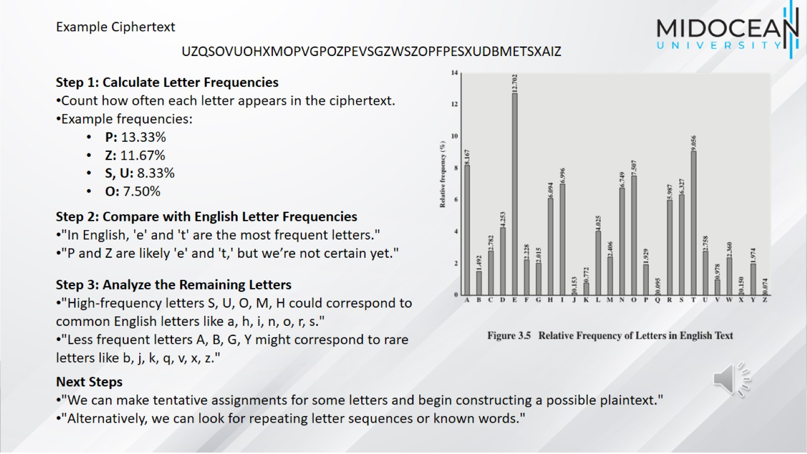

Slide 21
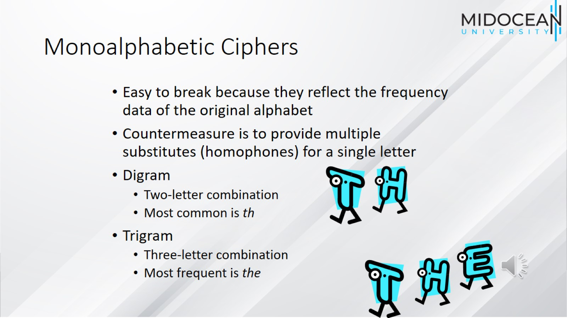
Monoalphabetic Ciphers

Slide 22
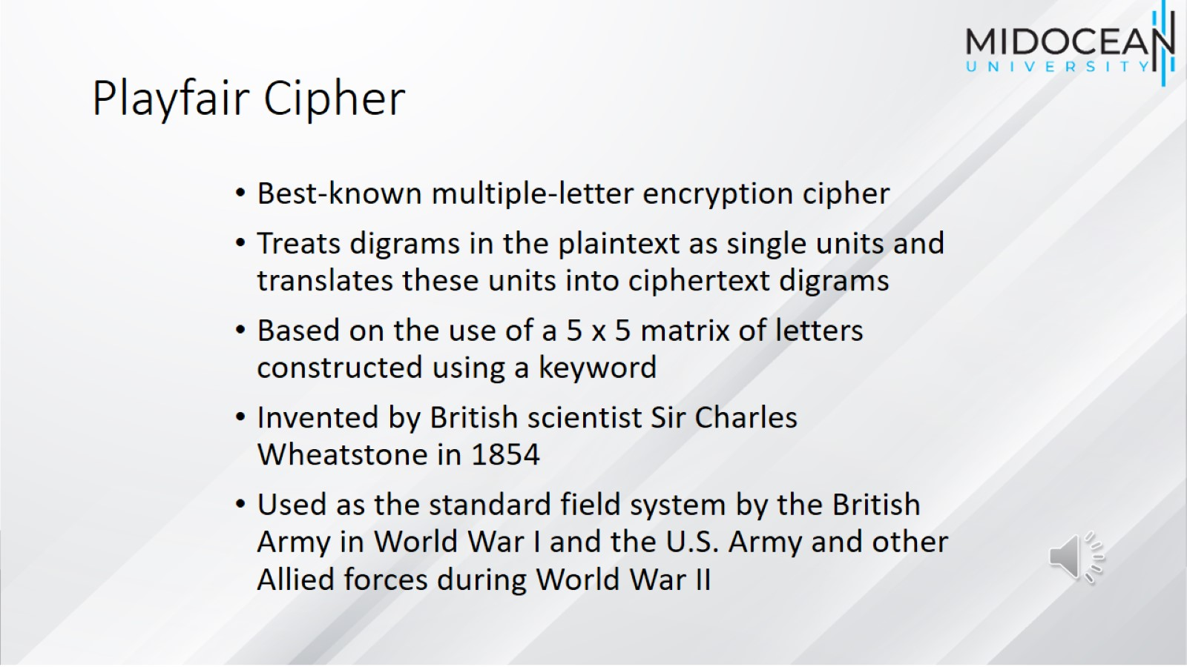
Playfair Cipher

Slide 23
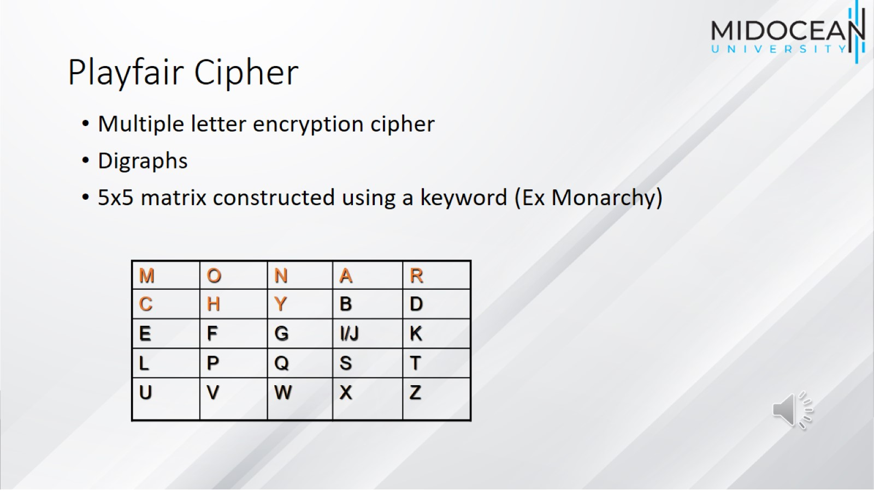
Playfair Cipher

Slide 24
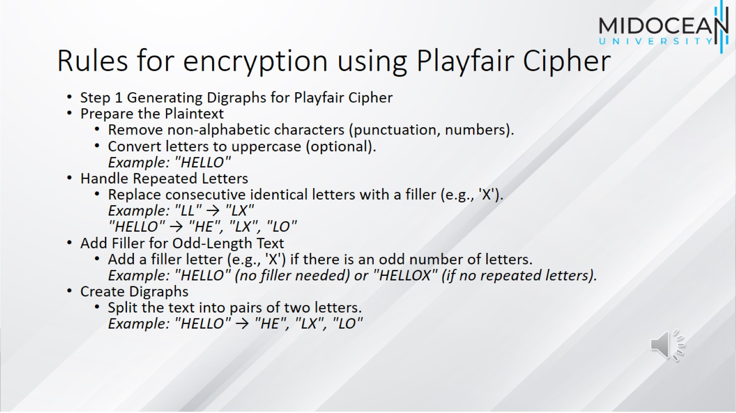
Rules for encryption using Playfair Cipher

Slide 25
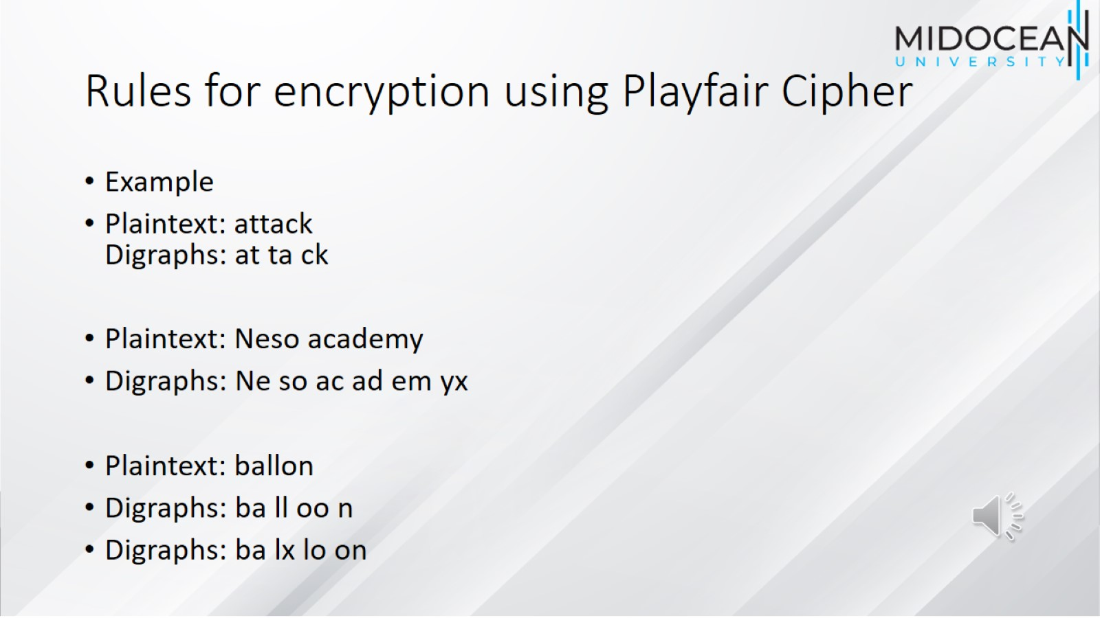
Rules for encryption using Playfair Cipher

Slide 26
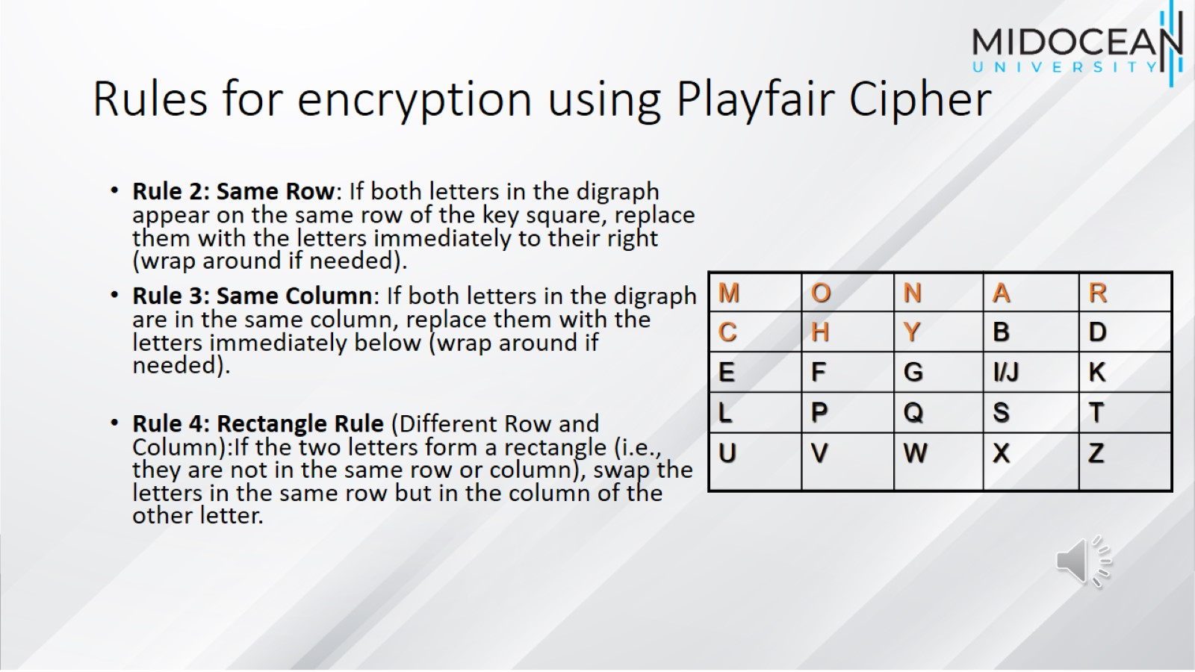
Rules for encryption using Playfair Cipher

Slide 27
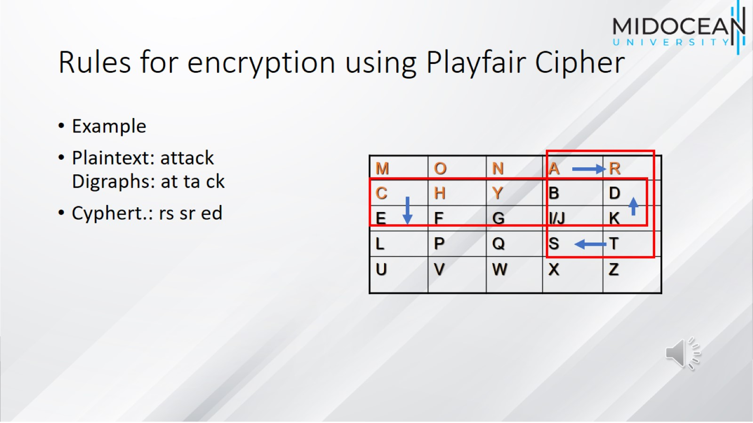
Rules for encryption using Playfair Cipher

Slide 28
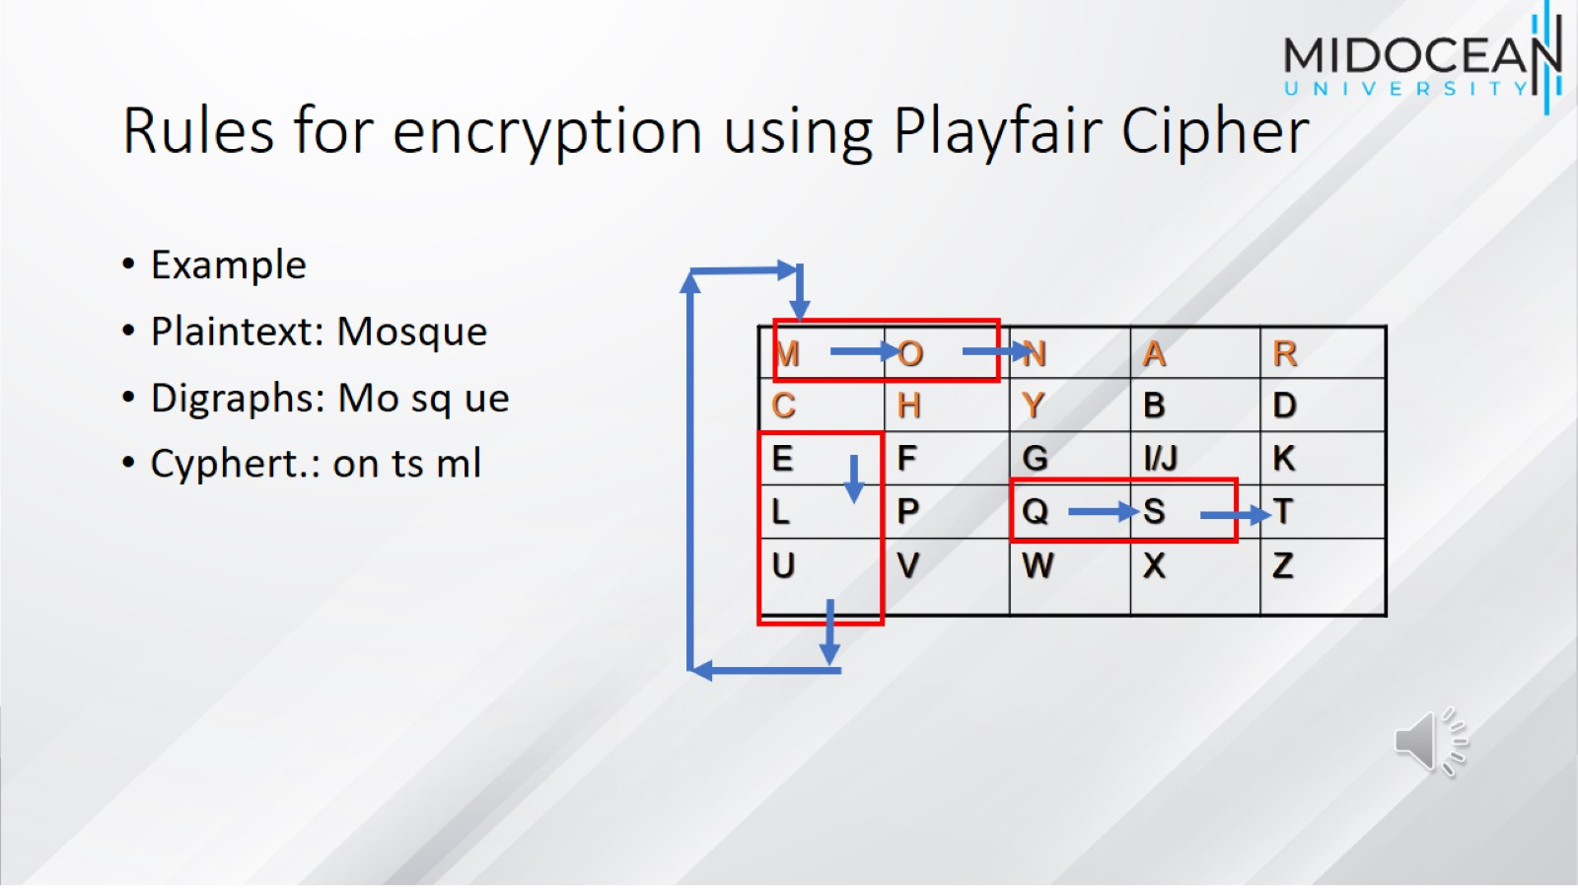
Rules for encryption using Playfair Cipher

Slide 29
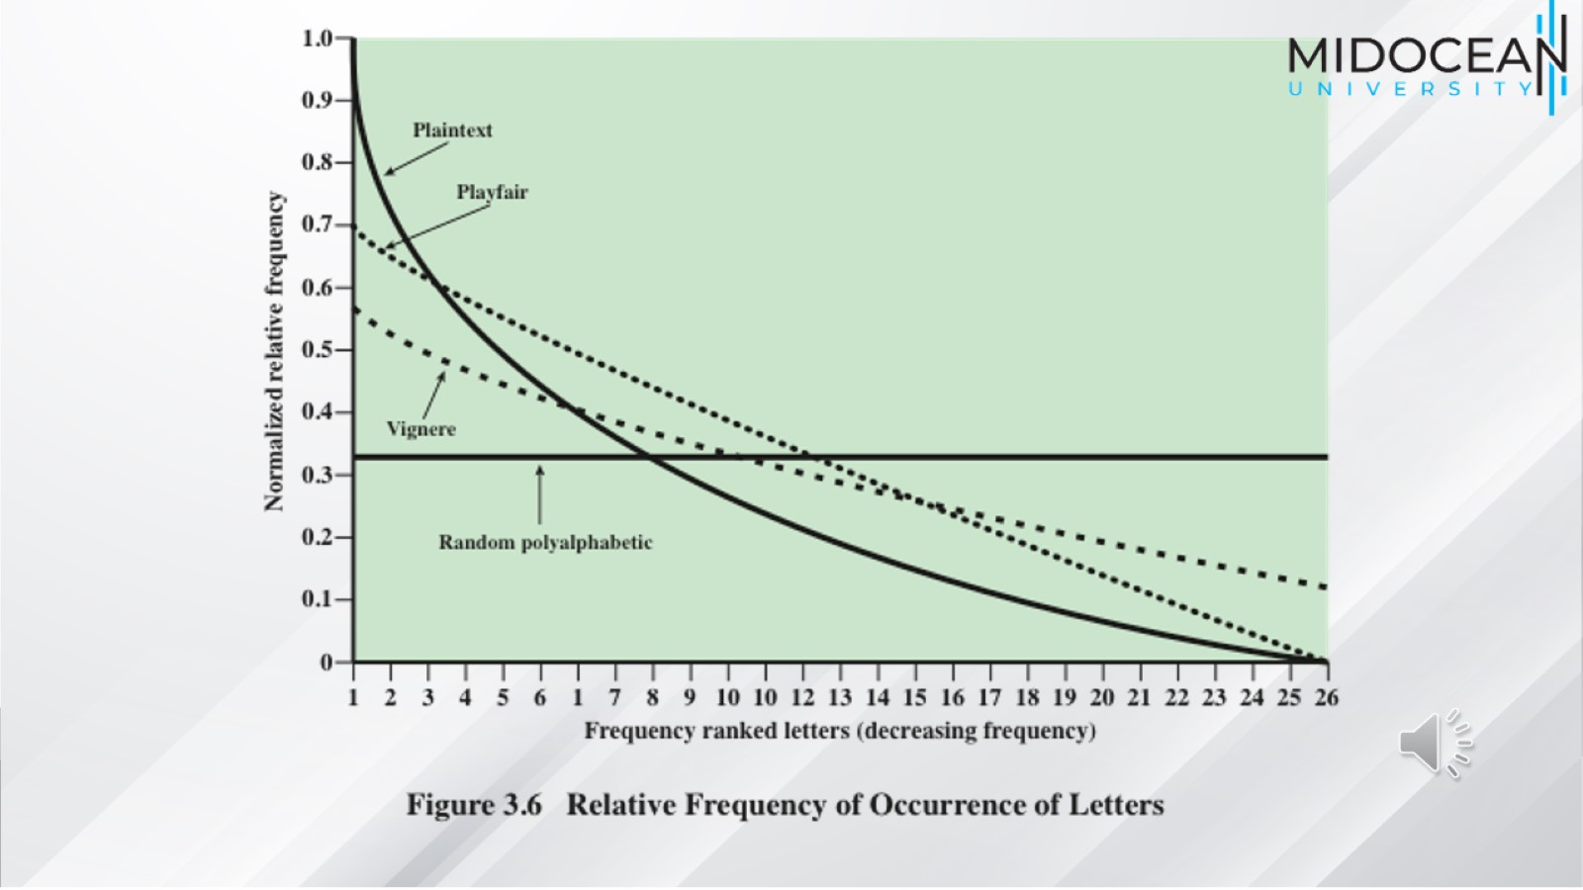

Slide 30
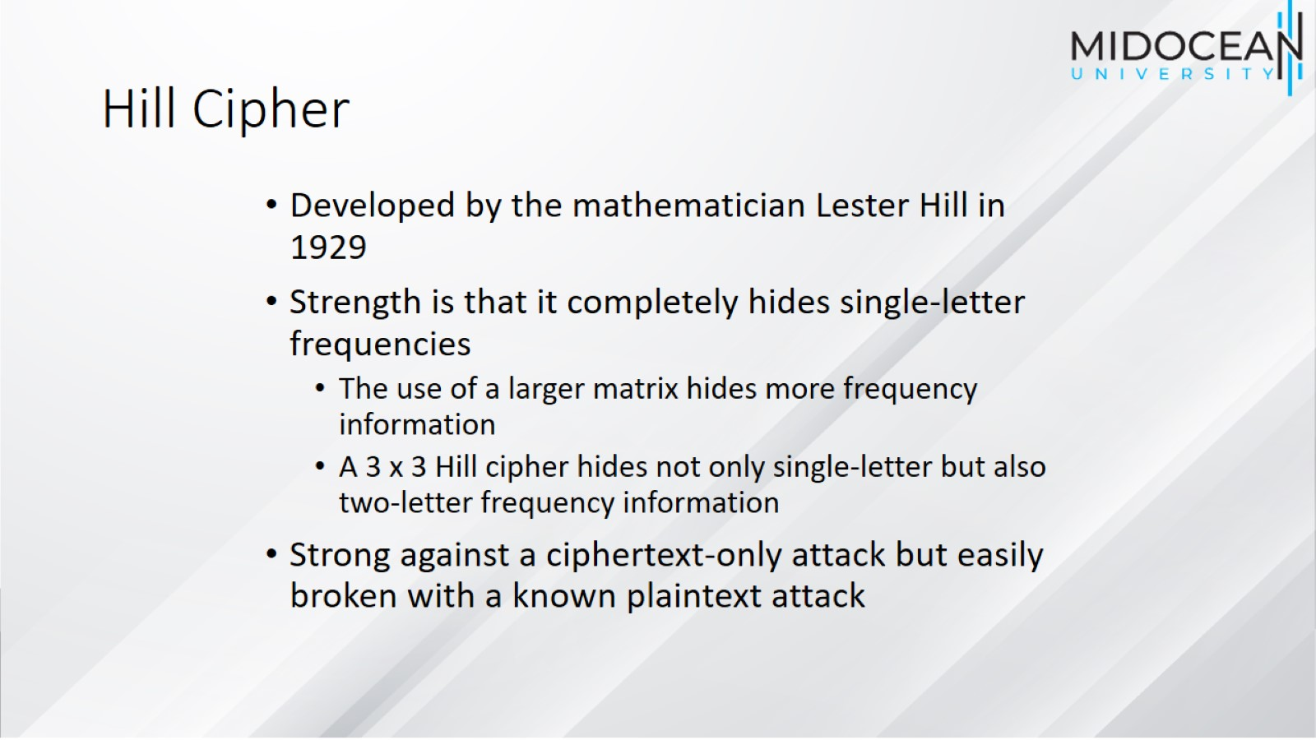
Hill Cipher

Slide 31
Hill Cipher

Slide 32
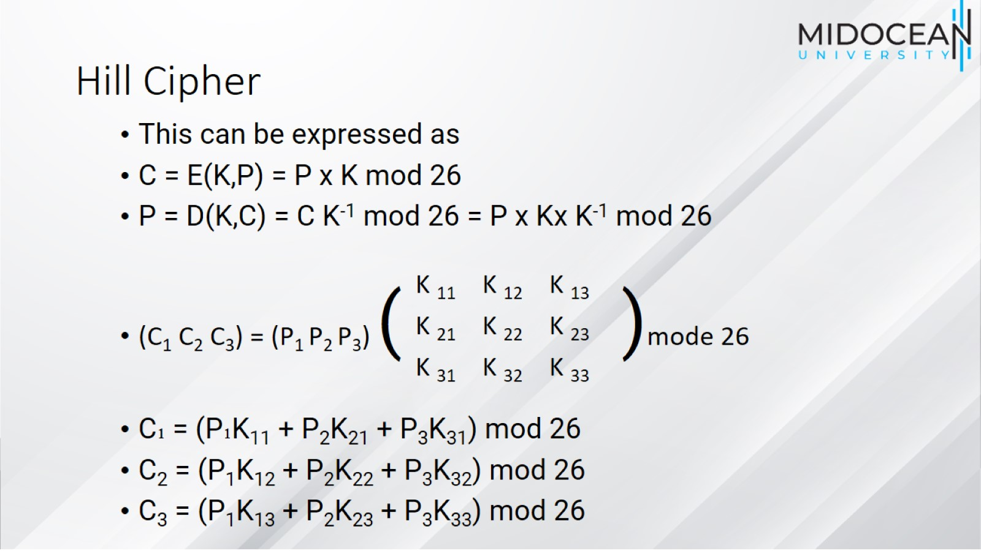
Hill Cipher

Slide 33
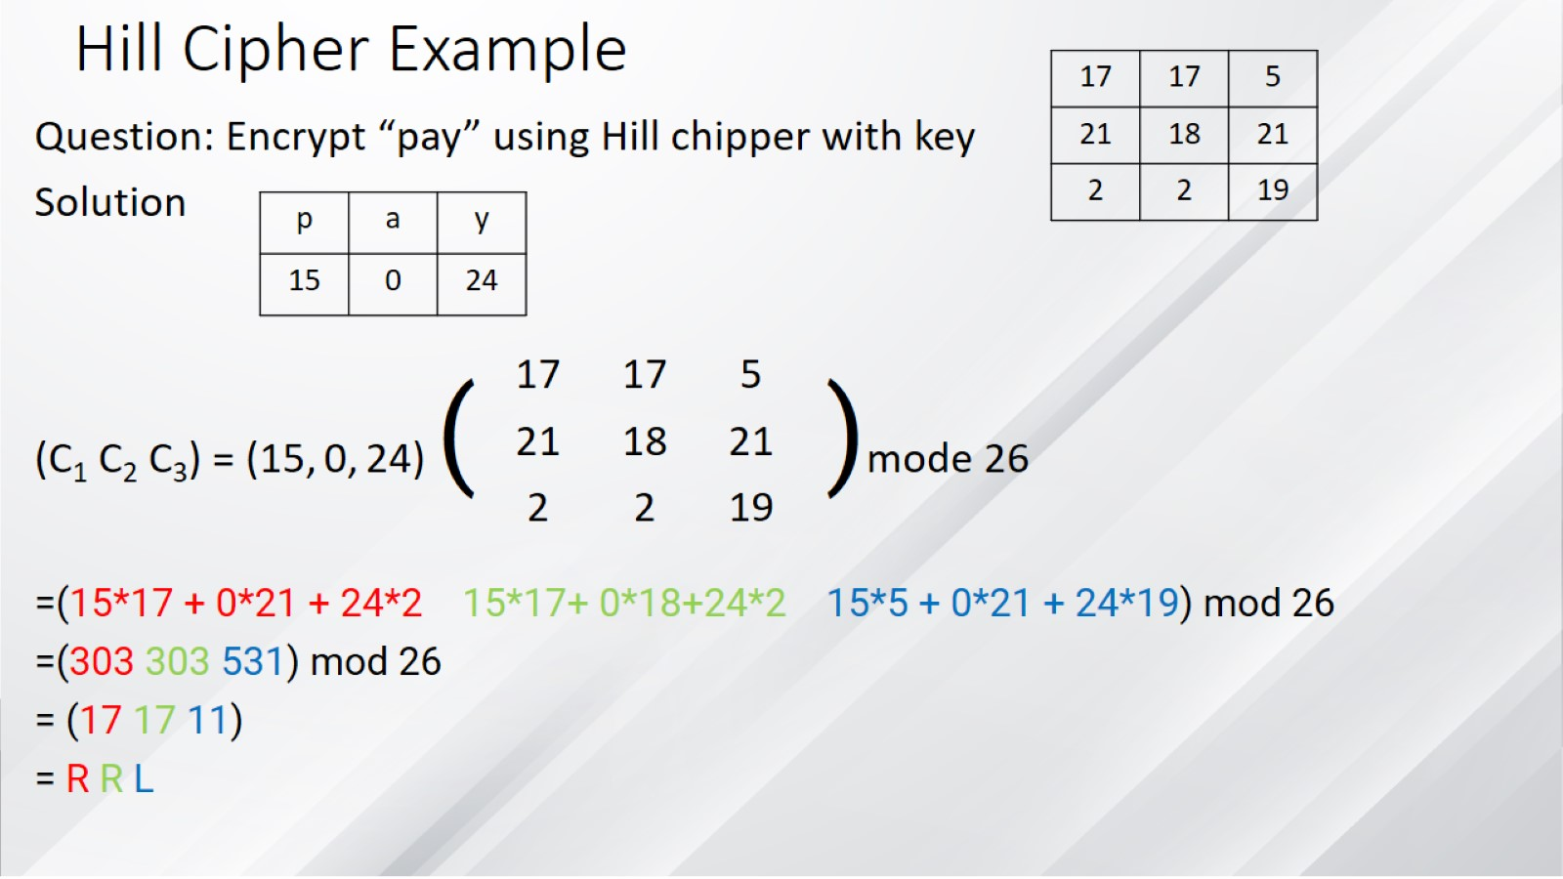
Hill Cipher Example

Slide 34
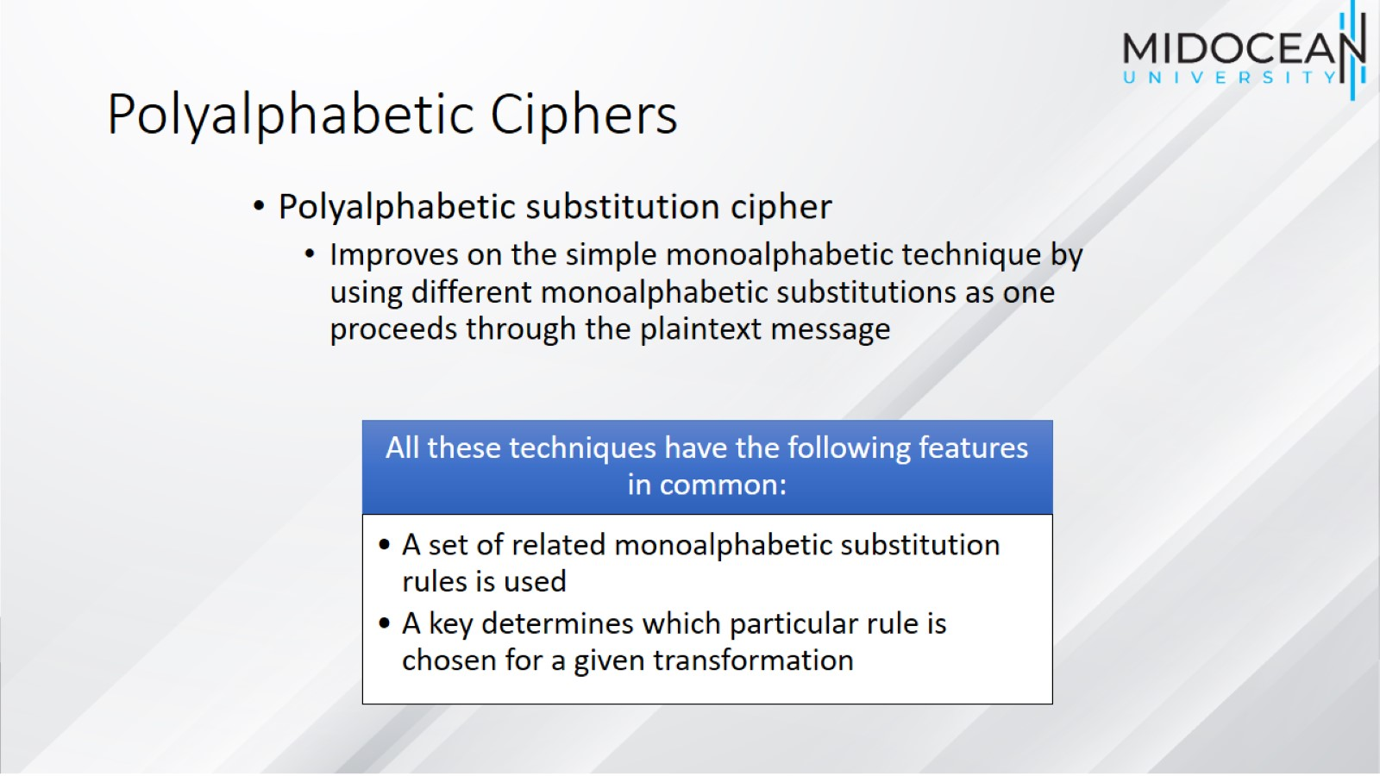
Polyalphabetic Ciphers

Slide 35
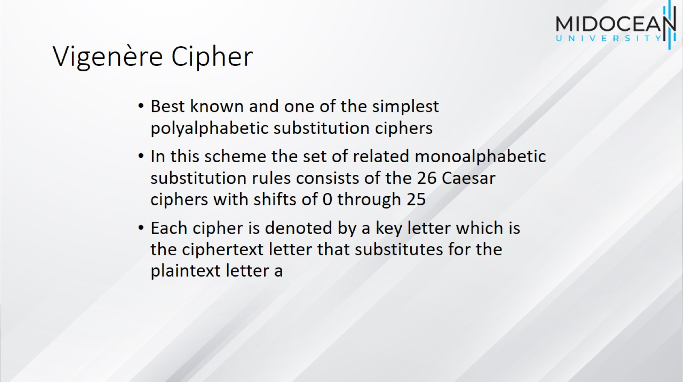
Vigenère Cipher

Slide 36
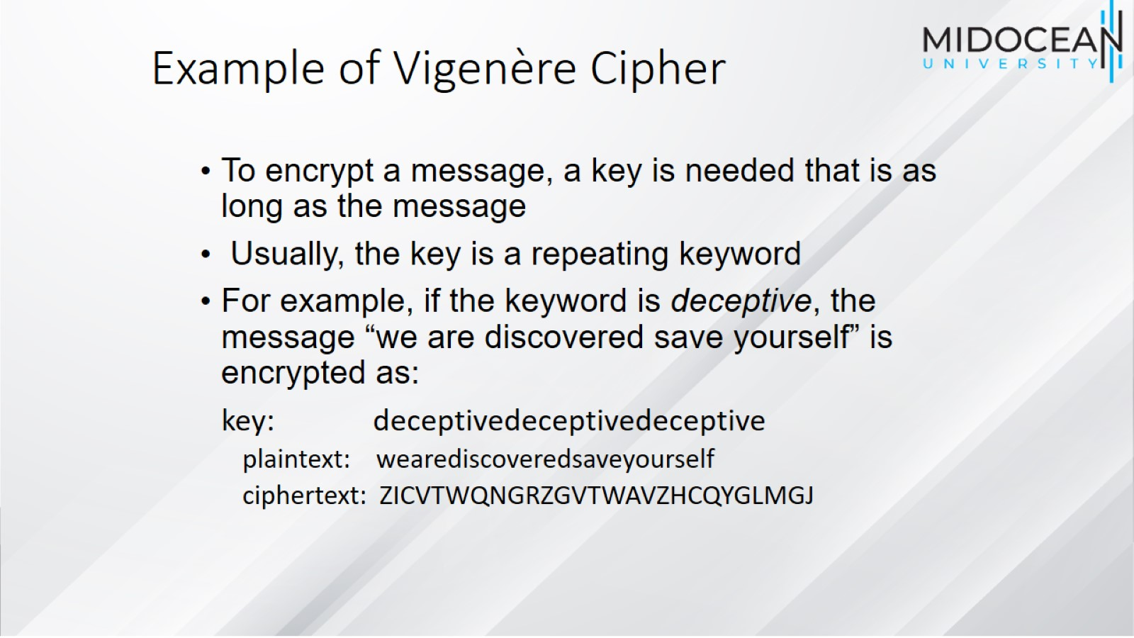
Example of Vigenère Cipher

Slide 37
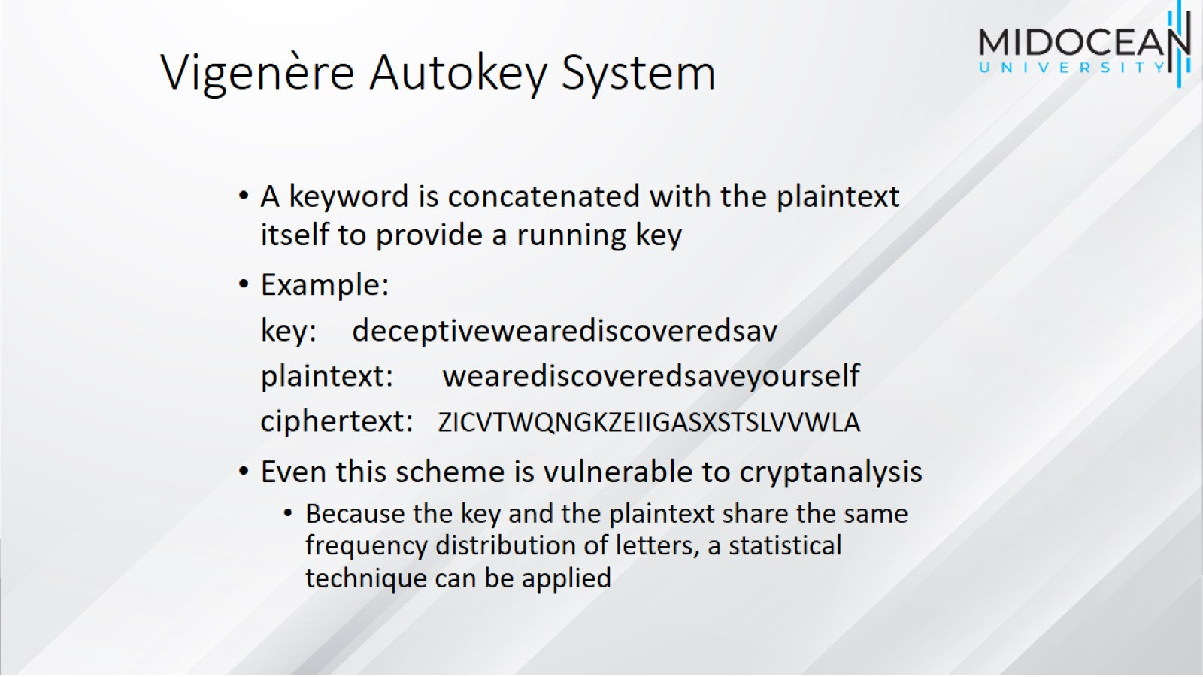
Vigenère Autokey System

Slide 38
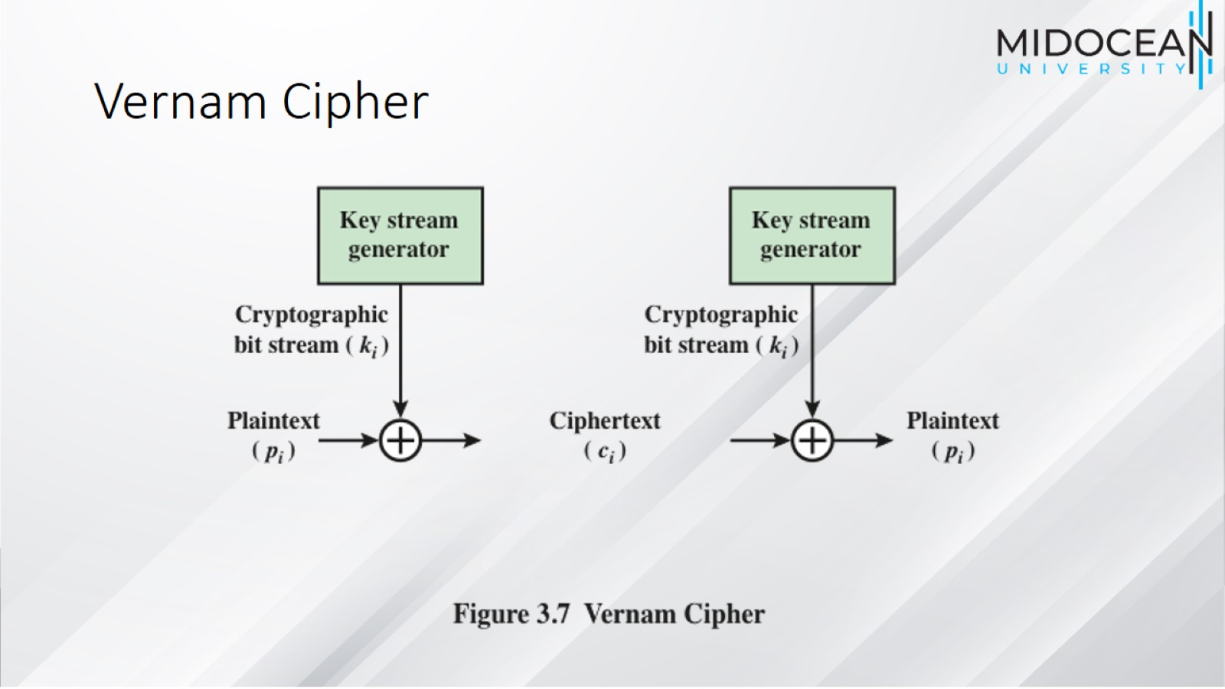
Vernam Cipher

Slide 39
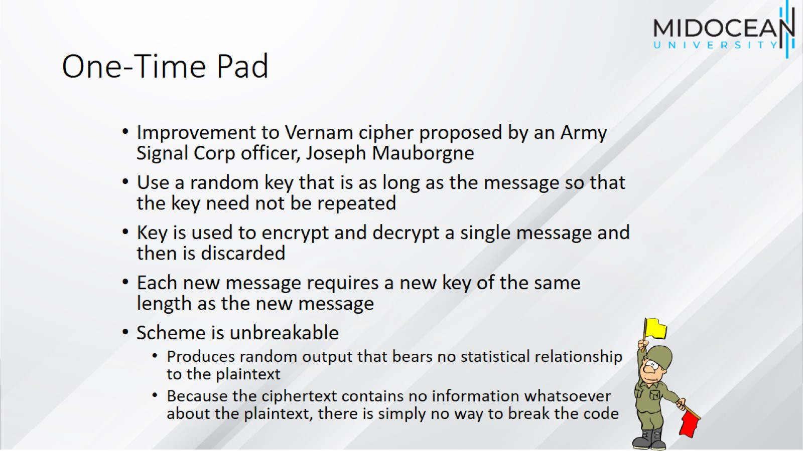
One-Time Pad

Slide 40
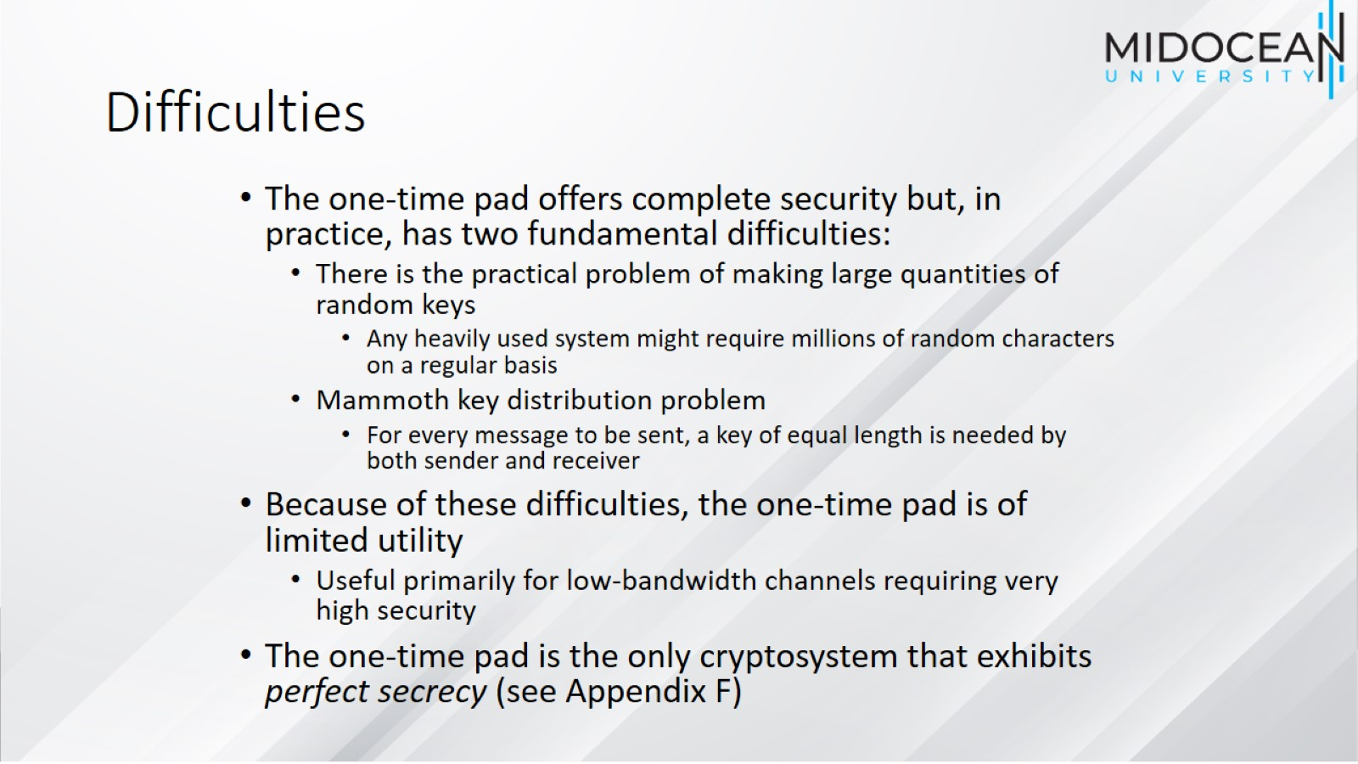
Difficulties

Slide 41
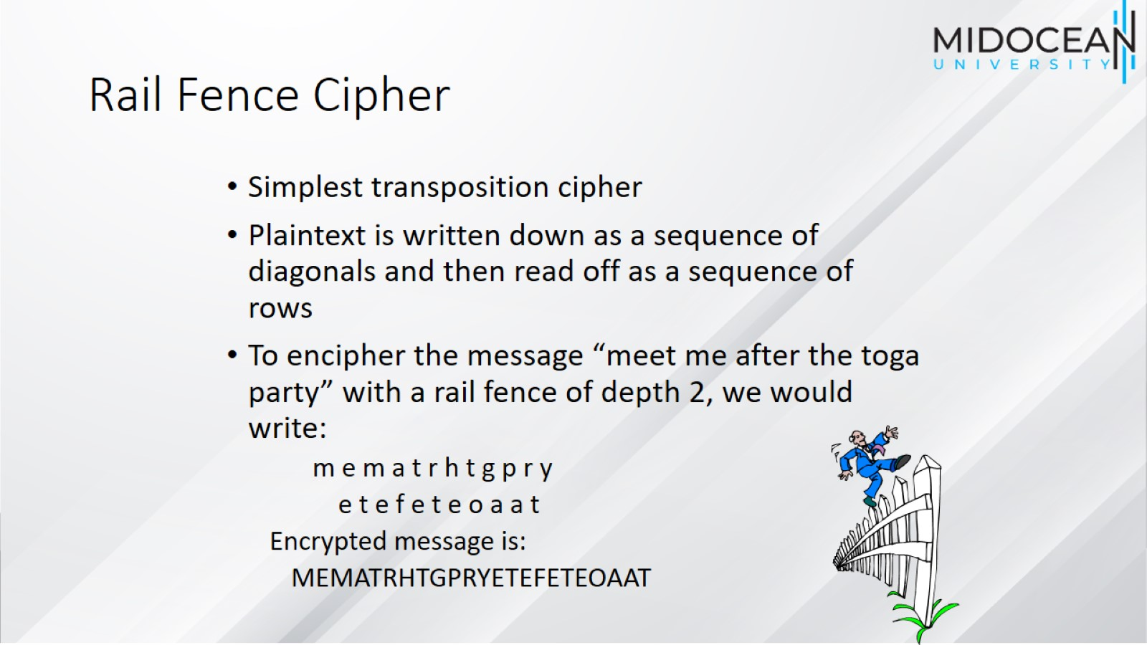
Rail Fence Cipher

Slide 42
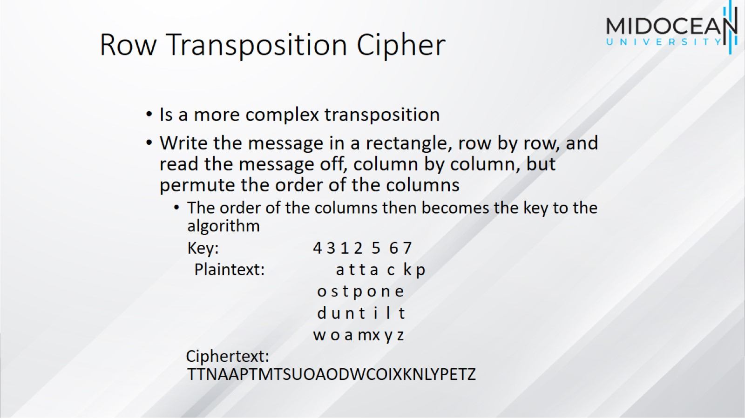
Row Transposition Cipher

Slide 43
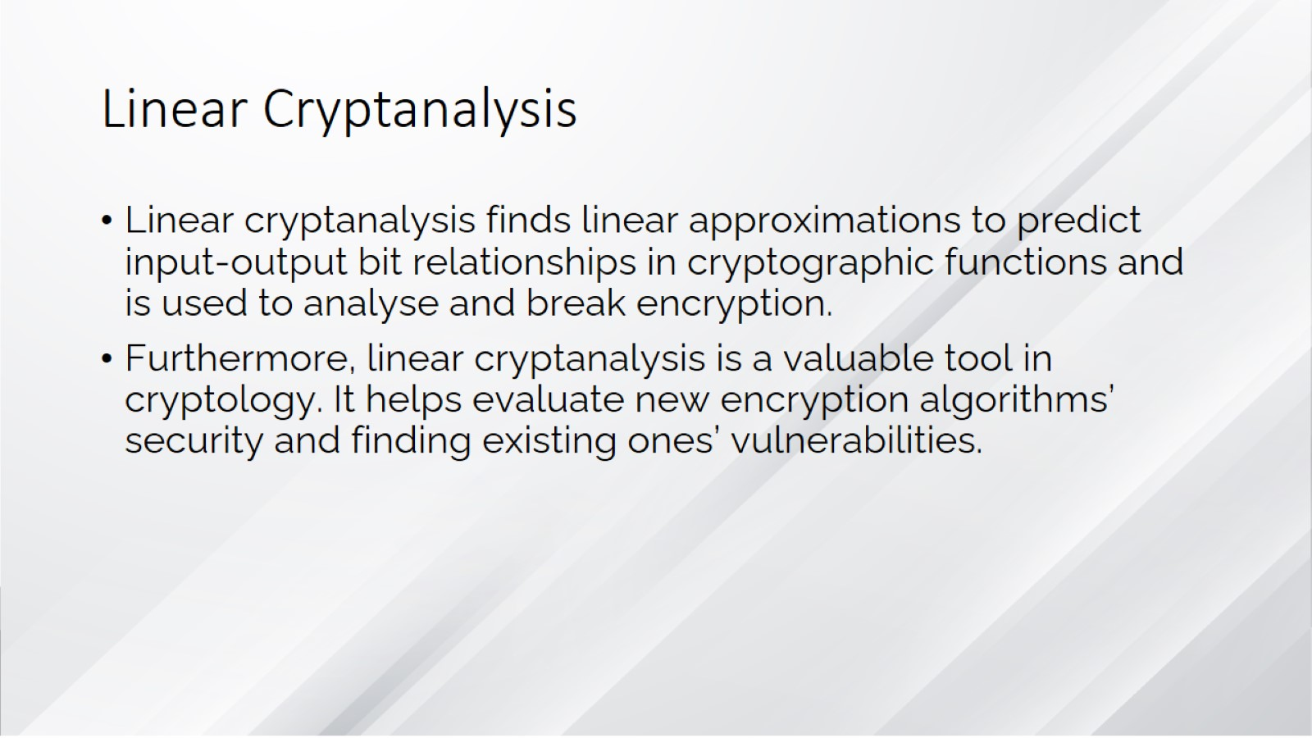
Linear Cryptanalysis

Slide 44
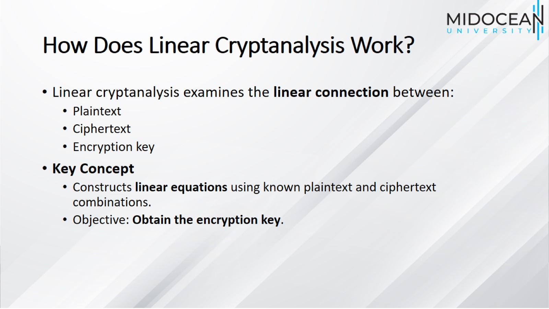
How Does Linear Cryptanalysis Work?

Slide 45
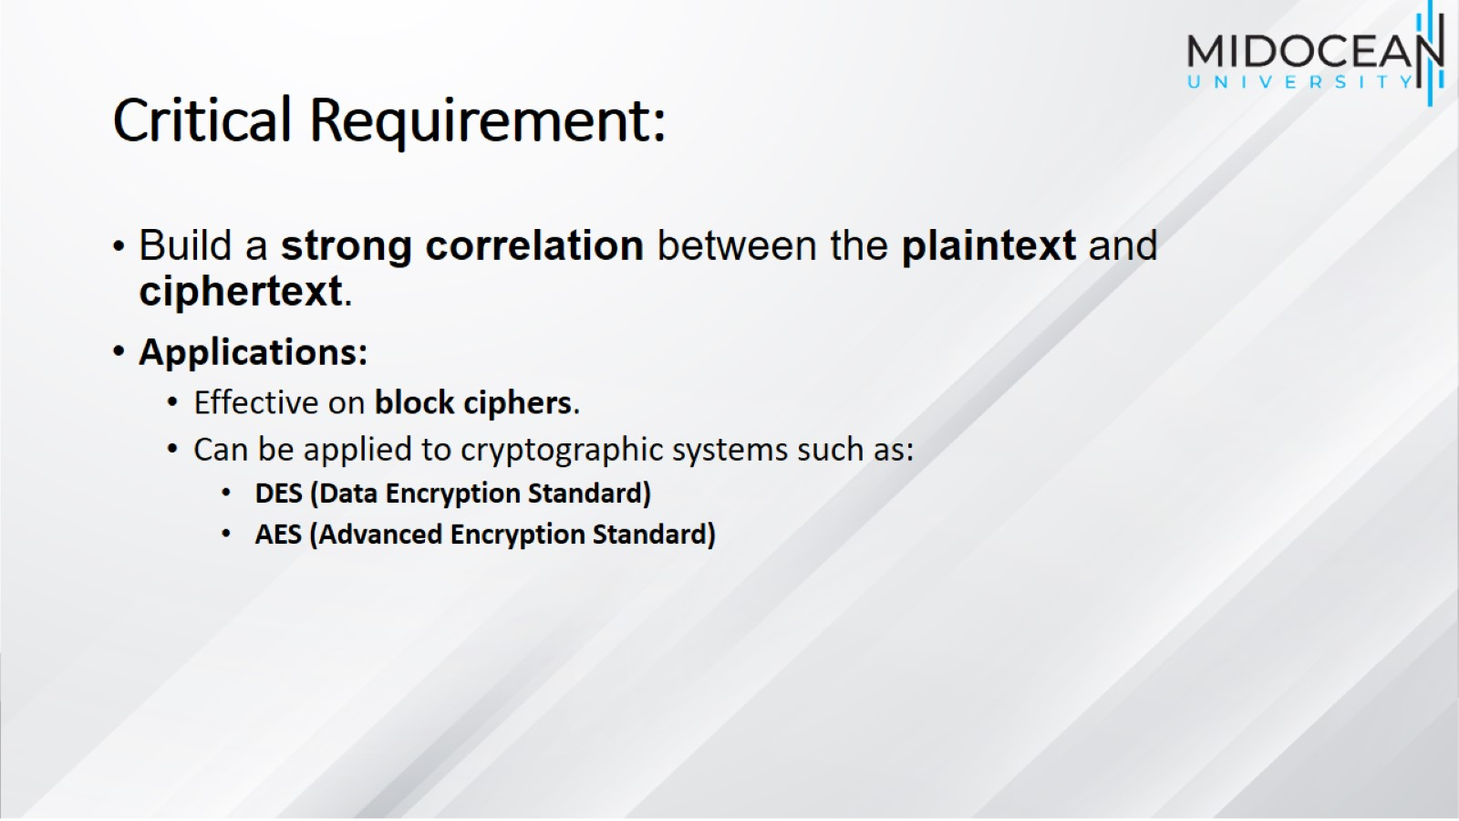
Critical Requirement:

Slide 46
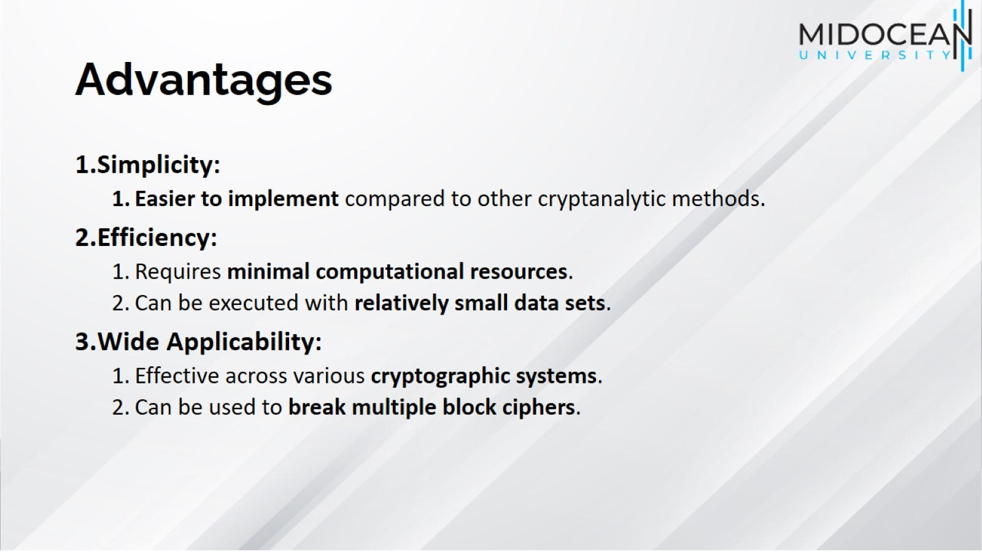
Advantages

Slide 47
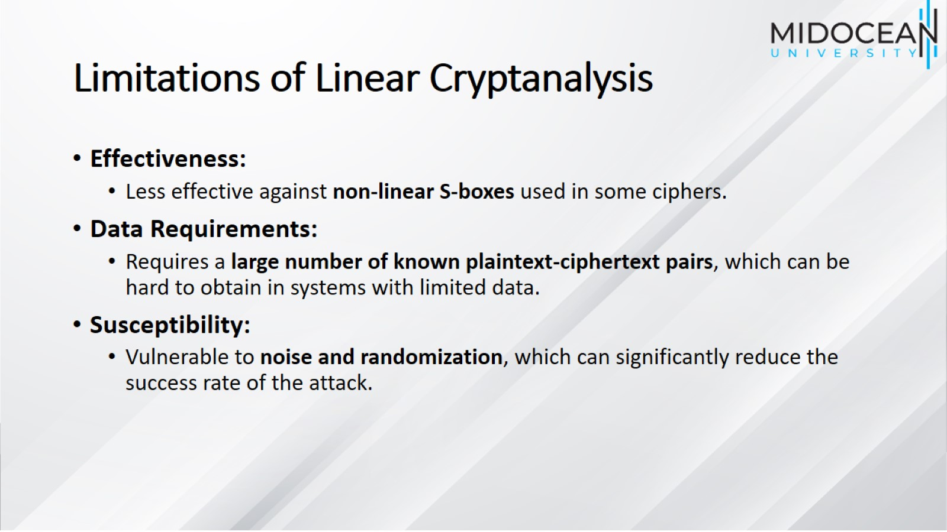
Limitations of Linear Cryptanalysis

Slide 48
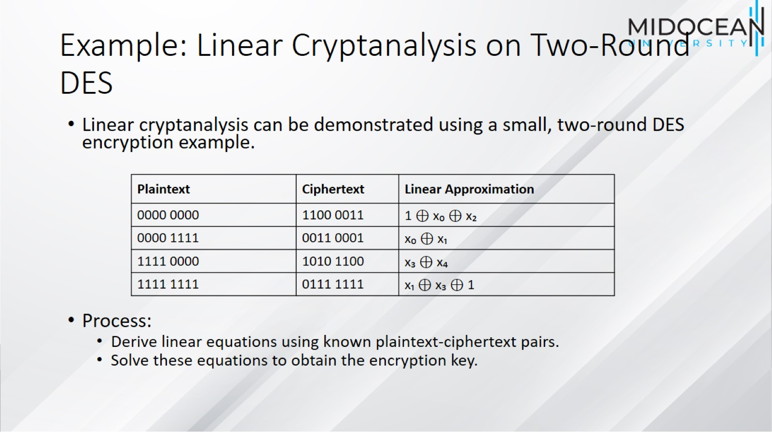
Example: Linear Cryptanalysis on Two-Round DES

Slide 49
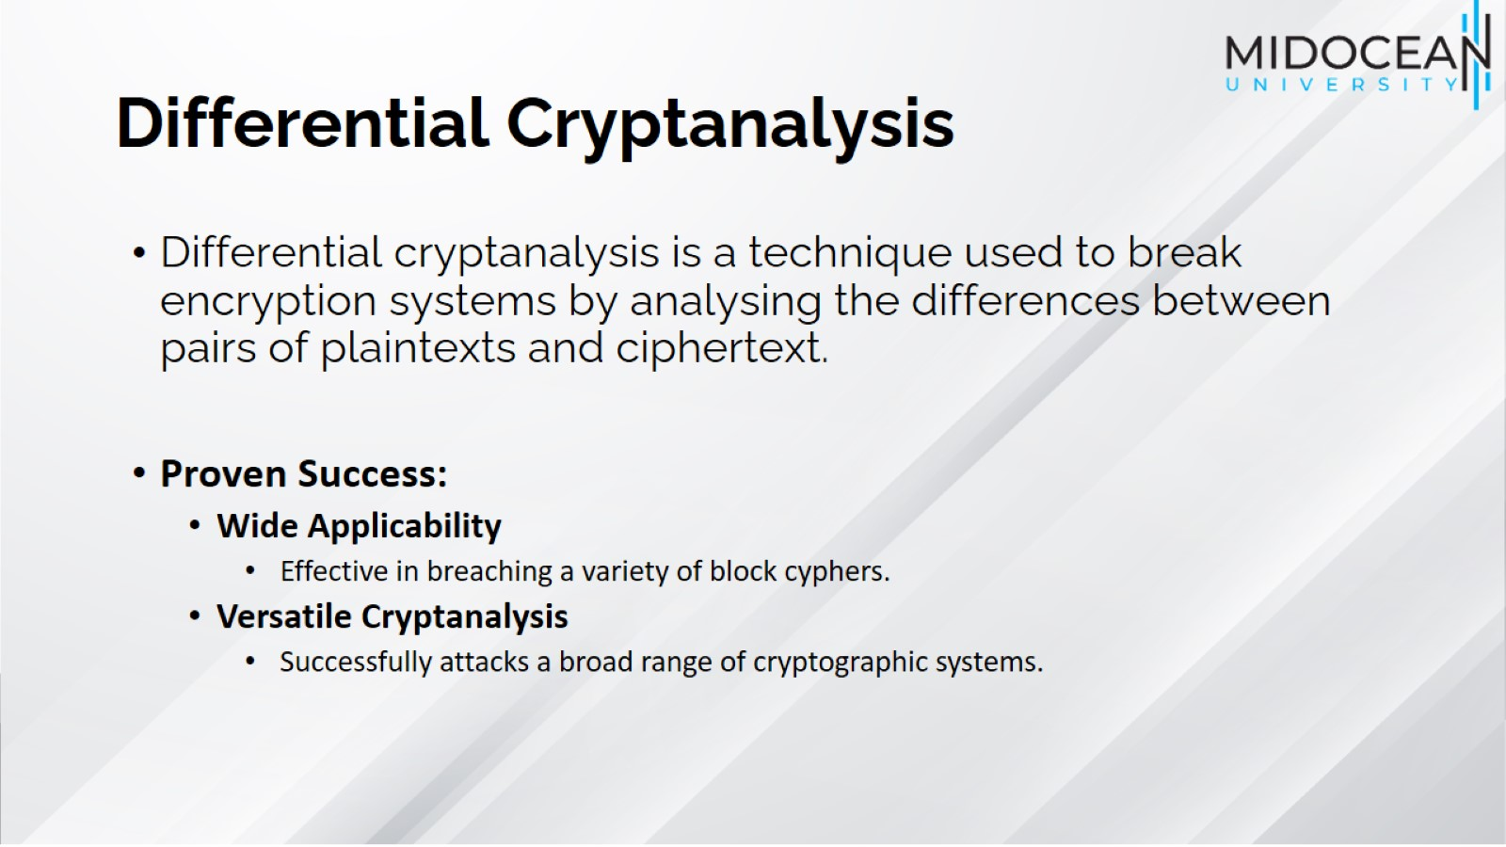
Differential Cryptanalysis

Slide 50
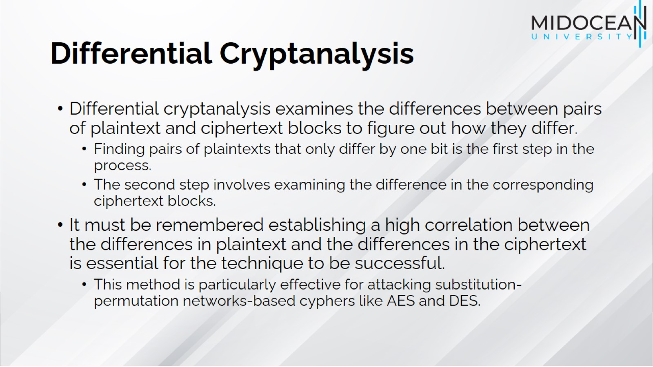
Differential Cryptanalysis

Slide 51
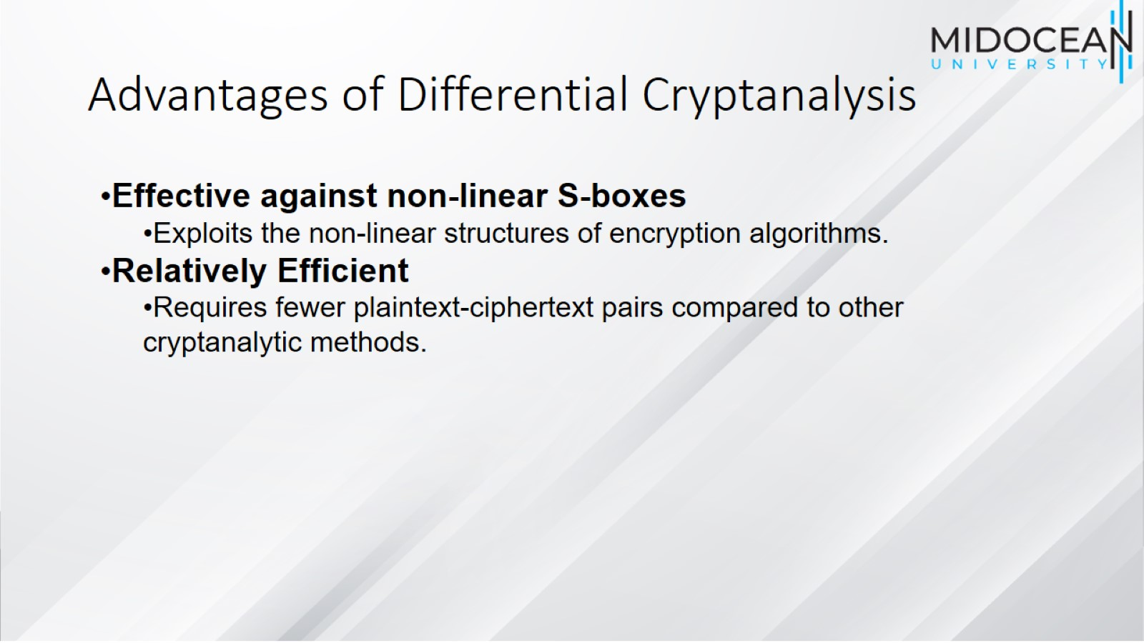
Advantages of Differential Cryptanalysis

Slide 52
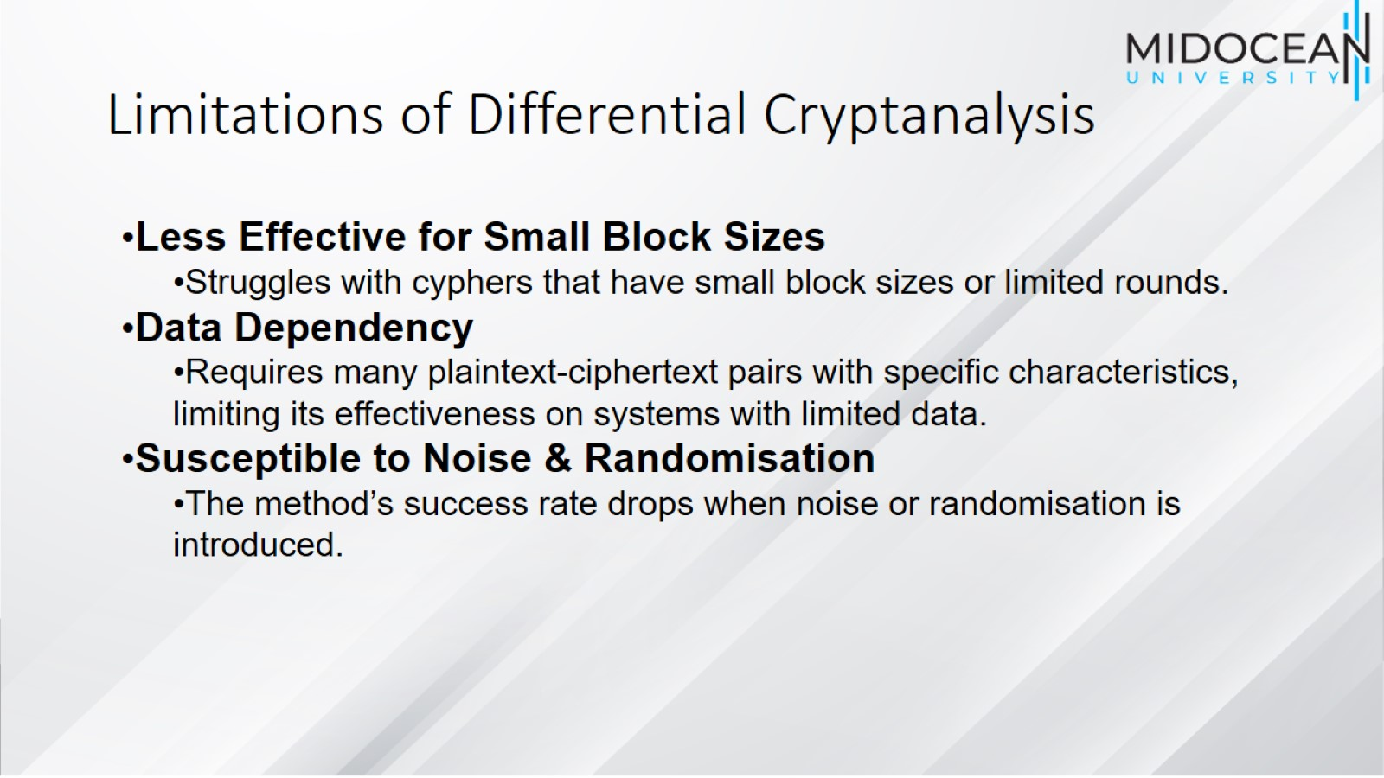
Limitations of Differential Cryptanalysis

Slide 53

Summary

Slide 54


