Slide 1


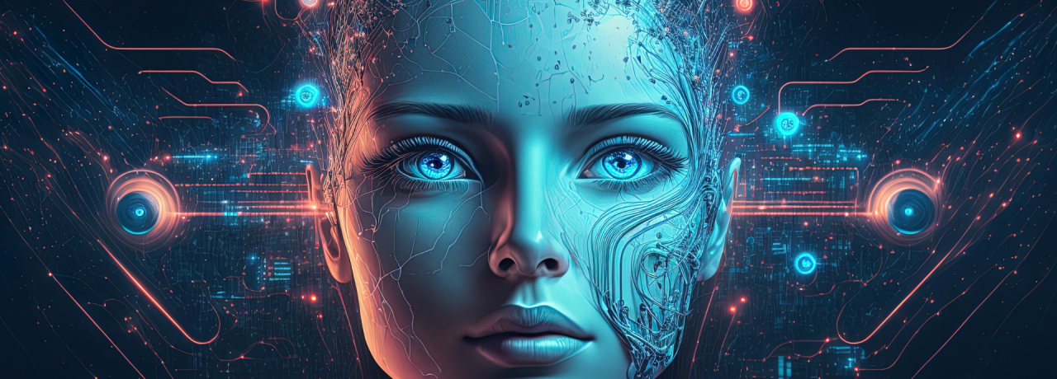

Deep Generative Models (AI314)
Master of Science in AI
Dr. Nibras Abdullah
Assistant professor
Faculty of Informatics
Midocean University
Lecture 1
www.midocean.ae

Slide 2

What Is Generative Modeling?
Generative Versus Discriminative Modeling
The Rise of Generative Modeling
Types of Generative Models
www.midocean.ae

Slide 3
What Is Generative Modeling?
Generative modeling can be broadly defined as follows:
Generative modeling is a branch of machine learning that involves training a model to produce new data that is similar to a given dataset.
www.midocean.ae

Slide 4
What Is Generative Modeling?
Figure 1-1. A generative model trained to generate realistic photos of horses
Figure 1-1. A generative model trained to generate realistic photos of horses
www.midocean.ae

Slide 5
What Is Generative Modeling?
a dataset consisting of many examples
training data
observation
Figure 1-1. A generative model trained to generate realistic photos of horses
www.midocean.ae

Slide 6
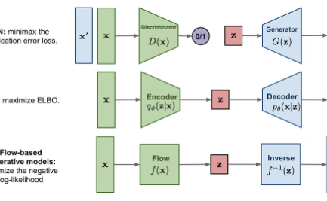
What are Generative Models?
Generating New Data
Generative models are a class of machine learning algorithms that can learn to generate new data samples that are similar to the training data, such as images, text, or audio. They aim to capture the underlying patterns and distributions in the data.
www.midocean.ae

Slide 7
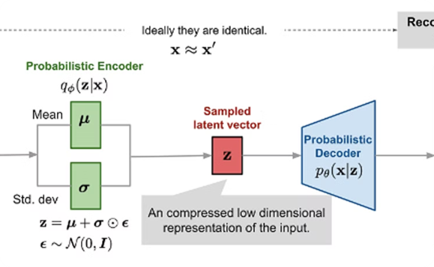
What are Generative Models?
Learning Latent Representations
These models learn a latent, or hidden, representation of the input data, which can then be used to generate new samples. This allows them to capture the essential features and structure of the data in a compact form.
www.midocean.ae

Slide 8
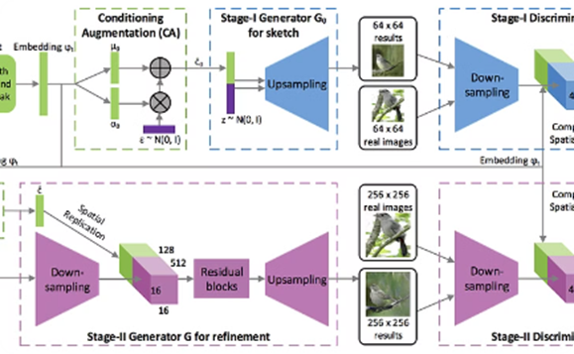
What are Generative Models?
Adversarial Training
Generative models like Generative Adversarial Networks (GANs) employ an adversarial training process, where a generator model competes with a discriminator model to produce increasingly realistic samples.
www.midocean.ae

Slide 9
What are Generative Models?
A generative model must also be probabilistic rather than deterministic, because we want to be able to sample many different variations of the output, rather than get the same output every time.
If our model is merely a fixed calculation, such as taking the average value of each pixel in the training dataset,
it is not generative.
www.midocean.ae

Slide 10
Generative Versus Discriminative Modeling
  In order to truly understand what generative modeling aims to achieve and why this is important, it is useful to compare it to its counterpart, discriminative modeling.
www.midocean.ae

Slide 11
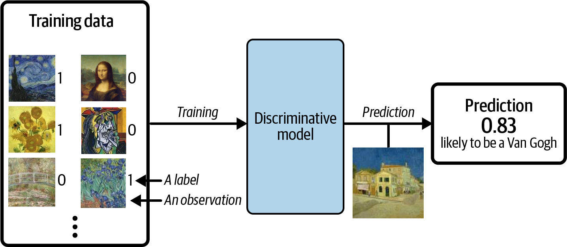
Generative Versus Discriminative Modeling
Figure 1-2. A discriminative model trained to predict if a given image is painted by
Van Gogh
Figure 1-2. A discriminative model trained to predict if a given image is painted by Van Gogh
www.midocean.ae

Slide 12
Generative Versus Discriminative Modeling
For a binary classification problem
For a binary classification problem:
Van Gogh paintings would be labeled 1
Non–Van Gogh paintings labeled 0
Figure 1-2. A discriminative model trained to predict if a given image is painted by Van Gogh
www.midocean.ae

Slide 13
Generative Versus Discriminative Modeling
For a binary classification problem
Generative modeling doesn’t require the dataset to be labeled because it concerns itself with generating entirely new images, rather than trying to predict a label of a given image.
www.midocean.ae

Slide 14
Generative Versus Discriminative Modeling
For a binary classification problem
Let’s define these types of modeling formally, using mathematical notation:
www.midocean.ae

Slide 15
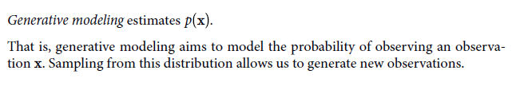
Generative Versus Discriminative Modeling
For a binary classification problem
Let’s define these types of modeling formally, using mathematical notation:
www.midocean.ae

Slide 16
Generative Versus Discriminative Modeling
For a binary classification problem
Let’s define these types of modeling formally, using mathematical notation:
www.midocean.ae

Slide 17

The Rise of Generative Modeling
The Rise of Generative Modeling
www.midocean.ae

Slide 18
The Rise of Generative Modeling
Figure 1-3. Face generation using generative modeling has improved significantly over
the last decade (adapted from Brundage et al., 2018)1
www.midocean.ae

Slide 19
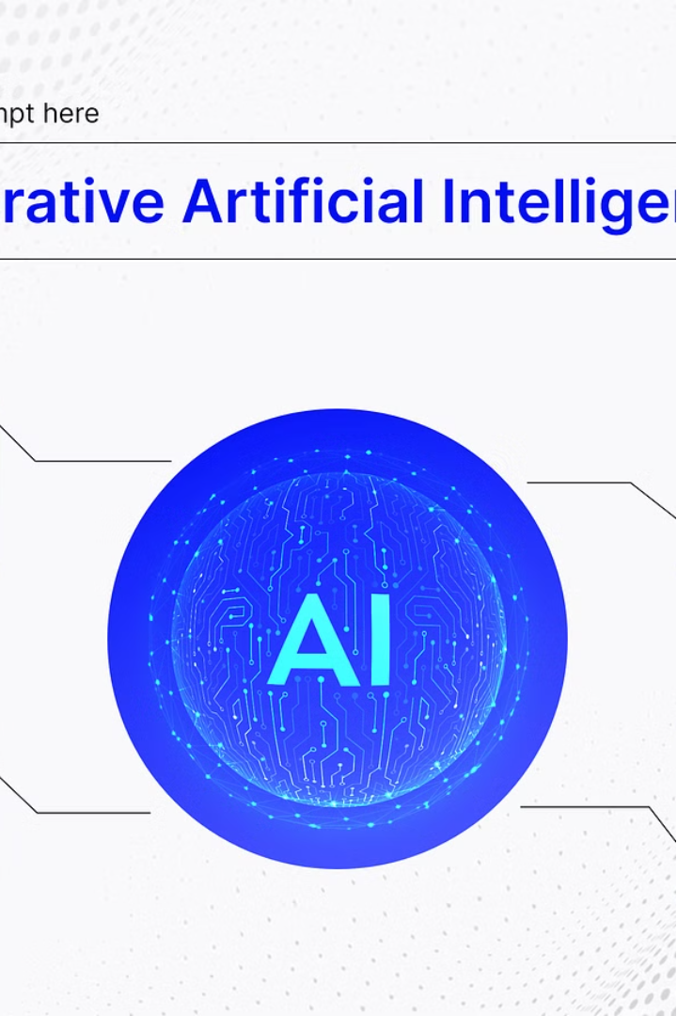
Generative Modeling: The Key to Unlocking Advanced AI
Generative modeling represents a significant advancement in the field of artificial intelligence, offering the potential to drive progress in various domains. This powerful technique goes beyond the limitations of traditional discriminative modeling, providing a more complete understanding of data distributions and paving the way for more sophisticated AI systems.

Slide 20
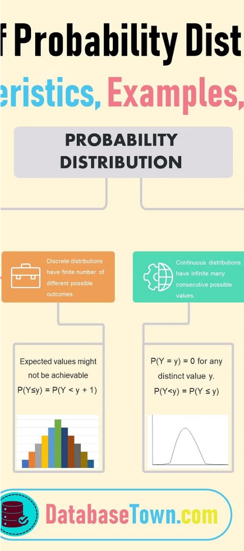
Theoretical Foundations of Generative Modeling
1
Capturing the Full Picture
Generative modeling is not simply about categorizing data; it aims to understand the underlying distribution of the data, going beyond the constraints of specific labels or classes.

Slide 21
Theoretical Foundations of Generative Modeling
Comprehensive Understanding
2
By training models to capture the complete data distribution, we can gain a more thorough understanding of the data, leading to more robust and adaptable AI systems.

Slide 22
Theoretical Foundations of Generative Modeling
3
Unlocking New Possibilities
This comprehensive understanding of the data distribution opens the door to a wide range of applications and advancements in the field of artificial intelligence.

Slide 23
Advancing AI with Generative Modeling
Reinforcement Learning
Generative modeling is now being used to drive progress in other areas of AI, such as reinforcement learning. By capturing the underlying distribution of data, generative models can be used to simulate and train agents in complex environments, improving their ability to optimize for a given goal.

Slide 24
Advancing AI with Generative Modeling
Robotic Control
For example, in the case of training a robot to walk across a given terrain, generative modeling can be used to create realistic simulations of the environment, allowing the robot to test and refine its strategies before deployment in the real world.

Slide 25
Advancing AI with Generative Modeling
Expanding AI Capabilities
By combining generative modeling with other AI techniques, such as reinforcement learning, we can develop more powerful and adaptable systems that can tackle a wide range of problems, pushing the boundaries of what is possible in the field of artificial intelligence.

Slide 26
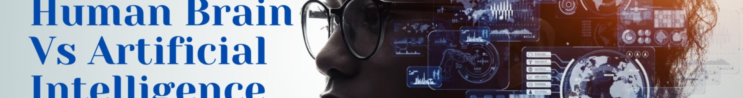
Generative Modeling and Human-level Intelligence
Capturing Complexity
To truly achieve a level of artificial intelligence comparable to a human's, we must move beyond the limitations of discriminative modeling and embrace the power of generative modeling. This approach allows us to capture the inherent complexity and nuances of the world around us.
1
2
3

Slide 27
Generative Modeling and Human-level Intelligence
Emulating Human Cognition
By training models to understand the underlying structure and distribution of data, we can begin to emulate the way humans perceive and make sense of the world, paving the way for AI systems that can truly think, reason, and problem-solve in a more human-like manner.
1
2
3

Slide 28
Generative Modeling and Human-level Intelligence
Towards Artificial General Intelligence
The integration of generative modeling into the development of artificial intelligence is a crucial step towards achieving a level of artificial general intelligence (AGI) that can rival and potentially surpass human capabilities in a wide range of tasks and domains.
1
2
3

Slide 29
Our First Generative Model
For a binary classification problem
Hello World!
www.midocean.ae
Notes:
With this in mind, let’s begin our journey into the exciting world of generative modeling.
To begin with, we’ll look at a toy example of a generative model and introduce
some of the ideas that will help us to work through the more complex architectures
that we will encounter later in the book.

Slide 30
Our First Generative Model
For a binary classification problem
Hello World!
Figure 1-4. A set of points in two dimensions, generated by an unknown rule pdata
www.midocean.ae

Slide 31
Types of Generative Models
Variational Autoencoders (VAEs)
Generative Adversarial Networks (GANs)
Autoregressive Models
Diffusion Models
Diffusion models learn to reverse a noising process, starting from pure noise and gradually removing it to produce new, realistic samples. They have shown impressive results in image and audio generation.
Autoregressive models, like Transformers and Recurrent Neural Networks, generate new data one element at a time, using the previously generated elements to predict the next.
VAEs are a type of deep generative model that learn a low-dimensional latent representation of input data. They can generate new samples by sampling from the learned latent space.
GANs pit two neural networks - a generator and a discriminator - against each other in a game-like framework, leading to the generation of highly realistic synthetic data.

Slide 32


Variational Autoencoders (VAEs)
Variational Autoencoders (VAEs) are a type of generative model that use neural networks to learn a compressed, probabilistic representation of the input data. VAEs can generate new, realistic-looking samples by sampling from this learned latent space.
VAEs work by training an encoder network to map the input data to a compact latent representation, and a decoder network to reconstruct the original input from the latent code. The latent space is structured to follow a standard normal distribution, allowing for smooth interpolation and generation of new samples.

Slide 33
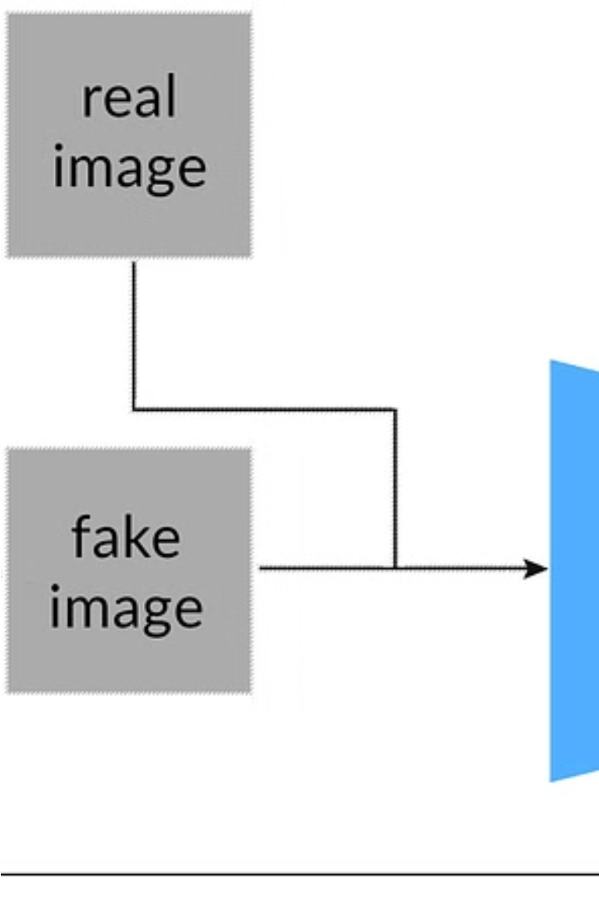
Generative Adversarial Networks (GANs)
GANs are a powerful class of generative models that pit two neural networks against each other in a competitive game. One network, the generator, learns to create realistic samples, while the other network, the discriminator, learns to distinguish real samples from the generator's output.
The interplay between the generator and discriminator networks allows GANs to generate highly realistic and diverse samples, making them particularly useful for tasks such as image and text generation.

Slide 34
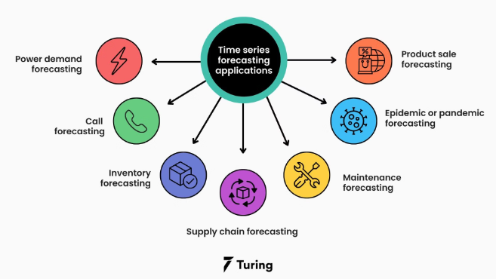
Autoregressive Models
Autoregressive models are a type of generative model that generate new data by predicting the next element in a sequence, based on the previous elements. These models learn the underlying statistical patterns in the training data and use them to generate plausible new samples.
Autoregressive models, such as Recurrent Neural Networks (RNNs) and Transformers, have been widely used for tasks like language modeling, speech recognition, and time series forecasting.

Slide 35

Applications of Generative Models
Healthcare
Generative models have enabled the synthesis of realistic medical images, assisting in diagnosis, treatment planning, and clinical decision-making.

Slide 36

Applications of Generative Models
Art & Design
Generative models can be used to create unique and visually stunning artwork, fashion designs, and other creative outputs.

Slide 37

Applications of Generative Models
Natural Language
Generative models excel at tasks such as text generation, language translation, and dialogue systems, revolutionizing natural language processing.

Slide 38
Challenges and Limitations
Data Availability
Generative models often require large, high-quality datasets for effective training. Limited data can hinder their performance and versatility.

Slide 39
Challenges and Limitations
Data Availability
Model Complexity
Generative models often require large, high-quality datasets for effective training. Limited data can hinder their performance and versatility.
The intricate architectures of some generative models can make them computationally intensive and challenging to train and deploy efficiently.

Slide 40
Challenges and Limitations
Data Availability
Model Complexity
Generative models often require large, high-quality datasets for effective training. Limited data can hinder their performance and versatility.
The intricate architectures of some generative models can make them computationally intensive and challenging to train and deploy efficiently.
Mode Collapse
GANs in particular can suffer from mode collapse, where the generator learns to produce limited, repetitive outputs instead of diverse samples.

Slide 41
Challenges and Limitations
Data Availability
Model Complexity
Generative models often require large, high-quality datasets for effective training. Limited data can hinder their performance and versatility.
The intricate architectures of some generative models can make them computationally intensive and challenging to train and deploy efficiently.
Mode Collapse
Lack of Control
GANs in particular can suffer from mode collapse, where the generator learns to produce limited, repetitive outputs instead of diverse samples.
Generating high-fidelity, controllable outputs remains an active area of research, as users often desire more fine-grained control over the generative process.

Slide 42
Thank You

