Slide 1

PMG 506
Advanced Project Management
Review: LECTURES 01, 02 & 03
Everyone’s Smart
University
Eng. Dr. Akram Mustafa Suliman Ali,
PhD. AU, MSc. AAST, CEng CMarEng MIMarEST, PE, PMP®,
ASQ CSSBB, ISO Lead Auditor, NDT Level II,

Slide 2
Lecture 01 Review
Introduction to APM and Initial Project Strategy

Slide 3
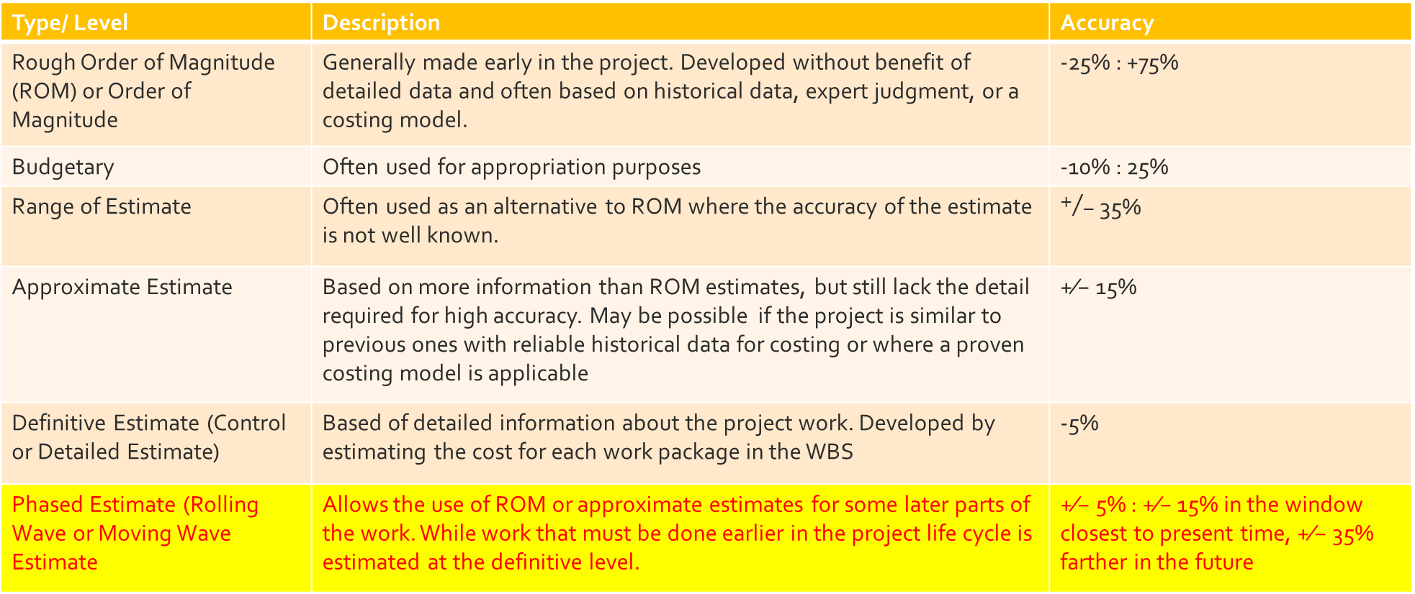
Types of Cost Estimates
Type/ Level | Description | Accuracy
Rough Order of Magnitude (ROM) or Order of Magnitude | Generally made early in the project. Developed without benefit of detailed data and often based on historical data, expert judgment, or a costing model. | -25% : +75%
Budgetary | Often used for appropriation purposes | -10% : 25%
Range of Estimate | Often used as an alternative to ROM where the accuracy of the estimate is not well known. | $+/−$ 35%
Approximate Estimate | Based on more information than ROM estimates, but still lack the detail required for high accuracy. May be possible if the project is similar to previous ones with reliable historical data for costing or where a proven costing model is applicable | +⁄− 15%
Definitive Estimate (Control or Detailed Estimate) | Based of detailed information about the project work. Developed by estimating the cost for each work package in the WBS | -5%
Phased Estimate (Rolling Wave or Moving Wave Estimate | Allows the use of ROM or approximate estimates for some later parts of the work. While work that must be done earlier in the project life cycle is estimated at the definitive level. | +⁄− 5% : +⁄− 15% in the window closest to present time, +⁄− 35% farther in the future

Slide 4
What is a project
A PROJECT is work that has:
    a specified beginning and ending, and
    that produces a unique product

Slide 5
What is project management?
Project management is the:
Planning
Organizing
Staffing
Scheduling
Leading
Communicating
Monitoring and controlling
of work activities to achieve a pre-defined outcome on time and within budget

Slide 6
Project vs ongoing work
Ongoing Work | Project Work
Repeating process | One of a kind, temporary process
Ongoing Work | Project Work
Repeating process | One of a kind, temporary process
No clear beginning or ending | Clear beginning and ending
Same output created each time the work is performed | Output is created only once
Everyone in work group performs similar functions | Requires multi-disciplined team
Ongoing Work | Project Work
Repeating process | One of a kind, temporary process
No clear beginning or ending | Clear beginning and ending
Same output created each time the work is performed | Output is created only once
Ongoing Work | Project Work
Repeating process | One of a kind, temporary process
No clear beginning or ending | Clear beginning and ending

Slide 7
The Project Management Life Cycle
Every project is unique, but they progress through the same phases:-
Project Initiating
Project Planning
Project Implementation
Project Close-Out
Notes:
The names and even the number of project phases may change from one organization to the next, but the same activities should take place in every project.
Some organizations break the initiation phase into concept and feasibility phases.
Some organizations break implementation phase into execution and monitoring and controlling phases.
A deliverable is an output from a project management activity. Deliverables from each phase are used to manage the next phases of the project.

Slide 8
Project Management Deliverables
In each phase, project management deliverables are created as an output of project management activities.
The deliverables from one project phase are used as tools to mange the next project phases.
Project management deliverables are not to be confused with product deliverables created during the project.

Slide 9
Pm Phases & deliverables
Phase | Deliverables
INITIATION
Defining and Scoping Identifying Stakeholders Team Building Making the Rules | Project charter Stakeholder Responsibility Matrix Statement Of Work Team Charter
PLANNING
Budgeting Scheduling Activity Planning | Deliverables Breakdown Structure Work Breakdown Structure Detailed Responsibility Matrix Schedule Budget Activity Plan
IMPLEMENTATION
Working the Plan Monitoring Progress Taking Corrective Action Reporting Progress | Status/ Progress Reports Earned Value Analysis Change Requests
CLOSE-OUT
Handing Off to End User Closing Down Operations Reporting Outcomes | Final Report Personnel Evaluations

Slide 10
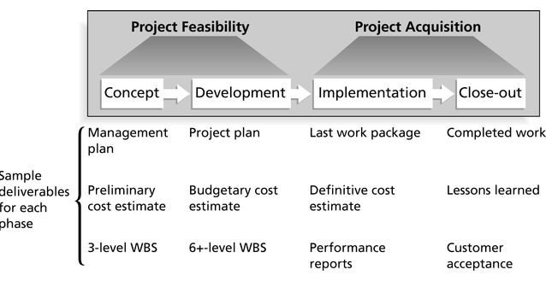
Phases of the Project Life Cycle

Slide 11
Role of Project Manager
Leader
Planner
Organizer
Controller
Communicator
Negotiator
Peace Maker
Advocate
Risk Manager

Slide 12
Project Manager’s Skills Set
Leadership
Teambuilding
Management
Delegation
Estimating & Budgeting
Risk Management
Software proficiency
Scheduling
Interviewing
Questioning
Persuading
Team Facilitation
Conflict Resolution
Negotiation
Writing
Presentation
Upwards, Downwards, and sideways communication
Technical Skills
Political Savvy

Slide 13
How do you define success?
The basic criteria for success in every project:
On time
Within budget
Satisfying or exceeding customer quality expectations

Slide 14


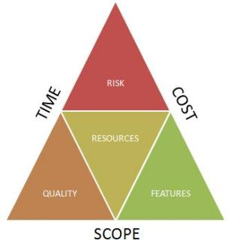
The Meaning of Success
The Triple Constraints

Slide 15
Common Project Problems
Dissatisfied customers or stakeholders
Misunderstood deliverables
Inappropriate budgets
Inappropriate schedules
Overworked or underworked resources
As Project Manager, it is up to you to insist that the proper foundation is laid during the initiation phase.
WARNING!
If you are handed a project that is already underway, backtrack and work with the stakeholders to define clear success criteria before moving forward

Slide 16
Project Definition and Scope
How do you define a project?
  Stakeholders and their responsibilities
  Project purpose
  Project Objectives
  Project Scope
  Project sign-off and review hierarchies
  Project reporting and communication plan

Slide 17
Project Primary Stakeholders: Examples
Corporate Shareholders
Project Team
Primary Stakeholders can be
internal or external to the
Project-implementing
organization
Managing all these stake
holders is challenging but
routine for the project
manager and project team
Senior Management
Project Partners
Project Sponsor
Project Customers
& Users
Project Steering
Committee
Project Input Suppliers
& Vendors (ext.)
Project Management
Office
Project Contractors /
Subcontractors
Chief Project Officer /
Programme Manager
Project Consultants
Functional /
Resource Managers
Project Financers (ext.)
Project Manager
Local, State and Federal
Government Entities

Slide 18
Project Secondary Stakeholders: Examples
Competitors
Intervenor Groups
Secondary Stakeholders are
external to the
project organization
Managing secondary
stakeholders can be especially
challenging for the project
manager and project team
Consumer Interest
Groups
Environmentalists
Civic and Professional
Organizations
Local Communities
Political Organizations
Private Individuals
Local, State and Federal
Government Entities
Tourists
Media
The General Population
Academia & Researchers
Countries, Regions,
World Community

Slide 19
VIP stakeholders
Who is most important?
    The group with the money?
    The group with the most influence?
    The ‘trouble-maker’
    The group with the biggest network?
    The group at the end of it all?
Notes:
The analysis brings about a summary of the stakeholders overall IMPORTANCE to the project… usually placed in terms of
Importance and Influence
Stakeholders fall into one of the four categories shown
Key stakeholders are those who are both important and influential
However, depending on the focus of the project special attention may be given to those who are deemed important but having little influence such as marginalised groups who have limited ‘voice’ or empowerment…

Slide 20
Project Definition and Scope
How do you define a project?
  Stakeholders and their responsibilities
  Project purpose
  Project Objectives
  Project Scope
  Project sign-off and review hierarchies
  Project reporting and communication plan

Slide 21
Project Purpose
Every project needs a purpose statement to lay out why the project exists and what it is supposed to achieve. The Purpose Statement includes two elements:
  Problem Statement. What problem will the project solve or what opportunity will the project exploit
  Mission Statement. What approach will be taken, for whom and by when.
It may take a while to get all the stakeholders to agree on the Purpose Statement.

Slide 22
Project Definition and Scope
How do you define a project?
  Stakeholders and their responsibilities
  Project purpose
  Project Objectives
  Project Scope
  Project sign-off and review hierarchies
  Project reporting and communication plan

Slide 23
Project Goals and Objectives
Targets project needs to hit.
Indicate how to accomplish project purpose.
Express success criteria to be met.
Clarifies project’s outcome to stakeholders
They should include enough detail so everyone understands:
  What you intend to do to achieve the project purpose
  Results you intend to produce
  What performance levels will be considered acceptable for each result.

Slide 24
Goals v. Objectives
Objectives
Specific
Measurable
Narrow
Concrete
Tactical – short-range, set by mangers to accomplish goals
Goals
General
Intangible
Broad
Abstract
Strategic – long-range direction, set by top executives
Although the terms “goals” and “objectives” are often used interchangeably, there is a difference between them:
Some people refer to Objectives as the activities you will carry out and Goals as the success criteria you intend to meet.

Slide 25
Project Definition and Scope
How do you define a project?
  Stakeholders and their responsibilities
  Project purpose
  Project Objectives
  Project Scope
  Project sign-off and review hierarchies
  Project reporting and communication plan

Slide 26

Project Scope
A Project Scope Statement explains what is included and what is not included in the project.
It also contains the constraints and assumptions.
Used to avoid Scope Creep.

Slide 27
Lecture 02 review
Project Quality Management

Slide 28
Dimensions of Project Quality Management
Project quality management must address both:
  The management of the project.
  The product of the project.
Notes:
The generic term product is occasionally used in literature regarding quality to refer to both goods and services.
Failure to meet quality requirements and objectives in either dimension can have serious negative consequences for any or all of the project stakeholders.

Slide 29
Quality vs grade
Quality : the degree to which a set of inherent characteristics fulfill requirements
Grade: is a category assigned to deliverables have the same functional use but different characteristics

Slide 30
Bottom line quality definition
Conformance to Specification

Slide 31
the Cost Of Quality
2 types of costs:
Unavoidable Costs: preventing defects (inspection, sampling, sorting, QC)
Avoidable Costs: defects and product failures (scrapped materials, labour for re-work, complaint processing, losses from unhappy customers
“Gold in the Mine”

Slide 32
The cost of quality
Costs
Total Costs
Unavoidable costs
Avoidable costs
100% defective
Point of “Enough quality”

Slide 33
Managing with Costs of Quality Information
Identify activities that generate quality costs
Measure them
Report them in a way that is meaningful to managers
Analyze them to identify areas for improvement
Notes:
3

Slide 34
COSTS OF QUALITY
Traditionally, accounting systems were designed to report inspection and testing costs; other quality-related costs were buried in overhead accounts. However, many experts believe the total costs of quality (COQ) average 20 - 30 percent of sales.
Definitions:
  Prevention costs: the costs of preventing defects before they happen.
  Appraisal costs: the costs of assessing the level of quality attained by the operating system.
  Internal failure costs: the costs resulting from defects that are discovered before the product or service reaches the end user.
  External failure costs: the costs that result when a defective product or service has been delivered to an end user.
Notes:
4

Slide 35
(1) Preventive cost category
Marketing/Customer/user costs
Product/Service/Design Developments costs
Purchasing costs
Operations (Manufacturing or Service) costs
Quality Administration costs
Other Preventive costs.

Slide 36
(2) Appraisal cost category
Purchasing appraisal costs
Operations (Manufacturing or service) appraisal costs
External appraisal costs
Review of test and inspection data costs
Miscellaneous quality evaluations

Slide 37
(3) Internal failure cost category
Product or service design failure costs
purchasing failure costs
Operations ( product or service) failure costs

Slide 38
(4) External failure cost category
Complaint investigations of customer or user service
Returned goods
Retrofit and recall costs
Warranty claims
Liability costs
Penalties
Lost sales
Other external failure costs
Notes:
Customer or user goodwill

Slide 39
CONTENTS OF TYPICAL PROJECT QUALITY PLAN
1. COVER SHEET + REVISION CONTROL
1.1 Document purpose
1.2 Policy statement
2.INTRODUCTION
2.1 Background
2.2 Project Scope
2.3 Project Objectives & Constraints
2.4 QA Standards (Consider putting in Document purpose)

Slide 40
CONTENTS OF TYPICAL PROJECT QUALITY PLAN
3. EXECUTION STRATEGY
3.1 Project Management risks.
3.2 Critical Activities.
3.3 Control Strategy.
3.4 Cost & Schedule.
3.5 HSE Plan.
3.6 Commissioning & Hand-over.

Slide 41
CONTENTS OF TYPICAL PROJECT QUALITY PLAN
4.ORGANISATION, RESPONSIBILITES & INTERFACES
4.1 Table with names
4.2 External interfaces
4.3 Definition of specific roles and responsibilities.
5. QUALITY REFERENCE SYSTEM
5.1 Controlling Documents
5.2 Applicable Procedures (Check list based)
6. INTEGRATION OF CONTRACTORS & SUPPLIERS
6.1 Define Contractor interfaces.
6.2 Contractor + Supplier Quality System.

Slide 42
CONTENTS OF TYPICAL PROJECT QUALITY PLAN
7.AUDITS & REVIEWS
This section should include schedule for all audits and reviews
planned during the project execution period
8. QUALITY IMPROVEMENT
8.1 LESSONS LEARNT
8.2 CLOSE-OUT REPORT

Slide 43
Lecture 03 review
Project Communication and team Management

Slide 44
Effective Communications
Elements of Effective Communications
Message
Coding
Medium
Decoding
Reactions of recipient
Number of communications channels
N(N-1)/2
Oral Communication
8 % words
17 % tone of voice
75 % body language

Slide 45
The Communication Plan 1
A communication plan helps project manager and stakeholders to understand:
What information will be communicated
Who is responsible for communicating it,
when it will be communicated and updated,
how it will be communicated, and
how records will be kept.

Slide 46
The Communication Plan 2
The communication plan should include
An outline of what documents will be collected how they will be filed, and where they will be housed.
A list of documents what will be published, outlining format and content areas, as well as the intended publication medium
A publication schedule for each document
A policy statement on how to deal with corrections and updates to published documents.

Slide 47
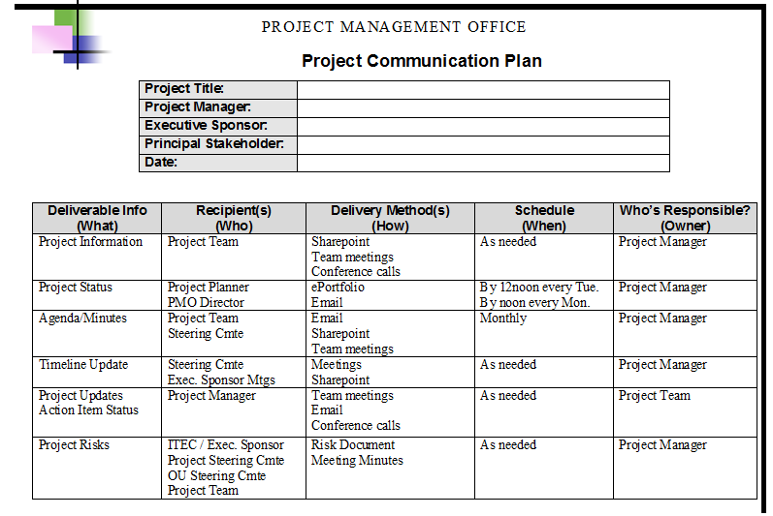
Communication Plan Example 1

Slide 48
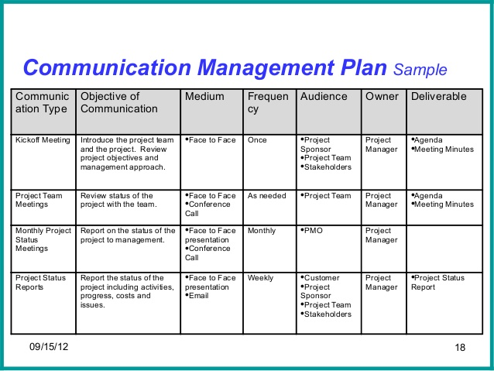
Communication Plan Example 2

Slide 49
Project Performance Reports
Reports should answer these questions
Type of Information | Key Questions
Status | Is the project on target? Are there problems or variances that need to be addressed
Progress | What has the project team accomplished since the last update? Which work packages are complete? Which partially complete? Etc.
Project Forecast | Based on trends, what is the outlook for ongoing status and progress? Are there scope or goal changes that must be made in order to complete the project successfully?

Slide 50
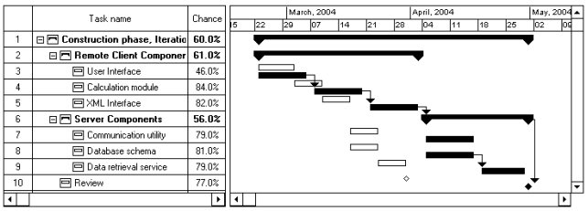
Reporting Formats 1/4
Gant Chart
  Visually presents project status
  Effective way to show project baseline and progress to date
  Can be used to display simple variance data

Slide 51
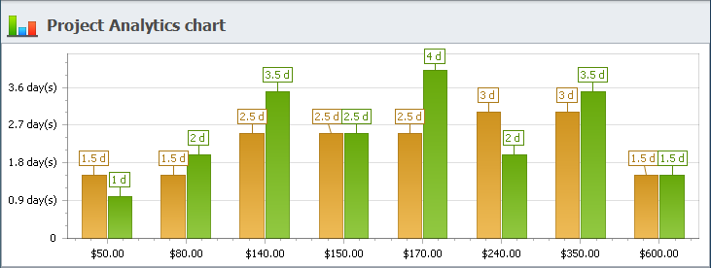
Reporting Formats 2/4
Bar Chart
  Visually summarizes and highlights key points
  Can be used to show progress to date
  Can be used to display simple variance data

Slide 52
Reporting Formats 3/4
Table
  Itemizes information
  Allows readers to pick out specific data points easily
Task | Budget to date ($) | Actual to Date ($) | Budget under-run ($) | Budget over-run ($) | Total budget ($) | Estim-ated at end ($)
6 | 6,000 | 5,000 | 1,000 |  | 7,500 | 6,500
8 | 10,000 | 11,000 |  | 1,000 | 12,000 | 13,000

Slide 53
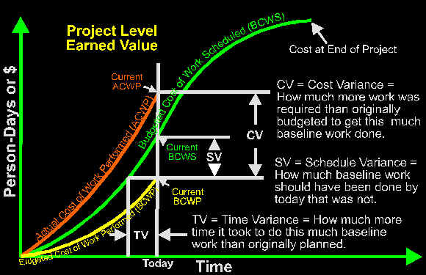
Reporting Format
S-CURVES 4/4
S Curves
  Visually displays interrelationships between 2 different types of data (for example cost and data)
  Useful for showing cumulative data and forecasting trends

Slide 54
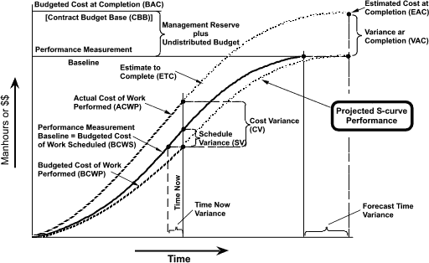

Slide 55
It takes strong players to win a game. It takes strong team to win a championship
- Michael Jordan

Slide 56
The Teamwork Challenge 2
What makes your group a team?
Committed to working together to reach a common goal

Slide 57
The Teamwork Challenge 1
Project Team: Individuals who collectively possess the skills to do a project, and who are committed to working together to reach the project goals.
Core Team: Key individuals who represent the major activities that the team will undertake during the project.
Implementation Team: Project team members who help carry out activities planned by the core team.

Slide 58
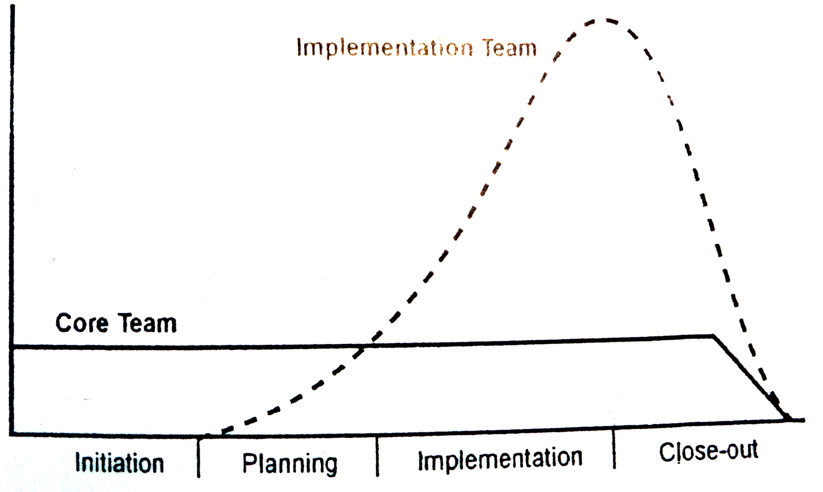
Team Membership during Project Management Life Cycle

Slide 59
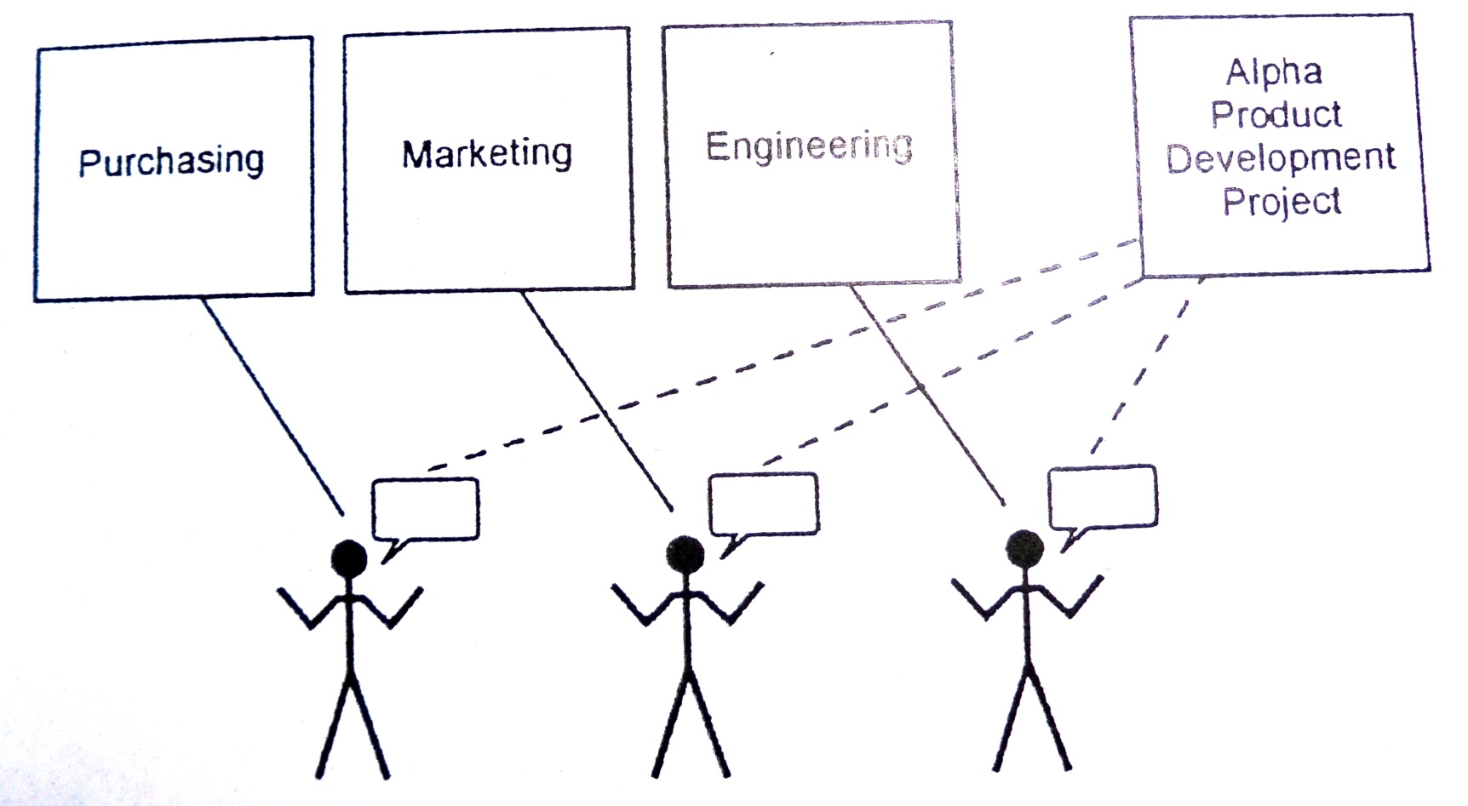
Core Team Members
Picked by stakeholders and occasionally by PM.
Might be reporting to functional managers

Slide 60
Selecting Team Members
Task-related criteria
  On small projects core team members selected based on ability to accomplish tasks.
  On larger or complex projects, core team are chosen based on their ability to manage those who can accomplish the tasks.

Slide 61
Team Selection Criteria
Skill | Skills level required for job | Supervision req’d for job | Experience level req’d for job | Education level req’d for job | Team member
Cooking | - Main dishes, sauces. - Familiar with Italian ingredients - Can convert from Italian to US metrics | - Ability to work unsupervised but willing to work under direction of Mme. Tosca - Willing to work from recipes | - Minimum 3 yrs as restaurant head chef; small rest. exp. Desirable. | - Culinary School certificate desirable but not required. | - Warren Scampia

Slide 62
Developing the team
Forming
Storming
Norming
Performing
And
  Reforming
  Adjourning
  Mourning
Notes:
Teams have associated with them a level of maturity. This is not related to the ages of the team members or the team itself but to the common experiences that the team has had together. It is possible to have an immature team that that has worked together for many years. At the same time, it is possible to mature a team relatively quickly by a common experience, particularly if that experience is in some way demanding or stressful. Teams do seem to pass through a number of stages and Tuckman is credited with identifying these stages. First there is the forming stage where the team members come together but do not yet know each other. Team members tend to be polite, somewhat guarded, dependent on the leader and see themselves very much as individuals as the team spirit has not yet been formed. The team then seems to move into the storming phase where conflicts start to occur, hidden agendas emerge and there tends to be a lack of listening. In this storming phase, the team sometimes splits into cliques, each with their own agenda. Once this phase is passed through the team then settles down into the norming phase where procedures are developed, leadership is shared, creativity improves and cliques tend to dissolve. The final stage is the performing stage where the team is resourceful, creative, flexible and effective. Group morale is high and individuals seem to develop empathy towards each other.
The performing phase is not the end of the story for a team. If a new member joins the team then a reforming stage may occur which may cycle the whole team through the forming, storming, norming cycle. When the team is disbanded at the end of a project there may be an adjourning phase whilst people find new working relationships and in some case this may result in a mourning phase where individual team members may feel sad or even depressed that the team is no longer in existence.
Study questions: Which stage is your team in currently? Would it be worth injecting a ‘storming phase’ in some way to stimulate the team and move it towards more effective performance? How will you handle the situation with a new member joining the team? What steps can you take to make the disbandment of the team less painful?

Slide 63
Forming
Become familiar with fellow team member(s)
Establish team goals
Provide work assignments

Slide 64
Storming
Set goals
Establish power levels
Identify leadership roles

Slide 65
Norming
Build interpersonal relationships with team members
Develop a common purpose for the project
Develop standard operating procedures

Slide 66
Performing
Start project work
Stage ends when the project is completed

Slide 67
Reforming, Adjourning, MOURNING
Complete project assignments
Team members are released from the project and reassigned
Different emotional reactions exhibited

Slide 68
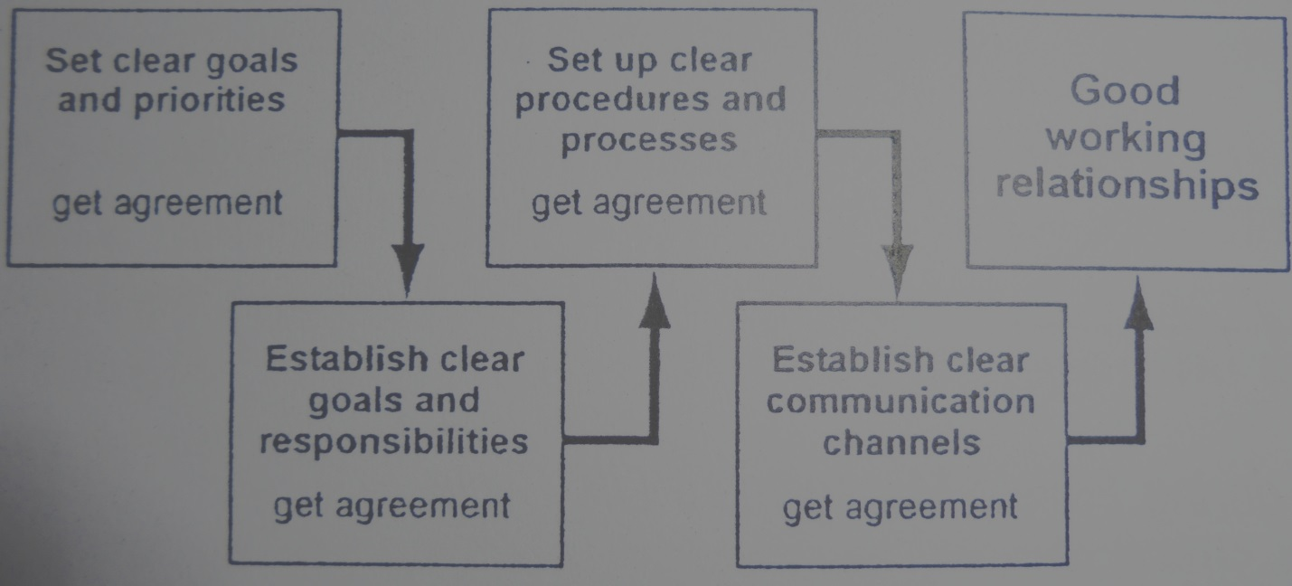
Getting to “Team-Hood”
The Keys to creating a strong project team are:
  Selecting individuals who have the required skills, attitudes and time availability
  Creating commitment to achieving the project goals
  Helping team members to learn to trust one another and their cumulative abilities to achieve the project goals

Slide 69
The Team Charter
The Team Charter is a set of rules that the team creates to set a standard of interpersonal behavior. The rules vary based on need, but should include rules about:
  Meetings
  Interpersonal behavior
  Record keeping
  Decision making
  Resources
  Communications

Slide 70
The Team Charter
The Team Charter is a living document – create one with:
  Core Team
  Implementation Team
  Sub Teams
Review the team charter when
  There is team interpersonal problems
  Team wishes to change the team rules

Slide 71
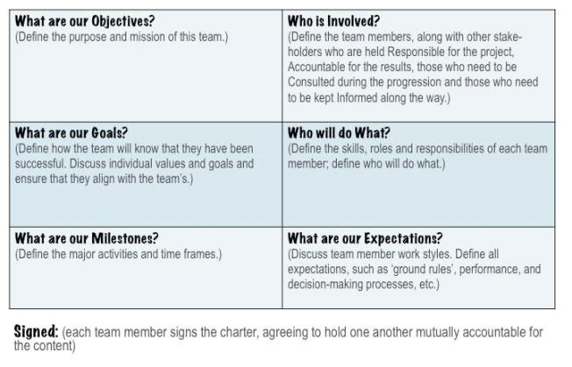
Sample Team Charter 2

