Slide 1


Entrepreneurial Leadership & Organizational Behaviour
ENT 612
Lecture 2

Slide 2
Lecture 2
Finding a Commercially Viable Problem

Slide 3
Lecture 2
The previous lecture has covered the following topics
Overview of the Entrepreneurship terms
Who is the Entrepreneur?
Definition of a Leader
The 3P's
What is the Leadership
Entrepreneurship
Entrepreneurial leaders
The five forms of entrepreneurial leadership
The five steps of the “Opportunity Model”

Slide 4
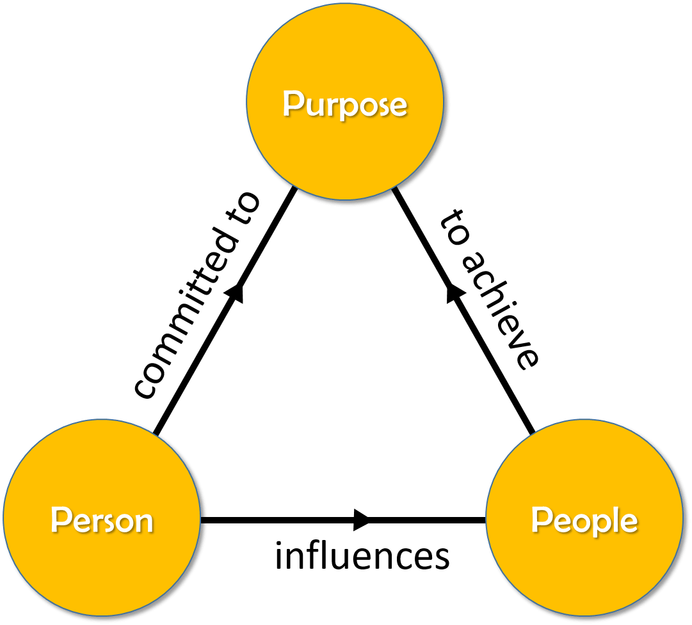

Who is the Entrepreneur?
Lecture 2
A team
Someone
An organization
Who changes an opportunity into a commercial success.

Slide 5
Lecture 2
Leadership
is the accomplishment of a goal through the direction of human assistants.
The good entrepreneurial leader realizes understands that the business world should be a “you” world, not a “we” or “me” world. Which mean focus on the needs and wants of the consumer, knowing that by satisfying the consumer first, the “we” and “me” will benefit later.
Entrepreneurship
the ability to recognize an opportunity worth pursuing and knowing what is needed to bring it to market and make it successful

Slide 6
Lecture 2
The five steps of the “Opportunity Model”
Identify a Commercially Viable Problem
Create a Product or Service That Has a Strong Competitive and Comparative Advantage
Ensure That Your Product or Service Is Sustainable through Patents, Trademarks, First-Mover Advantage, and Continuous Improvement
Secure Your Product or Service’s Profitability
Build an Effective Team

Slide 7
Lecture 2
Finding a Commercially Viable Problem
This lecture covers the following topics
Finding a Commercially Viable Problem
An excellent example
Demand: How Much Is Enough?
Total addressable market
The Perils of Head-to-Head Competition
Small Niches Can Be Profitable

Slide 8
Lecture 2
Finding a Commercially Viable Problem
There will always be frustrated customers who have problems that need to be solved. As a consumer, you’ve probably experienced some of this frustration yourself or at least seen it in others.
In marketing, one of the oldest sayings is, “Find a need and fill it.”
In other words, if you find an unsatisfied need, you’ll find a problem whose solution may provide an opportunity for you.

Slide 9
Lecture 2
Finding a Commercially Viable Problem
Not all problems that need to be solved are ready to be solved commercially. In other words, the demand for the product or service must be great enough to earn and sustain a profit.

Slide 10
Lecture 2
Finding a Commercially Viable Problem
Successful companies solve problems
I am sure you have heard of the business philosophy that in order to create a successful business it needs to add real value to a certain segment of consumers, so what is the value anyway? A successful company adds value, but they do so by solving a big problem that customers will pay money for, and if we ask how difficult the problem is? How easy is the solution? Do people have problems? And is the solution obvious enough to pay money for? These are the questions to ask when starting a business, and Problem, Solution, and Revenue are the order that business owners should consider when evaluating their business.

Slide 11
Lecture 2
Finding a Commercially Viable Problem
Identify the problem that is causing the pain.
If the problem is something undesirable and undefined, people are likely to pay a lot of money to solve it, and the problem can be anything; It may be the need for a more efficient way of transporting passengers, the lack of effective shipping options internationally, or the need for better marketing strategies; The problem is the need or the void that the customer wants to fill.

Slide 12

Lecture 2
An excellent example
An excellent example of a product that solved a “real” need at the time it was invented, but that wasn’t commercially viable, was the flush toilet. Its inventor, Sir John Harrington, presented the toilet as a gift for Queen Elizabeth I of England in 1569. Certainly, Harrington was solving an important problem: the sanitary disposal of human waste.
A Toilet Before Its Time

Slide 13
Lecture 2
An excellent example
However, his toilet wasn’t commercially viable until the late 1800s. Why? Because no adequate sewer systems existed until the Industrial Age. The shifts in population from the country to cities created a demand for flush toilets in great enough numbers to establish a large and growing market.
Though Sir John’s product was a bust financially, entrepreneurs like Thomas Crapper and John Douglas were so successful that their names remain linked with the flush toilet even today.

Slide 14
Lecture 2
An excellent example
Clearly, you need not be an inventor to be a successful entrepreneur. All you need is to be able to recognize a problem that is commercially viable and develop a unique solution.

Slide 15
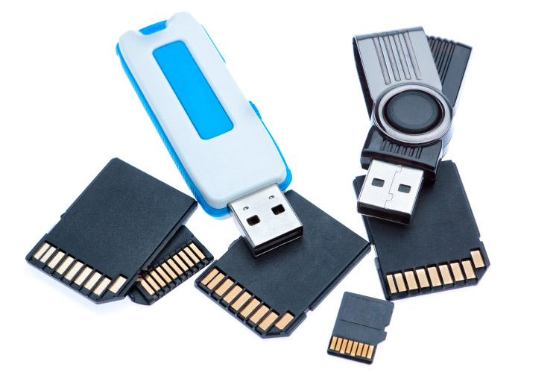
Lecture 2
An excellent example
Flash Memory
Flash memory was invented in the early 1980s by Japanese engineer Masuoka Fujio, who was then working at the Toshiba Corporation and who was searching for a technology that would replace existing data-storage media such as magnetic tapes, floppy disks, and dynamic random-access memory (DRAM) chips
Flash memory is the most widely used data storage technology in consumer devices today. It stores our photos, our videos, our music, our documents and so much more. In fact, flash memory has mostly replaced the magnetic hard drive disks (HDDs) that used to be common in computers.

Slide 16

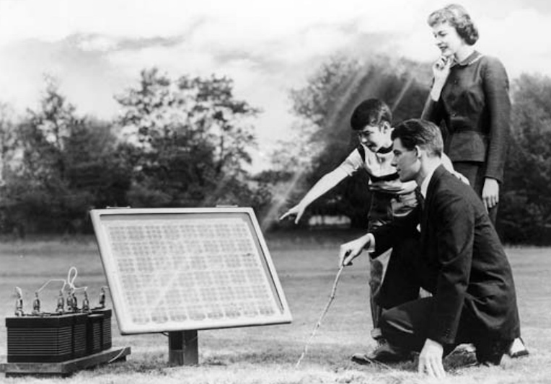

Lecture 2
An excellent example
Solar kits
The image below is an advertisement photo that appeared in the 1956 issue of Look Magazine, show off the “Bell Solar Battery” to the American public.

Slide 17
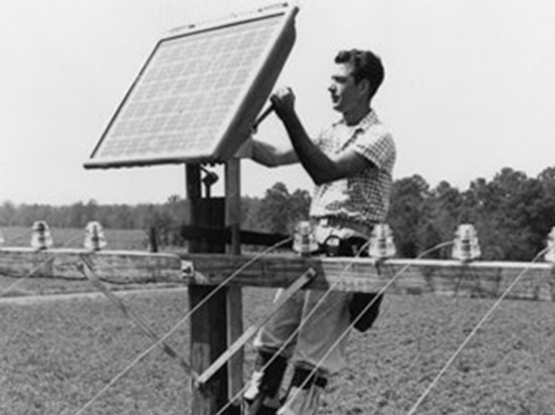
Lecture 2
An excellent example
In 1939, Russell Ohl created the solar cell design that is used in many modern solar panels. He patented his design in 1941. In 1954, this design was first used by Bell Labs to create the first commercially viable silicon solar cell.
THE HISTORY OF SOLAR ENERGY

Slide 18

Lecture 2
An excellent example
What happened to businessman and programmer Mark Zuckerberg when he started Facebook? Zuckerberg greatly helped develop the ability to communicate online.

Slide 19

Lecture 2
An excellent example
and what void did Sergey Brin and Larry Paige fill when creating Google? Is the need for an effective commercial search engine on the Internet

Slide 20

Lecture 2
An excellent example
Google & Facebook
They were solving real problems, and thanks to the scalability of those problems, they were able to grow their business to be as significant as it is today.

Slide 21
Lecture 2
So what is your problem? What is the problem you are trying to solve? If you don't solve a problem, you don't have a job, but defining the problem doesn't stop there. The most important question you can ask when checking a company's capabilities is: How big is the problem? The bigger the problem and the more intense the pain, the more potential clients you have. Moreover, the greater the pain, the more a person is willing to pay to relieve it. So, to make money, make sure that the size and scope of the problem will support your company's vision

Slide 22
Lecture 2
Demand: How Much Is Enough?
“Is a problem ready to be solved?” is a convenient way of asking, “Is there enough demand for the product or service I’m about to create to make it commercially viable? Will there be enough demand that translates into sales volume to pay the bills and show a profit?”

Slide 23
Lecture 2
Demand: How Much Is Enough?
In the case of the flush toilet, the answer to whether it was commercially viable is very obvious.
But how do we make these determinations in real time when we are faced with the challenge? The answer lies in assessing the size of the market (large and growing ones are the best) and how big a chunk of the market you can chop off.

Slide 24
Lecture 2
Demand: How Much Is Enough?
Many times, customers are too lazy, unaware, or too busy to do their own research and find a solution to their problem, and that's where the opportunity lies by precisely defining the problem and then providing a clear solution to those experiencing the problem, it is possible to create a viable business; People are willing to pay someone to do the hard work and solve their problems so they don't have to invest time or energy figuring it out themselves.

Slide 25
Lecture 2
“In niches there are riches”
David Koffman, a successful entrepreneur has said that “In niches there are riches” A niche is a portion of a market that you’ve identified as having some special characteristic that’s worth marketing to. The portion is the keyword in this definition because it means settling on a segment that you can own with your solution.

Slide 26
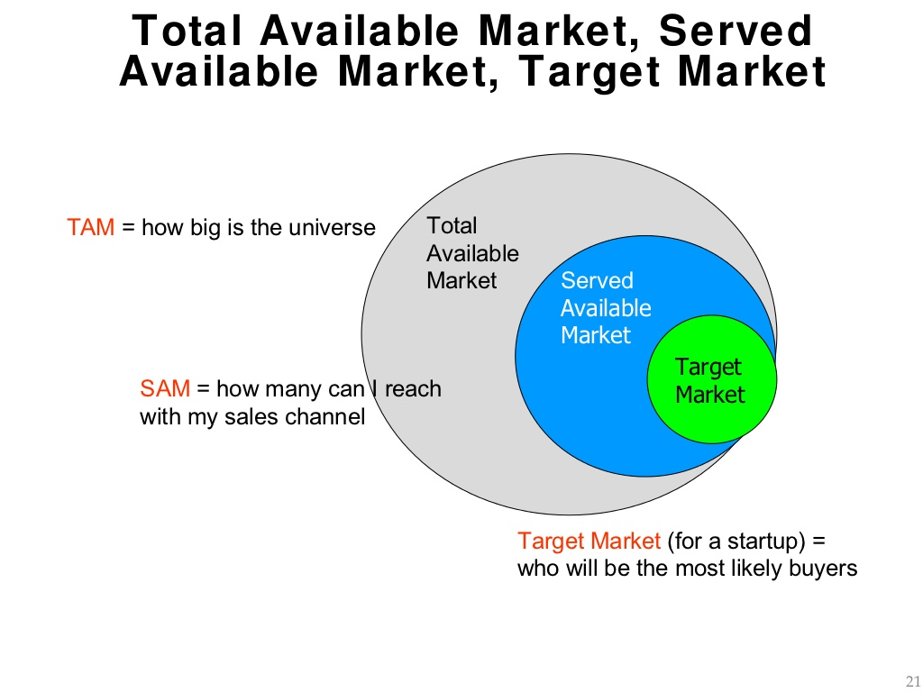
Lecture 2
Total addressable market
Total addressable market (TAM), also called total available market, is a term that is typically used to reference the revenue opportunity available for a product or service.
TAM helps prioritize business opportunities by serving as a quick metric of a given opportunity's underlying potential.
Total Available Market (TAM), Served (or Serviceable) Available Market, and Target Market. One approach is to estimate how much of the market any company can gain if there were no competitors.

Slide 27
Lecture 2
Total addressable market
The inclusion of constraints such as competition and distribution challenges then modifies the strategy to frame it with realistic boundaries, reducing the market down to the serviceable available market (SAM), the percentage of the market that can be served (either by that company or all providers) out of the TAM.

Slide 28
Lecture 2
Total addressable market
Serviceable obtainable market (SOM),the share of the market, or Target Market, is the percentage of SAM which is realistically reached.

Slide 29
Lecture 2
The Perils of Head-to-Head Competition
It’s always tempting to take the leader on head-to-head, because that’s where the volume is, and where there’s seemingly the most to gain.
Head-to-head competition refers to a situation where two or more individuals, companies or organizations directly compete with each other for the same market share, customers, resources, etc.

Slide 30

Lecture 2
The Perils of Head-to-Head Competition
Jay Yarrow, the editor for “SAI,” the tech section of Business Insider, told that in 2013 that since the first quarter of 2005, Microsoft’s online division, Online Services Division, which is made up of Bing, MSN, and other pieces, has lost $10.9 billion. As of 2014, they seem to be making headway because of their partnership with Yahoo; however, things aren’t all rosy with this arrangement. Bing’s “search” share of the market was up in June 2013 to 17.9 per cent, while Yahoo’s dropped to 11.4 per cent, according to comScore. The percentage Bing grew was exactly the amount of market share Yahoo lost.

Slide 31
Lecture 2
The Perils of Head-to-Head Competition
This type of competition can be intense and result in several negative outcomes, including:
1. Price Wars: Companies may lower their prices to try and gain a competitive advantage, leading to a decrease in profit margins for everyone involved.
2. Decreased Quality: Companies may sacrifice quality in an effort to cut costs and compete on price, leading to a decrease in customer satisfaction.

Slide 32
Lecture 2
The Perils of Head-to-Head Competition
3. Increased Advertising Costs: Companies may increase their advertising budget to try and gain an edge in the market, leading to increased costs and potentially reduced profitability.
4. Legal Issues: Companies may engage in unethical or illegal practices to gain a competitive advantage, resulting in legal challenges and reputational damage.

Slide 33
Lecture 2
The Perils of Head-to-Head Competition
5. Negative Impact on the Market: Intense head-to-head competition can lead to a decline in market growth and overall profitability for everyone involved.

Slide 34
Lecture 2
Small Niches Can Be Profitable
Keep in mind that all products and services serve niche markets when they start. Some go on to command large segments of the market, yet others remain small but rewarding for the companies that survive in an environment with relatively modest demand.

Slide 35

Lecture 2
The hand-crafted luxury car niche is an example of a niche that has remained small for many years, and yet is still highly profitable for certain companies. In 2013, Rolls-Royce announced its highest-ever annual sales, delivering 3,630 cars in its fourth consecutive record-breaking year. This made Rolls-Royce the best-selling automaker in the world of cars that cost more than $250,000.

Slide 36
Lecture 2
How much demand is enough?
“How much demand is enough?” Can I afford it? In other words, can we eventually sell enough to make a profit? Can we afford to lose money in the short term while building sales? It helps to do research to reduce uncertainty and provide some peace of mind. Yes, you can’t research a product that doesn’t exist, but you can research users of similar products to learn how many there are, the size of the market in dollars, and the income levels of buyers, along with other valuable demographic indicators.

Slide 37
Lecture 2
How much demand is enough?
So how do you go about finding a problem whose solution is commercially viable?
Our search begins with primary demand, which is consumer interest in purchasing an entire class of products, versus consumers wanting only to purchase a certain brand within that class.

Slide 38
Lecture 2
Conclusion
This lecture covered the following topics
Finding a Commercially Viable Problem
An excellent example
Demand: How Much Is Enough?
Total addressable market
The Perils of Head-to-Head Competition
Small Niches Can Be Profitable

Slide 39
Lecture 2
References
- Entrepreneurial Leadership: A practical Guide to Generating New Business by Angelo Mastrangelo 1st Edition.
- Definition of a Leader: https://www.vtaide.com/gleanings/leader.html
Understanding Leadership, Harvard Business Overview:https://hbr.org/2004/01/understanding-leadership
https://www.deegesolar.co.uk/history_of_solar_energy/
https://www.techtarget.com/searchstorage/feature/A-history-of-flash-memory-and-its-rise-in-the-enterprise

Slide 40
Lecture 2
Contact information with Dr Nahed Ahmed
nahed.kamal@esu.ac.ae

Slide 41

Lecture 2
Wish you all the best

