Slide 1



Object Oriented Programming
Prepared by Dr. Yasser Abdelhamid
IT223
Object Oriented Programming
Lecture 05

Slide 2

outline
Inheritance.
Access modifiers and inheritance
Method overriding
Method overloading.
Calling superclass methods
Programming challenge

Slide 3
Inheritance

Slide 4
Inheritance
In Java, it is possible to inherit attributes and methods from one class to another.
We can create new classes from existing classes.
Inheritance supports reusability.

Slide 5
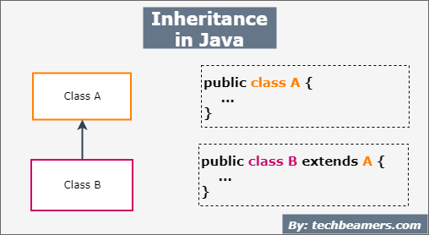
Inheritance (cont.)
Superclass, Parent, Base class.
Subclass, Derived, Child, Extended class.

Slide 6
Inheritance
When we create a class based on an existing class, we can reuse methods and fields of the parent class.
We can add new methods and fields in our new child class.

Slide 7
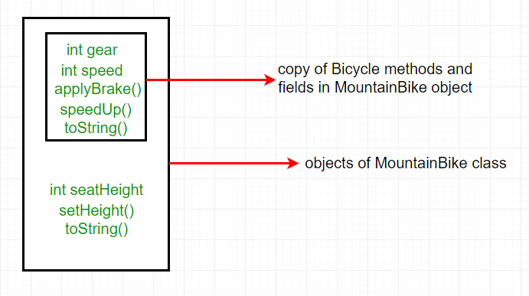
Inheritance (cont.)

Slide 8
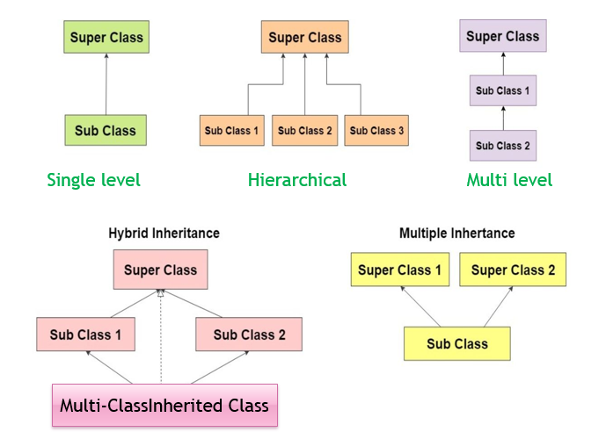
inheritance

Slide 9
Example: single level inheritance
class Employee{
double basicSalary =40000.0;
}
class Programmer extends Employee{
double bonus=10000;
public static void main(String[] args){
Programmer p=new Programmer();
System.out.println("Programmer basic salary is:\t"+p.basicSalary);
System.out.println("Bonus of Programmer is:"+p.bonus);
}
}

Slide 10
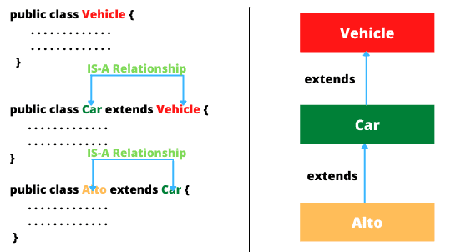
multi level inheritance

Slide 11
Example: multi level inheritance
class Animal{
void eat() {System.out.println("eating...");}
}
class Dog extends Animal{
void bark() {System.out.println("barking...");}
}
class BabyDog extends Dog{
void breastfed() {System.out.println("breastfed...");}
}
class TestInheritance2{
public static void main(String args[]){
BabyDog d=new BabyDog();
d.breastfed();
d.bark();
d.eat();
}
}

Slide 12
example: hierarchical inheritance
class Animal{
void eat(){System.out.println("eating...");}
}
class Dog extends Animal{
void bark(){System.out.println("barking...");}
}
class Cat extends Animal{
void meow(){System.out.println("meowing...");}
}
class TestInheritance3{
public static void main(String args[]){
Cat c=new Cat();
c.meow();
c.eat();
}
}

Slide 13
the Object Class
Object Class is the Default Superclass.
If a class does not specify a superclass using the keyword extends in its class declaration, it inherits from the java.lang.Object class.
We usually declare a class like this
    public class P {
    // Code for class P goes here
    }
We can declare a class explicitly like this
    public class P extends Object {
    // Code for class P goes here
    }
Object
Class P
Class q

Slide 14
Access modifiers and inheritance

Slide 15
Access modifiers and inheritance
A subclass inherits non-private members of its superclass.
Public
Default 
Private 
Protected 

Slide 16
example: private access modifier
class TestInheritance {
private int x;
int y;
public TestInheritance(){
x=10;
y=9;
}
}
class Test extends TestInheritance{
public static void main(String[] args) {
Test a = new Test();
System.out.println(a.y);
System.out.println(a.x); \\ won’t work
}
}

Slide 17
protected modifier
There are two cases:
  Protected member is accessible in the package in which it is declared.
  A protected class member is always accessible inside the body of a subclass whether the subclass is in the same package as the class or in a different package.

Slide 18
example: protected modifier
package myTestClasses;
public class TestInheritance {
protected int p;
public TestInheritance(){
p=88;
}
}
class A {
public static void main(String[] args) {
TestInheritance a = new TestInheritance();
a.p = 77; // protected members are accessible in the same package
}
}

Slide 19
Accessing protected member from other package
package package1;
import myTestClasses.TestInheritance;
class Test extends TestInheritance {
public static void main(String[] args) {
Test t = new Test();
t.p = 777;
TestInheritance t2 = new TestInheritance();
t2.p = 888;
}
}

Slide 20
Method overriding

Slide 21
method overriding
Child class can declare methods with the same name of a method declared in the parent class.
This is known as method overriding in Java.
This technique is usually used to develop specific implementation of the method that has been declared by its parent class.

Slide 22
example: method overriding
class Vehicle{
//defining a method
void run(){System.out.println("Vehicle is running");}
}
//Creating a child class
class Bike2 extends Vehicle{
//defining the same method as in the parent class
void run(){System.out.println("Bike is running safely");}
public static void main(String args[]){
Bike2 obj = new Bike2();//creating object
obj.run();//calling method
}
}

Slide 23
method overriding rules
The method name of the child class must be the same name as the method of the parent class.
The two methods ( of the child class and parent class) must have the same parameters.
method must not be static.
The method declared in child class must not be more restrictive (must be less restrictive).

Slide 24
Question?
Can we override java main method?
No, because it is static

Slide 25
Question?
Would this code run?
class ParentClass{
void msg(){System.out.println("Overriden method");}
}
class ChildClass extends ParentClass{
protected void msg(){System.out.println("Overriding method");}
public static void main(String args[]){
ChildClass obj=new ChildClass();
obj.msg();
}
}
Yes , because Overriding method is less restrictive.

Slide 26
visibility order of access modifiers from least to most
**** private
*** default
** protected
* public
Memorize this sequence
PRI DEF PRO PUB

Slide 27
Method overloading

Slide 28
method overloading
Declaring multiple methods with the same name and different parameters.
Method overloading increases the readability of the program.
Overloading can be implemented by:
  Changing number of parameters.
  Changing the data type of parameters.

Slide 29
Question?
Method Overloading is possible by Only changing the return data type of the method. (True/False)
Justify your answer
No, a conflict occurs.

Slide 30
example: method overloading
class Operator{
static int add(int a,int b){return a+b;}
static int add(int a,int b,int c){return a+b+c;}
static double add(double a,double b){return a+b;}
}
class TestOverloading1{
public static void main(String[] args){
System.out.println(Operator.add(1,2));
System.out.println(Operator.add(1,2,3));
System.out.println(Operator.add(1d,2d));
}
}

Slide 31

Question?
public class MainOverloading {
// This version must be included
public static void main(String[] args) {
System.out.println("all ok");
main();
main("Hello");
}
public static void main() {
System.out.println("No arguments");
}
public static void main(String o) {
System.out.println(o);
}
}
Can we overload java main() method?

Slide 32
Calling superclass methods

Slide 33
calling superclass methods
Creating an instance of a subclass, implicitly creates a superclass instance.
The superclass instance is referenced by super keyword.
super keyword can be used as follows:
  Referring to immediate parent class instance variable.
  Invoking immediate parent class method.
  Invoking immediate parent class constructor.

Slide 34
calling immediate parent class instance variable
class Animal{
String color="white";
}
class Dog extends Animal{
String color="black";
void printColor(){
System.out.println(color);
System.out.println(super.color);
}
}
class TestSuper1{
public static void main(String args[]){
Dog d=new Dog();
d.printColor();
}
}

Slide 35
Calling parent class methods
class Animal{
void eat(){
System.out.println("eating...");
}
}
class Dog extends Animal{
void eat(){
System.out.println("eating bread..."); }
void bark(){
System.out.println("barking..."); }
void work(){
super.eat();
bark();
}
}
class TestSuper2{
public static void main(String args[]){
Dog d=new Dog();
d.work();
}
}

Slide 36
Calling parent class constructor
class Animal{
Animal(){
System.out.println("animal is created");
}
}
class Dog extends Animal{
Dog(){
super(); // What if I removed this line?
System.out.println("dog is created");
}
}
class TestSuper3{
public static void main(String args[]){
Dog d=new Dog();
}
}
Nothing happens because it calls the superclass constructor by default.

Slide 37
Programming challenge

Slide 38
Programming challenge
Electricity invoices in Egypt are calculated in slices as follows:
  First 50 KWatts cost L.E. 0.80 /KW
  Next 150 KWatts cost L.E. 0.90 /KW
  Next 150 KWatts cost L.E. 1.00 /KW
  More than 350 KWatts cost L.E. 1.20 /KW
Develop a Java application to calculate the electricity invoice for customers.
The application should print the invoice which include the following information:
Customer name, Customer Address, Amount of KWatts consumed, and Amount of the invoice in L.E. calculated as specified above.
The application will ask the user for his name and address and consumed KWatts.
Hint. You have to create classes for Slices, Customers, Invoices, In addition to the main application class, and any other classes that you may need in the application.
Use OOP principles like encapsulation, inheritance as possible.

Slide 39
SUmmary
Inheritance.
Access modifiers and inheritance
Method overriding
Method overloading.
Calling superclass methods
Programming challenge

Slide 40


Thank You

