Slide 1


PMG 611
Enterprise Risk Management
Prepared by:
Dr. Abdullah Jameel Halawany
Lecture 1
Introduction to ERM
Lecture 1
www.midocean.ae

Slide 2

Dr. Eng. Abdullah Jameel Halawany
ahalawany@esu.edu.sa
PhD in Industrial Engineering
  University of Central Florida, Orlando, FL, USA
Project Engineering Certificate
Quality Assurance Certificate
Six Sigma Green Belt Certificate
Trainer of Trainee (TOT)
Professional Engineer Certificate

Slide 3

Session Outline
Introduction to the Course
- Brief Description
- Topics
- Learning Outcomes
ERM
- ERM History and Drivers
- Learning Platform
- References
- Summary
- What is ERM?
- Benefits of ERM
- Clearing Misconceptions
- Internal Control vs. ERM
- ERM Limitations
Session Outline

Slide 4

Introduction to the course

Slide 5
Learning Platform
https://lms.midocean.ae/
IT MUST be checked frequently
Include All course material and information
  Lectures’ Videos and PDF/PPT files
  Course grades distribution
  Quizzes/Assignments/Exams Dates
  Regulations for accepted excuses
  Zoom weekly meeting link (same link is used for all meetings)

Slide 6
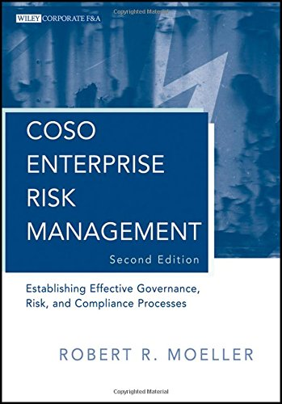

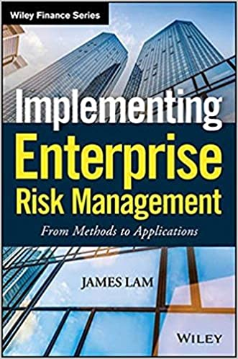
References
COSO Enterprise Risk Management: Establishing Effective Governance, Risk, and Compliance Processes. Robert R. Moeller.
Implementing Enterprise Risk Management: From Methods To Applications. James Lam.

Slide 7

Brief Description of The Course
In Enterprise Risk Management, we develop a holistic approach to the identification and management of risks facing an organization, allowing leaders to identify and quantify the risks facing the enterprise.
This course will present management tools and frameworks to understand and identify risk.
Emphasis will be placed on how to improve a firm’s risk position, and how to adapt an organization to deal with risk.
In addition, this course discusses issues related to the implementation of risk management systems and compliance with key regulatory requirements, and the importance of Governance, Risk, and Compliance Principles (GRC).

Slide 8

Topics
Introduction to Enterprise Risk Management
Risk Management Fundamentals and Risk Portfolio Management
Importance of Governance, Risk, and Compliance Principles and Practices.
ERM Frameworks: COSO ERM Frameworks, ISO 31000, and 38500 Risk Management Worldwide Standards
Implementing ERM in the Enterprise
Integration of KPIs and KRIs and ERM Dashboard Reporting
Enterprise Compliance Issues Today
Role of Internal Audit in Enterprise Risk Management
Importance of GRC Principles in the Board Room
Cybersecurity and Information Technology and Enterprise Risk Management
Establishing an Effective GRC Culture throughout the Enterprise
ERM and GRC Principles Going Forward

Slide 9

Course Learning Outcomes
1-
2-
3-
4-
5-
6-
7-
Provide a definition of risk and describe why risk management is important.
Understand the Importance of Governance, Risk, and Compliance Principles
Describe the elements of an ERM framework.
Identify the obstacles to effective risk management.
Recognize and be able to discuss the rising expectations for risk management to be more strategic and value-adding.
Identify some of the organizational arrangements, processes and culture that enable successful risk management.
Clarify what KRIs are and demonstrate their practical applications and value to an organization.

Slide 10
Enterprise Risk Management (ERM)
History and Drivers

Slide 11
Risk Management (RM)
Protecting ourselves against risk is a natural practice.
In fact, one could argue that risk management has existed as long as human history.
Despite the intuitive nature of risk management—or perhaps because of it—it did not become part of formal business practice until the second half of the last century.
It wasn’t until 1963 that the first discussion on risk appeared in an attempt to codify and improve such practices.

Slide 12
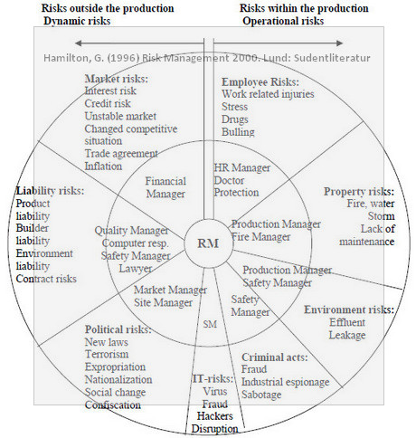
Enterprise Risk Management (ERM)
The concept of a holistic approach of ERM traces its roots to the early 1970s when Gustav Hamilton proposed the “Risk Management Circle” to describe the interaction of all elements in the risk management process (assessment, control, financing and communication).

Slide 13
Enterprise Risk Management (ERM)
In the 20th century, risk managers were primarily responsible for managing "pure" risks through the purchase of insurance.
The concept of risk management soon became associated with financial risk management with the use of derivative financial products.
There are several checkpoints that have driven the need for enterprise risk management.

Slide 14
ERM Drives
This includes an increase in:
  Greater transparency
  Financial disclosures with more strict reporting and control requirements
  Security and technology issues
  Business continuity and disaster
  Focus from rating agencies
  Regulatory compliance
  Globalization in a continuously competitive environment

Slide 15
What is ERM?

Slide 16
Event
Events can have negative impact, positive impact, or both.
Events with a negative impact represent risks, which can prevent value creation or erode existing value.
Events with positive impact may offset negative impacts or represent opportunities.
Opportunities are the possibility that an event will occur and positively affect the achievement of objectives, supporting value creation or preservation.
Management channels opportunities back to its strategy or objective-setting processes, formulating plans to seize the opportunities.

Slide 17
What is ERM?
All organizations need to set strategy and periodically adjust it, always staying aware of
  ever-changing opportunities for creating value
  the challenges that will occur in pursuit of that value.
To do that, they need the best possible framework for optimizing strategy and performance.

Slide 18
What is ERM?
“is a methodology that looks at risk management strategically from the perspective of the entire firm or organization. It is a top-down strategy that aims to identify, assess, and prepare for potential losses, dangers, hazards, and other potentials for harm that may interfere with an organization's operations and objectives and/or lead to losses.”

Slide 19
What is ERM?
Definition by Committee of Sponsoring Organizations of the Treadway Commission (COSO)
“Enterprise risk management is a process, effected by an entity’s board of directors, management and other personnel, applied in strategy setting and across the enterprise, designed to identify potential events that may affect the entity, and manage risk to be within its risk appetite, to provide reasonable assurance regarding the achievement of entity objectives.”

Slide 20
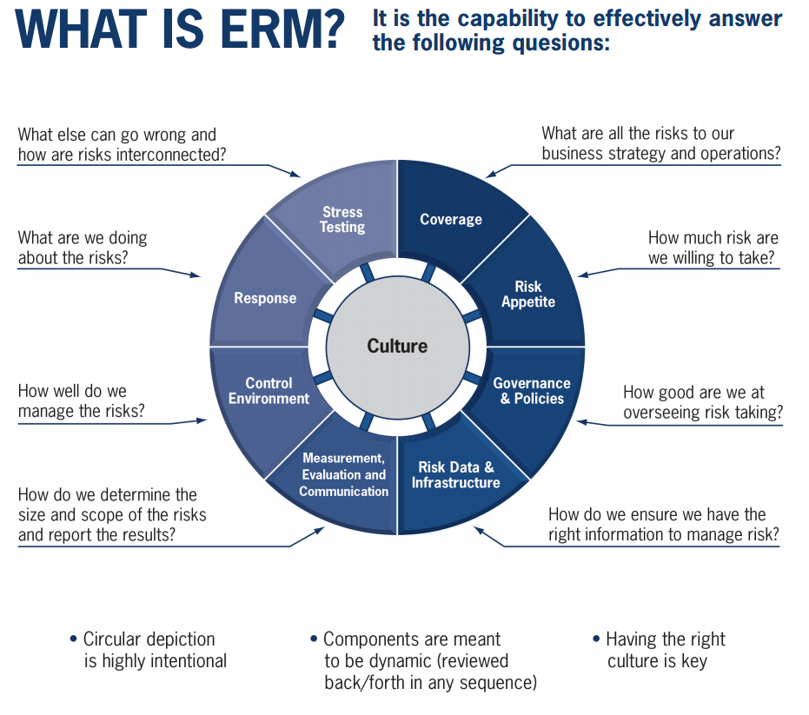

Slide 21
Benefits of ERM

Slide 22
Benefits of ERM
Organizations that integrate enterprise risk management throughout the entity can realize many benefits, including, though not limited to:
  Increasing the range of opportunities
  Identifying and managing risk entity-wide
  Increasing positive outcomes and advantage while reducing negative surprises
  Reducing performance variability
  Improving resource deployment
  Enhancing enterprise resilience

Slide 23
Benefits of ERM
Increasing the range of opportunities
  By considering all possibilities—both positive and negative aspects of risk—management can identify new opportunities and unique challenges associated with current opportunities.
Identifying and managing risk entity-wide
  Countless risks that can affect many parts of the organization. Sometimes a risk can originate in one part of the entity but impact a different part. Consequently, management identifies and manages these entity-wide risks to sustain and improve performance.

Slide 24
Benefits of ERM
Increasing positive outcomes and advantage while reducing negative surprises
  ERM improve ability to identify risks and establish appropriate responses, reducing surprises and related costs or losses, while profiting from advantageous developments.
Reducing performance variability
  Performing ahead of schedule or beyond expectations may cause as much concern as performing short of scheduling and expectations.
  ERM allows organizations to anticipate the risks that would affect performance and enable them to put in place the actions needed to minimize disruption and maximize opportunity.

Slide 25

Benefits of ERM
Improving resource deployment
  Every risk could be considered a request for resources. Obtaining robust information on risk allows management, in the face of finite resources, to assess overall resource needs, prioritize resource deployment and enhance resource allocation.
Enhancing enterprise resilience
  An entity’s medium- and long-term viability depends on its ability to anticipate and respond to change, not only to survive but also to evolve and thrive. It becomes increasingly important as the pace of change accelerates and business complexity increases.

Slide 26
Clearing Up a Few Misconceptions

Slide 27
Clearing Up a Few Misconceptions
“Enterprise risk management is not a function or department.”
It is the culture, capabilities, and practices that organizations integrate with strategy-setting and apply when they carry out that strategy, with a purpose of managing risk in creating, preserving, and realizing value.

Slide 28
Clearing Up a Few Misconceptions
“Enterprise risk management is more than a risk listing.”
It requires more than taking an inventory of all the risks within the organization.
It is broader and includes practices that management puts in place to actively manage risk.

Slide 29
Clearing Up a Few Misconceptions
“Enterprise risk management is not a checklist.“
It is a set of principles on which processes can be built or integrated for a particular organization, and it is a system of monitoring, learning, and improving performance.

Slide 30
Clearing Up a Few Misconceptions
“Enterprise risk management can be used by organizations of any size.”
If an organization has a mission, a strategy, and objectives—and the need to make decisions that fully consider risk—then enterprise risk management can be applied.
It can and should be used by all kinds of organizations, from small businesses to community-based social enterprises to government agencies to Fortune 500 companies.

Slide 31
Clearing Up a Few Misconceptions
“Enterprise risk management addresses more than Internal Control.“
It also addresses other topics such as strategy-setting, governance, communicating with stakeholders, and measuring performance.
Its principles apply at all levels of the organization and across all functions.

Slide 32
Internal Control vs. ERM

Slide 33
Internal Control
Internal control is a process, effected by an entity’s board of directors, management, and other personnel, designed to provide reasonable assurance regarding the achievement of objectives relating to operations, reporting, and compliance.
Operations – Effectiveness and efficiency of operations
Reporting – Reliability of reporting for internal and external use
Compliance – Compliance with applicable laws and regulations”

Slide 34
Internal Control
Internal control is indeed important to developing reasonable assurance that the applicable processes will operate as designed and achieve the desired objectives.
Organizations can have objectives outside of these three categories.
Any choice of a future action typically entails risk.
Those choices extend far beyond the execution of currently implemented business processes and include any decision for future action not dependent on an existing process.

Slide 35
ERM Encompasses Internal Control
Internal control is an integral part of enterprise risk management.
This enterprise risk management framework encompasses internal control, forming a more robust conceptualization and tool for management

Slide 36

ERM Limitations
Human judgment in decision making can be faulty
Decisions on responding to risk and establishing controls need to consider the relative costs and benefits, breakdowns can occur because of human failures such as simple errors or mistakes
Controls can be circumvented by collusion of two or more people
Management has the ability to override enterprise risk management decisions.
These limitations prevent a board and management from having absolute assurance as to achievement of the entity’s objectives.

Slide 37
Summary

Slide 38
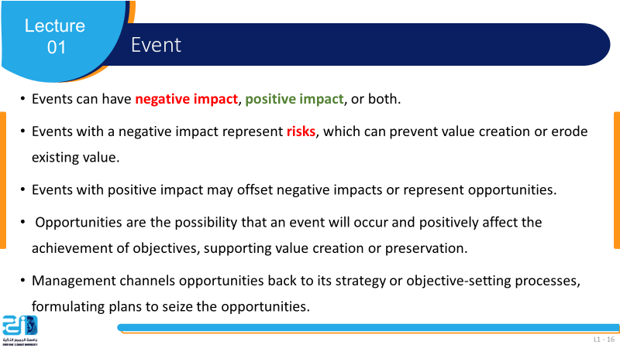
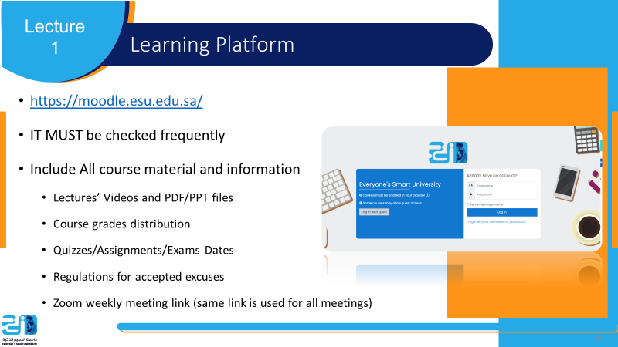
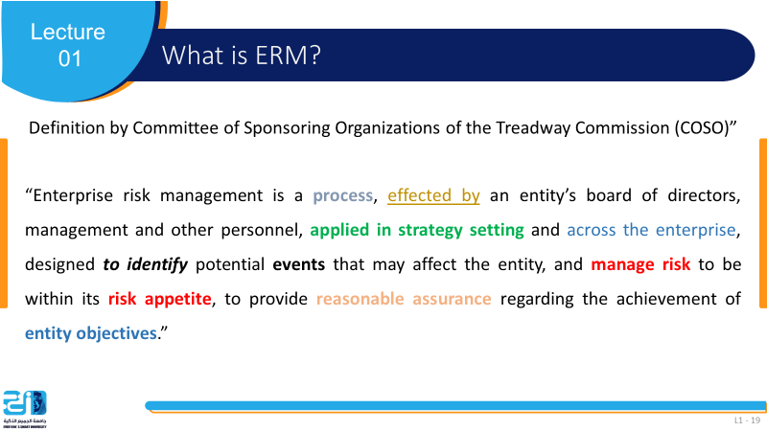

Slide 39

ERM: Enterprise Risk Management
GRC: Governance, Risk, and Compliance
RM: Risk Management
COSO: Committee of Sponsoring Organizations of the Treadway Commission

Slide 40
References
COSO Enterprise Risk Management: Establishing Effective Governance, Risk, and Compliance Processes
Guidance on Enterprise Risk Management. https://www.coso.org/Pages/erm.aspx

