Slide 1

Strategic and Operational Management
(part 1 Analysis)
Prepared by Dr. Adam Yagoub
Lecture 1
MGM 630
Basic Model of Strategic Management

Slide 2

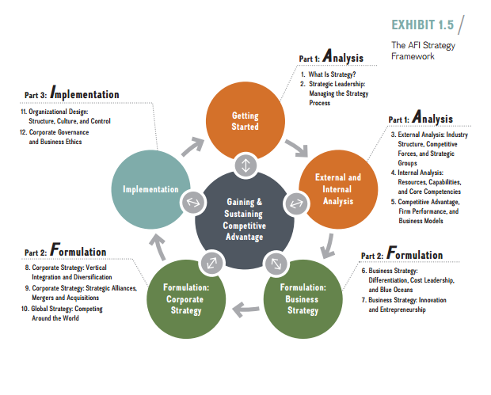

Slide 3
Lecture 1
Lecture Outline
1.1 What Strategy Is: Gaining and Sustaining Competitive Advantage
- What Is Competitive Advantage?
- Industry vs. Firm Effects in Determining Firm Performance
1.2 Stakeholders and Competitive Advantage
- Stakeholder Strategy
- Stakeholder Impact Analysis
1.3 The AFI Strategy Framework

Slide 4

Lecture 1
Learning Objectives
1. Explain the role of strategy in a firm’s quest for competitive advantage.
2. Define competitive advantage, sustainable competitive advantage, competitive disadvantage, and competitive parity.
3. Differentiate the roles of firm effects and industry effects in determining firm performance.
4. Evaluate the relationship between stakeholder strategy and sustainable competitive advantage.
5. Conduct a stakeholder impact analysis.

Slide 5
Lecture 1
Basic Model of Strategic Management
1.1. What Strategy Is: Gaining and Sustaining Competitive Advantage
Strategy is a set of goal-directed actions a firm takes to gain and sustain superior performance relative to competitors. To achieve superior performance, companies compete for resources: New ventures compete for financial and human capital. Existing companies compete for profitable growth. Charities compete for donations, and universities compete for the best students and professors. Sports teams compete for championships, while celebrities compete for media attention.

Slide 6
Lecture 1
Basic Model of Strategic Management
What is a good strategy?
A good strategy consists of three elements:
1. A diagnosis of the competitive challenge. This element is accomplished through analysis of the firm’s external and internal environments (Part 1 of the AFI framework)
2. A guiding policy to address the competitive challenge. This element is accomplished through strategy formulation, resulting in the firm’s corporate, business, and functional strategies (Part 2 of the AFI framework).

Slide 7
Lecture 1
Basic Model of Strategic Management
3. A set of coherent actions to implement the firm’s guiding policy. This element is accomplished through strategy implementation(Part 3 of the AFI framework).

Slide 8
Lecture 1
Basic Model of Strategic Management
- What is Competitive Advantage?
Competitive advantage is always relative, not absolute. To assess competitive advantage, we compare firm performance to a benchmark—that is, either the performance of other firms in the same industry or an industry average. A firm that achieves superior performance relative to other competitors in the same industry or the industry average has a competitive advantage.

Slide 9
Lecture 1
Basic Model of Strategic Management
Google has a competitive advantage over Facebook, Twitter, and Yahoo in digital advertising. In smartphones, Apple has achieved a competitive advantage over Samsung, Microsoft, and BlackBerry. A firm that is able to outperform its competitors or the industry average over a prolonged period of time has a sustainable competitive advantage.

Slide 10
Lecture 1
Basic Model of Strategic Management
If a firm underperforms its rivals or the industry average, it has a competitive disadvantage. For example, a 15 percent return on invested capital may sound like superior firm performance. In the consulting industry, though, where the average return on invested capital is often above 20 percent, such a return puts a firm at a competitive disadvantage.

Slide 11
Lecture 1
Basic Model of Strategic Management
In contrast, if a firm’s return on invested capital is 2 percent in a declining industry, like newspaper publishing, where the industry average has been negative (25 percent) for the past few years, then the firm has a competitive advantage. Should two or more firms perform at the same level, they have competitive parity.
To gain a competitive advantage, a firm needs to provide either goods or services consumers value more highly than those of its competitors, or goods or services similar to the competitors’ at a lower price.

Slide 12
Lecture 1
Basic Model of Strategic Management
In addition, operational effectiveness, marketing skills, and other functional expertise all strengthen a unique strategic position. Those capabilities, though, do not substitute for competitive strategy. Competing to be similar but just a bit better than your competitor is likely to be a recipe for cut-throat competition and low profit potential. Let’s take this idea to its extreme in a quick thought experiment: If all firms in the same industry pursued a low-cost position through application of competitive benchmarking, all firms would have identical cost structures. None could gain a competitive advantage.

Slide 13
Lecture 1
Basic Model of Strategic Management
Everyone would be running faster, but nothing would change in terms of relative strategic positions. There would be little if any value creation for customers because companies would have no resources to invest in product and process improvements. Moreover, the least-efficient firms would be driven out, further reducing customer choice.
To gain a deeper understanding of what strategy is, it may be helpful to think about what strategy is not. Be on the lookout for the following major hallmarks of what strategy is NOT:

Slide 14
Lecture 1
Basic Model of Strategic Management
Grandiose statements are not strategy. You may have heard firms say things like, “Our strategy is to win” or “We will be No. 1.” Twitter declared its “ambition is to have the largest audience in the world.” Such statements of desire, on their own, are not strategy. They provide little managerial guidance and often lead to goal conflict and confusion. Moreover, such wishful thinking frequently fails to address economic fundamentals. As we will discuss in the next chapter, an effective vision and mission can lay the foundation upon which to craft a good strategy.

Slide 15
Lecture 1
Basic Model of Strategic Management
A failure to face a competitive challenge is not strategy. If the firm does not define a clear competitive challenge, managers have no way of assessing whether they are making progress in addressing it. Managers at the now-defunct video rental chain Blockbuster, for example, failed to address the competitive challenges posed by new players Netflix, Redbox, Amazon Prime, and Hulu.

Slide 16
Lecture 1
Basic Model of Strategic Management
Operational effectiveness, competitive benchmarking, or other tactical tools are not strategy. People casually refer to a host of different policies and initiatives as some sort of strategy: pricing strategy, Internet strategy, alliance strategy, operations strategy, IT strategy, brand strategy, marketing strategy, HR strategy, China strategy, and so on.

Slide 17
Lecture 1
Basic Model of Strategic Management
- Industry vs. Firm effects in determining Firm performance
Firm performance is determined primarily by two factors: industry and firm effects. Industry effects describe the underlying economic structure of the industry. They attribute firm performance to the industry in which the firm competes. The structure of an industry is determined by elements common to all industries, elements such as entry and exit barriers, number and size of companies, and types of products and services offered. In a series of empirical studies, academic researchers have found that about 20 percent of a firm’s profitability depends on the industry it’s in.

Slide 18
Lecture 1
Basic Model of Strategic Management
Firm effects attribute firm performance to the actions managers take. In Chapter 4, we’ll look inside the firm to understand why firms within the same industry differ, and how differences among firms can lead to competitive advantage. For now, the key point is that managers’ actions tend to be more important in determining firm performance than the forces exerted on the firm by its external environment.
Empirical research studies indicate that a firm’s strategy can explain up to 55 percent of its performance. Exhibit 1.1 shows these findings.

Slide 19
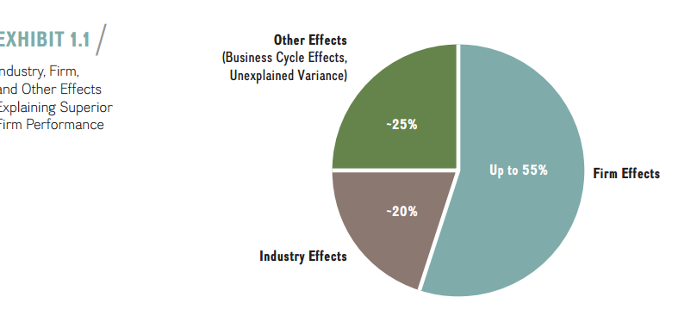
Lecture 1
Basic Model of Strategic Management

Slide 20
Lecture 1
Basic Model of Strategic Management
1.2. Stakeholders and Competitive Advantage
Companies with a good strategy generate value for society. When firms compete in their own self-interest while obeying the law and acting ethically, they ultimately create value. Value creation occurs because companies with a good strategy are able to provide products or services to consumers at a price point that they can afford while making a profit at the same time. Both parties benefit from this trade as each captures a part of the value created. In so doing, they make society better.

Slide 21
Lecture 1
Basic Model of Strategic Management
Value creation in turn lays the foundation for the benefits that successful economies can provide: education, public safety, and health care, among others. Superior performance allows a firm to reinvest some of its profits and to grow, which in turn provides more opportunities for employment and fulfilling careers.

Slide 22
Lecture 1
Basic Model of Strategic Management
- Stakeholder strategy
Stakeholders have a vested claim or interest in the performance and continued survival of the firm. Stakeholders can be grouped by whether they are internal or external to a firm. As shown in Exhibit 1.2, internal stakeholders include stockholders, employees (including executives, managers, and workers), and board members. External stakeholders include customers, suppliers, alliance partners, creditors, unions, communities, governments at various levels, and the media.

Slide 23
Lecture 1
Basic Model of Strategic Management
All stakeholders make specific contributions to a firm, which in turn provides different types of benefits to different stakeholders. Employees contribute their time and talents to the firm, receiving wages and salaries in exchange. Shareholders contribute capital in the hope that the stock will rise and the firm will pay dividends. Communities provide real estate, infrastructure, and public safety. In return, they expect that companies will pay taxes, provide employment, and not pollute the environment. The firm, therefore, is embedded in a multifaceted exchange relationship with a number of diverse internal and external stakeholders.

Slide 24
Lecture 1
Basic Model of Strategic Management
If any stakeholder withholds participation in the firm’s exchange relationships, it can negatively affect firm performance. The aerospace company Boeing, for example, has a long history of acrimonious labor relations, leading to walk-outs and strikes. This in turn has not only delayed production of airplanes but also raised costs. Borrowers who purchased subprime mortgages are stakeholders (in this case, customers) of financial institutions. When they defaulted in large numbers, they threatened the survival of these financial institutions and, ultimately, of the entire financial system.

Slide 25
Lecture 1
Basic Model of Strategic Management
Stakeholder strategy is an integrative approach to managing a diverse set of stakeholders effectively in order to gain and sustain competitive advantage. The unit of analysis is the web of exchange relationships a firm has with its stakeholders (see Exhibit 1.2). Stakeholder strategy allows firms to analyze and manage how various external and internal stakeholders interact to jointly create and trade value.

Slide 26
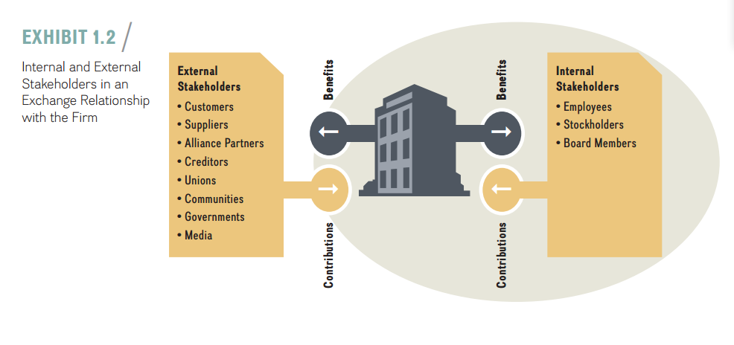

Slide 27
Lecture 1
Basic Model of Strategic Management
A core tenet of stakeholder strategy is that a single-minded focus on shareholders alone exposes a firm to undue risks. Simply putting shareholder interest above all else can undermine economic performance and even threaten the very survival of the enterprise. The strategist, therefore, must under-stand the complex web of exchange relationships among different stakeholders.

Slide 28
Lecture 1
Basic Model of Strategic Management
With that understanding, the firm can proactively shape the various relationships to maximize the joint value created and manage the distribution of this larger pie in a fair and transparent manner. Effective stakeholder management exemplifies how managers can act to improve firm performance, thereby enhancing the firm’s competitive advantage and the likelihood of its continued survival.

Slide 29
Basic Model of Strategic Management
- Stakeholder impact Analysis
The key challenge of stakeholder strategy is to effectively balance the needs of various stakeholders. The firm needs to ensure that its primary stakeholders—the firm’s share-holders and other investors—achieve their objectives. At the same time, the firm needs to recognize and address the concerns of other stakeholders—employees, suppliers, and customers—in an ethical and fair manner, so that they too are satisfied. This all sounds good in theory, but how can managers go about this in practice?

Slide 30
Lecture 1
Basic Model of Strategic Management
Stakeholder impact analysis provides a decision tool with which managers can recognize, prioritize, and address the needs of different stakeholders. This tool helps the firm achieve a competitive advantage while acting as a good corporate citizen. Stakeholder impact analysis takes managers through a five-step process of recognizing stakeholders’ claims. In each step, managers must pay particular attention to three important stakeholder attributes: power, legitimacy, and urgency.

Slide 31
Lecture 1
Basic Model of Strategic Management
■ A stakeholder has power over a company when it can get the company to do something that it would not otherwise do.
■ A stakeholder has a legitimate claim when it is perceived to be legally valid or otherwise appropriate.
■ A stakeholder has an urgent claim when it requires a company’s immediate attention and response.
Exhibit 1.3 depicts the five steps in stakeholder impact analysis and the key questions to be asked. Let’s look at each step in detail.

Slide 32
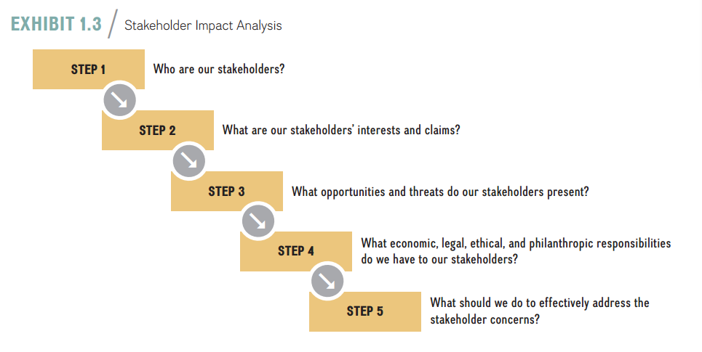

Slide 33
Lecture 1
Basic Model of Strategic Management
1.3. The AFI Strategy Framework
How do firms craft and execute a strategy that enhances their chances of achieving superior performance? A successful strategy details a set of actions that managers take to gain and sustain competitive advantage. Effectively managing the strategy process is the result of three broad tasks:
1. Analyze (A)
2. Formulate (F)
3. Implement (I)

Slide 35
Lecture 1
Basic Model of Strategic Management
Strategy Analysis (A)Topics and Questions
■ Strategic leadership and the strategy process: What roles do strategic leaders play? What are the firm’s vision, mission, and values? What is the firm’s process for creating strategy and how does strategy come about?(Chapter 2)
■ External analysis: What effects do forces in the external environment have on the firm’s potential to gain and sustain a competitive advantage? How should the firm deal with them?(Chapter 3)

Slide 36
Basic Model of Strategic Management
■ Internal analysis: What effects do internal resources, capabilities, and core competencies have on the firm’s potential to gain and sustain a competitive advantage? How should the firm leverage them for competitive advantage?(Chapter 4)
■ Competitive advantage, firm performance, and business models: How does the firm make money? How can one assess and measure competitive advantage? What is the relationship between competitive advantage and firm performance?(Chapter 5)

Slide 37
Lecture 1
Basic Model of Strategic Management
Strategy Formulation (F)Topics and Questions
■ Business strategy: How should the firm compete: cost leadership, differentiation, or value innovation(Chapters 6)
■ Corporate strategy: Where should the firm compete: industry, markets, and geography?(Chapters 8)
■ Global strategy: How and where should the firm compete: local, regional, national, or international?(Chapter 10).

Slide 38
Lecture 1
Basic Model of Strategic Management
Strategy Implementation (I)Topics and Questions
■ Organizational design: How should the firm organize to turn the formulated strategy into action?(Chapter 11)
■ Corporate governance and business ethics: What type of corporate governance is most effective? How does the firm anchor strategic decisions in business ethics?(Chapter 12)

Slide 39
Lecture 1
Basic Model of Strategic Management
References:
Strategic management, third edition, 2017
Frank t. Rothaermel
Georgia Institute of Technology
Chapter 1

